Slide 1
The Interplay Between Delay and Device in a Moving Target Selection Game
Aritra Kundu
Worcester Polytechnic Institute, USA
akundu@wpi.edu
Ragnhild Eg
Nofima, Tromso, Norway
Ragnhild.Eg@Nofima.no
Mark Claypool
Worcester Polytechnic Institute, USA
claypool@wpi.edu
IEEE Conference on Games
Milan, Italy
August 2024

Slide 2
Introduction
Real-time games sensitive to delay
Even 10s of milliseconds of delay impacts player performance and quality of experience (QoE)
Mitigate with delay compensation (e.g., time warp, player prediction, dead reckoning …)
But when to apply (what player actions)?
And how effective?
Need research to better understand effects of delay on games

Slide 3
Research in Games and Delay
Game Genres
Valorant
Warcraft
EverQuest
Research
[Fitts, 7]
[Quax, 1]
Counter Strike
[Pavlovych, 8]
[Amin, 2]
Effect of delay on games?
[Long, 10]
[Liu, 4]
[Eg, 11]
[Chen, 5]
[Ivkovic, 12]
[Slivar, 6]
[Friston, 13]
Target Selection
[Fitts’ Law]
Avatar Navigation
(Move/Dodge)
Moving Target Selection
Research
[Pavlovych, 14]
Game Input

Slide 4
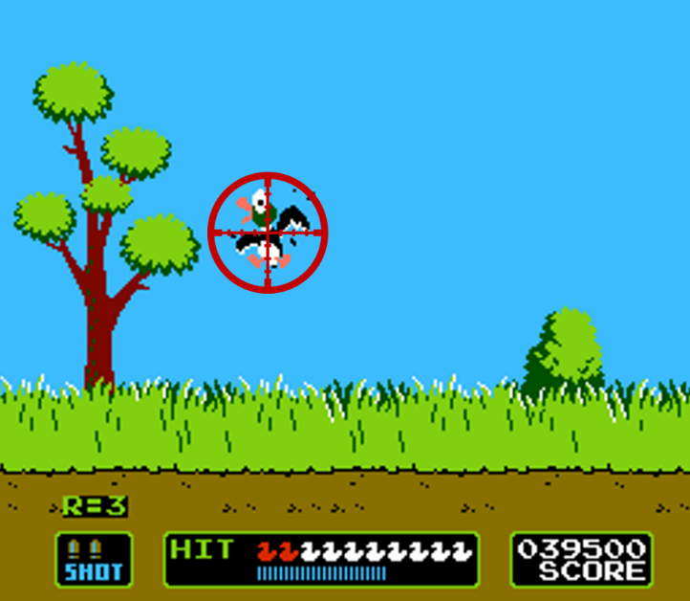
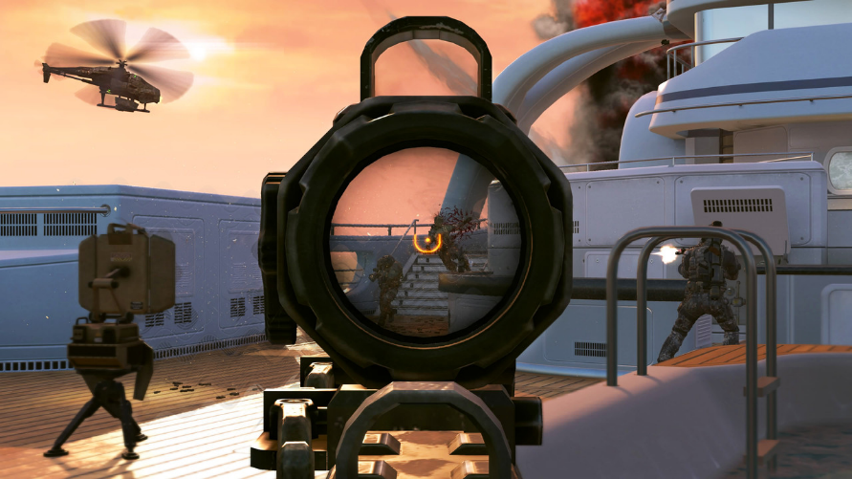
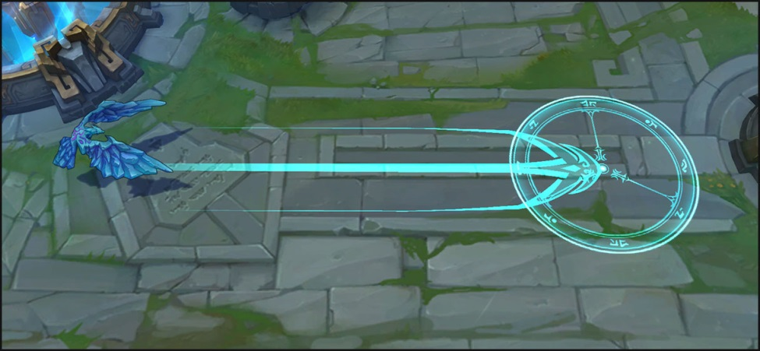
Why Moving Target Selection?
[Call of Duty, Activision, 2003]
[Duck Hunt, Nintendo, 1984]
[League of Legends, Riot Games, 2009]

Slide 5
Moving Target Selection with Delay
Next? → virtual reality
R1. Player performance vs. level of delay?
R2. Player performance vs. device? With delay?
R3. QoE across delays and devices?
Add VR
Add cursor
Speed, Size, Delay
complex motion
mouse
[MMSys’19]
Target Motion
Lissajous curve
mouse
[GI’12]
constant velocity mouse
[MMM’17]
constant velocity
thumbstick
[TOMM’18]
constant velocity
Kinect
[TR’19]
constant velocity
mouse, touch, trackball, joystk,
[MacKenzie, 16]
constant velocity
mouse, touch, stylus, gamepad,
[Long, 10]
constant velocity mouse, touch, VR
[CoG ‘24]
stationary
stylus
[Fitts, 7]
stationary
mouse
[MacKenzie ‘93]
Single Device
Multi-Device

Slide 6
Outline
Introduction (done)
Methodology (next)
Results
Conclusion

Slide 7
Methodology
Select devices
Develop game
Focus player action on selecting moving target
Parameterize: speed, size
Control added delay
Conduct user study
Analyze results
Graphs, statistics
Disseminate (IEEE CoG )

Slide 8
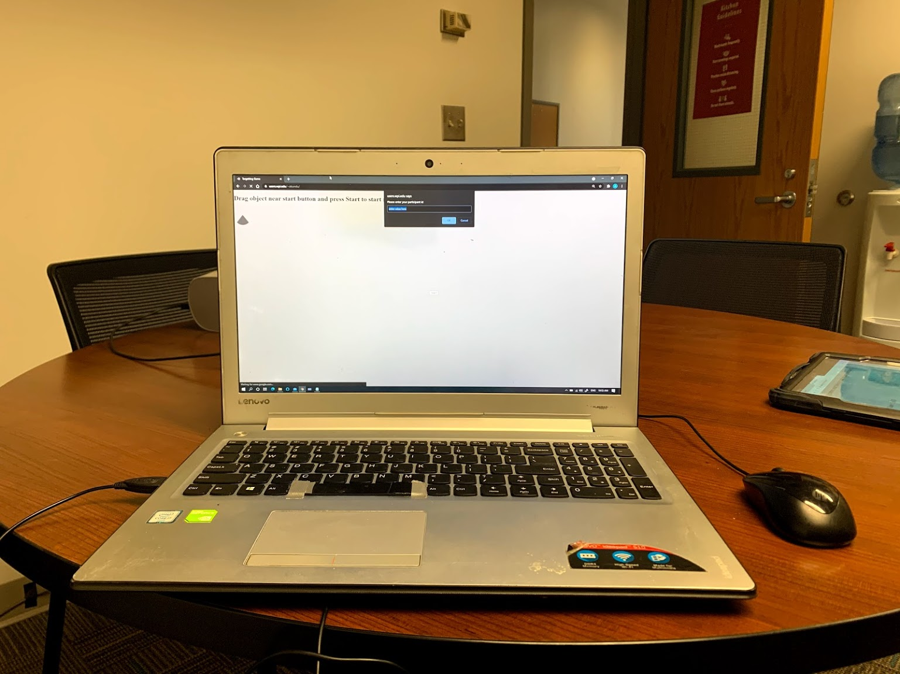
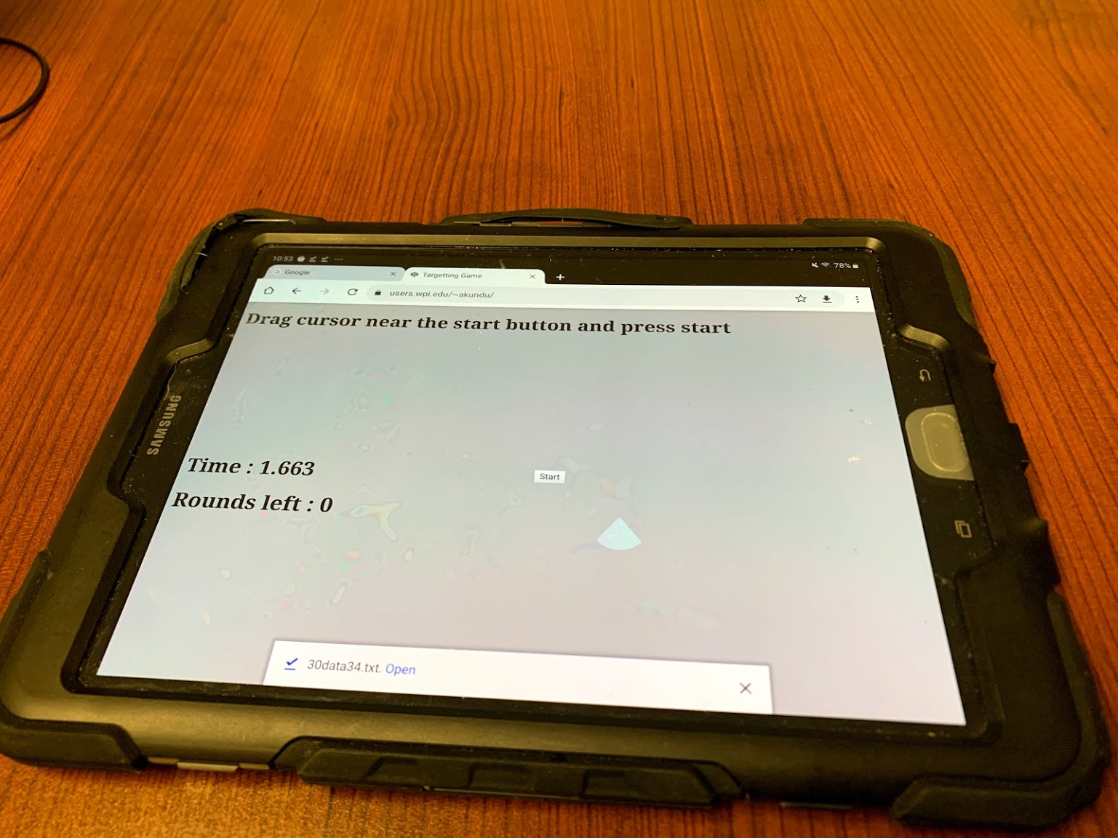
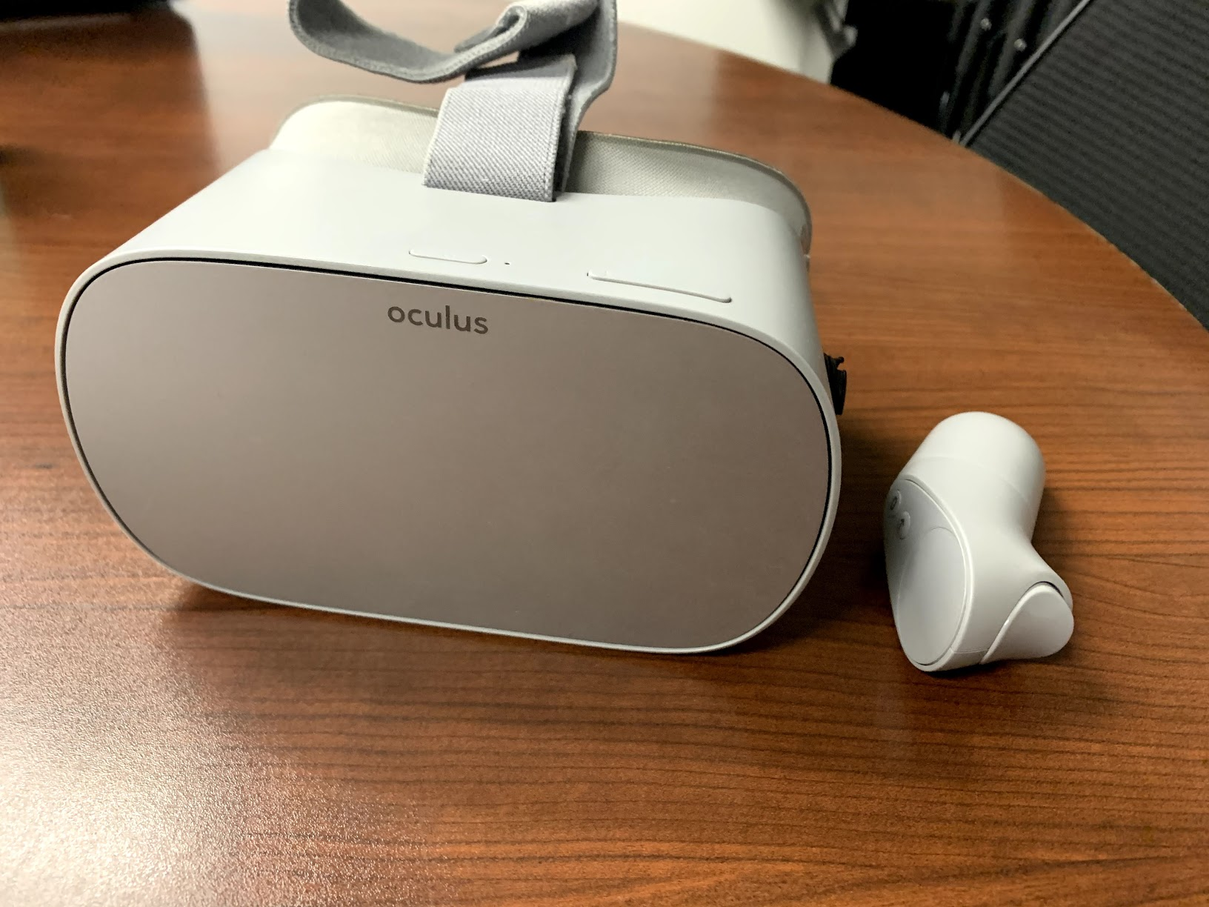
Methodology – Devices
PC
Tablet
VR
Lenovo Ideapad 510
Windows 10
Dual-core Intel i7 @ 2.5 GHz
20 GB RAM
NVIDIA GeForce 940 mx
15.6” w/ 1920x1080 px @ 60 Hz
Mouse: 1000 DPI, @125 Hz
Samsung Galaxy Tab S3t
Android
Quad-core Qualcomm Snapdragon
810 @ 2.15 GHz
4 GB RAM
9.7” w/ 1024x768 px @ 240 Hz
Touch
Oculus Go
Android
Quad-core Qualcomm Snapdragon
821 @ 2.15 GHz processor
3 GB RAM
2560x1460 pixels @ 60 Hz
Controllers

Slide 9
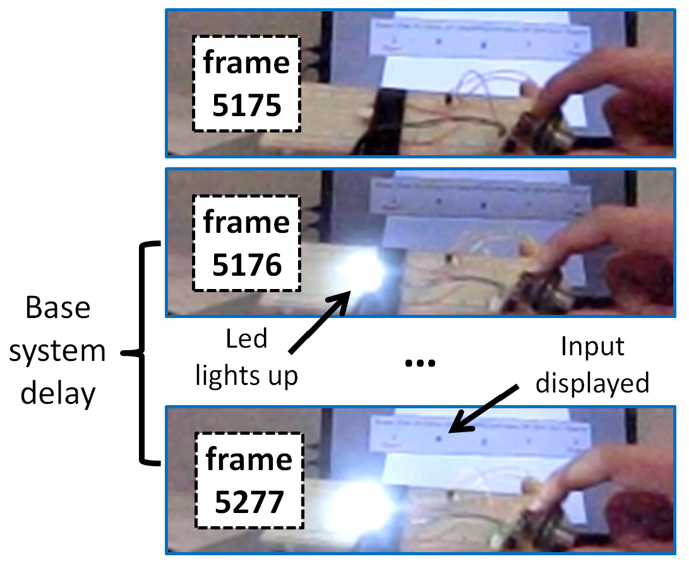
Measuring Base (Local) Delay
Base system delay shown to be significant
5 measurements, each system
Local Delays:
PC 69.0 ms (SD = 11.8)
Tablet 31.4 ms (SD = 10.8)
VR 31.6 ms (SD = 4.9)
Add extra delay to Tablet & VR → All 69 ms

Slide 10
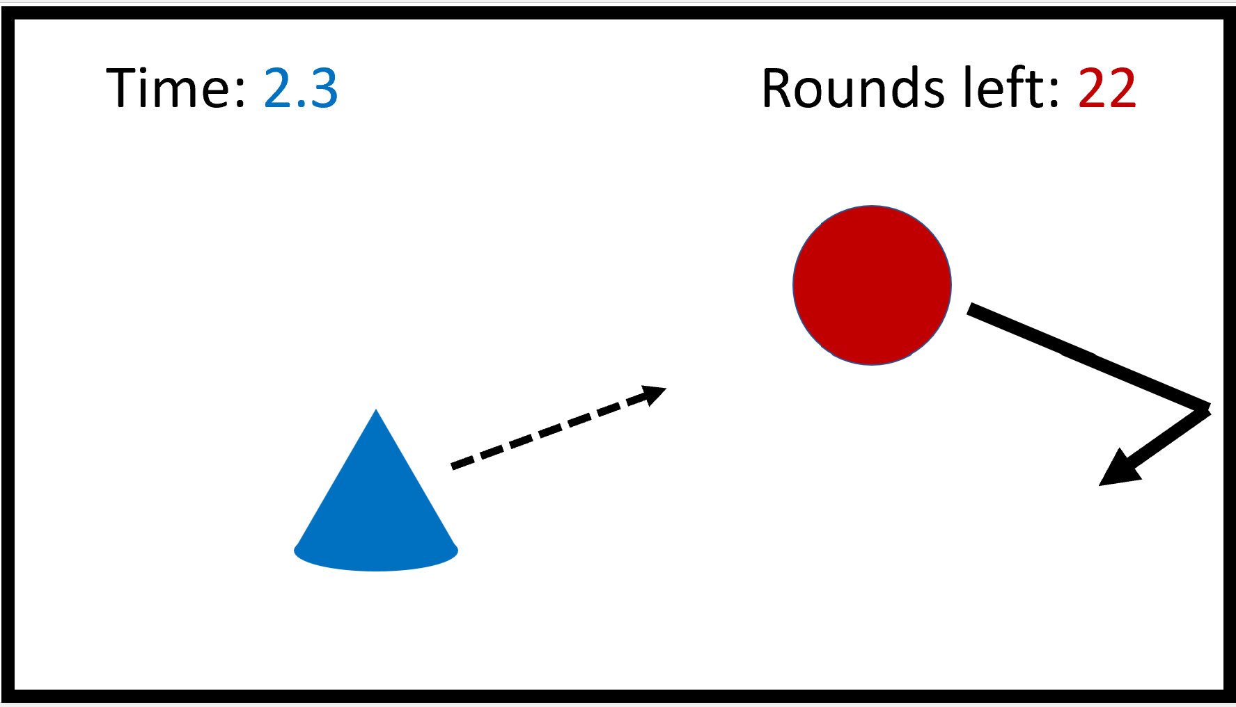
Methodology – Game
QoE: “How was the previous game session?”
- Once for each unique condition
5 - Excellent
4 - Good
3 - Fair
2 - Poor
1 - Bad
Chrome Browser

Slide 11
Methodology – Procedure
Consent
One device: PC, Tablet, VR
Adjust device for comfort
Two practice rounds
Survey
Repeat for each device
Play
3 target speeds: 0, 400, 500 px/s
3 target sizes: 50, 60, 70 px
3 delay levels: 69, 144, 219 ms
Repeat twice (only 1 QoE/condition)
54 rounds total, shuffled

Slide 12
Demographics
Recruited through University mailing lists
$25 raffle, plus course credit
30 participants
Age 20.7 (4.0)
19 males, 10 females, 1 other
Gamer self-rating 3.6 (1.2)
Hours/week:
Play: 10.7 (10.3)
PC: 46.9 (17.4)
Tablet: 3.0 ( 7.6)
VR: 0.2 ( 0.7)

Slide 13
Outline
Introduction (done)
Methodology (done)
Results (next)
Conclusion

Slide 14
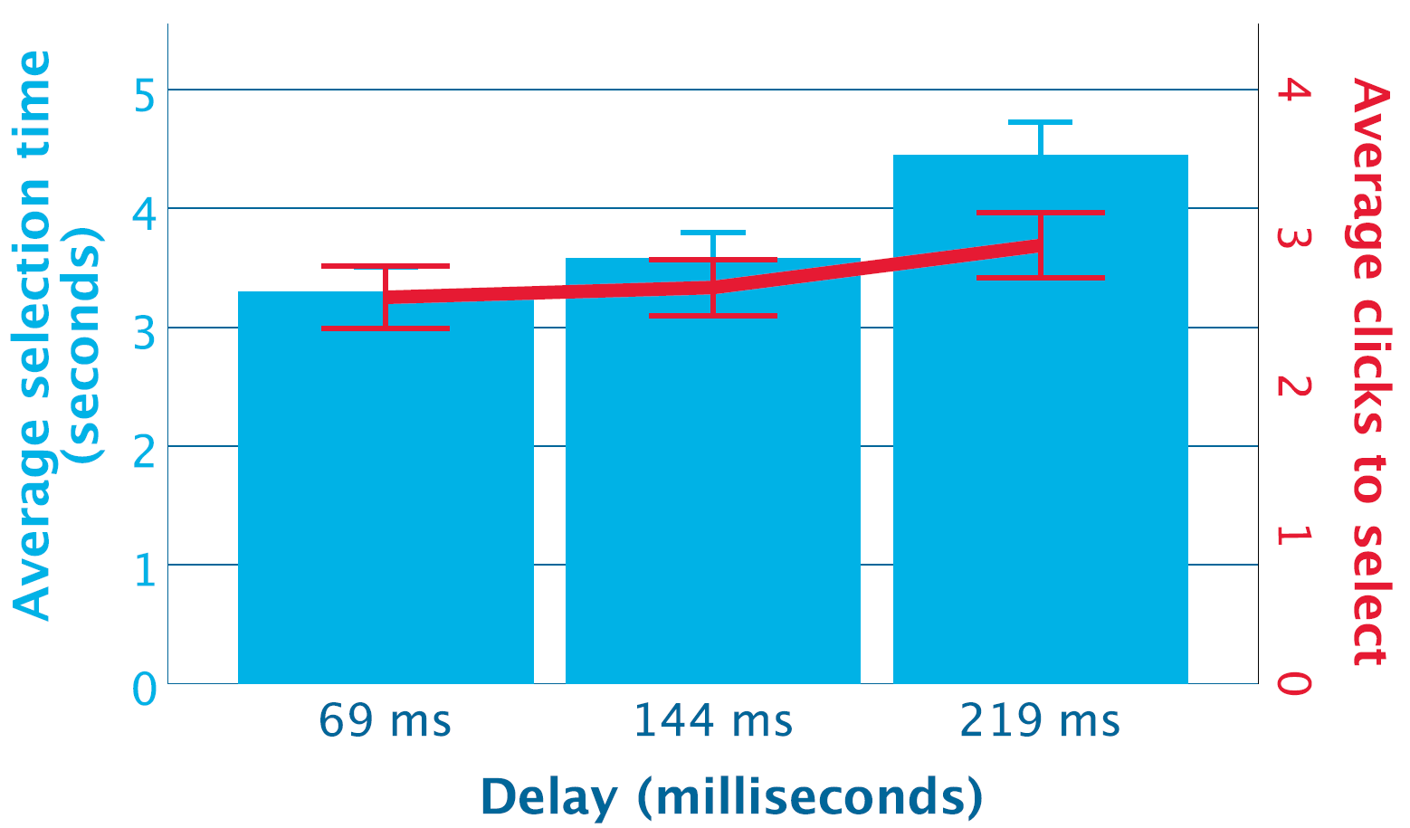
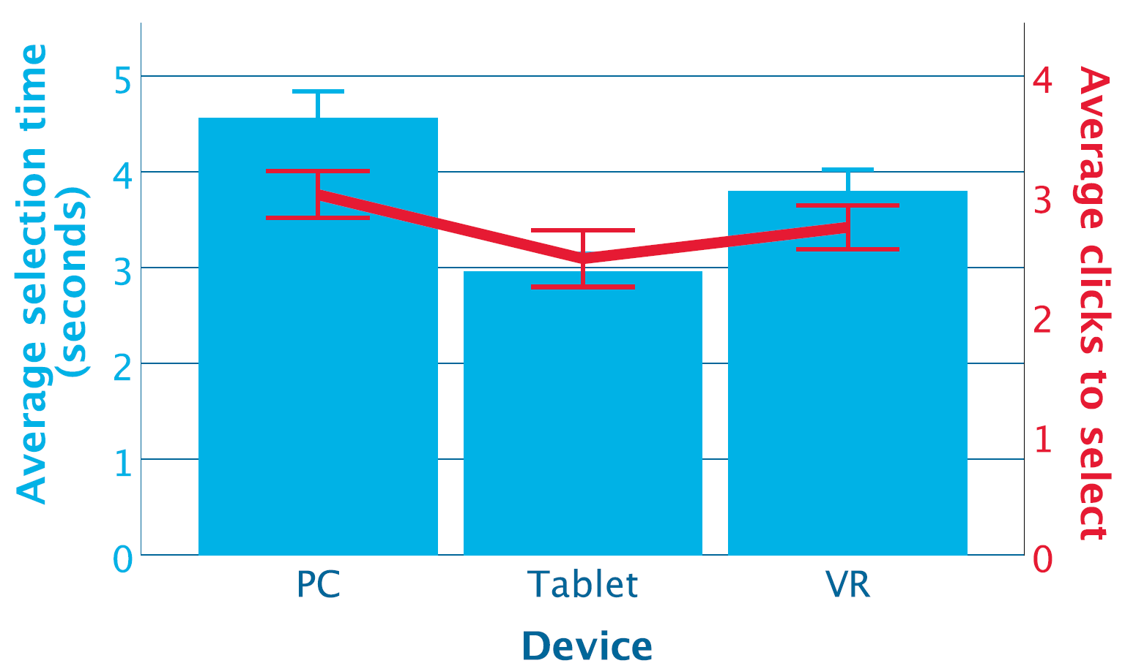
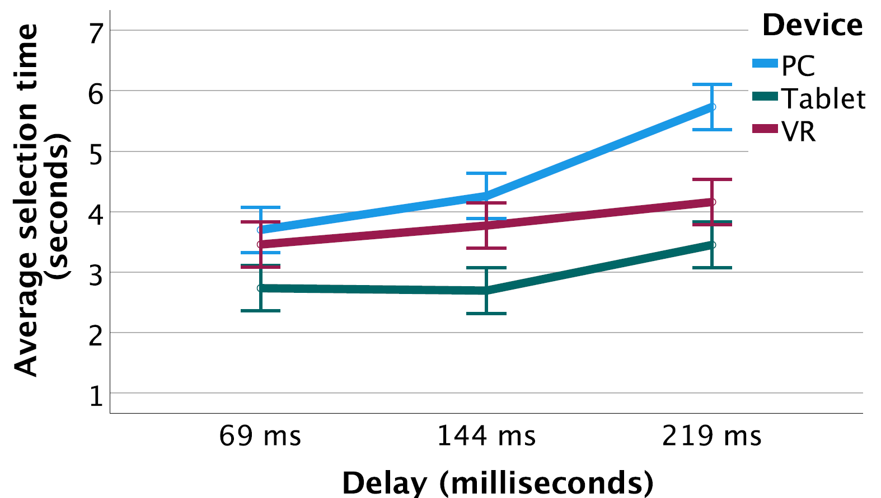
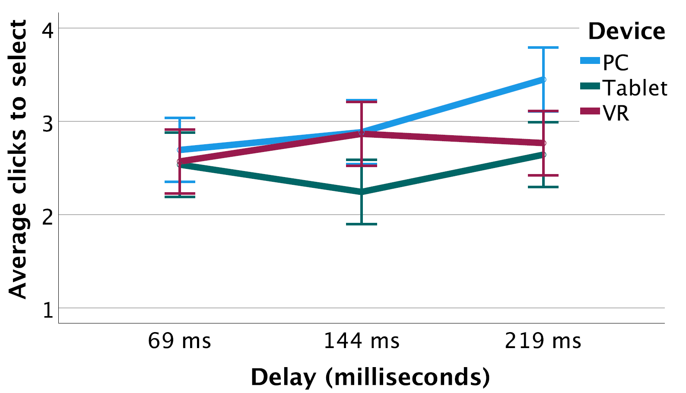
Player Performance

Slide 15
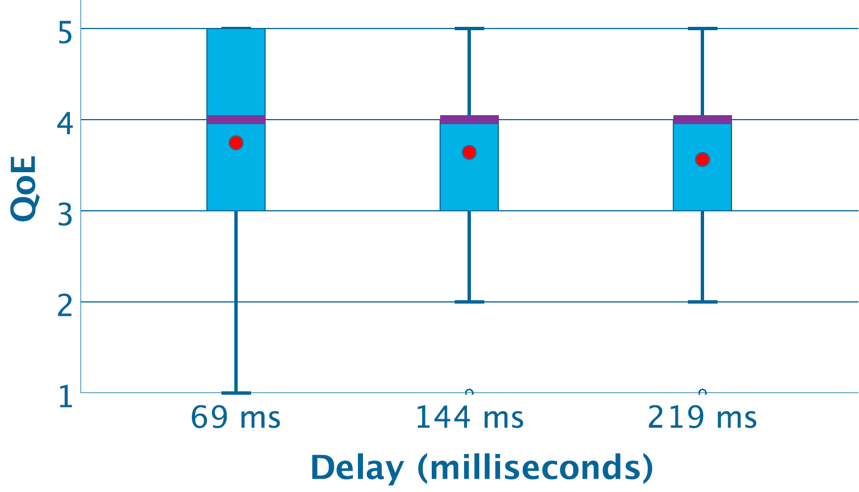
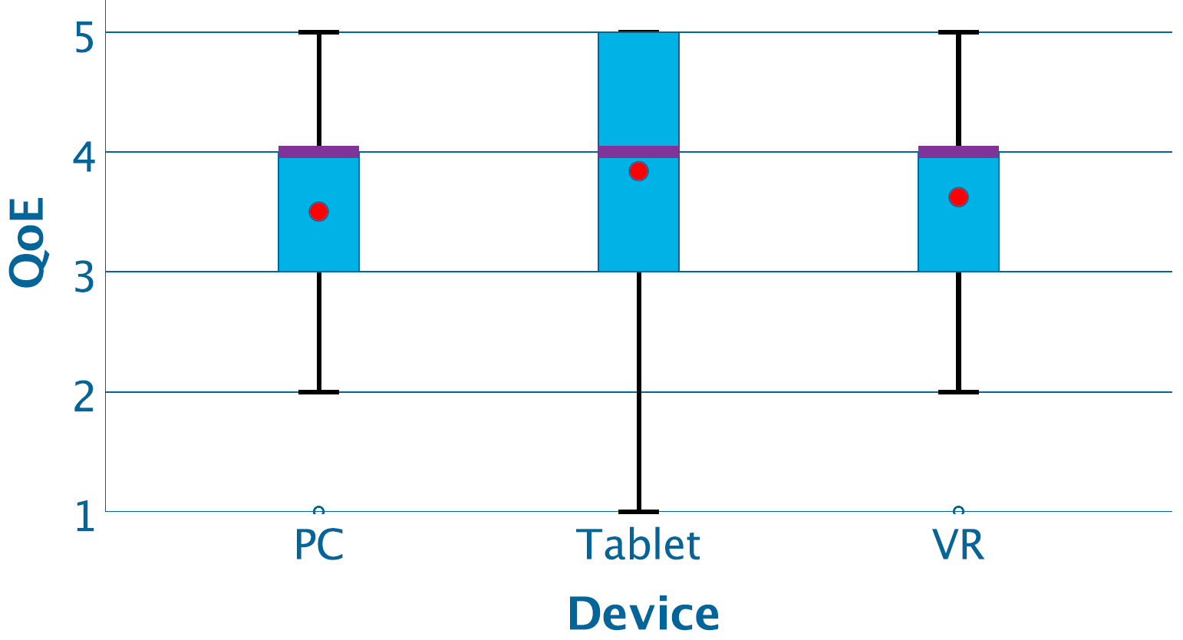
QoE

Slide 16
Conclusion
Delay matters
But only at highest level (200 ms)
Confirm long line of results [9-11, 13], novel for VR
Device matters
PC worst, Tablet best
Contradicts mouse [16], controller [10], but PC has small screen, may matter [20]
Mediates delay – high-end not as bad for Tablet, VR
QoE similar for all (significant, but small)

Slide 17
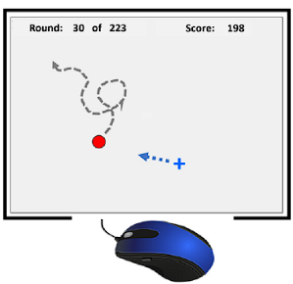
Future Work
Local delay versus Network delay
More complex object movement
Object tracking, other actions
Users with VR experience

Slide 18
The Interplay Between Delay and Device in a Moving Target Selection Game
Thank-you for your attention!
Aritra Kundu
Ragnhild Eg
Mark Claypool
IEEE Conference on Games
Milan, Italy
August 2024

