Slide 1
Measurement of Cloud-based Game Streaming Systems Competing with DASH Flows
Xiaokun Xu
PhD student of Computer Science
xxu11@wpi.edu
Mark Claypool
Professor of Computer Science
claypool@wpi.edu

Slide 2
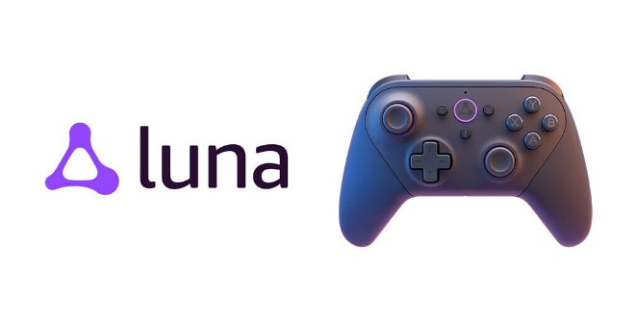
1. Introduction
\
~==-
/
____
/___o\
Want large frames (4k even 8k)
Sent often (30, 60, 120 f/s)
→ High bitrate
Traditional
console
Client
Player input
Game frames
\
~==-
/
____
/___o\
\
~==-
/
____
/___o\
\
~==-
/
.**
**.**
*.*
server
\
~==-
/
____
/___o\
Cloud-based
server
Player input
server
Thin Client
Cloud Servers

Slide 3
1. Introduction
High bitrates→ response to congestion key
Common scenario: competing DASH flow
How do game systems adjust to new flows?
How do game systems share congested link?
Goal of this paper:
Congestion response commercial systems to competing DASH flows
Vary: Game system (Luna, GeForce), Network (capacity, queue limit)
Consider: Bitrate, Fairness

Slide 4
Outline
1. Introduction (done)
2. Methodology (next)
3. Analysis
4. Conclusion
5. Future Work

Slide 5
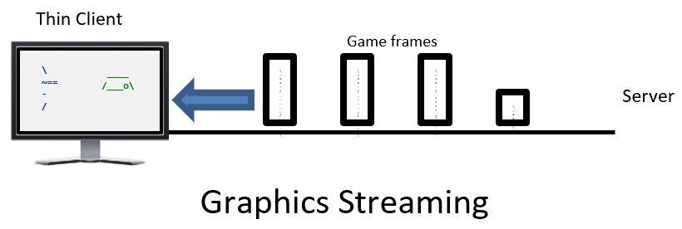
2. Methodology
To explore our research questions we:
Selected game systems and game common to all
Setup measurement testbed
Gathered network traces
Analyzed the data
Gather network traces via middleware
Selected games

Slide 6
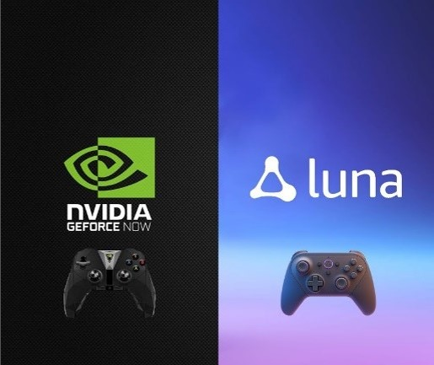
2. Methodology – Platform & Game
Platforms:
NVIDIA GeForce Now
Amazon Luna
Game: Ys VIII – Lacrimosa of Dana (Nihon Falcom, 2016)
3rd person action/explore
Scripted – play automatically

Slide 7
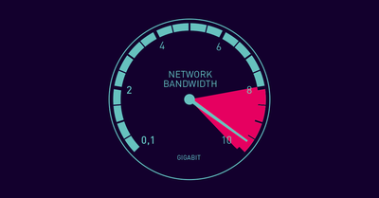
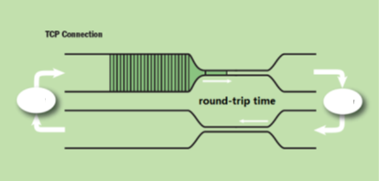
2. Methodology – Network Conditions
Capacity limit: ~25 Mb/s without constraints
Surplus: 35 Mb/s
Sufficient: 25 Mb/s
Deficient: 15 Mb/s
Queue limit: link capacity x round-trip time (BDP)
Bloated: 7x BDP
Typical: 1x BDP
Shallow: 0.5x BDP

Slide 8
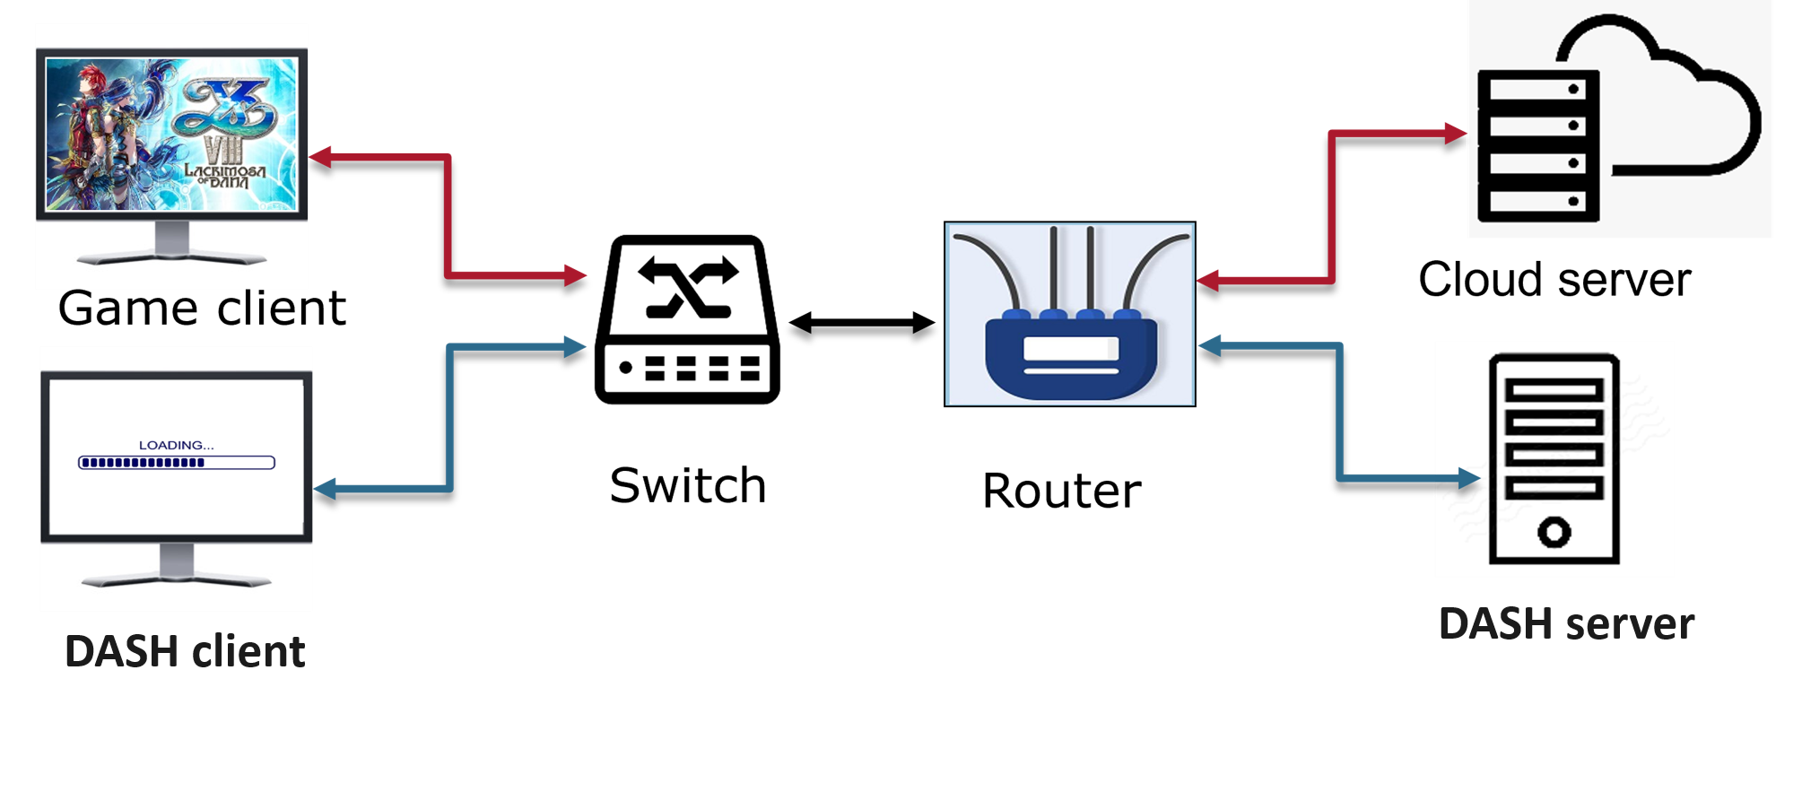
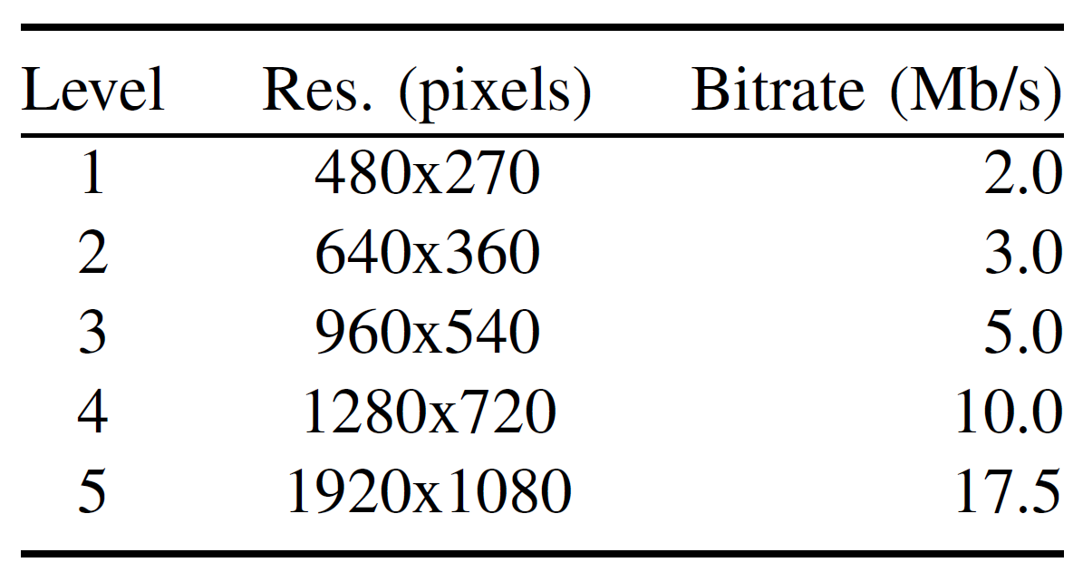
2. Methodology – Testbed
Big Buck Bunny

Slide 9
2. Methodology – Testbed
RTT for server:
GeForce 4.5 ms
Luna 16.4 ms
DASH 1.5 ms
Added delay:
GeForce 12 ms
Luna 0ms
DASH 15 ms
Total RTT delay:
GeForce 16.5 ms
Luna 16.4 ms
DASH 16.5 ms

Slide 10
2. Methodology – Experiment Parameters
Game | Ys VIII: Lacrimosa of Dana
Game system | GeForce, Luna
Capacity limit | 15, 25, 35, Mb/s, or no restriction
Queue limit | 0.5x, 1x, 7x BDP
Competing flow | None & DASH
Trace length | 9 minutes
Iterations | 15 runs per condition
Wireshark traces trimmed to core gameplay

Slide 11
Outline
1. Introduction (done)
2. Methodology (done)
3. Analysis (next)
4. Conclusion
5. Future Work

Slide 12
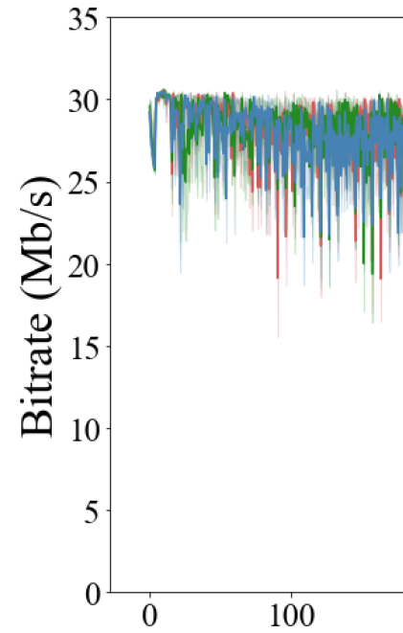
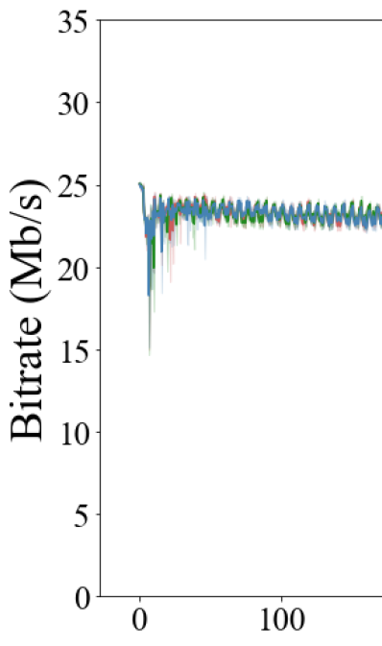
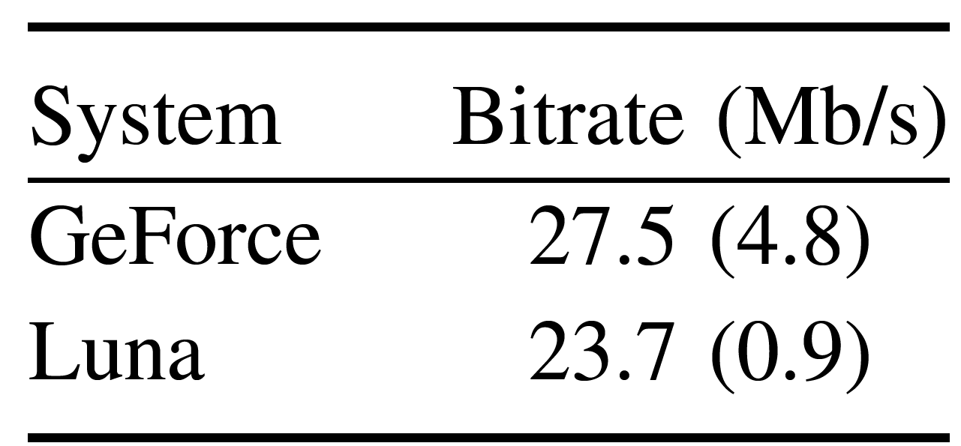
3. Analysis – Bitrate
GeForce
Luna
No self-induced congestion
Time (s)
Time (s)

Slide 13
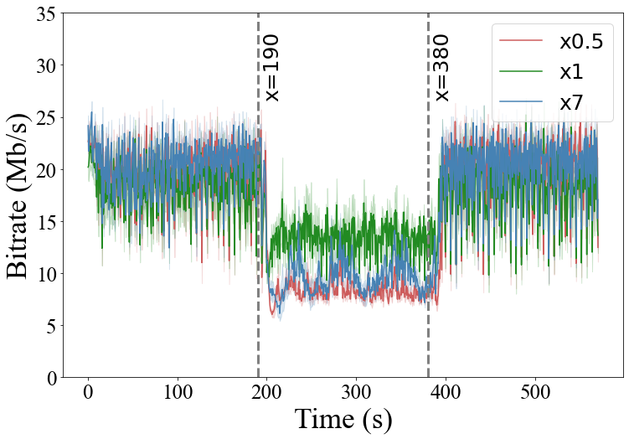
3. Analysis – Bitrate

Slide 14
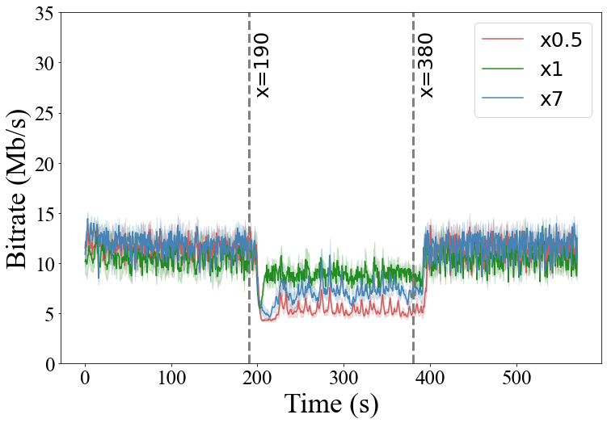
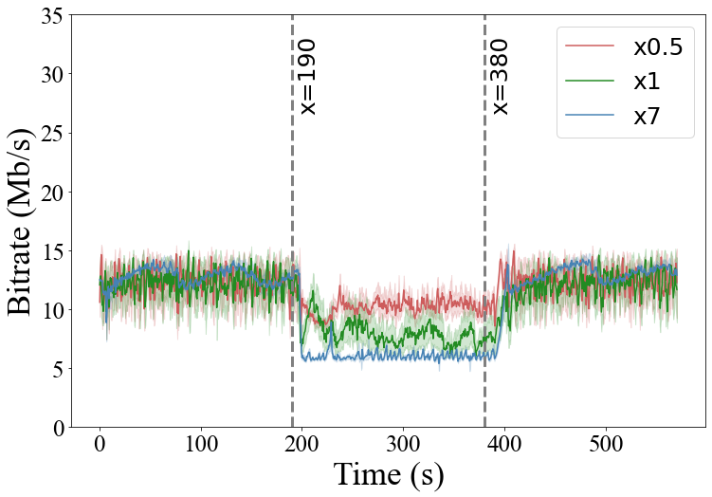
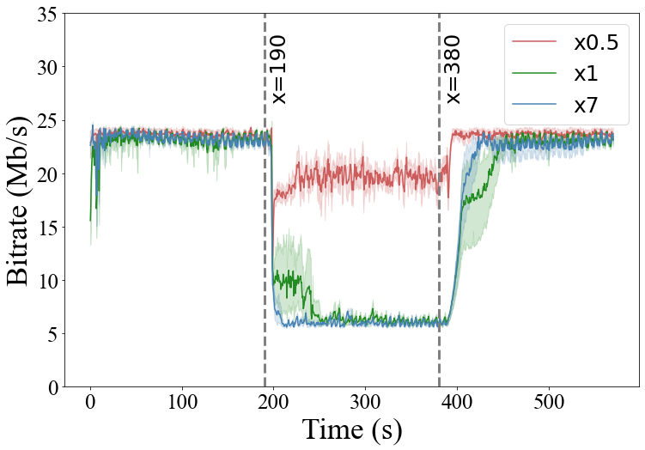
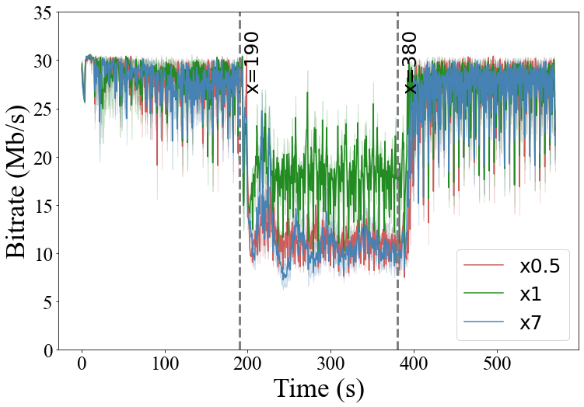
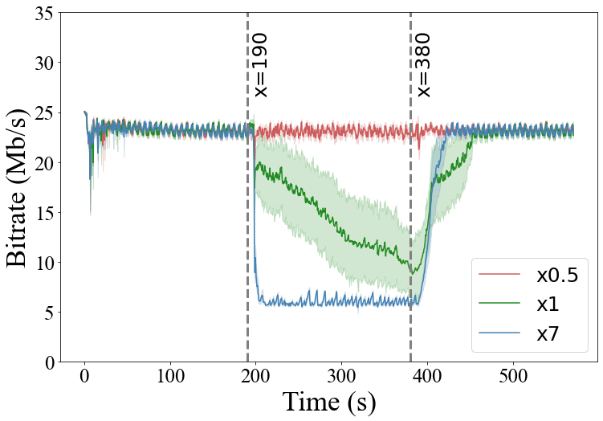
3. Analysis – Bitrate
GeForce Luna
B15
B25
B35

Slide 15
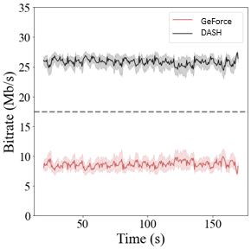
3. Analysis – Ratio of bitrate difference
Bitrate example w/simultaneous flows
Fairness
Ratio bitrate difference (R):
$$R= \frac{B_{s}− B_{i}}{C}$$
Fair share line
symmetric
$B_{s}$: average cloud system
$B_{i}$: average competing flow
$C$: link capacity

Slide 16
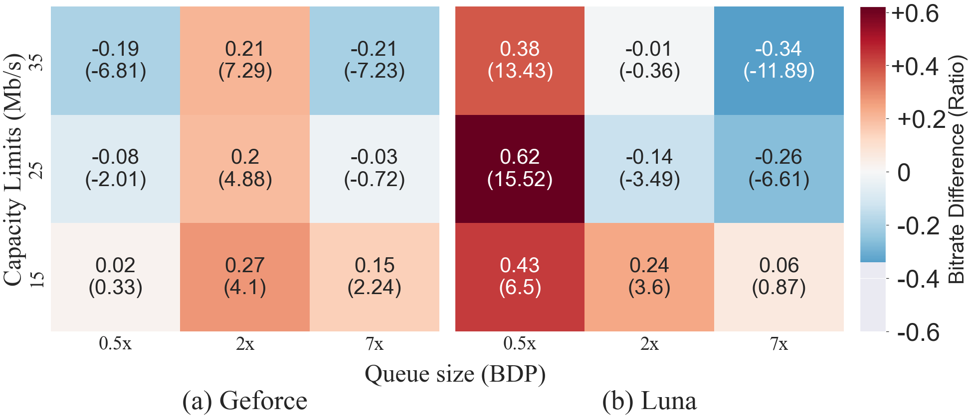
3. Analysis – Fairness
1x
1x

Slide 17
4. Conclusion
Bitrate
Without competing flow, no self-induced congestion
GeForce, Luna similar maximum bitrates
GeForce higher variation, Luna lower
With competing DASH flow
GeForce bitrates slightly higher with typical queue
Luna bitrates depend upon the bottleneck queue sizes
Fairness
GeForce generally fair
Luna varies based on queue limit – aggressive with small queue, defers with large queue

Slide 18
5. Future Work
Other games
Comparative differences hold for other games
Other congestion scenarios
Commercial DASH (e.g., Netflix or YouTube), videoconferencing (e.g., Zoom), multiple flows
With other network conditions (4G, 5G, Wifi)
AQM (e.g., Pi, FQ-Codel)
Other game systems
Sony Playstation Now and Microsoft XCloud

Slide 19
Measurement of Cloud-based Game Streaming Systems Competing with DASH Flows
Thank you!
Xiaokun Xu
PhD student of Computer Science
xxu11@wpi.edu
Mark Claypool
Professor of Computer Science
claypool@wpi.edu

