Slide 1
User Study-based Models of Game Player Quality of Experience with Frame Display Time Variation
Xiaokun Xu
PhD student of Computer Science
xxu11@wpi.edu
Mark Claypool
Professor of Computer Science
claypool@wpi.edu
Acknowledgement:
S1: Thomas Flanagan, Carter Nakagawa, Michael Oliveira
S2: Ryan Darcy, Sean O’Connor, Wenjie Zhang
S3, S4: Shengmei Liu. And Atsuo Kuwahara and James Scovell
Notes:
Welcome everyone to my presentation on "User Study-based Models of Game Player Quality of Experience with Frame Display Time Variation." I'm Xiaokun Xu, a PhD student in Computer Science at Worcester Polytechnic Institute. This research was conducted under the guidance of my advisor, Professor Mark Claypool.

Slide 2

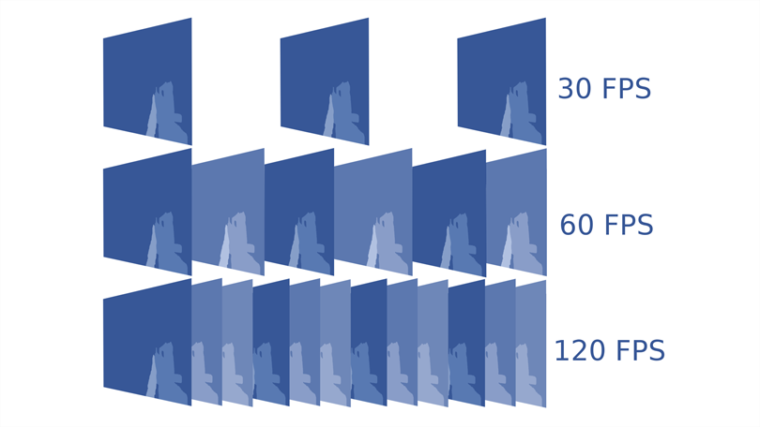


1. Introduction - Frame time variation
FT
FT
FT
FT
FT
Consistent frame time
Both high frame rate!
FT
FT
FT
FT
Inconsistent frame time
(variation)
Notes:
When discussing game performance, one important term is : frame rate (FPS). Previous studies have investigated the importance of frame rate in determining the Quality of Experience, often advocating for stable frame rate characterized by consistent frame times. Consistent frame times ensure that images are displayed smoothly and regularly, contributing to a seamless gaming experience.
However, it's crucial to understand that the average frame rate can remain the same in scenarios with inconsistent frame times. In such cases, both consistent frame time and inconsistent frame time can have high frame rate. But inconsistent frame times cause visual interrupts, which can significantly diminish the Quality of Experience. It highlights a critical area of our study: understanding how frame time varication can impact QoE in games.

Slide 3





1. Introduction - Motivation
Previous Model [1], 95% frame rate floor
$$Q=0.025∗f+2.6, R2=0.96$$
Do fit!
Our Model
$$Q=0.026∗f+2.8, R2=0.61$$
Do not fit!
[1] Shengmei Liu, Atsuo Kuwahara, James Scovell, and Mark Claypool. The Effects of Frame Rate Variation on Game Player Quality of Experience, In Proceedings of the ACM Conference on Human Factors in Computing Systems (CHI), Hamburg, Germany, April 23-28, 2023. Online at: https://web.cs.wpi.edu/~claypool/papers/frame-variation-chi-23/
Notes:
Our motivation stems from a prior study exploring the impact of frame time variation in first-person shooter games. One model examined in this study is the 95% frame rate floor, which demonstrated a strong fit to the data with an R-squared value of 0.96. However, when attempting to apply this model to other user studies, it fails to fit. This variance prompts us to question how we can develop more generalizable models that can accommodate diverse cases.

Slide 4





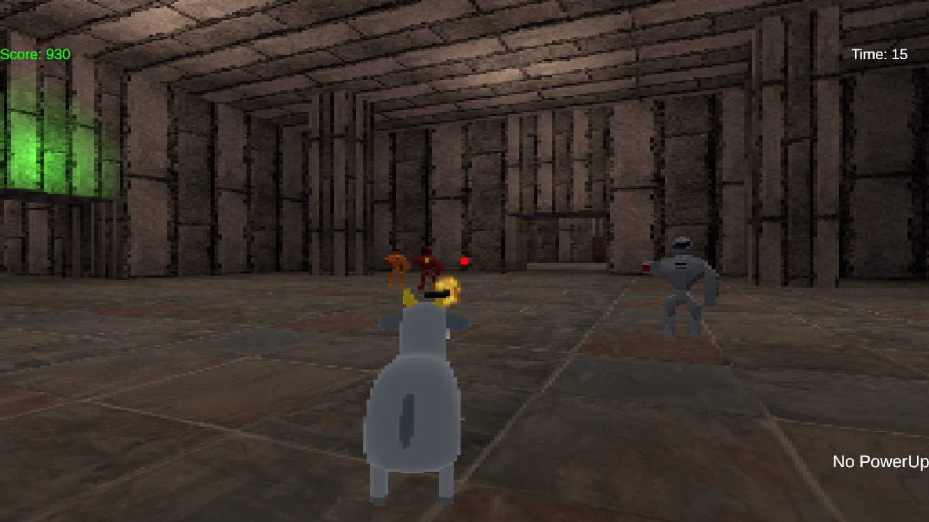



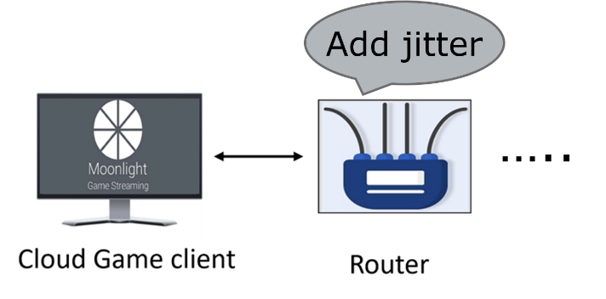
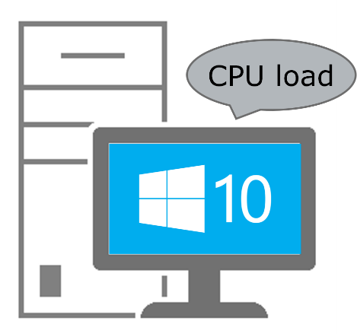
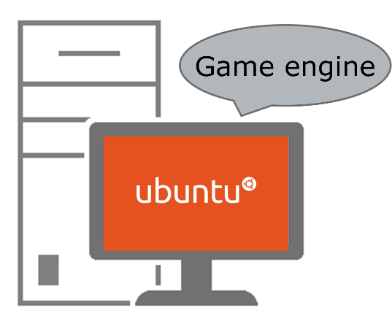
1. Introduction - Motivation
Games
Systems
Settings
Notes:
For doing this, we examined our previous studies. We selected 4 user studies that focused on different purposes but had similar datasets related to frame time variation. The 4 user studies covered different games, systems and settings.

Slide 5



2. Introduction – User study procedure
General user study procedure:
Selected game systems and games
Setup user study testbed
Pilot user study to determine game settings
Recruiter users to play games with different settings
Ask QoE questions for each round in game play
Collect data and analyze data collected from user studies
High jitter
Quality of Experience
Medium jitter
Low jitter
1 2 3 4 5
Users
…
Notes:
The general user study procedure was thorough, starting from selecting games and systems, setting up a testbed, and conducting a pilot study to determine the game settings. Participants played under various settings, providing QoE feedback after each round. This allowed us to capture detailed data on their experiences.

Slide 6
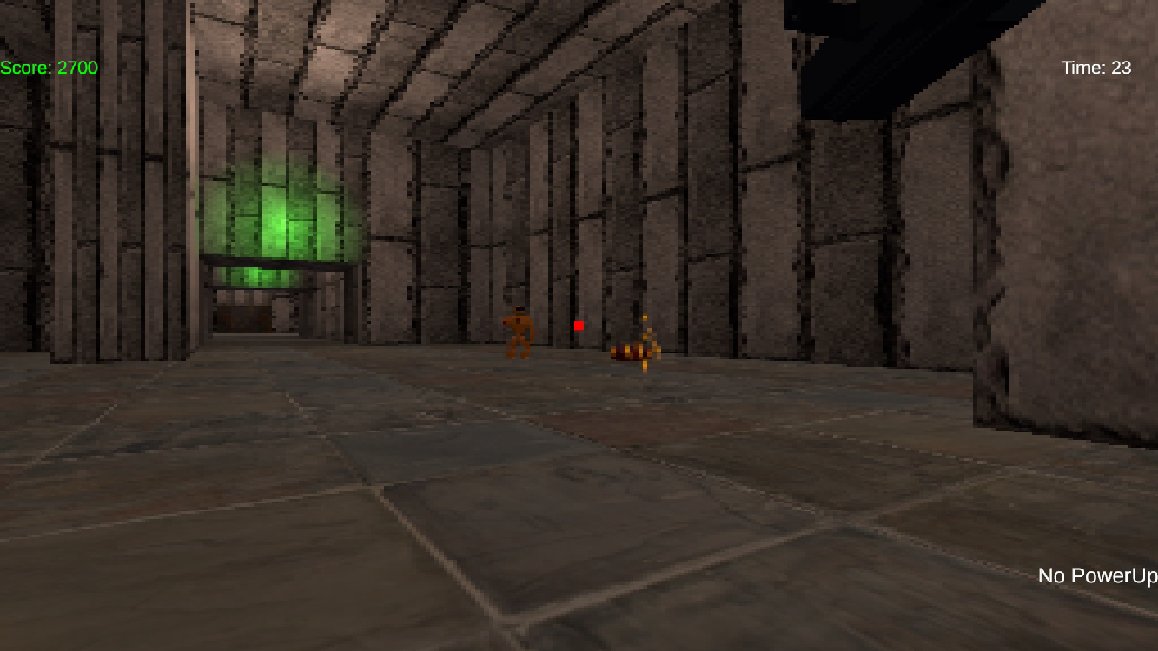
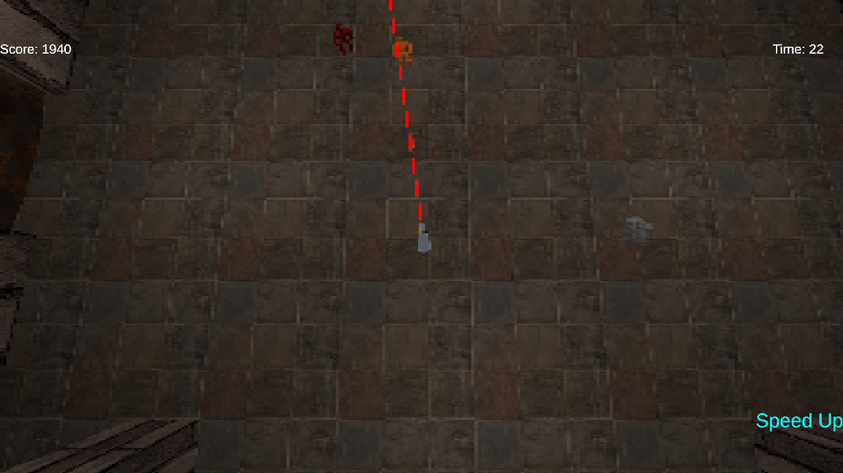
2. Introduction – Summary
User study
Systems
Games
Frame Jitter Method
Jitter settings
Number of users
S1
10 combinations
28
S2
3 combinations
35
S3
7 combinations
31
S4
10 combinations
38
Notes:
In summary, we conducted 4 user studies across 3 systems and 11 games.
For Studies S1 and S2, we introduced custom network jitters through the router, effectively emulating the frame time variation that players might encounter in real-world scenarios.
In Study S3, the variation was simulated by loading the CPU with additional tasks, thereby affecting the frame time indirectly through increased processing demands.
Study S4 took a direct approach by integrating variation within the game engine itself, inserting random sleep time between frames to mimic fluctuating frame times.
The 30 combinations of jitter setting allowed us to cover a broad spectrum of frame time variations, providing us with a rich dataset for analysis. With a total of 132 participants across all studies, we were able to gather a substantial and diverse range of data, making our sample size and findings robust.

Slide 7
Outline
1. Introduction
2. Methodology
3. Analysis
4. Conclusion
5. Future Work
Notes:
Here is the outline of my presentation. Let’s continue for how we conducted this study and what we found.

Slide 8
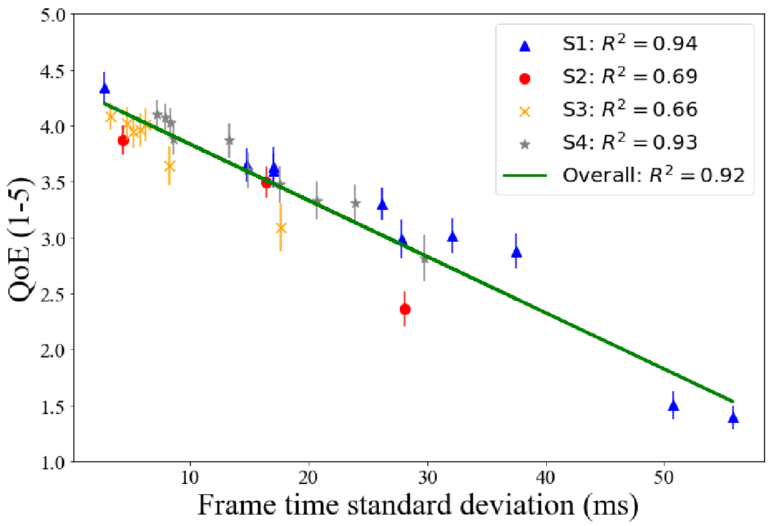
2. Methodology
To do so, we:
Collect data from 4 different user studies
Analyze the data for each user study
Derive models of player QoE from the data of each user study
Explore the common models for all data
Common QoE Model
4 User studies
3 systems
…
11 games
Different settings
Notes:
Our methodology involved collecting and analyzing data from four distinct user studies to derive models of player QoE. We considered various games across different systems and settings, aiming to uncover common QoE models that apply universally.

Slide 9
3. Analysis - Interrupt frequency (IF) and Magnitude (IM)
Netem: customized distribution file to control the IF and IM.
PresentMon[2]: capture the frame time of the streaming.
[2] GameTechDev. 2022. PresentMon V1.8.0. Online: https://github.com/GameTechDev/PresentMon.
Notes:
A crucial part of our user study was to precisely control and calculate the frequency and magnitude of frame playout interrupts.
This figure illustrates the concept of interrupts Frequency and Magnitude for a game that's supposed to be running smoothly at frame rate of 60. On this graph, the x-axis represents time, and the y-axis shows inter frame time
Ideally, frame times should be consistent at 16.7 ms. However, the figure reveals significant "spikes" indicating interrupts, with magnitudes ranging from 70 to 100 ms and with a frequency of about 1.5 times per second.
We implemented the spikes by creating a customized distribution file in netem. This graph indicates our capability to control the frequency and magnitude of the interrupts.
To accurately monitor these variations, we use PresentMon, a tool that captures frame times during streaming without the need for full video recordings.

Slide 10
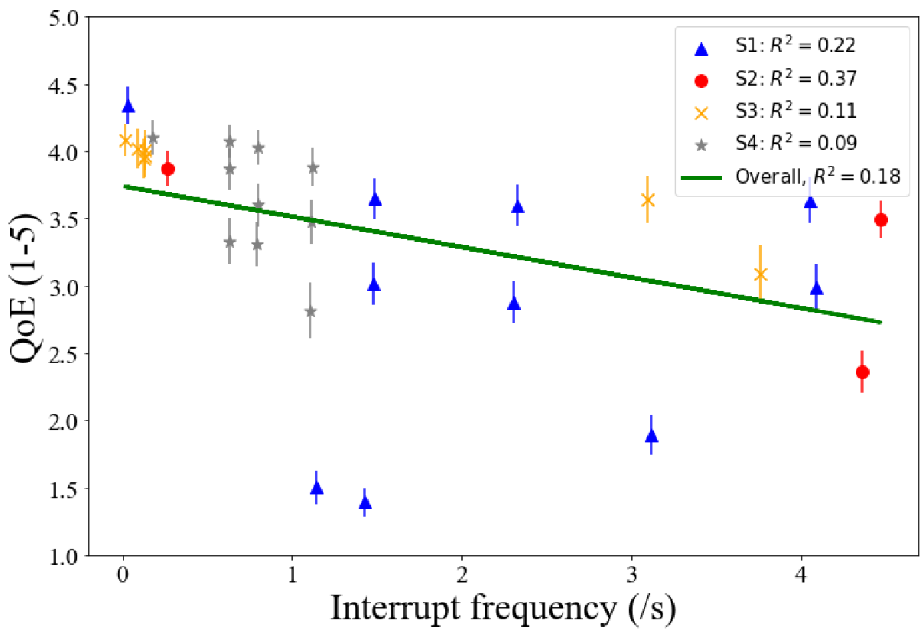
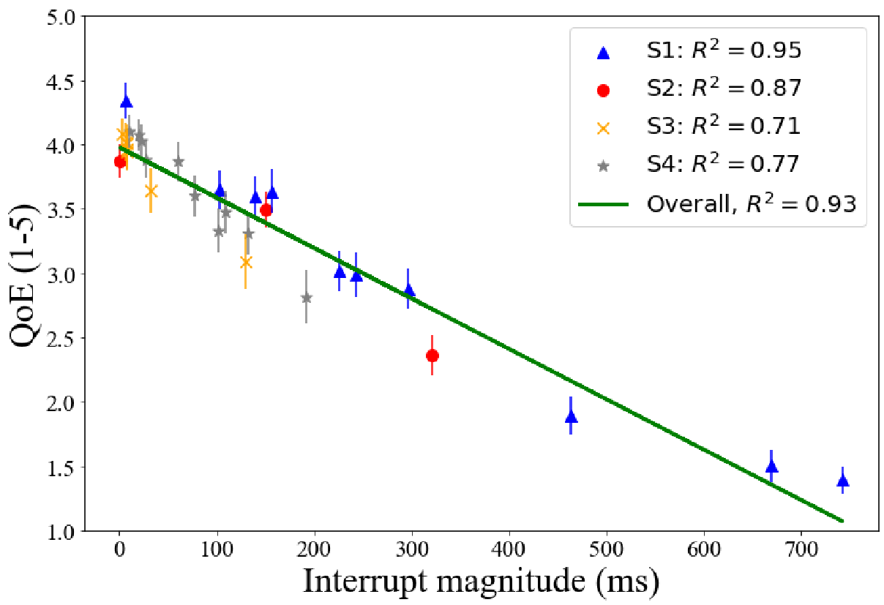
3. Analysis - IF and IM
IF model – Do not fit
R²=0.16
IM model – Do fit
R²=0.93
Notes:
These graphs reveal effects of interrupt frequency and magnitude on gaming QoE.
we found little correlation between interrupt frequency and QoE, with an R^2 value of 0.18, suggesting that within the tested frequencies, the variation was not significantly related to users experience. In contrast, interrupt magnitude showed a strong correlation with QoE, evidenced by an R^2 value of 0.93. This indicates that the interrupt magnitude impacts QoE far more than the frequency, highlighting the importance of minimizing interrupt magnitude to enhance the gaming experience.
From graphs, interrupt magnitude is a good predictor of gaming QoE , but Interrupt frequency is not

Slide 11

4. Conclusion
Linear prediction models: 𝑄𝑜𝐸 = 𝑠𝑙𝑜𝑝𝑒 ・ 𝑥 + 𝑖𝑛𝑡𝑒𝑟𝑐𝑒𝑝𝑡 .
Predictor | R²
Interrupt freq. (/s) | 0.18
95% Frame rate floor (f/s) | 0.61
Average frame rate (f/s) | 0.92
Frame time std. dev. (ms) | 0.92
Interrupt mag. (ms/s) | 0.93
 |  | 10-fold | 1-out
Predictor | R² | R² | MSE
Interrupt freq. (/s) | 0.18 | 0.18 | 0.52
95% Frame rate floor (f/s) | 0.61 | 0.53 | 0.11
Average frame rate (f/s) | 0.92 | 0.78 | 0.05
Frame time std. dev. (ms) | 0.92 | 0.84 | 0.05
Interrupt mag. (ms/s) | 0.93 | 0.81 | 0.05
 |  |  |  | 10-fold | 1-out
Predictor | R² | Slope | Intercept | R² | MSE
Interrupt freq. (/s) | 0.18 | -0.023 | 3.7 | 0.18 | 0.52
95% Frame rate floor (f/s) | 0.61 | +0.026 | 2.8 | 0.53 | 0.11
Average frame rate (f/s) | 0.92 | +0.061 | 0.4 | 0.78 | 0.05
Frame time std. dev. (ms) | 0.92 | -0.056 | 4.6 | 0.84 | 0.05
Interrupt mag. (ms/s) | 0.93 | -0.004 | 4.0 | 0.81 | 0.05
Notes:
Our research utilized linear regression models to predict Quality of Experience (QoE), Summarized in a key table, our models are ranked from lowest to highest effectiveness based on the adjusted R^2 value
In conclusion, our study found frame time standard deviation, interrupt magnitude and average frame rate to be reliable predictors of QoE. While some conventional models like the frame rate floor and interrupt frequency proved ineffective across all games and conditions.
Further analysis through cross-validation techniques—specifically, 10-fold and leave-one-out methods—reveals that while the IM and AFR models show some overfitting, the FTSD model presents a more balanced approach, potentially offering the most reliable insights into QoE prediction without overfitting the data as much.

Slide 12
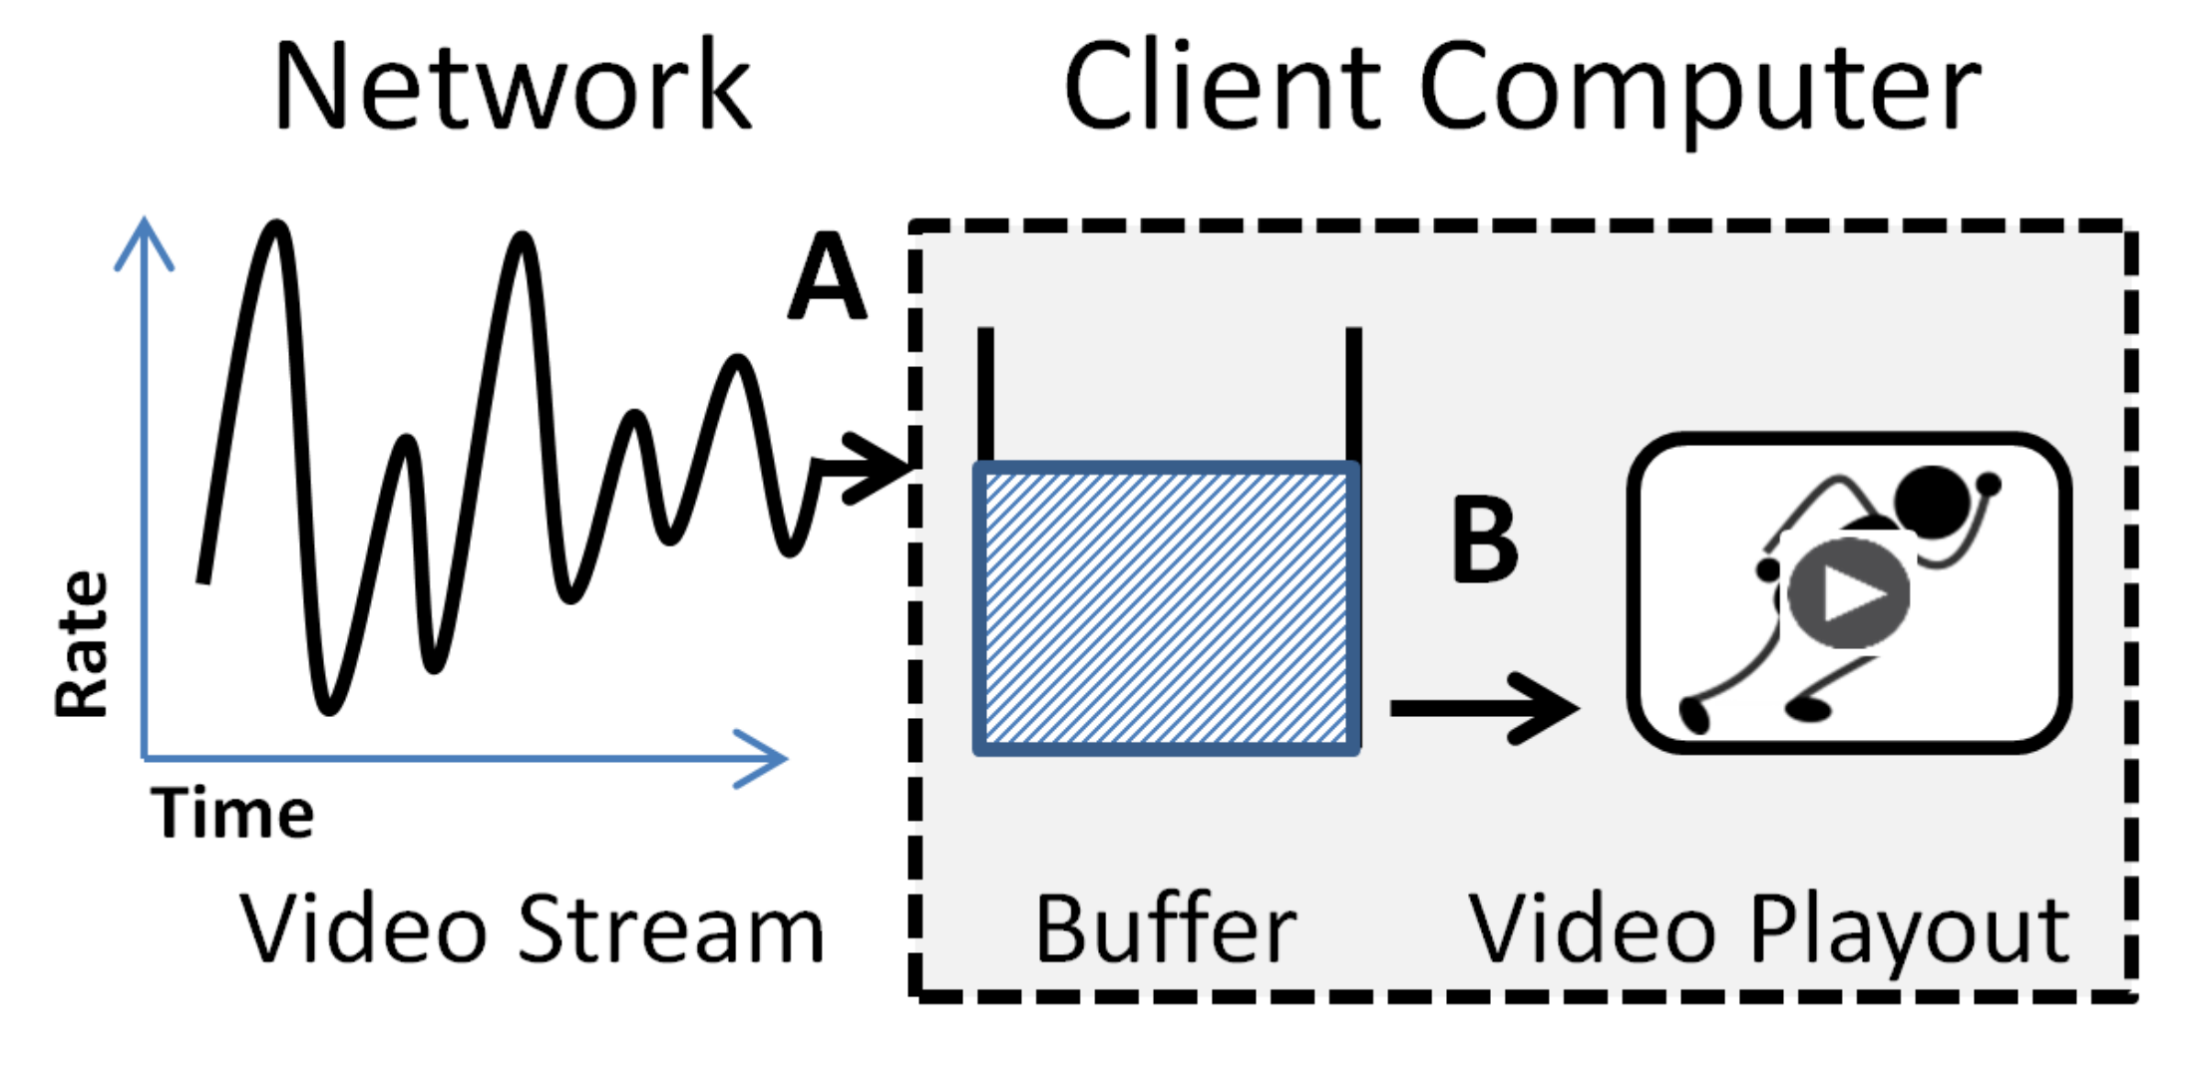

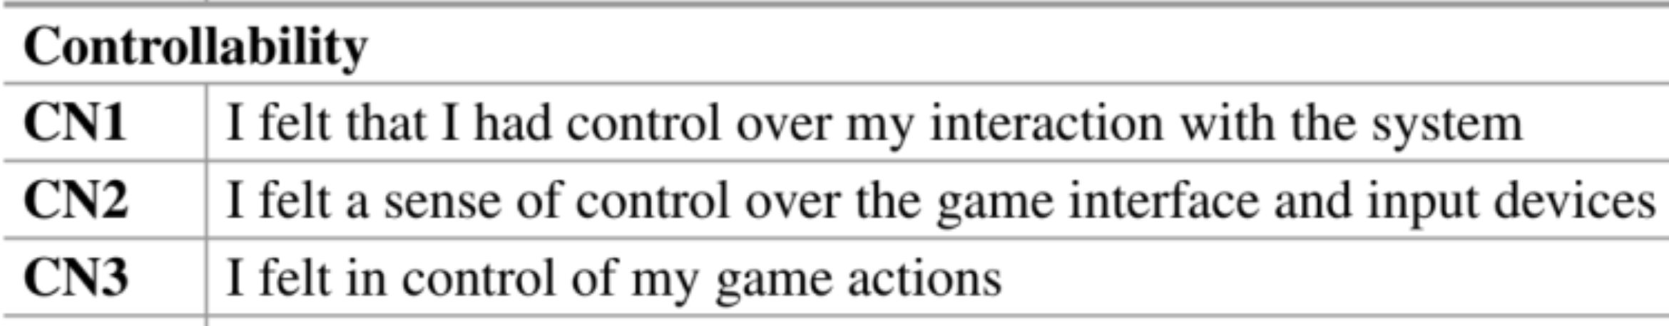
4. Future work
Playout buffer improves QoE.
Frame jitter during specific scenarios, such as shooting in FPS games.
Use Detailed QoE Assessments: such as GIPS[3] questionnaire.
[3] S. Schmidt. 2022. Assessing the Quality of Experience of Cloud Gaming Services. Springer International Publishing, Switzerland. https://books.google.com/books?id=LRaIEAAAQBAJ
Notes:
For future work, we aim to explore additional factors that influence QoE, such as the role of playout buffers in improving QoE of cloud gaming, and the impact of frame jitter in specific game scenarios, such as shooting in FPS games,
Using comprehensive QoE assessment tools will also be a priority.

Slide 13
Thank you！
Xiaokun Xu
PhD student of Computer Science
xxu11@wpi.edu
Mark Claypool
Professor of Computer Science
claypool@wpi.edu
Notes:
Thank you for your attention. We're happy to take any questions now. You can also reach out to us via email for further discussions.

Slide 14
4. Conclusion
Frame time deviation and interrupt magnitude are reliable QoE predictors (𝑅2 = 0.92 and 0.91).
Average frame rate is a good but not always accurate QoE predictor.
Interrupt frequency is a poor QoE predictor.
frame rate floor models are ineffective for all games/conditions.
PresentMon is a valuable tool for capturing frame time during streaming without the need to record the full video.
Notes:
Summarizing, our research highlights the importance of considering frame time variation and interrupt magnitude in assessing game QoE.
Tools like PresentMon are invaluable for capturing the details of frame time without needing extensive video recording.

Slide 15
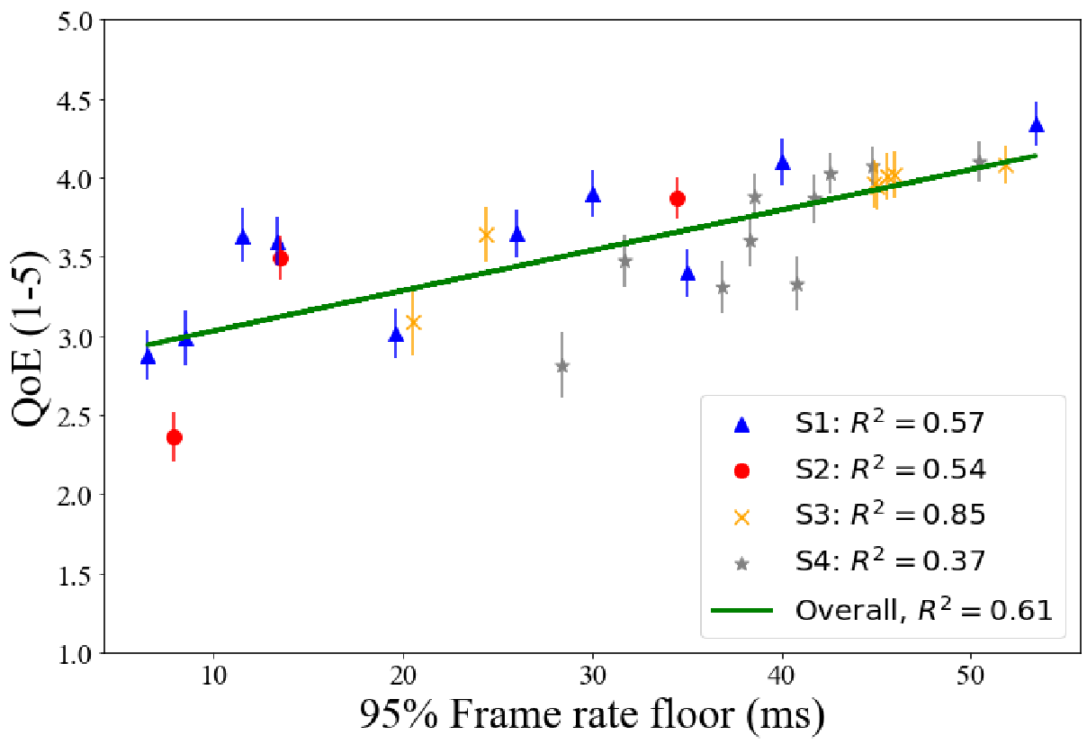
3. Analysis - Frame rate floor 95% (FRF)
Previous model – Fits [1]
Our model – Not fits
[1] Shengmei Liu, Atsuo Kuwahara, James Scovell, and Mark Claypool. The Effects of Frame Rate Variation on Game Player Quality of Experience, In Proceedings of the ACM Conference on Human Factors in Computing Systems (CHI), Hamburg, Germany, April 23-28, 2023. Online at: https://web.cs.wpi.edu/~claypool/papers/frame-variation-chi-23/
Notes:
In our analysis, we compared our model against previous models, particularly looking at the frame rate floor 95% metric.
In this graph, the x-axis is frame rate 95% floor, and the y axis is QoE.
we can see for previous study,Frame rate 95% floor fits the data well with R^2 0.96
Unlike previous model, ours did not fit the conventional expectations with R^2 0.61, suggesting frame rate 95% floor is not an effective predictor for general case.

