Slide 1
Effects of Variation in Frame Rate on Game Player Quality of Experience
Atsuo Kuwahara
James Scovell
Shengmei Liu
Mark Claypool
Worcester Polytechnic Institute
Intel Corporation
Notes:
Hi, my name is Shengmei. I’m a Ph.D. student in computer science at WPI, an engineering school near … My research area is latency and gaming. Today I will present out work …

Slide 2
What is frame time variation?
FT
FT
FT
FT
FT
Consistent frame rate
FT
FT
FT
FT
Inconsistent frame rate
(variation)
Notes:
Frame rate is a well-known term which means how many times the pictures are displayed to the screen in a second. For example, 30 fps means 30 pictures displayed per second.
Frame time means how long it takes for a frame of picture to be displayed on the screen. It’s the delta between the display time of current frame and the last frame. Higher frame rate, shorter frame time. On the top we have consistent frame rate where the pictures come out regularly and smoothly.
The frame time of the frames are the same.
Instead of consistent frame time, we are studying frame time with variation. Now we have the inconsistent frame rate with variation. Here some frames are rendered faster and some are slower.
The frame time here is inconsistent. The slower frames will have longer frame time and fasters frames will have shorter frame time. And there is variation across the frame time.
There are many possible sources of variation. The variation may from come both hardware and software, the game itself and also graphic settings.

Slide 3
Motivation
😃
🤨
Quality of Experience
Prediction model : QoE = f (variation)
Who can benefit?
Gamers:
Gamer developers:
Hardware companies:
Mouse
Display
Local latency
Notes:
Variation in frame time is known to degrade player experience in games. However, it's not clear how much does the lower frame time variation help player quality of experience.
We aim to quantify the effects of frame time variation on players and provide a model where QoE is a function of variation.
We want to collect data on QoE and frame time variation and find the right matrix which represents variation. Then we will do mathematical modelings and provide a model which can precisely predict players quality of experience given frame rate variation.
The model can benefit many groups of people. For example, gamers would know how would they change in-game settings for better experience. Game developers would learn how should they optimize their game code for better variation. Hardware companies can leverage the results and decide how can they integrate technologies for more stable frame rate.

Slide 4
User Study Procedure
Base frame rate:
Games | Loaders
Valorant | 0 | 13 | 14 | 15
Strange | 0 | 13 | 14 | 15
Rocket | 0 | 14 | 17 | 20
120 fps
RTSS
60 fps
Loaders
Shuffled
1 minute per round,
~ 20 mins per game,
~65 minutes in total.
Perfect
2*Noticeable
Playable
3*chaos
Notes:
Our methodology is to run a user study.
For each of the game, there are two base frame rate, 60 and 120
The frame rate is capped by a tool called RTSS.
The variation is controlled by task loaders and there are 7 conditions for each frame rate: perfect condition without any loaders. 2 Noticeable condition where the frame rate variation are noticeable to players, playable where the game is barely playable. For the four conditions, you can find games and corresponding numbers of loaders in the table. For the 3 game we selected, the numbers of loaders are the same for game valorant and strange brigade. They are higher for game rocket league because rocket league is more tolerant to frame rate variation.
Other than the 4 consistent loaders conditions, there are 3 extra chaos rounds with a combination of all the 4 conditions.
The order of the all the game conditions are randomly shuffled but players will finish all game rounds of one game before proceed the next one. For each of the game, players will finish all the rounds for one fps before proceed to another fps. There is one extra practice round without any loaders for each of the game.
Each of game round lasts for 1 minute and players usually spend about 20 mins for a game and about 1 hr for the user study.

Slide 5
User Study Procedure
- In-game survey after each round
Script that controls launching of games and QoE survey automatically
Notes:
We have an in-game survey after each round asking about their experience. There are two questions in the survey. The first question is a widely used MOS question: …. The second question asks if the experience is acceptable. There is error control for both questions.
We have a Script that controls launching of games and QoE survey automatically

Slide 6
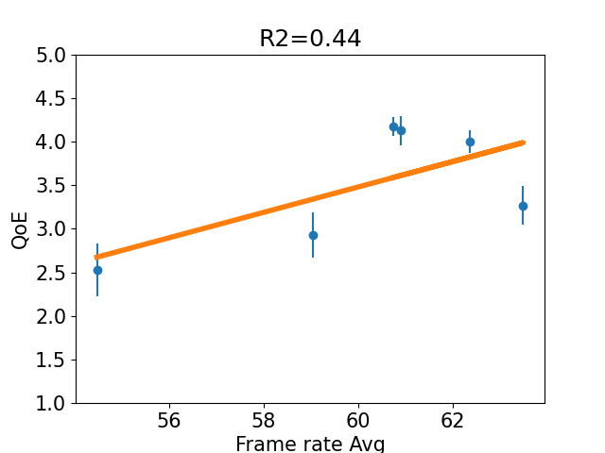
Frame rate average
Frame rate average is a bad predictor for QoE
Notes:
We proposed many different matrices for frame rate variation see how well they fit our data. We will first introduce frame rate average. The frame rate of every frame is recorded and this metric is the average across a game round.
In this graph, the x-axis is frame rate avg and the y axis is QoE. We divide the data from 120 HZ rounds by two and combine the data of 120 hz and 60 hz. The blue circles are the mean values across the 6 consistent loaders condition and the bars are 95% CI across the mean values. From this graph, the blue points are way off the line,
showing that frame rate average is a bad predictor for QoE.

Slide 7
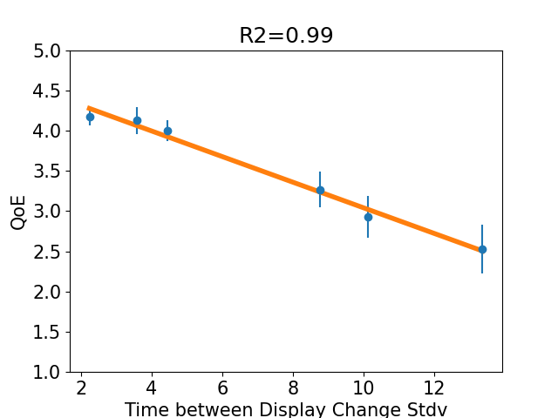
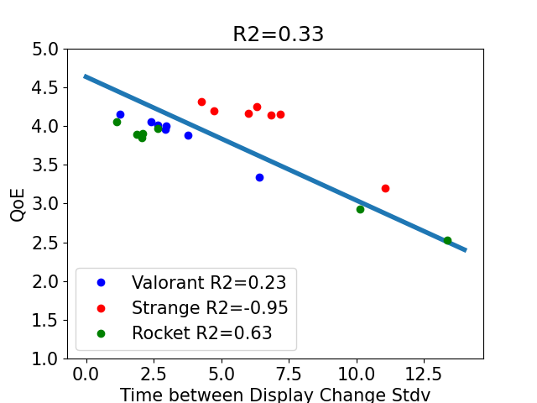
Time Between Display Change Stdv
Time between display change Stdv fits
our data well
Time Between Display change stdv might
not be accurate for a specific game
Notes:
The next metric is time between display change stdv. We fit the models with data from games with consistent loaders conditions, and then validate the models with data from the chaos rounds.
The graph is as last graph but the x axis is time between display change stdv. We can see that time between display change stdv fits our data well with R2 at 0.99.
We can learn that Time between display change Stdv fits our data well.
We then validate the model using the chaos rounds data. The axes are as graph on the left. 3 colors of points represent data from 3 different games. We can see that Time Between Display change stdv did not fit the individual games well and that
Time Between Display change stdv might not be accurate for a specific game.

Slide 8
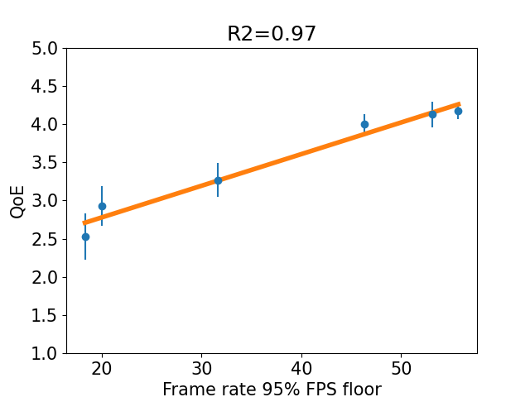
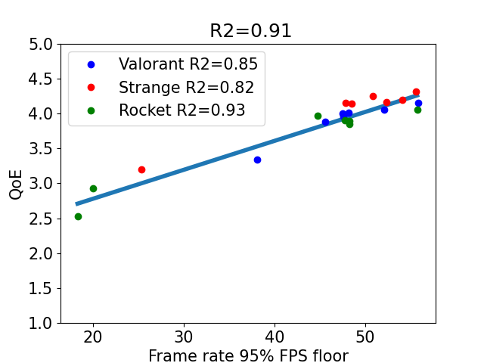
Frame rate 95% floor
*95% of frame rates are greater than this number
Frame rate 95% floor fits our data well
Frame rate 95% floor is an effective predictor for QoE
Notes:
The next metric is Frame rate 95% floor, which means 95% of frame rates are greater than this number.
This graph is … The x axis is frame rate 95% floor.. Y axis... From the R2 at 0.97,
we can see that Frame rate 95% floor fits our data well.
The graph on the right shows validation using chaos rounds data. We can see this frame rate 95% floor also fits the individual games well.
As a conclusion, Frame rate 95% floor is an effective predictor for QoE.

Slide 9
Future work
Study more games & genres
Examine difference based on player expertise
Investigate other sources of variation
Apply results beyond games
Notes:
Zoom, VR …
…And see how frame rate variation affects players from different skill groups differently.

Slide 10
Thanks for you attention!

