Slide 1
EvLag – A Tool for Monitoring and Lagging Linux Input Devices
Shengmei Liu
and
Mark Claypool
Notes:
Shengmei Liu and Mark Claypool. EvLag - A Tool for Monitoring and Lagging Linux Input Devices, In Proceedings of the ACM Multimedia Systems Conference (MMSys), Istanbul, Turkey, September 28 - October 1, 2021. Online at: http://www.cs.wpi.edu/~claypool/papers/evlag/

Slide 2
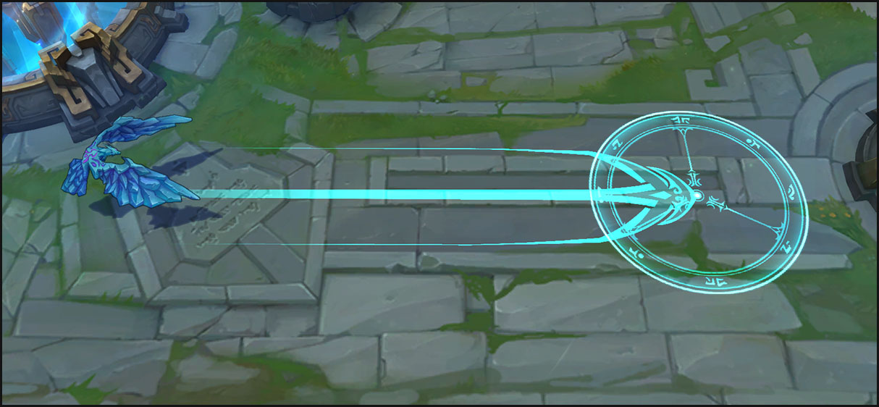
Introduction
Latency degrades interactivity
Particularly for games
Highly interactive
Player performance matters
Techniques to mitigate (latency compensation)
But need more studies of latency on games and game actions
[Call of Duty, Activision, 2003]
[League of Legends, Riot Games, 2009]

Slide 3
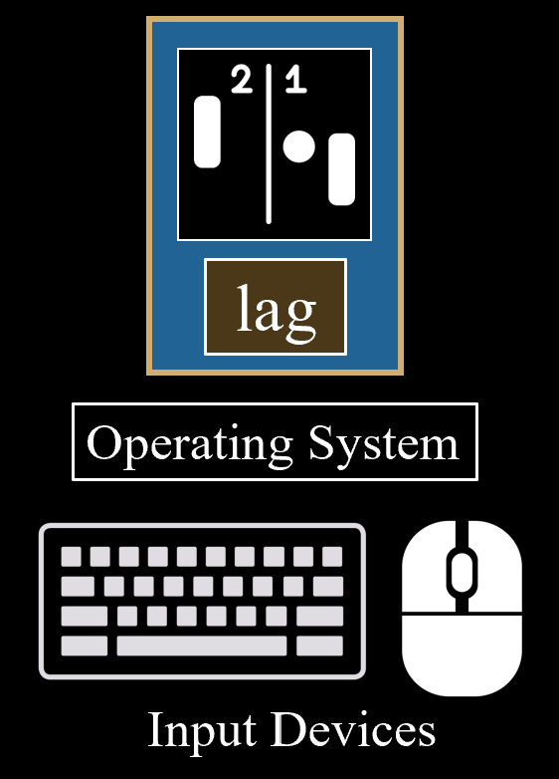
Introduction
Typically, via user study
Add latency
Play game
Measure perf, QoE
Repeat
Must add lag to game
Limits games (open source)
Re-implement code (bugs)

Slide 4
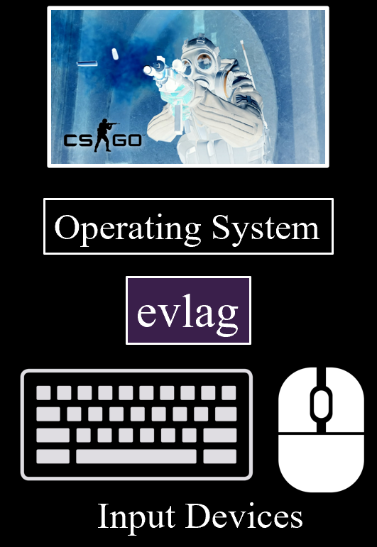
Introduction
EvLag
Sits outside game, so can use with close source (commercial)
Latency to any Linux input device
Also logging of input events
EvLag
This paper → features, implementation, evaluation, example use

Slide 5
Outline
Introduction (done)
Related Work (next)
Implementation
Evaluation
Use
Conclusion

Slide 6
Related Work
Network latency tools
Networking: dummynet [4], Clumsy [31], MahiMahi [18], netem [32]
Can be used for network latency, but not local latency
Local latency studies
[7, 8, 13, 16, 17, 20, 21, 29]
cloud-based game systems [26, 30]
All use same technique – modify small game/app with latency
Measuring local latency
Camera, sensors [13, 24, 27, 33]
We use to verify EvLag works

Slide 7
EvLag – Overview
Features
Fixed latency to any input device
Lag multiple devices at once (e.g., keyboard and mouse)
Log input events, one file per device
Implementation
Linux evdev
Generalize raw input as character devices
/dev/input
Three threads
Reader, Writer – handle events
Main – setup, handles timers

Slide 8
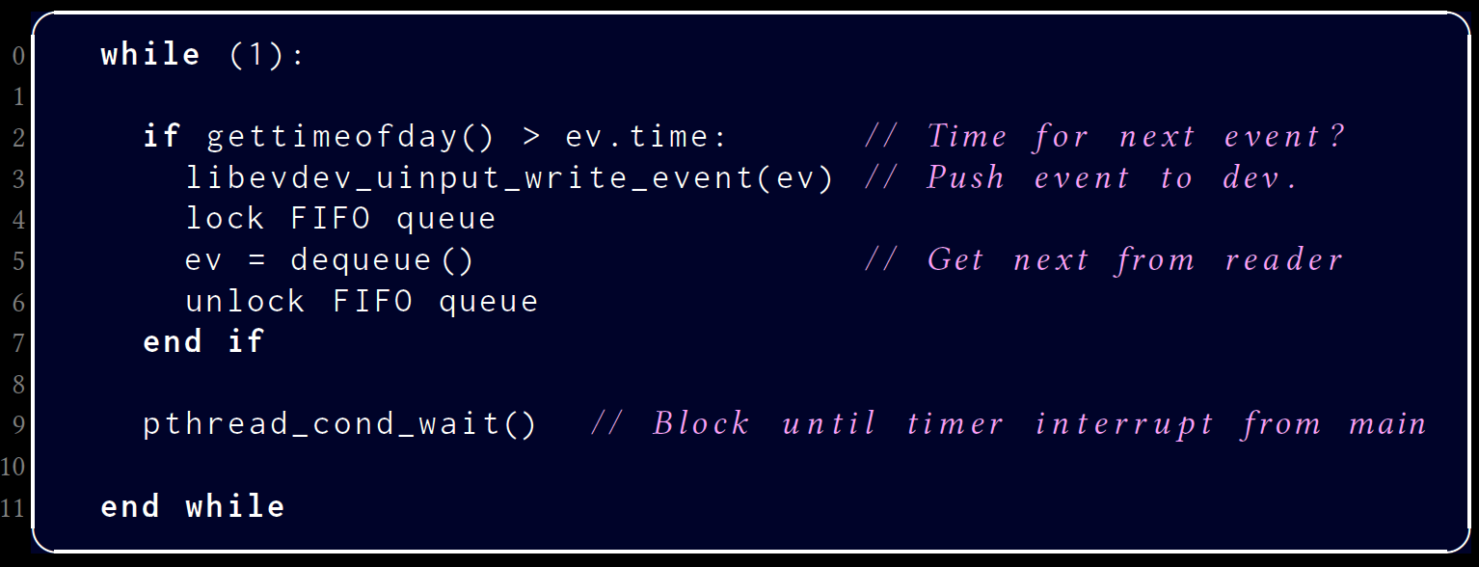
EvLag – Implementation
Reader
Writer

Slide 9
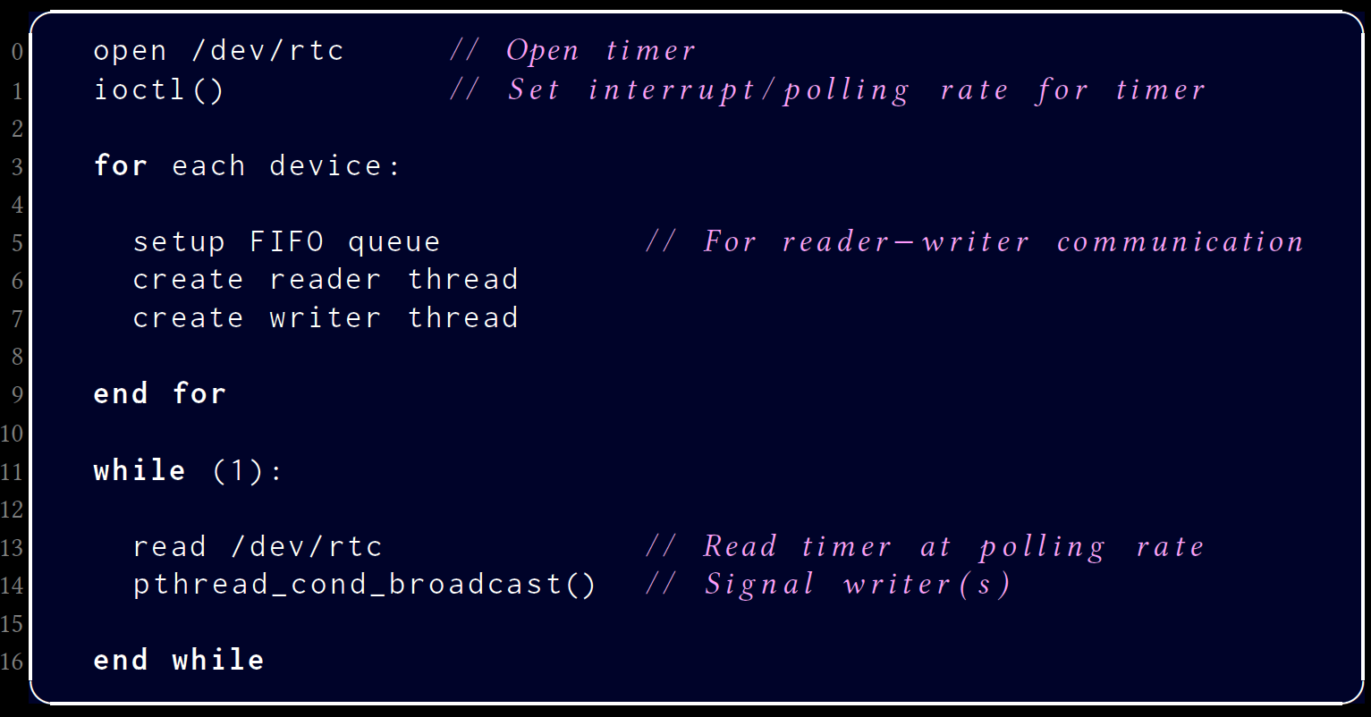
EvLag – Implementation
Main

Slide 10
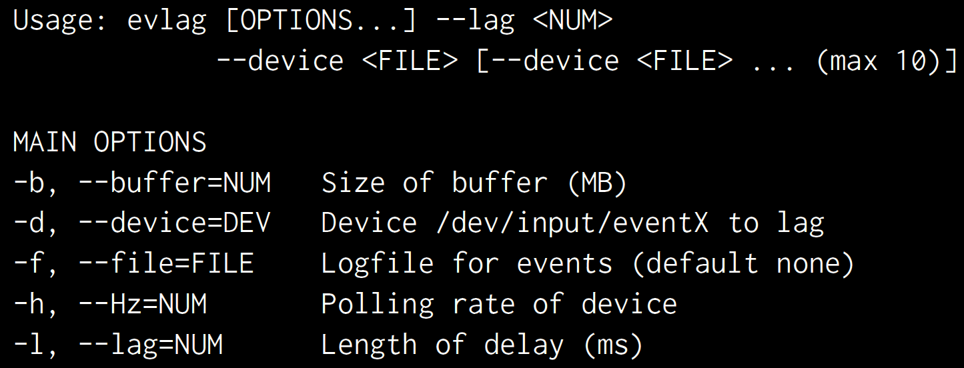
EvLag – Usage
Example:

Slide 11
EvLag – Utilities
EvParse – parse EvLag log files
EvDetect – automatically find device given string

Slide 12
Outline
Introduction (done)
Related Work (done)
Implementation (done)
Evaluation (next)
Use
Conclusion

Slide 13
Evaluation – Measuring Local Latency

Slide 14
Evaluation – Results

Slide 15
EvLag – Example Study
Shengmei Liu, Atsuo Kuwahara, James Scovell, Jamie Sherman, and Mark Claypool. “Lower is Better? The Effects of Local Latencies on Competitive First-Person Shooter Game Players”, In Proceedings of the ACM Conference on Human Factors in Computing Systems (CHI), Virtual Conference, May 8-13, 2021. Online at: http://www.cs.wpi.edu/~claypool/papers/csgo-lag-21/
User study,
43 participants
EvLag
25
0
100
200
300
(ms)
Gaming system
Normal PCs
Consoles, TV, etc.

Slide 16
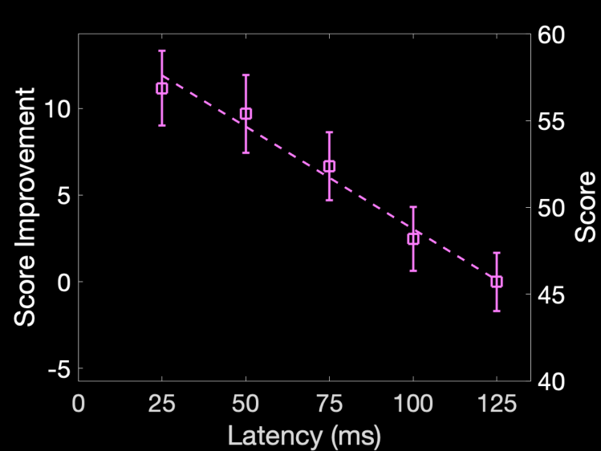
EvLag – Example Study

Slide 17
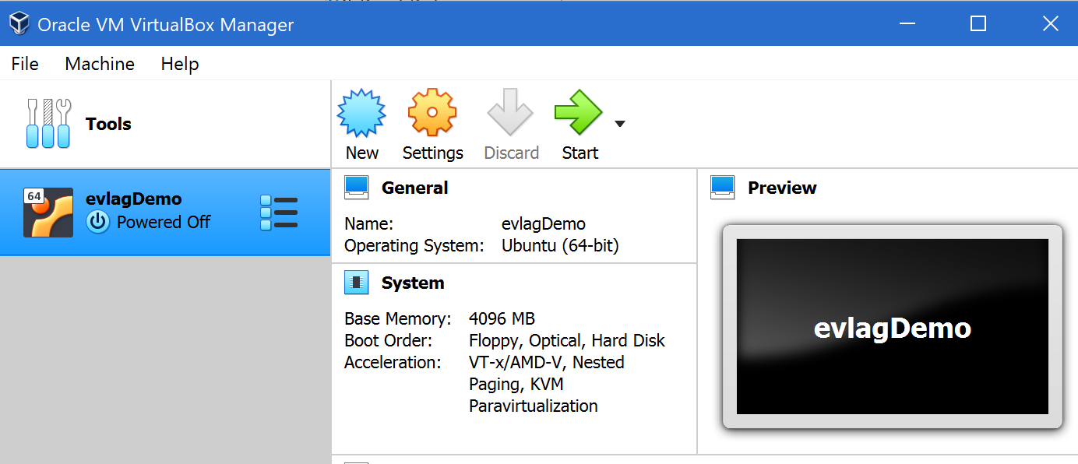
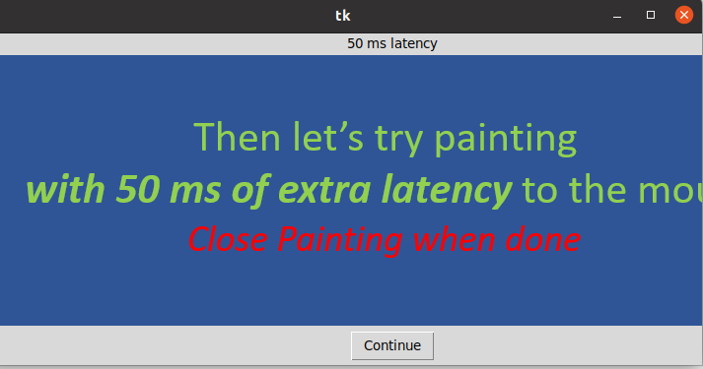
EvLag – Demo
https://web.cs.wpi.edu/~claypool/papers/evlag/

Slide 18
Summary
Understanding latency helpful for designs and techniques to compensate
User studies must modify code, limiting use of commercial games
EvLag – adds latency to input devices in Linux
Can be used for any application
Also logs input
Download:
apt package:
https://web.cs.wpi.edu/~claypool/papers/evlag/install.html
git repo:
https://claypool@bitbucket.org/claypool/evlag.git

Slide 19
Future Work
Additional features
Enhanced parsing of logs (game controllers)
Different lag for each device
Additional studies of latency
Games, game actions, input devices
Similar tools for other platforms
Windows, Mac, Android, iOS

Slide 20
EvLag – A Tool for Monitoring and Lagging Linux Input Devices
Thank-you for your attention!
Shengmei Liu
and
Mark Claypool
Notes:
Shengmei Liu and Mark Claypool. EvLag - A Tool for Monitoring and Lagging Linux Input Devices, In Proceedings of the ACM Multimedia Systems Conference (MMSys), Istanbul, Turkey, September 28 - October 1, 2021. Online at: http://www.cs.wpi.edu/~claypool/papers/evlag/

