Slide 1
EvLag – A Tool for Monitoring and Lagging Linux Input Devices
Shengmei Liu
and
Mark Claypool
Notes:
Shengmei Liu and Mark Claypool. EvLag - A Tool for Monitoring and Lagging Linux Input Devices, In Proceedings of the ACM Multimedia Systems Conference (MMSys), Istanbul, Turkey, September 28 - October 1, 2021. Online at: http://www.cs.wpi.edu/~claypool/papers/evlag/

Slide 2
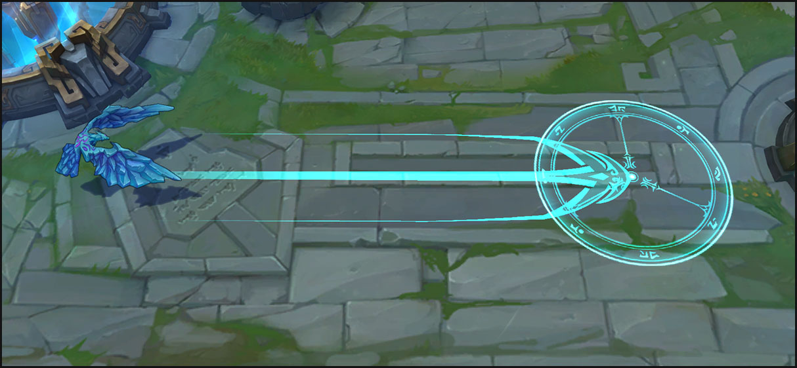
Studying Latency
Latency degrades interactivity
Particularly for games
Highly interactive
Player performance matters
Science via user studies
Add latency, test with users
[Call of Duty, Activision, 2003]
[League of Legends, Riot Games, 2009]

Slide 3
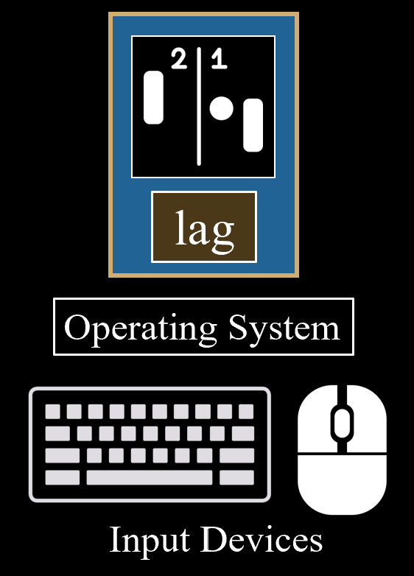
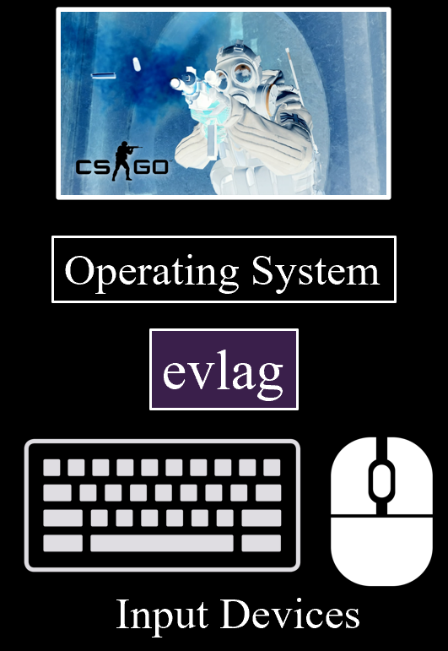
Challenge – Adding Latency
EvLag
This paper → features, implementation, evaluation, example use

Slide 4
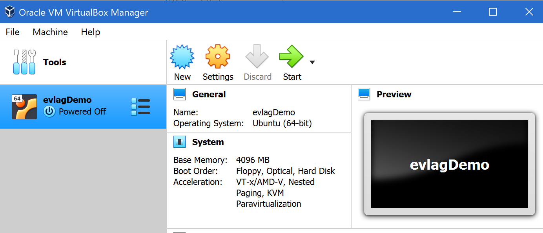
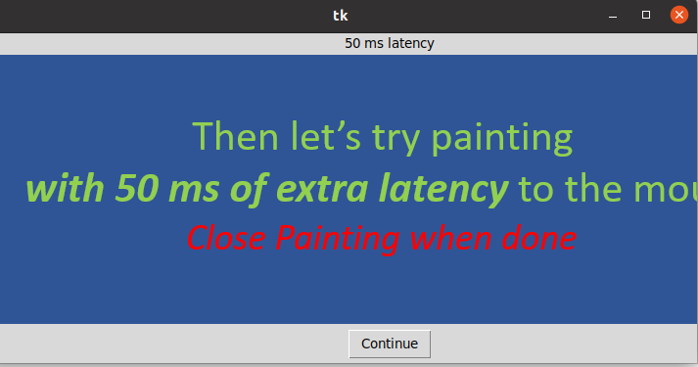
EvLag – Demo
https://web.cs.wpi.edu/~claypool/papers/evlag/

Slide 5
EvLag – A Tool for Monitoring and Lagging Linux Input Devices
Thank-you for your attention!
Shengmei Liu
and
Mark Claypool
Notes:
Shengmei Liu and Mark Claypool. EvLag - A Tool for Monitoring and Lagging Linux Input Devices, In Proceedings of the ACM Multimedia Systems Conference (MMSys), Istanbul, Turkey, September 28 - October 1, 2021. Online at: http://www.cs.wpi.edu/~claypool/papers/evlag/

