Slide 1
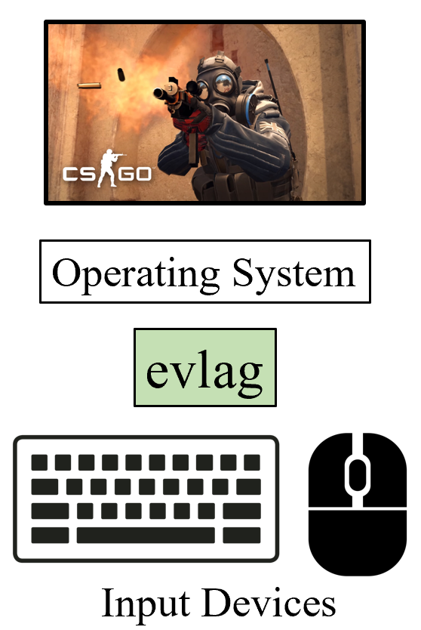
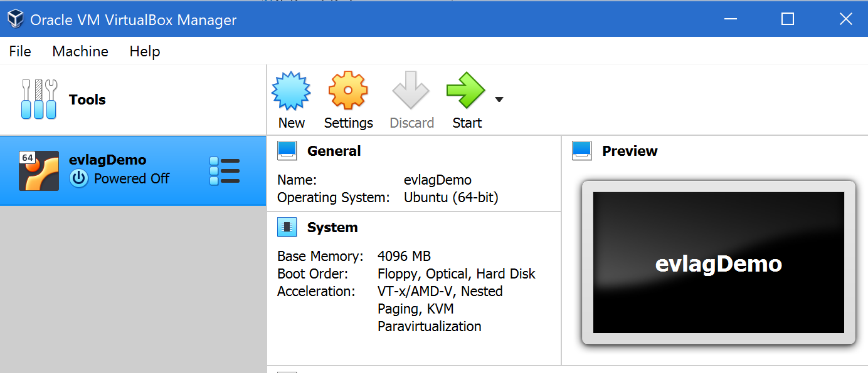
EvLag – A Tool for Monitoring and Lagging Linux Input Devices
Shengmei Liu, Mark Claypool
Evaluation
Features
Fixed latency to any input device
Lag multiple devices at once (e.g., keyboard and mouse)
Log input events, one file per device
Implementation
Linux evdev
Three threads
Reader, Writer – handle events
Main – setup, handles timers
Demo!
Notes:
Shengmei Liu and Mark Claypool. EvLag - A Tool for Monitoring and Lagging Linux Input Devices, In Proceedings of the ACM Multimedia Systems Conference (MMSys), Istanbul, Turkey, September 28 - October 1, 2021. Online at: http://www.cs.wpi.edu/~claypool/papers/evlag/

