Slide 1

Evaluating Streaming and Latency Compensation in a Cloud-based Game
Jiawei Sun and Mark Claypool
Worcester Polytechnic Institute
Notes:
Jiawei Sun and Mark Claypool. Evaluating Streaming and Latency Compensation in a Cloud-based Game, In Proceedings of the 15th IARIA Advanced International Conference on Telecommunications (AICT), Nice, France, July 28 - August 2, 2019. Online at: http://www.cs.wpi.edu/~claypool/papers/drizzle/

Slide 2

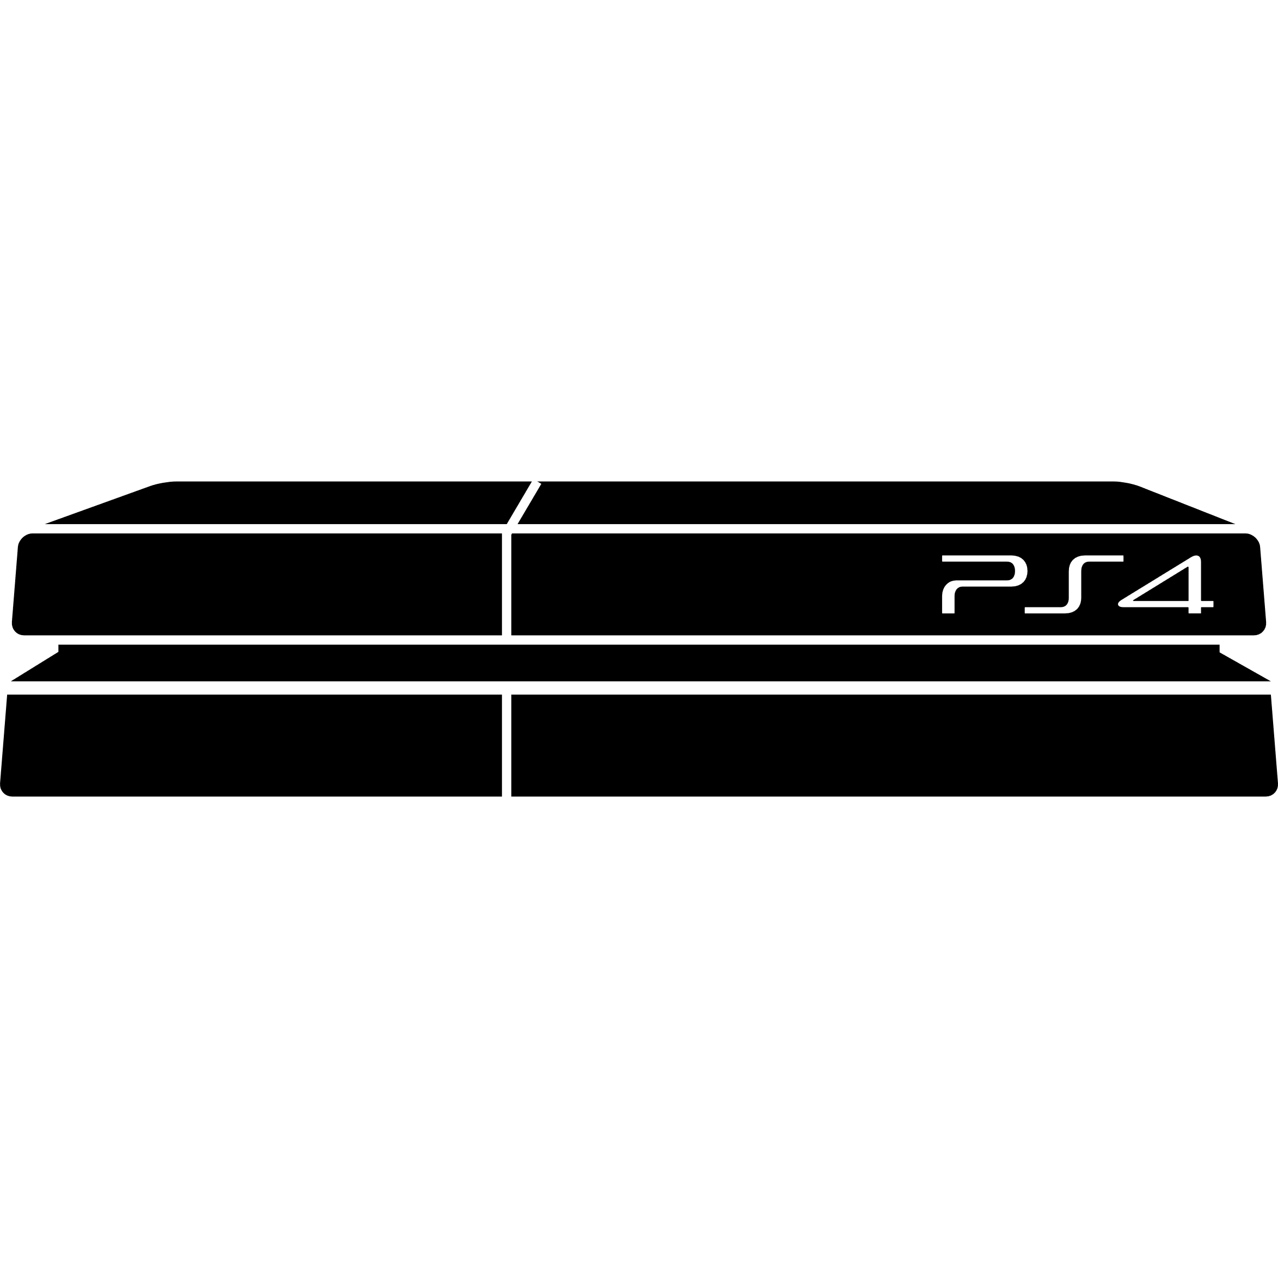


What are Cloud-based Games?
\
~==-
/
____
/___o\
Traditional
console
Client
Player input
Game frames
\
~==-
/
____
/___o\
\
~==-
/
____
/___o\
\
~==-
/
.**
**.**
*.*
server
\
~==-
/
____
/___o\
server
Cloud-based
Player input
server
Thin Client
Cloud Servers

Slide 3
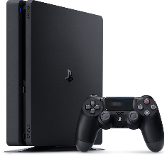






Why Cloud-based Games?
Complex games, simple hardware
  $100 “thin” console vs. $300 PS4/XBox
  3D, HD games on limited devices (e.g., mobile phone)
Elastic scalability – servers on demand
Piracy prevention – server controls content
Support fan streaming (e.g., Twitch)
Click-to-play
  Shadow of War 97 GB
  League of Legends patched 200 times (22/year)

Slide 4
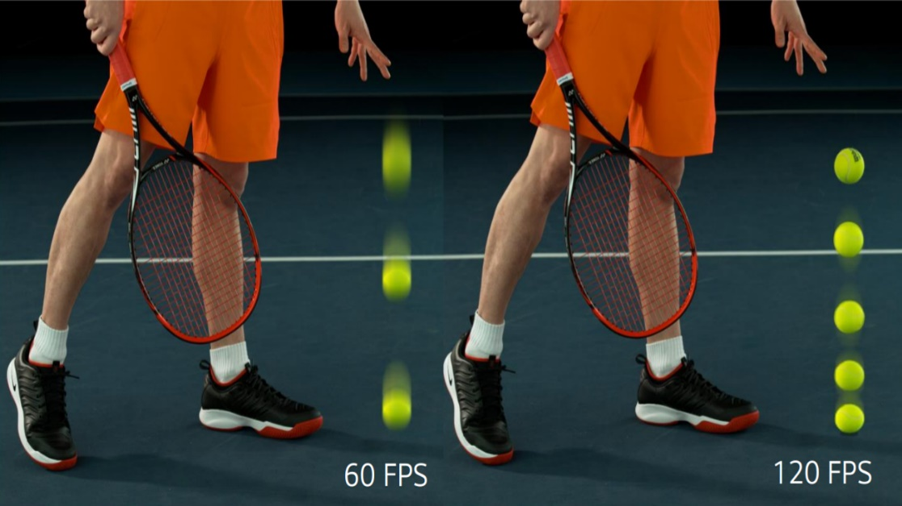
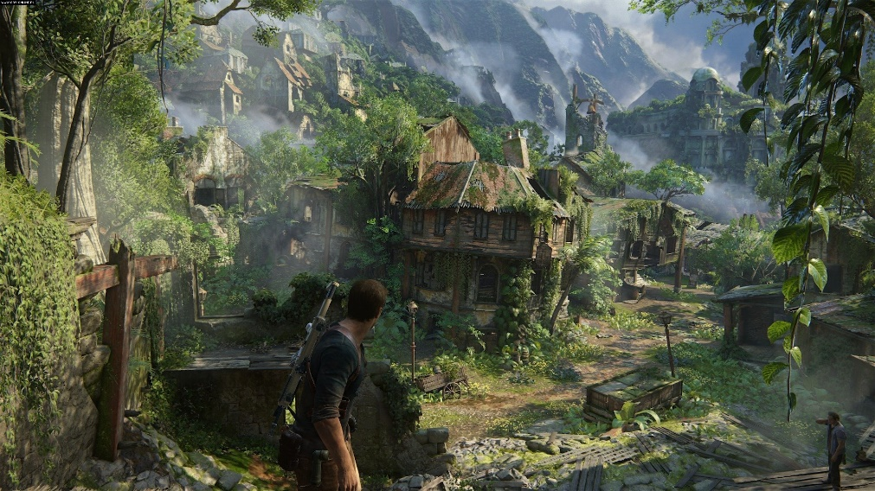

Challenge – Capacity
High frame rates, high def graphics
  → Improve player performance
  → Increase QoE
Bottleneck
Router
https://cdn.mos.cms.futurecdn.net/BZuaf3jjrnhCAxyM7ueaNj.jpg
server
capacity
\
~==-
/
____
/___o\
Minimum 10 Mb/s
4k, 60 f/s needs 35 Mb/s
Unchartered 4 [Sony, 2016]

Slide 5
Approach – Graphics Streaming
Thin Client
Game frames
\
~==-
/
____
/___o\
\
~==-
/
\
~==-
/
\
~==-
/
.**
**.**
*.*
____
/___o\
____
/___o\
Server
Image Streaming
Thin Client
Game frames
\
~==-
/
____
/___o\
\
~==-
/
____
/___o\
\
~==-
/
____
/___o\
\
~==-
/
.**
**.**
*.*
\
~==-
/
Server
Video Streaming
Thin Client
Game frames
This paper:
\
~==-
/
____
/___o\
\~=
=-/
___
__
/__
_o\
\~=
=-/
___
__
/__
_o\
\~=
=-/
**
**.** *.*
Server
\~=
=-/
Graphics Streaming

Slide 6

Challenge – Latency
\
~==-
/
____
/___o\
Game
client
Internet
server
Game
server
Latency - time to get from source to destination
  There and back (round-trip time)

Slide 7
Why Does Latency Matter?
\
~==-
/
____
/___o\
server
User
Input
Message:
User Input
Process
Input
Response
time
Game World
Display
World
Time
Degrades responsiveness

Slide 8
Approach – Latency Compensation
\
~==-
/
____
/___o\
server
User
Input
But developed for traditional games. What about cloud-based games?
Message:
User Input
“Warp” time
Game World
Display
World
Time
This paper: apply and evaluate latency compensation to a cloud-based game

Slide 9

Outline
Introduction (done)
Related Work (next)
Methodology
Results
Conclusions

Slide 10

Related Work (1 of 3)
Thin Client
Game frames
\
~==-
/
____
/___o\
\
~==-
/
____
/___o\
\
~==-
/
____
/___o\
\
~==-
/
.**
**.**
*.*
Server
Image Streaming
Thin Client
Game frames
\
~==-
/
____
/___o\
\
~==-
/
____
/___o\
\
~==-
/
____
/___o\
\
~==-
/
.**
**.**
*.*
\
~==-
/
Server
Video Streaming
Thin Client
Game frames
\
~==-
/
____
/___o\
\~=
=-/
___
__
/__
_o\
\~=
=-/
___
__
/__
_o\
\~=
=-/
**
**.** *.*
Server
\~=
=-/
Graphics Streaming
Cloud-based Game Systems
  Architectures [Huang et al, 2013] [Shea et al., 2013]
  Streaming approaches [De Winter, 2006] [Shea et al., 2013]
  Most use video streaming and little comparison

Slide 11
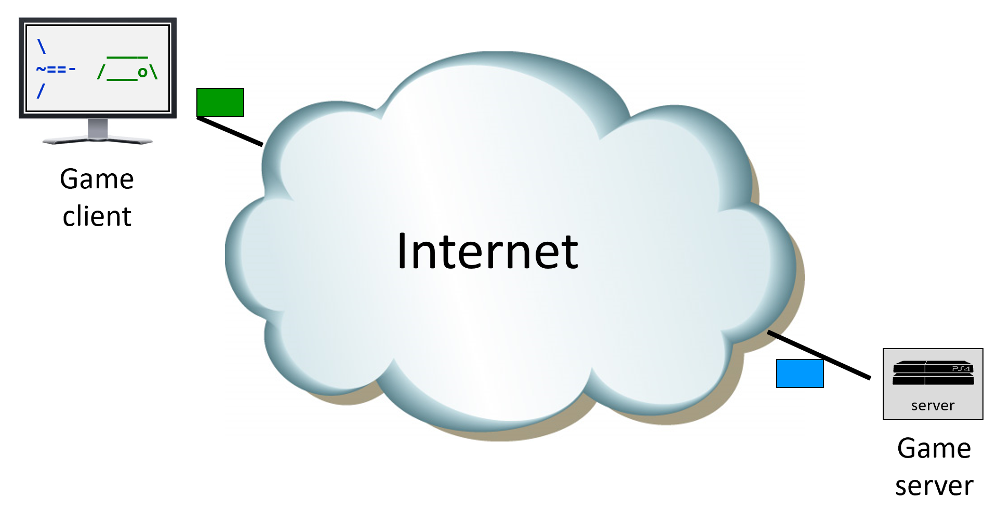
Related Work (2 of 3)
Latency and Cloud-based Games
  User studies [Jarschel et al. 2011] [Claypool and Finkel 2014] [Sackl et al. 2016]
  No use of latency compensation

Slide 12
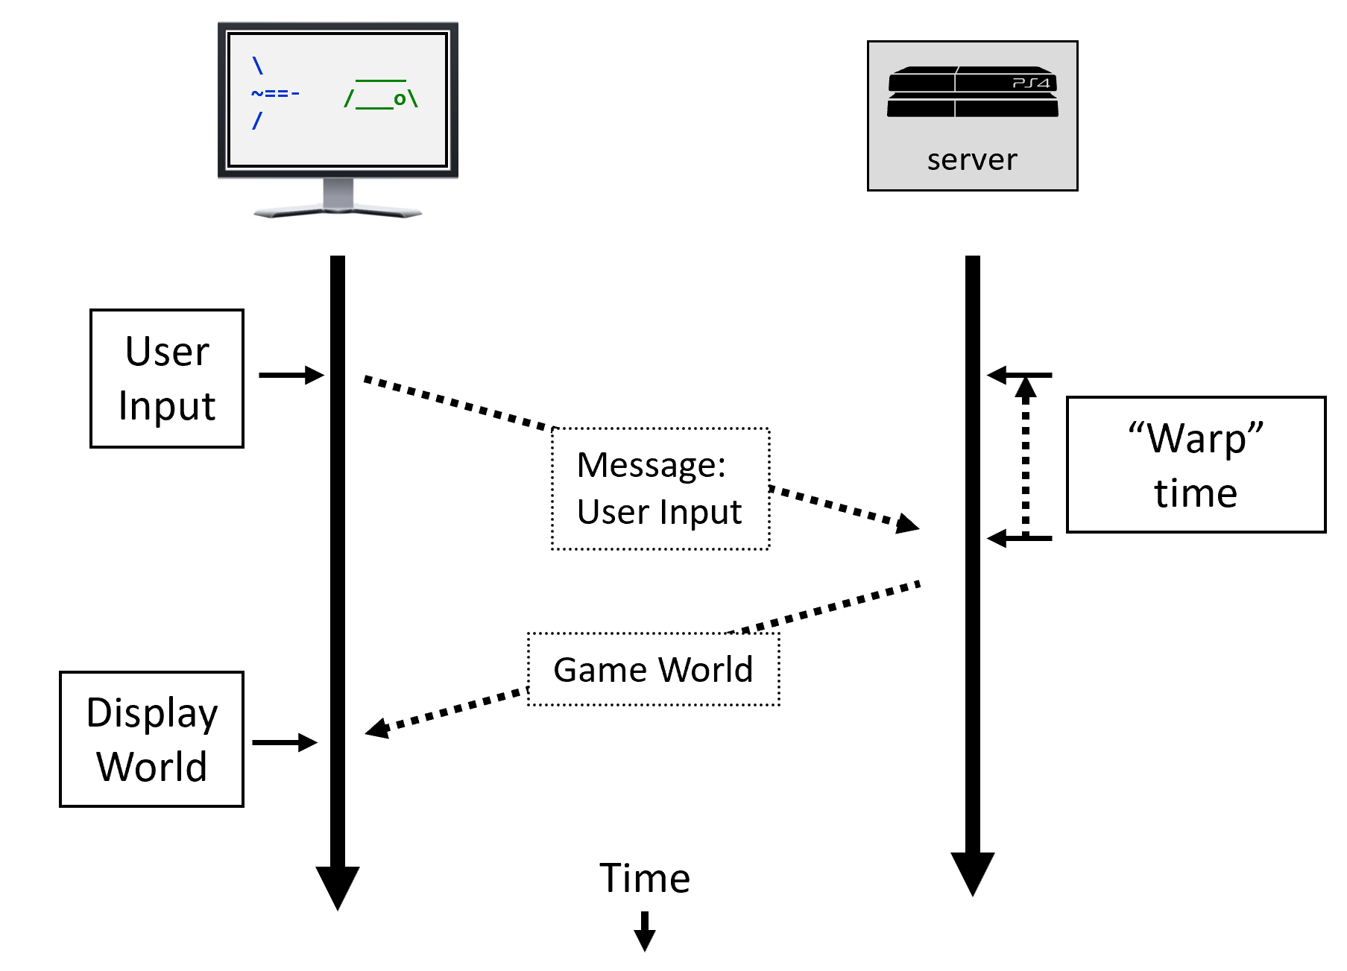

Related Work (3 of 3)
Latency Compensation
  Survey [Bernier 2001]
  Aiming in FPS [Ivkovic et al. 2015]
  Time warp in FPS [Lee and Chang 2015 & 2017]
\
~==-
/
____
/___o\
console
Client
Limited evaluation and not for cloud-based games

Slide 13
Outline
Introduction (done)
Related Work (done)
Methodology (next)
Results
Conclusions

Slide 14
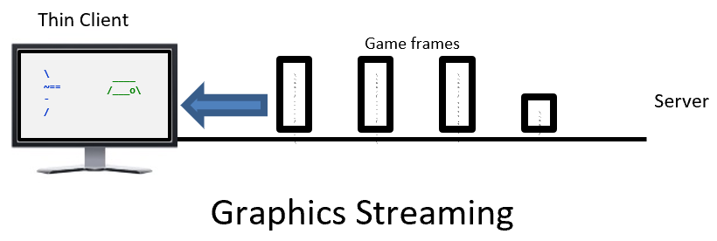

Methodology
Build cloud-based game system
  Graphics streaming
  Time-warp
Evaluate
  User study
  System experiments
https://www.cognizant.com/futureofwork/about

Slide 15

Drizzle – A Cloud-based Game System
Dragonfly – small, full-featured game engine (C++, SFML)
Add networking
Create authoritative server, thin client
Start engine
Wait for client
Loop
Receive input
(Time warp)
Update world
Send frame data
Shutdown engine
Connect to server
Loop
Capture input
Send input
Receive frame data
Render frame
Close connection
Client
Server

Slide 16
Capacity Compensation –
Bitrate versus Complexity
Image
Streaming
Thin Client
Game frames
\
~==-
/
____
/___o\
\
~==-
/
____
/___o\
\
~==-
/
____
/___o\
\
~==-
/
.**
**.**
*.*
Server
Image Streaming
Thin Client
Game frames
Network Bitrate
\
~==-
/
____
/___o\
Video
Streaming
\
~==-
/
____
/___o\
\
~==-
/
____
/___o\
\
~==-
/
.**
**.**
*.*
\
~==-
/
Server
Video Streaming
Graphics
Streaming
Thin Client
Traditional
Game
\
~==-
/
Game frames
____
/___o\
\~=
=-/
___
__
/__
_o\
\~=
=-/
___
__
/__
_o\
\~=
=-/
**
**.** *.*
Server
\~=
=-/
Graphics Streaming
Client Complexity

Slide 17
Latency Compensation – Time Warp
Time Warp
∆t
Opponent
Position when
player acted
Current
position
Player
Score: 120
.**
**.**
*.*
\
~==-
/
Apply to :
____
/_o__\
>-
____
/___o\

Slide 18

Evaluation
User Study
  Time Warp: On / Off
  Latency: 0, 100, 200, 400, 800 ms
System Experiments
  Bitrates for streaming: Image, Video, Graphics
  CPU load for number of game Objects
https://www.cognizant.com/futureofwork/about

Slide 19
Outline
Introduction (done)
Related Work (done)
Methodology (done)
Results (next)
Conclusions

Slide 20

User Study – Demographics
30 users
20-30 years old
25 male, 5 female
Online game playing:
  60% every day
  25% once per week
  15% once per month

Slide 21
User Study – Performance
Time warp improves player performance for mid-range latencies

Slide 22
User Study – QoE
Responsiveness and Consistency decrease with latency.
Consistency worse with Time Warp on.

Slide 23
System Experiments – Bitrates
Video about 20% of image
Graphics about 20% of video
Cloud-based game streaming highest
Drizzle graphics close to traditional

Slide 24
System Experiments – Bitrates
Bitrate requirements linear with visible game objects
Graphics streaming lowest by far

Slide 25
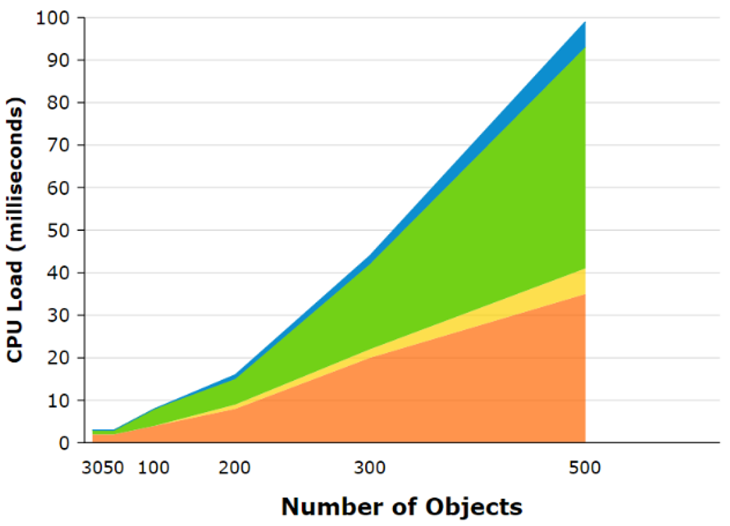
System Experiments – CPU Load
Update
Time Warp
Copy
Stream
CPU load increases with number of game objects
Time warp and Streaming highest load by far
→ Cloud-gaming server load considerably higher than traditional

Slide 26
Conclusions
Cloud-games challenges – capacity and latency
Drizzle – lightweight cloud-based game system with graphics streaming and latency compensation
Evaluation – streaming:
  Graphics streaming savings over Video streaming
  Traditional games still less
Evaluation – latency compensation:
  Time warp causes game state inconsistency
  Time warp helps player performance with latency
CPU loads for cloud game servers significant

Slide 27

Future Work
Time-warp with hit-scan weapons
Other latency compensation approaches (e.g., aim assistance, geometric scaling)
Graphics streaming for wider range of game genres
https://tinyurl.com/yyx8kwm6

Slide 28
Evaluating Streaming and Latency Compensation in a Cloud-based Game
Jiawei Sun and Mark Claypool
Worcester Polytechnic Institute
Notes:
Jiawei Sun and Mark Claypool. Evaluating Streaming and Latency Compensation in a Cloud-based Game, In Proceedings of the 15th IARIA Advanced International Conference on Telecommunications (AICT), Nice, France, July 28 - August 2, 2019. Online at: http://www.cs.wpi.edu/~claypool/papers/drizzle/

Slide 29
Extra Slides

Slide 30
Drizzle Server

Slide 31
Drizzle Client

Slide 32
Cloud Saucer Shoot
Score: 120
.
____
/_o__\
>-
\
~==-
/
____
/___o\
____
/____\
.**
**.**
*.*
.

