Slide 1
Machine Learning Prediction of Just Dance Exergame Enjoyment from Mobile Sensor Data
Joshua Audibert, Elijah Gonzalez, Ryan Orlando, Nicholas Wong, Emmanuel Agu and Mark Claypool
Computer Science Dept.,
Worcester Polytechnic Institute, Worcester, MA 01609

Slide 2
Talk Outline
The Problem
Project Goal in context of larger vision: Cypress
Related Work
Methodology
Data Gathering Study
Machine Learning Modeling Study
Results
Conclusion and Future work

Slide 3
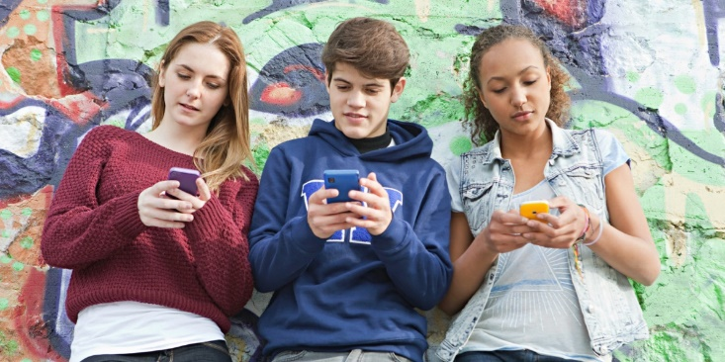
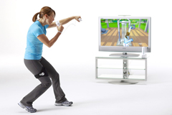
The General Problem
Physical inactivity/sedentary lifestyles is on the rise
Increases risk of obesity, many ailments
Leading cause of death in U.S.
Many young adults get insufficient exercise
Use electronic media (Internet, smartphone, social media, games) instead
Exergames (Gamify Physical Activity) can increase physical activity in young people
Demonstrated efficacy in improving health (aerobic fitness, etc)

Slide 4
The Specific Problem
Exergame engagement starts high, but drops quickly
95% of new exergamers stopped playing within 3 months
85% of new players stopped after one day!
Defn: exergame enjoyment is “A feeling of pleasure that results from playing a videogame, which gamifies physical activity”
Enjoyment of physical activity is important determinant of physical activity participation especially in young people
Our larger Cypress vision: an exergame
recommender system [26]
Passively monitors user enjoyment of
smartphone exergames (machine learning)
Whenever waning user enjoyment is
detected, recommends new game

Slide 5
Specific Objectives
Goal: Prediction of Just Dance game enjoyment scores from smartphone sensor data using Machine Learning (ML)
Initial focus on smartphone exergames
Sensor data easily collected
Processing power to run machine learning models
Challenges:
Smartphone is multi-purpose device, data can be noisy
Exergame enjoyment can be confounded by other factors (e.g., player’s mood)
Inter-player variability in enjoyment behavior:
Different expressions of enjoyment, not always distinct

Slide 6
Related Work
Explicit indicators of enjoyment/interest
Likert scales: player responds with their enjoyment score/interest
Actively responding may present burden to player
Player responses can be subjective
Physiological indictors of exergame enjoyment/interest
Affect: facial expressions and emotive gestures
Not considered in this paper

Slide 7
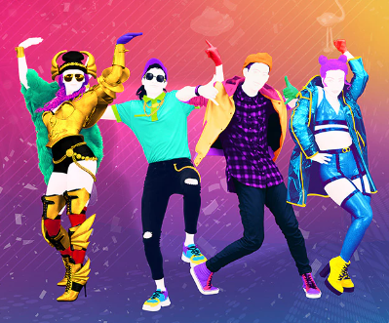
Background
Just Dance:
Popular exergame
Players hold smartphone while dancing to song of their choice
Players scored based on how accurately they can follow on-screen dancer
Implicit indicators of exergame interest/enjoyment:
Immersion, long session, excited gameplay
Immersive Experience Questionnaire (IEQ)
Jennett, C., Cox, A.L., Cairns, P., Dhoparee, S., Epps, A., Tijs, T. and Walton, A., 2008. Measuring and defining the experience of immersion in games. International journal of human-computer studies, 66(9), pp.641-661.
Instrument generates scale used to subjectively measure immersion in games

Slide 8
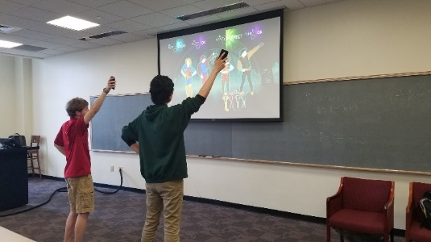
Methodology
Conduct study to generate labeled Just Dance enjoyment data
Informed consent, pre-questionnaire (demographics, etc)
Players played Just Dance exergame for 2 songs
Same first song all players
Players selected a second song
Smartphone app “AndroSensor” passively collected accelerometer and gyroscope data
Players filled out Immersive Experience Questionnaire (IEQ) after playing each song (Twice)
Filled out post-game questionnaire that explicitly asked them if they enjoyed the game

Slide 9
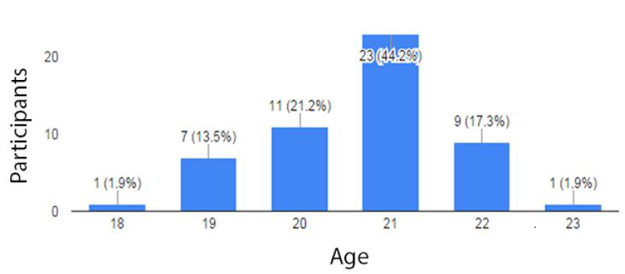
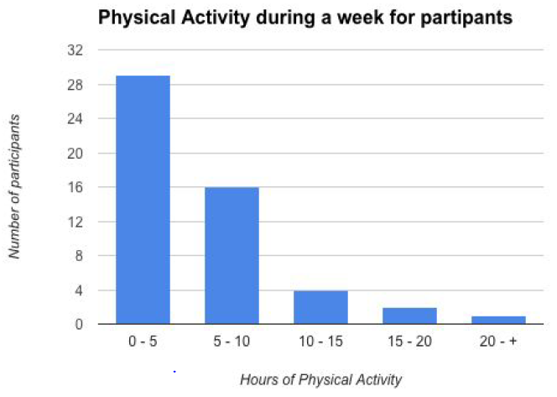
Results: Data Gathering Study
Participant Ages: median 21
Participant physical activity weekly
Many 0-5 hours per week!

Slide 10
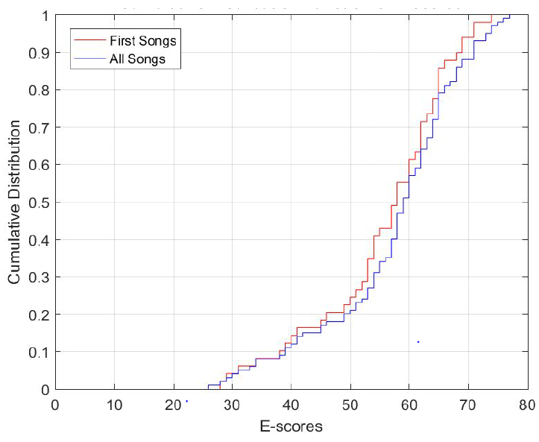
Results: Cumulative Density Function IEQ Scores (E-Scores)
IEQ score total: 0 to 80
Mean of ~60 (mostly enjoyed)
Slight difference between:
First song (imposed)
All songs

Slide 11
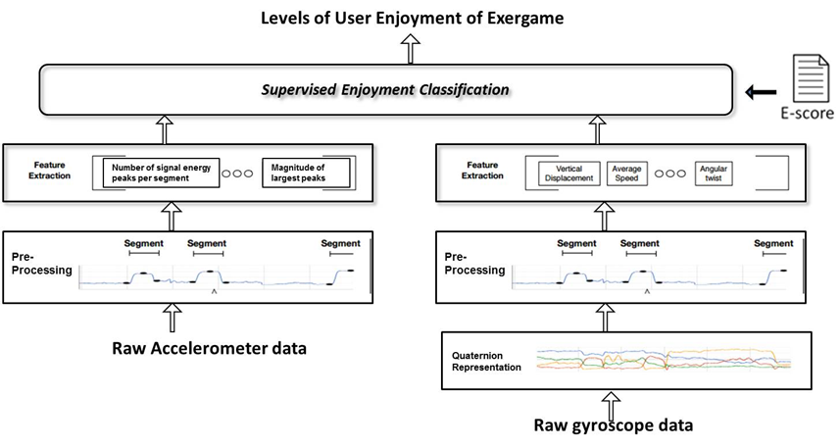
Methodology
Machine Learning prediction of player IEQ (immersion) scores from smartphone sensor data
Data pre-processing
Extraction of 31 statistical features
Machine learning modeling study: predict IEQ scores from smartphone sensor data

Slide 12
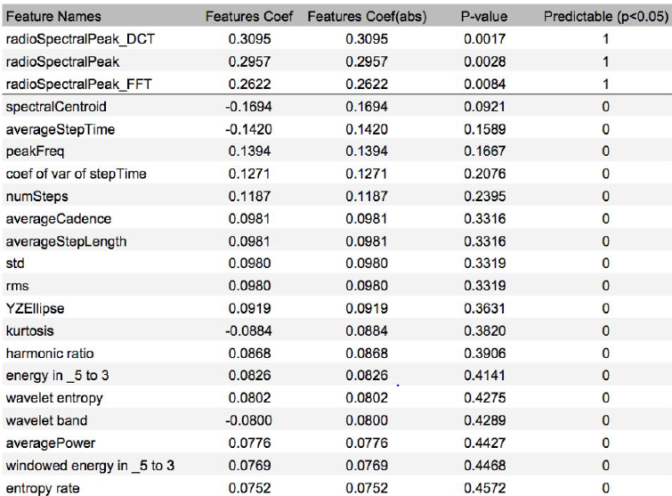
Correlation Based Feature Selection
Radio Spectral Peak feature was most statistically significant (p-value < 0.05)
Captured energetic gameplay
Other predictive features:
Energy in 0.5 to 3 Hz
Windowed Energy in 0.5 to 3 Hz

Slide 13
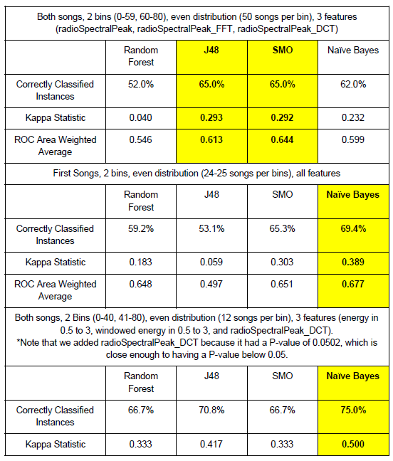
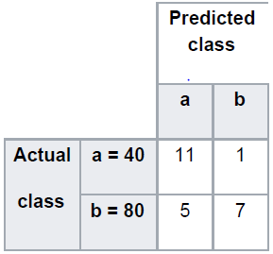
Results: Machine Learning
Naïve Bayes classification algorithm: 75% accuracy
Binary classification: enjoying vs. not enjoying (0 – 40, 41 – 80 IEQ score)
Confusion matrix: mostly on leading diagonal

Slide 14
Conclusion and Future Work
Proposed machine learning prediction of exergame enjoyment (immersion) from smartphone sensor data
Naïve Bayes achieved highest accuracy (75%)
Most predictive features were radio spectral peak using DCT, energy in the 0.5 to 3Hz range and windowed energy in the 0.5 to 3Hz range
Future Work:
Investigate other more flexible song selection rules
Collect more data, improve accuracy and utilize deep learning
Deploy game enjoyment models, compare to human raters

