Slide 1


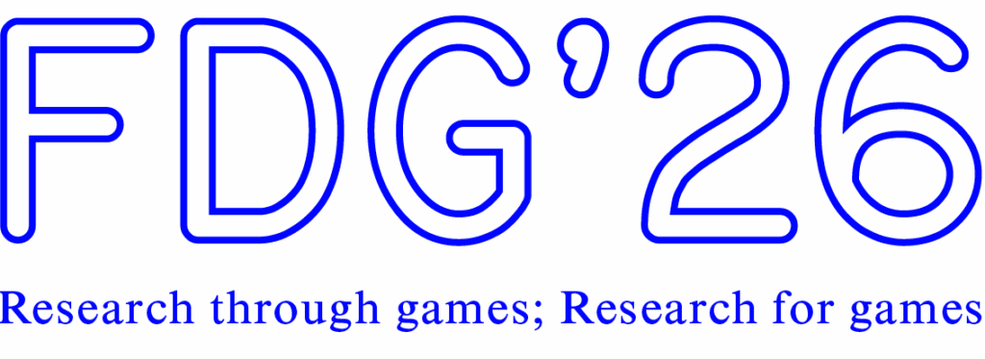
Adaptive Time Delay for Improving Player Experience and Fairness in First-Person Shooter Games with Network Latency
Samin Shahriar Tokey, Ben Boudaoud, Josef Spjut, Mark Claypool
Notes:
.

Slide 2


Latency Makes Games Unfair
Client A
Server
Client B
Message:
Enemy Spotted!
Message:
Enemy Spotted!
User
Input
User
Input
Message:
Shoot Enemy
Message:
Shoot Enemy
Message:
Confirmed Hit!
Message:
Eliminated!
Time
Latency affects fairness
A Solution? Manipulate time: Time Delay
Notes:
Everything you do goes to the server, gets validated, and comes back. A lagged player is always acting on old information.
Client A has low latency, Client B high. Same reaction, A's action reaches the server first and wins.

Slide 3
Time Delay: Fair but Unresponsive
Client A
Server
Client B
Message:
Enemy Spotted!
Delay Time
User
Input
Message:
Enemy Spotted!
User
Input
Message:
Shoot Enemy
Message:
Shoot Enemy
Message:
Eliminated!
Delay Time
Message:
Eliminated!
Time
But all players delayed by highest latency
Time delay improves fairness
Notes:
the server holds back the fast player's inputs so both effectively play at the same latency. That does fix fairness.
But the fast player now plays the whole match at the slow player's latency, even when the two are nowhere near each other. It just makes the game feel worse for that player

Slide 4

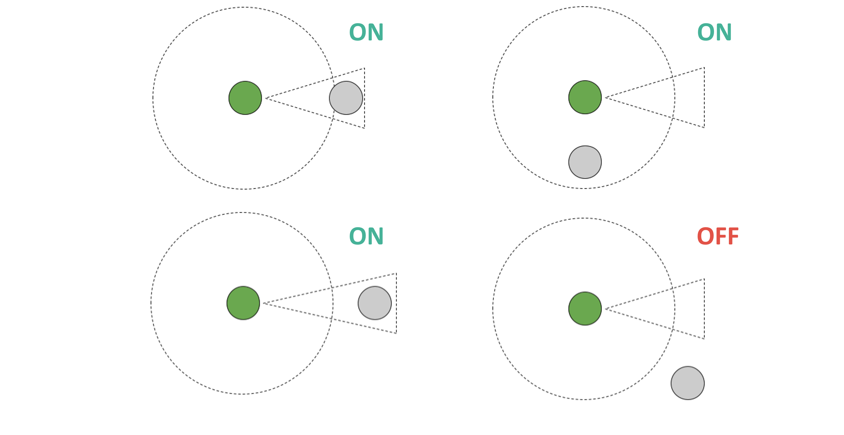
Our Idea: Adaptive Time Delay
Time Delay Enabled
Time Delay Disabled
Obstacle
Notes:
Our idea. If the players can actually interact - line of sight, close together - the delay is on and the game is fair. The moment they can't affect each other, the delay comes off and the fast player gets their responsiveness back.

Slide 5
Related Work
Latency & First-Person Shooter Games
Latency degrades performance and QoE in FPS games [Amin 2013, Armitage 2003, Quax 2004]
CS:GO — accuracy −3%, score −17%, QoE −25% as latency reaches 150 ms [Liu 2021]
Defenders facing “peekers” with 120 ms latency have a ~30% disadvantage [Tokey 2024]
Small, continuous latency variation (jitter) has no significant impact [Schmid 2024]
Notes:
work shows latency hurts both performance and experience in shooters. Even around 100 ms you can measure accuracy and QoE dropping

Slide 6
Related Work
Latency Compensation for Fairness
Time warp: roll back state to validate hits — “shot around the corner” [Jefferson 1985, Lee 2017]
Time delay: equalize latency by delaying low-latency players [Paik 2010, Zander 2005, Kaiser 2009, Savery 2010]
Prior time-delay methods are server-side and simulation-based — not evaluated with real players in playable FPS games
Our preliminary work: adaptive time delay improves responsiveness in a single-player FPS [Tokey 2025]
Notes:
Time warp rolls the game state back to validate hits - it works but causes shot around the corner.
Time delay goes the other way: equalize everyone's latency instead. Makes gameplay fair – Our work is based on that.

Slide 7
Our Study
We implement and evaluate Adaptive Time Delay
Delay low-latency players only while players can interact
R1: Does adaptive time delay preserve the fairness of time delay?
R2: How does adaptive time delay affect player experience compared to fixed time delay?
3 user studies with 3 custom FPS games
Notes:
We implemented adaptive time delay and asked two questions: does it keep time delay's fairness, and does it actually feel more responsive?
And a third question came up along the way that turned out to matter a lot.

Slide 8
Outline
Introduction
Methodology
Results
Conclusion
Future Work
Notes:
(15s) Quick roadmap: how we built the studies, then results, then a short wrap-up. Don't linger here.

Slide 9
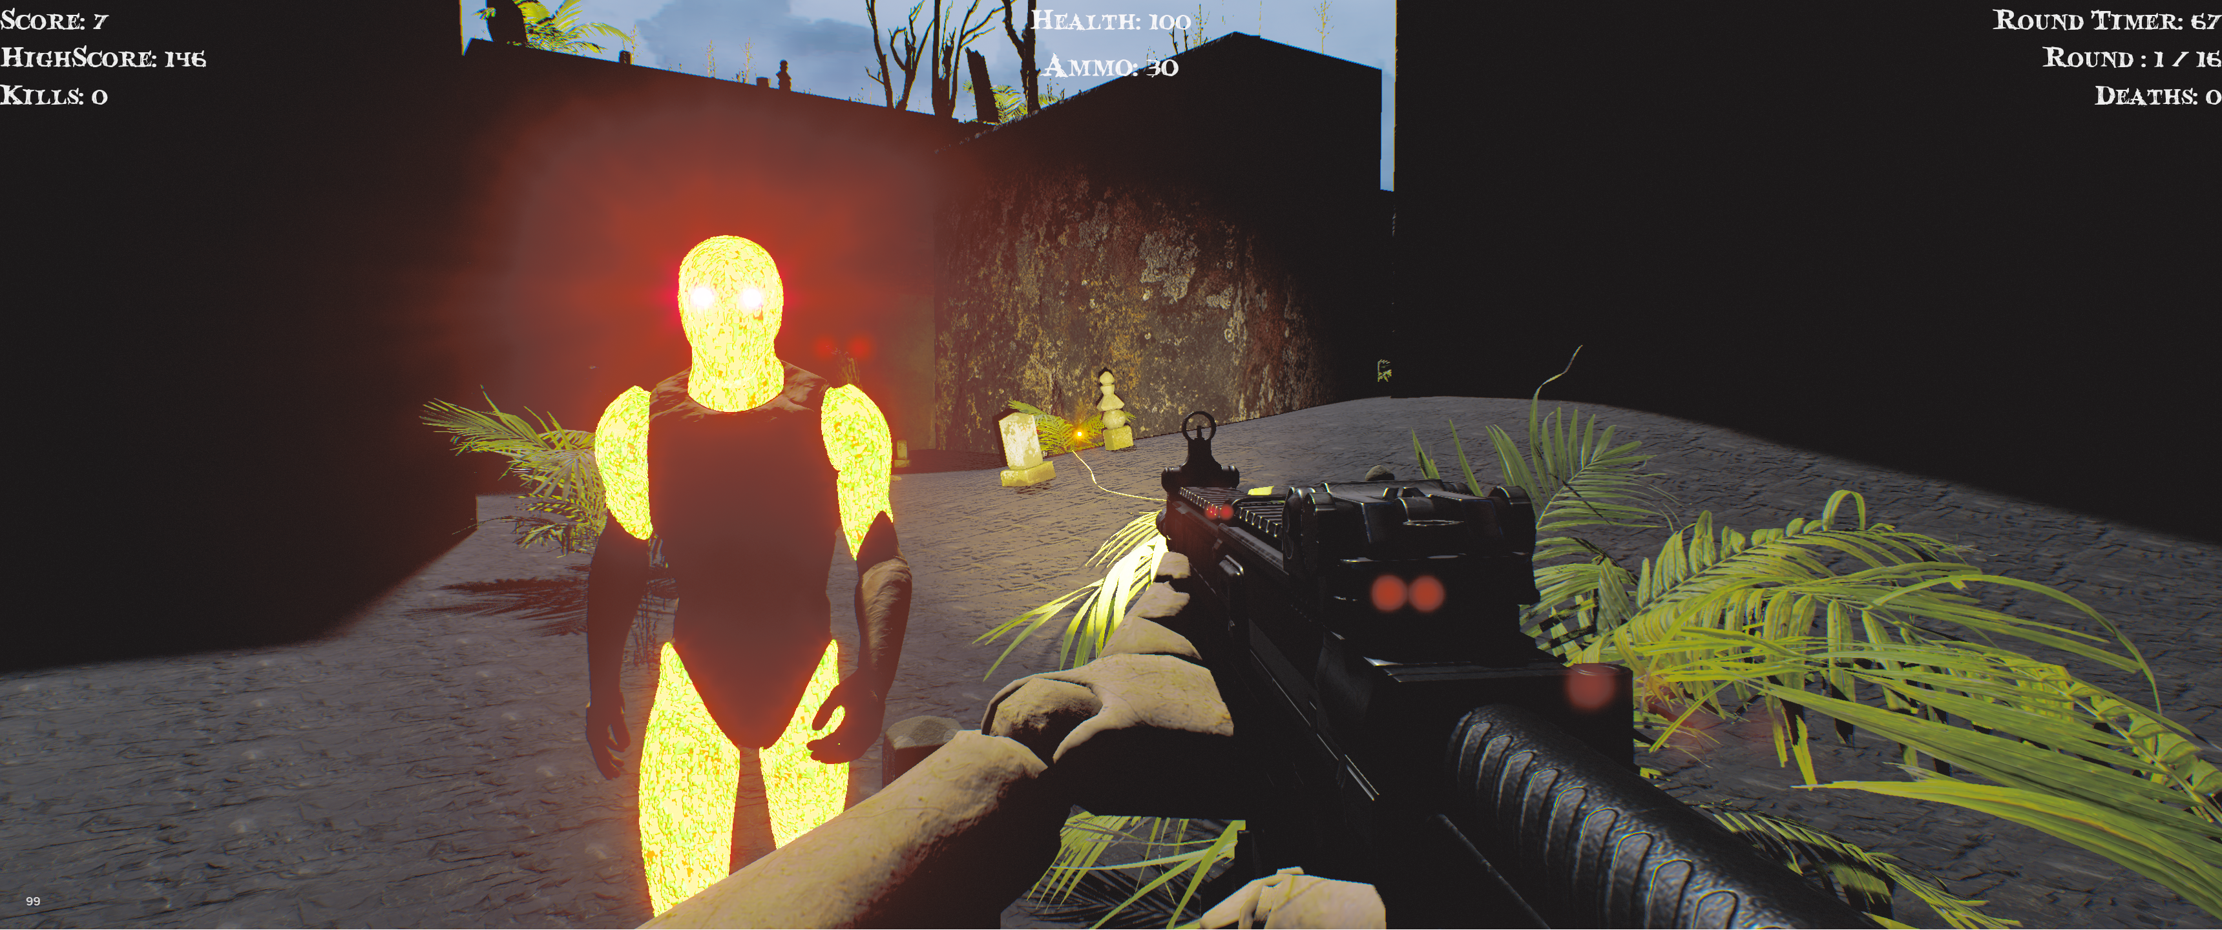
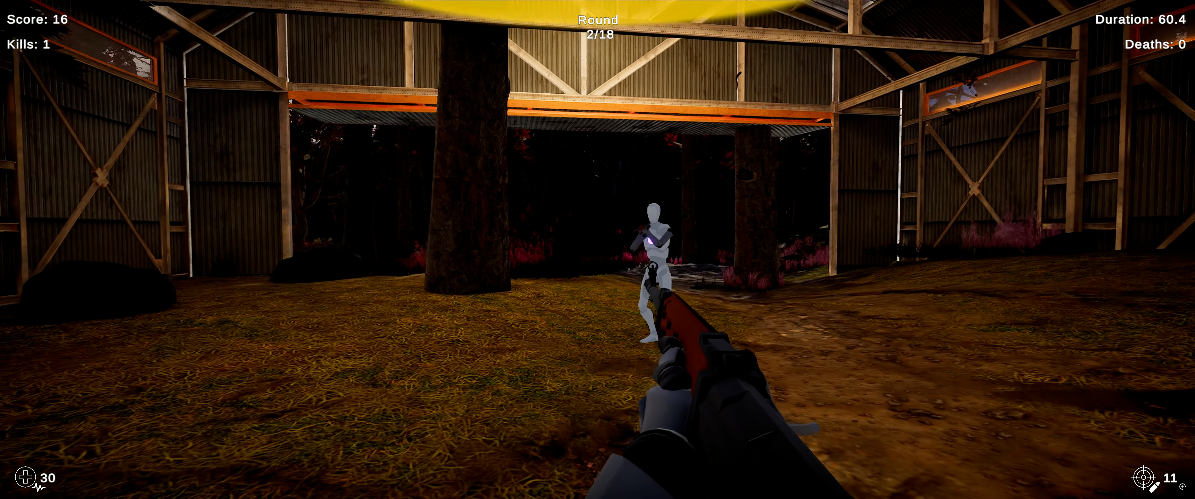
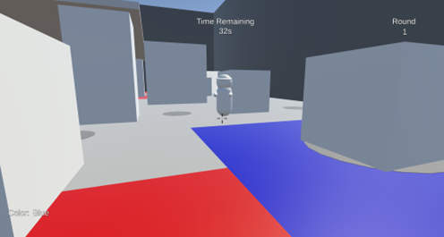
Methodology
Developed three custom FPS games to emulate client-server environments.
Simulated network lag by queuing and delaying player inputs.
Tested fixed time delay against four variations of adaptive time delay.
Used a custom test harness on high-end PCs to randomize round conditions.
Logged in-game performance data and surveyed players on QoE and fairness after each round.

Slide 10
Adaptive Time Delay
Detecting player interaction
Delay is ON only when players can potentially interact — line of sight or proximity checks
When no interaction is possible, delay turns OFF — low-latency players keep their responsiveness
Delay is added as input latency to all player actions
How delay is added / removed
Instant — next frame
Abrupt — within 50–100 ms
Smooth — gradually over 1–2 seconds
Keep on/off — hold state for at least 2 seconds
Notes:
The core mechanic, same in all three games: the game keeps checking whether the players could actually interact - line of sight and proximity (in CC)

Slide 11
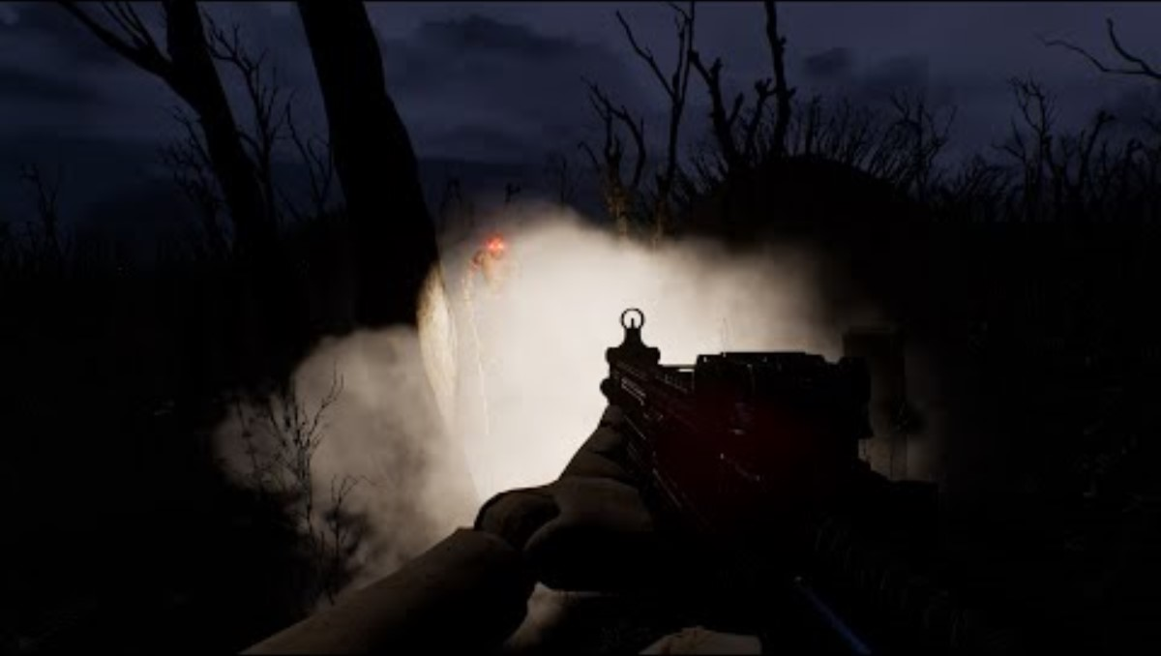
Zombiefield
Single-player survival shooter featuring endless waves of both standard (local) zombies and stronger "networked" zombies.
Scoring: 1 point for every second of survival and 10 points for each zombie kill.
Dying forces a respawn and resets your score entirely back to 0.
Delay Trigger: by a visibility check from the player to the networked zombies.
Notes:
(50s) From the paper, Sec 3.1:
Study 1 used a custom game Zombiefield - a single player FPS game developed with Unreal Engine 5 - extended to study adaptive time delay. The goal of Zombiefield was to survive unending waves of zombies, eliminating as many as possible. The player's avatar had 100 health and took rapid damage by close zombies. When the avatar health reached zero, it respawned to its original location, and the zombies also reset. Since Zombiefield was single player, interaction-like encounters that triggered adaptive time delay were done by a special type of “network” zombie that were faster and stronger than standard zombies and had more health.
Zombies spawned in cycles, each cycle repeating every 5-10 seconds. In a cycle, there was a 50% chance of spawning either three standard (non-networked) zombies with 2 hit-points (HP) or one strong (networked) zombie with 5 HP, with an additional 10% chance to spawn a super strong (networked) zombie with 15 HP. Each bullet inflicted 1 HP damage on any type of zombie. Player score increased by 1 point each second of survival and 10 points for each zombie kill. If the player avatar died, the score reset back to 0.
Participants played a 4-minute practice round (not analyzed), then 16 rounds: no latency (1 round); fixed time delay of 50, 100 or 150 ms (3 rounds); adaptive time delay (12 rounds - instant from 0 ms and from half target, smooth over 2 s, and keep on/off with 2 s holds, each to 50, 100 or 150 ms).
Each round was 75 seconds long. After the round ended, users rated their Quality of Experience for the round from 1 (Low) to 5 (High) and answered whether the experience was acceptable (Yes/No).

Slide 12
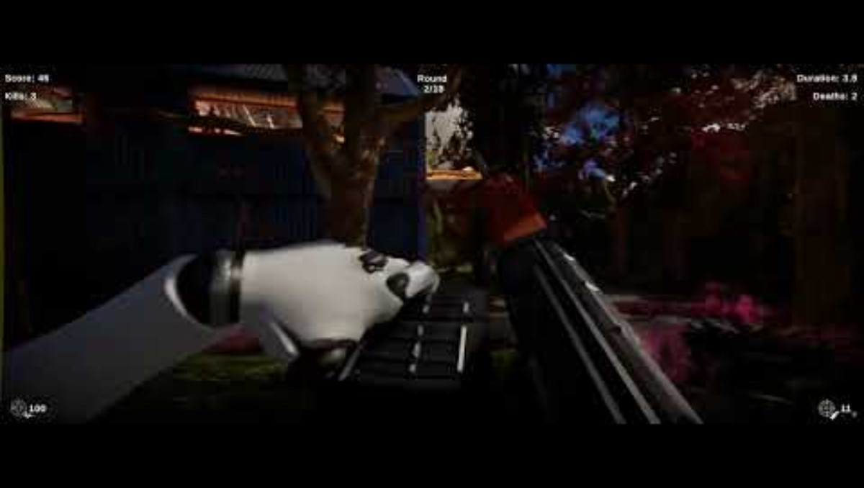
Last Stand
1v1 tactical deathmatch in an abandoned hangar where players track enemies using directional UI alerts.
Scoring: 1 point for a confirmed hit, 5 points for a headshot, and 10 points for a kill.
All scores, kills, and deaths are reset at the end of each round.
Delay Trigger: Determined by a visibility check between the players.
Notes:
Study two: Last Stand, a proper 1v1 deathmatch - hitscan weapons, client-server networking

Slide 13
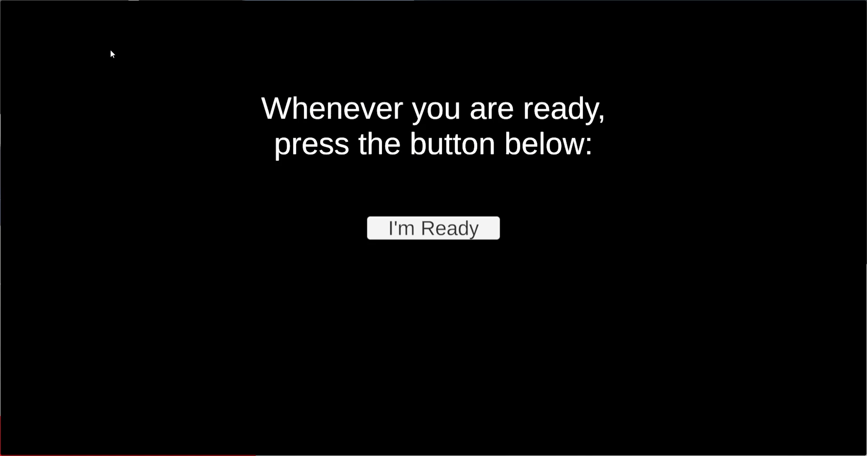
Color Clash
1v1 first person with paintable tiles than alter player speed.
Your color speeds you up, the opponent's color slows you down.
Scoring: 1 point for eliminating the opponent (a single hit results in an elimination).
The player with the most eliminations at the end of the round wins.
Delay Trigger: Determined by proximity and line-of-sight checks.
Notes:
Study three: Color Clashyou can spend your time painting floor tiles instead of fighting. Your color speeds you up, the opponent's color slows you down.

Slide 14
Experiment Design
Within-subjects studies with controlled latency
Zombiefield — 16 rounds × 75 s · latency 0 / 50 / 100 / 150 ms
Last Stand — 20 rounds × 80 s · latency 0 / 100 / 200 ms
Color Clash — 24 rounds × 50 s · latency 0 / 50 / 100 / 150 ms
Round conditions
No latency · unfair (only one player lagged) · fixed time delay · adaptive time delay
Condition order randomized across users · practice round first

Slide 15
Quality of Experience & Fairness Ratings
Two questions after every round
Zombiefield
  “Rate your Quality of Experience” 1 (Low) – 5 (High)
  “Was this experience acceptable?” (Yes / No)
Last Stand
  “ Rate how laggy the round felt” 1 (Very Laggy) – 5 (Very Smooth) ·
  “Was the round fair?” (Yes / No)
Color Clash
  “How much lag did you feel?” 1 – 5, inverted to QoE
  “Rate the fairness” −5 (Unfair) – +5 (Fair)
Notes:
After every round, two questions on screen - rate the experience, and was it fair or acceptable.

Slide 16
Outline
Introduction
Methodology
Results
Conclusion
Future Work

Slide 17
Participant Demographics
Study | Users | FPS Gaming Skill (1–5) | Reaction Time (ms)
Zombiefield | 35 | 2.9 (1.1) | 195.6 (24.1)
Last Stand | 23 | 2.7 (1.4) | 204.3 (39.7)
Color Clash | 38 | 3.5 (0.9) | 187.0 (18.5)
Notes:
under a hundred participants across the three studies - mostly students, mostly experienced FPS players, reaction times under 210 ms on average.

Slide 18
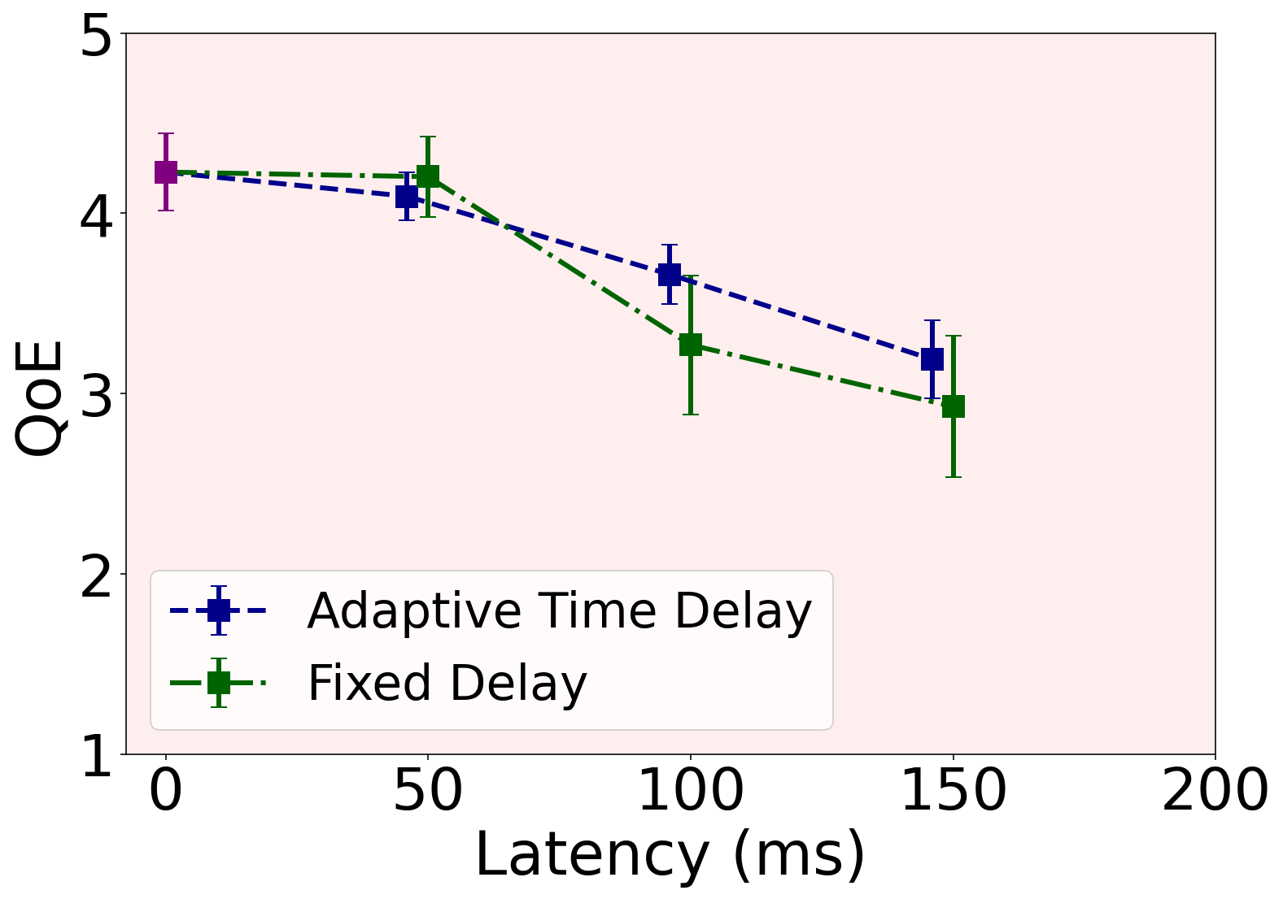
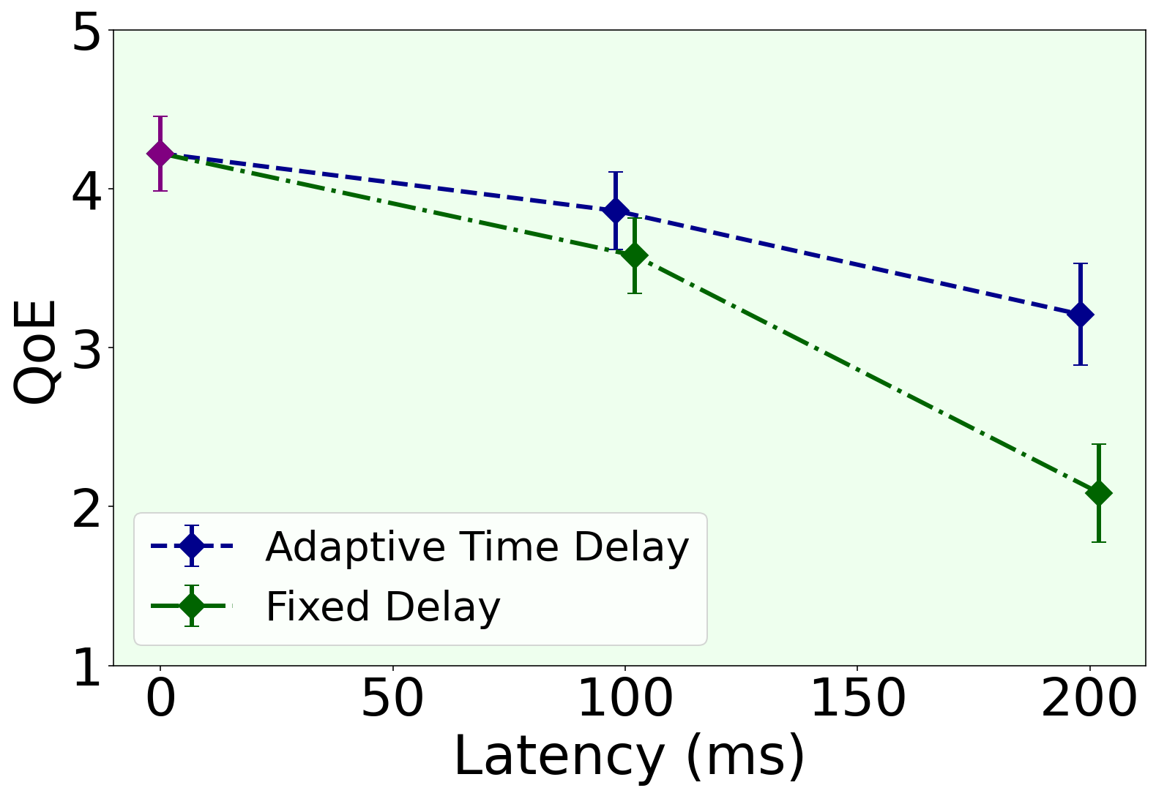
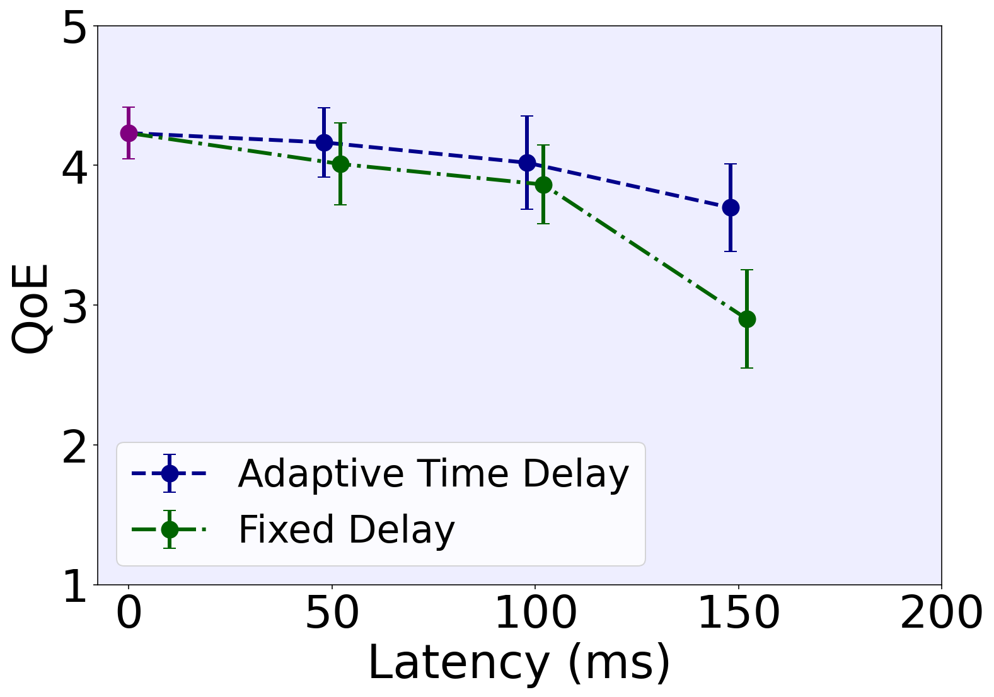
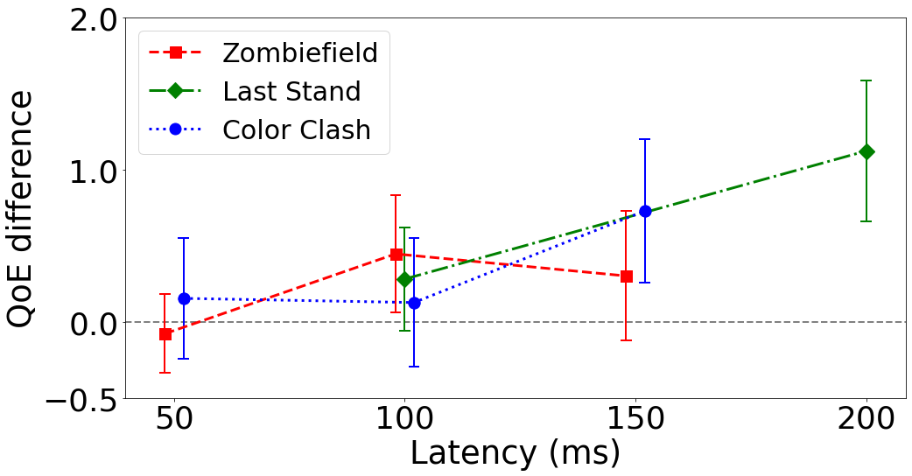
Responsiveness (QoE)
Zombiefield
Last Stand
Color Clash
Better QoE than fixed delay in all 3 games above 100 ms
Adaptive time delay improves QoE.
Notes:
QoE against latency.

Slide 19
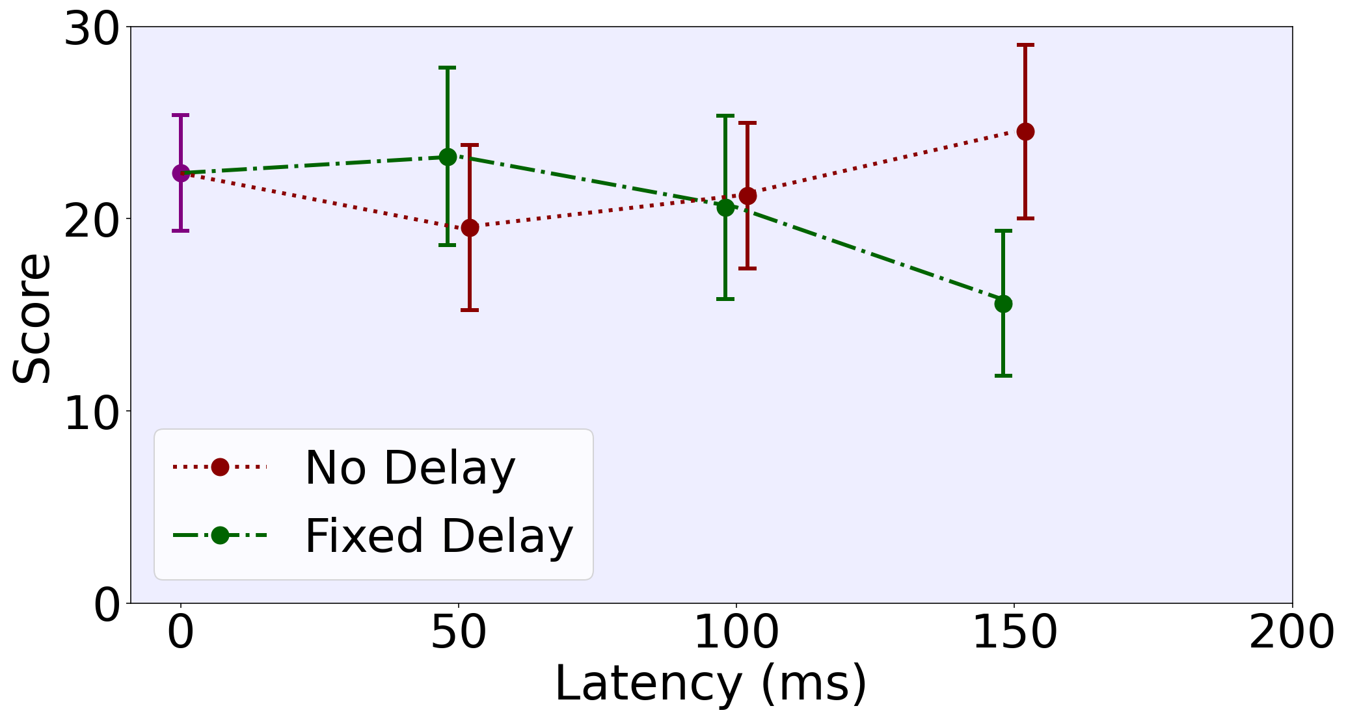
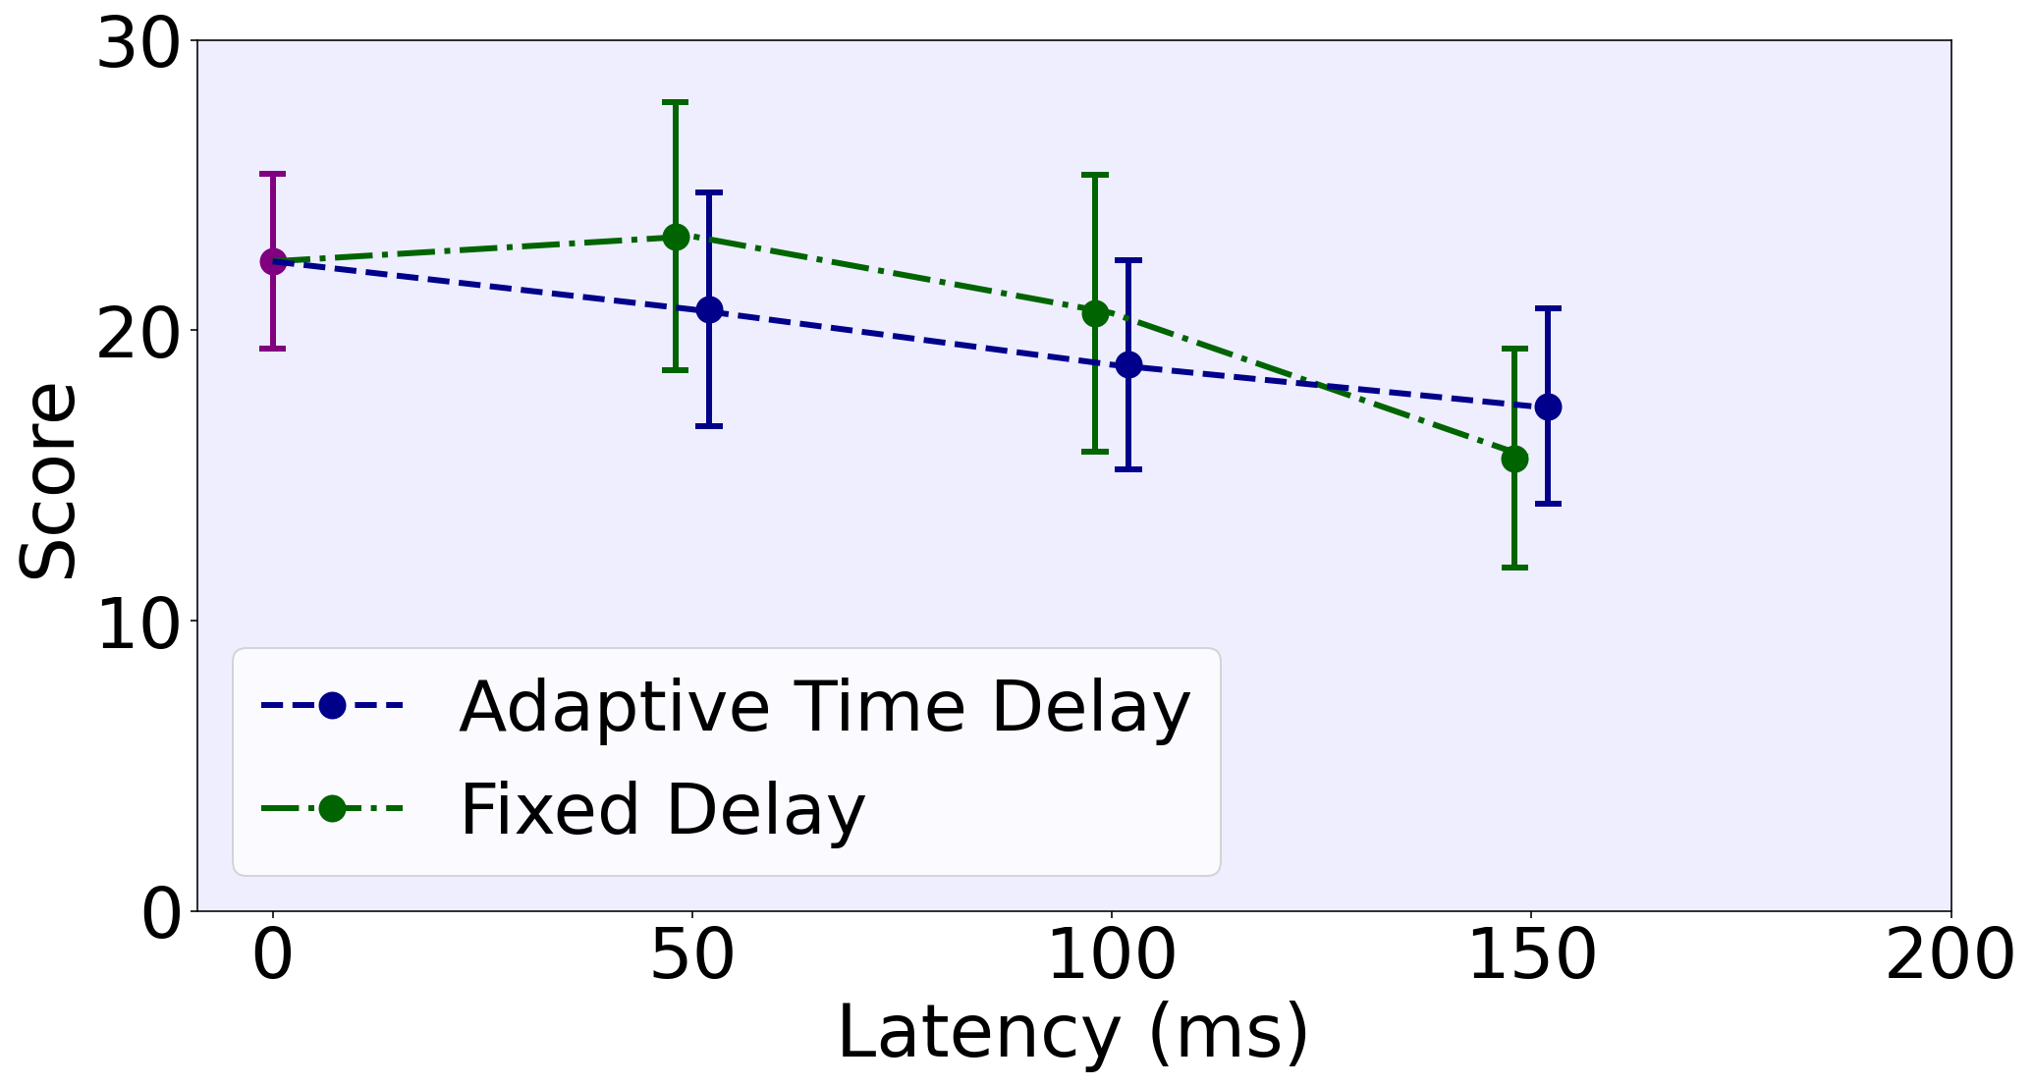
Fairness (Color Clash)
Without time delay, high latency players score lower
Adaptive time delay preserves fairness of fixed delay
Notes:
fairness, starting with Color Clash. Score against latency

Slide 20
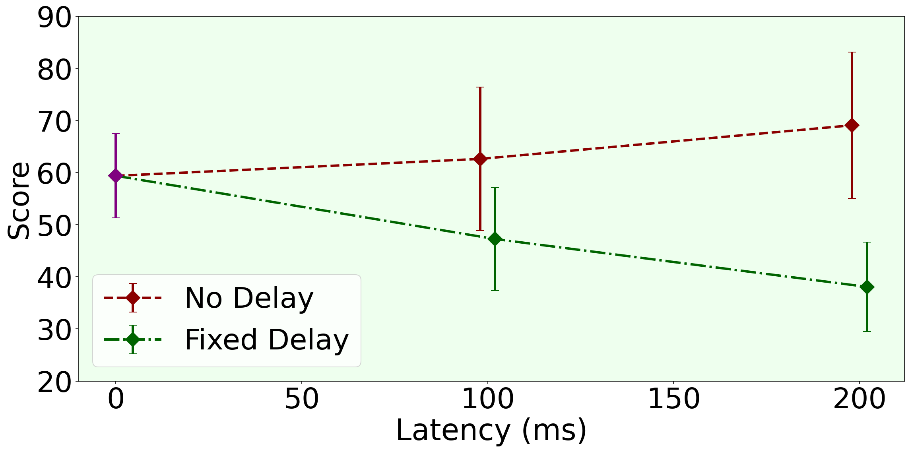
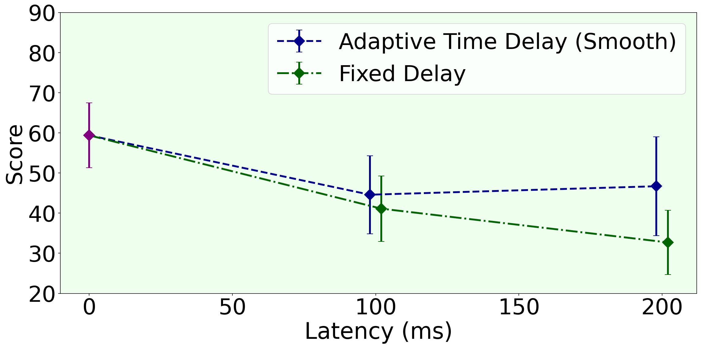
Fairness (Last Stand)
Without time delay, the 200 ms player scores far lower - unfair
Adaptive time delay keeps score gaps as small as fixed delay
Notes:
Same analysis for Last Stand

Slide 21
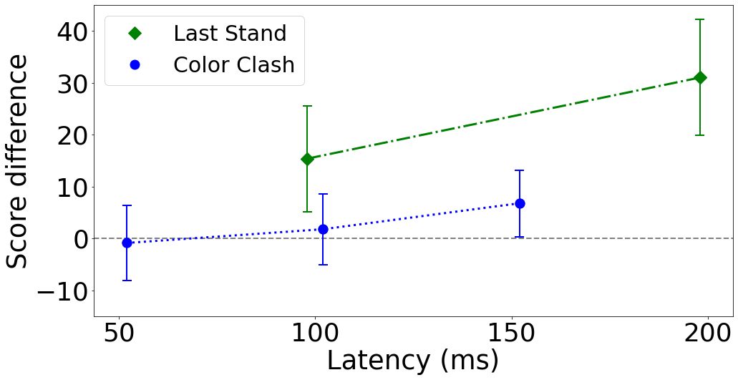
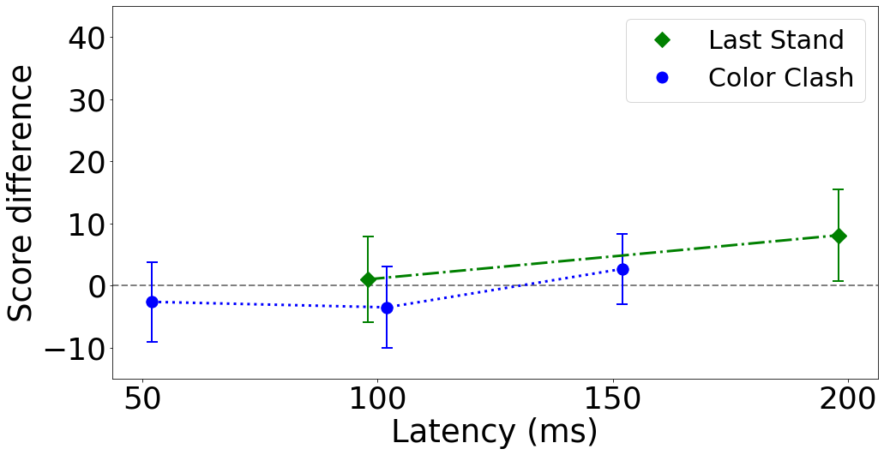
Fairness (Score Difference)
No delay - fixed delay
No delay: score gap grows with latency
Adaptive time delay - fixed delay
Adaptive time delay: score gap closer to zero
Notes:
Pulling both games together: this is the score gap between the two players. closer to zero means fairer.

Slide 22
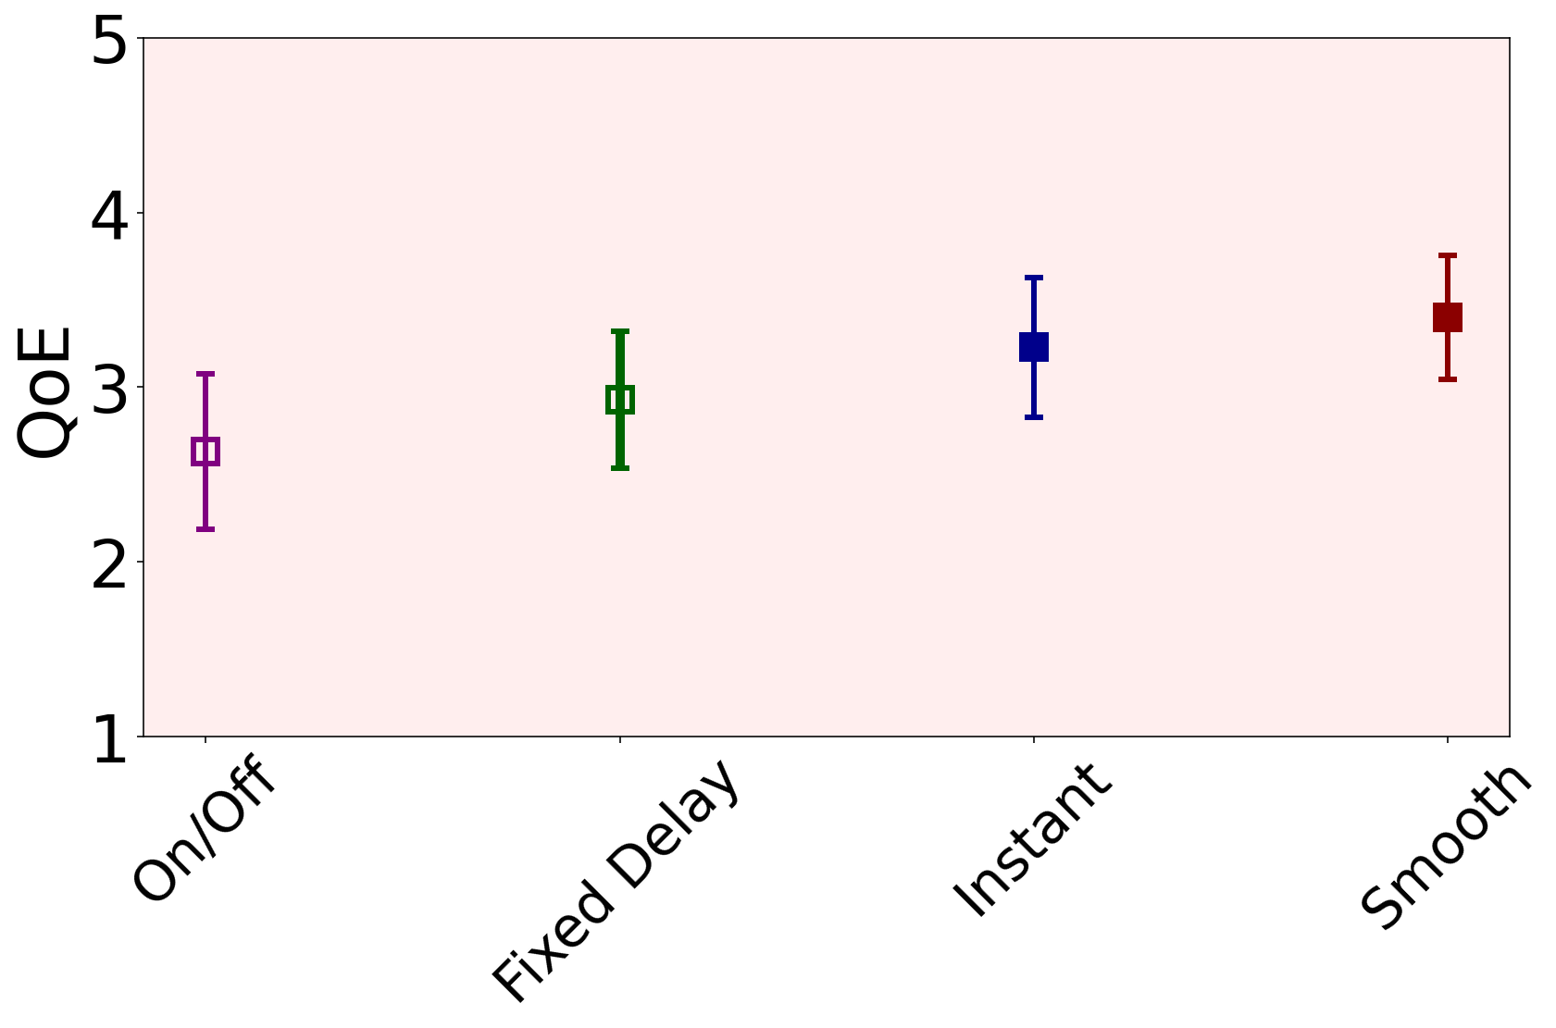
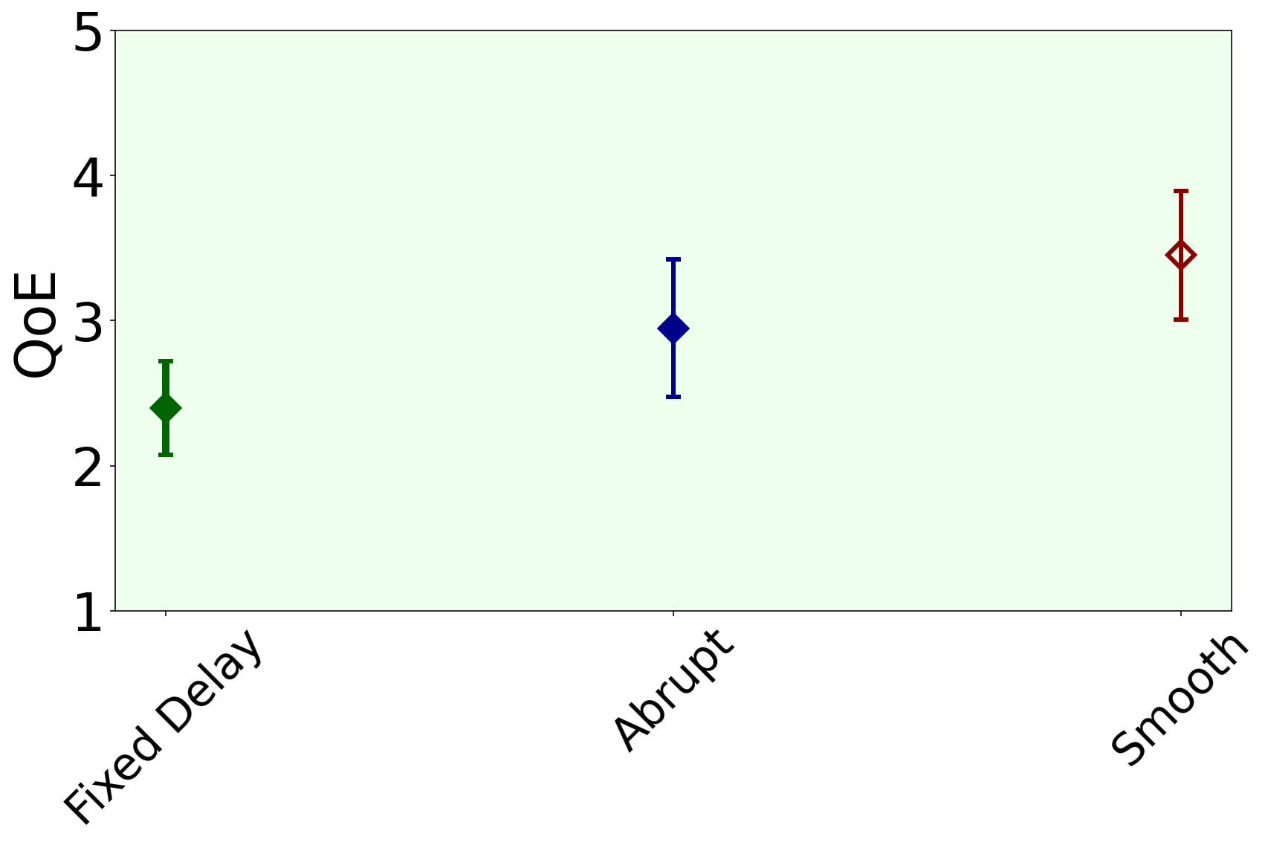
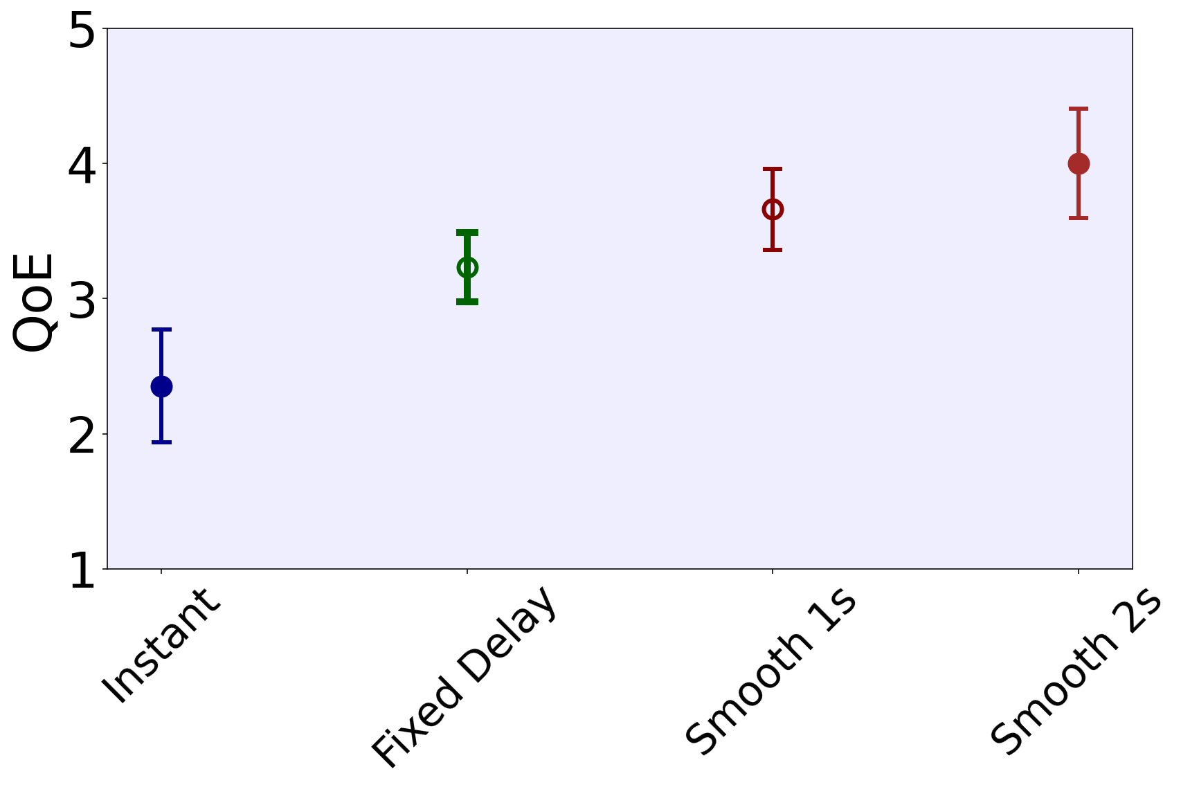
How Fast Should Delay Adapt?
Zombiefield (150 ms)
Last Stand (200 ms)
Color Clash (150 ms)
Smooth adaptation gives the best QoE in every game
Instant jumps can be worse than fixed delay
Notes:
Last question: when the delay switches on or off, how fast should it change? Each panel is one game at its highest latency, comparing adaptation strategies.

Slide 23
Conclusion
Adaptive time delay improves average QoE over fixed time delay, specially above 100 ms
Adaptive time delay preserves fairness, comparable to fixed delay, significantly better than no delay
Adaptation matters: smooth works best, instant switching can be worse than fixed delay

Slide 24
Future Work
Find the “sweet spot” for smooth adaptation
Better interaction detection: multiple rays, occlusion-aware checks
Scale to larger game modes (e.g., Battle Royale)
Other genres, and combining adaptive time delay with other latency compensation techniques
Handle real-world varying network latency (jitter, congestion)

Slide 25
Adaptive Time Delay for Improving Player Experience and Fairness in First-Person Shooter Games with Network Latency
Thank You
Samin Shahriar Tokey, Ben Boudaoud, Josef Spjut, Mark Claypool

