Slide 1



The Impact of Latency on Target Selection in First-Person Shooter Games
Shengmei Liu, and Mark Claypool
Presented by Wei Tsang Ooi (NUS, Singapore)
Notes:
This research regards the effects of latency on target selection, one of the actions used in first person shooter games.
Mark Claypool is a professor of computer science and game development at WPI, a medium-sized engineering school outside Boston, MA in the U.S.
Shengmei was his Ph.D. student, graduated last December, who now works as a scientist at Google.
Neither of them could be here to day, so the awesome Wei Tsang has generously agreed to present this work.

Slide 2
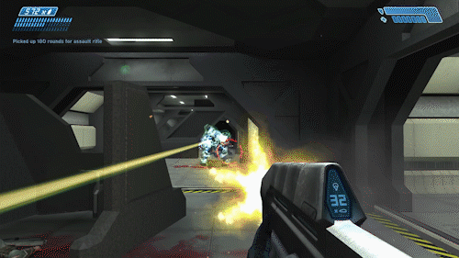
Introduction – Computer Games and First-Person Shooters
Computer games popular [14, 45], especially First-Person Shooters (FPS)
Player controls avatar from first-person perspective
Move into position to shoot and avoid being shot
Aims and shoot at opponents
Typically, multiple players connected to single server
Latency degrades player performance and experience. Why?
Notes:
Computer games are one of the world's most popular forms of entertainment
And for multi-player games, the first-person shooter game (FPS) is one of the most popular.
In FPS games:
1) Players take a first-person perspective of an avatar seeing through their characters eyes.
2) They then control the avatar by moving into position to shoot targets (or avoid being shot)
3) And aim a reticle at an opponent and shoot
FPS games are often played with multiple, geographically separated players, each connected to the server.
For FPS games, latency can degrade player performance and player quality of experience.

Slide 3
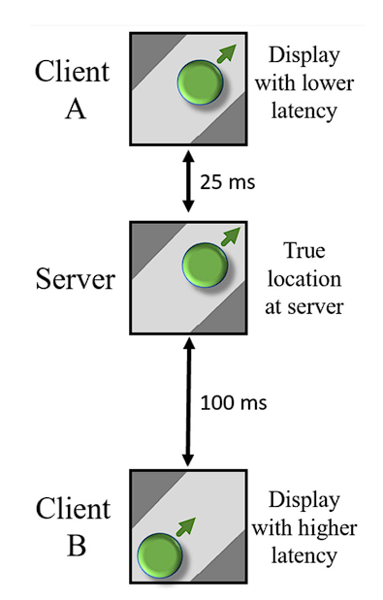
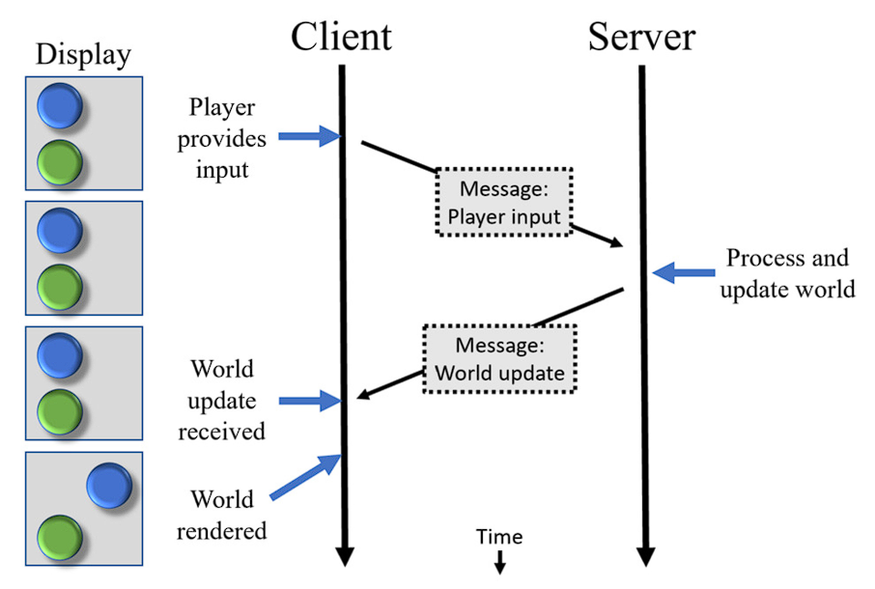
Introduction – Games and Latency
Responsiveness
Consistency
Mitigate via latency compensation. But how effective?
Notes:
Latency can make a multiplayer network computer game less responsive.
The figure on the left shows an event timeline for a network game with a client and a server, with time progressing top to bottom. The left side shows the display on the client over this time. In this example, the player provides input and the client encapsulates that input into a message that is sent to the server. The server receives the message, processes the input, updates the game world, and sends the world update back to the client. The client, upon getting the update, renders the new world for the player on the display. The time from the player input until the resulting change to the display is the response time. The larger the network latency, the greater the response time and the less responsive the computer game.
Latency can also make a network computer game less consistent.
The example on the right shows a multiplayer networked game with two clients with different latencies connected to a server. The authoritative server has the true location of an avatar depicted by the green circle. The avatar is moving up and to the right along the path. The server periodically sends position updates to each client. Ideally, in most game conditions, such as a race where avatars are running together around a virtual track, the view of the game worlds on both Client A and Client B would be the same (consistent), but because of latency they are not. Since Client A is 25 ms away from the server, the displayed position is close to that of the server. However, since Client B is more distant from the server at 100 ms, the displayed position is even farther away from the actual position. The client game worlds are inconsistent with each other and the server.
Latency compensation techniques have been developed to mitigate the effects of latency compensation. While commonly implemented in many FPS games, there has been little science quantifying their effects.

Slide 4
Latency and Responsiveness
Notes:
Latency can make a multiplayer network computer game less responsive.
The figure on the left shows an event timeline for a network game with a client and a server, with time progressing top to bottom. The left side shows the display on the client over this time. In this example, the player provides input and the client encapsulates that input into a message that is sent to the server. The server receives the message, processes the input, updates the game world, and sends the world update back to the client. The client, upon getting the update, renders the new world for the player on the display. The time from the player input until the resulting change to the display is the response time. The larger the network latency, the greater the response time and the less responsive the computer game.
Latency can also make a network computer game less consistent.
The example on the right shows a multiplayer networked game with two clients with different latencies connected to a server. The authoritative server has the true location of an avatar depicted by the green circle. The avatar is moving up and to the right along the path. The server periodically sends position updates to each client. Ideally, in most game conditions, such as a race where avatars are running together around a virtual track, the view of the game worlds on both Client A and Client B would be the same (consistent), but because of latency they are not. Since Client A is 25 ms away from the server, the displayed position is close to that of the server. However, since Client B is more distant from the server at 100 ms, the displayed position is even farther away from the actual position. The client game worlds are inconsistent with each other and the server.
Latency compensation techniques have been developed to mitigate the effects of latency compensation. While commonly implemented in many FPS games, there has been little science quantifying their effects.

Slide 5
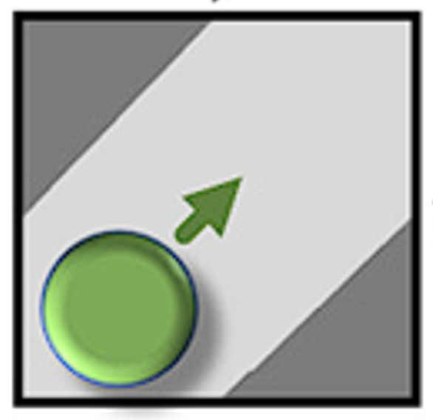
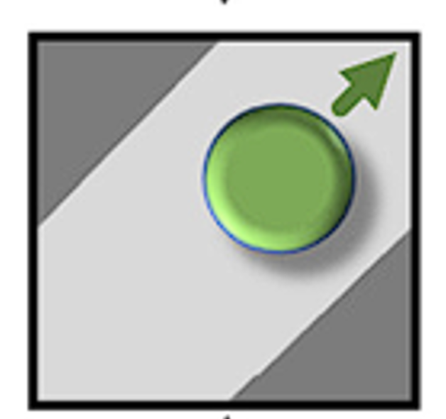
Latency and Consistency
Client A
Server
Client B
Message:
World update
Notes:
Latency can make a multiplayer network computer game less responsive.
The figure on the left shows an event timeline for a network game with a client and a server, with time progressing top to bottom. The left side shows the display on the client over this time. In this example, the player provides input and the client encapsulates that input into a message that is sent to the server. The server receives the message, processes the input, updates the game world, and sends the world update back to the client. The client, upon getting the update, renders the new world for the player on the display. The time from the player input until the resulting change to the display is the response time. The larger the network latency, the greater the response time and the less responsive the computer game.
Latency can also make a network computer game less consistent.
The example on the right shows a multiplayer networked game with two clients with different latencies connected to a server. The authoritative server has the true location of an avatar depicted by the green circle. The avatar is moving up and to the right along the path. The server periodically sends position updates to each client. Ideally, in most game conditions, such as a race where avatars are running together around a virtual track, the view of the game worlds on both Client A and Client B would be the same (consistent), but because of latency they are not. Since Client A is 25 ms away from the server, the displayed position is close to that of the server. However, since Client B is more distant from the server at 100 ms, the displayed position is even farther away from the actual position. The client game worlds are inconsistent with each other and the server.
Latency compensation techniques have been developed to mitigate the effects of latency compensation. While commonly implemented in many FPS games, there has been little science quantifying their effects.

Slide 6
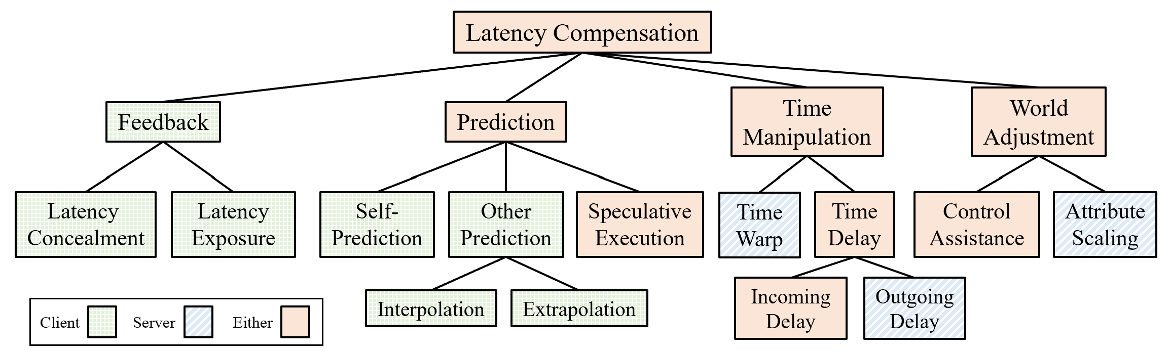
Latency Compensation Techniques
Shengmei Liu, Xiaokun Xu and Mark Claypool “A Survey and Taxonomy of Latency Compensation Techniques for Network Computer Games”, ACM Computing Surveys, Article 243, Volume 54, Issue 11S, January 2022 https://doi.org/10.1145/3519023
Notes:
There are dozens of latency compensation techniques. Liu. Xu and Claypool recently published a survey and taxonomy of those developed in research and used by industry. This figure shows the taxonomy.
At the top is latency compensation, grouping all latency compensation techniques.
Beneath latency compensation is the division of four classes of latency compensation: feedback, prediction, time manipulation, and world adjustment.
Each of these classes is further differentiated by families of techniques: latency concealment and latency exposure for feedback; self-prediction, other-prediction, and speculative execution for prediction; time warp and time delay for time manipulation; and control assistance and attribute scaling for world adjustment.
Some families of techniques are further refined: interpolation and extrapolation for other prediction and incoming delay and outgoing delay for time delay.
Note that individual network games can, and often do, use more than one technique. And not all genres use all techniques.
Notably, FPS games typically use the 4 techniques highlighted in the figure.
"Exposure" and "Interpolation" while commonly used in FPS games, primarily affect user experience not performance.
This paper studies "Self-Prediction" and "Time Warp" as they are the two most likely to effect performance and quality of experience.

Slide 7

Self-Prediction
Update
locally
Resolve
Conflict
(if any)
Notes:
Latency can make a multiplayer network computer game less responsive.
The figure on the left shows an event timeline for a network game with a client and a server, with time progressing top to bottom. The left side shows the display on the client over this time. In this example, the player provides input and the client encapsulates that input into a message that is sent to the server. The server receives the message, processes the input, updates the game world, and sends the world update back to the client. The client, upon getting the update, renders the new world for the player on the display. The time from the player input until the resulting change to the display is the response time. The larger the network latency, the greater the response time and the less responsive the computer game.
Latency can also make a network computer game less consistent.
The example on the right shows a multiplayer networked game with two clients with different latencies connected to a server. The authoritative server has the true location of an avatar depicted by the green circle. The avatar is moving up and to the right along the path. The server periodically sends position updates to each client. Ideally, in most game conditions, such as a race where avatars are running together around a virtual track, the view of the game worlds on both Client A and Client B would be the same (consistent), but because of latency they are not. Since Client A is 25 ms away from the server, the displayed position is close to that of the server. However, since Client B is more distant from the server at 100 ms, the displayed position is even farther away from the actual position. The client game worlds are inconsistent with each other and the server.
Latency compensation techniques have been developed to mitigate the effects of latency compensation. While commonly implemented in many FPS games, there has been little science quantifying their effects.

Slide 8
Time Warp
Client A
Server
Roll back the states
Message:
Player input
Notes:
Latency can make a multiplayer network computer game less responsive.
The figure on the left shows an event timeline for a network game with a client and a server, with time progressing top to bottom. The left side shows the display on the client over this time. In this example, the player provides input and the client encapsulates that input into a message that is sent to the server. The server receives the message, processes the input, updates the game world, and sends the world update back to the client. The client, upon getting the update, renders the new world for the player on the display. The time from the player input until the resulting change to the display is the response time. The larger the network latency, the greater the response time and the less responsive the computer game.
Latency can also make a network computer game less consistent.
The example on the right shows a multiplayer networked game with two clients with different latencies connected to a server. The authoritative server has the true location of an avatar depicted by the green circle. The avatar is moving up and to the right along the path. The server periodically sends position updates to each client. Ideally, in most game conditions, such as a race where avatars are running together around a virtual track, the view of the game worlds on both Client A and Client B would be the same (consistent), but because of latency they are not. Since Client A is 25 ms away from the server, the displayed position is close to that of the server. However, since Client B is more distant from the server at 100 ms, the displayed position is even farther away from the actual position. The client game worlds are inconsistent with each other and the server.
Latency compensation techniques have been developed to mitigate the effects of latency compensation. While commonly implemented in many FPS games, there has been little science quantifying their effects.

Slide 9
Time Warp
Client A
Server
Recompute the states
Message:
Player input
Message:
World update
Notes:
Latency can make a multiplayer network computer game less responsive.
The figure on the left shows an event timeline for a network game with a client and a server, with time progressing top to bottom. The left side shows the display on the client over this time. In this example, the player provides input and the client encapsulates that input into a message that is sent to the server. The server receives the message, processes the input, updates the game world, and sends the world update back to the client. The client, upon getting the update, renders the new world for the player on the display. The time from the player input until the resulting change to the display is the response time. The larger the network latency, the greater the response time and the less responsive the computer game.
Latency can also make a network computer game less consistent.
The example on the right shows a multiplayer networked game with two clients with different latencies connected to a server. The authoritative server has the true location of an avatar depicted by the green circle. The avatar is moving up and to the right along the path. The server periodically sends position updates to each client. Ideally, in most game conditions, such as a race where avatars are running together around a virtual track, the view of the game worlds on both Client A and Client B would be the same (consistent), but because of latency they are not. Since Client A is 25 ms away from the server, the displayed position is close to that of the server. However, since Client B is more distant from the server at 100 ms, the displayed position is even farther away from the actual position. The client game worlds are inconsistent with each other and the server.
Latency compensation techniques have been developed to mitigate the effects of latency compensation. While commonly implemented in many FPS games, there has been little science quantifying their effects.

Slide 10
Time Warp
Client A
Server
Client A
Server
Message:
Player input
Message:
Player input
as if
Message:
World update
Message:
World update
Notes:
Latency can make a multiplayer network computer game less responsive.
The figure on the left shows an event timeline for a network game with a client and a server, with time progressing top to bottom. The left side shows the display on the client over this time. In this example, the player provides input and the client encapsulates that input into a message that is sent to the server. The server receives the message, processes the input, updates the game world, and sends the world update back to the client. The client, upon getting the update, renders the new world for the player on the display. The time from the player input until the resulting change to the display is the response time. The larger the network latency, the greater the response time and the less responsive the computer game.
Latency can also make a network computer game less consistent.
The example on the right shows a multiplayer networked game with two clients with different latencies connected to a server. The authoritative server has the true location of an avatar depicted by the green circle. The avatar is moving up and to the right along the path. The server periodically sends position updates to each client. Ideally, in most game conditions, such as a race where avatars are running together around a virtual track, the view of the game worlds on both Client A and Client B would be the same (consistent), but because of latency they are not. Since Client A is 25 ms away from the server, the displayed position is close to that of the server. However, since Client B is more distant from the server at 100 ms, the displayed position is even farther away from the actual position. The client game worlds are inconsistent with each other and the server.
Latency compensation techniques have been developed to mitigate the effects of latency compensation. While commonly implemented in many FPS games, there has been little science quantifying their effects.

Slide 11
Introduction – Studying Latency’s Effects
Game Genres
Top-down – build/instrument full game
Bottom-up – isolate game action, combine for full game
Prior study 2D target selection, but not 3D target selection (e.g., shooting in FPS game)
  speed & size of target on screen changes with opponent positions in virtual world
UT
Warcraft
EverQuest
Research
Quake
Effect of delay on games?
1D and 2D Target Selection
Target Selection w/Delay
Moving Target Selection
Research
Input Types
Remiss in evaluating the impact of latency compensation techniques
Notes:
Broadly, there two different approaches to research in understanding the impact of delay on computer games.
Studies using specific games are a top-down approach, extending knowledge of delay and games one game at a time.
Such studies have tried to generalize to game genres (e.g., first person shooters), but game design and game engines may obfuscate important system details, making it difficult to pertain to other games and to analytic modeling.
An alternate approach is bottom-up, studying fundamental user input differentiated by actions (e.g., target selection).
Contributions to user input and delay has the potential to generalize to many games and even other interactive applications and allows for building analytic models that can predict the effects of delay for a wide-range of games and delay conditions.
While bottom up approaches have been effective, most have studied only 2D target selection whereas in FPS games, aiming and shooting is in 3D so the size and speed of the target on the screen (in 2D) changes with the opponent's relative position in the virtual world
And both top down and bottom up approaches have been remiss in evaluating the impact of latency compensation.

Slide 12
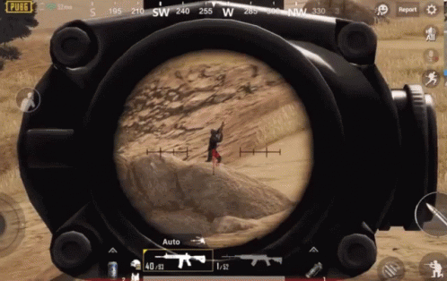
Problem Statement
Goal
Quantify (and model) the effects of latency on 3D target selection with (and without) latency compensation
Potential Benefits
Understand latencies effects (other games, interfaces)
Combine with navigation, generalize to all FPS games
Notes:
Based on this, this a concise summary of our problem statement is to: 1) quantify the effects of latency on 3d target selection, both with and without latency compensation and 2) based on those results, develop an analytic model for the same.
The potential benefits are: A) better understanding of the effects of latency on 3D target selection, and action common to many games and game-like applications, but also B) model of 3D selection can potentially be combined with a model of first-person navigation to simulate FPS game performance over a range of game and latency conditions.

Slide 13

Outline
Introduction (done)
User Study (next)
Analysis
Conclusion
Notes:
This is an outline of the talk. We've just worked through the introduction, summarizing our problem statement. We'll next present the user study designed to provide data to address our problem statement. We'll analyze the results and conclude.

Slide 14

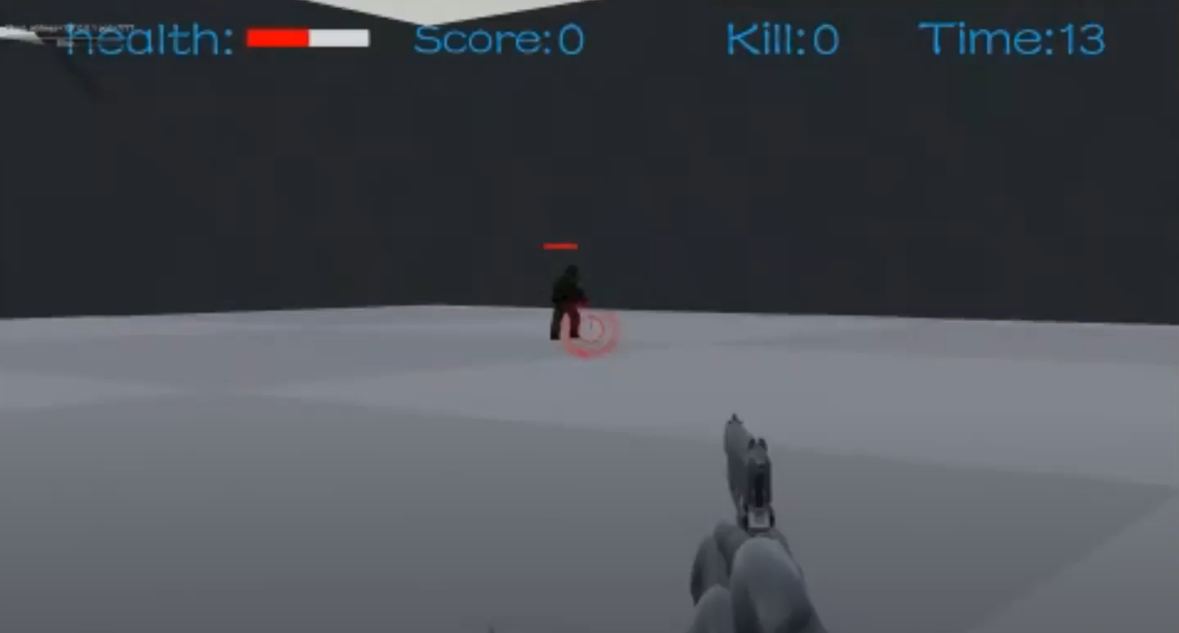
User Study Design
Custom FPS game that isolates 3D target selection
  Player cannot move
  Only aim and shoot
Uses client-server architecture
  Control network latency
Implement latency compensation: time warp, self-prediction
Notes:
We designed and implemented a custom game in Unity that isolated the action of 3D target selection in a first-person shooter-type setting.
In the game, the player stays at a fixed position at a corner of the map and can rotate to change orientation and aim, but cannot move or otherwise change positions.
The player tries to shoot the avatar by moving the reticle (in red) to the avatar and clicking the mouse. The avatar moves and jumps to avoid being shot.
The opponent’s 3d avatar size is fixed throughout, but the 2d size as seen by the player on the screen changes as the bot moves towards or away from the player.
A game round is over after the bot is killed (2 hits) or after 40 seconds, whichever comes first.
The game has a client-server architecture typical of most network games where an authoritative server keeps the master world state and communicates state updates to the clients. In the default state, without latency compensation, all player input is sent to the server, the server applies the input to the game world and sends the new world state to the client which renders the state for the player.

Slide 15
Study Parameter – Latency Values
25
50
75
100
22
Local System
Latency
Gaming system
Normal PCs
Console, TV, etc.
0
(ms)
100
200
300
0
50
100
150
1
Good Internet
Connection
Moderate Internet
Connection
Network
Latency
Other
0
(ms)
100
200
300
Notes:
Local system latencies are inherent in computer system from device drivers to OS to display software. While computers and some gaming devices have local system latencies in the hundreds of milliseconds, typical gaming systems have latencies under 100 ms.
We measured the latency in our base system with a high-speed camera and fount it to be 22 milliseconds.
We use EvLag [23] to add latencies to the input to provide a range of 4 tested latencies: 25, 50, 75 and 100 ms.
Network latencies can be over 200 ms, but are usually under 200 ms for most Internet games. Our base system on a LAN has about 1 ms.
We use Linux NetEm to add delays that provide a range of network latencies: 50, 100 and 150 ms.

Slide 16
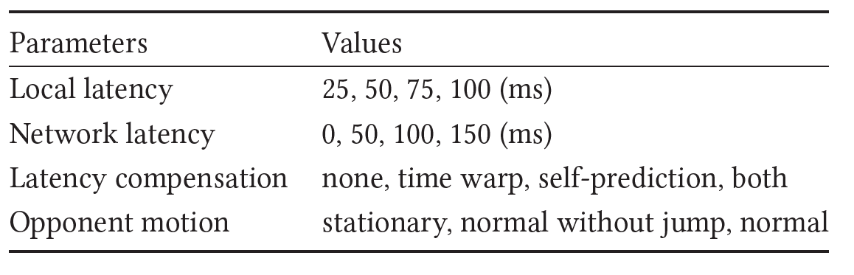
Study Parameters – All Values
3 trials for each, 30 seconds/trial
Recruited via University mailing lists
Notes:
This table has a summary of our user study parameters. The local and system latencies are as mentioned.
The latency compensation is either none, or time warp or self prediction or both.
The opponent is either stationary, moves normally without jumping or moves with jumping. Note, movement speed and changes of direction are based on observed value in CS:GO matches.

Slide 17
Outline
Introduction (done)
User Study (done)
Analysis (next)
Conclusion
Notes:
We next present results from the user study.

Slide 18
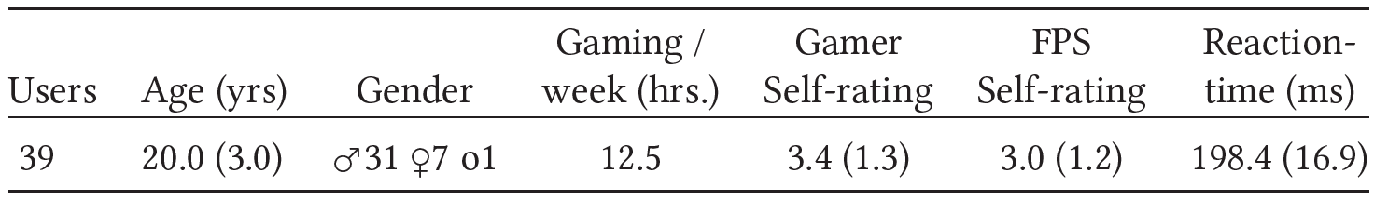
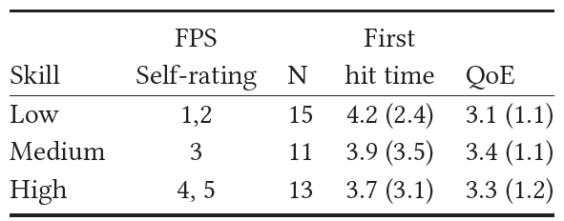
Demographics
Notes:
Thirty-nine (39) users were recruited and participated in total. This table provides summary demographics for the participants.
Gamer and first-person shooter (FPS) self-rating are on a five-point scale, 1-low to 5-high.
Ages ranged from 18-32 years old but with the large majority of typical college age.
Gender breakdown is predominantly male (31 males), but does reflect the gender breakdown of first-person shooter game players (only about 7% of first-person shooter gamers are women [20])
Users are generally gamers (playing a lot, and with moderate skill).
Player reaction times are fast, typical of experienced gamers.

Slide 19
Measurement
Elapse time to 1st hit and 2nd hit
Accucacy % (shots hit divided by shots fired)
QoE (Likert scale: rate the quality of the previous round)

Slide 20
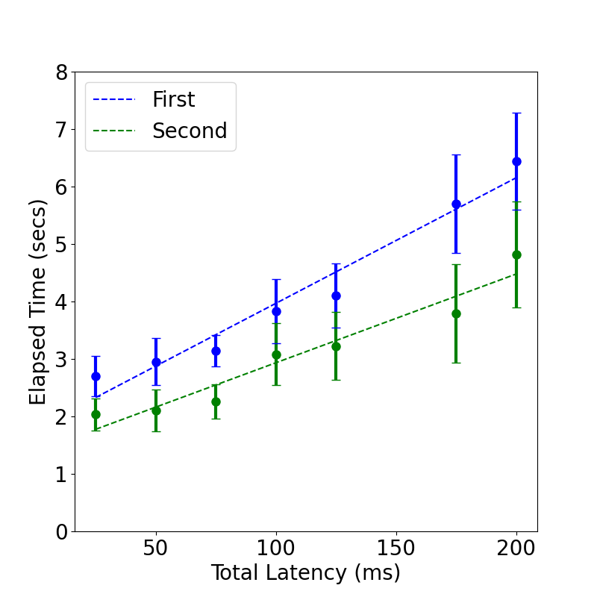
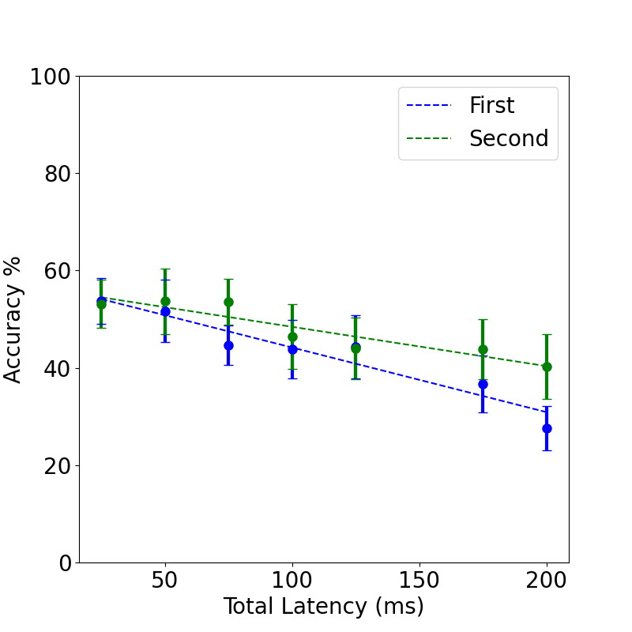
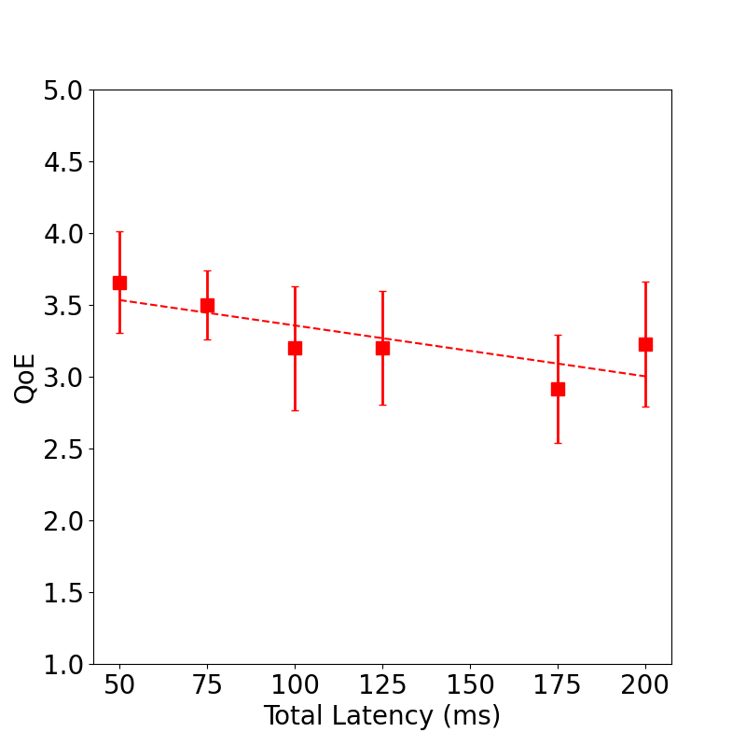
Versus Network Latency without Latency Compensation
Notes:
Since previous work has shown local and network latencies have the same effect without latency compensation, we combine them here.
The first figures depicts the elapsed times and accuracies required to select (hit) the target versus the total latency.
The x-axis is the total latency (network plus local) in milliseconds and the y-axis is elapsed time in seconds. The circles are the mean elapsed times bounded by 95% confidence intervals and the dashed lines are linear regressions through the mean values. The blue points and line are for the first hit and the green points and line are for the second hit (the target takes 2 hits for a kill and the round to end).
From the graph, the elapsed times increase with latency, indicating that latency makes it harder for players to shoot an opponent, approximately linearly with latency.
The figure on the right is the shows an analysis of quality of experience (QoE) versus total latency. The QoE is from answers to the question “Rate the quality of the previous game round” from 1 (low) to 5 (high). The y-axis is the QoE and the x-axis is the total latency. Each point is the QoE averaged over all users, bounded by 95% confidence intervals.
From the graph, latency degrades player experience linearly.

Slide 21
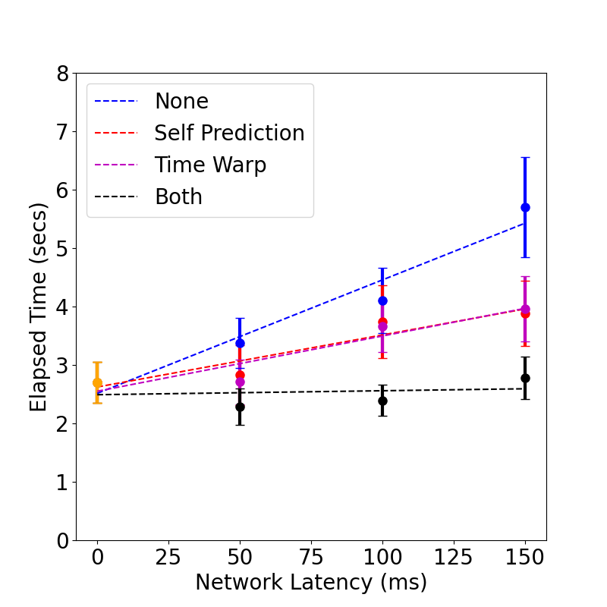
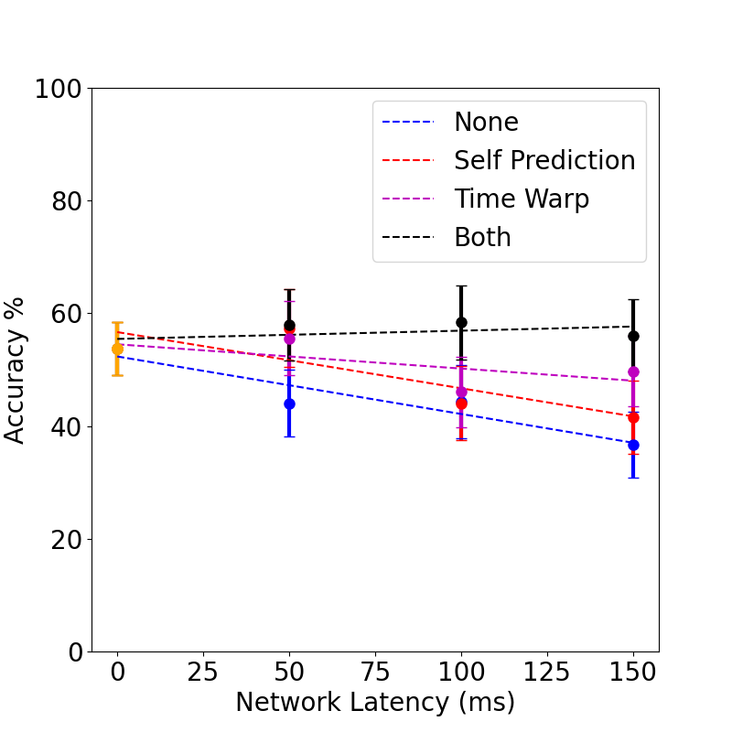
Versus Network Latency with Latency Compensation
Notes:
We compare four different latency compensation condition: none, only self-prediction, only time warp, and both self-prediction and time warp. Local latency is kept at a minimum (25 ms), and network
latency varies: 0 ms, 50 ms, 100 ms and 150 ms.
The graphs are for as the previous results, with separate trendlines for each latency compensation condition.
The red line and the purple lines have shallower slopes and are comparable, indicating that each technique individually has about the same ability to mitigate network latency. The black line is almost flat, indicating that both techniques together can nearly
completely overcome the effects of network latency.
The graph on the right is for QoE. As for player performance, QoE degrades the most with latency without compensation (blue), while self-prediction (red) and time warp (purple) both ameliorate the effects of network latency on QoE. The slightly steeper slope of the purple
line compared to the red line indicates self-prediction helps QoE more than does time warp.
As a take away, with both self-prediction and time warp together, latency does not appreciably affect player performance nor QoE for 3D target selection.

Slide 22
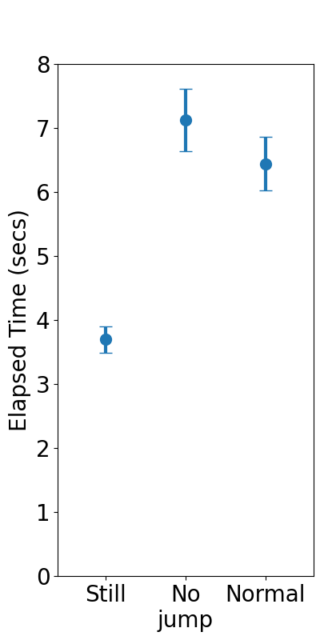
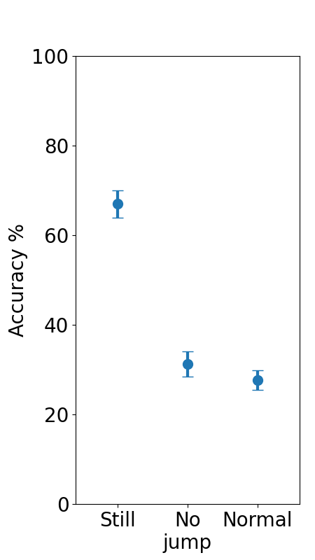
Versus Target Motion
Notes:
While players in first-person shooter games usually shoot at moving opponents, some opponents deliberately jump to avoid being shot
while others deliberately stand still, either unaware they are being shot at or to better aim their own weapons. Our methodology lets us assess how much these motion variants impact target selection.
For this analysis, only the motion varies – normal, normal without jumping, and stationary – whereas local latency and network latency
are fixed at 100 ms, each.
The graph depicts elapsed time versus the target motion condition. The x-axis is the motion condition. The circles are mean values and the bars are 95% confidence
intervals.
From the graphs, player performance is significantly better – about 1/2 the elapsed time and twice the accuracy – when the target is still. Moreover, jumping – a commonly
used tactic by first-person shooter opponents – does not significantly degrade the shooting performance of players shooting at the jumper.
While we believe these results likely hold in other first-person shooter games, the degree to which they hold will depend upon the avatar speeds, and frequency and height of the jumping
and frequency of direction changes.

Slide 23
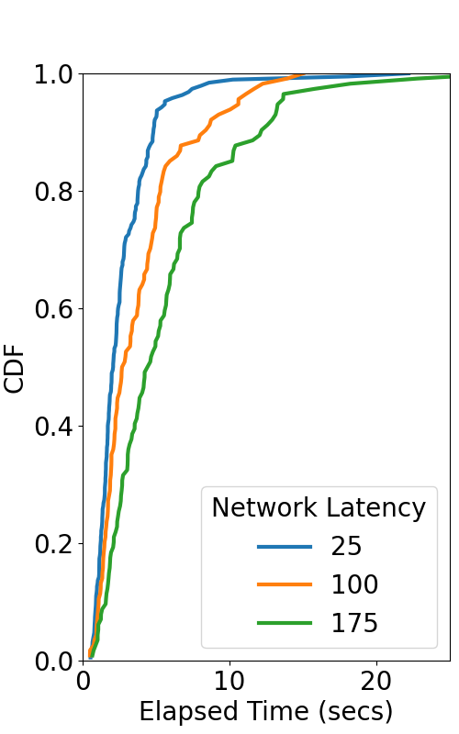
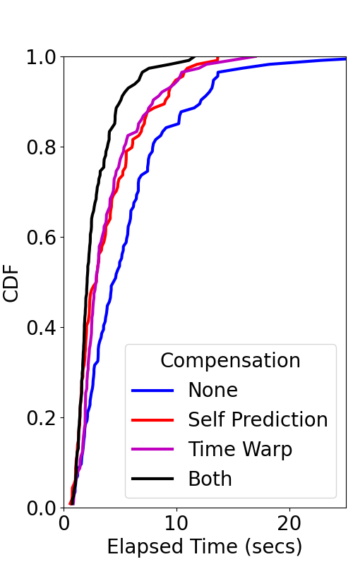
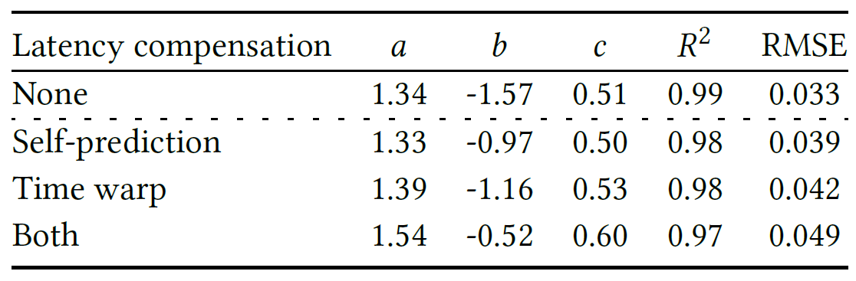
Models of Selection Time
R² = 0.98
Notes:
-bLThis figure depicts the cumulative distribution functions (CDF) of elapsed time. The x-axis is length of elapsed time in seconds and the y-axis is the cumulative distribution. The data is grouped for three different total latency conditions. From the graph, there is some visual separation of the lines based on latency, with lower latencies having shorter elapsed times (the lines are shifted up and to the left).
We tried different mathematical distribution to fit the data and exponential turns out to be the most parsimonious one. The equations, with local latency, network latency, firing rate, distance, target size and elapsed time as parameters.
The model fits the data well with R2 at 0.98.
These models illustrate the mathematical relationship of target selection times but also provide the potential to be combined with navigation models for simulations.

Slide 24

Limitations
Bots not human opponents
Only pistols for weapon
Study mostly young males
Could be learning effects
Players could not customize settings
Notes:
Our methodology intentionally had users play against a bot. The movement of the target can alter the difficulty of the game and hence affect player performance and experience. Although the movement of the bot is simulated from real player data from the first-person shooter game (CS:GO), the results may not generalize to all FPS games which may differ in their target motion parameters.
In our custom game, the player only has a pistol as the weapon. However, play style and strategy can vary with type of weapon, which, in turn, may result in different elapsed times and accuracies. Similarly, weapon accuracies and firing rates different than the ones in our study may have alternate performance data.
Our sample is skewed towards young males. While this may reflect the gender and age breakdown present in some first-person shooter games today, the results reported may not be indicative of players outside of this demographic.
There might be learning effects where players become more familiar with the game and perform better at later rounds, regardless of the latency. While we did not explicitly observe learning effects in our five baseline values, our shuffled test conditions across all rounds should minimize any learning effects on specific conditions.
Serious game players often customize the software settings on their computers and games to suit their personal play preferences. However, since customizations would have created a difference in test conditions between users, we did not allow any changes to the computer settings. This holds for other game configurations, too, such as other mice, keyboards or monitors.

Slide 25

Conclusions
Player performance and quality of experience both degrade linearly as latencies increase from 25 ms to 200 ms
  Elapsed times to select at 25 ms of latency average about 60% shorter than elapsed times at 200 ms.
  Quality of Experience (QoE) decreases about 0.4 (on a 5-point scale) with every 100 ms of latency.
Time warp and self-prediction together can eliminate the effects of latency on both player performance and QoE
  About 50% each
  Players can feel and perform as if there is no network latency when time warp and self-prediction are both used
Notes:
Analysis of the results from a 37-person user study with a custom game that isolates 3D target selection shows that:
Across the range of total latencies studied, player performance and quality of experience both degrade linearly as latencies increase from 25 ms to 200 ms. Specifically, elapsed times to select at 25 ms of latency average about 60%
shorter than elapsed times at 200 ms.
Over this same range, Quality of Experience (QoE) decreases about 0.4 (on a 5-point cale) with every 100 ms of latency.
Time warp and self-prediction both mitigate the effects of latency, and, when applied together, can eliminate the effects of latency on both player performance and QoE – i.e., players can feel and perform as if there is no network latency when time warp and self-prediction are both used

Slide 26
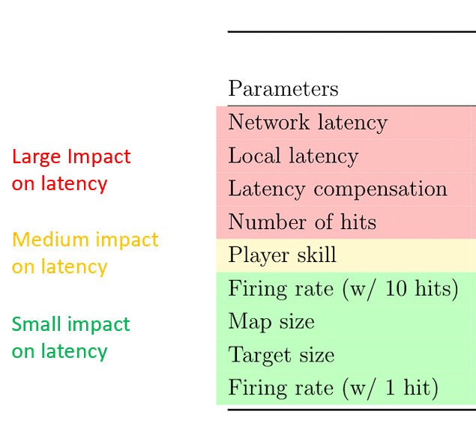
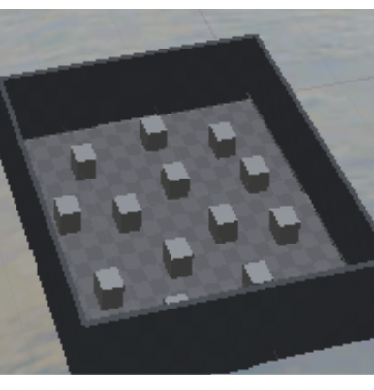



Ongoing Work
Combine model with Navigation model [25]
Simulate FPS games
Validate simulations
Explore!
Degree of which
latency affects
Large
Medium
Small
Notes:
Our ongoing work is to investigate the impact of latency on first-person shooter games by simulating first-person shooter behavior
using the models in this paper and additional models for first-person navigation (published at ACM CHI this past Spring).
Once developed, such simulations would need to be validated before being used to generalize performance over a wide range of first-person shooter game configurations.
Spoiler alert! Preliminary results suggest avatar attributes (e.g., health and armor) can significantly affect the degree to which latency affects a FPS game player,
as can the player skill, while other game attributes have less of an effect. Stay in touch for more details! ☺

Slide 27
The Impact of Latency on Target Selection in First-Person Shooter Games
Thank-you! Questions?
Shengmei Liu, and Mark Claypool

