Slide 1


MQP: Intelligent Customer Support Case Routing
By
Ziyan Ding
Joseph Perez
Xuanzhe Wang
Juniper Networks
Steven Tufts
Aditya Sood
Amogh Rao
Advised By
Mark Claypool
Notes:
Add logos and names, amogh, aidtya, steve, mark

Slide 2

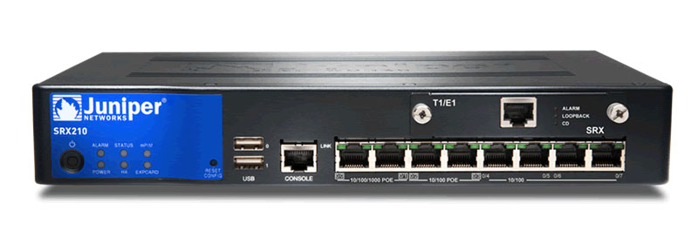
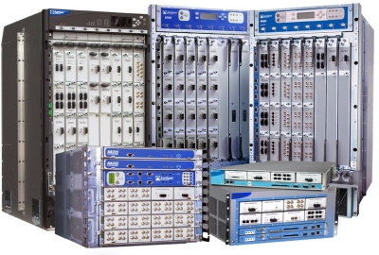
Introduction
Company
Problem Description
Project Goal
New Support Case
New Support Case
Intelligent Case Routing
Retrieved fromhttp://www.veebersystems.com/
Engineer
Engineer
Retrieved from https://www.townsendassets.com/

Slide 3
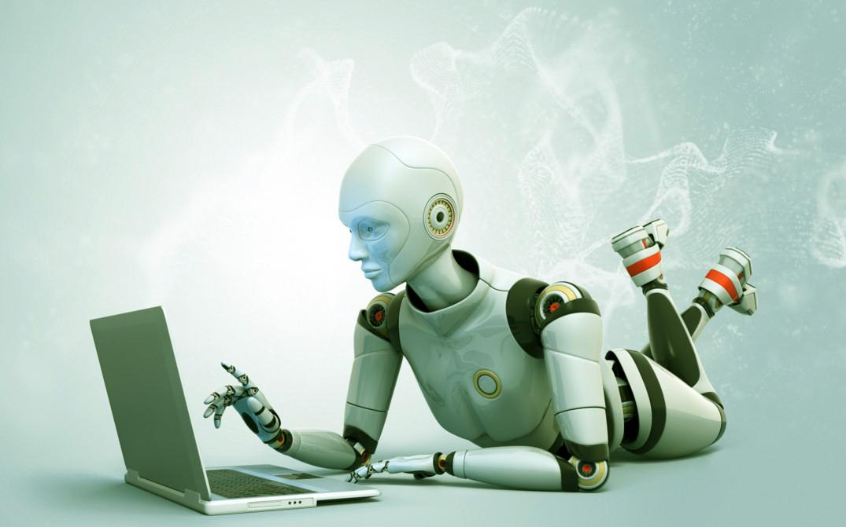
Background Context
Machine Learning
A form of Artificial Intelligence
Build intelligent programs to solve complex tasks without explicitly programming it.
http://www.fraudscoop.com/wp-content/uploads/2016/05/Big-Data-Makes-For-Exceptional-Machine-Learning.jpg

Slide 4
Problem Solving without Machine Learning

Slide 5
Machine Learning Approach
A supervised learning problem
Notes:
Change “Result/Data” to be more clear, and output should be very clear

Slide 6
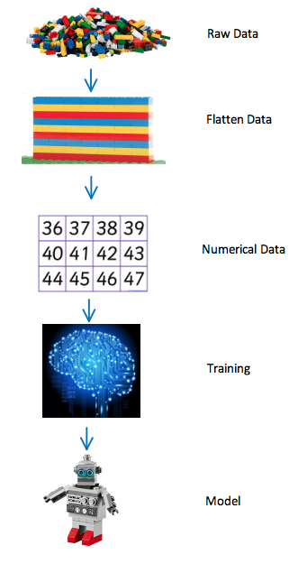
Methodology
http://visitlegoliberty.com/
http://www.nature.com/nature/journal/v433/n7024/fig_tab/433369a_F1.html
https://k-3teacherresources.com/teaching-resource/printable-number-cards/
https://www.theodysseyonline.com/artificial-intelligence-from-myth-to-reality
http://forthemommas.com/free-stuff/free-lego-robot-build-lego-stores

Slide 7
Machine Learning is Function Approximation
Regression and Classification
We know input X, and output Y,
Find function f(X) => Y
Supervised Learning
Given an input X
Find function f(X) that describes the patterns in X.
Unsupervised Learning
Reinforcement Learning
Given an environment and a goal
Find function f, such that f interacts with the environment and eventually achieves the goal.

Slide 8
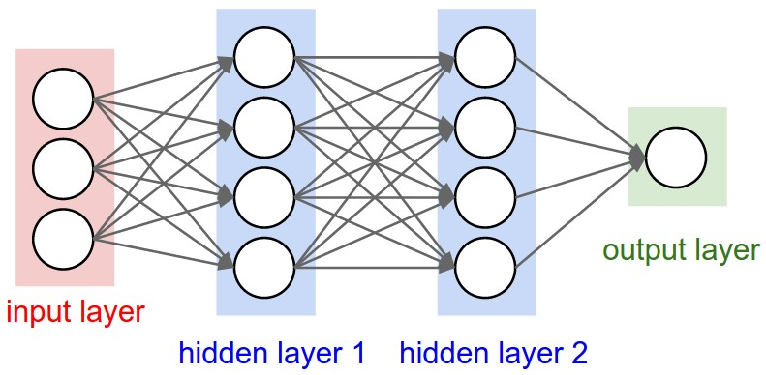
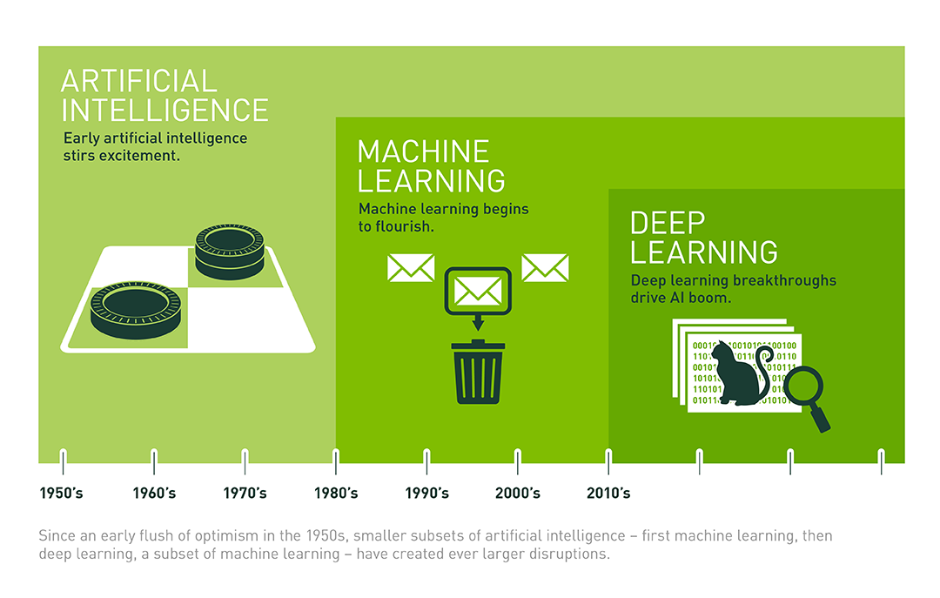
Deep Learning
Using neural network as function approximator.
https://cs231n.github.io
https://blogs.nvidia.com/blog/2016/07/29/whats-difference-artificial-intelligence-machine-learning-deep-learning-ai/

Slide 9
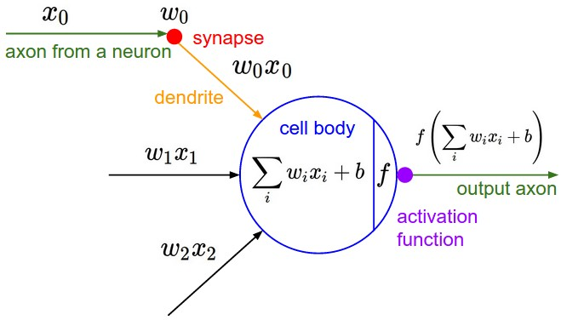
Computational Graph - One Neuron
https://cs231n.github.io

Slide 10
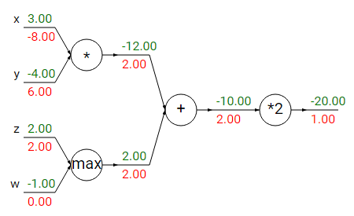
Neural Network with Back Propagation
cs231n.github.io

Slide 11
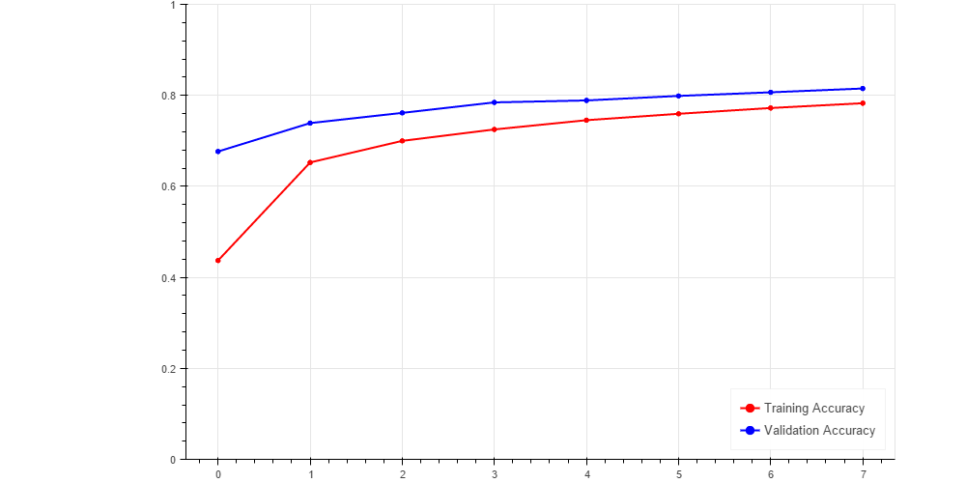
Model Accuracy
accuracy
iteration

Slide 12
Results
Web Application
  Create a new case
  Supplies results set for 2 models
  Store user feedback for later use
Backend
ma growth

Slide 13
Thank you!

Slide 14
MQP: Intelligent Customer Support Case Routing
By
Ziyan Ding
Joseph Perez
Xuanzhe Wang
Juniper Networks
Steven Tufts
Aditya Sood
Amogh Rao
Advised By
Mark Claypool
Notes:
Add logos and names, amogh, aidtya, steve, mark

