Slide 1
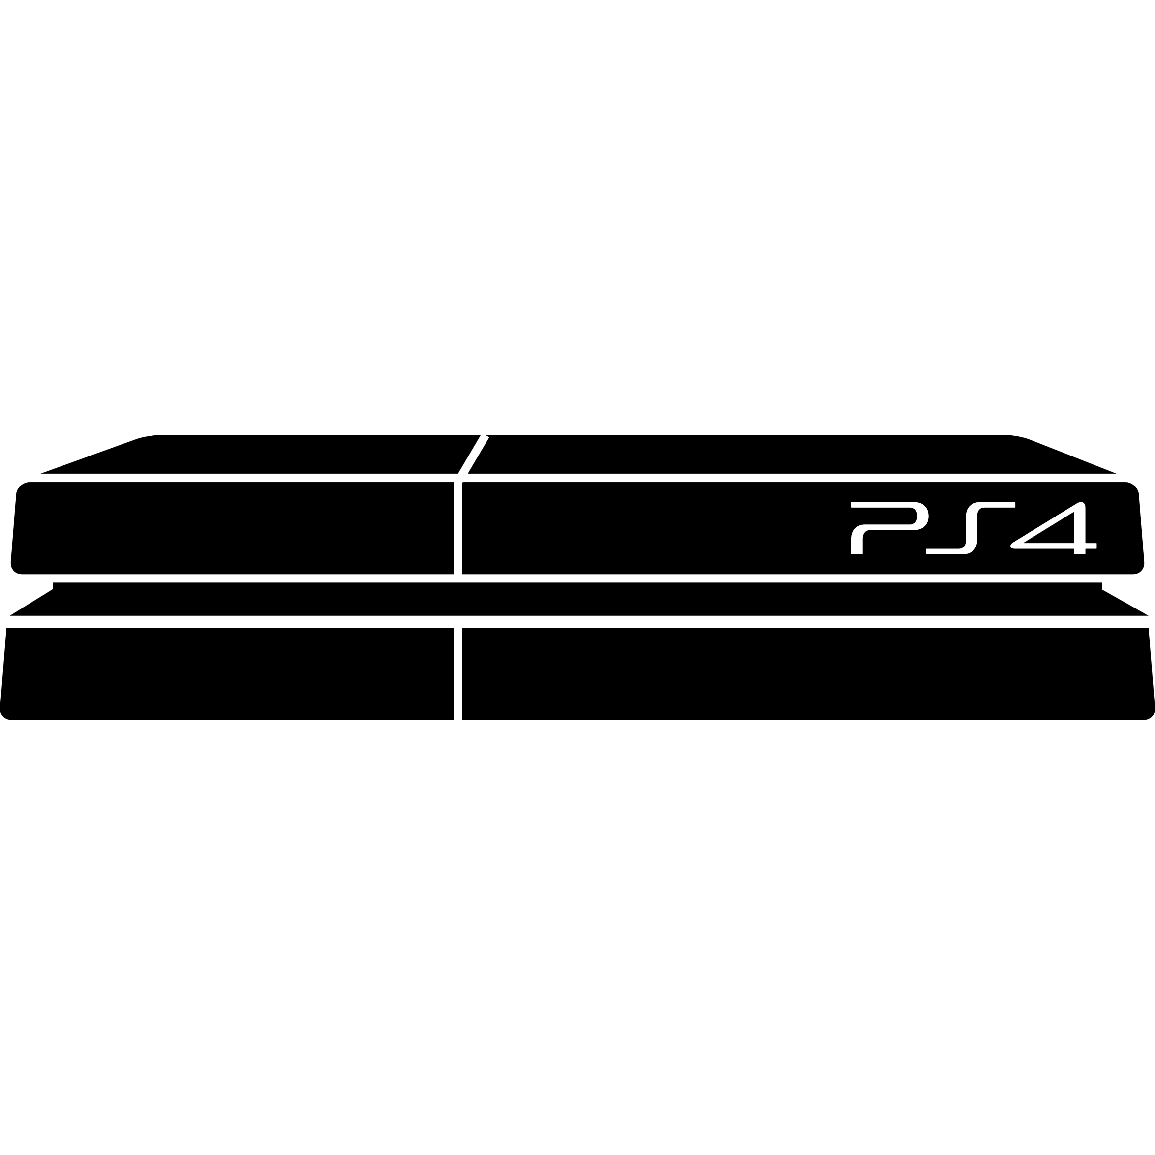
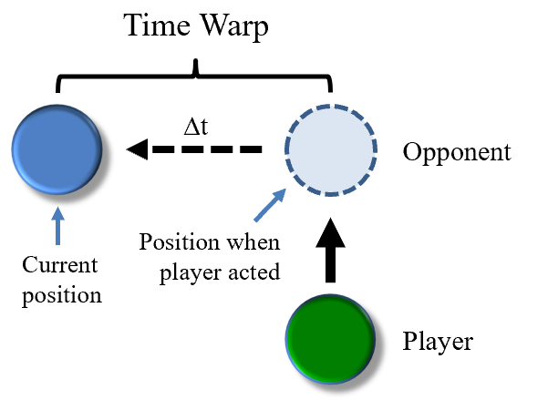
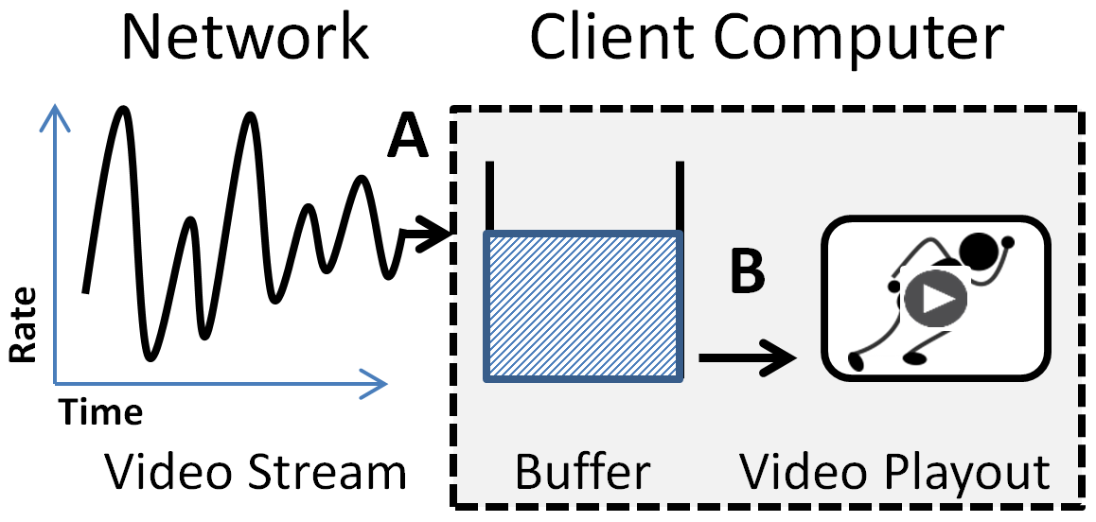
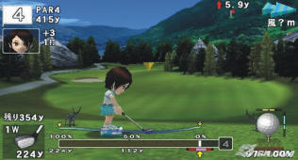
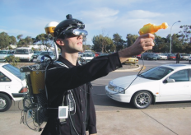
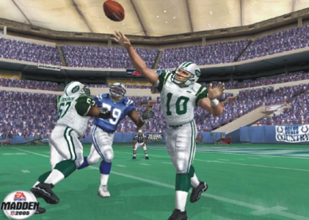
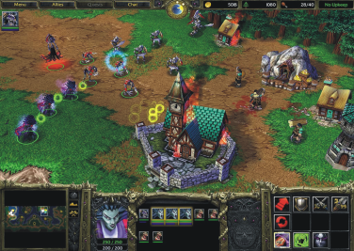
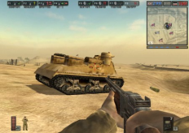
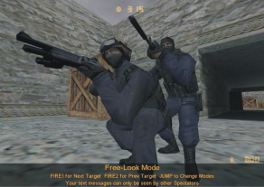
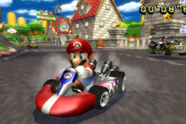
Better QoE for Cloud-based Game Streaming
Lag can kill!
(your fun)
\
~==-
/
____
/___o\
\
~==-
/
____
/___o\
\
~==-
/
____
/___o\
Traditional
console
server
User
Input
Client
Player input
Response
time
Message:
User Input
Process
Input
Game frames
Display
World
Game World
\
~==-
/
____
/___o\
\
~==-
/
____
/___o\
\
~==-
/
.**
**.**
*.*
server
Time
\
~==-
/
____
/___o\
server
Cloud-based
Degrades responsiveness
Player input
server
Need latency compensation!
Need buffering for smoothing jitter!
Thin Client
Cloud Servers
Methodology
Thin clients
Cloud Tracker
Build latency compensation & buffering
Evaluate with user study experiments
Measure and model benefits
Provide API for game developers
Build game to demonstrate
Deploy to Cloud/Testbed
Network Games
Mark Claypool
claypool@cs.wpi.edu

Slide 2
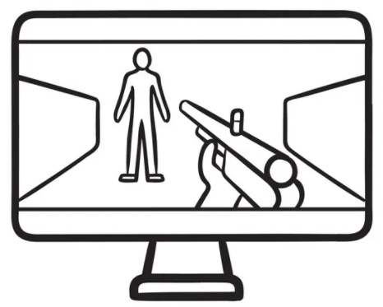
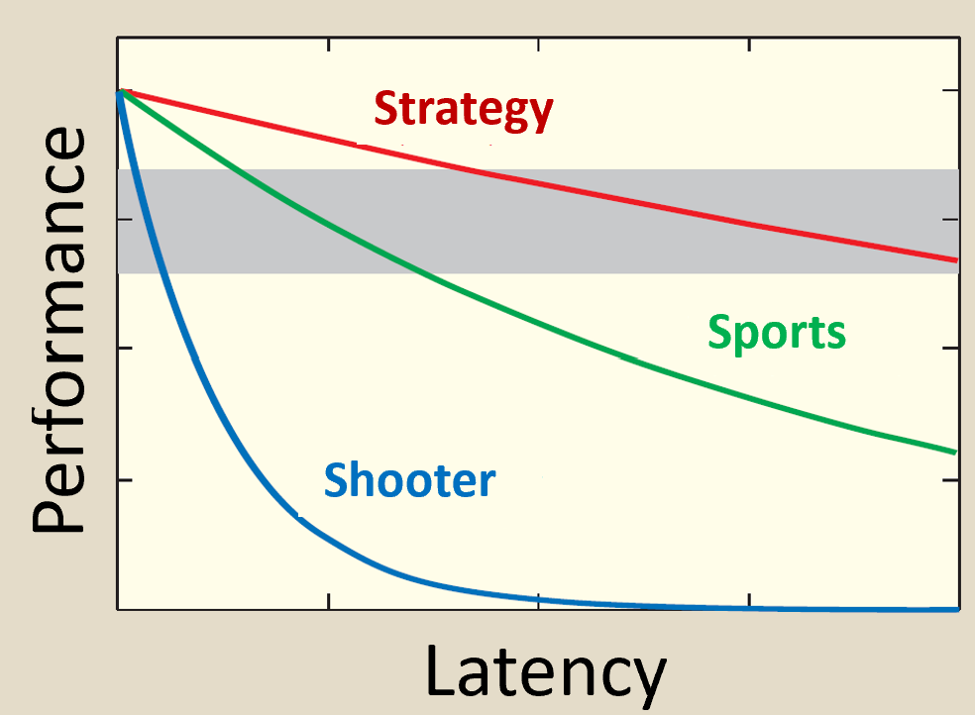
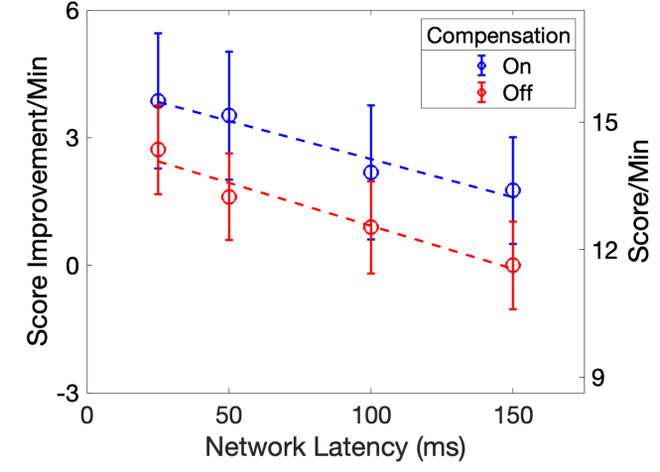
First-Person Science - Exploring FPS Games and Latency
\
~==-
/
____
/___o\
\
~==-
/
____
/___o\
server
User
Input
Client-server architecture
Response
time
Message:
User Input
Process
Input
FPSci
Display
World
Game World
Lag can kill!
(your fun)
Time
Need latency compensation!
Degrades responsiveness
Methodology
C++
Latency and Games
Research
g3d
Lag Can Kill
Build network game
Add latency compensation
Evaluate with user study
Analyze
Network Games
Mark Claypool
claypool@cs.wpi.edu

Slide 3
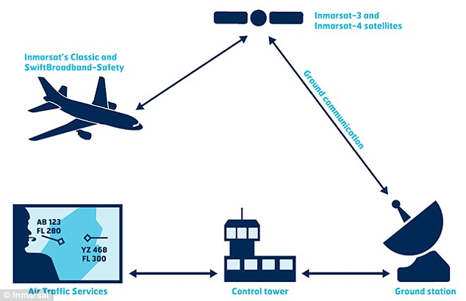
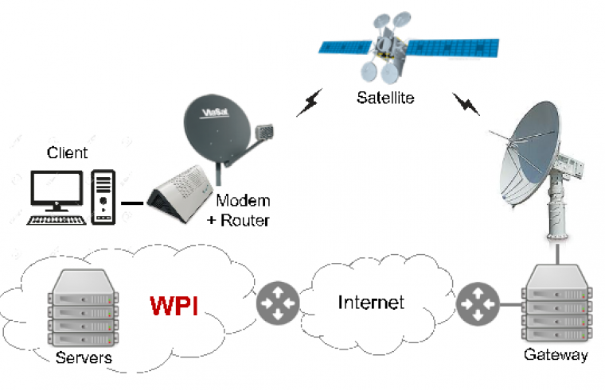
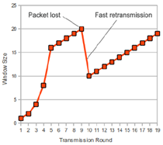
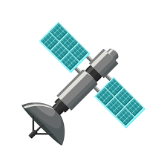
TCP/QUIC Performance
CC over Sat Nets
Satellite Testbed
Suffers when high round-trip time → Satellite Internet!
Methodology
Read and discuss research papers on networking
Design and run experiments (programs sending network traffic)
Analyze the data (stats and drawing graphs)
Improve congestion control algorithms
Repeat 2-4, as needed → publish!
Congestion Control
Research Group
Mark Claypool
claypool@cs.wpi.edu

