Slide 1
Chapter 3
Tutorial

Slide 2
Overview
Work through tutorial making a game
Goal is to get used to Dragonfly
  2D (text-based graphics) game engine
  From game programmer’s perspective
Objectives
  Setup development environment for building Dragonfly (Chapter 2)
  Learn how to develop game using game engine
  Provide foundational knowledge for building engine (Chapter 4)
  Provide ideas of scope for custom game

Slide 3

What is a “Text-based” Game?
(Question: What differences do you notice with newest Dragonfly?)

Slide 4

Saucer Shoot – New and Improved

Slide 5
Tutorial
Saucer Shoot
  Book Chapter 3
  Online: http://dragonfly.wpi.edu/tutorial/
Work through start to finish
  “Cook-book” like, but with some explanations
Need Sprite package (sprites.zip) and Sounds package (sounds.zip)
  Online: http://dragonfly.wpi.edu/tutorial/sprites.zip
  Online: http://dragonfly.wpi.edu/tutorial/sounds.zip
Also available is source code if stuck (gameX.zip)
Internal understanding not necessarily needed
  That comes later in course (Chapter 4)
Basic external understanding expected
  Needed when extending Saucer Shoot game

Slide 6
A 10,000-Foot View of Game Code
Startup Game Engine
  Initialize graphics, input devices, file logging
Populate World with Objects
  Player object (Hero), Enemies (Saucers), Decorations (Stars)
    Object know how to respond to events (e.g., keyboard or collisions)
Run Game
  Move objects, get input, send events to objects (e.g., collisions), draw screen (objects draw themselves)
Shutdown

Slide 7
Core Attributes of Engine in Tutorial
Startup
  Managers
Resource loading (sprites and sounds)
Objects
  Made once (Hero, Stars)
  Made many times (Saucers, Bullets, Explosions)
Events
  Built-in: Keyboard, Mouse, Collision
  Custom: Nuke
Not explicit, but also
  Debugging (own code)
  Reading logfiles

Slide 8
Why Text-based Graphics?
Inherently 2d, so easier math than 3d
Conceptually easy
  (x,y) location, all cells
Reduce temptation to spend time on art
  “Programmer art” is ok!
Note, for game design, constraints can help with creativity!

Slide 9
Text-based Graphics Animation
How is something “animated”?
Update display, making changes often enough
What is “enough”?
  Full-motion video about 30 frames per second (fps)
  Dragonfly does 30 updates/second (→ can potentially change frame each update)
Taking a Walk
0
|
|
Taking a Walk
0
|
/ \
Taking a Walk
0
|
|

Slide 10

“Only” Text? Check out Star Wars
,-'//__\\`-.
,' ____ `.
/ / ,-.-. \
(/# /__`-'_| || || )
||# []/()] O || || |
__`------------------'__
|--| |<=={_______}=|| |--|
| | |-------------|| | |
| | |={_______}==>|| | |
| | | |: _ :| || | |
> _| |___|:===:| || |__<
:| | __| |: - :| || | |:
:| | ==| |: _ :| || | |:
:| | ==|_|:===:|___||_| |:
:| |___|_|:___:|___||_| |:
:| ||| ||/_\|| ||| -| |:
;I_|||[]_||\_/|| ||| -|_I;
|_ |__________________| _|
| `\\\___|____|____/_//' |
J : | \____/ | : L
_|_: | |__| | :_|_
-/ _-_.' -/ \- `.-_- \-
/______\ /______\ /______\
http://www.asciimation.co.nz/

Slide 11
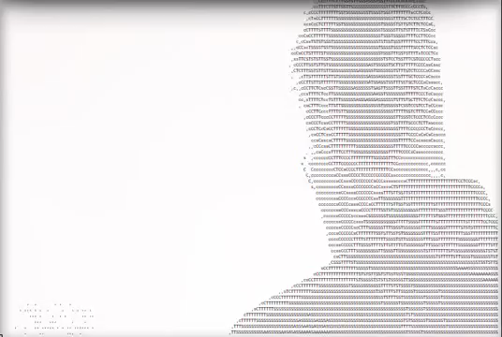
Note “Pixels” of Resolution
Don’t have to limit to 80x24!
(Above, about 200x60. Many monitors can do 600x400 → about VGA)

Slide 12
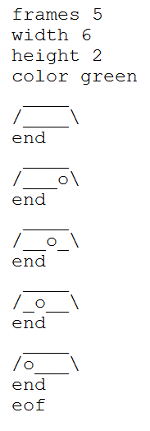
Text-based Graphics Sprites
Animations stored in Sprite file
  Read in by engine before use
Sprite file with fixed format
  Note, must be exact (spaces at end)
Included sprites (sprites.zip) all work with tutorial
Note, if doing your own may need to “deubug” art
  If doesn’t load, see “dragonfly.log” for messages – will help pinpoint problem

Slide 13
Extending Tutorial Game
Add additional code (and sprites, if needed)
Possible functionality
  Additional weapons (e.g., Missile with explosion)
  Additional bad-guys (e.g., UFO that zig-zags)
  Lives or Health for Hero (with status)
See end of Chapter 3 for more suggestions

