Slide 1
Chapter 2
Setup

Slide 2
Platforms
Engine can be developed on common desktop development environments
Linux (any distribution)
Windows (Windows 7, 8, & 10)
Using Visual Studio (v14, 2015)
MacOS
Via Homebrew

Slide 3
Development Environment
Tools and Libraries
Environment
C++ compiler
Standard C++ libraries
Simple and Fast Multimedia Library (SFML)
Note - pre-compiled SFML sensitive to IDE
Project development software (e.g., make or IDE)
Configuration adjusts
include directories (for header files)
library directories (for linking)
Debugger (e.g., gdb)

Slide 4
Full Dragonfly Header Files
Available:
Online: http://dragonfly.wpi.edu/documentation
(Screenshot next slide)
Download: http://dragonfly.wpi.edu/book
In Appendix B of book
Note, these are from complete engine, with all optional elements
Not a starting point
Use as reference when making games with Dragonfly

Slide 5
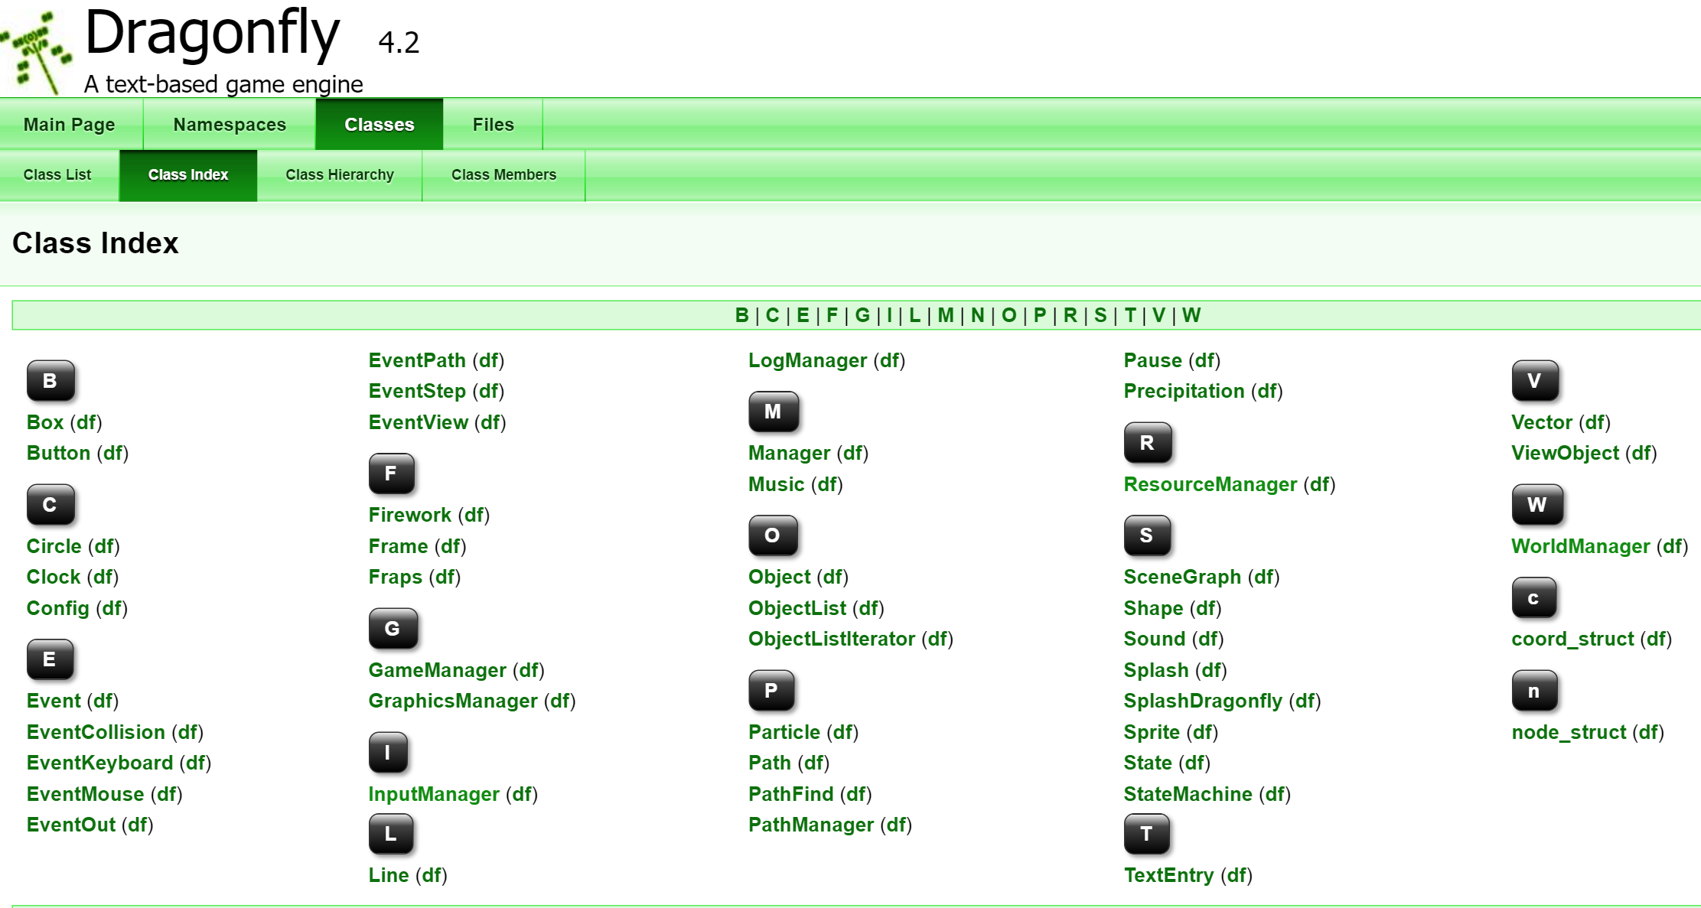
Dragonfly Documentation
http://dragonfly.wpi.edu/documentation/

