Slide 1
Operating Systems
Review
ENCE 360

Slide 2
High-level Concepts
What are three conceptual pieces fundamental to operating systems?

Slide 3
High-level Concepts
What are three conceptual pieces fundamental to operating systems?
Virtualization – sharing computer hardware in time and space
Concurrency – simultaneous access to shared resources
Persistence – making information exist across power outages, crashes, etc.

Slide 4
Operating System Model
Arrange layers in order, top (user) to bottom
Device driver (e.g., mouse)
Computer game (e.g., FIFA 2018)
Shell (e.g., Bash)
Physical devices (e.g., Hard disk)
Operating System (e.g., Linux)
Program control (e.g., Task Manager)

Slide 5
Operating System Model
Arrange layers in order, top (user) to bottom
Music App
Web Browser
Game
Applications
Task Manager
Shell
Shell
System
Programs
Operating System
Device Driver A
Device Driver B
Device Driver C
Hardware
Physical Devices

Slide 6
The Process
What is a process?

Slide 7
The Process
What is a process?
“A program in execution”

Slide 8
Process States
What are the 3 main process states?
What are the transitions between them?

Slide 9
Process States
What are the 3 main process states?
What are the transitions between them?
Clean up
Initialization
Running
Terminate
Dispatch
I/O request
Create
Interrupt
Ready
Waiting
I/O complete

Slide 11
Process Control Block
What is a process control block?
What are the main components?

Slide 12
Process Control Block
What is a process control block?
A data structure the OS uses to manage a running program (a process)
What are the main components?
Running current code stuff – PC, registers, state, …
Memory stuff – stack, heap, code, …
I/O stuff – file descriptors, working directory, …

Slide 13
Process Creation in Unix
main() {
fork();
puts(“hello”);
}
What does the code to the left do when run?
How can we change it to only have child process print “hello”?

Slide 14
Process Creation in Unix
main() {
fork();
puts(“hello”);
}
What does the code to the left do when run?
hello
hello
How can we change it to only have child process print “hello”?
Change fork() line to be:
if (fork() == 0)

Slide 15
Processes and Threads
What is a process?
What is a thread?
For two processes, what is private?
For two threads in the same process, what is private?

Slide 16
Processes and Threads
What is a process?
A program in execution / a running program
What is a thread?
A single sequence of execution within a process
For two processes, what is private?
Code, memory (global variables, stack), hardware state (program counter, registers), OS resources (file descriptors+)
For two threads in the same process, what is private?
Memory (stack), Hardware state (program counter, registers)

Slide 17
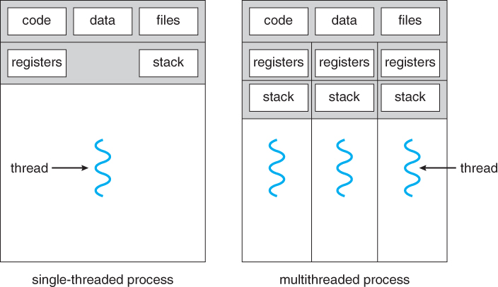
Processes and Threads
For two processes, what is private?
For two threads in the same process, what is private?
(Helpful picture)

Slide 18
Thread Creation with Pthreads
void A() {
puts(“hello”);
}
void main() {
pthread_create(&t,A);
puts(“goodbye”);
}
What does the code to the left do when run?

Slide 19
Thread Creation with Pthreads
void A() {
puts(“hello”);
}
void main() {
pthread_create(&t,A);
puts(“goodbye”);
}
What does the code to the left do when run?
goodbye or hello
hello goodbye
What code to add to always have “hello” before “goodbye”?

Slide 20
Thread Creation with Pthreads
void A() {
puts(“hello”);
}
void main() {
pthread_create(&t,A);
pthread_join(t);
puts(“goodbye”);
}
What does the code to the left do when run?
goodbye or hello or goodbye
hello goodbye
What code to add to always have “hello” before “goodbye”?
pthread_join(t) before puts(“goodbye”)

Slide 21
IPC Paradigms
What are two main paradigms for Interprocess Communication (IPC)?
What are some advantages/disadvantages for each?

Slide 22
IPC Paradigms
What are two main paradigms for Interprocess Communication (IPC)?
What are some advantages/disadvantages for each?
Message passing
Good: explicit, less chance for programmer error
Bad: overhead
Shared memory
Good: performance, flexibility for programmer
Bad: changes without process knowing (side effects), programmer needs to handle sync

Slide 23
IPC Mechanisms
What are some IPC mechanisms?

Slide 24
IPC Mechanisms
What are some IPC mechanisms?
Pipe
Files
Shared memory
Signals
Sockets
…

Slide 25
Pipe
What is a pipe? What operations does it support?

Slide 26
Pipe
What is a pipe? What operations does it support?
IPC mechanism provided by OS
Gives bounded-buffer, FIFO/queue access
Write to one end, Read from other
Block on full write, Block on empty read
b
l
a
h
.
c
\0
read fd
write fd

Slide 27
System Exploration
File-descriptors and exec()
Signal-signal
Thread-signal
Challenge: once you use dup2() to change STDOUT, can you restore it?
Hint, see:
https://stackoverflow.com/questions/11042218/c-restore-stdout-to-terminal

Slide 28
Dup2
From the user’s perspective, what does this code do?
fd = open(“dup.txt”, O_WRONLY)
dup2(fd, STDOUT_FILENO)
What does it do from the system’s perspective?

Slide 29
Dup2
From the user’s perspective, what does this code do?
fd = open(“dup.txt”, O_WRONLY)
dup2(fd, STDOUT_FILENO)
Opens a file and changes standard output to go to the file instead of the screen
What does it do from the system’s perspective?
Closes STDOUT_FILENO, copies the file descriptor to the new file descriptor
0
1
2
3
0
1
2
3
stdout
stdout
file
file
...
...
Before dup2()
After dup2()

Slide 30
Signals
What is an operating system signal?
Broadly describe how to write code to use one
Provide an example of how signals might be used

Slide 31
Signals
What is an operating system signal?
A message to a process corresponding to an event, sent by either another process or the OS
Broadly describe how to write code to use one
Provide an example of how signals might be used

Slide 32
Signals
What is an operating system signal?
A message to a process corresponding to an event, sent by either another process or the OS
Broadly describe how to write code to use one
Write handler function
Make system call
Send signals
Provide an example of how signals might be used

Slide 33
Signals
What is an operating system signal?
A message to a process corresponding to an event, sent by either another process or the OS
Broadly describe how to write code to use one
Write handler function
Make system call
Send signals
Provide an example of how signals might be used
Gracefully shut down upon ctrl-c
Indicate to parent child has finished work
Wake up and do some action upon an alarm
…

Slide 34
Sockets
What two (maybe three) pieces of information does a client need to know to connect to a server?

Slide 35
Sockets
What two (maybe three) pieces of information does a client need to know to connect to a server?
IP Address – gets data to right computer
Port – gets data to right process
(Network protocol – TCP or UDP)
any port
agreed port
socket
socket
message
client
server
other ports
Internet address = 138.37.94.248
Internet address = 138.37.88.249

Slide 36
Sockets – Put in Order for Client & Server
Client
Server
send()
connect()
bind()
close()
recv()
accept()
listen()
socket()

Slide 37
Sockets – Put in Order for Client & Server
Client
socket()
connect()
send()
recv()
close()
Server
socket()
bind()
listen()
accept()
recv()
close()
send()
connect()
bind()
close()
recv()
accept()
listen()
socket()

Slide 38
Sockets - Describe
What is the difference between
send() and recv()
vs.
read() and write()

Slide 39
Sockets - Describe
What is the difference between
send() and recv()
vs.
read() and write()
Answer: send() and recv() have flags that may be useful
E.g., MSG_PEEK, MSG_DONTWAIT

Slide 40
Sockets - Describe
What does “non-blocking” mean for a socket?

Slide 41
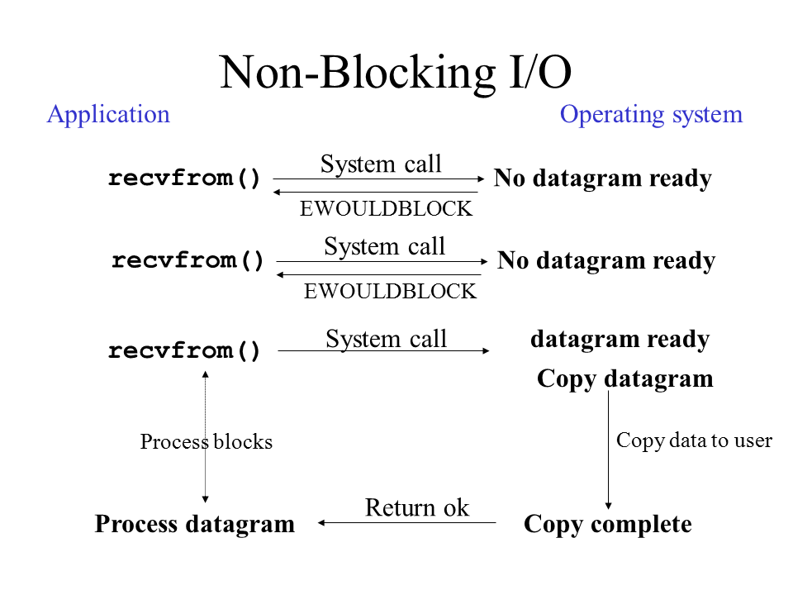
Sockets - Describe
What does “non-blocking” mean for a socket?
Answer: recv()/send(), do not sleep if no data.
Note: can be done for accept() too on server

Slide 42
CPU Scheduling
Briefly describe the shortest time to completion first (STCF) algorithm
Is STCF pre-emptive?

Slide 43
CPU Scheduling
Briefly describe the shortest time to completion first (STCF) algorithm
From ready to run processes, select process with shortest time to finish it’s CPU burst
Is SCTF pre-emptive?
Yes – if a process arrives that has a shorter completion time than the one currently running, it is chosen instead

Slide 44
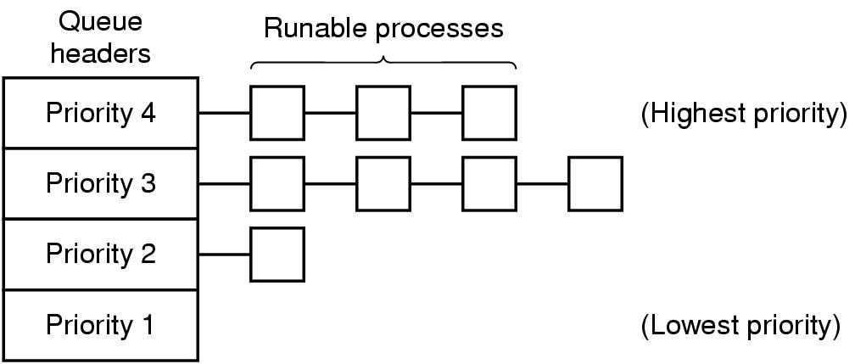
CPU Scheduling
Describe some rules that will make the MLFQ adaptive

Slide 45
CPU Scheduling
Describe some rules that will make the MLFQ adaptive
New processes at highest priority
If process uses all of timeslice, reduce priority
If process voluntarily blocks before timeslice expires, increase priority

Slide 46
Sempahore
Define using:
enqueue proc
s = s - 1
sleep
dequeue proc
if (s < 0) then
s = s + 1
wake proc
if (s <= 0) then
int sem_wait(sem_t &s) {
}
int sem_post(sem_t &s) {
}

Slide 47
Sempahore
Define using:
enqueue proc
s = s - 1
sleep
dequeue proc
if (s < 0) then
s = s + 1
wake proc
if (s <= 0) then
int sem_wait(sem_t &s) {
s = s - 1
if (s < 0)
add process to queue and sleep
}
int sem_post(sem_t &s) {
s = s + 1
if (s <= 0)
remove process from queue and wake
}

Slide 48
Critical Region
Processes pid 0 & pid 1
What is this doing, in general?
Can both be in critical region?
What is inefficient?
Fix with semaphore
shared int turn;
while (1) {
while (turn != pid)
/* spin */ ;
/* critical region code */
if (pid == 1) turn = 0;
else turn = 1;
/* other code */
}

Slide 49
Critical Region
Processes pid 0 & pid 1
What is this doing, in general?
Strict alternation
Can both be in critical region?
No
What is inefficient?
Spin wait
Maybe not alternate
Fix with semaphore
wait(s)
/* cr */
signal(s)
shared int turn;
while (1) {
while (turn != pid)
/* spin */ ;
/* critical region code */
if (pid == 1) turn = 0;
else turn = 1;
/* other code */
}

