Slide 1
Operating Systems
Threads
ENCE 360

Slide 2
Outline
Model
Motivation
Libraries
Chapter 2.2
MODERN OPERATING SYSTEMS (MOS)
By Andrew Tanenbaum
Chapter 26.1, 26.2
OPERATING SYSTEMS: THREE EASY PIECES By Arpaci-Dusseau and Arpaci-Dusseau

Slide 3
Threads (Lightweight Processes)
Process
Single sequence of execution within a process
Basic unit of CPU utilization
Private
Program counter
Register set
Stack space
Shared
Code section
Data section
OS resources
A
B
C
Program
Counter
(Threads)
text segment
A stack
B stack
C stack
A
B
C
Because have some process properties (but not all), often called lightweight process
data segment
“Multithreaded Program”

Slide 4
Thread – Private vs. Shared
int g_x;
B() {
int x = 10;
printf(x);
}
A(int x) {
B();
}
main() {
A(1);
}
Assume two threads (A and B)
in same process running code on left
What is shared between them?
What is private?
Hint: remember other components of system, too!
A PC
B PC

Slide 5
Thread – Private vs. Shared
int g_x;
B() {
int x = 10;
printf(x);
}
A(int x) {
B();
}
main() {
A(1);
}
B(): x = 10
A PC
A(): x = 1
A(): x = 1
B PC
main()
main()
g_x
Thread A
Thread B
Shared
Private
(OS Internals)
Beware non-thread safe library/system calls!
e.g., strtok(), rand(), readdr()
Use thread-safe version: e.g., rand_r()
file
descriptor
SOS: “pcb-thread.h”
includes stdio, stdin

Slide 6
Thread – Private vs. Shared Summary
(Shared by each thread)
(Private to each thread)

Slide 7
Outline
Model (done)
Motivation (next)
Libraries

Slide 8
Example: A Threaded Spreadsheet
Display
Thread
Recalculate
Thread
Spreadsheet
Data
Other
Data
Command
Thread

Slide 9
What Kinds of Programs to Thread?

Slide 10
What Kinds of Programs to Thread?
Independent tasks (e.g., spreadsheet)
Single program, concurrent operation
Servers: e.g., file server, Web server
OS kernels: concurrent system requests by multiple processes/users
Especially when block for I/O!
→ With threads, can continue execution in another thread
Registers
Registers
CPU1
CPU1
Especially with multiple-CPUs!
→ Each CPU can run one thread
Mem
Disk

Slide 11
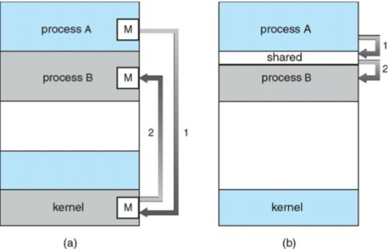
Potential Thread Benefits
“What about just using multiple communicating processes?”
Sure, this can be made to work
But separate code needed to coordinate processes
e.g., pipes
e.g., shared memory + locks
And debugging tougher
Also, processes “cost” more
Up to 100x longer to create/destroy
Far more memory (since not shared)
Slower to context switch among
Few thousand processes not ok
Few thousand threads ok

Slide 12
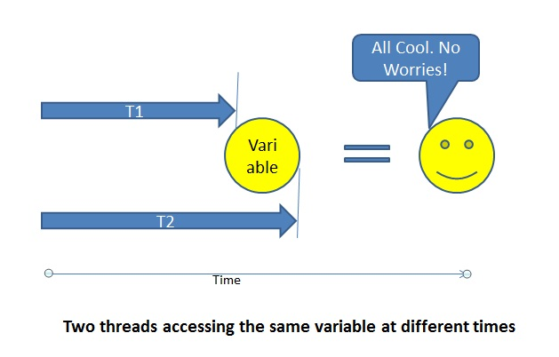
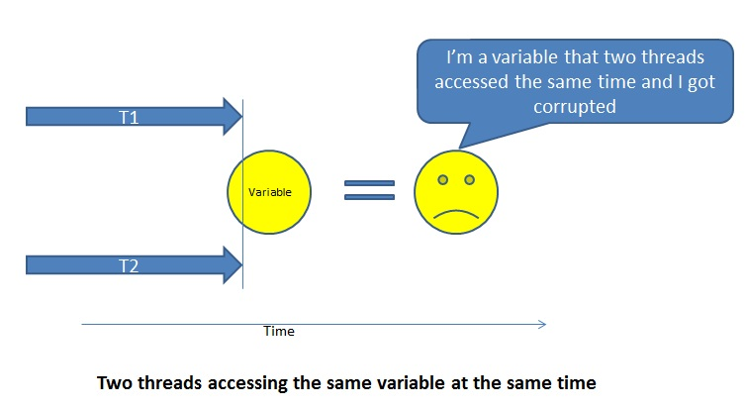
Warning Using Threads
Versus single threaded program, can be more difficult to write and debug code
Concurrency problems for shared resources
Global variables
But also system calls and system resources
Only use threads when performance an issue (blocking too costly and/or multi-processor is available)
So … is performance an issue?

Slide 13
Is Performance an Issue?
You don’t need to improve performance of your code
Most important → Code that works, is robust
More important → Code that is clear, readable
It will be re-factored
It will be modified/extended by others (even you!)
Less important → Code that is efficient, fast
Is performance really issue?
Can hardware upgrade fix performance problems?
e.g., Moore’s Law
Can design fix performance problems?
Ok, so you do really need to improve performance
Use threads … but carefully! (Concurrency)
(http://en.wikipedia.org/wiki/Moore's_law)

Slide 14
Outline
Model (done)
Motivation (done)
Libraries (next)

Slide 15
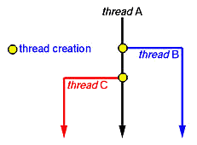
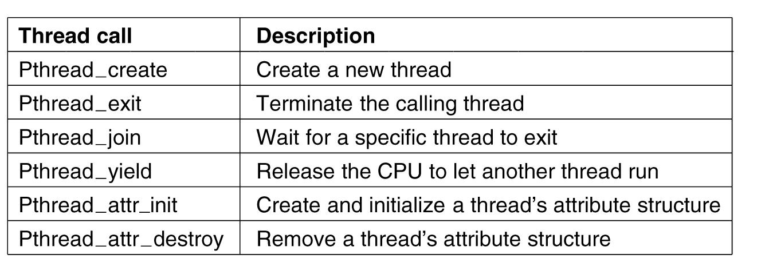
Thread Libraries for C/C++
Dozens: https://en.wikipedia.org/wiki/thread-lib
Main – POSIX threads (pthreads) and Windows
Totally different
Fortunately, common functionality
Create, Destroy, Join, Yield
Lock/Unlock (for concurrency)
#include <pthread.h>
Linker: -lpthread

Slide 16
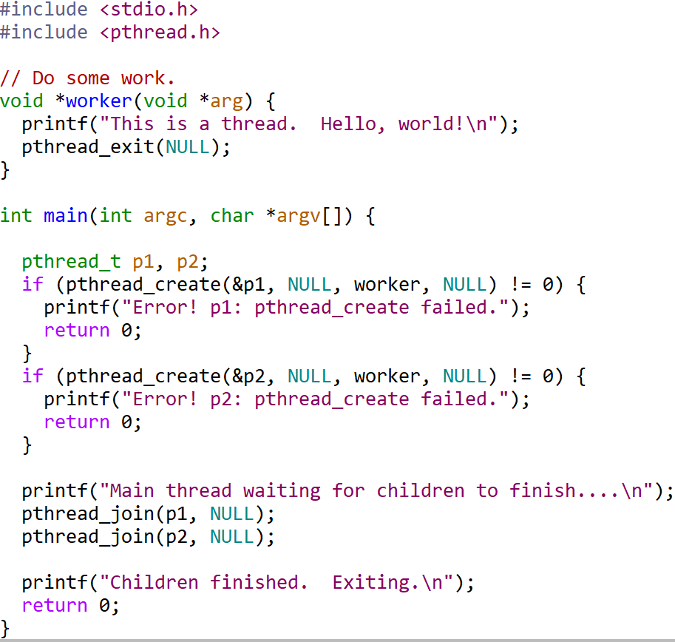
POSIX Threads - Example
See: “threads-hello.c”

Slide 17
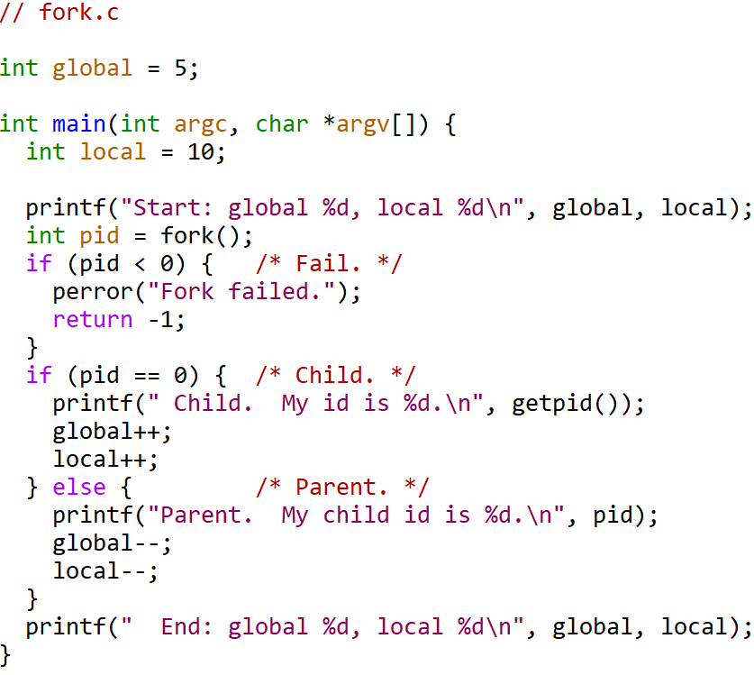
Example – Thread vs. Fork (1 of 2)
See: “fork.c”
What do you think the output will be?

Slide 18
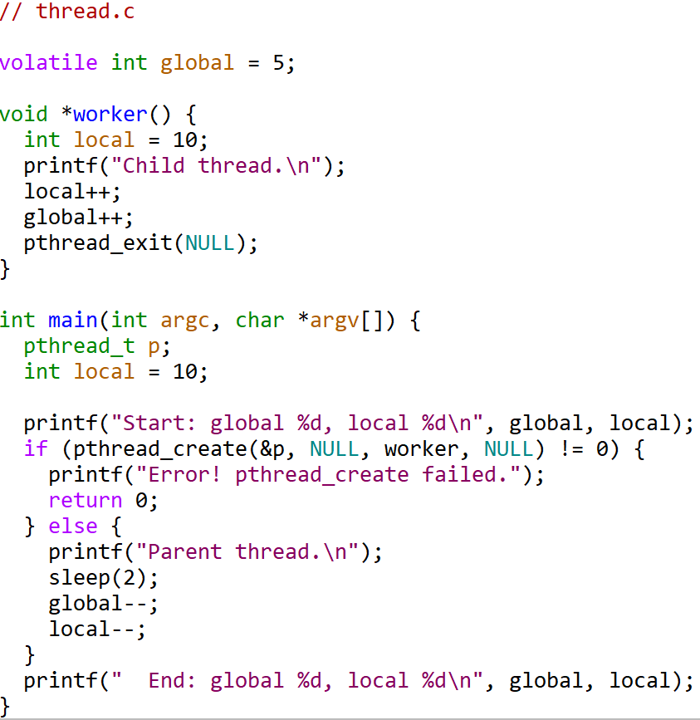
Example – Thread vs. Fork (2 of 2)
“thread.c”
What do you think the output will be?

Slide 19
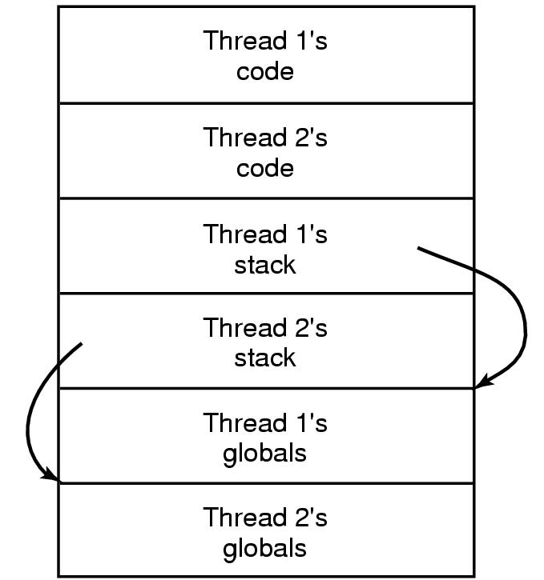
Making Single-Threaded Code Multithreaded
e.g., non-thread safe library
Many legacy systems single-threaded
If benefit, (see “performance?” above) can convert → But tricky!
Yes, local variables easy
But many library functions expect to be single-threaded
Not re-entrant code
Look for _r versions (e.g., strtok_r())
And global variables difficult
Can create private “globals”
Still other issues, signal handling, stack management, and so on
→ Proceed with caution!
Thread 1
Thread 2
sys_call() fail
sys_call() fail
check errno
check errno
Overwritten!

Slide 20
Outline
Model (done)
Motivation (done)
Libraries (done)

