Slide 1
Operating Systems
Introduction
ENCE 360

Slide 2
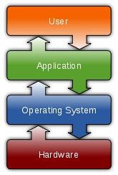
Outline
Background
Motivation
History
Hardware

Slide 3
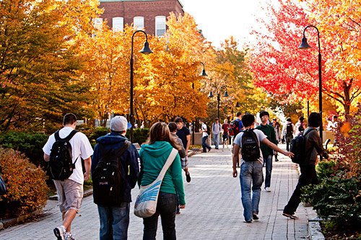
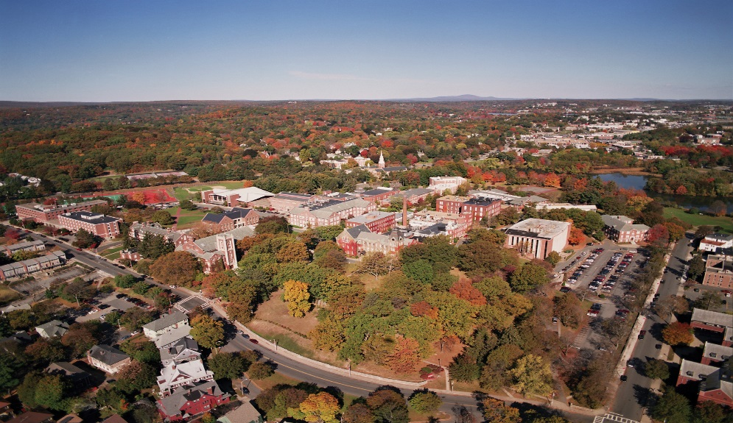
Worcester Polytechnic Institute
Private engineering university (founded 1865)
Near Boston, Massachusetts, USA
4000 Undergraduate students
1500 Graduate students
250 Faculty
4-year bachelor of science in Computer Science

Slide 4
Professor Background (Who am I?)
Mark Claypool (“professor”, “Mark”)
Professor (~20 years)
Computer Science, Interactive Media & Game Development
Teaching Research
Networking – Multimedia networking
Systems – Congestion control
Game development – Network games
Currently playing
Currently programming
Computer
Systems
- x
| o |
-

Slide 5
Student Background (Who are you?)
Year?
Major?
Computer Science
Software Engineering
Other
Background?
COSC 262 (Algorithms)
ENCE 260 (Systems)
Programming (1-5)?
C
Language of Choice?
C/C++
Java
Python
Other
Platform of Choice?
Windows
Linux
Mac

Slide 6
Outline
Background (done)
Motivation (next)
History
Hardware

Slide 7
Why are you here?

Slide 8
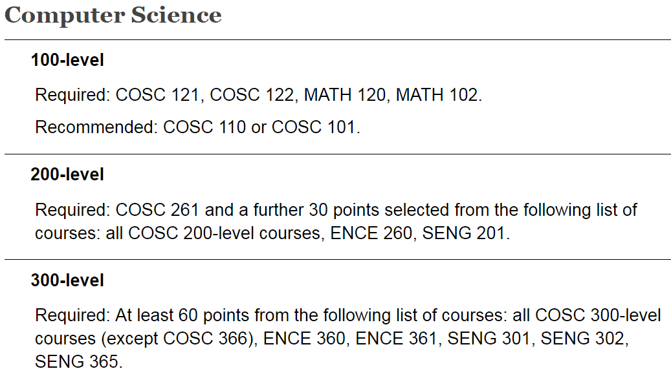
Extremely Practical Reasons
Degree!

Slide 9
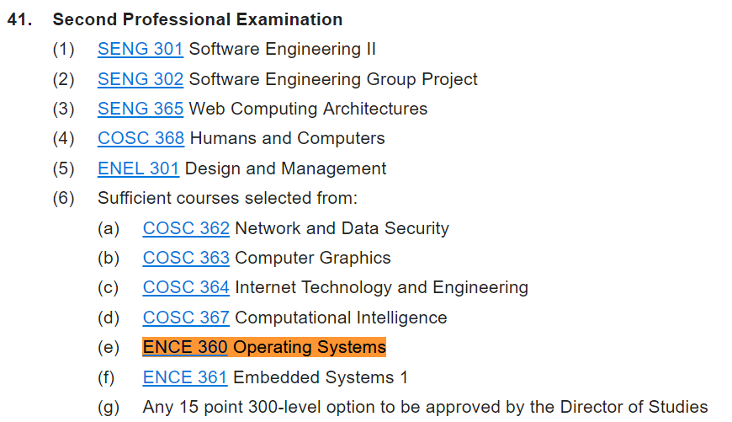
Extremely Practical Reasons
Software Engieering
Degree!

Slide 10
More Meaningful Reasons
Operating systems are everywhere, in all shapes and sizes
PC, Smartphone
Game console, Hand-held
TV, Thermostat
Car
While you may never write an OS (but you may!), you will develop software for an OS
Understanding operating systems will make you a better computer scientist/software engineer
“I want to make computers dance for me.”
Last, but not least ...
Combines previous classes – hardware, algorithms, coding
Provides deep knowledge, insights
“Operating systems are cool.”

Slide 11
Let’s Get Started!
Virtualization
Time (CPU)
Space (memory)
Concurrency
Persistence (I/O)
Chapter 1
MODERN OPERATING SYSTEMS (MOS)
By Andrew Tanenbaum
OPERATING SYSTEMS: THREE EASY PIECES By R. Arpaci-Dusseau and A. Arpaci-Dusseau
http://www.ostep.org/

Slide 12
Operating Systems are Foundational
“Nobody has time for all those crazy details.”
Abstraction
“Sharing all these devices… it’s like herding cats!”
Resource Manager
Convience & Efficiency
An OS is an extended machine
Hides messy details which must be performed
Presents user with virtual machine, easier to use
An OS is a resource manager
Each program gets time with resource
Each program gets space on resource

Slide 13
Outline
Background (done)
Motivation (done)
History (next)
Hardware

Slide 14
History of Operating Systems
First Generation:
(1945–55) Vacuum Tubes and Hard-wiring
Second Generation:
(1955–65) Transistors and Batch Systems
Third Generation:
(1965–1980) Integrated Circuits and Multiprogramming
Fourth Generation:
(1980–Present) Personal Computers
(Present–Future) Quantum Computing and AI

Slide 15
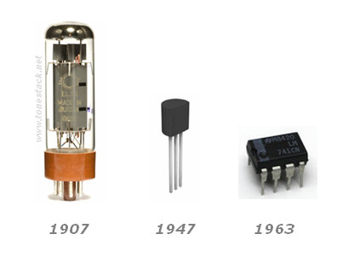
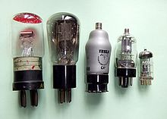
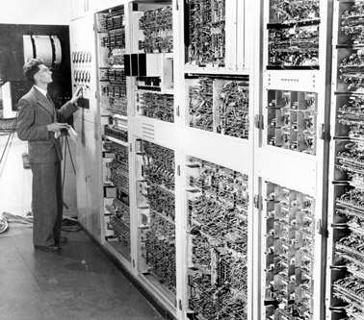
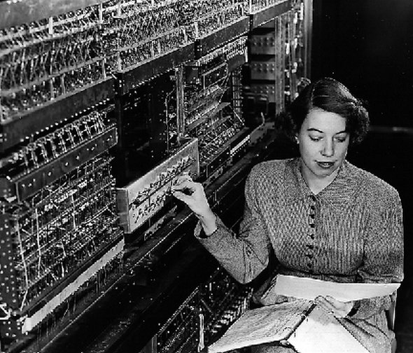
First Generation
Each computer custom built, “programmed” with wires
No operating system

Slide 16
Second Generation
Batch systems
Programming (e.g, Fortran)
“Operating system” only loaded, cleaned up jobs

Slide 17
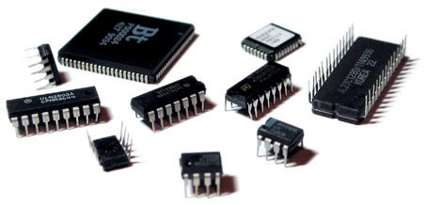
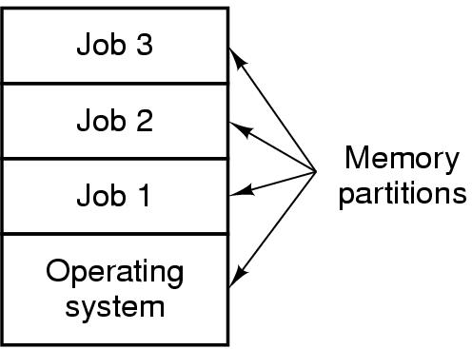
Third Generation
Multiprogramming
Two+ jobs in memory
“Time sharing” and “multi-tasking”
First real operating systems
MULTICS
Led to Unix

Slide 18
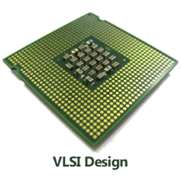
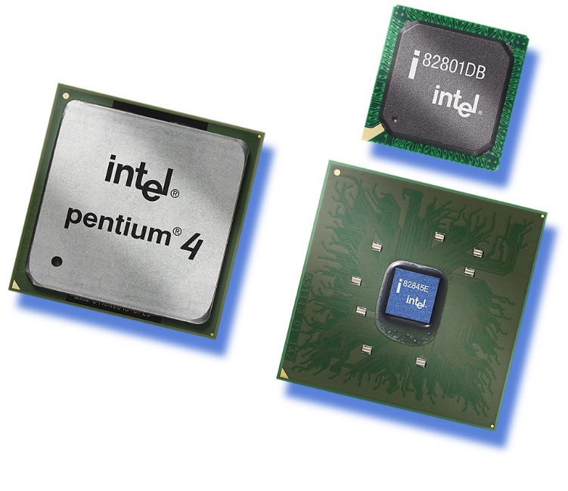
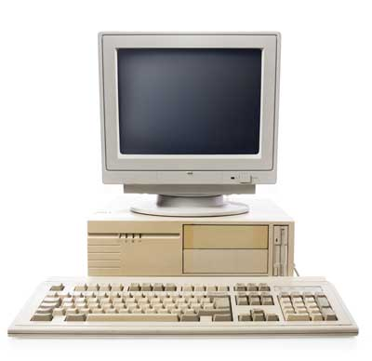
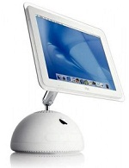
Fourth Generation
Personal computers
Modern operating systems
Windows (DOS), Mac OS, Linux
Fifth generation?
VLSI → “Ultra” LSI
Quantum computing and AI

Slide 19
Outline
Background (done)
Motivation (done)
History (done)
Hardware (next)

Slide 20
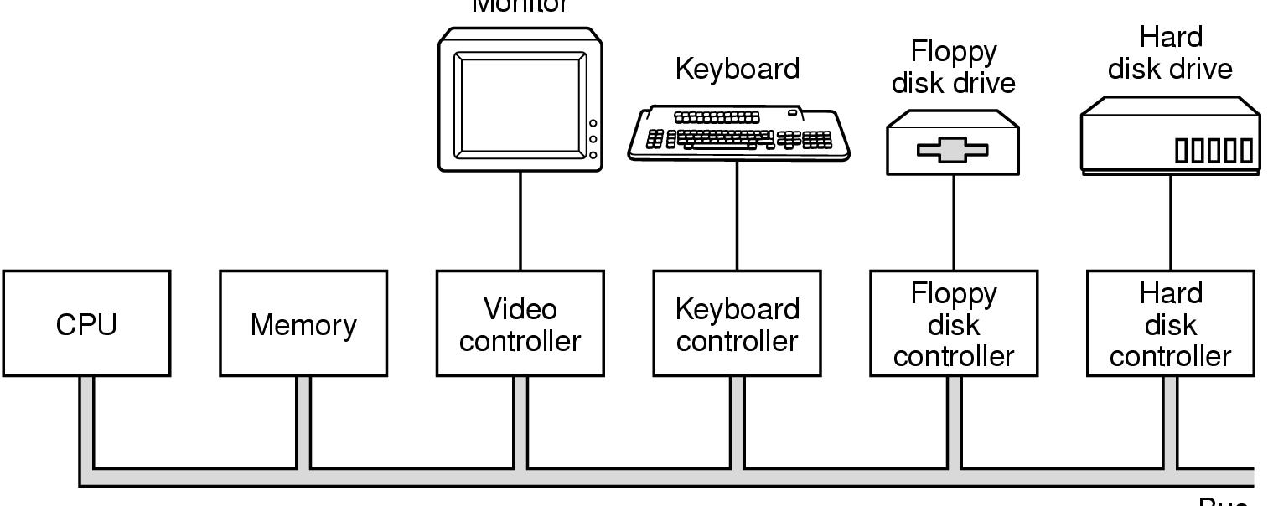
Hardware Review – Inside a PC
Monitor
Optical
Optical
disk
controller
Bus
Let’s look at one example – Hard Disks

Slide 21
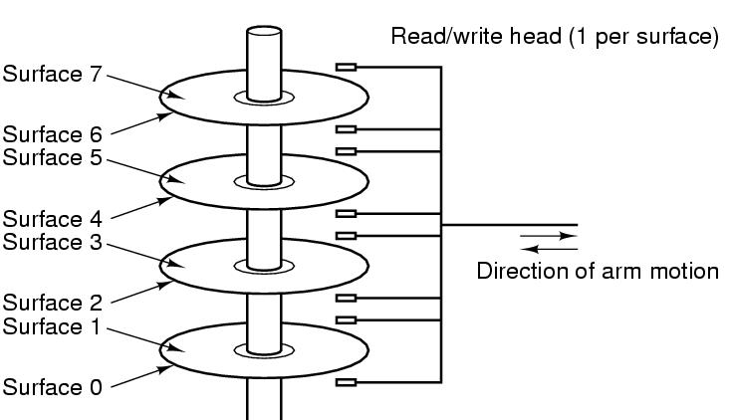
Hard Disks
“That sounds complicated!” But OS doesn’t deal directly with hardware

Slide 22
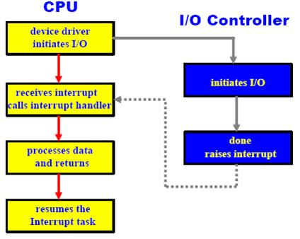
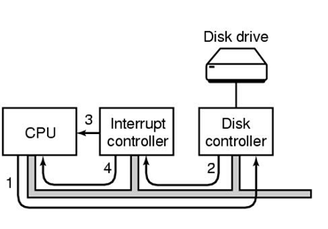
Communicating with Hard Disks (and other I/O devices)
OS communicates (via device driver) with disk controller
Controller “knows” hardware, processes asynchronously
OS informed via interrupt when controller done

Slide 23
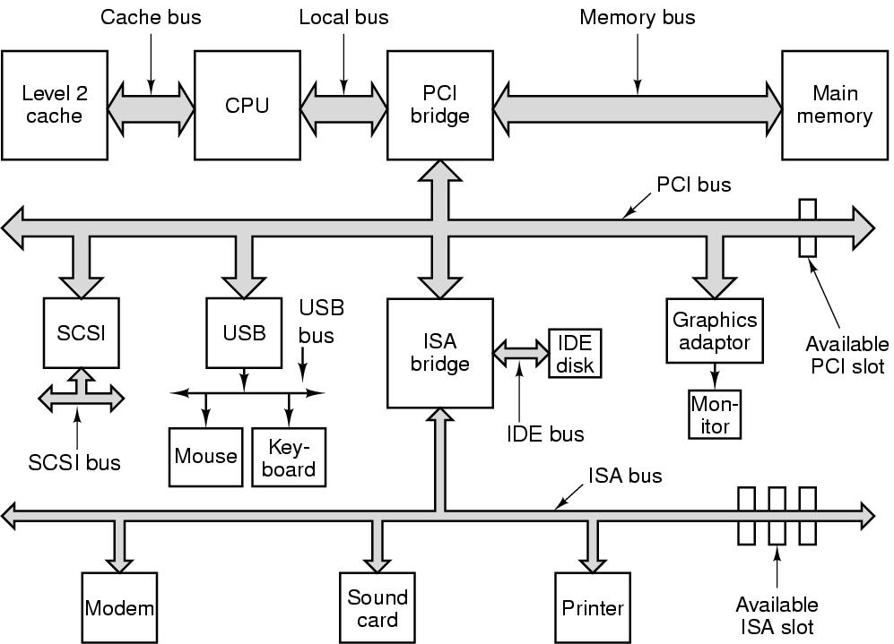
Buses
Impacts communication processing time (e.g, to storage).

Slide 24
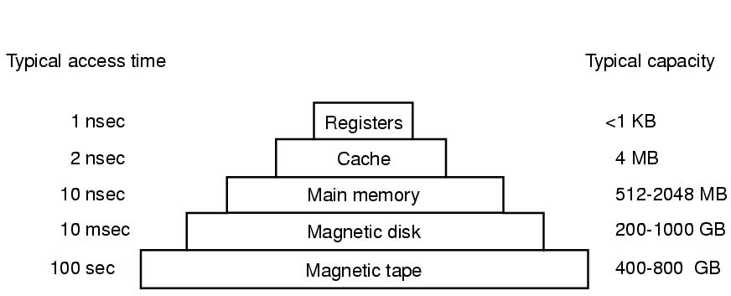
Storage Hierarchy
Note, capacities have changed from figure somewhat, as have technologies
Examples?

Slide 25
Storage Hierarchy (Revised)
100 msec
Cloud storage
TBs
10 microsec Solid state drives 100-1000 GB

Slide 26
Outline
Background (done)
Motivation (done)
History (done)
Hardware (done)

