Slide 1


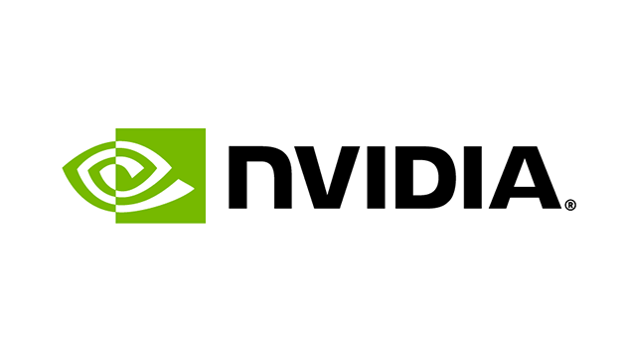
The Effects of Network Latency on the Peeker’s Advantage in
First-person Shooter Games
Samin Shahriar Tokey, Zesheng Chen, Colin Mettler, Dexuan Tang, Ben Boudaoud, Joohwan Kim, Josef Spjut, Mark Claypool
Notes:
ADD WPI LOGO, ADD NVIDIA LOGO, MAKE MY NAME BOLDER. Undergrad students.

Slide 2

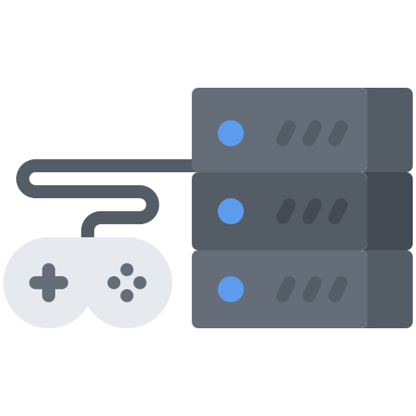



Effects of Network Latency On Games
Client 1
Server
Client 2
Client 1
Moves Avatar
Message:
Client 1 move
30 ms
Message:
Client 1 move
60 ms
Client 2
Sees Movement
Time
Notes:
Make It animate
Add number 60 ms ….
When client 2 gets further, it takes even longer to see what c1 is doing… change the slide

Slide 3
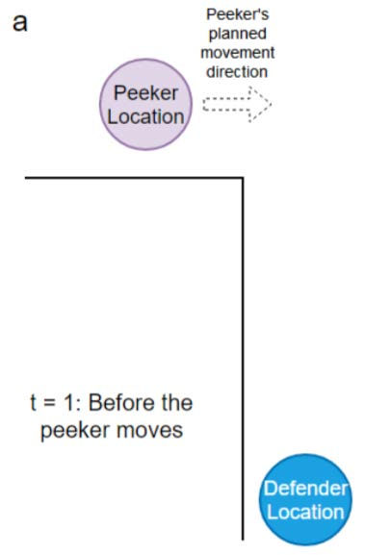
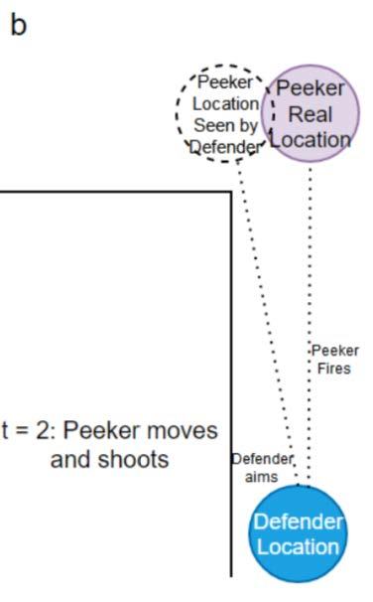
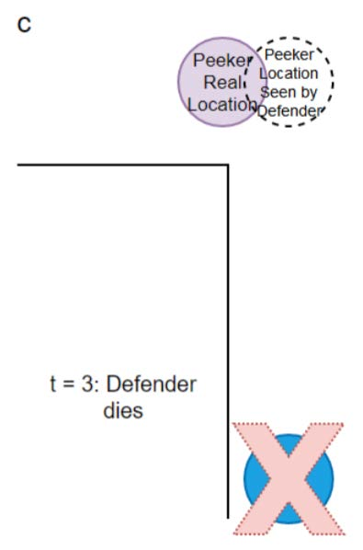
Peeker’s Advantage
lost
Notes:
NEED TO SAY INTRO … FPS
PEEKER MOVES AROUND THE CORNER, PEEKER SEES THE DEF AND SHOOTS,
HOW LATENCY EFFECTS PEEKERS ADVANTAGE.
WE WANT TO MEASURE IT, CONFIRM IT, QUANTIFY IT.
WHY - MAYBE WE CAN TRY TO FIX IT?
As the defs lat is even higher, it will take even longer to see the peeker.
Defender sees them here…. Draw highlight… circle it.
Don’t say peekrs ad is discussed is here

Slide 4
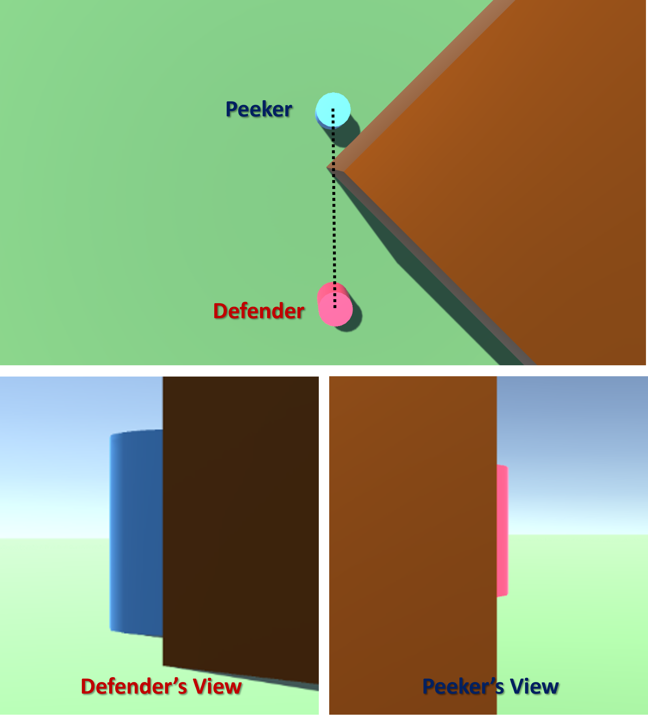
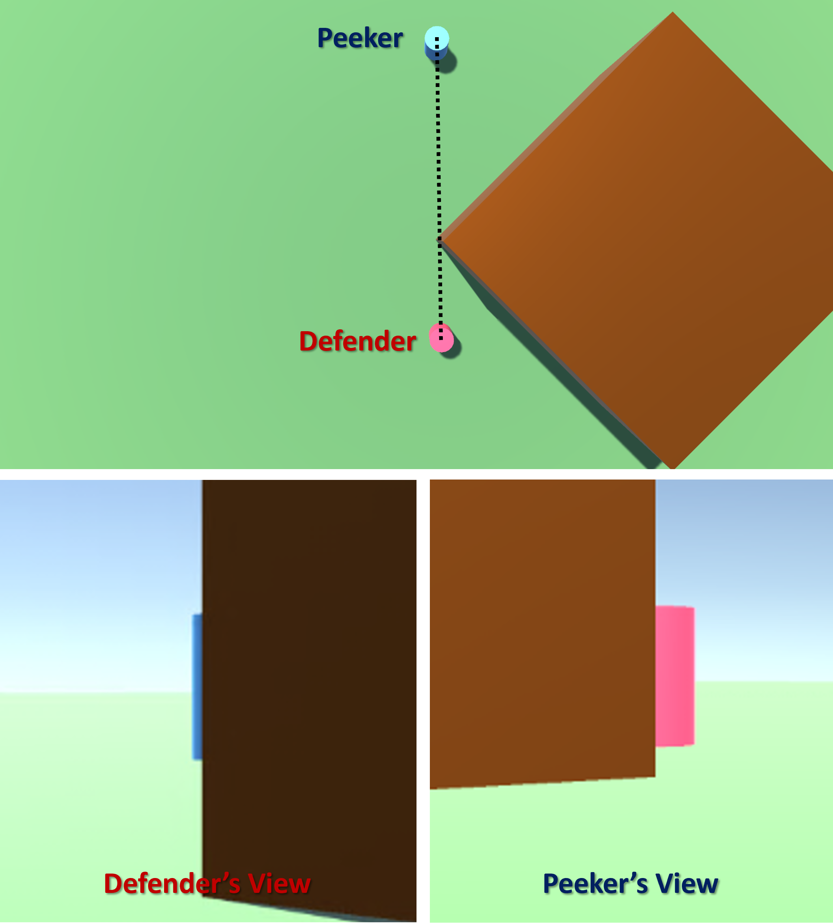
Advantage based on distance
Notes:
TRANSITION SMOOTHLY.
Highlight the defs view, and peekers view …

Slide 5
Goals
Related Works
  R1: Confirm that peeker’s advantage exists
  R2: Quantify peeker’s advantage
    Due to latency
    Due to peeker’s distance
  Enable ways of mitigating peeker’s advantage
  Pantel and Wolf [22]
  Sabet et al. [24]
  Liu et al. [13,14]
  Xu et al. [29]
  Long and Gutwin [19, 20]
  Claypool et al. [7]
None of the studies have evaluated the impact of latency on peeker’s advantage
Notes:
If I ask you to play game, vs if your goal is to win, the outcome may be different. Phenomena we study is a competitive thing, that’s why we did second study.
Build custom game
Short rounds
Control latency
Control dist
Recruit players
Analyze results
Looked at games, looked at lat com, looked

Slide 6
Outline
Introduction
Methodology
Results
Conclusion
Notes:
Make a related works slide – People have studied latency games, gamers have faced peekers advantage, but there isn’t any study to confirm this phenomena.
This is also common knowledge.

Slide 7
Methodology Overview
Took an existing FPS game
Added networking
Designed a peeker’s advantage scenario
Implemented experimental harness to
  Control latency
  Control peeker distance
Recruited players
Ran user study and gathered data
Analyzed results
Notes:
If I ask you to play game, vs if your goal is to win, the outcome may be different. Phenomena we study is a competitive thing, that’s why we did second study.
Build custom game
Short rounds
Control latency
Control dist
Recruit players
Analyze results

Slide 8
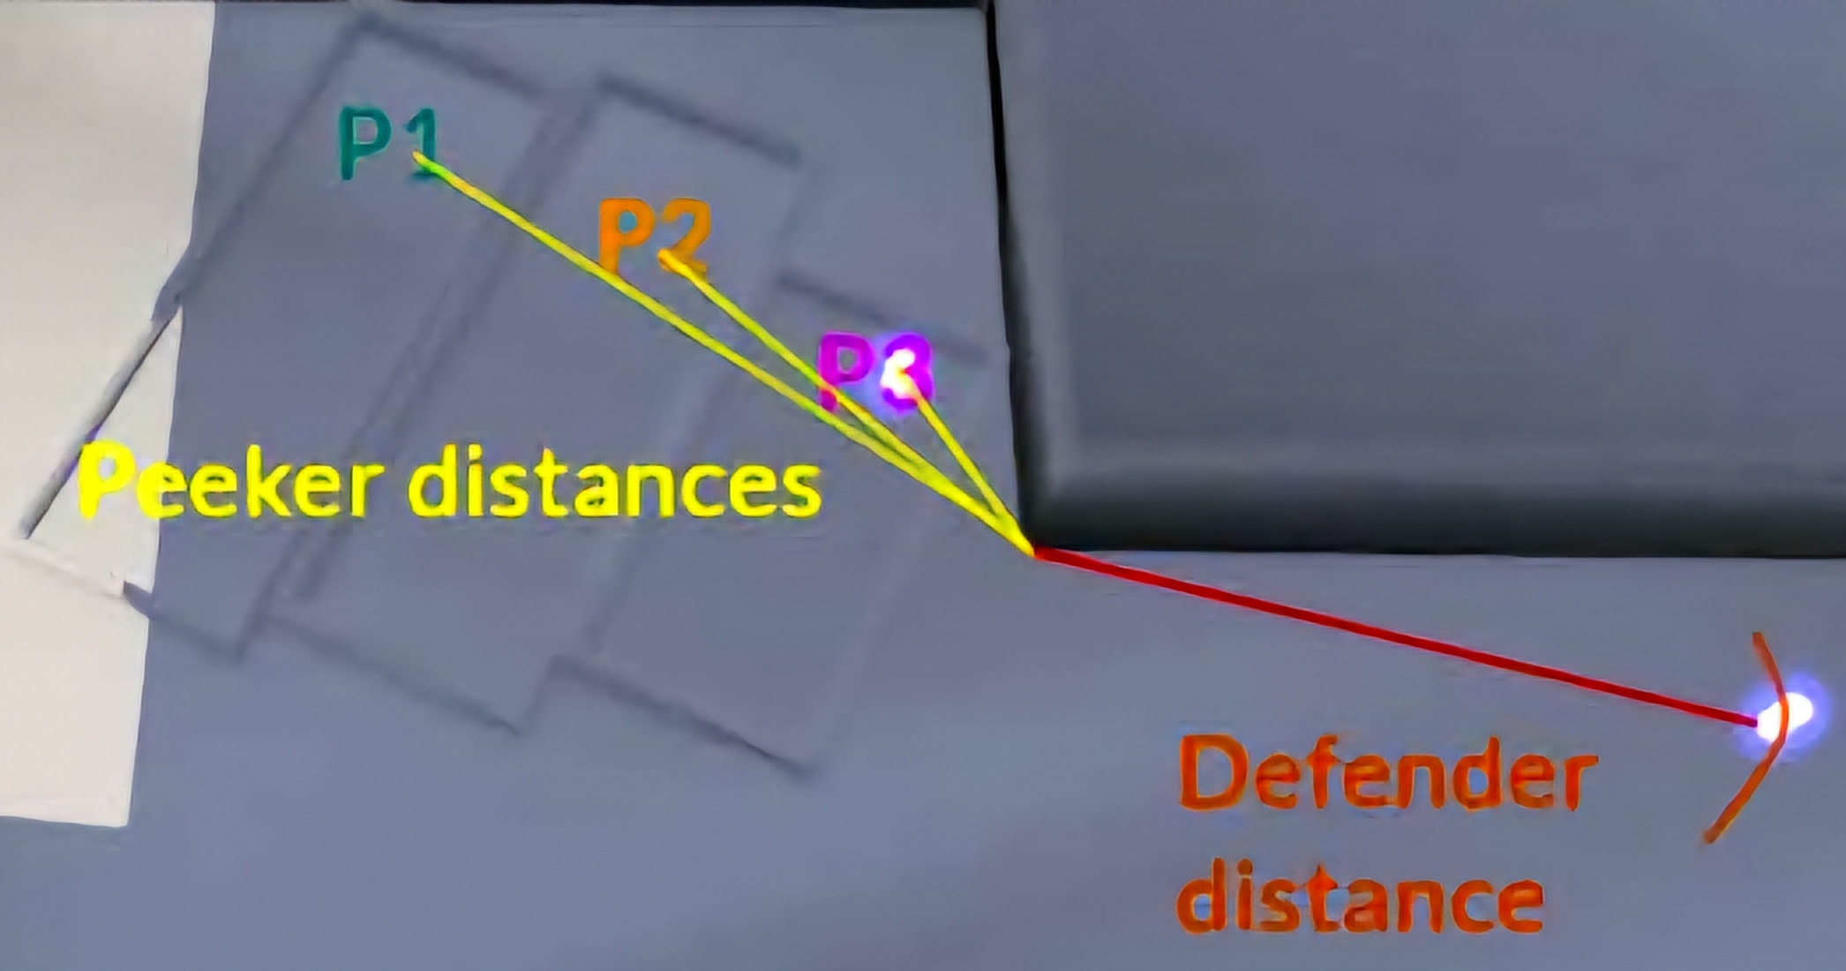
Peeker and Defender Game
  Peeker - Can move, bound by short walls, spawns hidden from defender
  Defender - Can not move, distance same from corner always, moves along arc on respawn
The Game
FPSci - Single Player
Client-server networking
Server does hit registration
Controlled network Latency
Notes:
Latency point should be shorter
SHOW THE MAP FIRST?
YOU COULD JUST SAY 1 HIT KILL, RESPAWN
SERVER REG HITS
WE CONTROL LATENCY

Slide 9
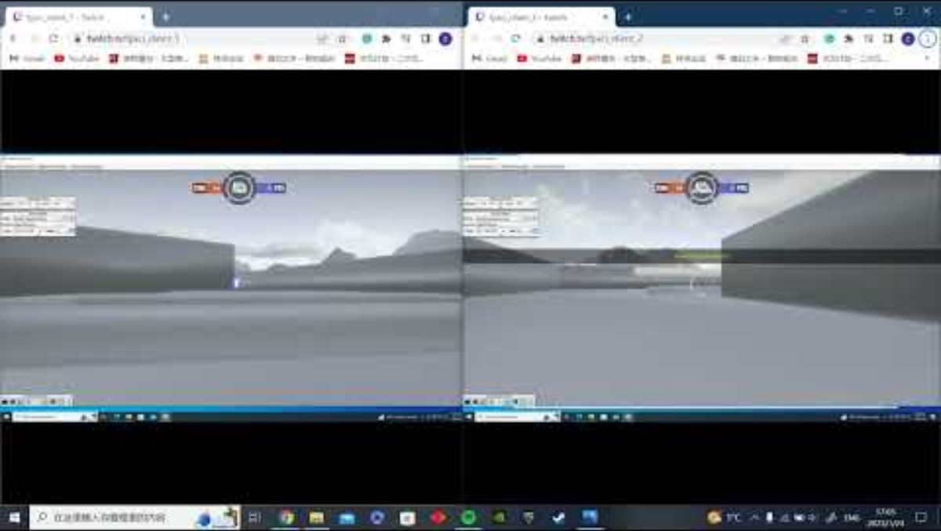
Gameplay Video
Notes:
WE CAPTURED BOTH DEF AND PPEK IN THE SAME SCREEN, B4 PLAYING. SNAPS BACK SHOTS. DON’T SAY QOE, WHITE SCREEN EOR.

Slide 10
Experiment Design
    Each round was 15 seconds
    54 main rounds
    18 practice rounds before the main study with 0 latency
    Independent Variables
Roles | Network Latency | Peeker’s Distance
Peeker | 0 ms | 7 m
Defender | 30 ms | 19 m
 | 60 ms | 27 m
Quality of Experience Question after each round
“Please rate the latency of the previous round”
“Options: 1(low) 2 3 4 5(high)”
Notes:
Fix bullets, make consistent.
Make the independent variable a table…
Say quality of experience…..
3 Peeker Latency
3 Defender Latency
3 Peekers Distance
2 Roles each client
3 * 3 * 3 * 2 = 54

Slide 11
Tournament
Round 1
Round 2
Semi-Finals
Finals
Winner
FPS are highly competitive
15 users were asked to participate in a tournament
Winner received an NVIDIA RTX 3090
Gabriel
Carson
Naomi
Carson
Gabriel
Shim
Jacob
Zach
Zach
Jacob
Jacob
Ryan
Gabriel
Jon
Jon
Alex
James
Alex
Troy
Jon
Jon
Jon
Mike M.
Nate
Conor
Mike M.
Mike S.
Nate
Nate
Notes:
Fps are competitive, and we wanted to do a competitive study as well. Reformat.

Slide 12
Introduction
Methodology
Results
Conclusion

Slide 13
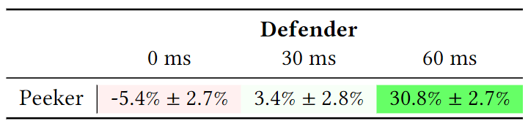
Results - Latency
Peeker gains advantage with defender latency
Notes:
60ms STT – 120 RTT … not as high but still..
Print… title, author, table, graph, full citation.

Slide 14
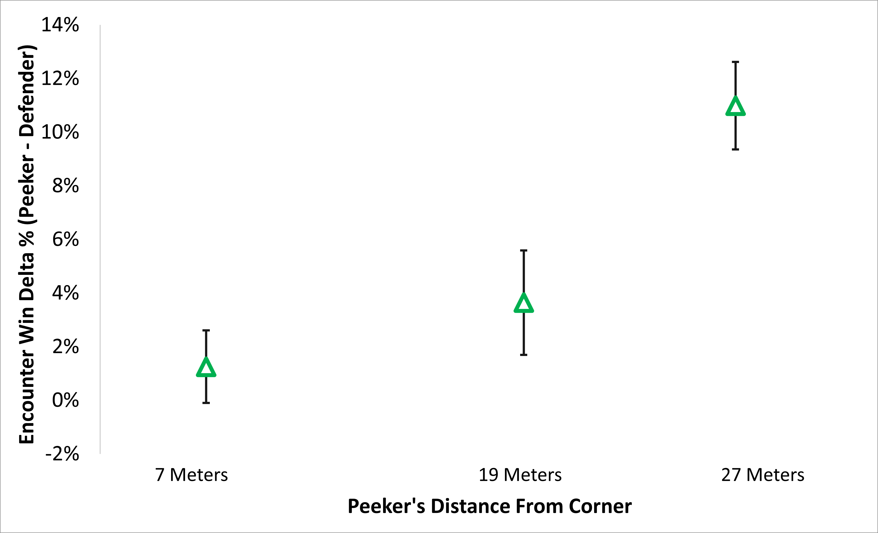
Results – Peeker’s Distance
Peeker gains advantage with higher distance from corner

Slide 15
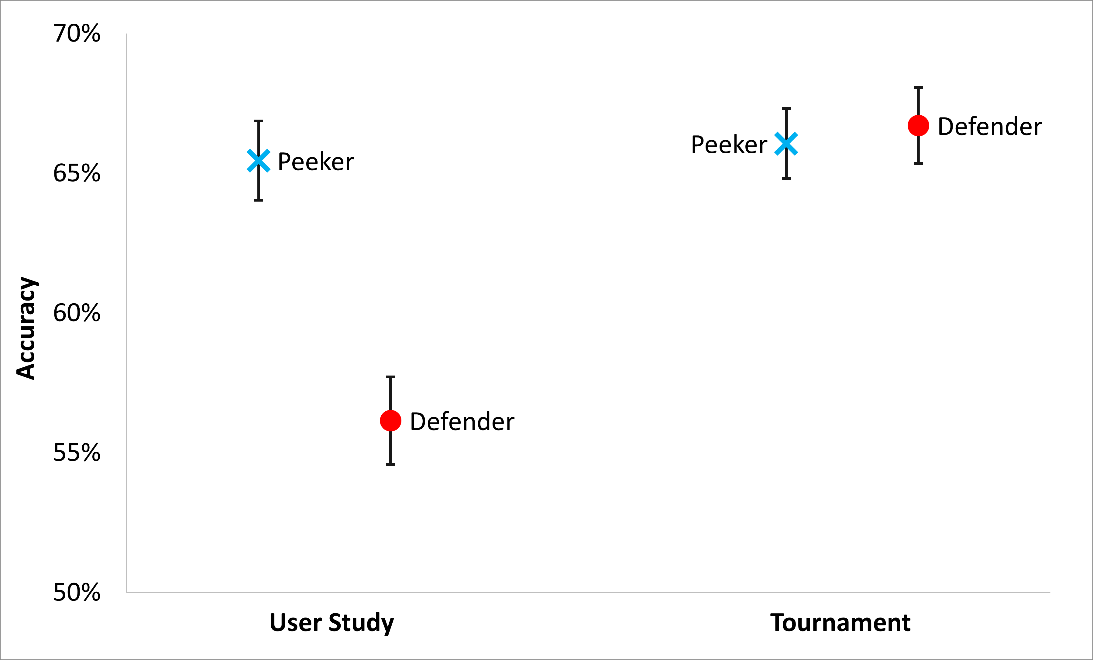
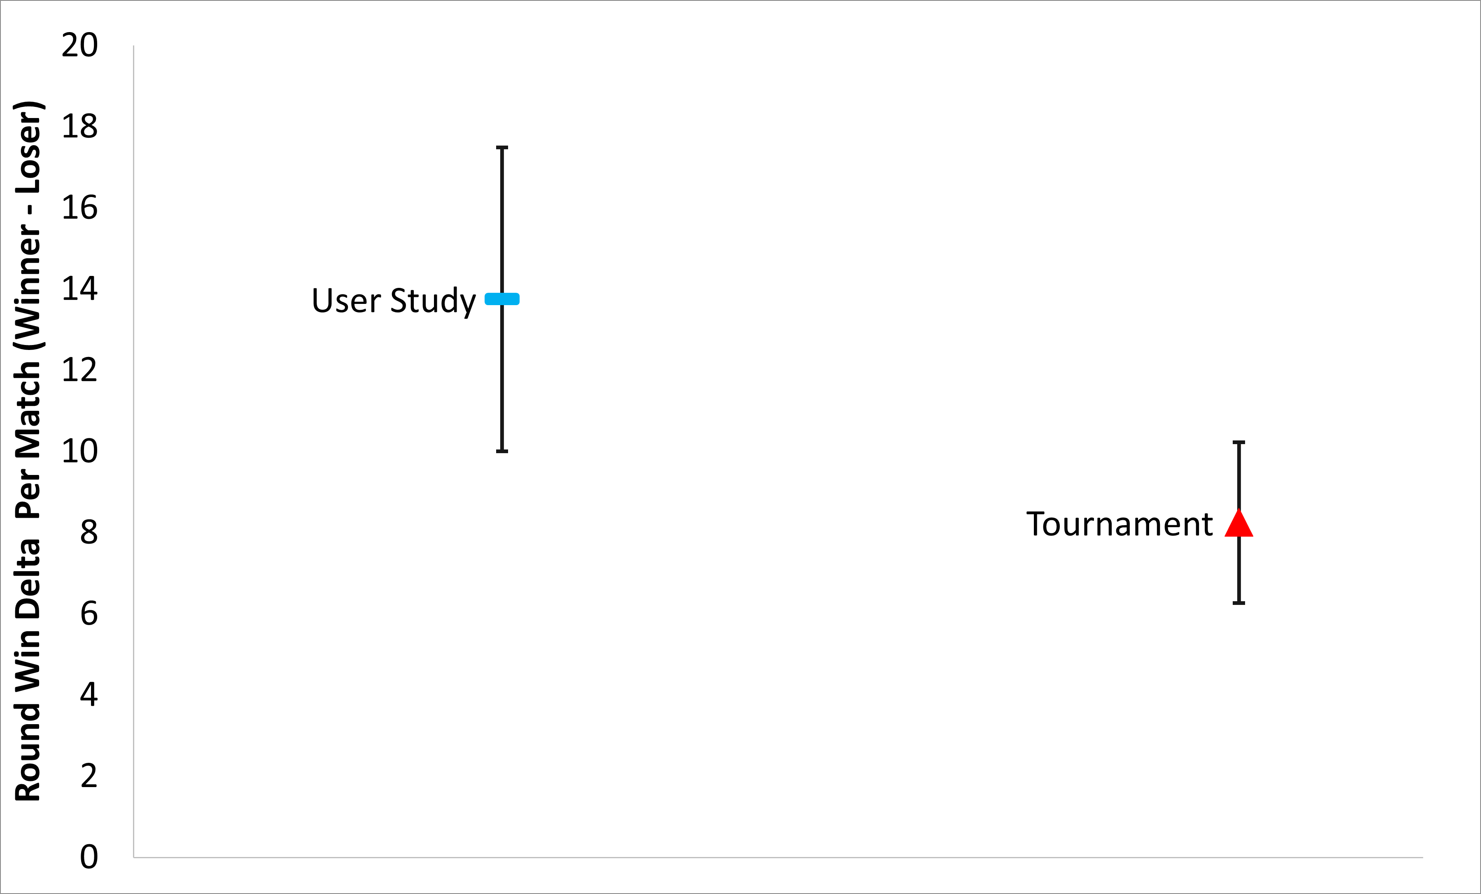
Results - Tournament
Peeker’s advantage decreases for competitive gameplay
Notes:
Make the fonts larger …. May prune, en / rnd ----- top two only ----

Slide 16
Conclusion
R1: Our study confirms peeker’s advantage when there is network latency
R2: Peeker’s advantage increases -
  About 25% with 100 ms defender latency
  About 10% with 20 m peeker distance
Peeker’s advantage decreases for competitive gameplay
Notes:
PUT NUMBERS
Add colors

Slide 17


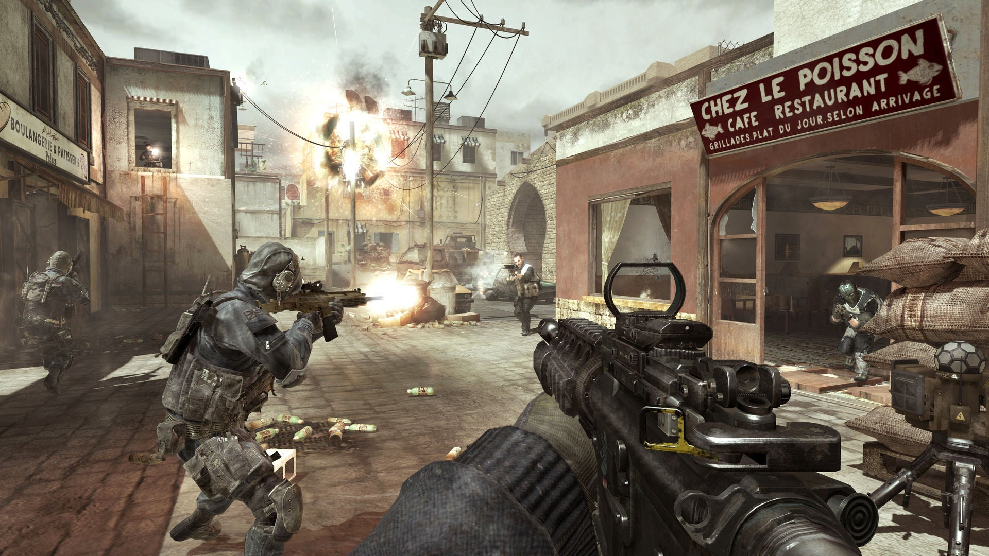
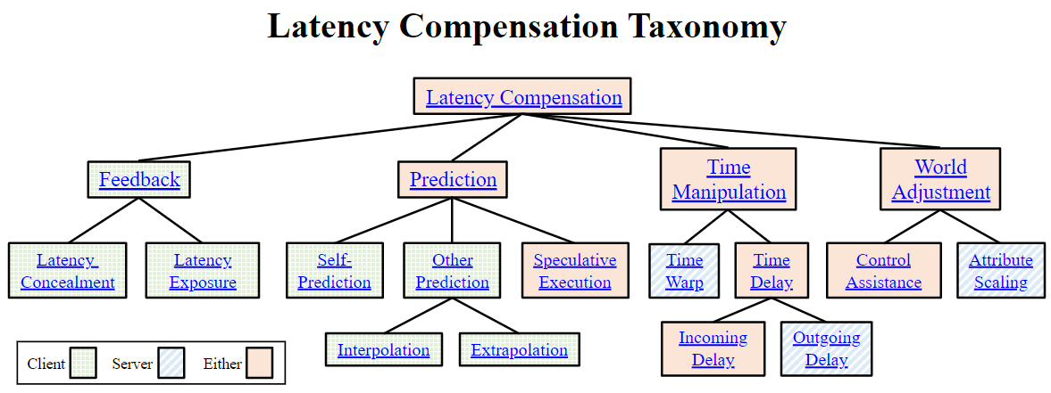

Future Work
Evaluate peeker’s advantage on a game with immersive graphics
Studying latency compensation techniques to mitigate peeker’s advantage
Adaptive time delay may help reduce peeker’s advantage
Time Delay enabled
Screenshot: Call of Duty
Time Delay disabled
Notes:
We could talk about fairness, latency compensation to make things fair,
Maybe a better game???
talk about next cool thing…. Put as bullets. 3 max. HAVE PICTURES!!
Put COD
Don’t say simple graphics… latency comp. adaptive time delay can improve fairness. Spend 15 secs
Pause lil bit more. … 2nd bullet, lot of known techniques that …
I gave a short paper. …. Talk about time, delay, we have a variation of that … adt, helps with unfairness. …

Slide 18
The Effects of Network Latency on the Peeker’s Advantage in
First-person Shooter Games
Thank You
Samin Shahriar Tokey, Zesheng Chen, Colin Mettler, Dexuan Tang, Ben Boudaoud, Joohwan Kim, Josef Spjut, Mark Claypool
Notes:
ADD WPI LOGO, ADD NVIDIA LOGO, MAKE MY NAME BOLDER.

Slide 19
Timeline Depicting Peekers Advantage
Peeker shoots
and hits
Peeker respawns to end
current encounter
Peeker moves in view
Peeker
Peeker’s time to aim & shoot
Server applies
movement
Server registers
Peeker’s hit
as valid
Server
Server registers Defender’s hit as invalid
Server propagates Peeker’s
movement to Defender
Defender’s
available time
to aim & shoot
Defender
shoots
& hits
Defender
Defender sees
movement
Defender’s last chance
to shoot
Defender respawns after
getting shot
Any shot fired after last chance is invalid
Notes:
May not need to do this one.

Slide 20
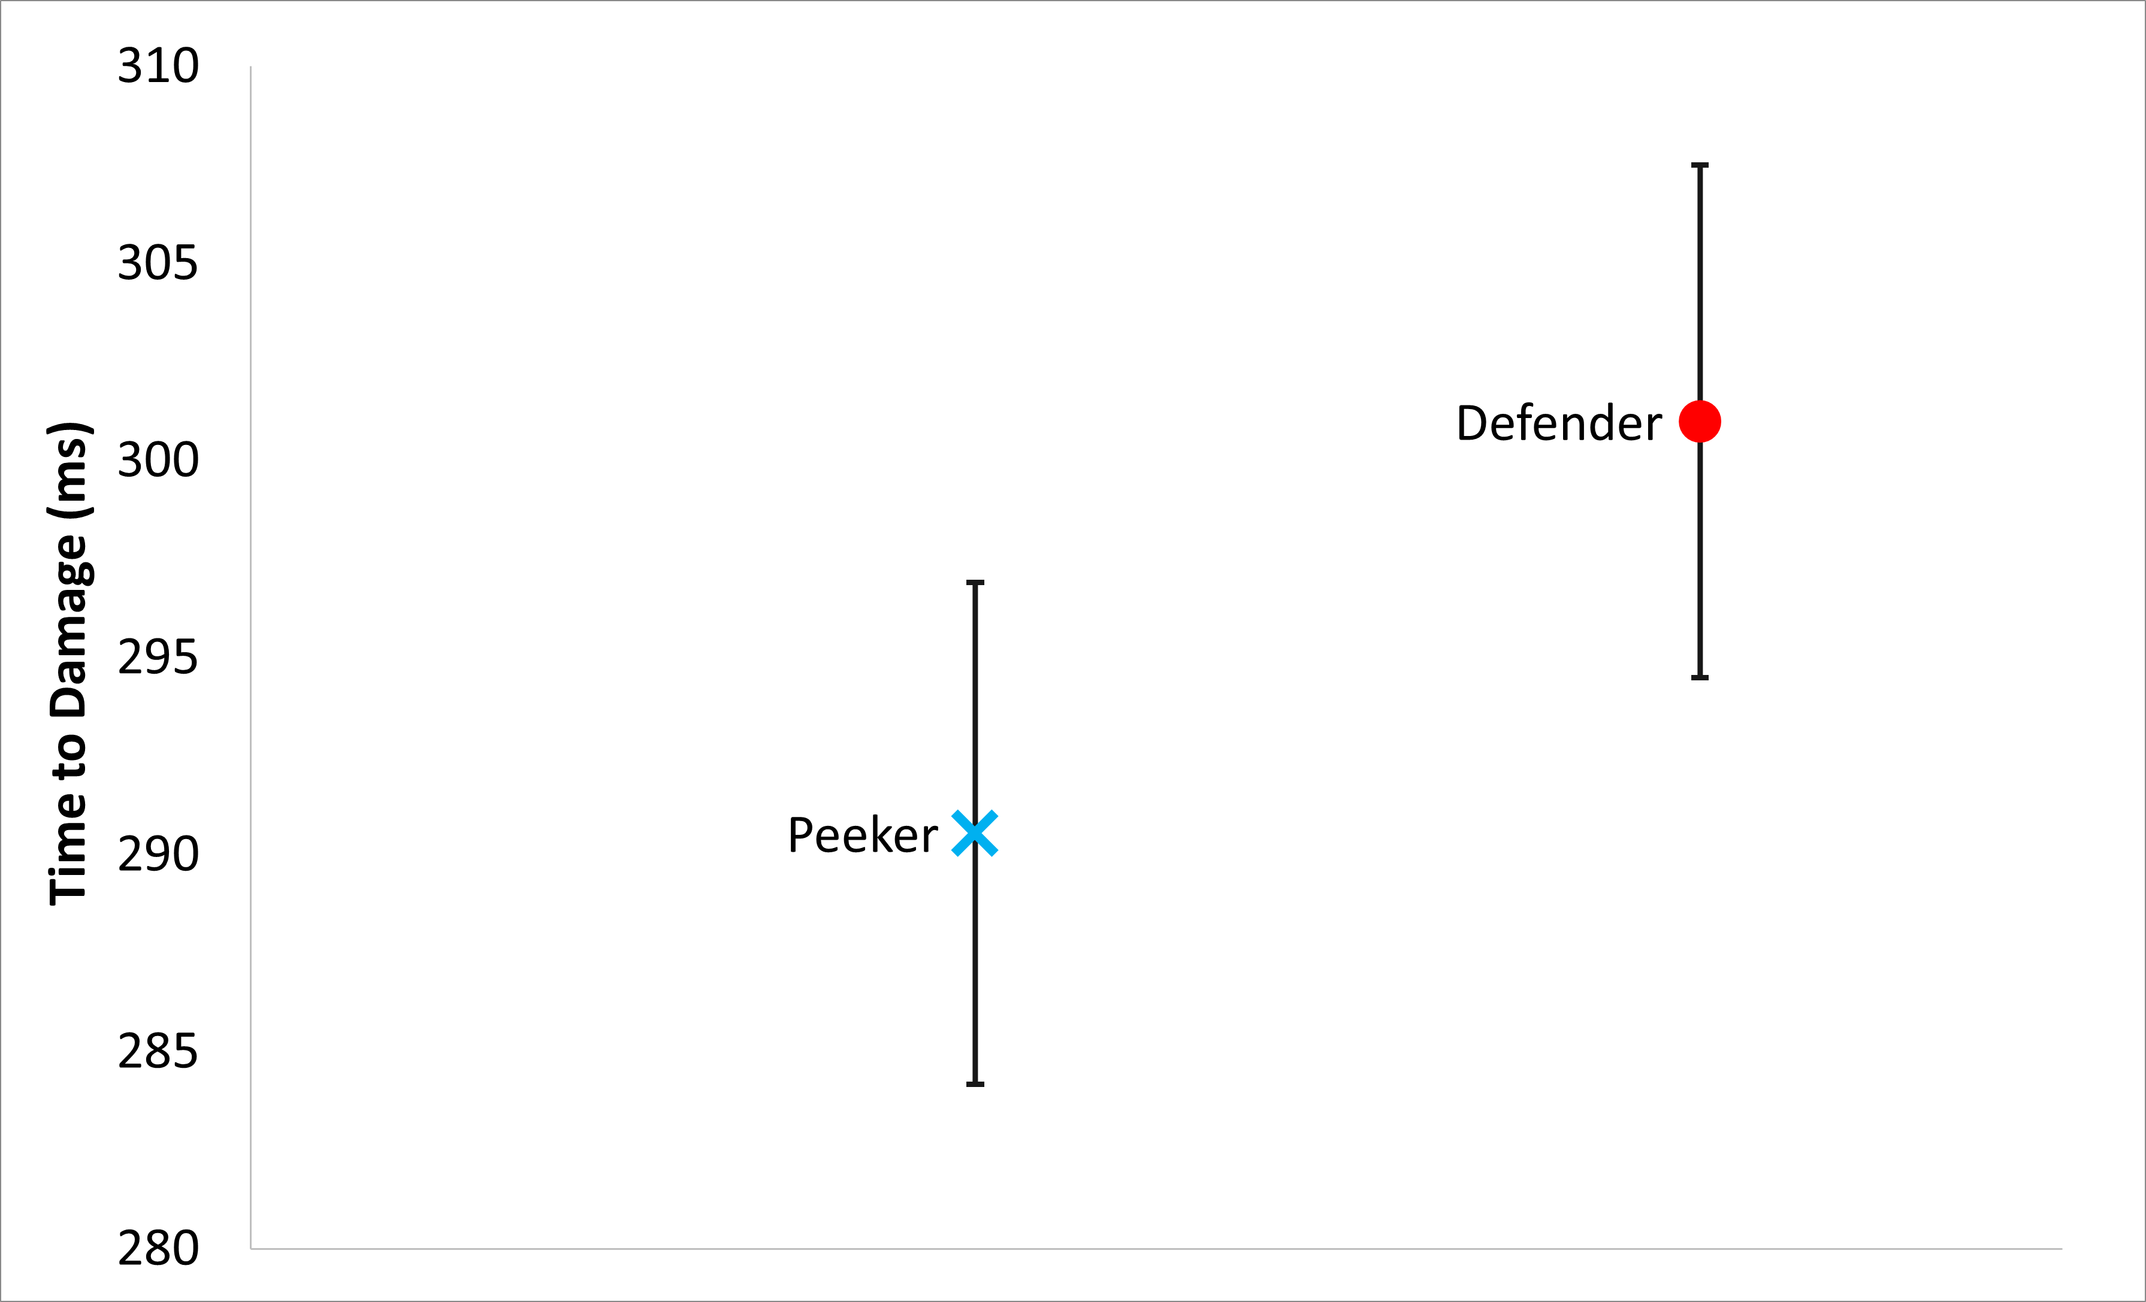
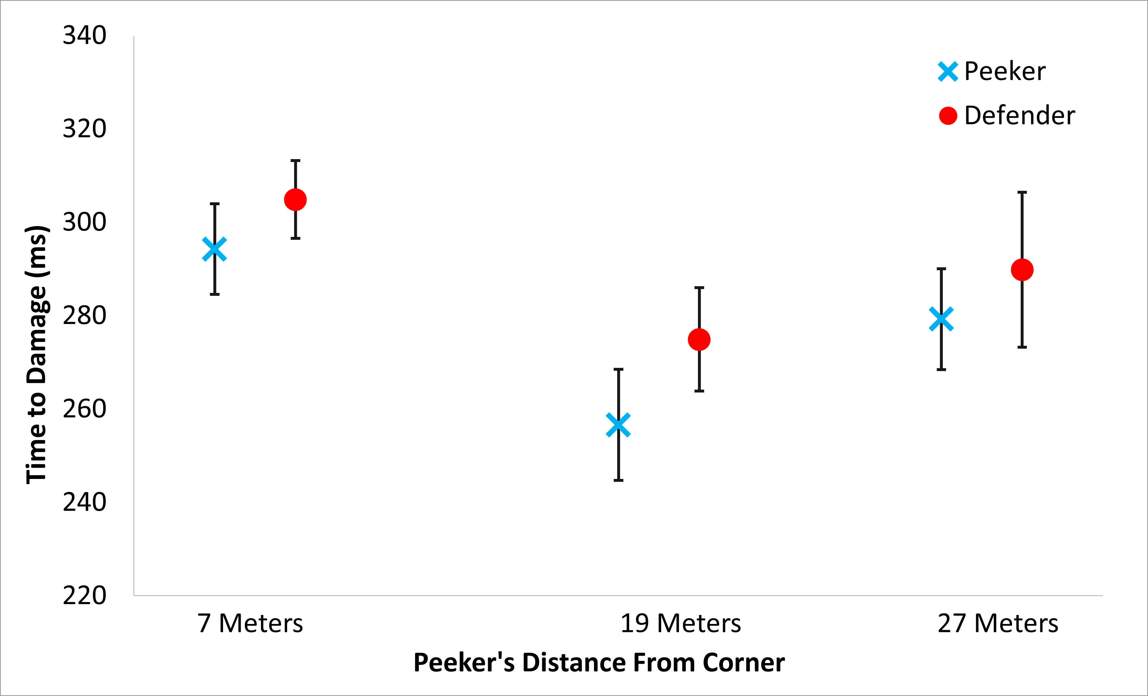
Time to Damage
Peekers has overall lower time to damage
Notes:
Could be pruned…

Slide 21
Related Works - Navigation
Pantel and Wolf [22]
Measured time to steer a car around a race track with input delay.
Found 50 ms latency acceptable; 250 ms latency doubled lap time.
Sabet et al. [24]
Investigated QoE for navigating a car in Need for Speed Shift 2 with latency.
Found latency degrades player performance, lowering quality of experience.
Liu et al. [13]
Studied first-person navigation under network and local latency.
Found latency decreases player scores, more so for seekers than hiders.
Xu et al. [29]
Analyzed player movement per minute in a competitive FPS game.
Found increased latency decreases avatar movement, depending on the weapon used.
Notes:
CORRESPOND TO PAPER

Slide 22
Related Works - Selection
  Long and Gutwin [19, 20]
  Studied effects of latency on selecting moving targets.
  Found latency affects fast targets at 50 ms; slow targets resilient up to 150 ms.
  Found latency effects on selection impacted by target speed.
  Claypool et al. [7]
  Investigated selecting moving targets with a mouse under latency.
  Found selection times impacted exponentially by latency and target speed.
  Liu et al. [14]
  Evaluated latency impact on 3D target selection in a custom FPS game.
  Found latency degrades performance; combined latency compensation techniques can mitigate but not fully overcome effects.
None of the studies have evaluated the impact of latency on peeker’s advantage
Notes:
If I ask you to play game, vs if your goal is to win, the outcome may be different. Phenomena we study is a competitive thing, that’s why we did second study.
Build custom game
Short rounds
Control latency
Control dist
Recruit players
Analyze results

Slide 23
References
[22] Lothar Pantel and Lars C. Wolf. 2002. On the Impact of Delay on Real-Time Multiplayer Games. In Proceedings of the Workshop on Network and Operating Systems Support for Digital Audio and Video (NOSSDAV). Miami, FL, USA.
[24] Shafiee Sabet Saeed, Steven Schmidt, Saman Zadtootaghaj, Carsten Griwodz, and Sebastian Moller. 2018. Towards Applying Game Adaptation to Decrease the Impact of Delay on Quality of Experience. In Proceedings of IEEE International Symposium on Multimedia (ISM). 114 – 121.
[13] Shengmei Liu and Mark Claypool. 2022. The Impact of Latency on Navigation in a First-Person Perspective Game. In Proceedings of the ACM CHI Conference on Human Factors in Computing Systems (New Orleans, LA, USA) (CHI ’22). Association for Computing Machinery, New York, NY, USA, Article 154, 11 pages.
[29] Xiaokun Xu, Shengmei Liu, and Mark Claypool. 2022. The Effects of Network Latency on Counter-strike: Global Offensive Players. In 14th International Con- ference on Quality of Multimedia Experience (QoMEX). 1–6.
[19] Michael Long and Carl Gutwin. 2018. Characterizing and Modeling the Effects of Local Latency on Game Performance and Experience. In Proceedings of the Annual Symposium on Computer-Human Interaction in Play (CHI Play). Association for Computing Machinery, New York, NY, USA, 285–297.
[20] Michael Long and Carl Gutwin. 2019. Effects of Local Latency on Game Pointing Devices and Game Pointing Tasks. In Proceedings of the ACM CHI Conference on Human Factors in Computing Systems. Association for Computing Machinery, Glasgow Scotland, UK, 1–12
[7] Mark Claypool, Ragnhild Eg, and Kjetil Raaen. 2017. Modeling User Performance for Moving Target Selection with a Delayed Mouse. In Proceedings of the 23rd International Conference on MultiMedia Modeling (MMM). Reykjavik, Iceland.
[14] Shengmei Liu and Mark Claypool. 2023. The Impact of Latency on Target Selection in First-Person Shooter Games. In Proceedings of the ACM Multimedia Systems Conference (MMSys). Vancouver, Canada.
Notes:
If I ask you to play game, vs if your goal is to win, the outcome may be different. Phenomena we study is a competitive thing, that’s why we did second study.
Build custom game
Short rounds
Control latency
Control dist
Recruit players
Analyze results

Slide 24
Log System
Number of hits across all games for both players
Wins/Losses
  Rounds won by a player
  Round win rates
Time to Damage (TTD)
Mean reflex time
Quality of Experience (QoE) answers

Slide 25
Time to Damage
Peekers has overall lower time to damage

Slide 26
The Game
  FPSci – was used as a base
    Base FPSci is single player
    1 hit to kill
    Both players respawned on kill
FPSci was modified to support client-server architecture
    Enet was used to prepare the client-server architecture
    Client-side prediction was built into the game
    Hit confirmations were resolved by the server
    Packet based structure was used to maintain client-server communication
    Desired latency was added by putting the packets onto a heap and holding onto them
Notes:
May not need [red]
We took an existing game, modified it to support peekers advantage, added networking, designed a map. MERGE IT WITH NEXT SLIDE

