Slide 1
Soulcalibur 534
Or: How to Make a Better Training Dummy
Mike Sandman
CS 534

Slide 2
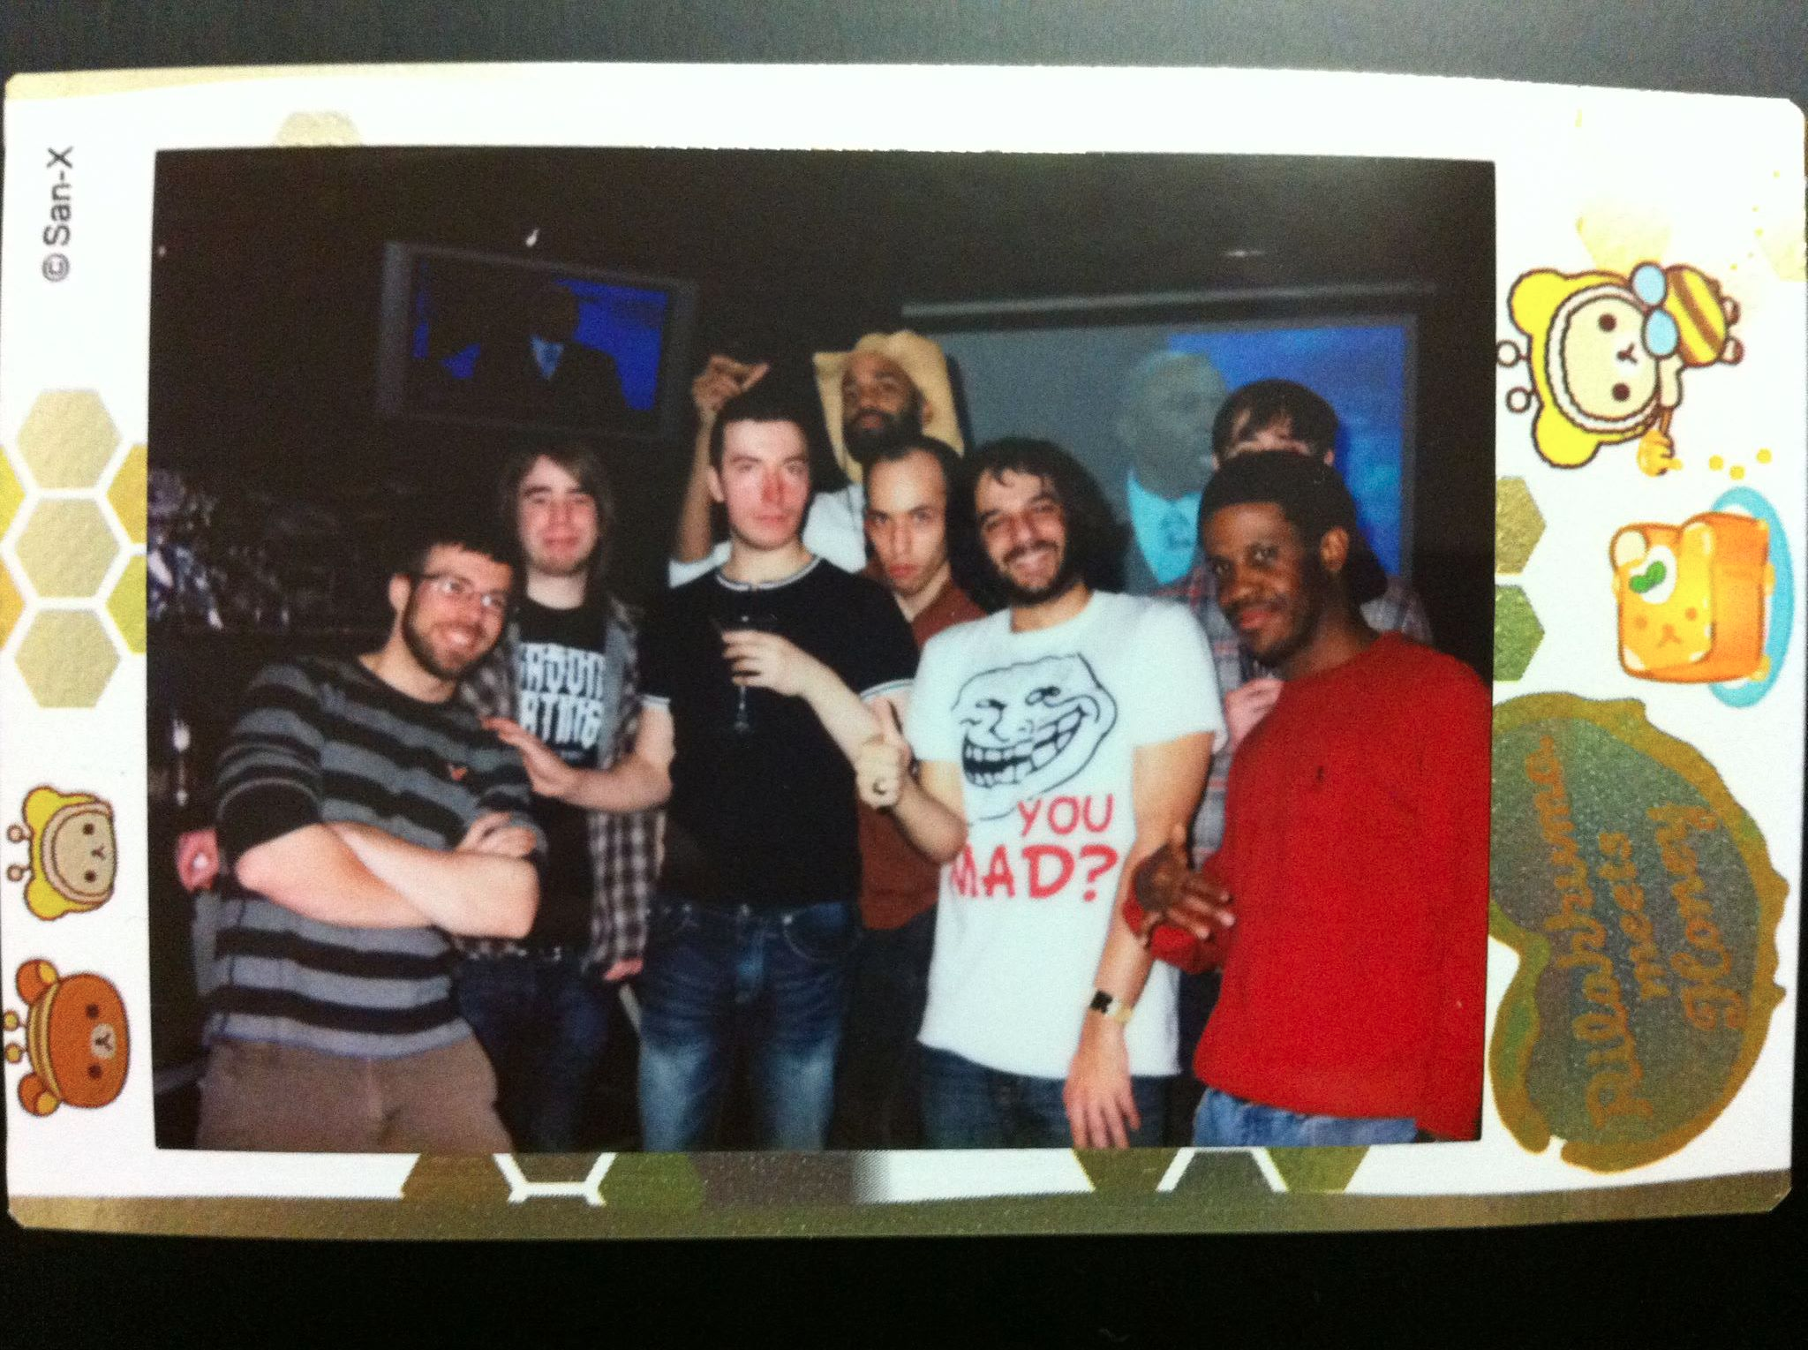
Astral Summary
Calibur 101
AI in Soulcalibur
Advanced Concepts
AI Improvements
Conclusion

Slide 3
Calibur 101
Time – measured in frames
60 FPS
Anything shorter is said to be concurrent
240 health per side, you get to 0, you die
Attacks - vertical/horizontal, low/mid/high
Safety – advantage/disadvantage
Measured in frames (like everything else)
Grabs – 50/50
Stuns, wallsplats, knockdowns
Just Guard

Slide 4
AI in Soulcalibur
Most of the time we want an AI that can win the game/beat the best humans/etc.
Deep Blue
Watson
Go
Soulcalibur – this is extremely easy
You can program it yourself in training mode!
Problem – design an AI that can beat the best humans by acting as a human would

Slide 5
AI in Soulcalibur - Good
How does AI work?
Pretends to react to moves
Reacts based on input
In contrast: humans react to visual feedback
Move choice appears mostly random (better moves having higher probability)
Reacts to player position/state
I.e. horizontals if you’re stepping, mids if you’re ducking for too long
Makes decisions based on advantage/disadvantage
Attacks at advantage, guards/steps/fast moves at DA
Will press forward if opponent downed
Performs combos based on pre-programmed strings
Knows how to hit-confirm

Slide 6
AI in Soulcalibur - Bad
Always a probability of using a move – even bad moves
Always a probability of eating a move – even bad moves (option selects)
Teaches the player that bad moves can work
Leads to bad habits
Throw breaks on probability
>50% chance is unrealistic
Assuming randomness
Just Guards too randomly
Good players JG specific strings and ignore others

Slide 7
Advanced Tactics
“Mind games”
Throws are 50/50…
What if your opponent only does A grabs?
What if your opponent does A,B,A,B,A,B?
What if your back is to the ring edge?
Combo vs tech trap
Guaranteed 15 damage, or
Chance for 60 damage IF opponent stands up?
AI does both, but again, randomly

Slide 8
Improvements - Learning
Learning
Make note of particular player habits based on user ID (or even within a single playthrough)
Assign greater probability to “anti” measures
Can be easily beaten by switching tactics…
…but is this so bad?
Learn combos the way people do – trial and error
Do a move that looks like it’ll combo based on its speed and your advantage
If it works, increase probability and try again
If it doesn’t work (player techs or guards), make note, and greatly decrease probability

Slide 9
Improvements - Position
Know when you’re near a wall or ring edge
Maintain database of ringout throws
Character specific but consistent (<1KB)
Break ringout throws ~100% of the time
EAT opposite throw ~100%
Good players will just take the damage when faced with the option
In practice, you still go for the ringout in desperation
If <20% health, it’s 50/50 again…

Slide 10
Improvements - Advantage
Reacts poorly to advantage on block
Some moves give advantage even if guarded (agA), AI ignores this
Reacts “better” to eating guard crushes (big stun, big advantage when blocked), but not always
Punishes very poorly
Punish – you have enough frame advantage to guarantee a move hits
AI is VERY bad at this
Guard Impacts well at disadvantage
Again, punishes badly

Slide 11
Improvements – State
Good at recognizing stepping opponents, ducking opponents, stunned
Bad at auto-parries
Moves that deflect certain types of attacks
AI should be able to detect this state
Guard break is virtually unrecognized
Should be detectable as 60 frames of advantage
Correct combo to use here is almost always the same

Slide 12
Conclusion
AI attempts to emulate some human tactics
Must depend on input reading
Would be much better if it could recognize patterns/learn
Reacts some states well but completely ignores others

Slide 13
Resources
www.soulcalibur.com - Official Namco-Bandai sponsored website
www.8wayrun.com - Our community run forum (the premier resource anywhere for Calibur)

Slide 14
Questions?

