Slide 1
Simultaneous Localization and Mapping
(SLAM)

Slide 2
Localization
Perfect Map
+
Observations with errors
=
Pretty good Localization
(Average out errors in observations, look for a place on the map that matches our observations)

Slide 3
Mapping
Perfect Localization
+
Observations with errors
=
Pretty good map
(Average out errors, add new observations to the map)

Slide 4
Perfect Map
Perfect Localization
Unfortunately, we don’t usually have either of these.
Often, we want to build the map as we go
GPS isn’t perfect, wheel rotation sensors aren’t either

Slide 5
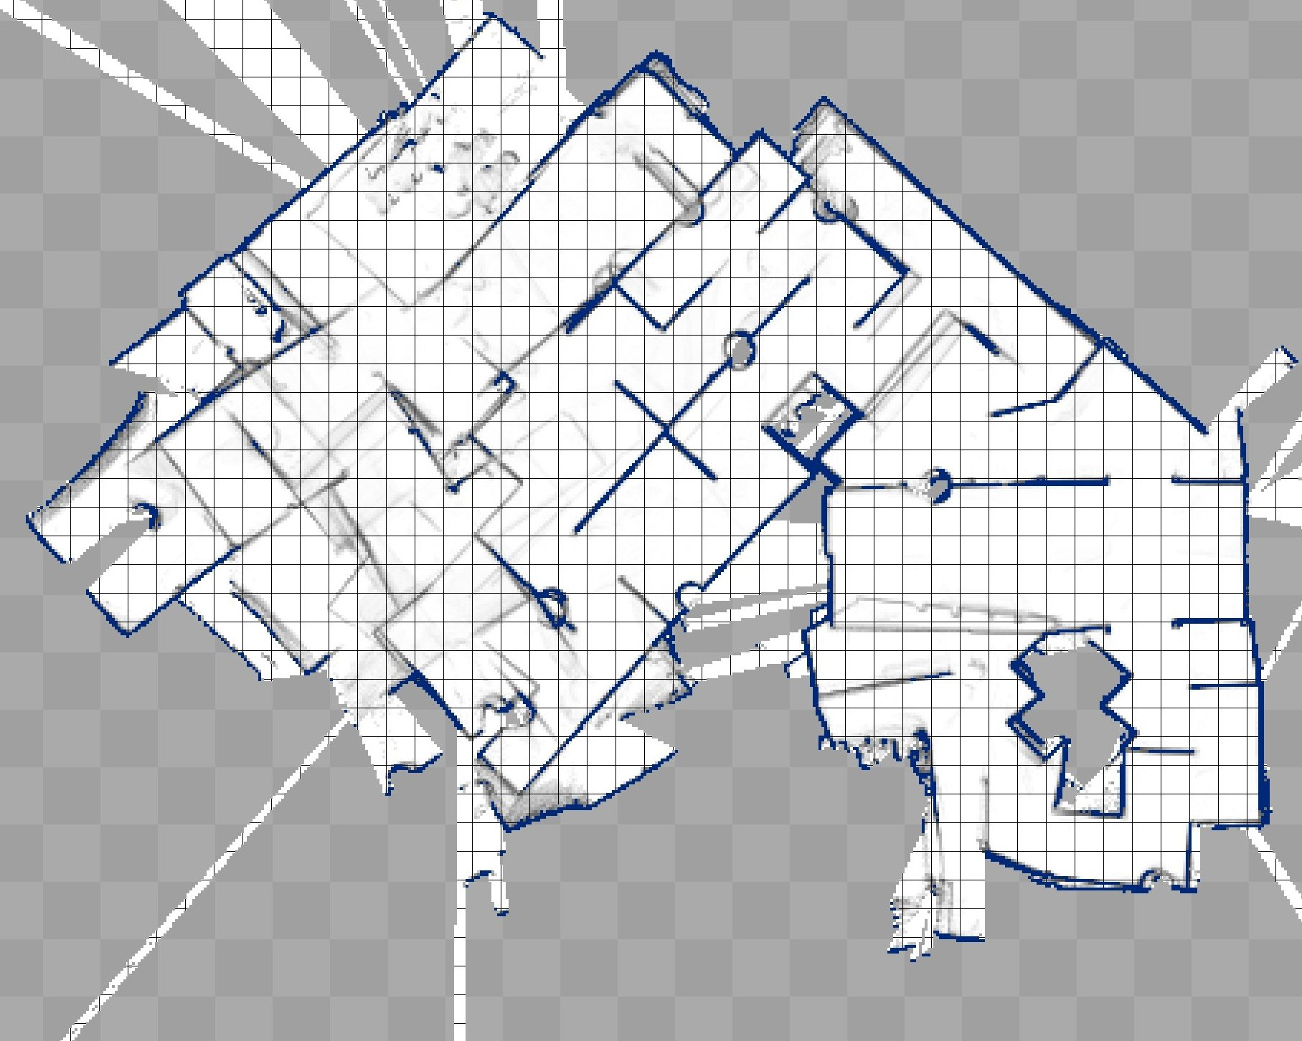
http://robotics.jacobs-university.de/sites/default/files/images/mappingfinal-back-kob.jpg

Slide 6
SLAM
How do we estimate localization and map at the same time?
Explore multiple (path, map) possibilities
For each, keep track of:
$p\left(x_{1:t},m\right|z_{1:t}{,u}_{1:t})$
After each update, return the (path, map) combination with the highest probability.

Slide 7
How do we calculate those probabilities?
Kalman Filters
Particle Filters
Bayesian networks

Slide 8
References
Russel, Stuart. Norvig, Peter. Artifical Intelligence: A Modern Approach
Chapter 15 talks about kalman filters, etc.
Chapter 25 talks about SLAM
Thrun, Sebastian, et. all. Probabilistic Robotics
Slides at http://www.probabilistic-robotics.org/
Thrun, Sebastian. Videos and Animations. http://robots.stanford.edu/videos.html

