Slide 1
Ticket, Police
By Daniel Acito, Yingying Chen, Tianyu Lei and Caitlin Malone
IMGD 4600 c15

Slide 2
Summary
The majority of bad drivers in the US are in Massachusetts
Our game looks to:
teach drivers the rules of the road
encourage them to build good habits
Our target audience: 16-25 year-old new drivers
Platform: PC, web-based (possible port to iPad)

Slide 3
Need Analysis
Problem Statement
There are many fundamental rules of driving in city communities that are commonly not followed
This includes obeying traffic signs, lines, etc.
Many people are aware of the basic the rules of the road, but choose to ignore them.

Slide 4
Need Analysis (ctd.)
Learning Objectives
What is the proper way to respond to a passing emergency vehicle?
Being fully cognizant of the rules of a given road
Observing street signs, lights and lines on the highway
Recognize the consequences of bad driving habits
Not using turn signals, or ignoring speed limits
When are the appropriate times to make a turn?

Slide 5
Task Analysis
Objectives
To remind drivers, both old and new, of rules of driving that are not commonly followed or are easy to forget
To promote good driving habits
To encourage people to drop bad habits that they may have developed or are in the process of developing

Slide 6
Task Analysis (ctd.)
Steps to take
Show players different driving situations
Have players respond to the situation by choosing their next course of action
If user responds incorrectly, show them the consequence of their action
Let the user try again, and repeat until they choose the most appropriate action

Slide 7
Concept Art and User Interface

Slide 8
User Interface – Car Side View

Slide 9
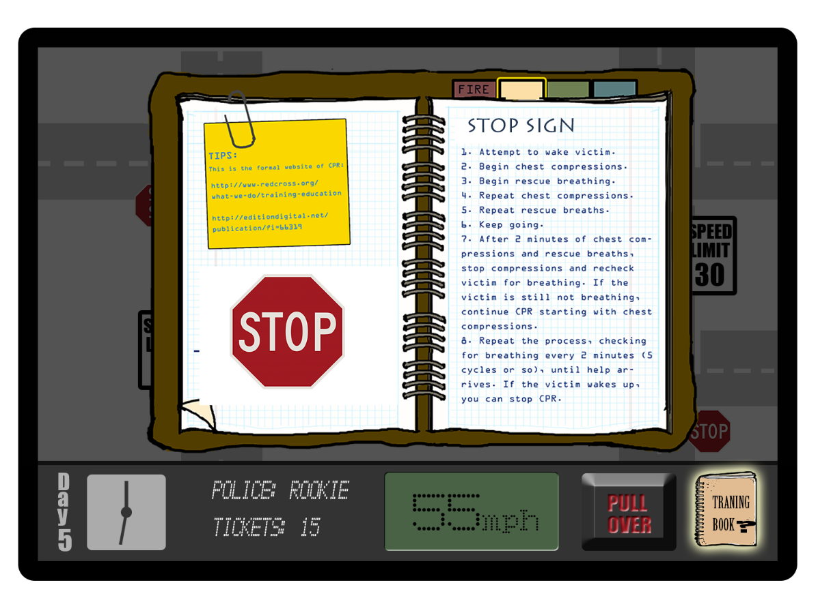
User Interface – Training Book

Slide 10
Gameflow
New elements added to each level
Elements are cumulative – once they’ve been introduced, the player must watch for all offenses
Stages of play in each level
Reviewing
Lecturing
Playing
Conclusion

Slide 11
Gameflow -- Levels
Win condition
Timed
Player receives points for accurate tickets
Lose condition
Issuing wrong tickets
Missed offenses cause car crash
3 mistakes allowed per level

Slide 12
Narrative
Rookie traffic cop, trying to be certified
End goal: Pass the certification test with the knowledge you’ve gained
Set in Worcester, MA

Slide 13
Assessments
Pre- and post- written tests
Assessment at end of each level
Newspaper explains results of actions at beginning of next level

Slide 14
Paper Prototype (yay!)

Slide 15
Paper Prototype (yay!)

Slide 16
Playtest Video

Slide 17
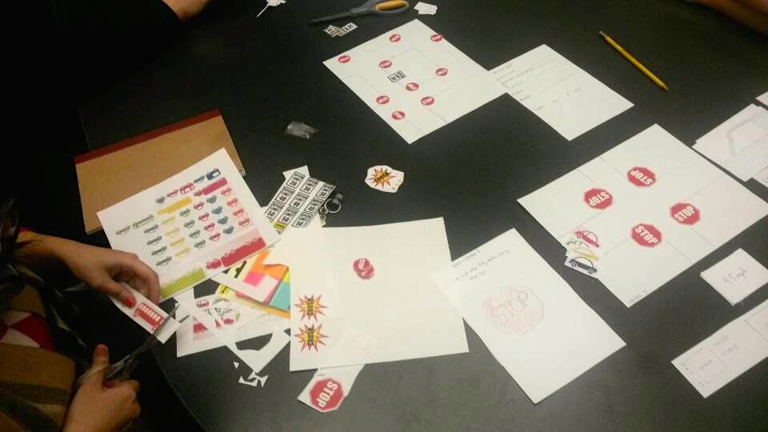
Postmortem
Paper prototype issues
Paper hard to manipulate
Signs were not stable
Mistakes were made
Presentation to user was confusing
AI too complicated to easily replicate
Speed and timing of cars not clear
Feedback to player not easy (AI could not communicate issues, facilitator had to guess)
Failed to simulate car accident or transitions

Slide 18
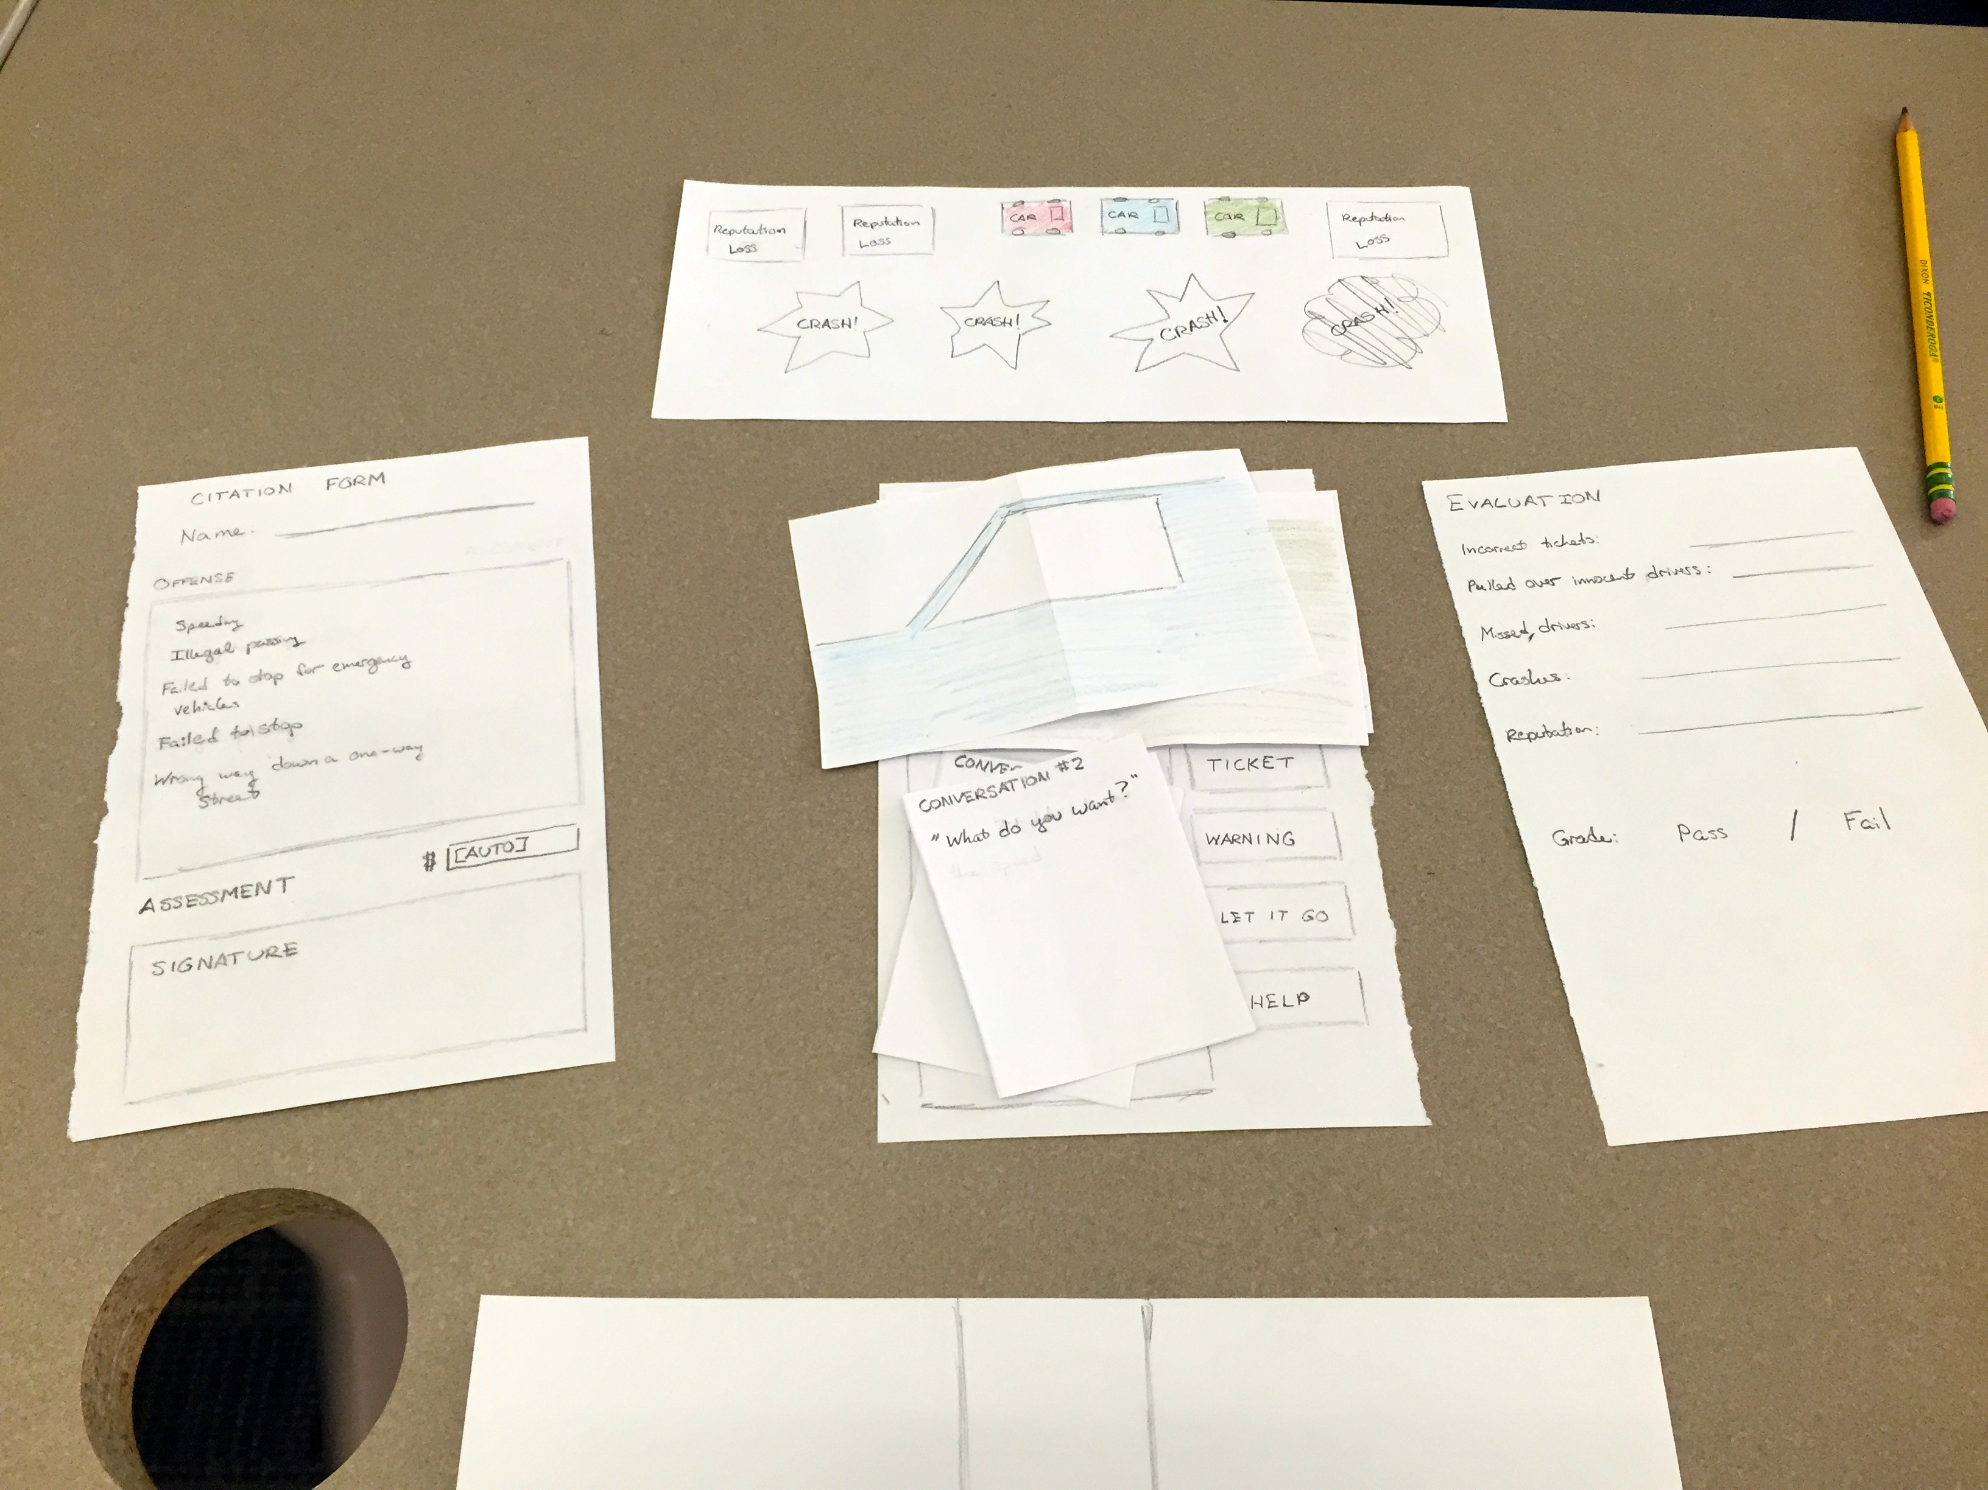
Postmortem (ctd.)
Design issues
Help button name not clear
Grey areas in rules (31mph)
First two levels too easy – everyone already knows the rules

Slide 19
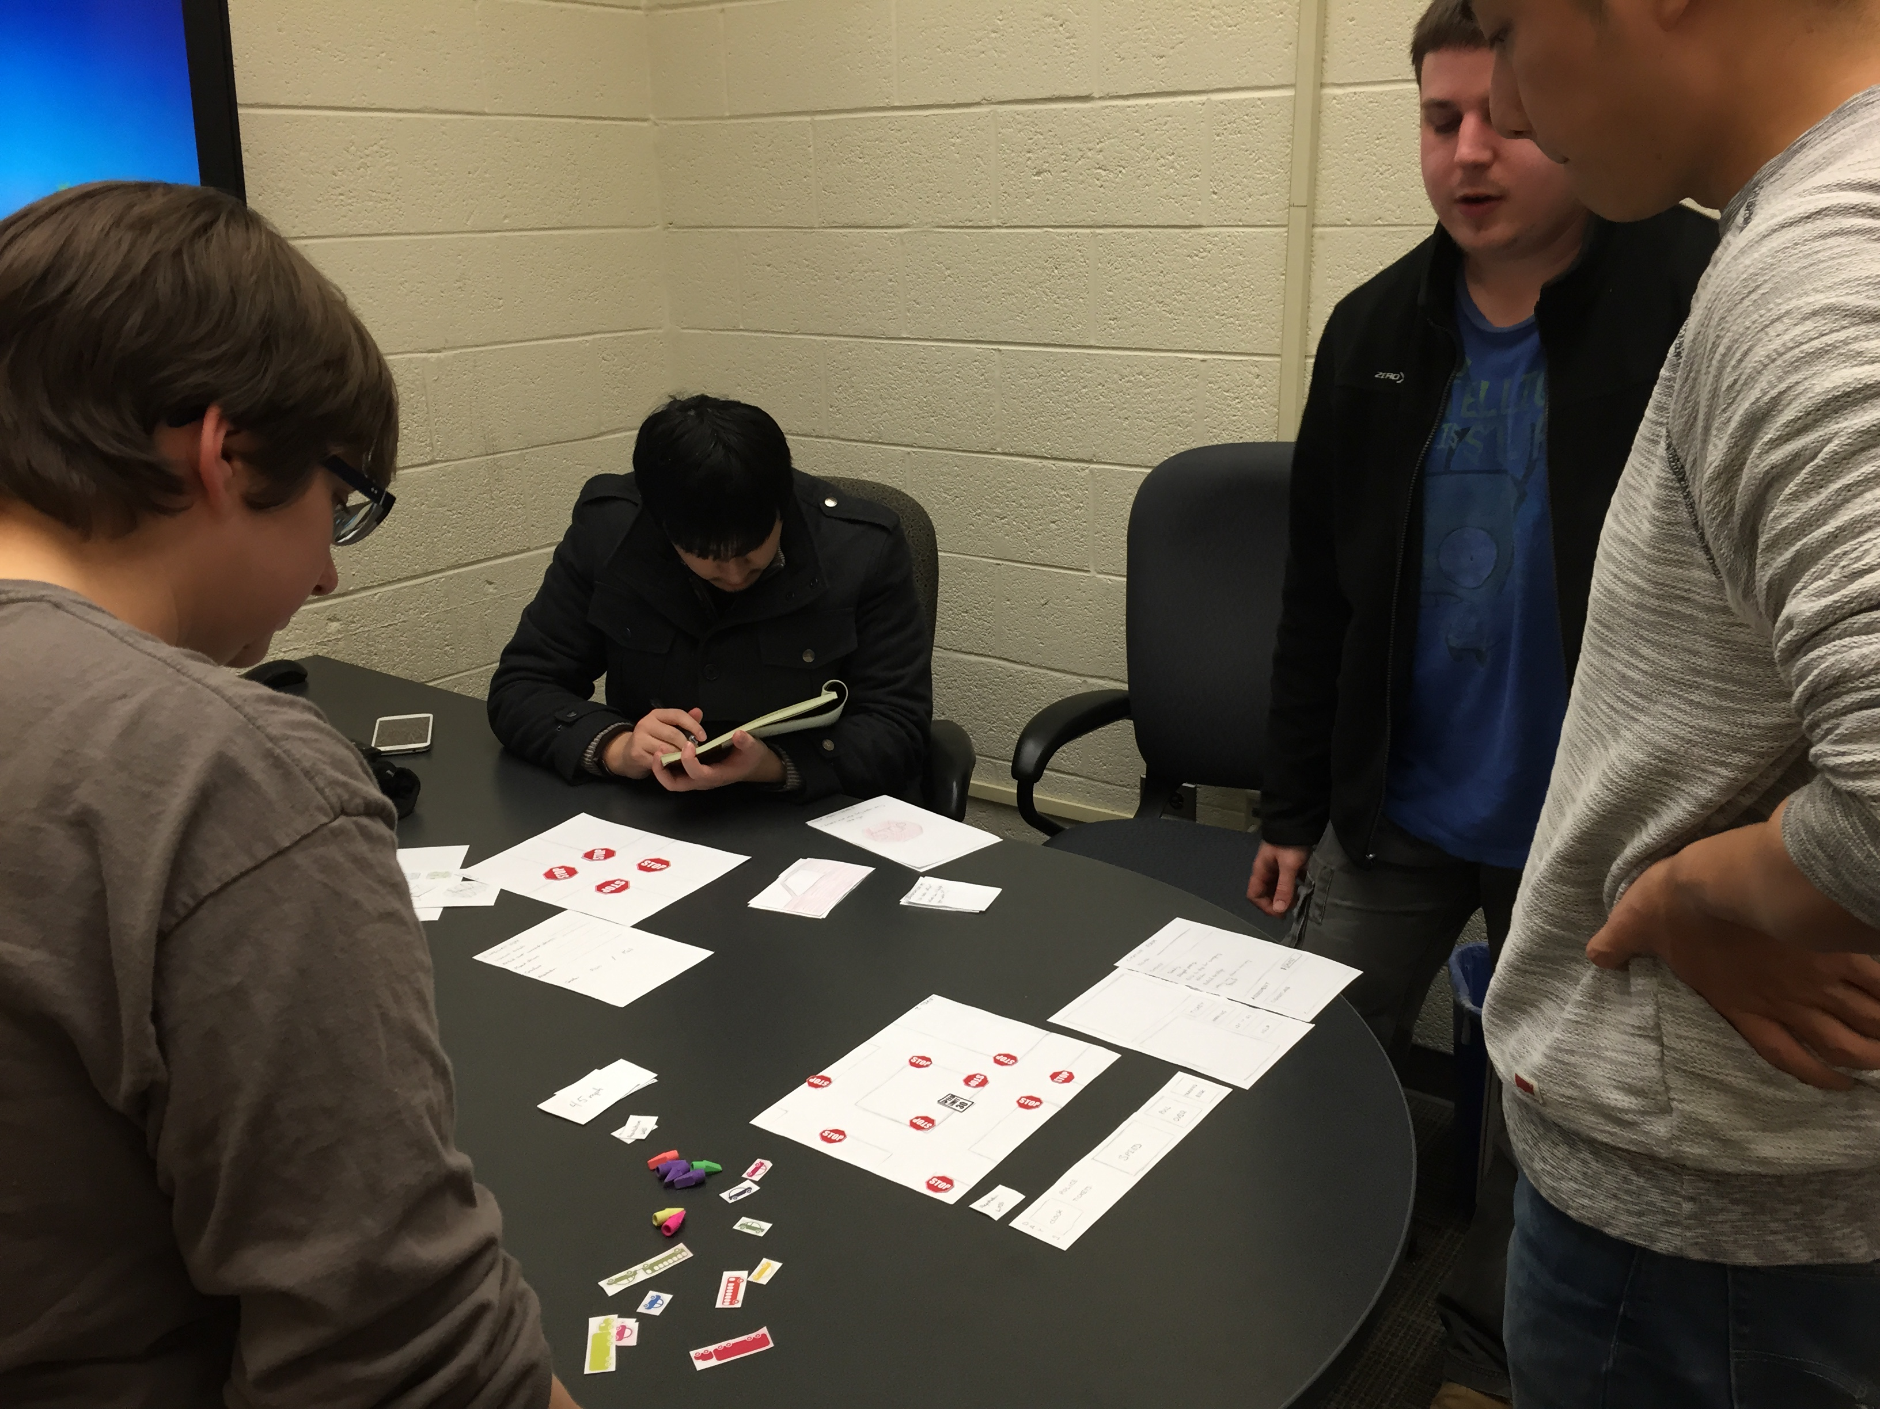
Postmortem (ctd.)
Feedback
Seemed to understand game
Liked idea but too easy and motivation not clear
Introduce more concepts sooner
Have more cars committing offenses

Slide 20
Postmortem (ctd.)
Recommendations
Make UI buttons consistent
Have more elements in earlier levels
Show clear boundaries or focus on grey areas (ex. Speed limits)
For later testing, plan to either communicate player mistakes better or to have a set plan for AI so all team members know which car is supposed to receive a ticket.

Slide 21
Thank you!
Any questions?

