Slide 1
Give It Your Best “Shot”
Paper Prototype for Helping Children with Fears of Vaccines
Adrian Oyola, Peter Lepper, Robert Smieja, Christina Webb
Notes:
(Peter)
‹#›

Slide 2
Needs Analysis/Motivation
Educate kids on a doctor’s purpose
Educate kids on the benefit of the doctor’s office
Educate kids on what happens during a typical vaccination visit
Teach behaviors that help reduce stress and anxiety during vaccinations
IMGD 4600 (C 15)
‹#›
Notes:
(Peter)

Slide 3
Task Analysis
Teach definitions of a doctor’s office
examples
teaching agent
Provide resources for the player to interact with
Procedural challenges of getting a vaccination
Use positive reinforcement to encourage the retention and repetition of the challenge
IMGD 4600 (C 15)
‹#›
Notes:
(Peter)
What needs to be done in order to meet the “needs”?

Slide 4
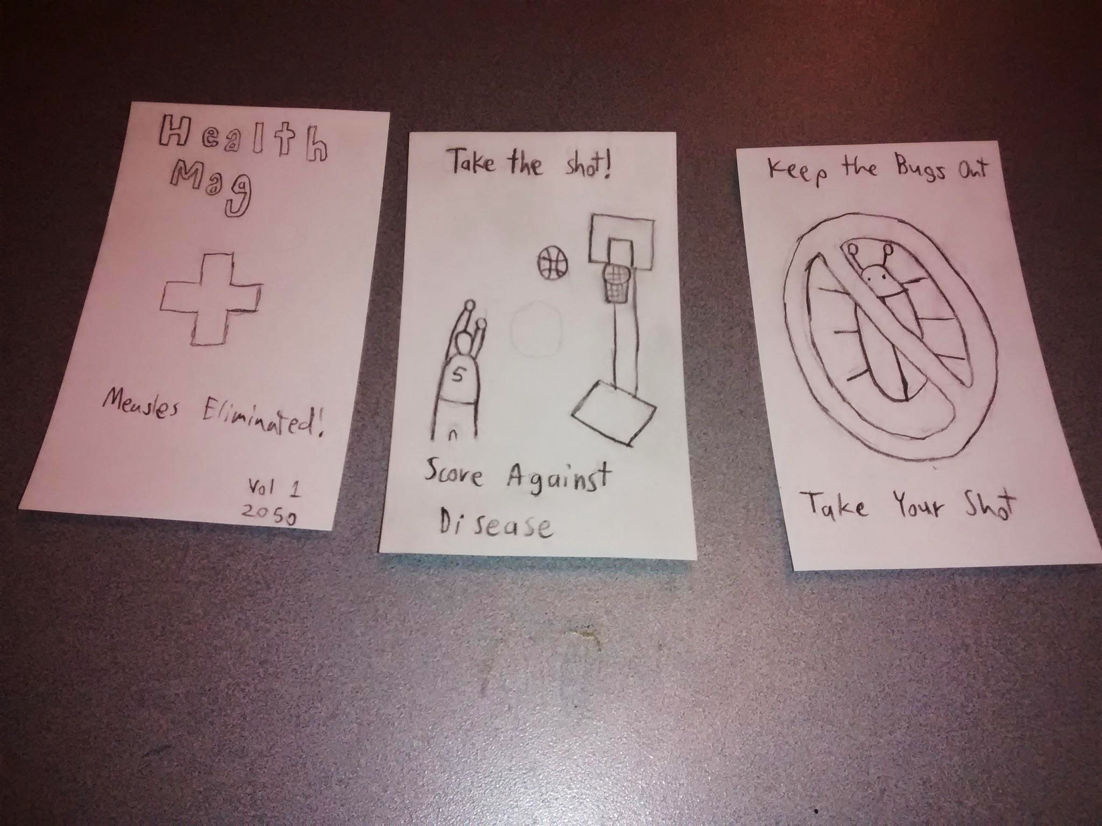
Gameflow and Gameplay
The game takes place over the course of 3 “scenes” or areas:
Waiting Room
Doctor’s Office
Shot Mini-Game
Player is allowed to explore waiting room and interact with objects
Magazines
Other patients
Posters
IMGD 4600 (C 15)
‹#›
Notes:
(Christina)
Progressing to the Doctor’s Office is in the form of a dialogue with the nurse

Slide 5
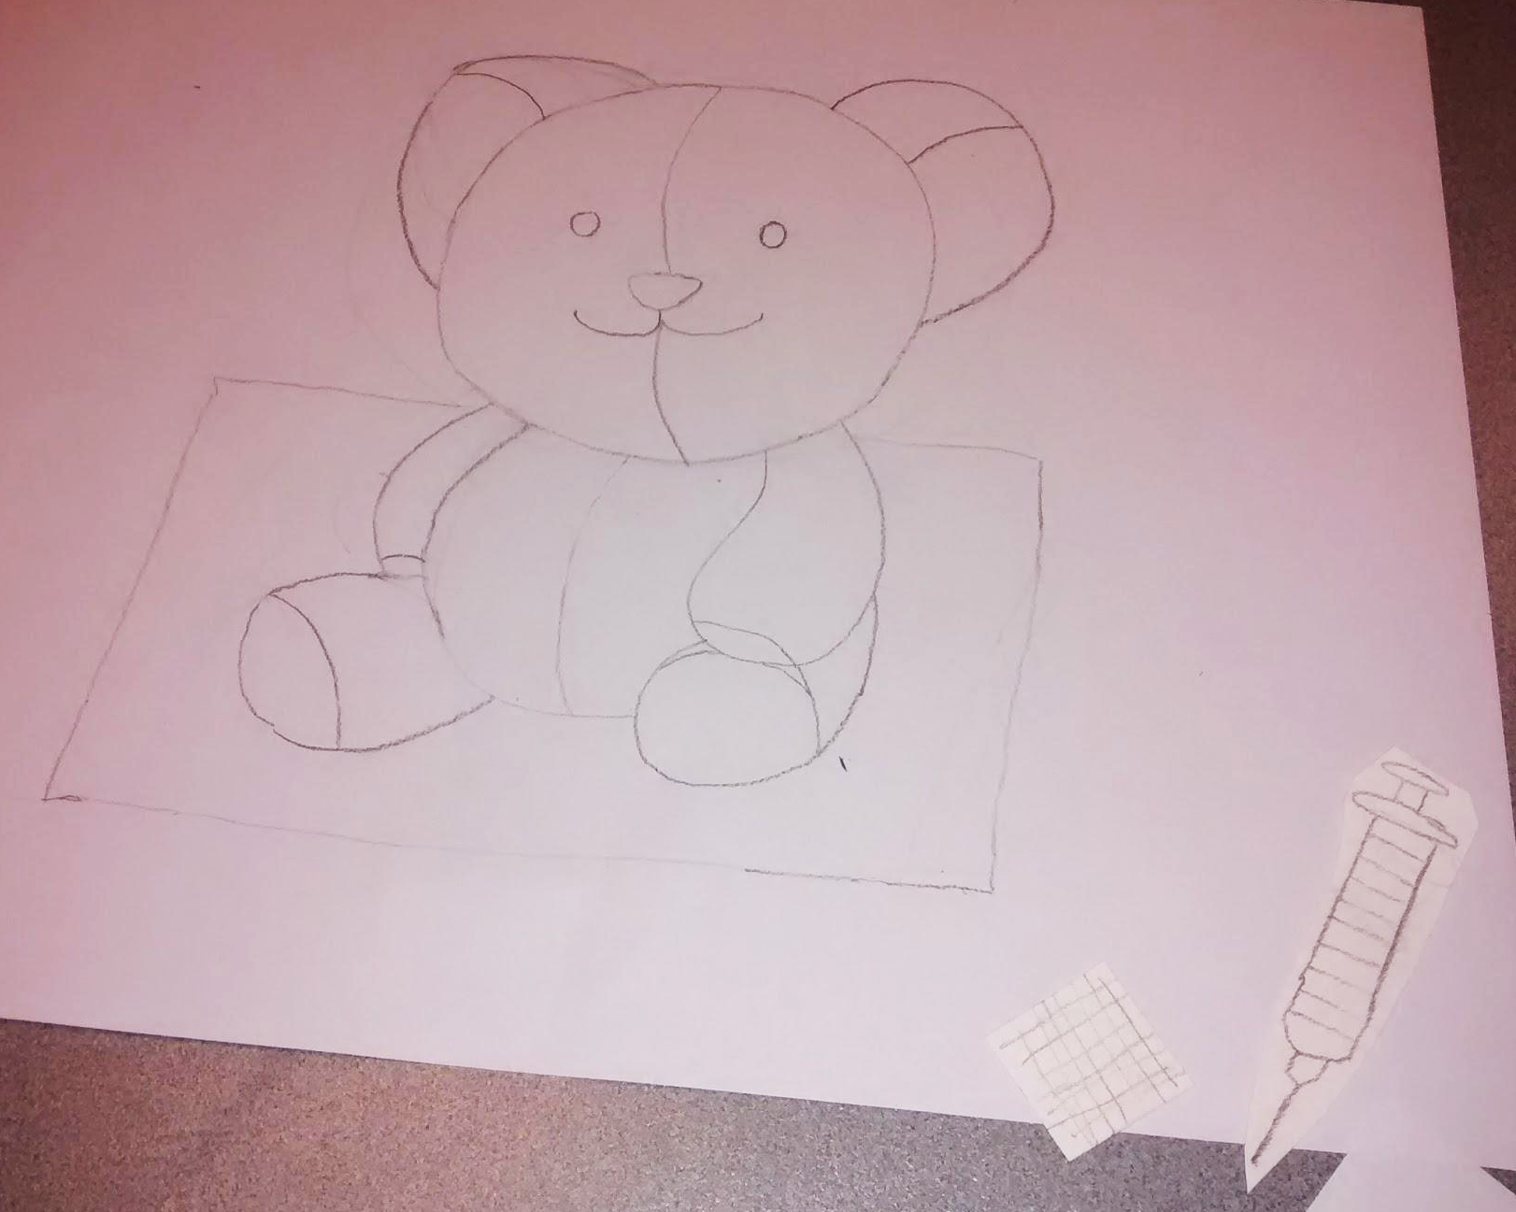
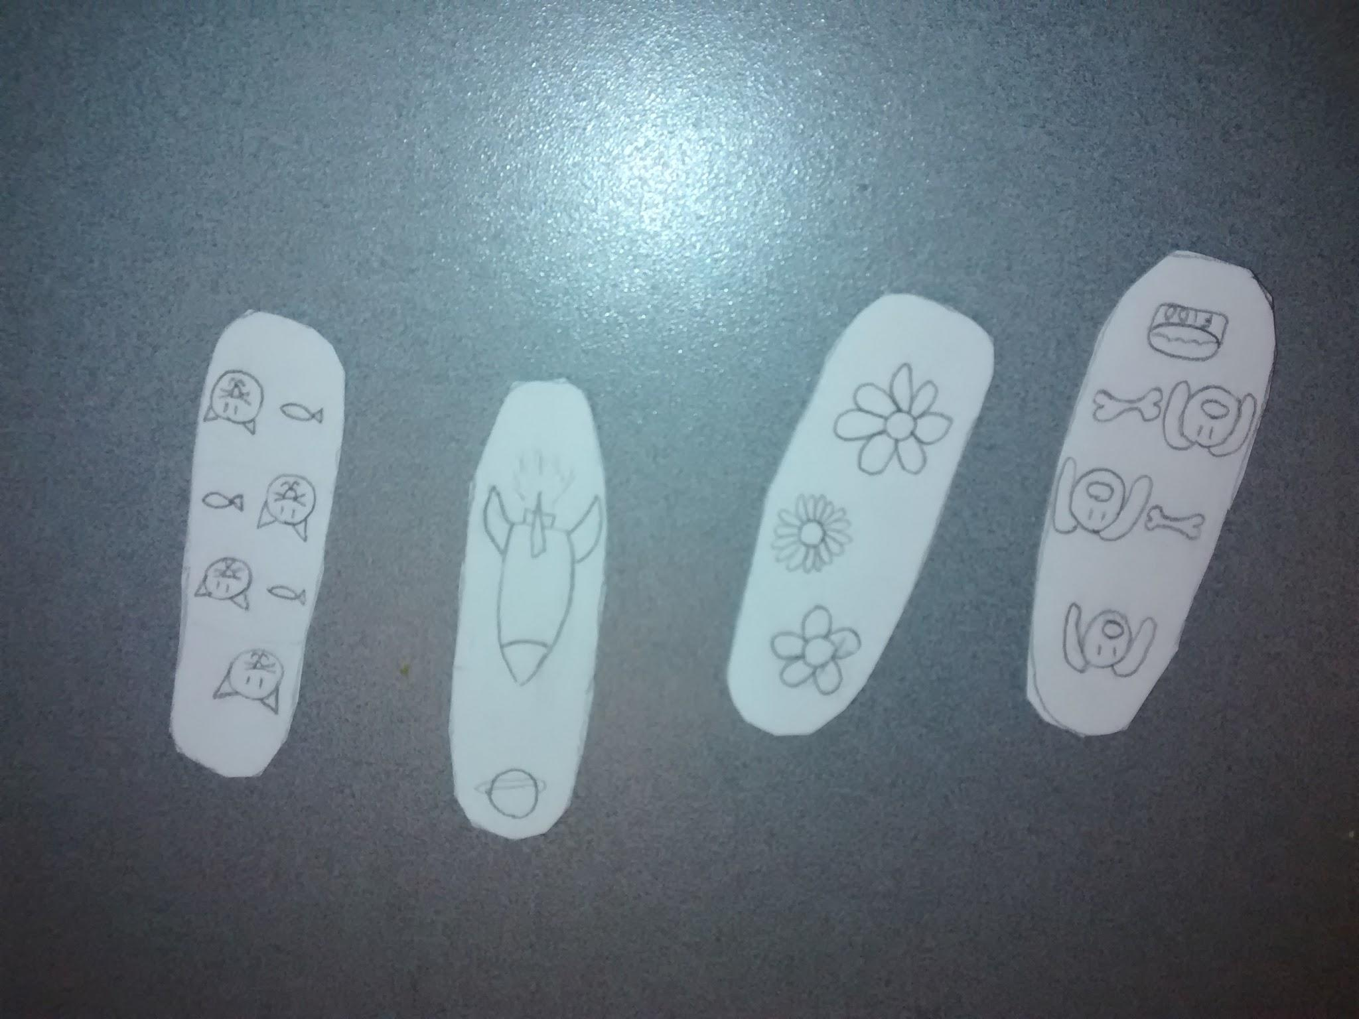
Gameflow and Gameplay
After 3 objects examined player is allowed to progress into the Doctor’s Office, or finish examining all the options
After 3 objects in the Doctor’s Office, the player begins the Shot Mini-Game
Shot Mini-Game walks the player through the process of getting a shot
Player follows procedure on a doll
Clean the area
Insert the needle
Place a Band-Aid
IMGD 4600 (C 15)
‹#›
Notes:
(Christina)
Progressing to the Doctor’s Office is in the form of a dialogue with the nurse

Slide 6
Assessment/Evaluations
Pre-test and Post-tests of knowledge and player opinions
Compare using a control group
Use observational data
Test it on target age group
IMGD 4600 (C 15)
‹#›
Notes:
(Adrian)

Slide 7
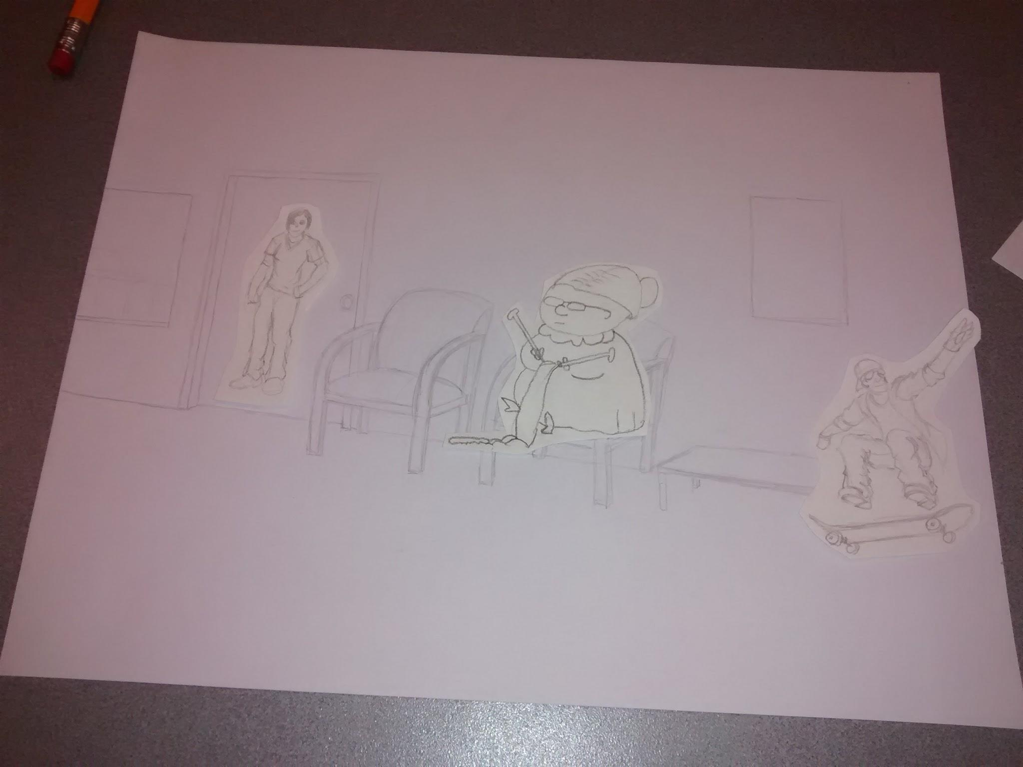
Prototype
Notes:
(Adrian)

Slide 8
Playtesting Session Results
Game wasn’t perfect:
Winning or Losing wasn’t clear
Could have been solved with an introduction
Room for improvements:
Superhero
Address the pain of the shot directly
Video:
IMGD 4600 (C 15)
‹#›
Notes:
(Robert)
Add video of playtest - 2~3 min
Notes
End game/goal unclear?
Win/lose conditions?
Rotation? Multi-page magazines?
A bit text heavy, not much goal based gameplay
Tyler didn’t add much, no introduction
Trying to speed through info
Some pathing issues -
+Good options
+Simple, to the point
Emphasize pain isn’t that bad
Superhero friend?

Slide 9
Discussion Questions
Should be the game be expanded to cover additional medical fears?
Where the game benefit from additional interactivity?
Would additional characters be beneficial to the game?
What types of characters would be beneficial to the game?
IMGD 4600 (C 15)
‹#›
Notes:
(Robert)
Any questions?
‹#›

