Slide 1
CS2303 C14 Systems Programming Concepts
Bob Kinicki

Slide 2
Introduction
Systems Programming

Slide 3
Introduction
Survey and TA/SA Introductions
Pause to Look Backwards and Forwards
Course Objectives
Course Operation/Expectations
Course Plan and Syllabus
Systems Concepts
Higher Level Language History
‘Old’ Development Environment
C and C++
3
Notes:
c

Slide 4
Quick Look Backwards/Forwards
Computing Devices
From mainframes to PCs to
smart phones to ??
Changes in WPI CS Curriculum
Instructor
Students
Expected Background
Going Forward
Your Future
4

Slide 5
CS2303 Course Objectives
To expose students to the low level systems interface ’grunge’ clearly visible in C.
To learn to program in C++ by learning to program in C first.
To further develop the ability to design programs with emphasis on the abstract view of data structures.
To get experience with low level implementation of data structures in C.
5

Slide 6
CS2303 Course Objectives
To learn the advantages of programming in an object-oriented language such as C++.
To experience programming in the
Large
6

Slide 7
CS2303 Course Objectives
Pointers!!
7

Slide 8
Course Operation/Expectation
The course web page is an essential student asset.
* Students are responsible for all information on web page!
5 Required Labs
5 Programming Assignments
2 Closed Book Exams
8

Slide 9
Course Plan and Syllabus
To cover the details of C briskly.
Assumes students already have an understanding of iteration and conditional constructs.
Using only C I/O {grunge as promised!} at first.
To introduce data structures in C by doing at least one program with structs and call by value.
To finish up with as much C++ as possible.
{Note - reading of the textbook will require jumping around during the C portion of the course.}

Slide 10
Systems Concepts
The goal of this programming course is to expose the students to places where the software and hardware meet or where the application interfaces with the operating system (OS).
A ‘systems viewpoint’ includes resource management (CPU and memory), process scheduling, concurrency and performance.
{But this is too much material for this instance of the course!}

Slide 11
Systems Performance Viewpoint
The assignments include simulation and introduce two system performance concerns - efficiency and fairness.
The other important approach to appreciate is the computer scientist abstraction concept of insulating interfaces from ‘under-the-hood’ details (e.g., virtual memory and loaders).

Slide 12
1.5 Types of Programming Languages
Although assembly-language code is clearer to humans, it’s incomprehensible to computers until translated to machine language.
To speed the programming process even further, high-level languages were developed in which single statements could be written to accomplish substantial tasks.
High-level languages allow you to write instructions that look almost like everyday English and contain commonly used mathematical expressions.
Translator programs called compilers convert high-level language programs into machine language.
Interpreter programs were developed to execute high-level language programs directly, although more slowly than compiled programs.
Scripting languages such as JavaScript and PHP are processed by interpreters.
Copyright © Pearson, Inc. 2013. All Rights Reserved.

Slide 13
Higher Level Programming Languages History
Fortran_{W} 1957 COBOL 1959
Algol 1960 1968 Lisp 1959
PL1 1964 APL 1962
Pascal_{W} 1970 SNOBOL 1967
C_{W} 1972 Prolog 1972
Basic 1975 Scheme_{W} 1975
C++_{W} 1986 ADA 1983
Java_{W} 1995 Python_{W} 1989
13

Slide 14
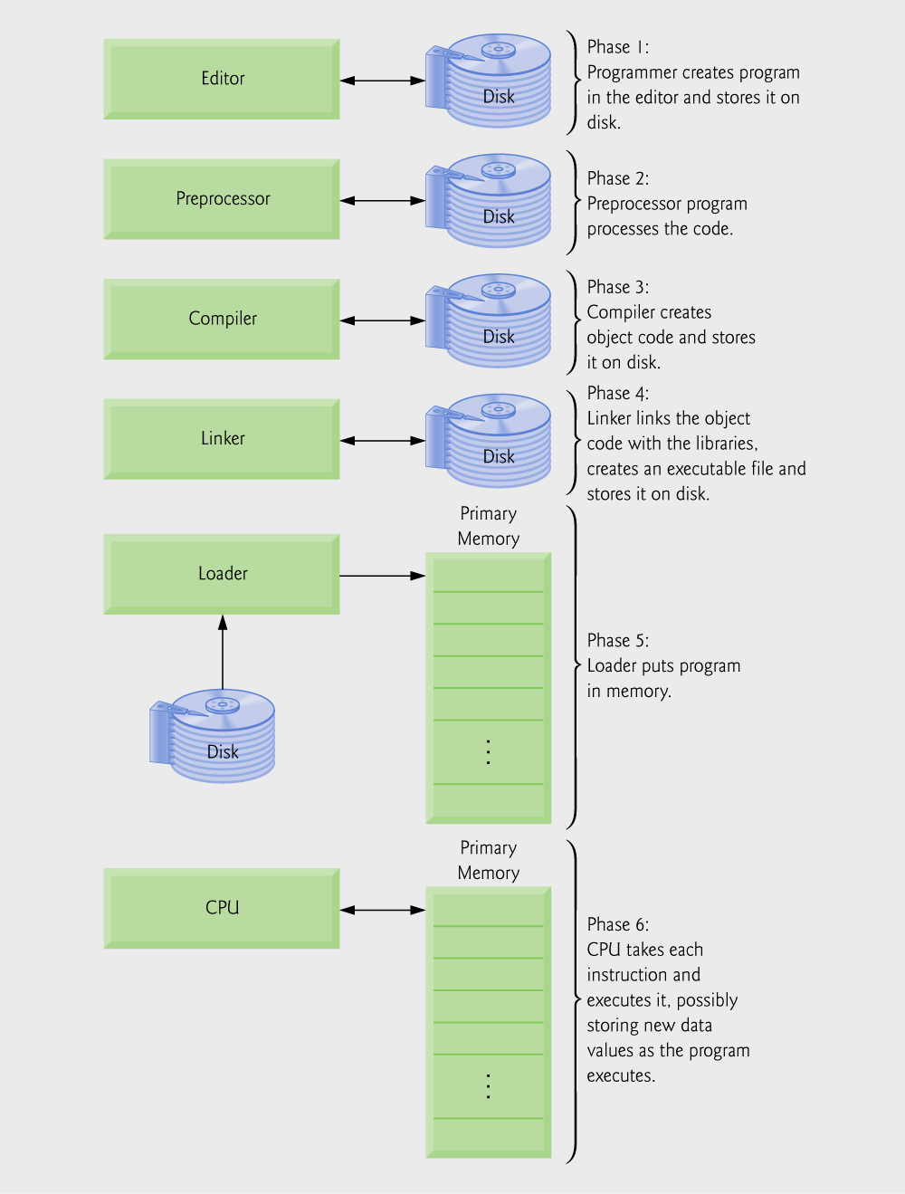
C Program Development Environment
Standard Steps
Edit
Preprocess
Compile
Link
Load
Execute
Deitel & Deitel
© 2007 Pearson Ed -All rights reserved.
Fig. 1.1 | Typical C development environment.
14

Slide 15
User Memory Protection

Slide 16
Virtual Memory

Slide 17
Review of Introduction
Course Objectives
Course Operation/Expectations
Course Plan and Syllabus
C, data structures, C++
Systems Viewpoint {more later}
Program Development Environment
17
Notes:
c

