Slide 1
Introduction to Data Structures
Systems Programming Concepts

Slide 2
Intro to Data Structures
Self-referential Structures
Dynamic Memory Allocation
A Simple malloc Example
Linear Lists
Linked Lists
Insertion Example (using strings)
Linked List Example
2

Slide 3
Self-Referential Structures
Self-referential structures contain a pointer member that points to a structure of the same structure type.
Example:
struct node { int data; struct node *nextPtr; }
nextPtr
is a pointer member that points to a structure of the same type as the one being declared.
is referred to as a link. Links can tie one node to another node.
Self-referential structures can be linked together to form useful data structures such as lists, queues, stacks and trees.

Slide 4
Fig. 12.1 Self-Referential Structures Linked Together
Terminated with a NULL pointer (0)
Not setting the link in the last node of a list to NULL can lead to runtime errors.
© 2007 Pearson Ed -All rights reserved.

Slide 5
12.3 Dynamic Memory Allocation
Creating and maintaining dynamic data structures requires dynamic memory allocation, namely, the ability to obtain and release memory at execution time.
In C, the functions malloc and free and the operator sizeof are essential to dynamic memory allocation.
© 2007 Pearson Ed -All rights reserved.

Slide 6
malloc
malloc
Takes as its argument the number of bytes to allocate.
Thus, sizeof is used to determine the size of an object.
Returns a pointer of type void *
A void * pointer may be assigned to any pointer.
If no memory is available, malloc returns NULL.
Example
newPtr = malloc( sizeof( struct node ))
Note – the allocated memory is NOT initialized.
© 2007 Pearson Ed -All rights reserved.

Slide 7
free
free
Deallocates memory allocated by malloc.
Takes a pointer as an argument.
Example
free ( newPtr );
© 2007 Pearson Ed -All rights reserved.

Slide 8
A Simple malloc Example
int main ()
{
int x = 11;
int *pptr, *qptr;
pptr = (int *) malloc(sizeof (int));
*pptr = 66;
qptr = pptr;
printf ("%d %d %d\n", x, *pptr, *qptr);
x = 77;
*qptr = x + 11;
printf ("%d %d %d\n", x, *pptr, *qptr);
pptr = (int *) malloc(sizeof (int));
*pptr = 99;
printf ("%d %d %d\n", x, *pptr, *qptr);
return 0;
}
$./malloc
11 66 66
77 88 88
77 99 88

Slide 9
A Simple free Example
int main ()
{
int x = 11;
int *pptr, *qptr;
pptr = (int *) malloc(sizeof (int));
*pptr = 66;
qptr = (int *) malloc(sizeof (int));
*qptr = 55;
printf ("%d %d %d\n", x, *pptr, *qptr);
free(pptr);
x = 77;
pptr = qptr;
qptr = (int *) malloc(sizeof (int));
*qptr = x + 11;
printf ("%d %d %d\n", x, *pptr, *qptr);
pptr = (int *) malloc(sizeof (int));
*pptr = 99;
printf ("%d %d %d\n", x, *pptr, *qptr);
free(qptr);
printf ("%d %d %d\n", x, *pptr, *qptr);
return 0;
}
./free
11 66 55
77 55 88
77 99 88
77 99 0
Cannot trust contents
of freed memory!!

Slide 10
Linear Lists
Aray[0]
With a linear list, the assumption is the next element in the data structure is implicit in the index.
This saves space, but is expensive for insertions!
Aray[99]

Slide 11
12.4 Linked Lists
Linked list ::
A linear collection of self-referential class objects, called nodes.
Connected by pointer links.
Accessed via a pointer to the first node of the list.
Subsequent nodes are accessed via the link pointer member of the current node.
The link pointer in the last node is set to NULL to mark the list’s end.
© 2007 Pearson Ed -All rights reserved.

Slide 12
12.4 Linked Lists
Use a linked list instead of an array when
You have an unpredictable number of data elements.
When members of node are of different types.
Your list needs to be sorted quickly.
Keeping the list sorted implies numerous insertions.
© 2007 Pearson Ed -All rights reserved.

Slide 13
Fig. 12.2 Linked List Graphical Representation
Line added to indicate pointer may be passed
to a called routine where data structure is
“hidden” and operated on.
© 2007 Pearson Ed -All rights reserved.

Slide 14
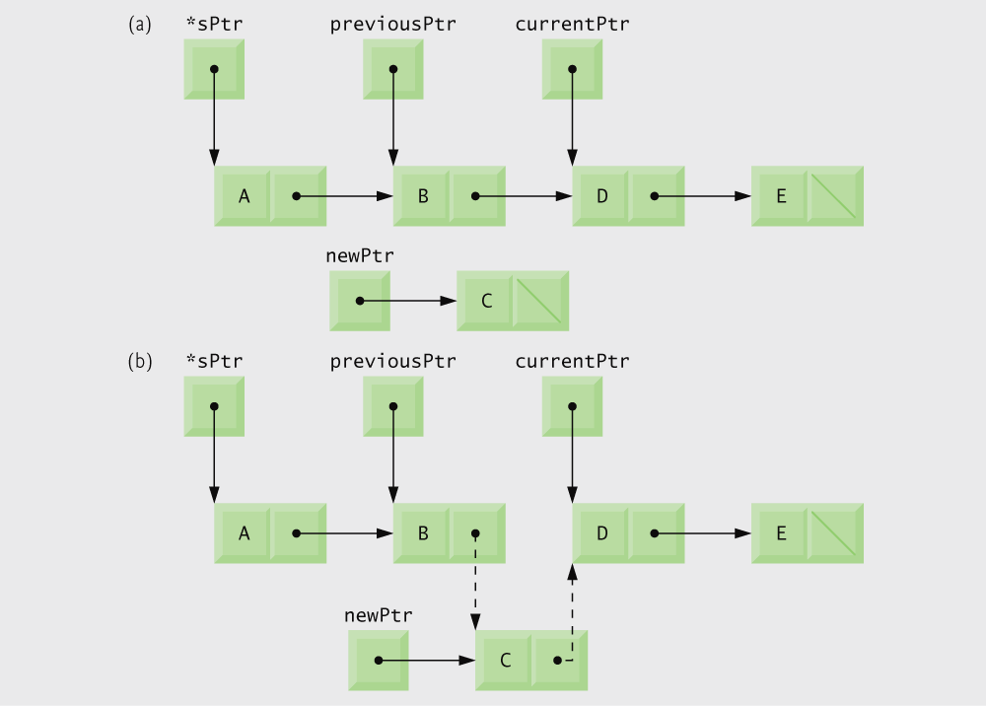
Fig. 12.5 Inserting a Node in an Ordered List
A pointer to a
pointer is used here.
© 2007 Pearson Ed -All rights reserved.

Slide 15
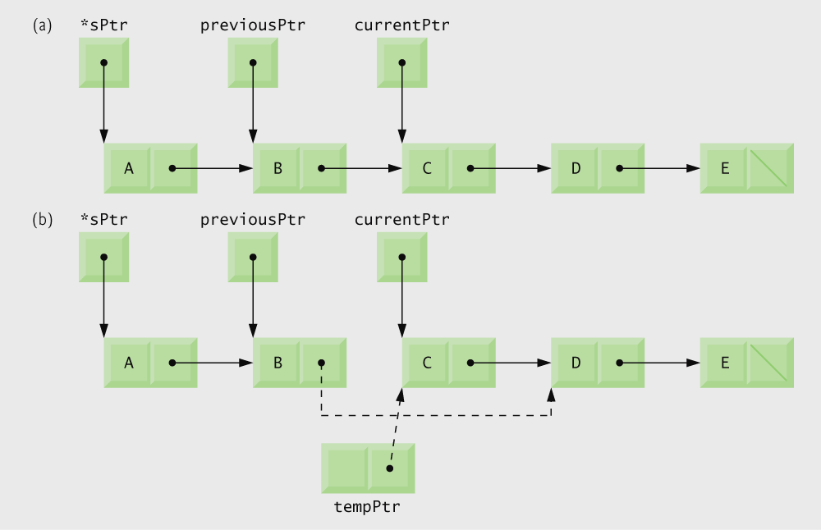
Fig. 12.5 Deleting a Node in an Ordered List
© 2007 Pearson Ed -All rights reserved.

Slide 16
Linked Lists
sptr
nptr->link = *sptr;
*sptr = nptr;
nptr
name
link

Slide 17
Linked List Insertion Example
/* An Example that uses strings in character
arrays as part of a linked list */
#define SIZE 4
#include <stdio.h>
#include <string.h>
typedef struct {
char name[4];
struct Node *link;
} Node;
typedef Node *Link;
/* init inserts a new string in a Node at the FRONT of the linked list */
void init (Link *sptr, char cray[]) /* Note this uses a pointer to a pointer */
{
Link nptr;
nptr = malloc(sizeof(Node)); /* nptr points to an empty Node */
if (nptr != NULL) /* malloc returns NULL when out of memory!! */
{
strcpy(nptr->name, cray); /* string copy string2 to string1 */
nptr->link = *sptr;
*sptr = nptr;
}
}

Slide 18
Linked List Insertion Example
/* Insert a new string into the
list in sorted order */
void insert( Link *sPtr, char *cray )
{
Link newPtr; /* new node */
Link previousPtr; /* previous node */
Link currentPtr; /* current node */
/* dynamically allocate memory */
newPtr = malloc( sizeof( Node ) );
/* if newPtr does not equal NULL */
if ( newPtr ) {
strcpy(newPtr->name, cray);
newPtr->link = NULL;
previousPtr = NULL;
/* set currentPtr to start of list */
currentPtr = *sPtr;
/* loop to find correct location in list */
while ( currentPtr != NULL && strcmp(cray, currentPtr->name) > 0) {
previousPtr = currentPtr;
currentPtr = currentPtr->link;
} /* end while */
/* insert at beginning of list */
if ( previousPtr == NULL ) {
newPtr->link = *sPtr;
*sPtr = newPtr;
} /* end if */
else { /* insert node between previousPtr and currentPtr */
previousPtr->link = newPtr;
newPtr->link = currentPtr;
} /* end else */
} /* end if */
else {
printf( "%s not inserted. No memory available.\n", cray );
} /* end else */
} /* end function insert */

Slide 19
Linked List Insertion Example
/* Print the linked list */
void printList( Link currentPtr ) /* Note here just the pointer itself is passed */
{
/* if list is empty */
if ( !currentPtr ) {
printf( "List is empty.\n\n" );
} /* end if */
else {
/* loop while currentPtr does not equal NULL */
while ( currentPtr ) {
printf( "%s ", currentPtr->name );
currentPtr = currentPtr->link;
} /* end while */
printf( "*\n" );
} /* end else */
} /* end function printList */

Slide 20
Linked List Insertion Example
int main (void)
{
int i;
/* Five strings to place in the linked list */
char b[] = "Bat";
char c[] = "Cat";
char h[] = "hat";
char m[] = "mat";
char v[] = "vat";
char n[4];
char atray[5][4];
Link lptr = NULL; /* Set the linked list to empty */
strcpy (&atray[0][0], v); /* string copy string2 to string1 */
strcpy (&atray[1][0], m);
strcpy (&atray[2][0], c);
strcpy (&atray[3][0], b);
for (i = 0; i < SIZE; i++)
printf("%s ", &atray[i][0]);
printf("\n");
./LList
vat mat Cat Bat

Slide 21
Linked List Insertion Example
/* init assumes the linked list is being initialized
with node elements entered in reverse alphabetical order */
for (i = 0; i < SIZE; i++)
init(&lptr, &atray[i][0]);
printList (lptr);
/* insert is the same as in the textbook except it
compares strings to insert in alphabetical order */
insert (&lptr, h); // insert ‘hat’ in alphabetical ASCII order
printList (lptr);
scanf("%s", n);
/* continue reading and inserting until EOF */
while (strcmp(n, "EOF") != 0)
{
insert (&lptr, n);
printList (lptr);
scanf("%s", n);
}
return;
}
./LList
vat mat Cat Bat
Bat Cat mat vat *
Note: a pointer to a pointer!!
Only the pointer passed here.
./LList
vat mat Cat Bat
Bat Cat mat vat *
Bat Cat hat mat vat *

Slide 22
Linked List Insertion Example
sPtr
previousPtr
currentPtr
Bat
Cat
mat
vat
\
newPtr
hat
\

Slide 23
Linked List Implementation
Each node in the list contains a data element and a pointer to the next node
main is an example of a “driver” program. Its role is to test the operations on the data structure.
© 2007 Pearson Ed -All rights reserved.

Slide 24
Linked List Implementation
Function insert inserts data into the list
Function delete removes data from the list
© 2007 Pearson Ed -All rights reserved.

Slide 25
Linked List Implementation
© 2007 Pearson Ed -All rights reserved.

Slide 26
Linked List Implementation
To insert a node into the list, memory must first be allocated for that node
while loop searches for new node’s place in the list
© 2007 Pearson Ed -All rights reserved.

Slide 27
Linked List Implementation
If there are no nodes in the list, the new node becomes the “start” node
Otherwise, the new node is inserted between two others (or at the end of the list) by changing pointers
© 2007 Pearson Ed -All rights reserved.

Slide 28
Linked List Implementation
while loop searches for node’s place in the list
Once the node is found, it is deleted by changing pointers and freeing the node’s memory
© 2007 Pearson Ed -All rights reserved.

Slide 29
Linked List Implementation
If the start node is NULL, there are no nodes in the list
© 2007 Pearson Ed -All rights reserved.

Slide 30
Linked List Implementation
© 2007 Pearson Ed -All rights reserved.

Slide 31
Output from Linked List Implementation
© 2007 Pearson Ed -All rights reserved.

Slide 32
Output from Linked List Implementation
© 2007 Pearson Ed -All rights reserved.

Slide 33
Review of Intro Data Structures
Introduced malloc and free.
Discussed the tradeoffs between a linear list and a linked list.
Provided two linked examples.
Explained event lists as one instance of linked lists.
Important operations on linked lists:
Insertion in the list.
Taking a random node out of the list.
Taking the ‘next’ node off the front of the list.
Printing the linked list in order.

Slide 34
Review of Data Structures Seen
Arrays
Arrays of pointers to strings
Arrays of structs (note: this is a linear list)
Linked lists
singly-linked lists
[not] doubly-linked lists!!

