Slide 1
Arrays
Systems Programming Concepts

Slide 2
Arrays
Arrays
Defining and Initializing Arrays
Array Example
Subscript Out-of-Range Example
Passing Arrays to Functions
Call by Reference
Multiple-Subscripted Arrays
Double-Subscripted Array Example
enum and switch

Slide 3
Arrays
Arrays:: Structures of related data items
Static entities, namely, the size of an array remains constant throughout the program execution.
A group of contiguous memory locations with the same name and type.
© 2007 Pearson Ed -All rights reserved.

Slide 4
Arrays
To refer to an array element, specify
the array name
the position number {in C this is an offset}
referred to as a subscript.
Format:
arrayname[position number]
First element is at position 0
n element array named c:
c[ 0 ], c[ 1 ]...c[ n – 1 ]
© 2007 Pearson Ed -All rights reserved.

Slide 5
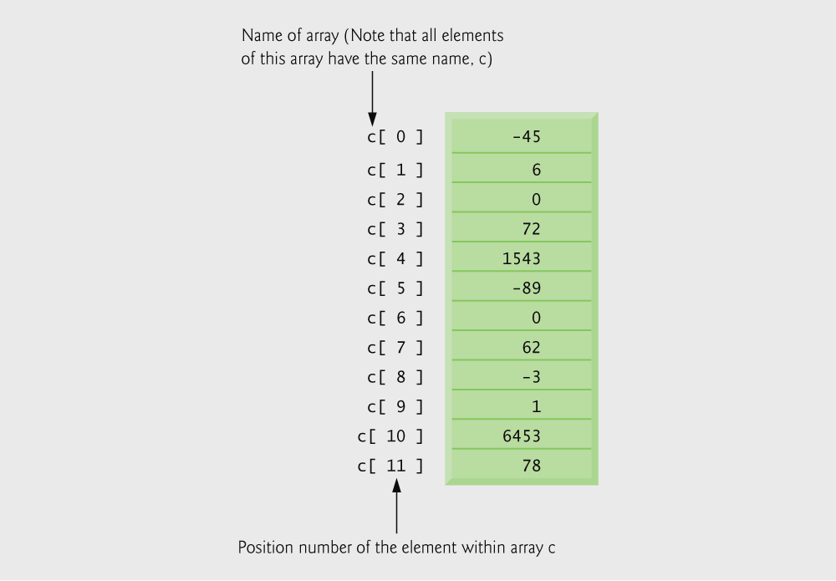
Fig. 6.1 12-element Array
© 2007 Pearson Ed -All rights reserved.

Slide 6
Arrays
Array elements are like normal variables.
c[ 0 ] = 3;
printf( "%d", c[ 0 ] );
One can perform operations within the subscript which must be an integer or an integer expression.
Examples:
c[x - 2] = 6;
c[i+j-4] = c[x-2];
c[intfcn(i)] = 0;
© 2007 Pearson Ed -All rights reserved.

Slide 7
6.3 Defining Arrays
When defining arrays, specify
Name
Type of array
Number of elements
arrayType arrayName[ numberofElements ];
Examples:
int c[ 10 ];
float myArray[ 3284 ];
Defining multiple arrays of same type
Format similar to regular variables
Example:
int b[ 100 ], x[ 27 ];
© 2007 Pearson Ed -All rights reserved.

Slide 8
Initializing Array
int n[ 5 ] = { 1, 2, 3, 4, 5 };
If not enough initializers, rightmost elements become 0.
int n[ 5 ] = { 0 } ;
All elements 0
If too many initializers, a syntax error occurs!
C arrays have no bounds checking!!
If size omitted, initializers determine size.
int n[ ] = { 1, 2, 3, 4, 5 };
5 initializer elements, therefore n is a 5 element array.
© 2007 Pearson Ed -All rights reserved.

Slide 9
Fig. 6.5 Array Example [old]
#define directive tells compiler to replace all instances of the word SIZE with 10.
SIZE is replaced with 10 by the compiler, so array s has 10 elements.
© 2007 Pearson Ed -All rights reserved.

Slide 10
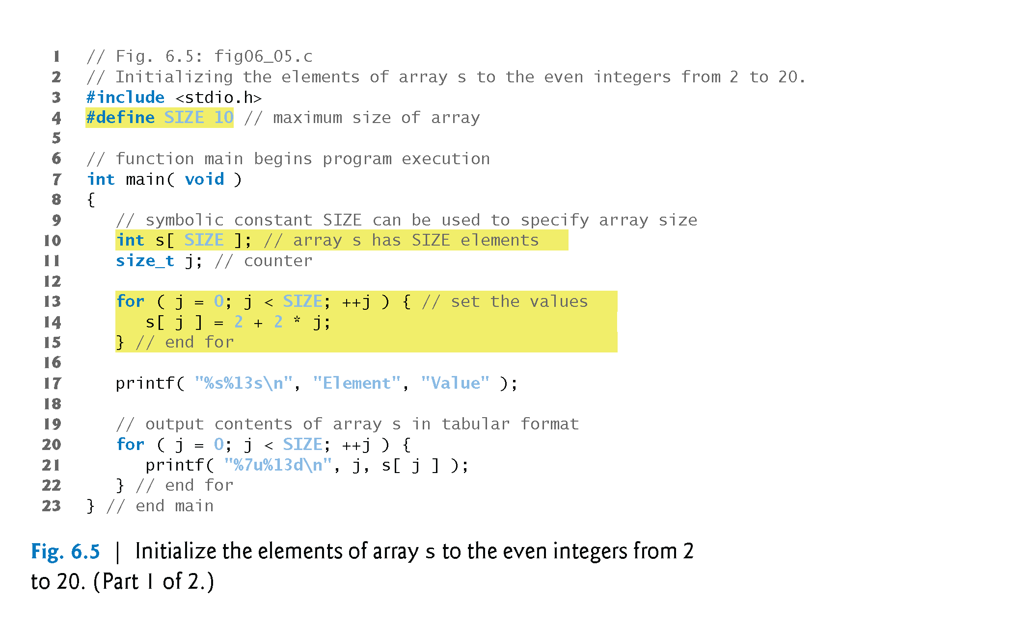
Fig. 6.5 Array Example [new]
size_t type is shorthand for unsigned int
printf also needs to indicate unsigned int
10

Slide 11
Fig. 6.5 Array Example [new]
11

Slide 12
Arrays
Arrays are dangerous in C because:
There is no default initialization.
There is no bounds checking for subscripts out-of-range.

Slide 13
‘Scary’ Out-of-Range Example
/* Bizarre Example of subscripting out of range */
int main ()
{
int i, m , n, j;
int a[100], k, p;
j = 77; k = 88; p = 99;
for (i= -1; i<=103; i++)
{
a[i] = 2*i;
if (i > 98) printf("i =%d, a[i] = %d\n", i, a[i]);
}
printf("j = %d, n = %d, m = %d, i = %d, k = %d, p = %d\n",
j, n, m, i, k, p);
printf("%d %d %d %d %u\n",
a[-1], a[99], a[100], a[102], a[i]);
return 0;
}
p a[-2]
k a[-1]
a[0]
a[1]
a[99]
j a[100]
n a[101]
m a[102]
i a[103]
99
-2
198
200
202
204
206
i =99, a[i] = 198
i =100, a[i] = 200
i =101, a[i] = 202
i =102, a[i] = 204
i =206, a[i] = 15
j = 200, n = 202, m = 204, i = 207, k = -2, p = 99
-2 198 200 204 3220526203

Slide 14
6.5 Passing Arrays to Functions
To pass an array argument to a function, specify the name of the array without any brackets.
The array size is usually passed to the function.
int myArray[ 24 ];
myFunction( myArray, 24 );
Arrays are passed by-reference.
The name of the array is associated with the address of the first array element.
The function knows where the array is stored and it can modify the original memory locations.
© 2007 Pearson Ed -All rights reserved.

Slide 15
6.5 Passing Arrays to Functions
Individual array elements
Are passed by value.
Pass the subscripted name (i.e., myArray[ 3 ]) to function.
Function prototype
void modifyArray( int b[], int arraySize );
Parameter names are optional in prototype.
int b[] could be written int []
int arraySize could be simply int
© 2007 Pearson Ed -All rights reserved.

Slide 16
Passing Arrays to Functions
/* Arrays are passed using Call by Reference */
#include <math.h>
#define SIZE 6
void flip (float fray [], int fsize)
{
float temp;
int i,j;
i = fsize - 1;
for (j = 0; j < fsize/2 ; j++)
{
temp = fray[j];
fray[j] = fray[i];
fray[i] = temp;
i--;
}
return;
}

Slide 17
Passing Arrays to Functions
int main ()
{
float var[SIZE];
int i,j;
for (i=0; i < SIZE; i++)
{
var[i] = 1.0/pow (2.0,i);
printf(" %5.3f", var[i]);
}
printf("\n");
for (j=0; j < 2; j++)
{
flip (var, SIZE);
for (i=0; i < SIZE; i++)
printf(" %5.3f", var[i]);
printf("\n");
}
}
$./passray
1.000 0.500 0.250 0.125 0.062 0.031
0.031 0.062 0.125 0.250 0.500 1.000
1.000 0.500 0.250 0.125 0.062 0.031

Slide 18
6.9 Multiple-Subscripted Arrays
Multiple subscripted arrays
Tables with rows and columns (m by n array)
Like matrices: specify row, then column
Initialization
int b[ 2 ][ 2 ] = { { 1, 2 }, { 3, 4 } };
Initializers grouped by row in braces
If not enough, unspecified elements set to zero
int b[ 2 ][ 2 ] = { { 1 }, { 3, 4 } };
Referencing elements
Specify row, then column
printf( "%d", b[ 0 ][ 1 ] );
© 2007 Pearson Ed -All rights reserved.

Slide 19
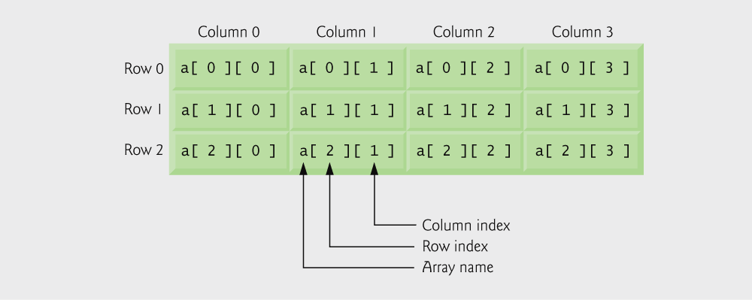
Fig. 6.20 Double-Subscripted Array
Three rows and four columns.
© 2007 Pearson Ed -All rights reserved.

Slide 20
Double-Subscripted Array Example
Notice “const”
Each row in the array corresponds to a single student’s set of grades
© 2007 Pearson Ed -All rights reserved.

Slide 21
Double-Subscripted Array Example
average function is passed a row of the array
© 2007 Pearson Ed -All rights reserved.

Slide 22
Double-Subscripted Array Example
© 2007 Pearson Ed -All rights reserved.

Slide 23
Double-Subscripted Array Example
© 2007 Pearson Ed -All rights reserved.

Slide 24
Double-Subscripted Array Example
© 2007 Pearson Ed -All rights reserved.

Slide 25
Double-Subscripted Array Example
© 2007 Pearson Ed -All rights reserved.

Slide 26
An enum and a switch Example
/* A program that uses enumerated types, switch and a
sentinel to terminate input */
#define SENTINEL 10
int main ()
{
int day;
/* enum starts assigning positional integers
beginning with 0 */
enum days {SUN, MON, TUES, WED, THUR, FRI, SAT};
scanf("%d", &day);
while( day != SENTINEL)
{
switch (day)
{
case MON:
case WED:
case FRI:
printf("%d - Go to class\n", day);
break;

Slide 27
An enum and switch Example
case TUES:
printf("%d - Sleep in until 10\n", day);
break;
case THUR:
printf("%d - Do laundry\n", day);
break;
case SAT:
printf("%d - Go to gym. ", day);
printf("Go out to a movie\n");
break;
case SUN:
printf("%d - Study lots!\n", day);
break;
default:
printf("%d - This is invalid input. Try again.", day);
break;
}
scanf("%d", &day);
}
printf("Sentinal encountered.\n");
return 0;
}

Slide 28
Review of Arrays
Arrays
Defining and Initializing Arrays
Array Example
Subscript Out-of-Range Example
Passing Arrays to Functions
Call by Reference
Multiple-Subscripted Arrays
Double-Subscripted Array Example
Enum and Switch Example

