Slide 2
Motivation
“Once the population’s standard of living rises sufficiently to satisfy basic requirements—reliable food and shelter—the focus shifts from survival to happiness.”
-王国枫
Notes:
Jeremy

Slide 3
Cultural Infrastructure
Context
Methods
Results
Conclusions
Presentation Outline

Slide 4
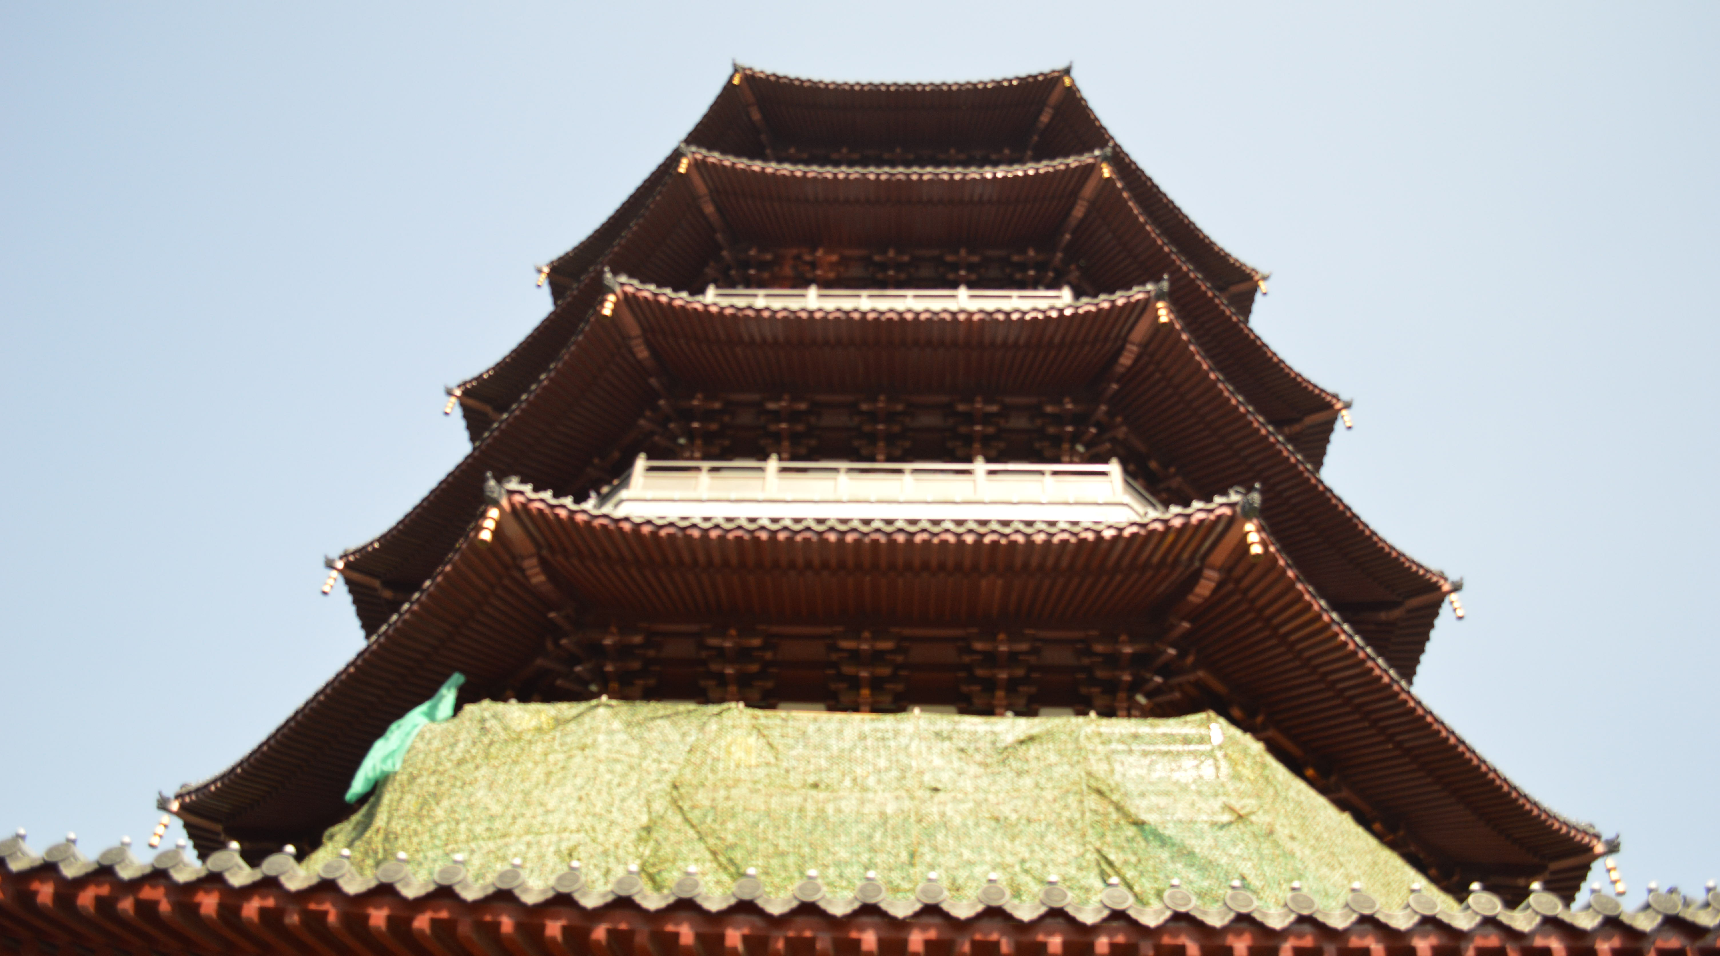
Cultural Infrastructure

Slide 5
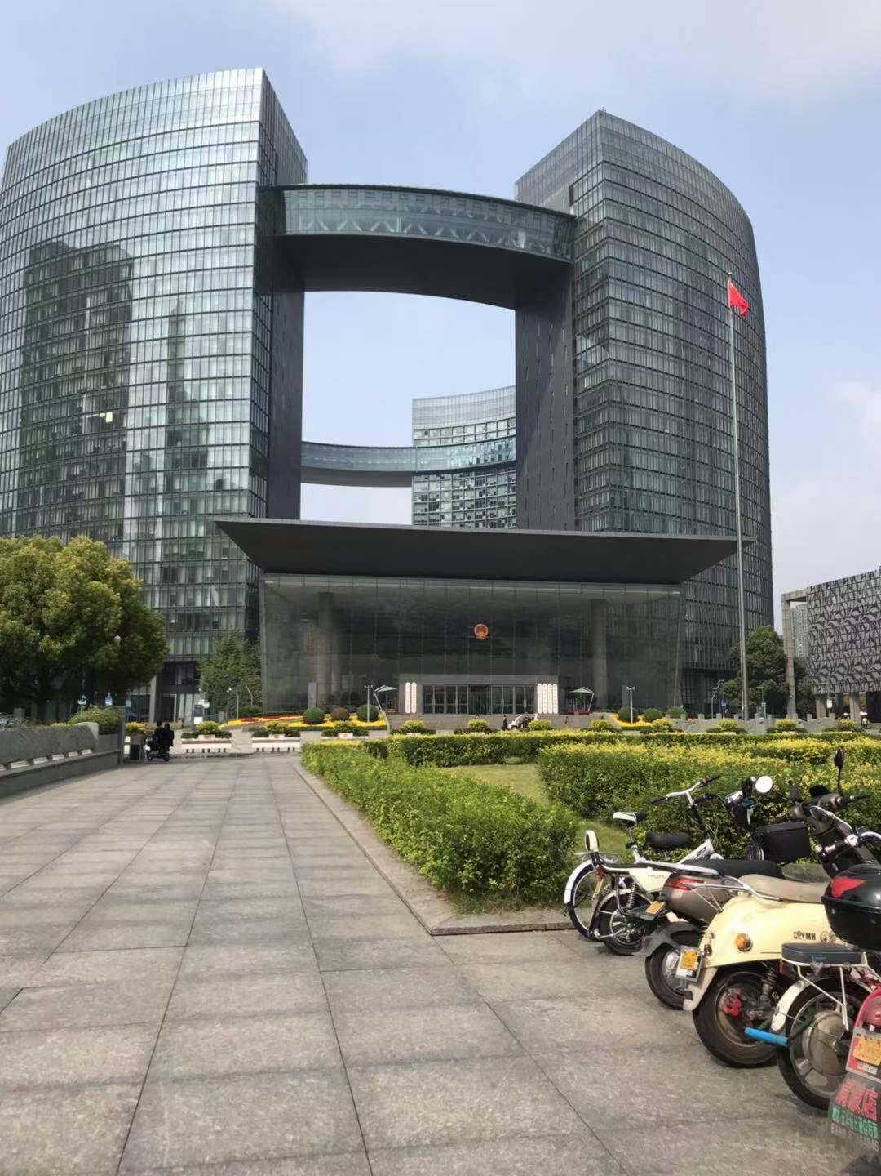
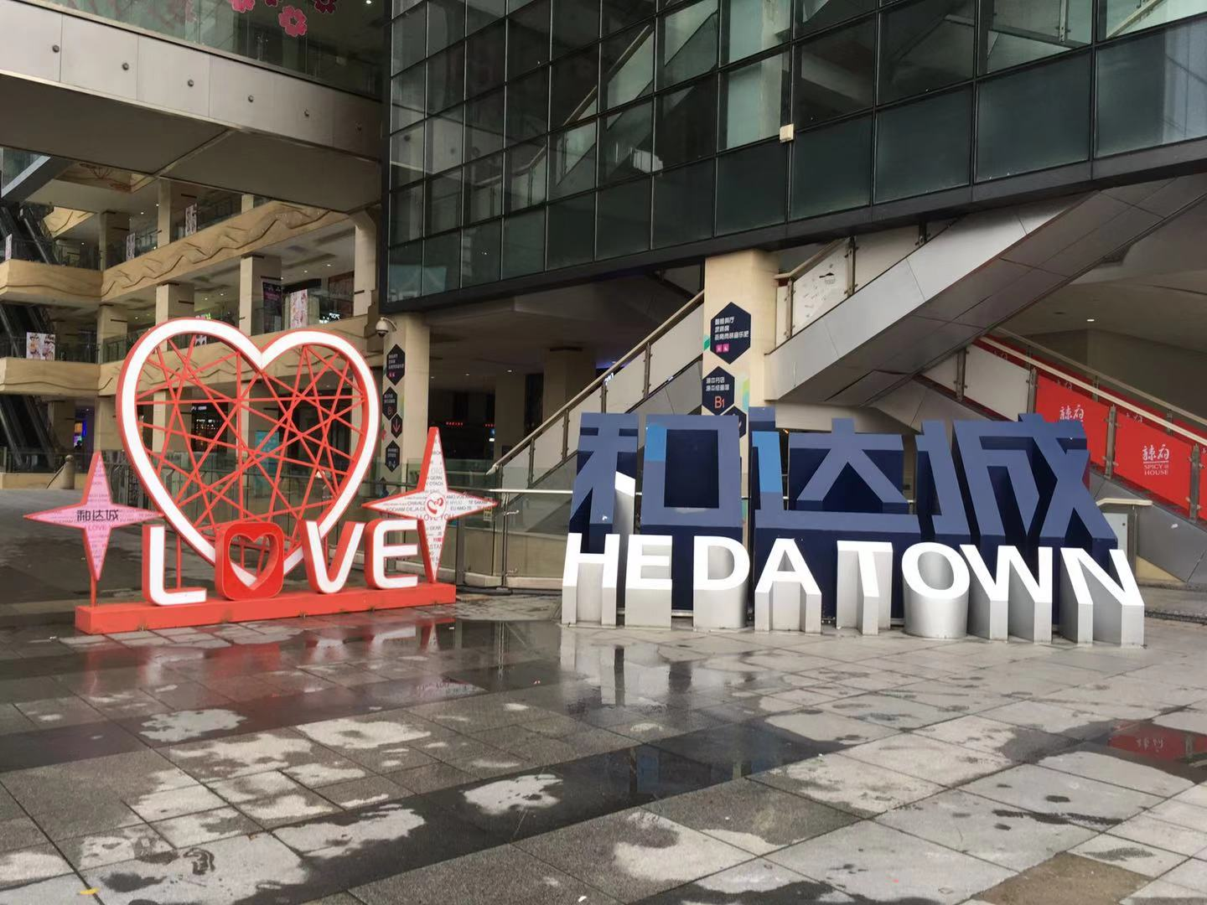
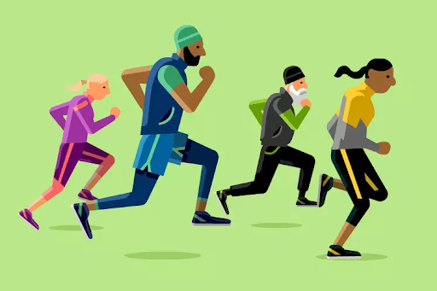
Context
Urban Planning
HEDA
Quality of Life
[1]
Notes:
Lorenzo

Slide 6
Urban Planning
Top – down planning
Designated areas
Disconnect between administration and residents
Hangzhou Public Library
Notes:
Lorenzo

Slide 7
Context
Urban Planning
HEDA
Quality of Life
[1]
Notes:
Jeremy

Slide 8
HEDA - Xiasha
Notes:
Jeremy

Slide 9
Context
Urban Planning
HEDA
Quality of Life
[1]
Notes:
Caroline

Slide 10
Quality of Life
Notes:
Caroline

Slide 11
Quality of Life – Leisure Activity
Team in youth palace ping pong room

Slide 12
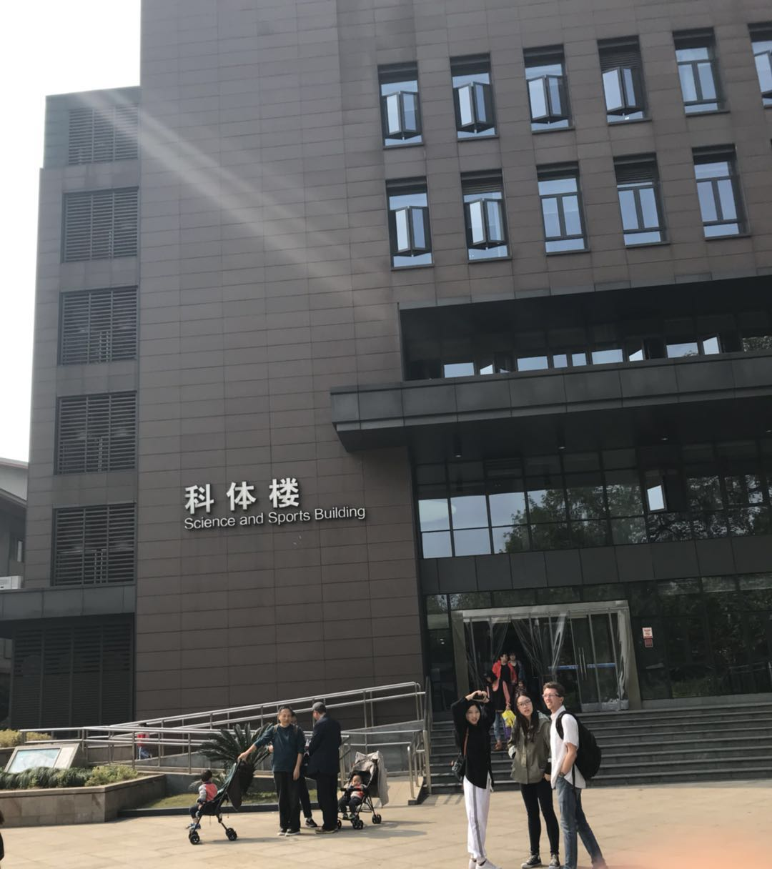
Quality of Life - Education
Hangzhou Dianzi University
Xihu Youth Palace

Slide 13
Quality of Life – Physical Activity
Pool in Suzhou

Slide 14
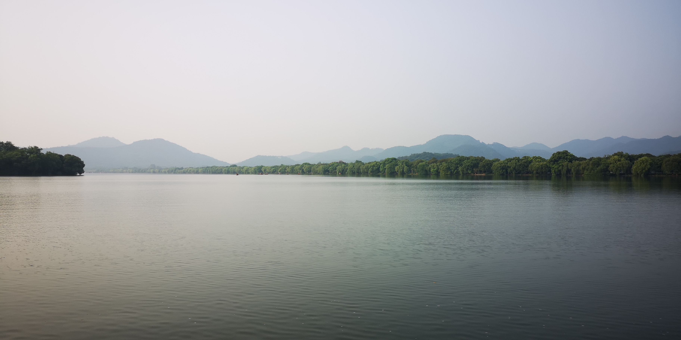
Project Goal
To raise the quality of life in Xiasha by identifying the strengths and weaknesses of its cultural infrastructure and determine how to improve the infrastructure in the future.
[2]
Notes:
Caroline

Slide 15
Casual Interviews

Slide 16
Casual Interviews Locations
Notes:
Alex

Slide 17
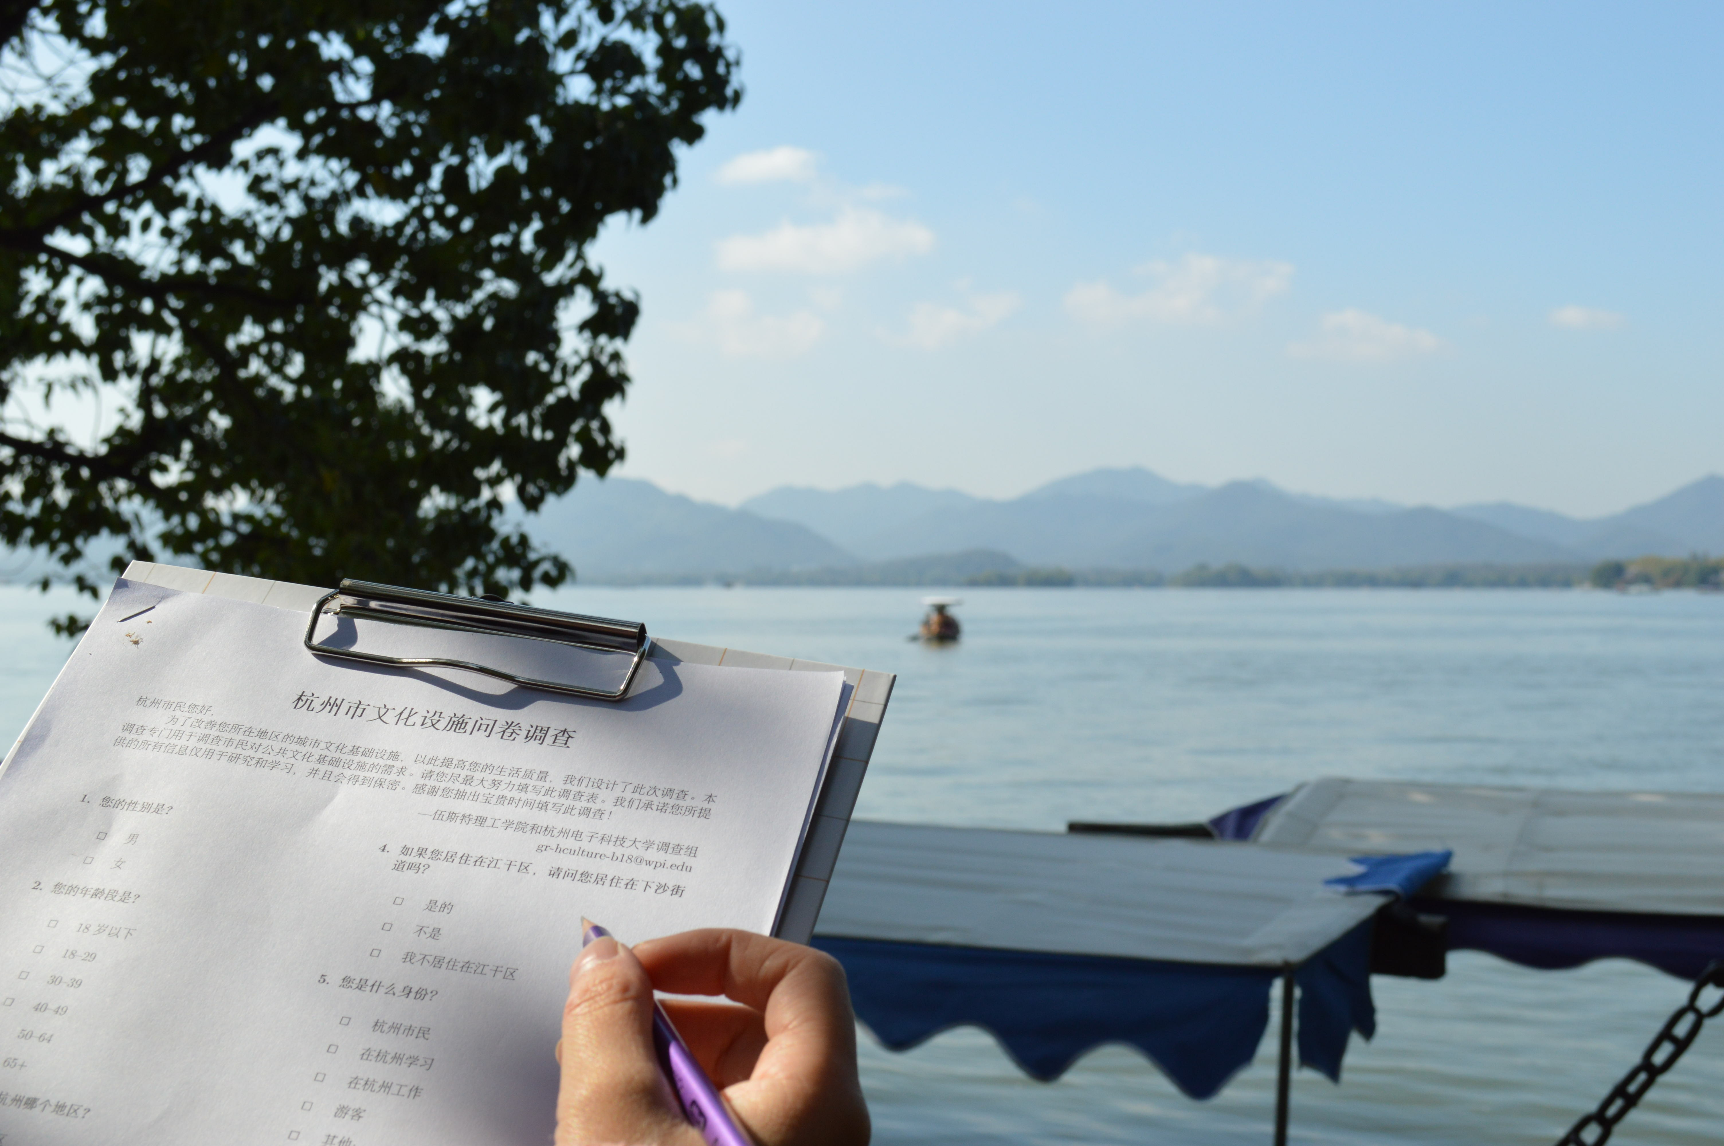
Survey

Slide 18
Survey Locations

Slide 19
Survey - WeChat
[3]
Survey on WeChat Moments
Survey Question on WeChat
Notes:
Caroline

Slide 20
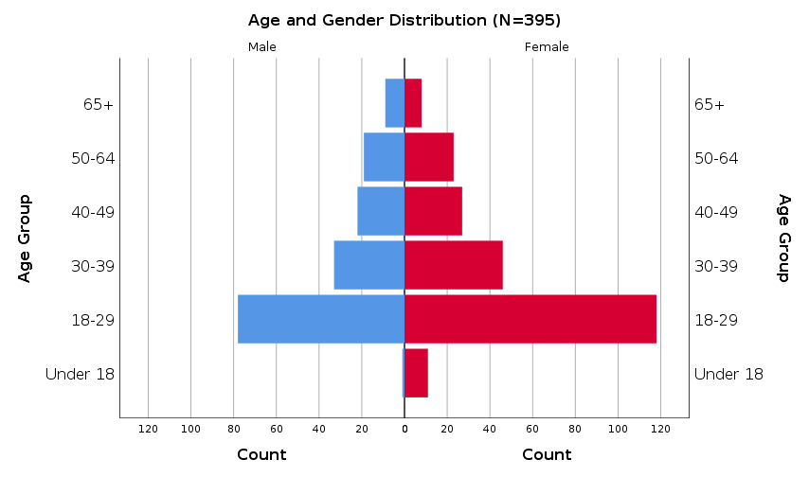
Notes:
Caroline

Slide 21
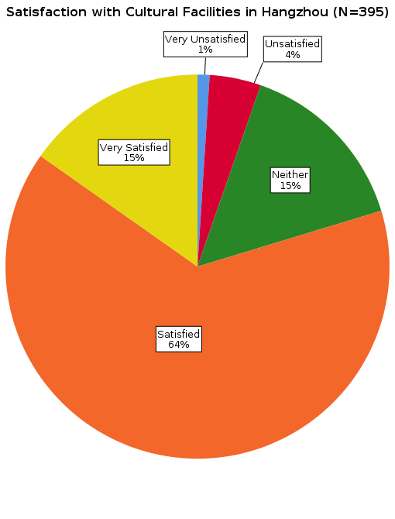

Slide 22
Notes:
Lorenzo

Slide 23
Notes:
Lorenzo

Slide 24
Notes:
Lorenzo

Slide 25
Notes:
Lorenzo

Slide 26
N = 175
N = 64
Notes:
Lorenzo

Slide 27
N = 175
N = 64
Notes:
Lorenzo

Slide 28
N = 175
N = 64
Notes:
Caroline

Slide 29
N = 175
N = 64
Notes:
Caroline

Slide 30
N = 175
N = 64
Notes:
Alex

Slide 31
N = 175
N = 64
Notes:
Alex

Slide 32
N = 175
N = 64
Notes:
Jeremy

Slide 33
N = 175
N = 64
Notes:
Jeremy

Slide 34
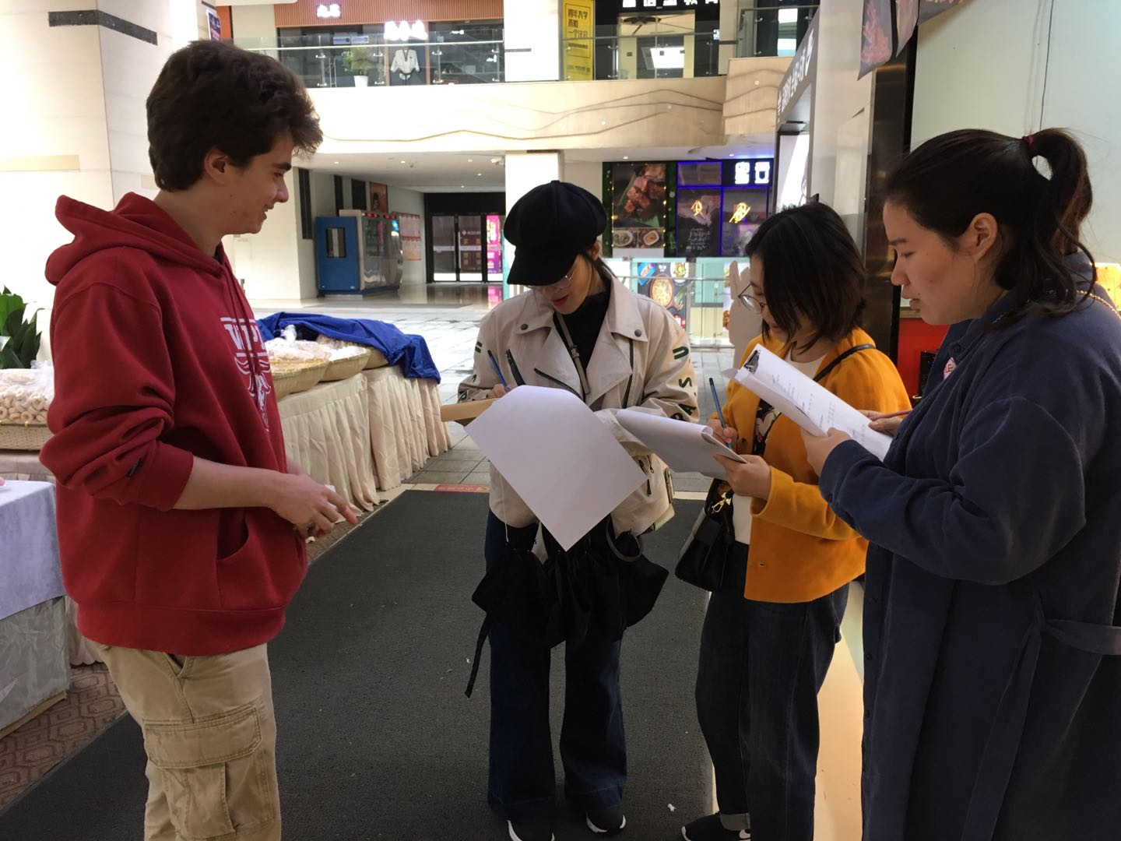
Recommendations for Xiasha Government
Refurbish Facilities
Outdoor Exercise Equipment
Build Facilities
Youth Palaces
Museums
Public Libraries
Sports Facilities
Parks
Notes:
Lorenzo

Slide 36
Thank you
谢谢
Questions?
问题?
Notes:
Alex

Slide 37
Image Sources
[1] Photo Credit: Wen
[2] Birmingham, C. (2016, August 23). [Runners]. Retrieved from https://www.nytimes.com/2018/08/29/well/move/exercise-now-sit-in-front-of-the-tv-later.html
[3] Wjx.cn
[4] Check. Retrieved from https://www.clipartmax.com/so/check-mark-clip-art-free/.

Slide 38
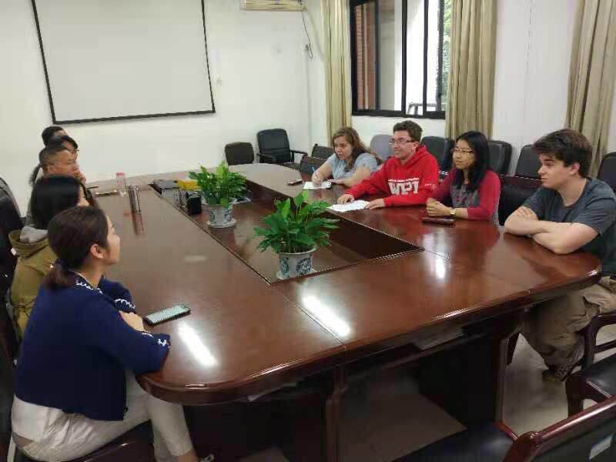
Interview Quote – HDU Professor
“Xiasha has big demand for cultural infrastructure because of the new growth and economic growth, [which have] advanced and developed.”

Slide 39
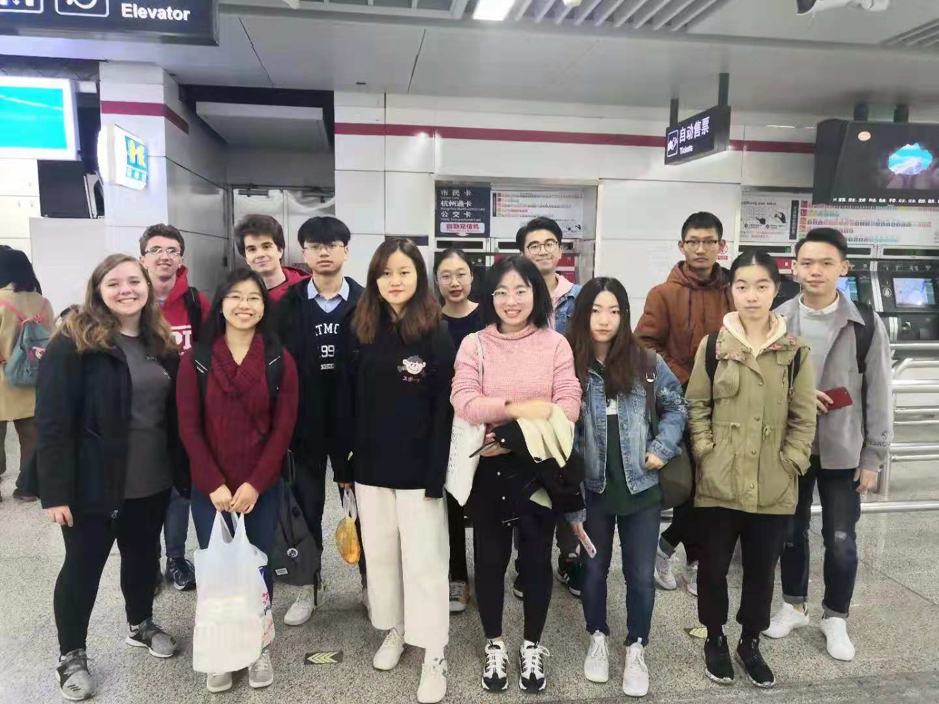
Interview Quote - Student
“[I] like to go and watch the shows, but [I] do not go often [because they are] too far away and traffic is often inconvenient.”

Slide 40
[7]

Slide 41
Per Capita Metric
Facility Type | Number of Facilities | Number per 100k Residents
Arts and Entertainment | 8 | 4.4
Libraries | 9 | 5.0
Museums | 6 | 3.3
Parks | 21 | 11.6
Sports Facilities | 14 | 7.7

Slide 42
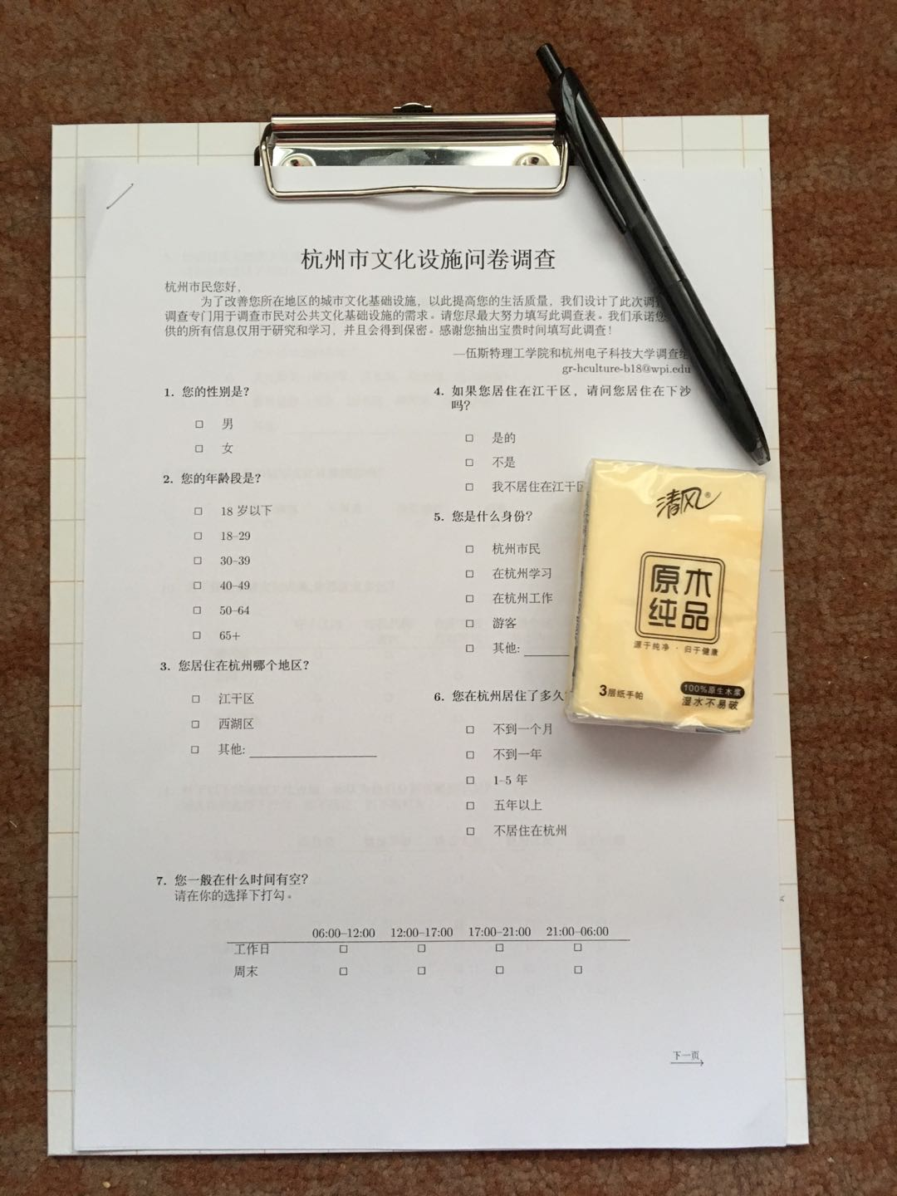
Survey
All surveys in folders
Survey with small gift of tissues

Slide 43
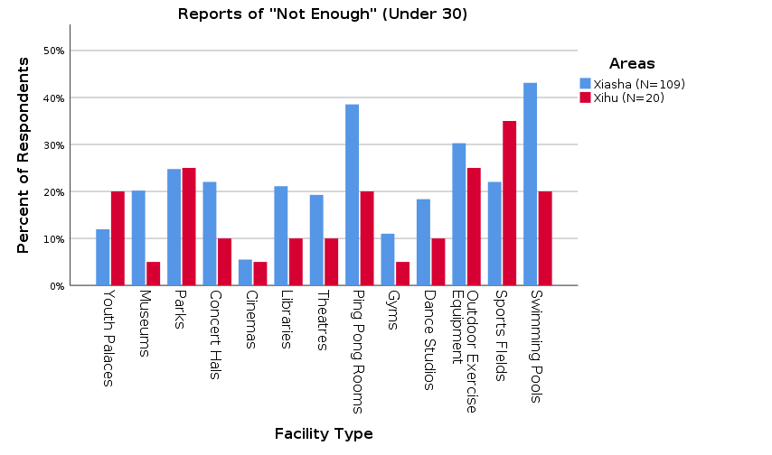

Slide 44
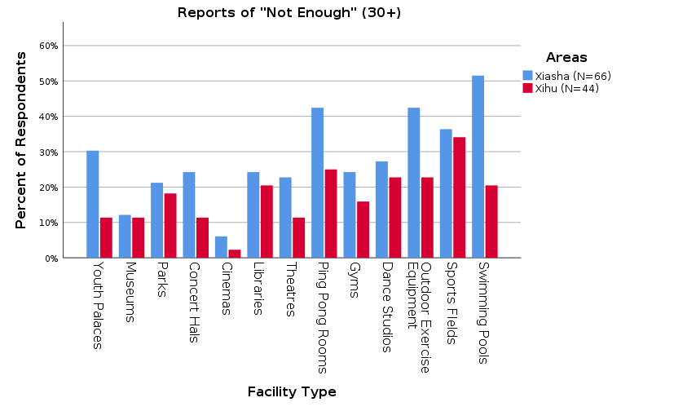

Slide 45
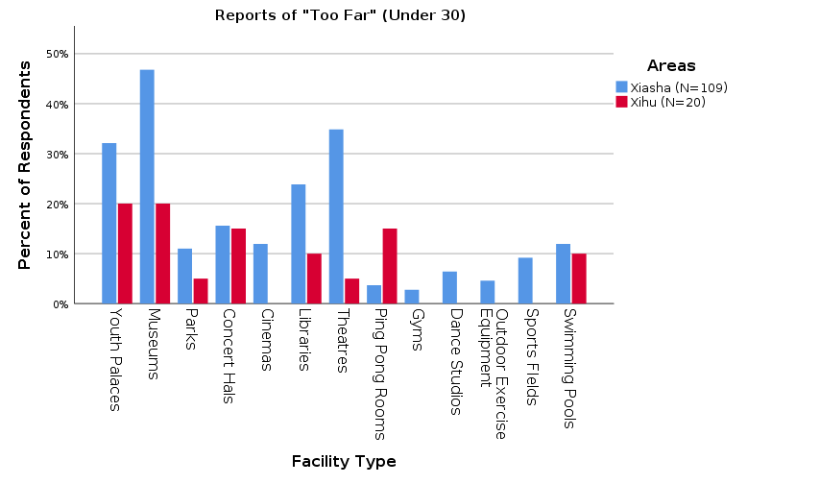

Slide 46
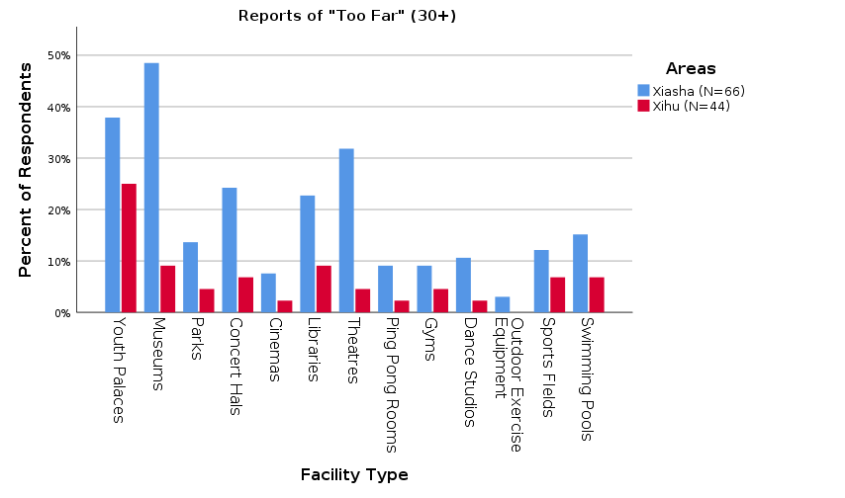

Slide 47
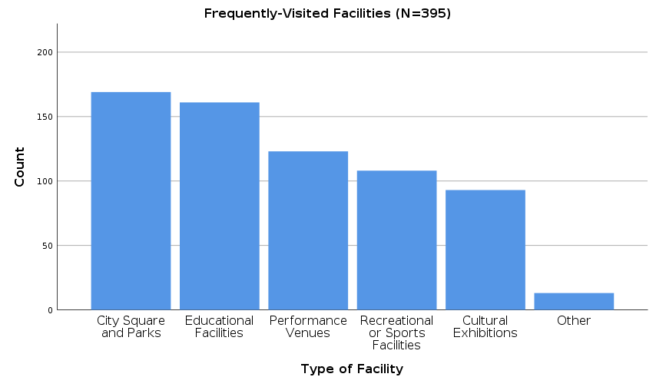

Slide 48
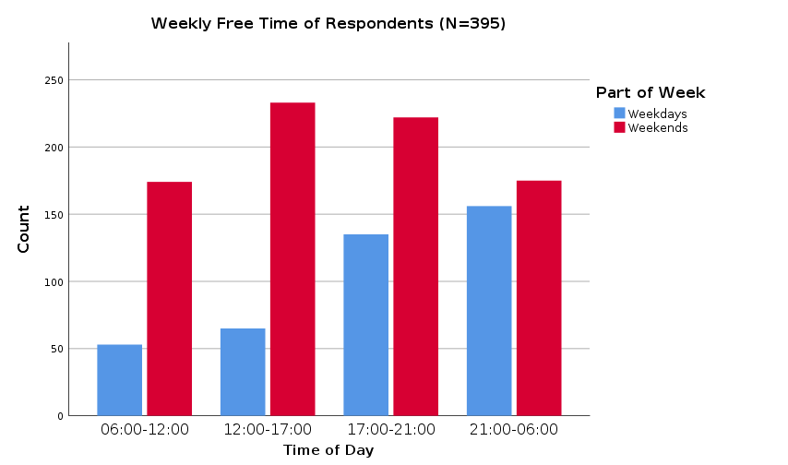

Slide 49
