Slide 1
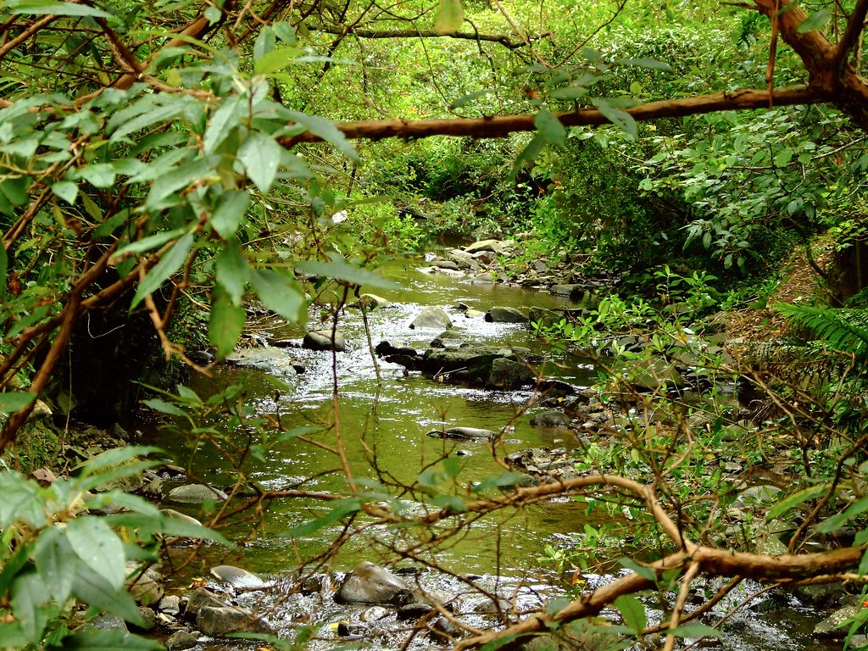
ASSESSING THE MAURI OF THE KAIWHARAWHARA CATCHMENT
Grant Kortfelt
Thomas O'Leary
Benjamin Petrich
John Sirois

Slide 2
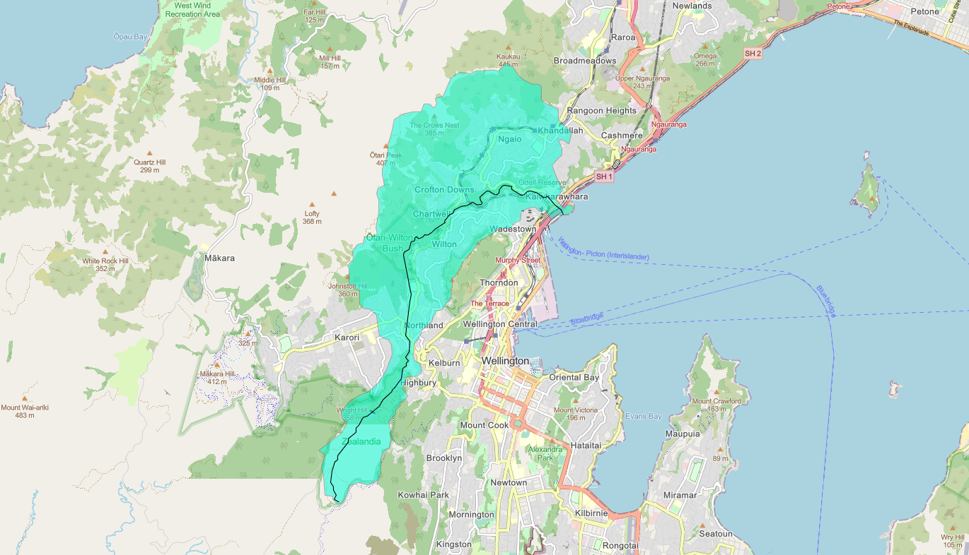
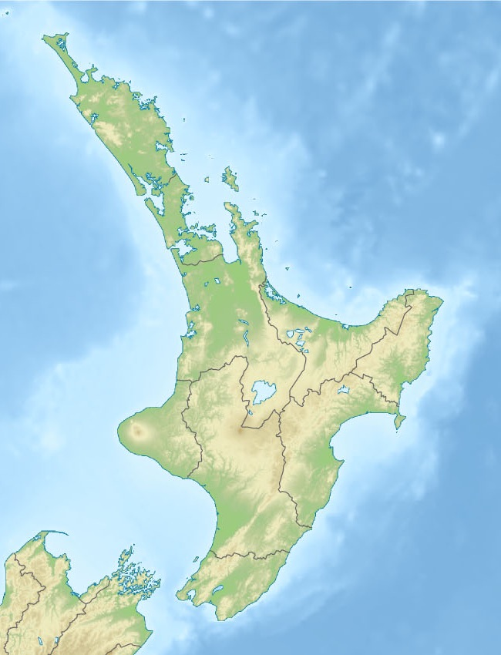

Slide 3
KAIWHARAWHARA CATCHMENT
CONTAMINATION
UNORGANIZED DATA

Slide 4
These contamination sources impact mauri
RETIRED LANDFILLS
SEWAGE LEAKS
WATER
FOREST
PEOPLE

Slide 5
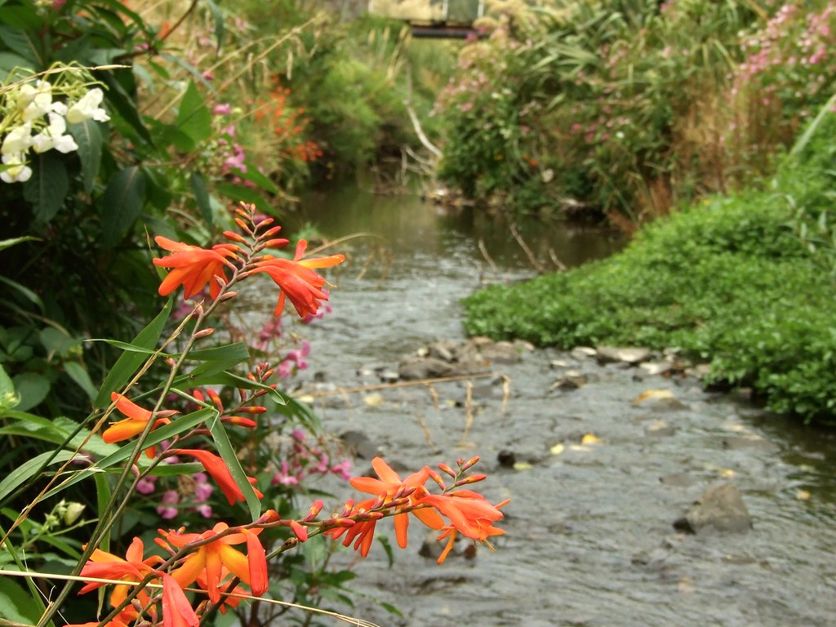
Nature’s Rights
Natural entities can be granted personhood

Slide 6
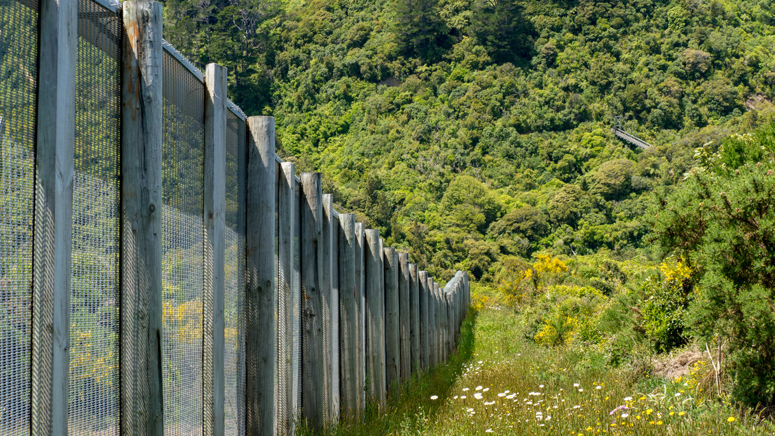
Zealandia Wildlife Sanctuary
6
Fenced-in wildlife sanctuary
At the head of the stream
Working to restore the catchment

Slide 7
Goal
To partner with Zealandia Sanctuary to Sea to develop a framework for characterizing the mauri of the Kaiwharawhara catchment.

Slide 8
We will complete the following objectives
ORGANIZE
IDENTIFY
COMMUNICATE

Slide 9
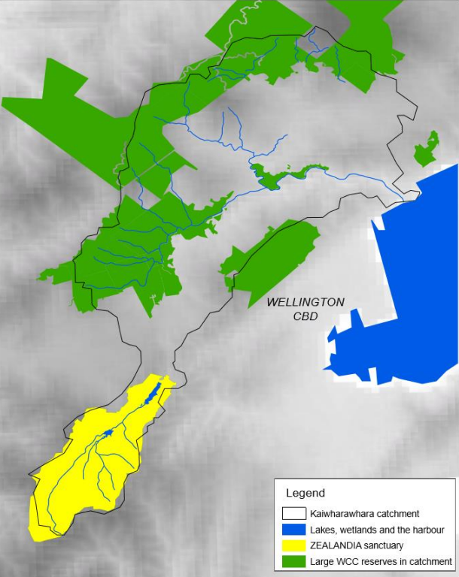
We will organize existing data
SITE ASSESSMENT
GIS MAPPING
CONSOLIDATE ARCHIVES

Slide 10
We will identify areas of improvement
EVALUATE MAURI
INTERVIEW EXPERTS

Slide 11
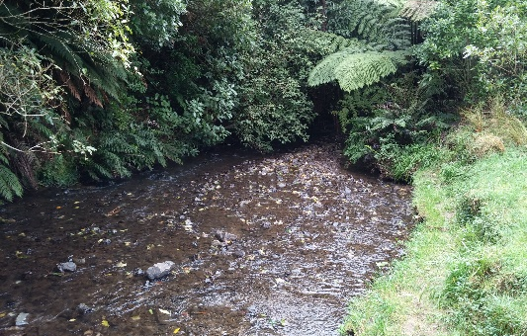
We will communicate our findings
DASHBOARD
USER TESTING
PRESENT TO IWI

Slide 12
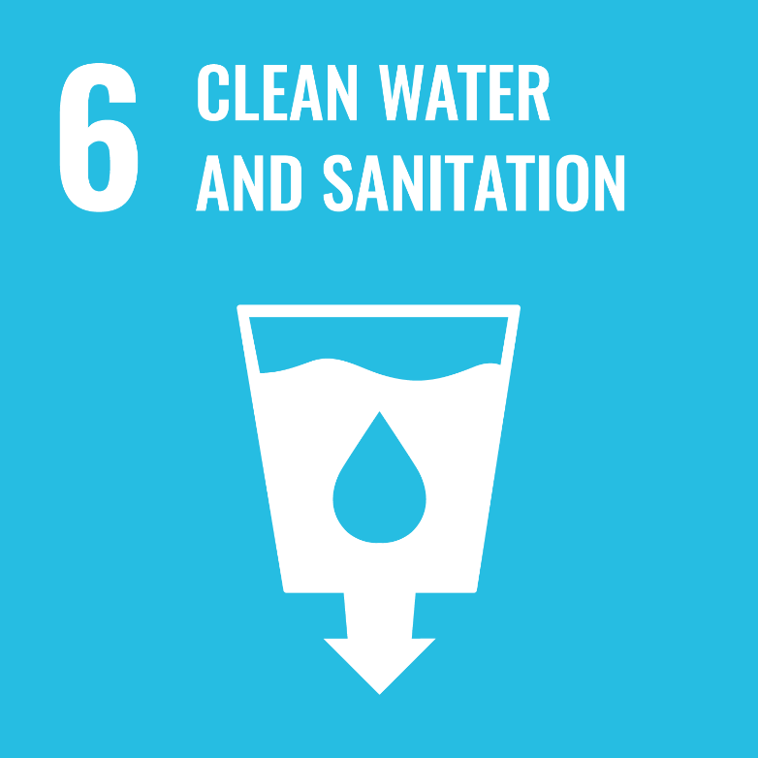
We hope that our project contributes the framework necessary for analyzing the mauri of the Kaiwharawhara catchment.

Slide 13
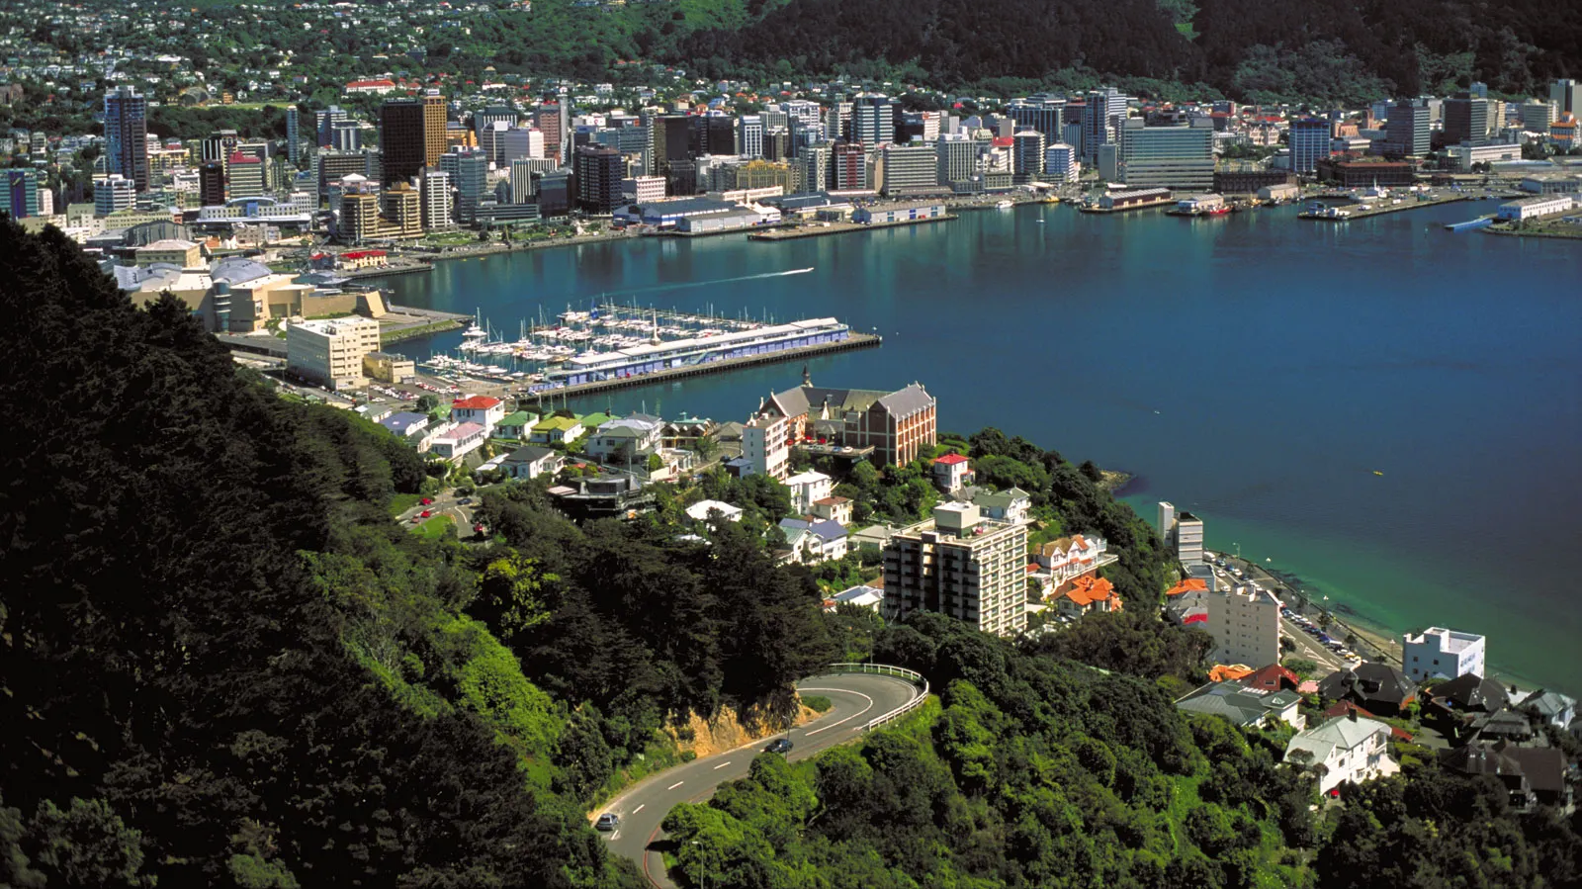
Thank you for your time!
13

Slide 14
Image Credits
WPI Logo (1): https://upload.wikimedia.org/wikipedia/en/thumb/e/ec/WPI_logo.svg/1200px-WPI_logo.svg.png
Zealandia Logo (1, 6): https://raisely-images.imgix.net/zealandia-donations/uploads/zealandia-orange-black-2-png-7b8c5c.png?fit=max&w=1000&auto=format&q=62
Cover Slide (1): https://live.staticflickr.com/2135/2263998309_21fa210a28_b.jpg
New Zealand North Island (2): https://upload.wikimedia.org/wikipedia/commons/f/fa/New_Zealand_North_Island_relief_map.jpg
Map of Wellington and Catchment (2): Grant Kortfelt via ArcGIS
Kaiwharawhara Catchment (3): https://digitalnz.org/records/31928803
Kaiwharawhara Personhood (5): https://live.staticflickr.com/2040/2264798112_4b8356edcc_b.jpg
Zealandia Fence (6): https://static.sciencelearn.org.nz/images/images/000/003/677/full/ART_Weasel_incursion_at_Zealandia_ZEALANDIA's_fence.jpg?1674171507
Zealandia Map (9): Zealandia. (2018). Sanctuary to Sea Strategy 2018-2028 (p. 5).
Kaiwharawhara Stream (11): https://upload.wikimedia.org/wikipedia/commons/b/b2/Wilton%2C_Wellington_6012%2C_New_Zealand_-_panoramio.jpg
UN Sustainability Goals (12): https://unosd.un.org/content/sustainable-development-goals-sdgs
Wellington Harbor (13): https://cdn.britannica.com/72/74872-050-743569FA/Wellington-top-Mount-Victoria-New-Zealand.jpg

Slide 15
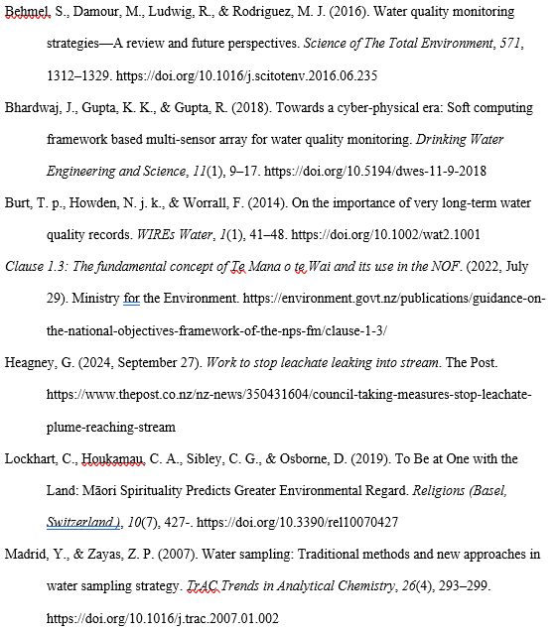
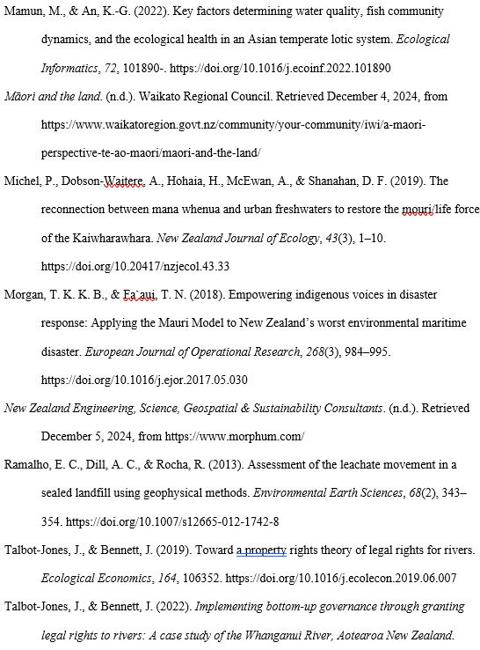
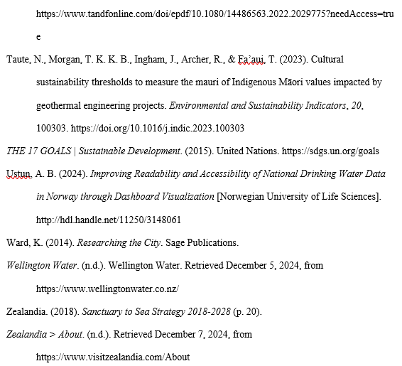
References

