Slide 1
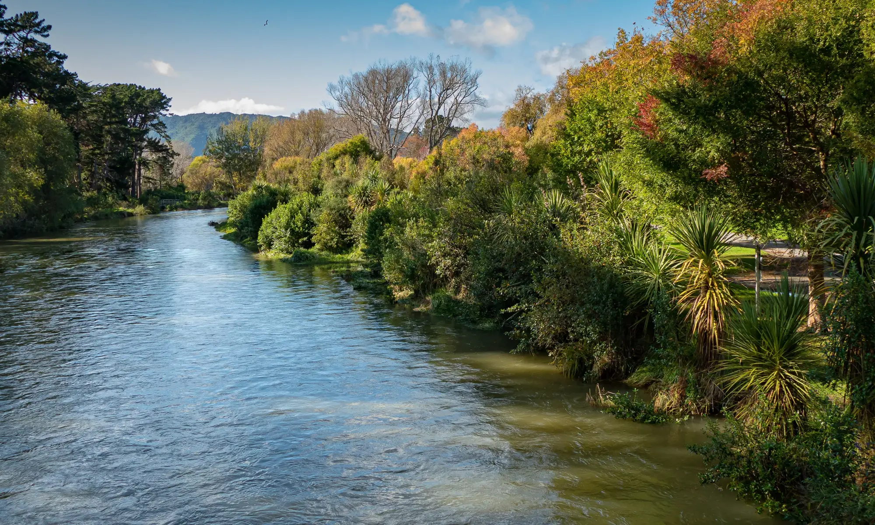


[1]
Understanding Perceptions of the Waikanae River Trail
BETHANY BROWN LORENZO CASSANO CHAUNCEY MICHAEL ZACH ZOLADZ

Slide 2
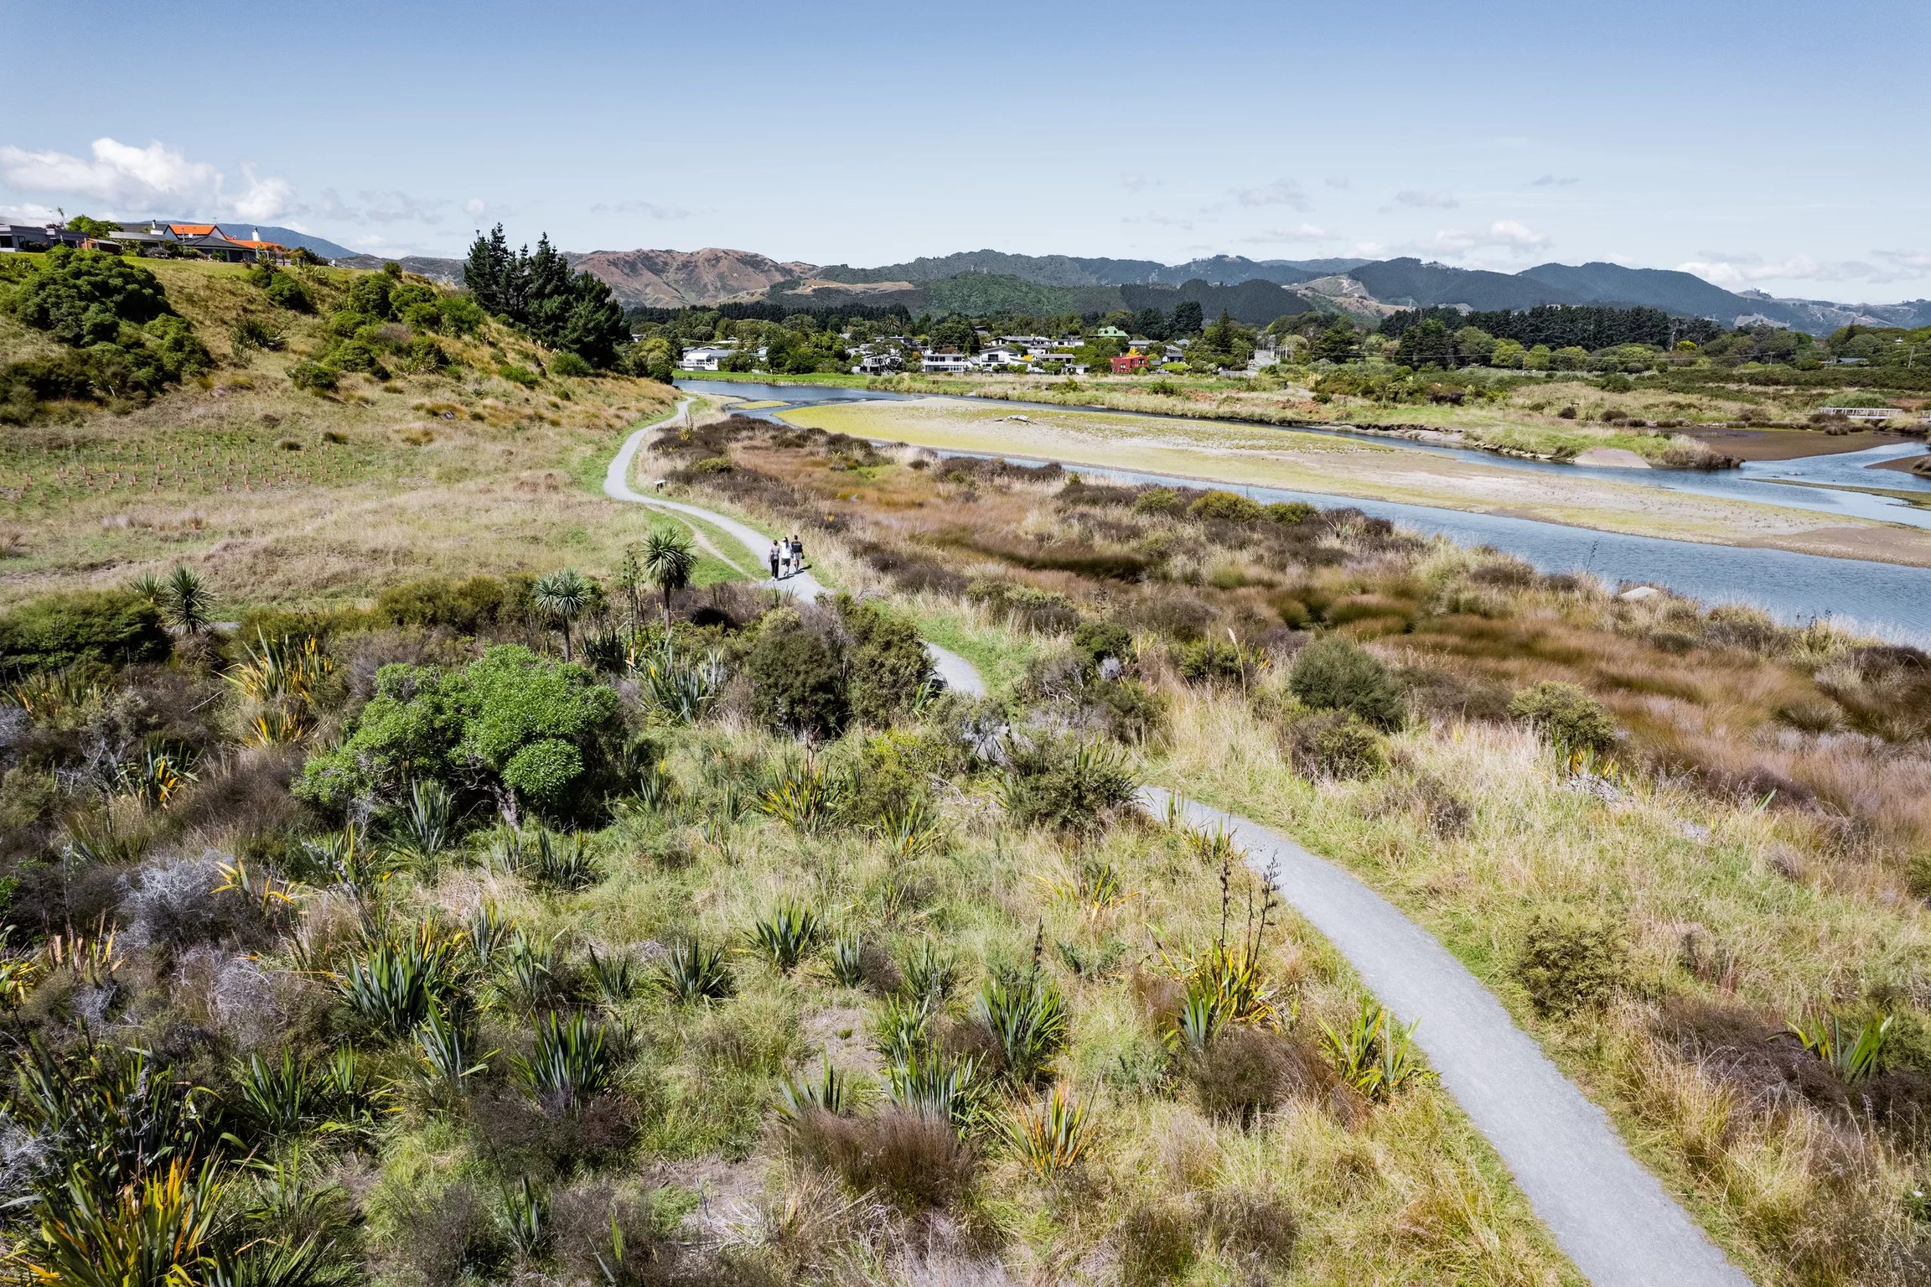
THE WAIKANAE REGION IS A DYNAMIC ENVIRONMENT
[2]
1

Slide 3
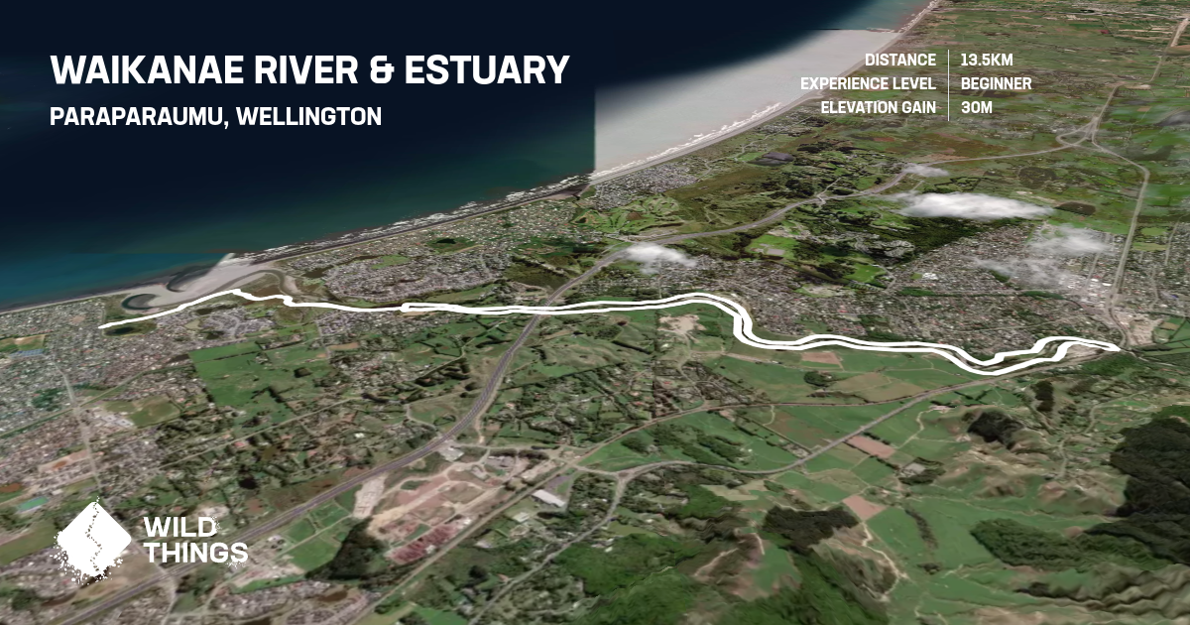
A VITAL NETWORK CONNECTING COMMUNITY AND NATURE
[3]
2

Slide 4





TRAILS FACILLITATE COMMUNITY ENGAGEMENT
3

Slide 5
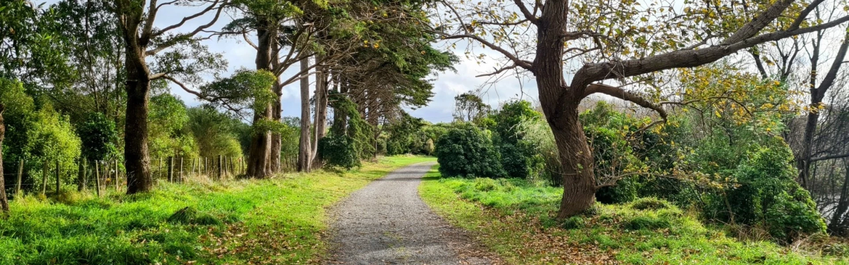
Understand evolving perceptions of Waikanae River Trails and assist the GWRC in maintaining this shared space
[4]
4

Slide 6
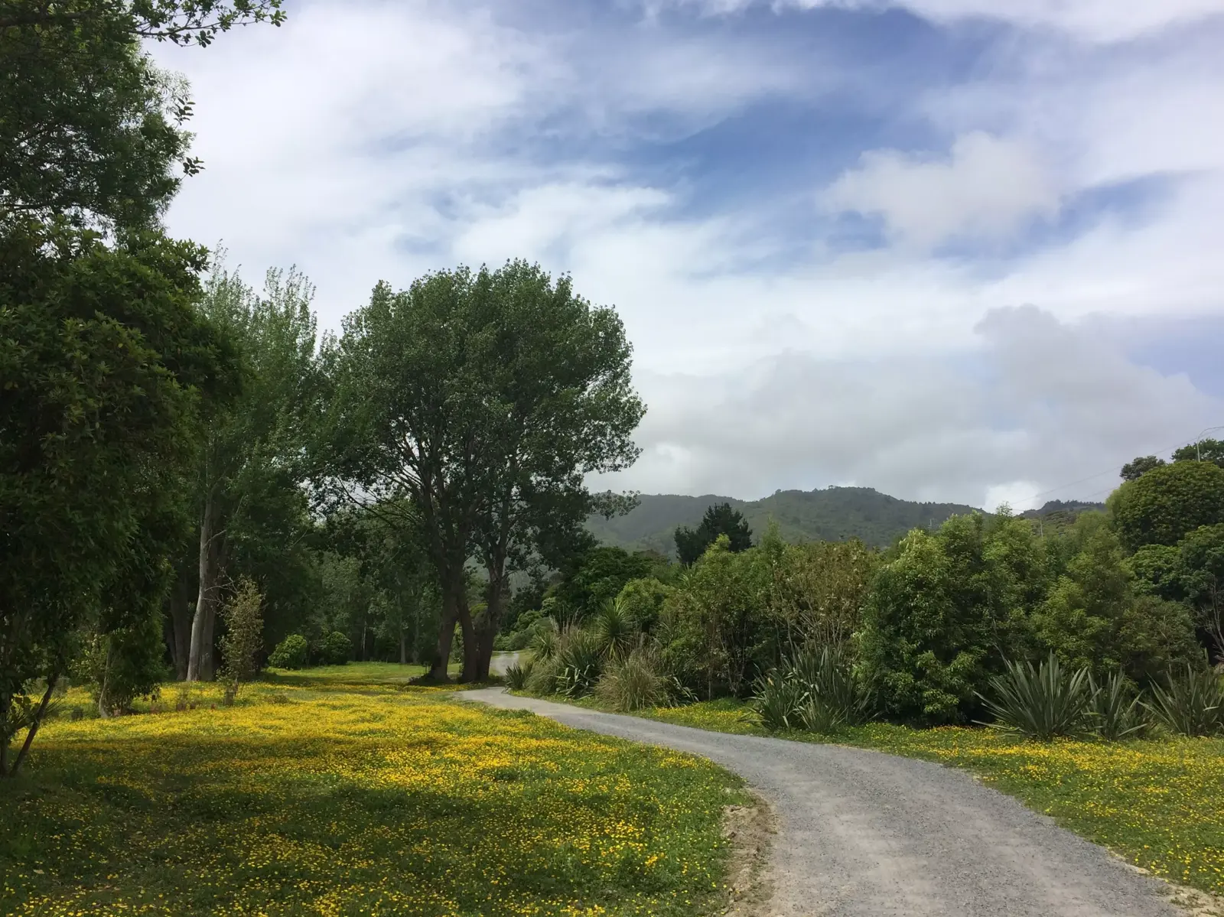



Observe and understand community interactions with the trails
Evaluate user perceptions of the trail system
Identify strategies to enhance user experience and trail conditions
[5]
5

Slide 7
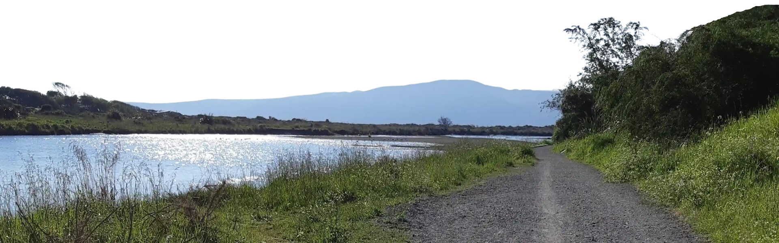
Observe and understand community interactions with the trails
  Participant observations
  Photographic documentation
  Semi structured expert interviews
[6]
6

Slide 8
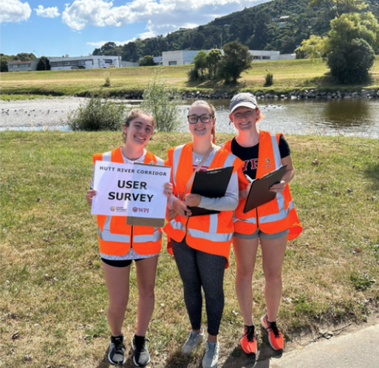
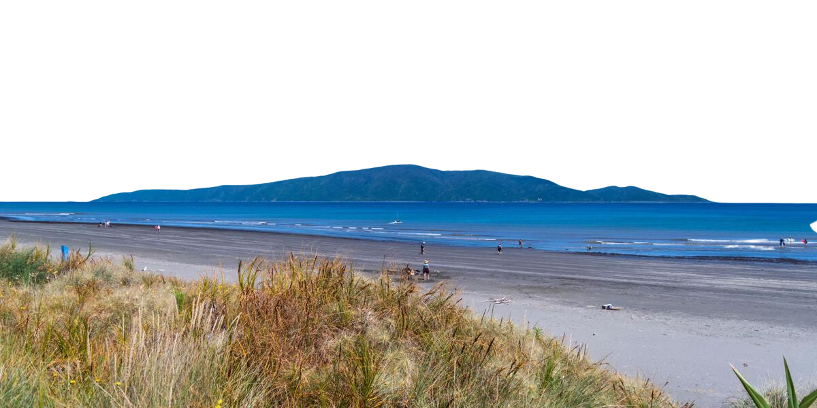
Evaluate user perceptions of the trail system
  On-site surveys
  Online survey links posted at trails
[10]
[7]
7

Slide 9
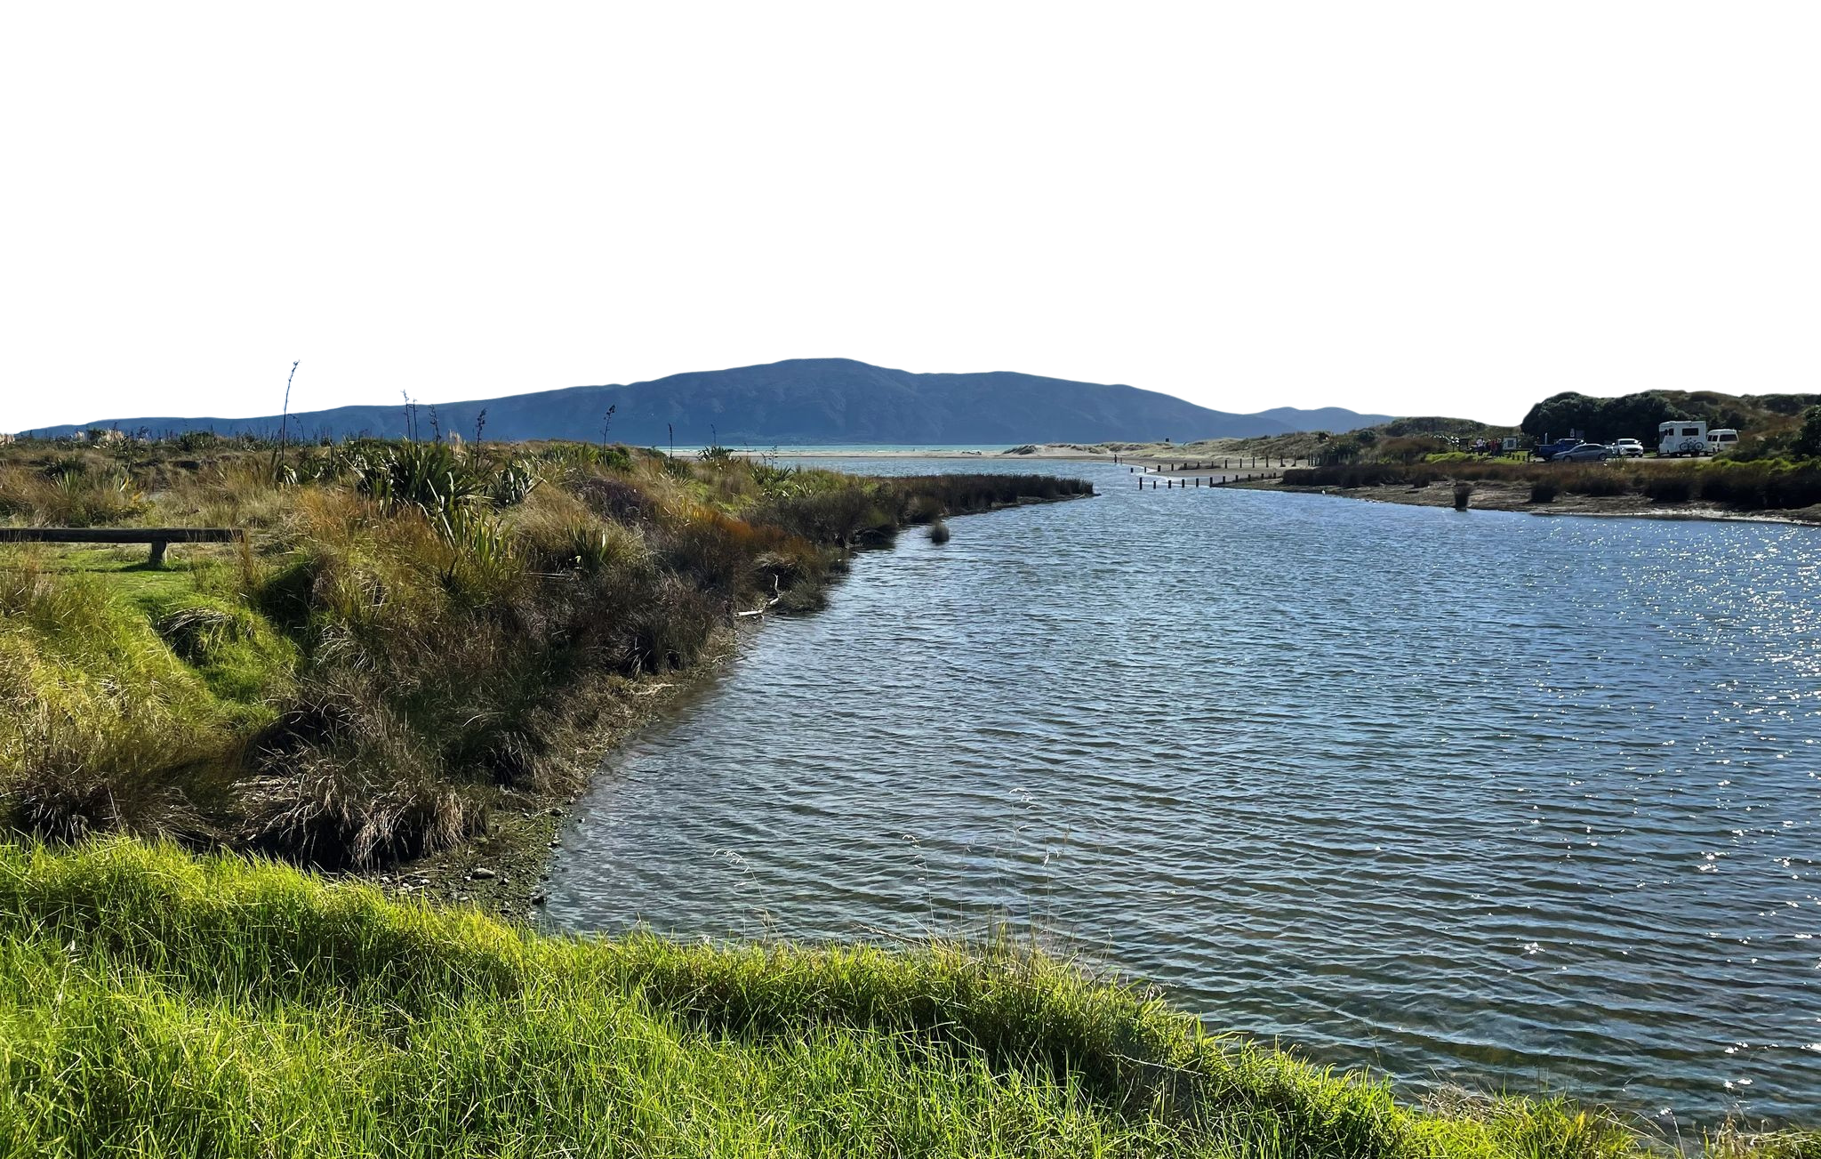
Identify strategies to enhance user experience and trail conditions
  Identify thematic frameworks
  Determine user goals
[8]
8

Slide 10
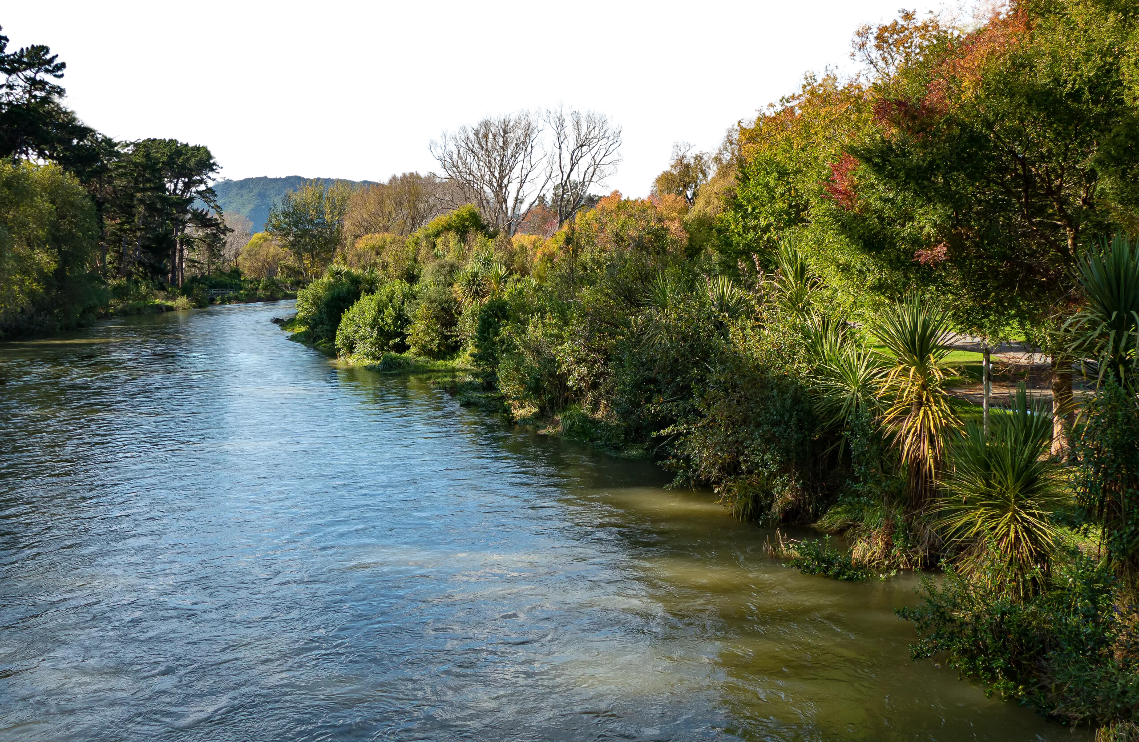
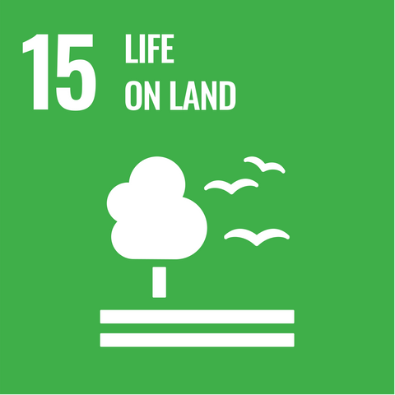
[1]
THE PATH FORWARD
9

Slide 11
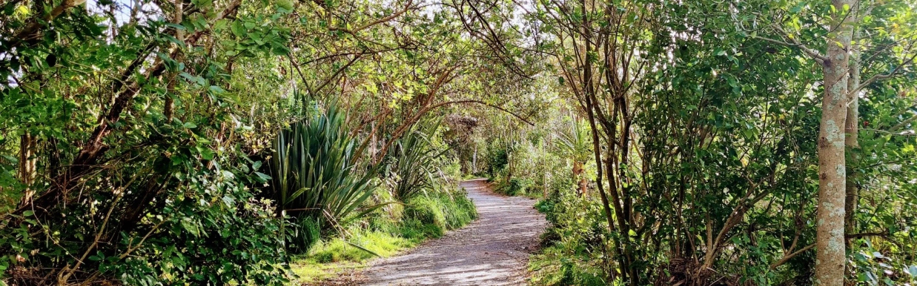
ACKNOWLEDGEMENTS
Thank you to Professor Kinicki and Professor Shockey
Special thanks to Ross Jackson & partners at the GWRC
[9]
[6]
10

Slide 12

Thank you!
ANY QUESTIONS?
Bethany Brown
Lorenzo Cassano
Chauncey Michael
Zach Zoladz

Slide 13
References:
Greater Wellington Regional Council. (1997). Waikanae Floodplain Management Plan. https://www.gw.govt.nz/assets/Documents/2022/05/FP-Waikanae-FMP.pdf
Greater Wellington Regional Council. (2014, October). Waikanae River Environmental Strategy. Greater Wellington Regional Council.
Greater Wellington Regional Council. (2017, October). Waikanae River mouth - historic aerials [PDF]. Greater Wellington Regional Council.
Greater Wellington Regional Council. (2021, November). Whaitua Te Whanganui-a-Tara (Publication No. GW/EP-G-21/58). Greater Wellington Regional Council. https://gw.govt.nz/whaitua-te-whanganui-a-tara
Kāpiti Coast District Council. (n.d.). Our district’s history - Kāpiti Coast District Council. https://www.kapiticoast.govt.nz/community/community-insights/district-history/
Peddie, A., Carim, L., Valentiner Morrison, B., & Marrocco, F. (2024). Shared Spaces: Understanding Perceptions of Te Awa Kairangi Hutt River Corridor. Worcester Polytechnic Institute.
Top trails on the Kāpiti Coast. (n.d.). WellingtonNZ. https://www.wellingtonnz.com/visit/trails/top-trails-on-the-kapiti-coast
Images:
[1] Smith, R (n.d.). [Waikanae River]. [Photograph]. WellingtonNZ. https://www.wellingtonnz.com/visit/trails/waikanae-river-trail
[2] RoadyNZ. (n.d.). [Waikanae River Trail]. [Photograph]. WellingtonNZ. https://www.wellingtonnz.com/visit/trails/waikanae-estuary
[3] Wild Things Club. (n.d.). Waikanae River and Estuary. Retrieved December 6, 2024, from https://www.wildthings.club/trails/wellington/paraparaumu/waikanae-river-and-estuary/
[4] Plan My Walk. (n.d.). [Waikanae Trail]. [Photograph]. Plan My Walk. https://planmywalk.nz/tracks/waikanae-river-trail
[5] WellingtonNZ. (n.d.). [Gravel Trail]. [Photograph]. WellingtonNZ. https://www.wellingtonnz.com/visit/trails/waikanae-river-trail
[6] Plan My Walk. (n.d.). [Waikanae Lanscape]. [Photograph]. Plan My Walk. https://planmywalk.nz/tracks/waikanae-river-trail
[7] WellingtonNZ. (n.d.). [Kapiti Coast View]. [Photograph]. WellingtonNZ. https://www.wellingtonnz.com/visit/trails/waikanae-river-trail
[8] Unknown. (n.d.). Waikanae River Trail [Photograph]. AllTrails. https://www.alltrails.com/trail/new-zealand/wellington/waikanae-river-trail/photos
[9] Plan My Walk. (n.d.). [Trail & Trees]. [Photograph]. Plan My Walk. https://planmywalk.nz/tracks/waikanae-river-trail
[10] Peddie, A., Carim, L., Valentiner Morrison, B., & Marrocco, F. (2024). Shared Spaces: Understanding Perceptions of Te Awa Kairangi Hutt River Corridor. Worcester Polytechnic Institute.

Slide 14
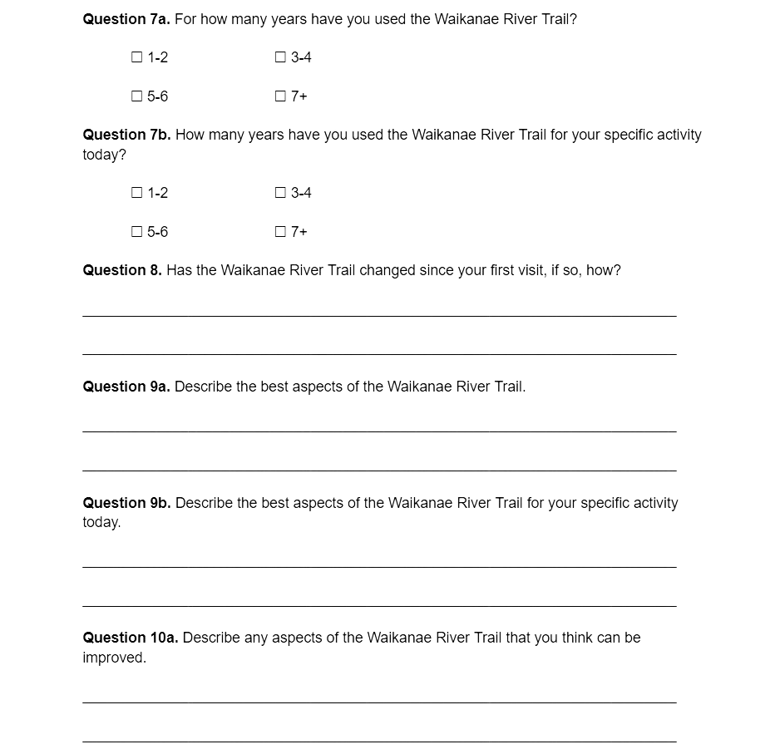
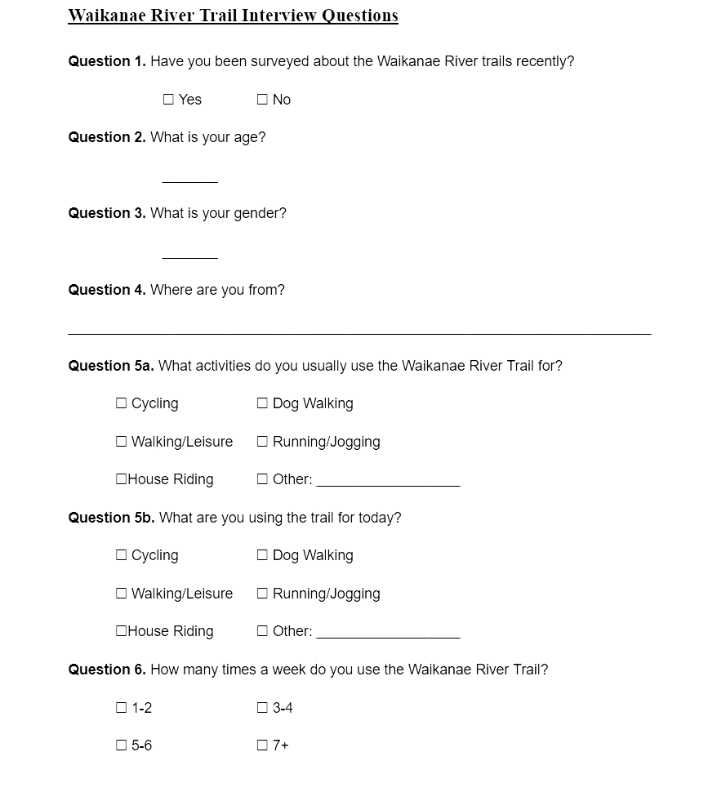
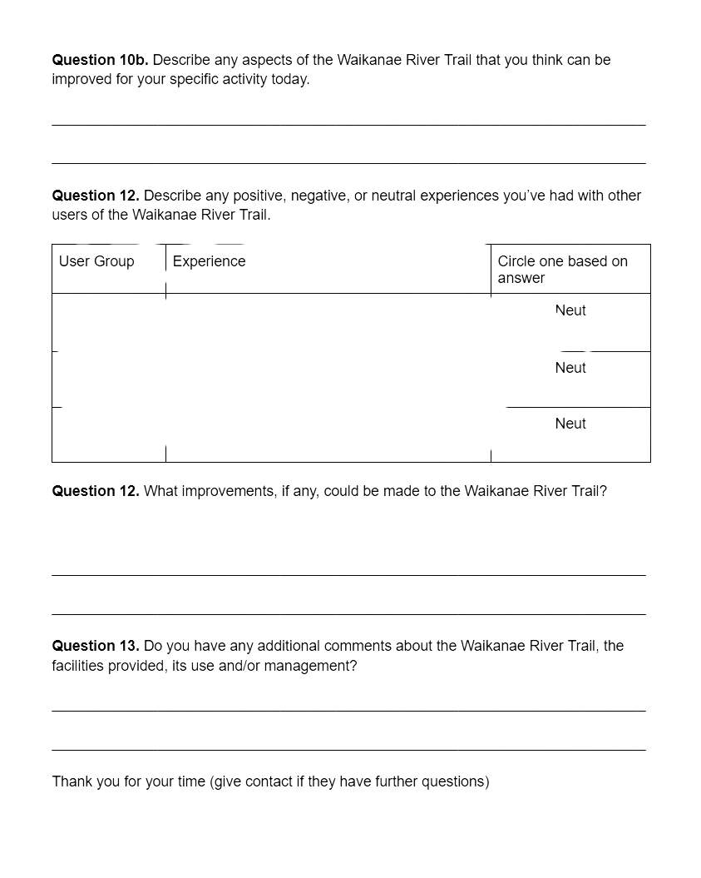
EXAMPLE SURVEY QUESTIONS

