Slide 1
SENIORS TEAM
Improving Senior Involvement in Tech Connect
Mary Braen, Tommy Ciolfi, Kyle Lopez
Notes:
hi

Slide 2
From Bucharest to Worcester
[1]
2

Slide 3
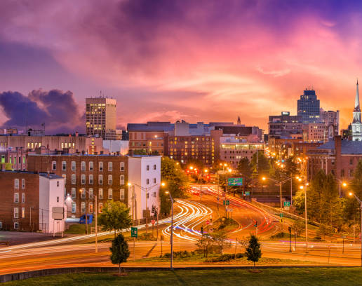
From Bucharest to Worcester
[2]
3

Slide 4
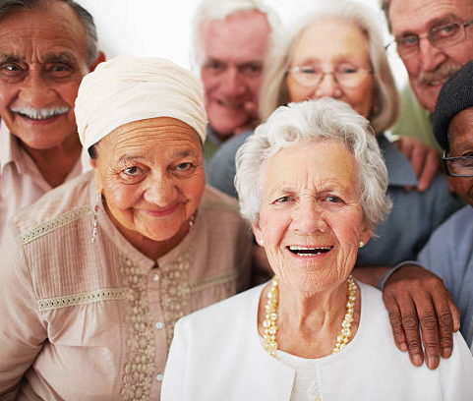
MA Senior Demographics
[3]
Social Security payments:
$13,340 annually for non-married
$21,744 annually for married (1)
Standard costs of living in MA surpass senior income (2)
1:3 without internet access (3)
4
Notes:
The majority of the income for retired seniors comes from their Social Security payments:
$13,340 annually for non-married
$21,744 annually for married (1)
Standard Costs of Living to Social Security Ratio for Worcester County, MA:
1.70 to 1.80 for single seniors
Below 1.60 for married seniors (2)
In Massachusetts, 1 out of 3 seniors aged 65 and older reported not using the internet in 2020 (6
92% of higher-income seniors and 59% of low-income seniors identified themselves as frequent internet users (7)
A single senior lives at an annual financial loss of 70% to 80%
A senior couple lives at an annual financial loss of below 60%
Massachusetts seniors are unable to cover all of their annual costs of living if they solely rely on their Social Security.
seniors require external financial support to alleviate some of the major costs of living.

Slide 5
Impact of Covid-19 Pandemic
[4]
53.57% of seniors in 2022 were classified as depressed compared to 24.9% in 2017 (4)
Telehealth offers a more affordable alternative to traditional physician visits (5)
5
Notes:
Seniors have difficulty accessing needed care and supplies. (6)
Since these services were moved to digital platforms, most seniors were unable to access and benefit from these services
More affordable alternative to traditional physician visit (8)
Requires technology and technological knowledge (9)
The Jefferson Health, a group that provided telehealth services before the pandemic, saw a 10-fold increase in telehealth appointments after the COVID-19 pandemic began.

Slide 6
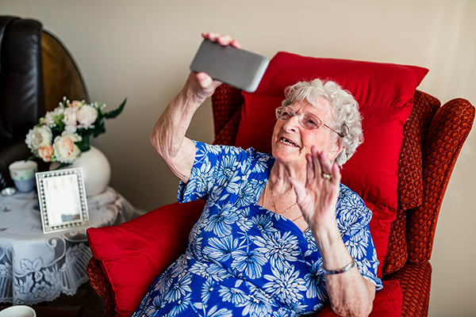
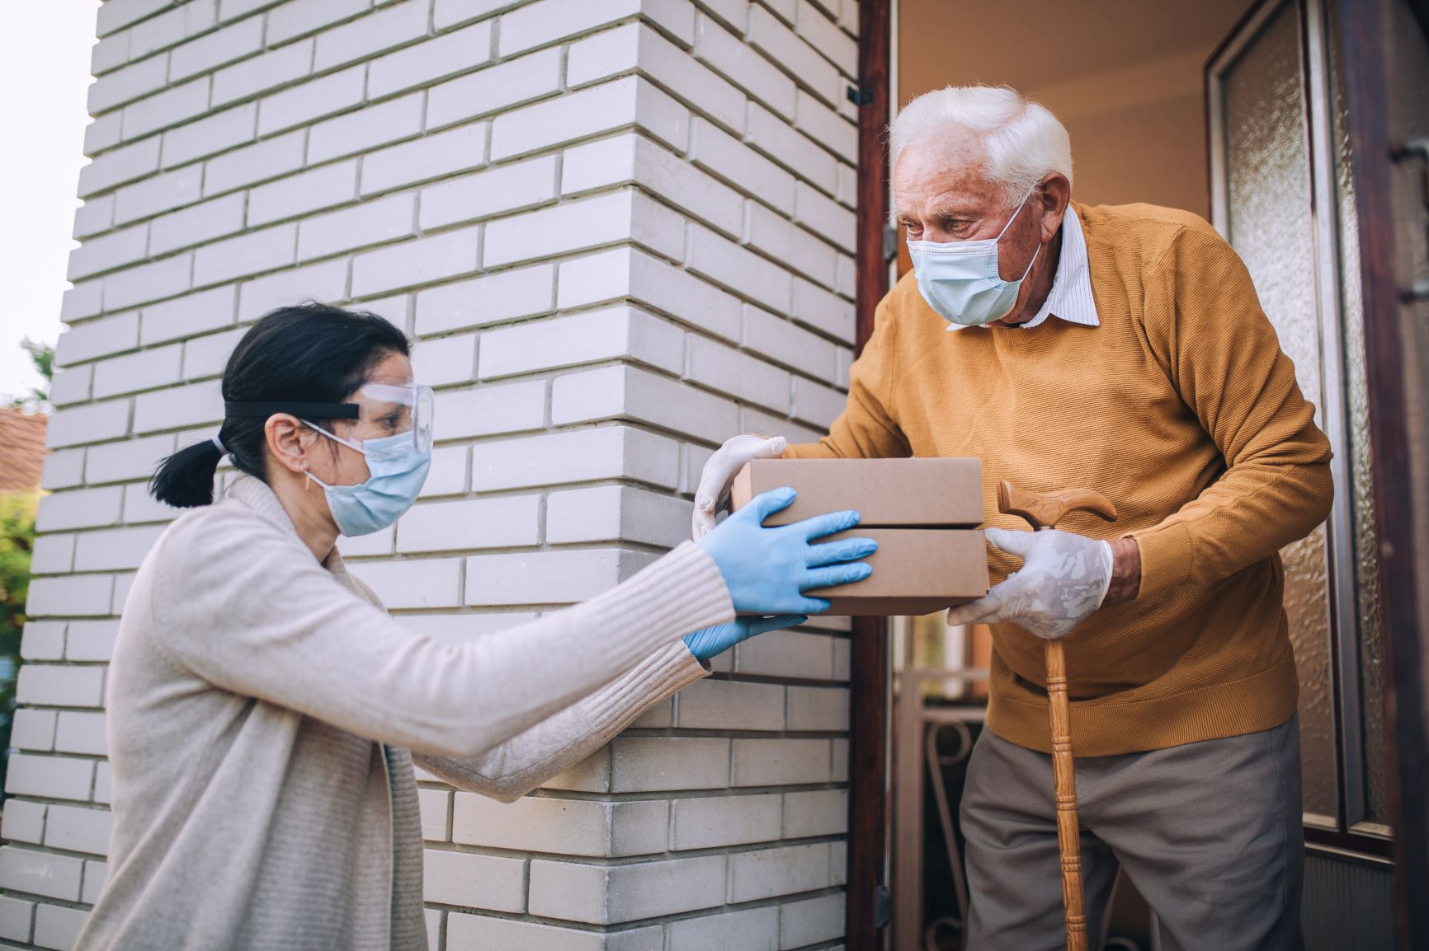
Elder Services of Worcester Area (ESWA)
Offers variety of programs:
Meals on Wheels
Tech Connect program
[5]
[6]
6

Slide 7
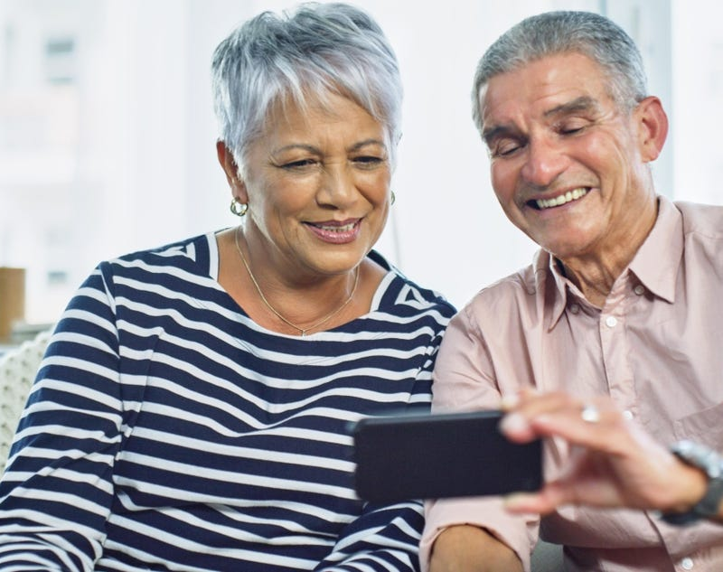
Project Goal:
[7]
The goal of this project is to increase senior involvement in the Elder Services of Worcester Area Tech Connect program.
7

Slide 8
Goals and Objectives
Increase involvement in the Tech Connect program
Goal
Investigate current participation in the Tech Connect program
Objective 1
Create promotional material for the Tech Connect program
Objective 2
Create informational material to increase utilization program
Objective 3
8

Slide 9
Goals and Objectives
Increase involvement in the Tech Connect program
Goal
Investigate current participation in the Tech Connect program
Objective 1
Create promotional material for the Tech Connect program
Objective 2
Create informational material to increase utilization program
Objective 3
9

Slide 10
Methods for Objective 1
Interview Case Managers
Analyze Interview Results
Interview Former Tech Connect Consumers
Analyze Interview Results
10

Slide 11
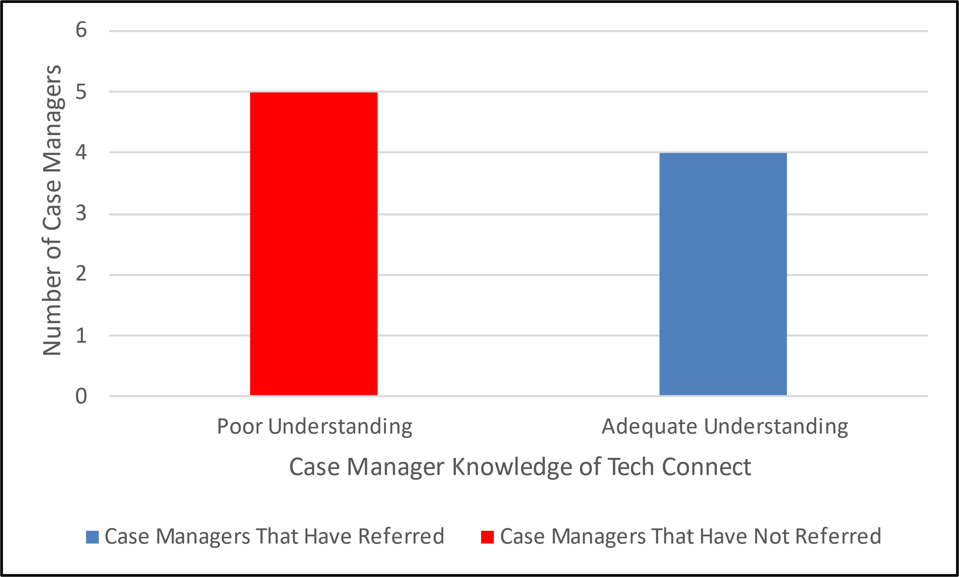
Case Manager Knowledge of Tech Connect
11
N = 4 N = 5

Slide 12
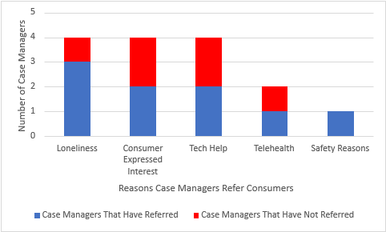
Reasons to Refer Consumers
12
N = 4 N = 5

Slide 13
Objective 2
Increase involvement in the Tech Connect program
Goal
Investigate current participation in the Tech Connect program
Objective 1
Create promotional material for the Tech Connect program
Objective 2
Create informational material to increase utilization program
Objective 3
13

Slide 14
Methods for Objective 2
Survey Consumers in the Program
Analyze Survey Results
Research Brochure Best Practices
14

Slide 15
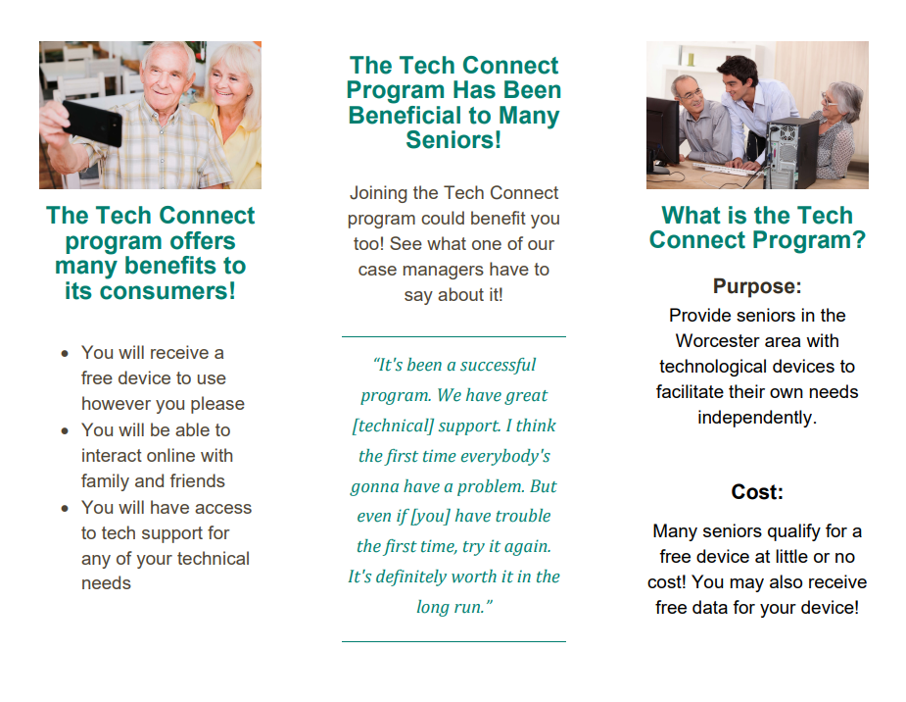
Best Practices for Creating a Brochure
15

Slide 16
16

Slide 17
Objective 3
Increase involvement in the Tech Connect program
Goal
Investigate current participation in the Tech Connect program
Objective 1
Create promotional material for the Tech Connect program
Objective 2
Create informational material to increase utilization program
Objective 3
17

Slide 18
Methods for Objective 3
Interview Current Consumers
Analyze Interview Results
Research Infographic Best Practices
18

Slide 19
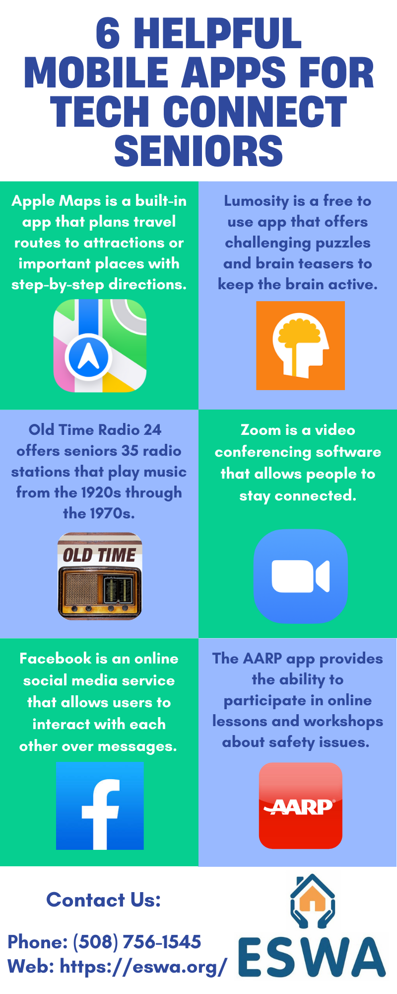
Best Practices for Creating an Infographic
19
Notes:
Font sizes
Color scheme
Section info

Slide 20
Recommendations to ESWA
In-person senior interviews/surveys
Use brochure and infographic during referral process
How-to guides for apps
20

Slide 21
[Image References]
https://www.thetimes.co.uk/article/a-weekend-in-bucharest-romania-lwr3chgj5
https://www.istockphoto.com/photos/worcester-massachusetts-skyline
https://www.istockphoto.com/photos/diverse-seniors
https://labblog.uofmhealth.org/lab-report/coronavirus-decoding-spiky-fuzz-ball
https://www.uchealth.org/today/how-to-help-older-adults-use-video-calling-to-stay-connected-and-combat-loneliness/
https://eswa.org/about-us/programs-and-information/nutrition/?doing_wp_cron=1649185163.4560699462890625000000
https://www.forbes.com/sites/forbescommunicationscouncil/2020/10/20/how-a-home-care-agency-can-use-videos-to-acquire-clients/?sh=2d30eb2b169f https://www.digitalinformationworld.com/2018/10/infographic-elderly-the-world-wide-web.html
21

Slide 22
(Citations)
Russell, L. (2009). Lifelines for Elders Living on the Edge: How Elder Support Programs Compare to Living Costs (The Elder Economics Standard Index for Massachusetts, p. 75) [Finance]. University of Massachusetts Boston. https://www.townofsharon.net/sites/g/files/vyhlif3801/f/file/file/lifelinesforelderslivingontheedgereport.pdf
Bruce, E., Gottlieb, A., Lyu, J., Shih, Y.-C., & Mutchler, J. E. (2012). Evaluating Economic Security for Massachusetts Seniors. Gerontology Institute, University of Massachusetts Boston. https://scholarworks.umb.edu/ocp_posters/49
Luger, T. M., Hogan, T. P., Richardson, L. M., Cioffari-Bailiff, L., Harvey, K., & Houston, T. K. (2016). Older Veteran Digital Disparities: Examining the Potential for Solutions Within Social Networks. Journal of Medical Internet Research, 18(11), e6385. https://doi.org/10.2196/jmir.6385
Identification of Depression Among Elderly During COVID-19—Meily Kurniawidjaja, Indri Hapsari Susilowati, Dadan Erwandi, Abdul Kadir, Bonardo Prayogo Hasiholan, Rijal Al Ghiffari, 2022. (n.d.). Retrieved April 6, 2022, from https://journals.sagepub.com/doi/full/10.1177/21501319221085380
Monaghesh, E., & Hajizadeh, A. (2020). The role of telehealth during COVID-19 outbreak: A systematic review based on current evidence. BMC Public Health, 20(1), 1193. https://doi.org/10.1186/s12889-020-09301-4
22

Slide 23
Thank you!
Questions?

Slide 24
24

Slide 25
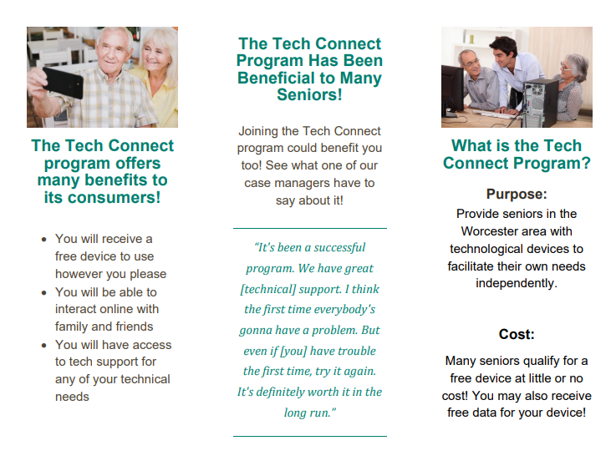
25

Slide 26
26

Slide 27
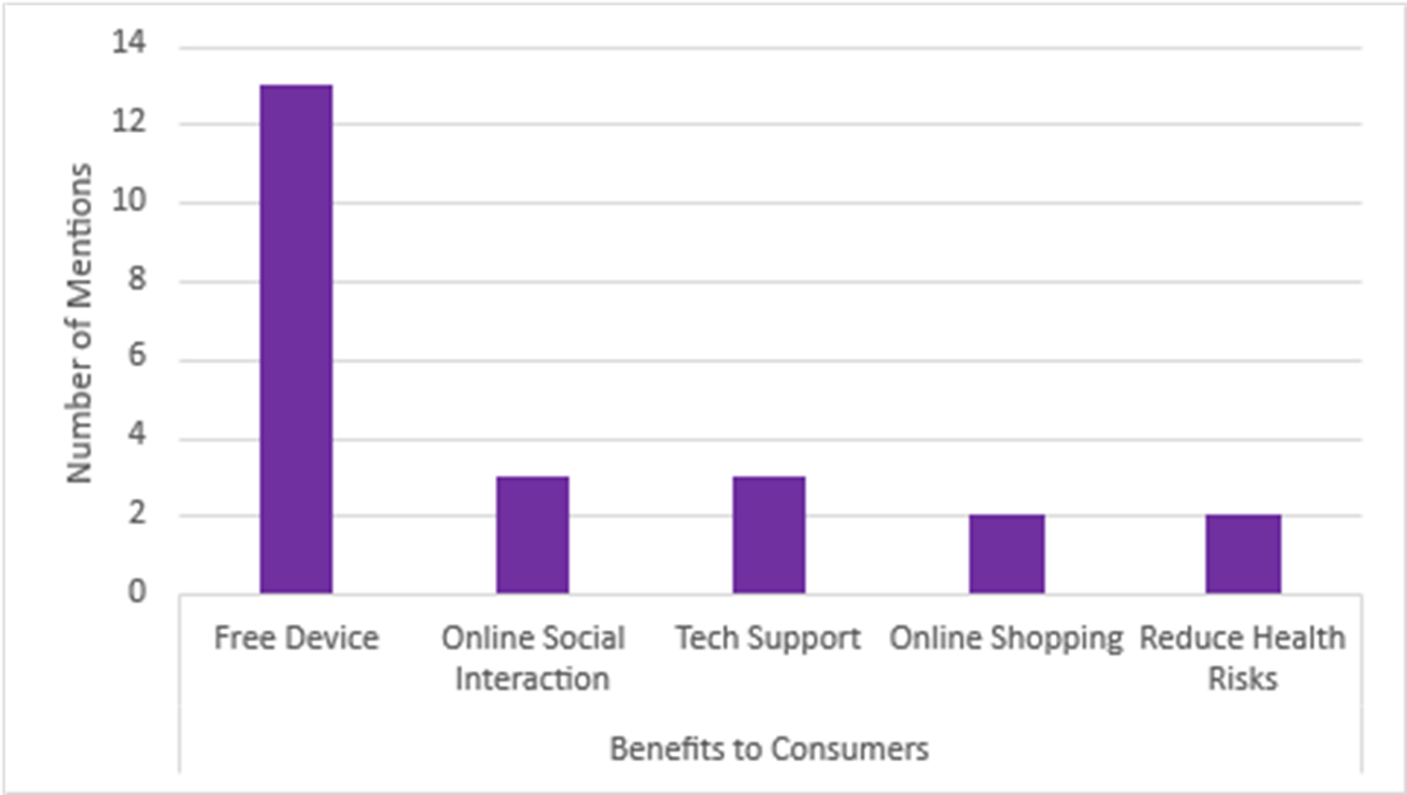
Benefits of Tech Connect
27

Slide 28
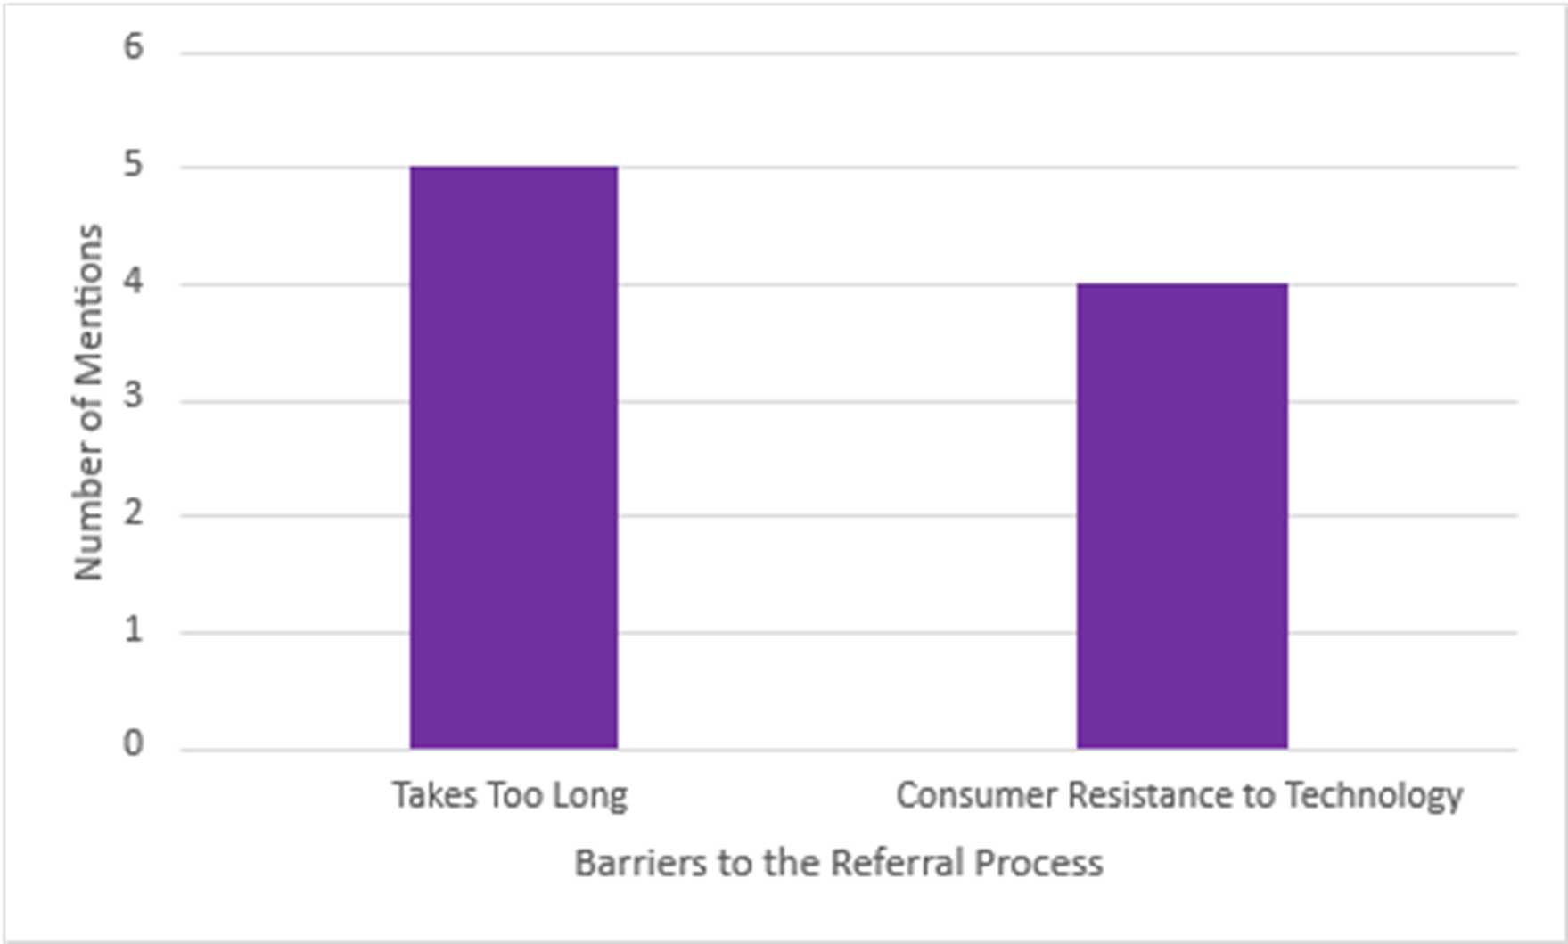
Barriers to Referral Process
28

Slide 29
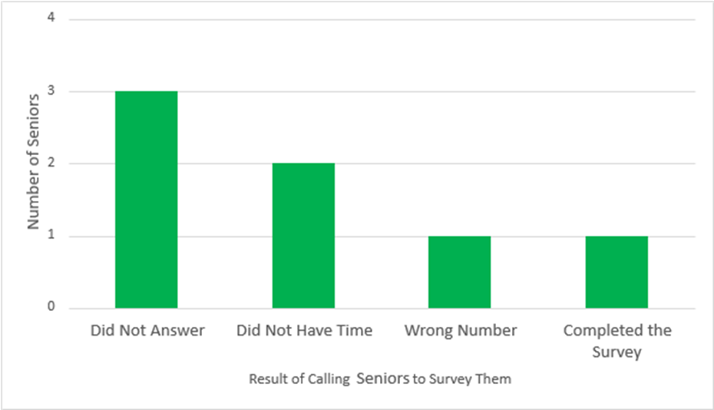
Method: Survey Seniors in Tech Connect Program
N = 7

Slide 30
Method: Interview Clients no longer in Tech Connect Program
Attempted to interview 20 seniors
Spoke with 7, none willing to be interviewed
Unable to reach 13 seniors
Recommendation for future: Home visits

