Slide 1
Determining the Viability of Teak Growth in Central America
October 9, 2020
Rosina comatas, monika nowak, Tim Santos-heiman, tyler stack
gr-otei2-20@wpi.edu

Slide 2
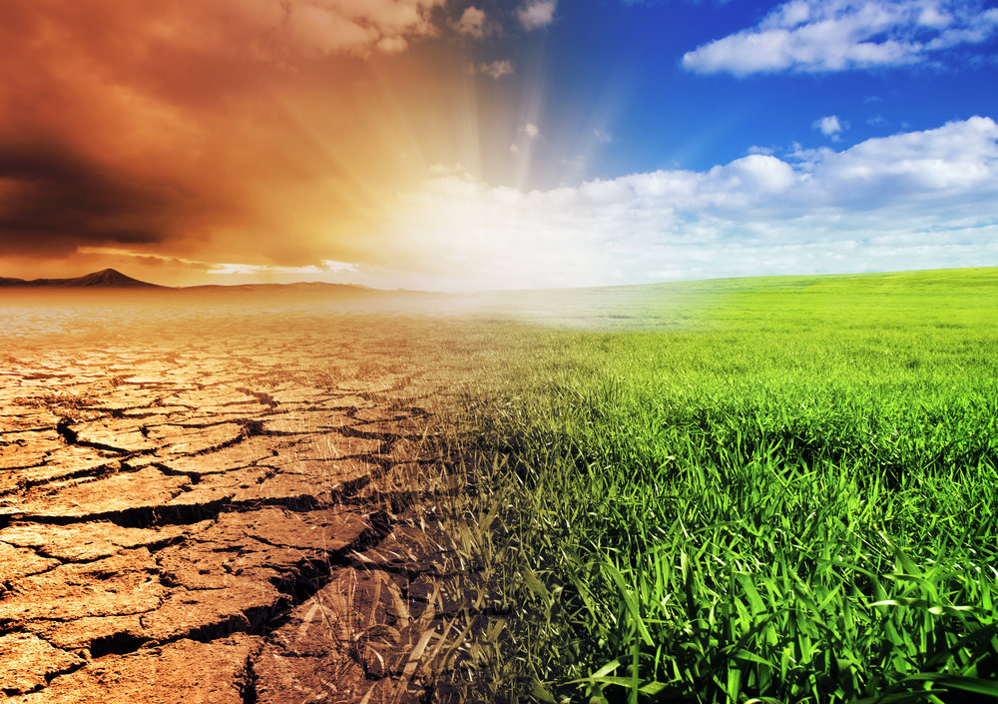
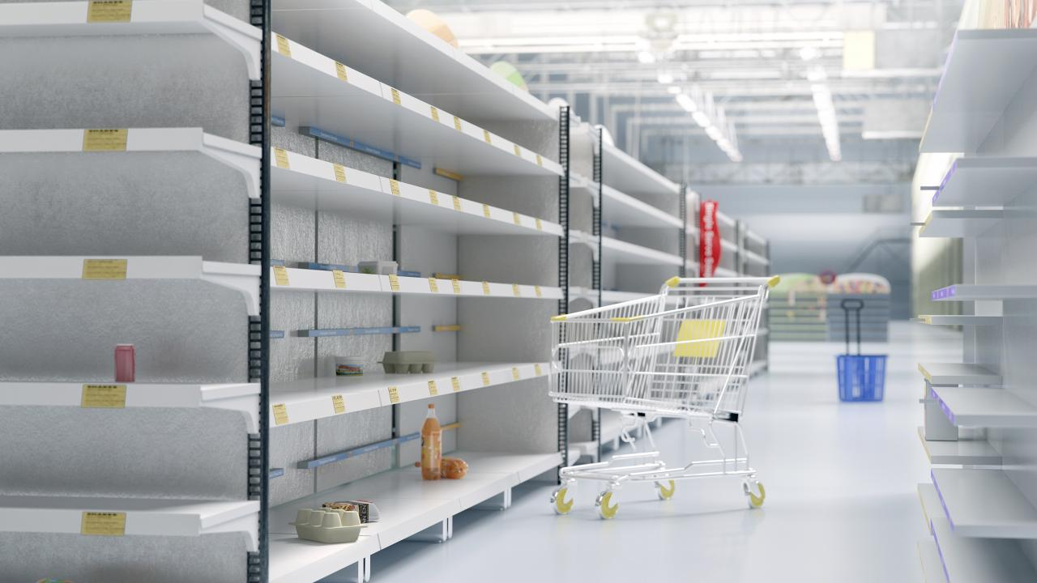
Life in Central America
[1]
[2]
Notes:
Currently, central american inhabitants are experiencing effects of climate change like drought and erratic weather conditions. These effects *click* often lead to food shortages and hunger, a serious concern because over half the central american population lives in poverty. We are trying to improve this way of life through farming

Slide 3
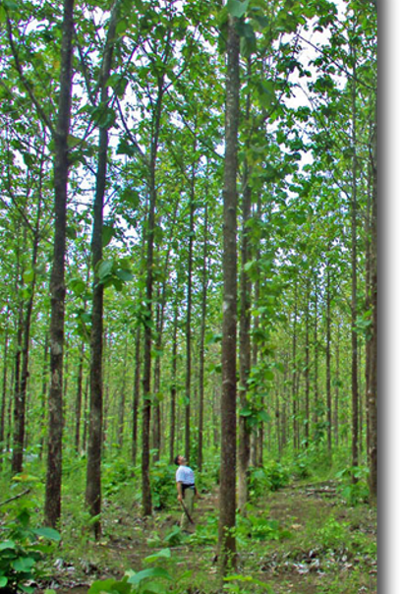
The goal of our project is to investigate growth factors for teak in Central America and to determine the viability of teak farms in Central America
[3]
Notes:
-investigate favorable growth factors for teak production in the Central American region
-account for the limitations and barriers native to the region

Slide 4
Outline
Background Research
Results & Analysis
Methodology
Conclusion & Recommendations

Slide 5
What is Teak?
Tropical hardwood tree species native to Southeast Asia
Properties
Water resistant
Durable
Uses
Indoor flooring
Outdoor furniture
Boat decking
[4]
Notes:
Properties due to High oil content and high tensile strength.

Slide 6
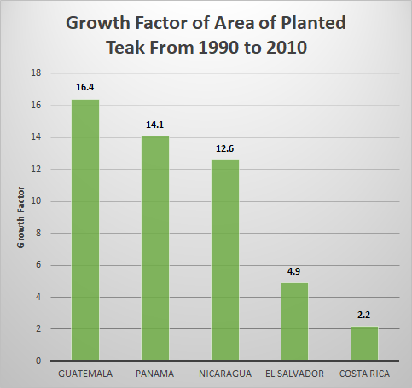
Teak Fever
In the 1990's, teak plantations were rapidly established
Causes:
Threat of deforestation
Massive marketing campaign
Government incentives
Outcomes:
Failed plantations left many in debt
Surplus of teak
[5]

Slide 7
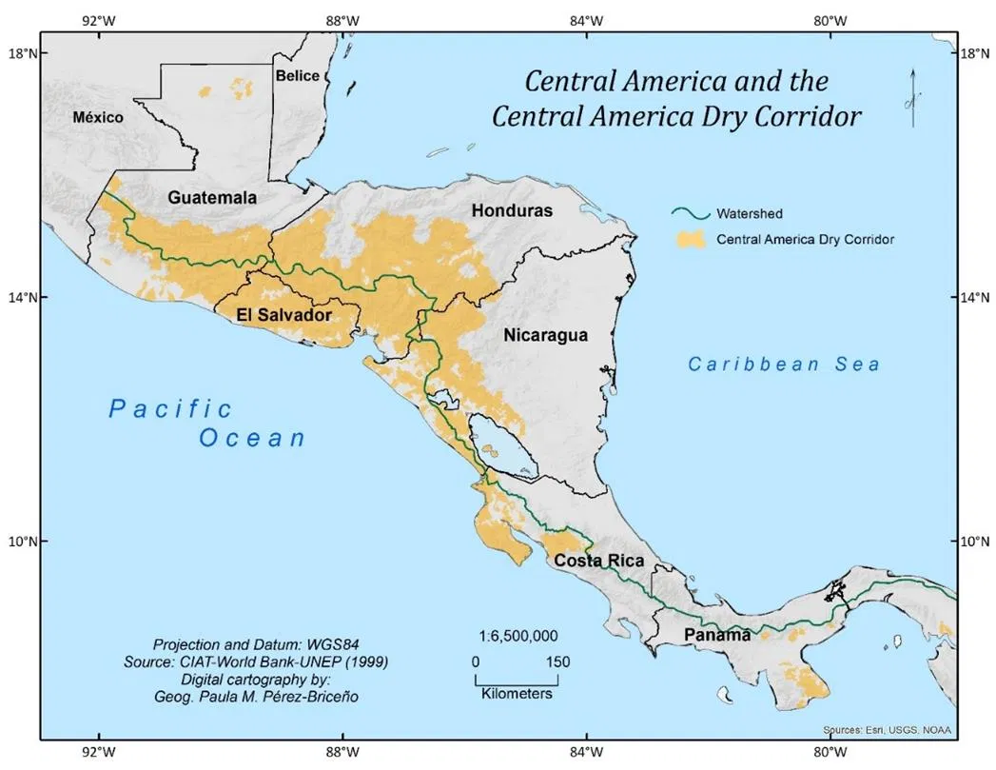
Climate Change
Effects of Climate Change
Central America Dry Corridor
Region's dependence on Agriculture
Severe and more frequent storms
Drought and damage to crops
Farmers experiencing lack of water, erosion, poor soil
Agriculture is a large portion of many countries' economies and employment
[6]
Notes:
1.6 million people are food insecure
>1 million families survive off subsistence farming in dry corridor

Slide 8
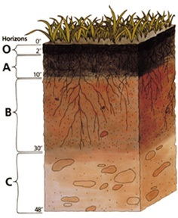
Central American Soil
USDA Soil Taxonomy System
Soil orders
Central American Soil Survey
Horizons
Categories separated by fertility and other aspects
Trends across Central America
Ultisols: acidic, low fertility and nutrient content
Inceptisols: slightly acidic, undeveloped horizons
Alfisols: slightly acidic, high native fertility
[7]
[8]
[8]

Slide 9
Objectives and Methods
Objective 1 - Collect information from various sources to understand every necessary consideration for teak growth
Method 1.1 - Perform extensive online research on important teak growth factors
Method 1.2 - Conduct interviews with experts in relevant fields
Objective 2 - Determine the viability of growing teak in Central America based on all information available
[9]

Slide 10
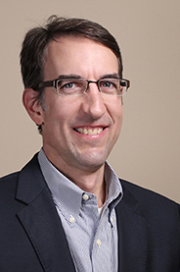
Interviewees
Dr. Peter Hobbs, Cornell
Dr. Jefferson Hall, Smithsonian Tropical Research Institute
Dr. Alex Finkral, The Forestland Group
Dr. Pamela Weathers, WPI
[10]
[11]
[12]
[13]

Slide 11
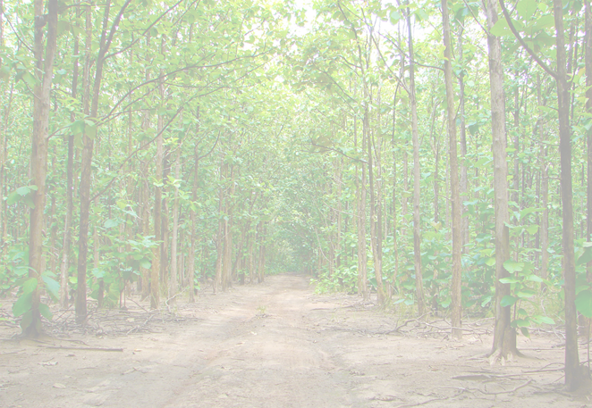
Inductive Coding
“...a data analysis process whereby the researcher reads and interprets raw textual data to develop concepts, themes or a process model through interpretations based on data” (Chandra, 2019).
[14]

Slide 12
Coding Themes
Ideal Growth Conditions
Pre-Planting Site Preparation
Site Management
Harvest and Sales
Environmental Impact
Current Land Use and Competition
Notes:
The team developed these common themes from the interviews. We will explain each topic in more detail.

Slide 13
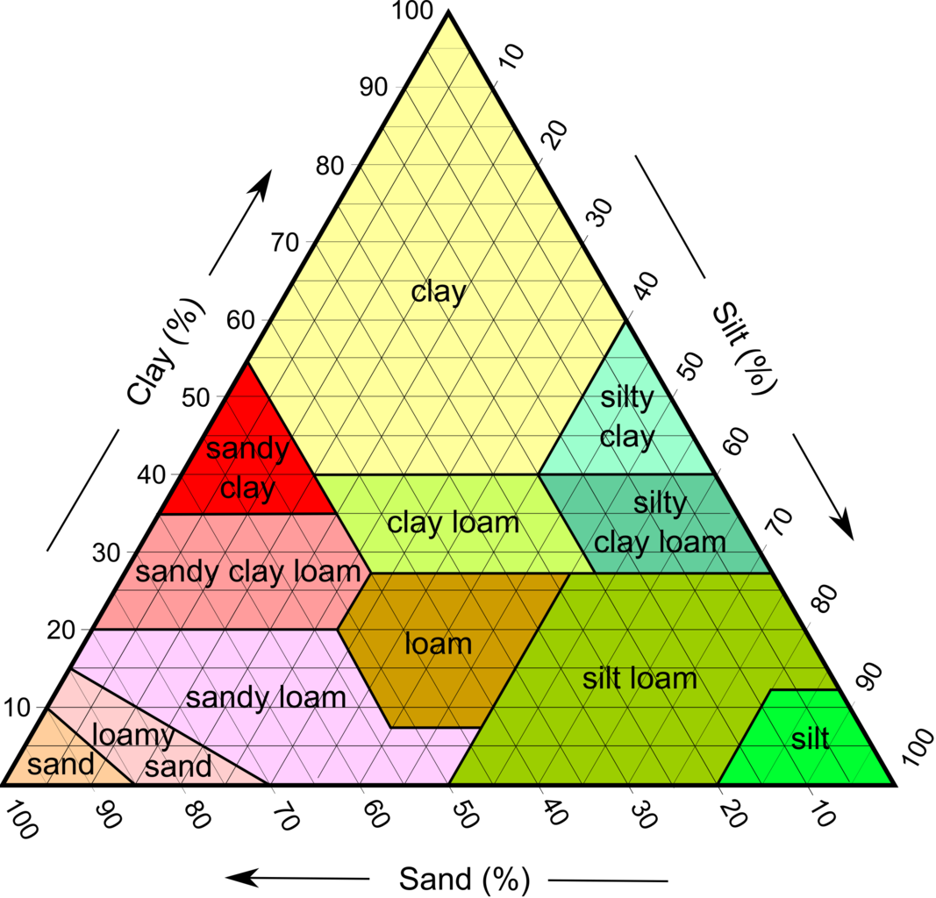
Teak's Ideal Growth Conditions
Soil
Fertile, well-drained
Non-acidic pH
Central American soil lacks these qualities
Water
Balance between too much and too little
Irrigation
Landscape
Grows best in hilly areas
[15]

Slide 14
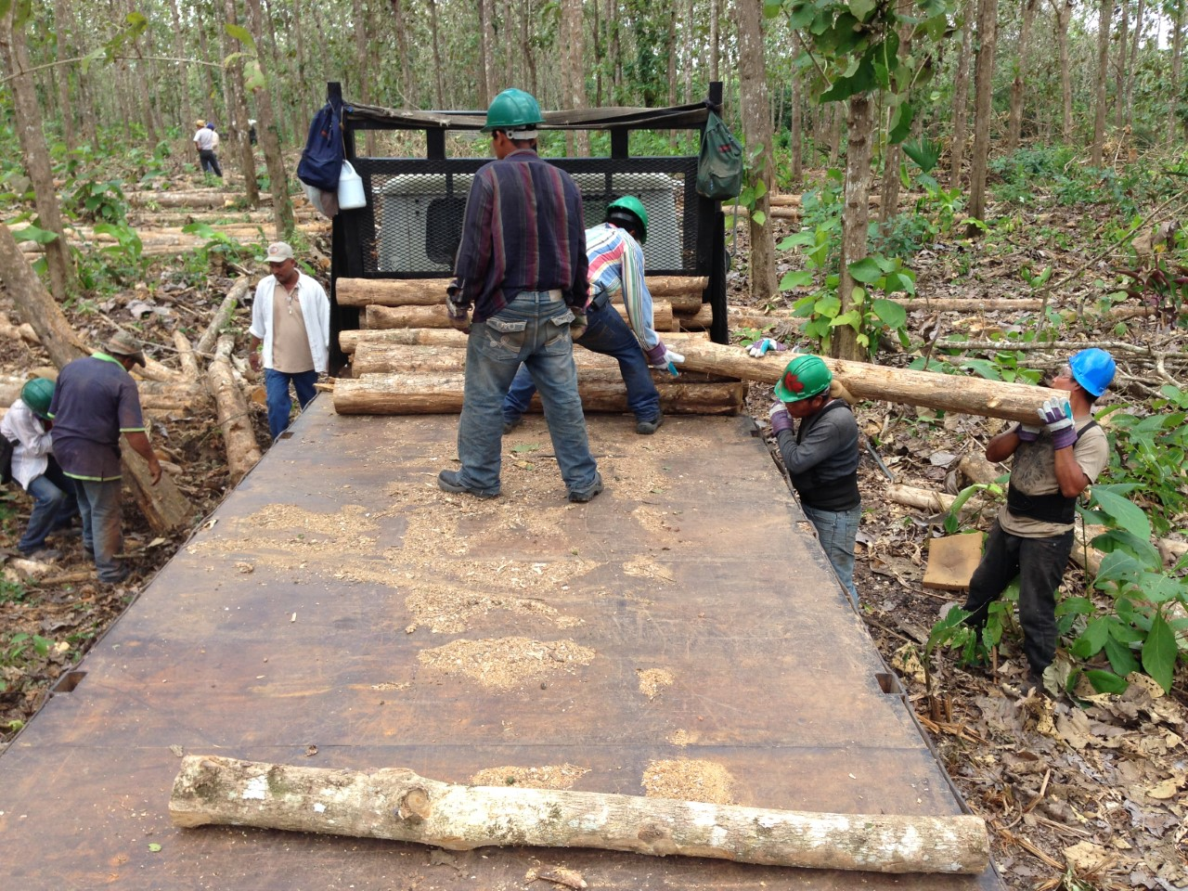
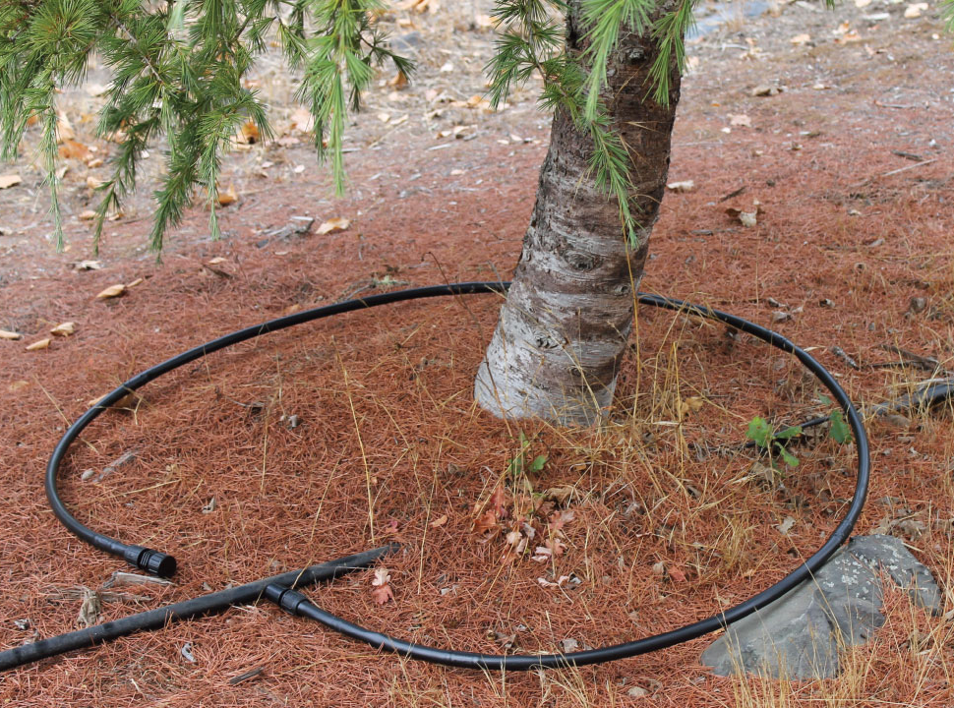
Pre-Planting and Site Management
Equipment
Drip irrigation system
Fertigation systems
Pruning
Clean trees of stray branches
[17]
Thinning
3 rounds of thinnings
No profit from first round
Some profit from final rounds
[16]

Slide 15
“...by irrigating through that dry period, you’re increasing growth by [about] 25-35% ...our experiments in Honduras [showed] we could grow teak to a final rotation age of… ten to twelve years. That would be kind of equivalent of 18-year-old stands without irrigation”
-Dr. Alex Finkral

Slide 16
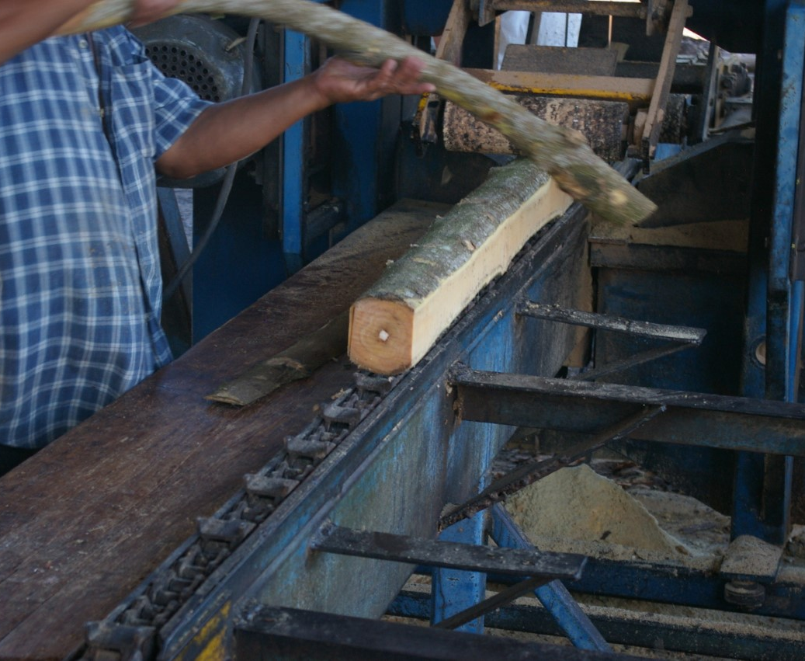
Harvest and Sales
Logging
Export and Processing
Cut into 2-meter logs
Minimal processing
96% of plantation teak sent to India
Average pricing
Globally: $350-$550/m³
Panama: $175-$200/m³
[18]

Slide 17
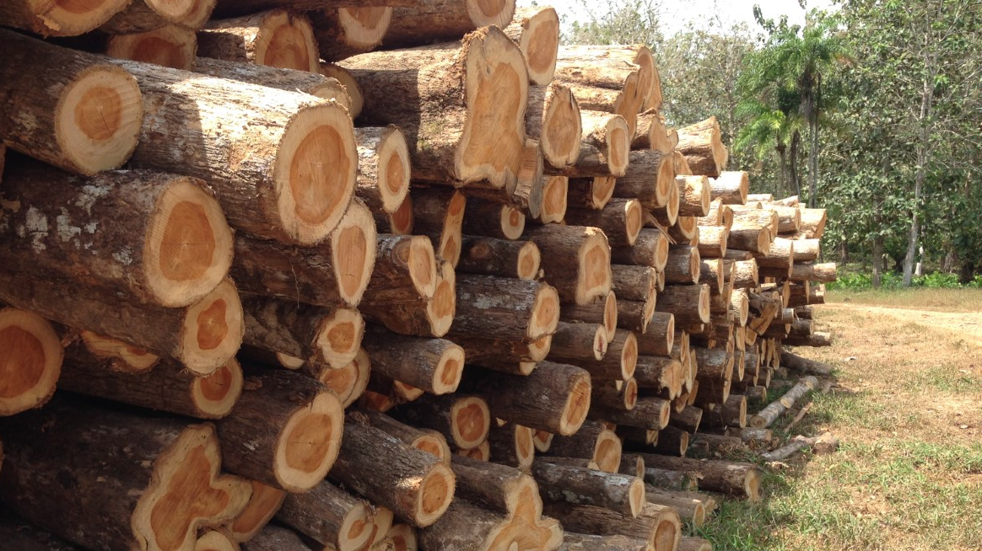
Environmental Impact
Climate change
Water usage
Monoculture harm
Reforestation
Think globally, act locally
Needs a large volume of water
Disrupts water cycle
Strips soil of nutrients
Minimizes biodiversity
[19]

Slide 18
"We have a term... essentially want to maximize the "crop-per-drop" in other words we want to get the maximum amount of production out of every drop of water."
-Dr. Peter Hobbs

Slide 19
Teak's Current Land Use, Competition, and Potential Alternatives
Teak Monoculture
Native Trees
Intercropping
Cattle Ranching
Agroforestry
[20]
Notes:
Silvopastoral systems (SPS) are a type of agroforestry arrangements that allows the intensification of cattle production based on natural processes that are recognized as an integrated approach to sustainable land use.

Slide 20
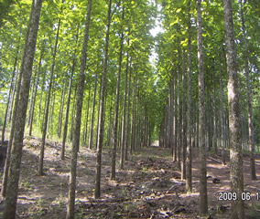
Teak Monocultures
Dominant form of teak production
Bad for...
Biodiversity
Soil nutrients
[21]

Slide 21
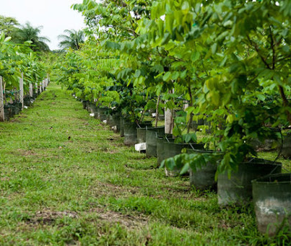
Native Species Monoculture / Mixed Plantation
Better suited for the environment
Provides more ecological services
Economically competitive
[22]

Slide 22
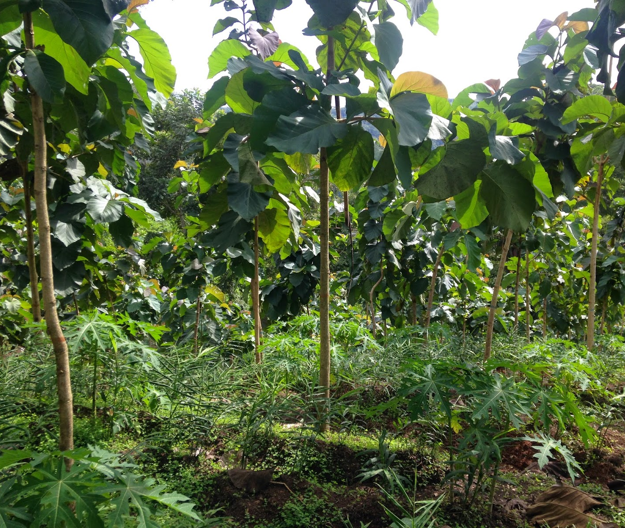
Intercropping
Rejuvenates soil
Fosters biodiversity
Provides additional income
Commonly intercropped with teak
Maize
Peanuts
Cassava
Papaya
Soybeans
Other types of timber
Long beans
Bananas
Ginger
[23]

Slide 23
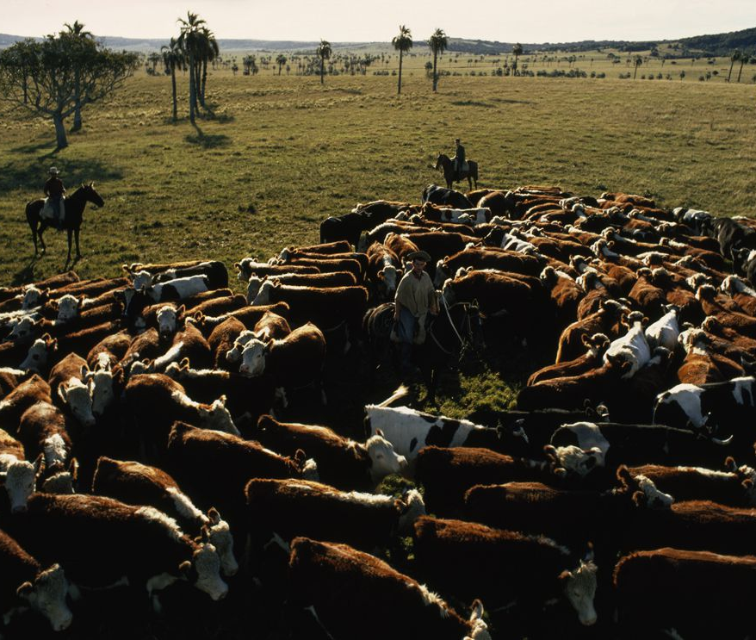
Cattle ranching
Harmful to environment
Climate change threatens productivity
Less risky and seen as a "bank account"
Economically competitive with teak
[24]

Slide 24
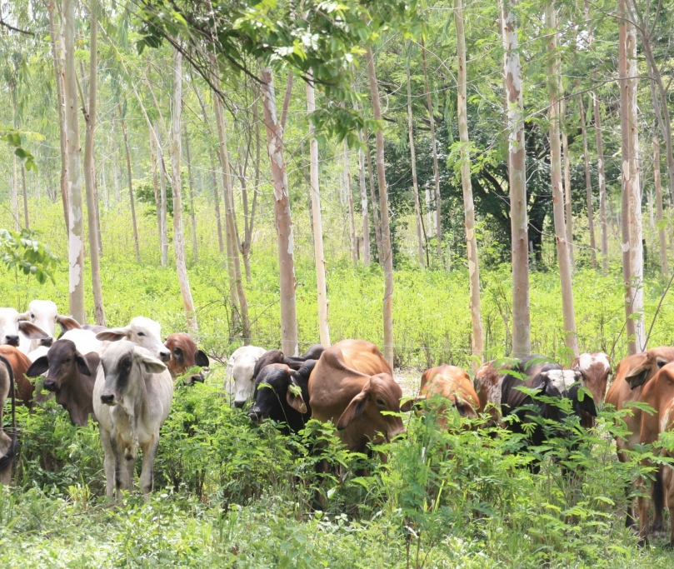
Agroforestry
Agroforestry
Silvopastoral Systems
Combines forestry and agriculture
Subset of agroforestry
Symbiotic relationship between plant life, cattle's food, and cattle
[25]

Slide 25
"Now we're kind of in a time where the world is awash with plantation teak and the market is maybe oversupplied, which then suppresses prices... I would tap the breaks on further teak development right now..."
-Dr. Alex Finkral

Slide 26
Conclusion and Recommendations
Intercrop
Invest in fertigation
Small Subsistence Farmers
Soil survey
Plant native trees
Large Company Investing in Teak
Better investments
Purchase fertile site
Established Teak Plantations
Native species
Fertigation
Notes:
Upon analysis and review of the information received from online research and expert interviews, the team concludes that expanding the teak industry in Central America will result in more negative consequences than positive impacts.

Slide 27
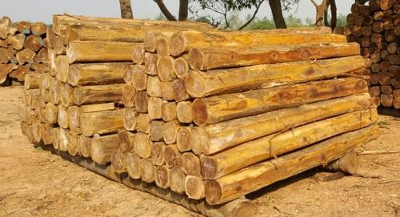
Going Forward
[26]
Investment in Central American teak plantations
Cattle ranchers implementing more sustainable methods
Smallholder and subsistence farms and intercropping with teak
Notes:
Due to time constraints, the team did not explore all possible investigations regarding teak. Some additional, promising investigations include

Slide 28
Acknowledgments
James Chiarelli
Robert Kinicki
Aaron Sakulich
Dr. Alex Finkral
Dr. Pamela Weathers
Dr. Jefferson Hall
Dr. Peter Hobbs

Slide 29
References
https://www.asyousow.org/our-work/energy/climate-change
https://rmi.ucdavis.edu/events/savor-food-shortages-pandemic
https://www.panamateakforestry.com/
https://community.snapwire.co/photo/detail/5ad30631f5d7bc4c8509f7dd
http://www.fao.org/3/a-an537e.pdf
https://www.revistayuam.com/volumen-2/numero-3/notas-de-divulgacion-cientifica/the-central-american-dry-corridor-a-consensus-statement-and-its-background/
https://www.soils4teachers.org/soil-horizons
https://www.nrcs.usda.gov/wps/portal/nrcs/detail/soils/use/worldsoils/?cid=nrcs142p2_054013
https://photos.com/featured/teak-tree-forests-dangdumrong.html
https://scs.cals.cornell.edu/people/peter-hobbs/
https://global.si.edu/people/jefferson-hall
https://www.forestlandgroup.com/people/
https://www.wpi.edu/people/faculty/weathers
14. https://www.teakgardenindonesia.com/more-benefit-with-sustainable-teak-plantation/
15. https://www.clipartkey.com/view/mRwhwx_soil-texture-triangle/
16. https://www.dripworks.com/blog/watering-trees-and-shrubs-effectively
17. Dr. Alex Finkral, 2020
18. Dr. Alex Finkral, 2020
19. Dr. Alex Finkral, 2020
20. https://www.agroforestry.ac.uk/agroforestry-systems/pastoral
21. http://www.goldteak.com/web/indexbfcb.html?option=com_content&view=article&id=140:news-from-the-field&catid=1:news-from-the-field-cibening&Itemid=27
22. http://www.cocobolotreefarm.com/deanposts/6
23. http://costarica-invest.blogspot.com/2014/11/triple-intercrop-in-naturewalk.html
24. https://www.nationalgeographic.org/encyclopedia/ranching/
25. https://globalsilvopastoralnetwork.org/
26. https://www.alibaba.com/product-detail/Teak-Logs_50027123796.html
27. https://www.azamara.com/int/panama-canal

Slide 30
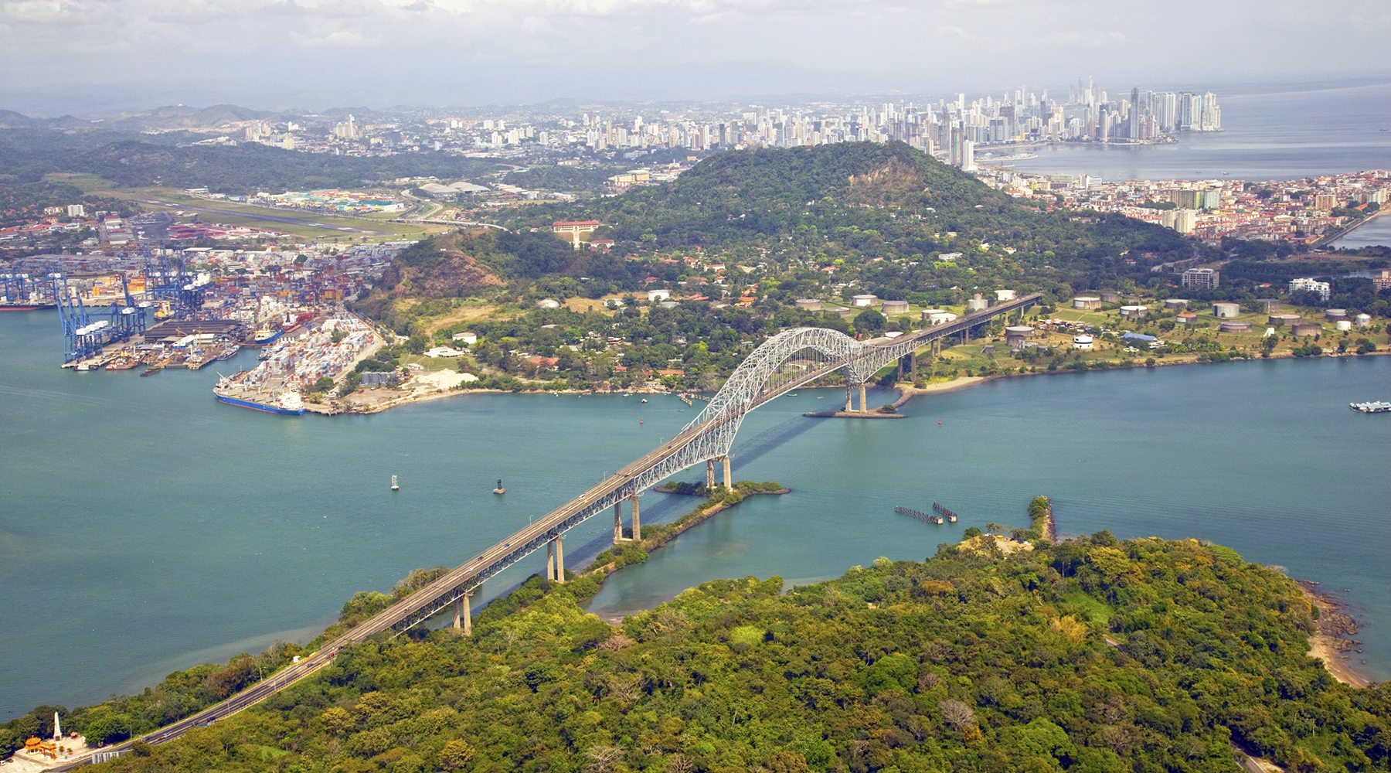
Thank you!
Questions?
[27]

