Slide 1
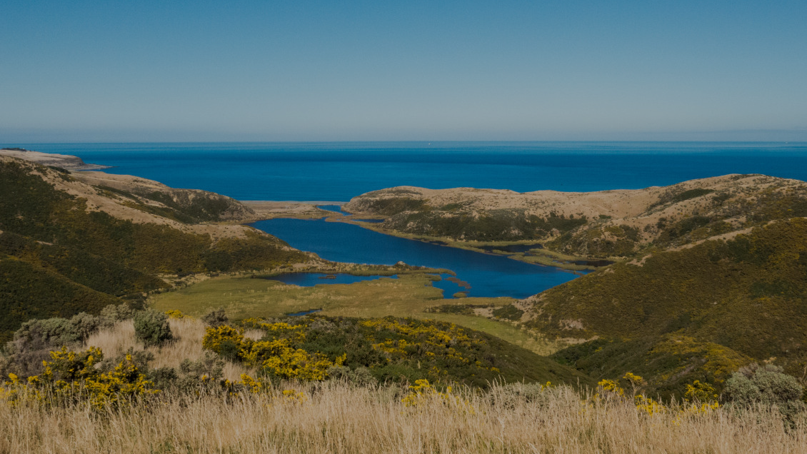
Re-storying the Indigenous Lizards of Te Arawa
Joshua Caputo, Jose Perez, Leah Uglevich,
Henry Wagg, Macayle Wells
[1]
Notes:
(25s)

Slide 2
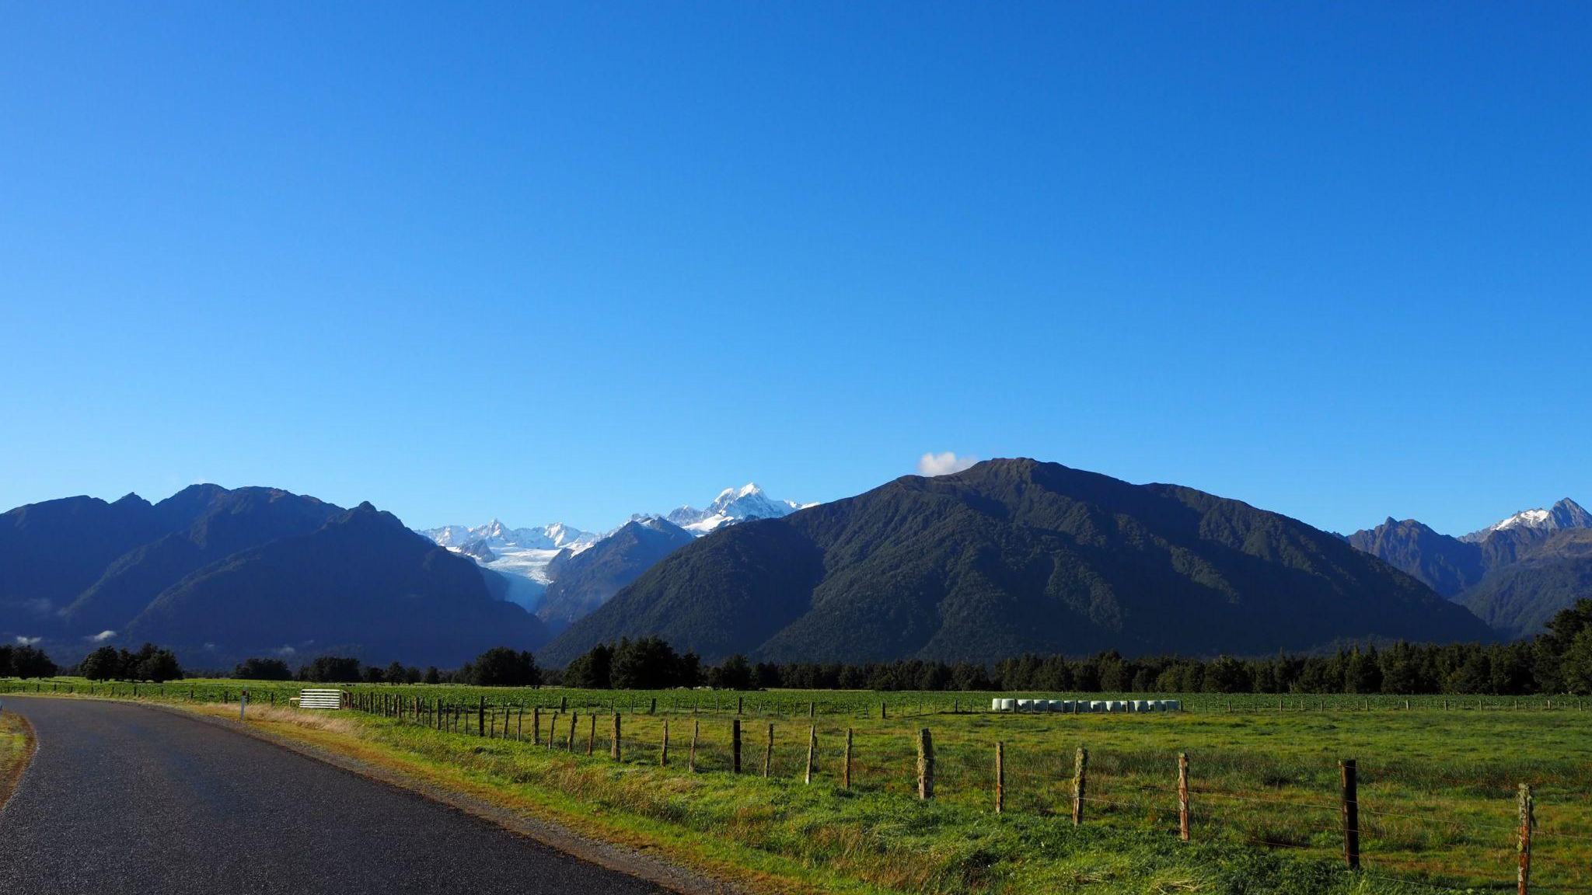
Outline
Partner
ㄧ
Background
ㄧ
Goal
ㄧ
Objectives
ㄧ
Methods
[16]
1
Notes:
(22s) Fix order of outline

Slide 3
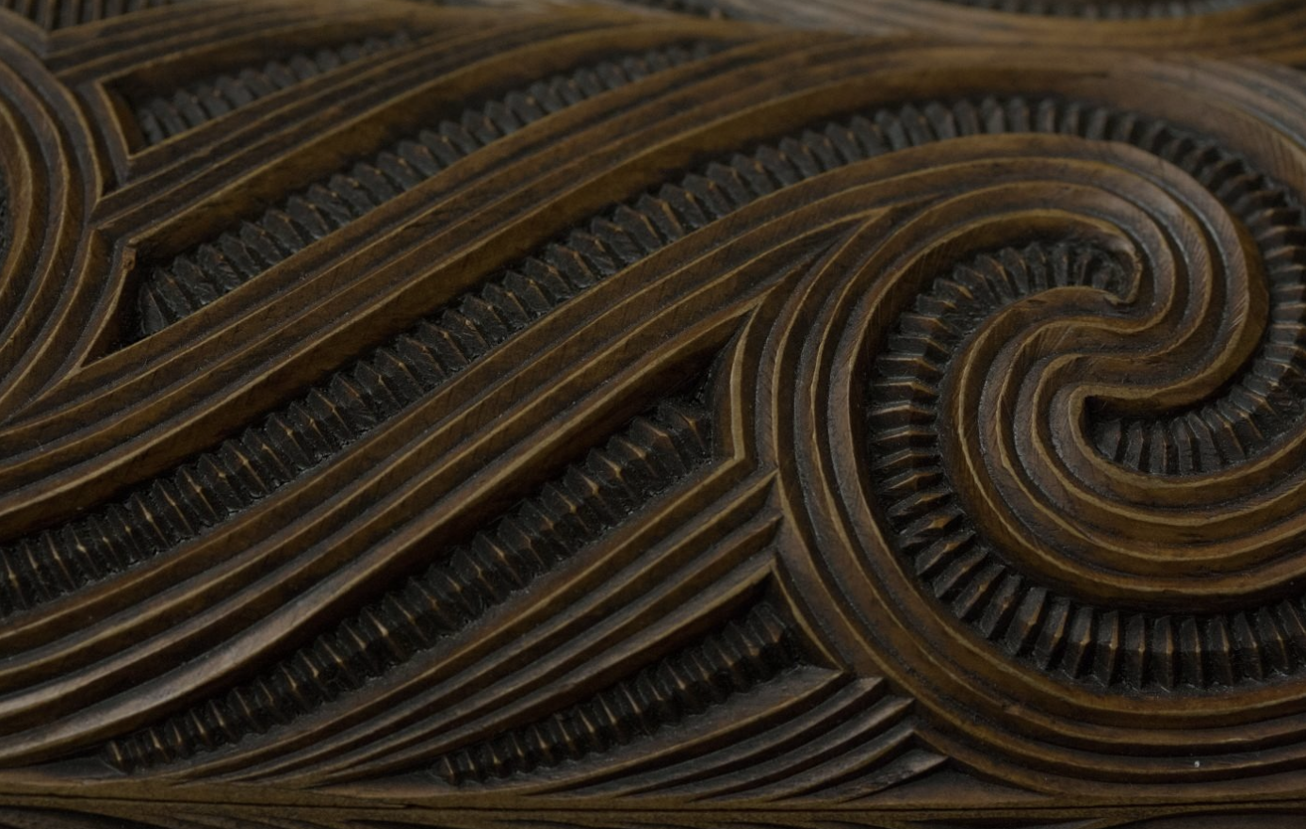
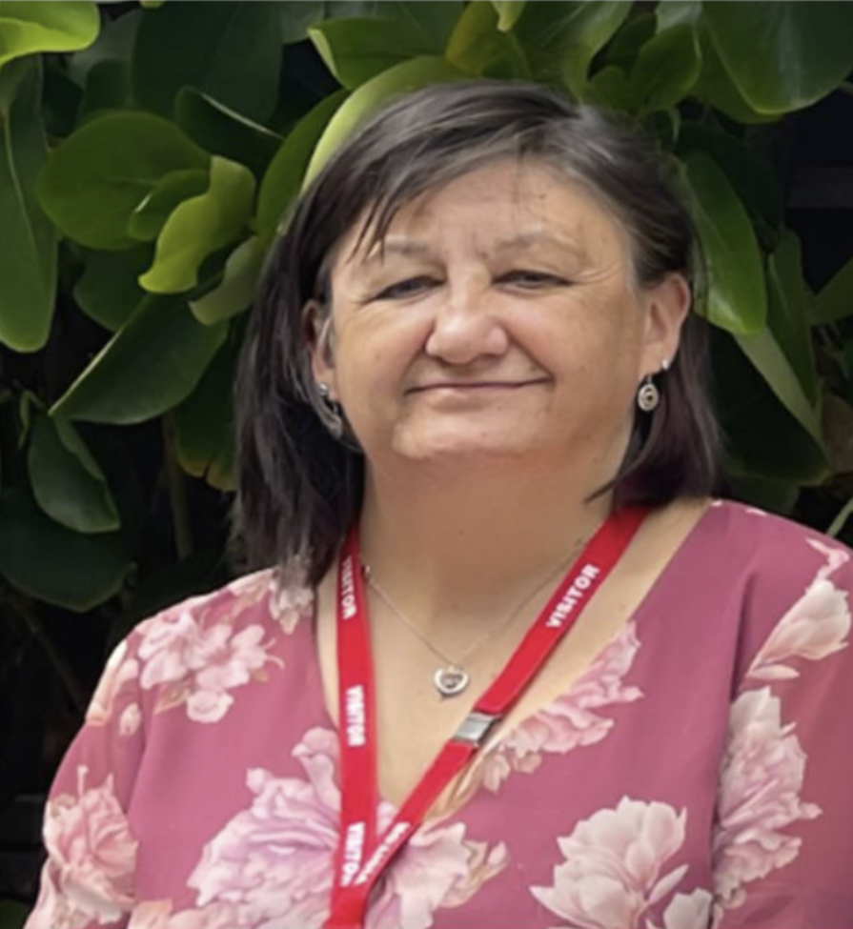
[11]
“I work at the intersection of Mātauranga Māori and mainstream ‘Western’ science.”
-Dr. Sara Belcher
[2]
2
Notes:
(30s) iffy erm
Talk about sara, her research, her interests. Talk about iwi, their conservation work, and how they don’t have a method for tracking their efforts that is in line with their ancestrial commitments to the land

Slide 4
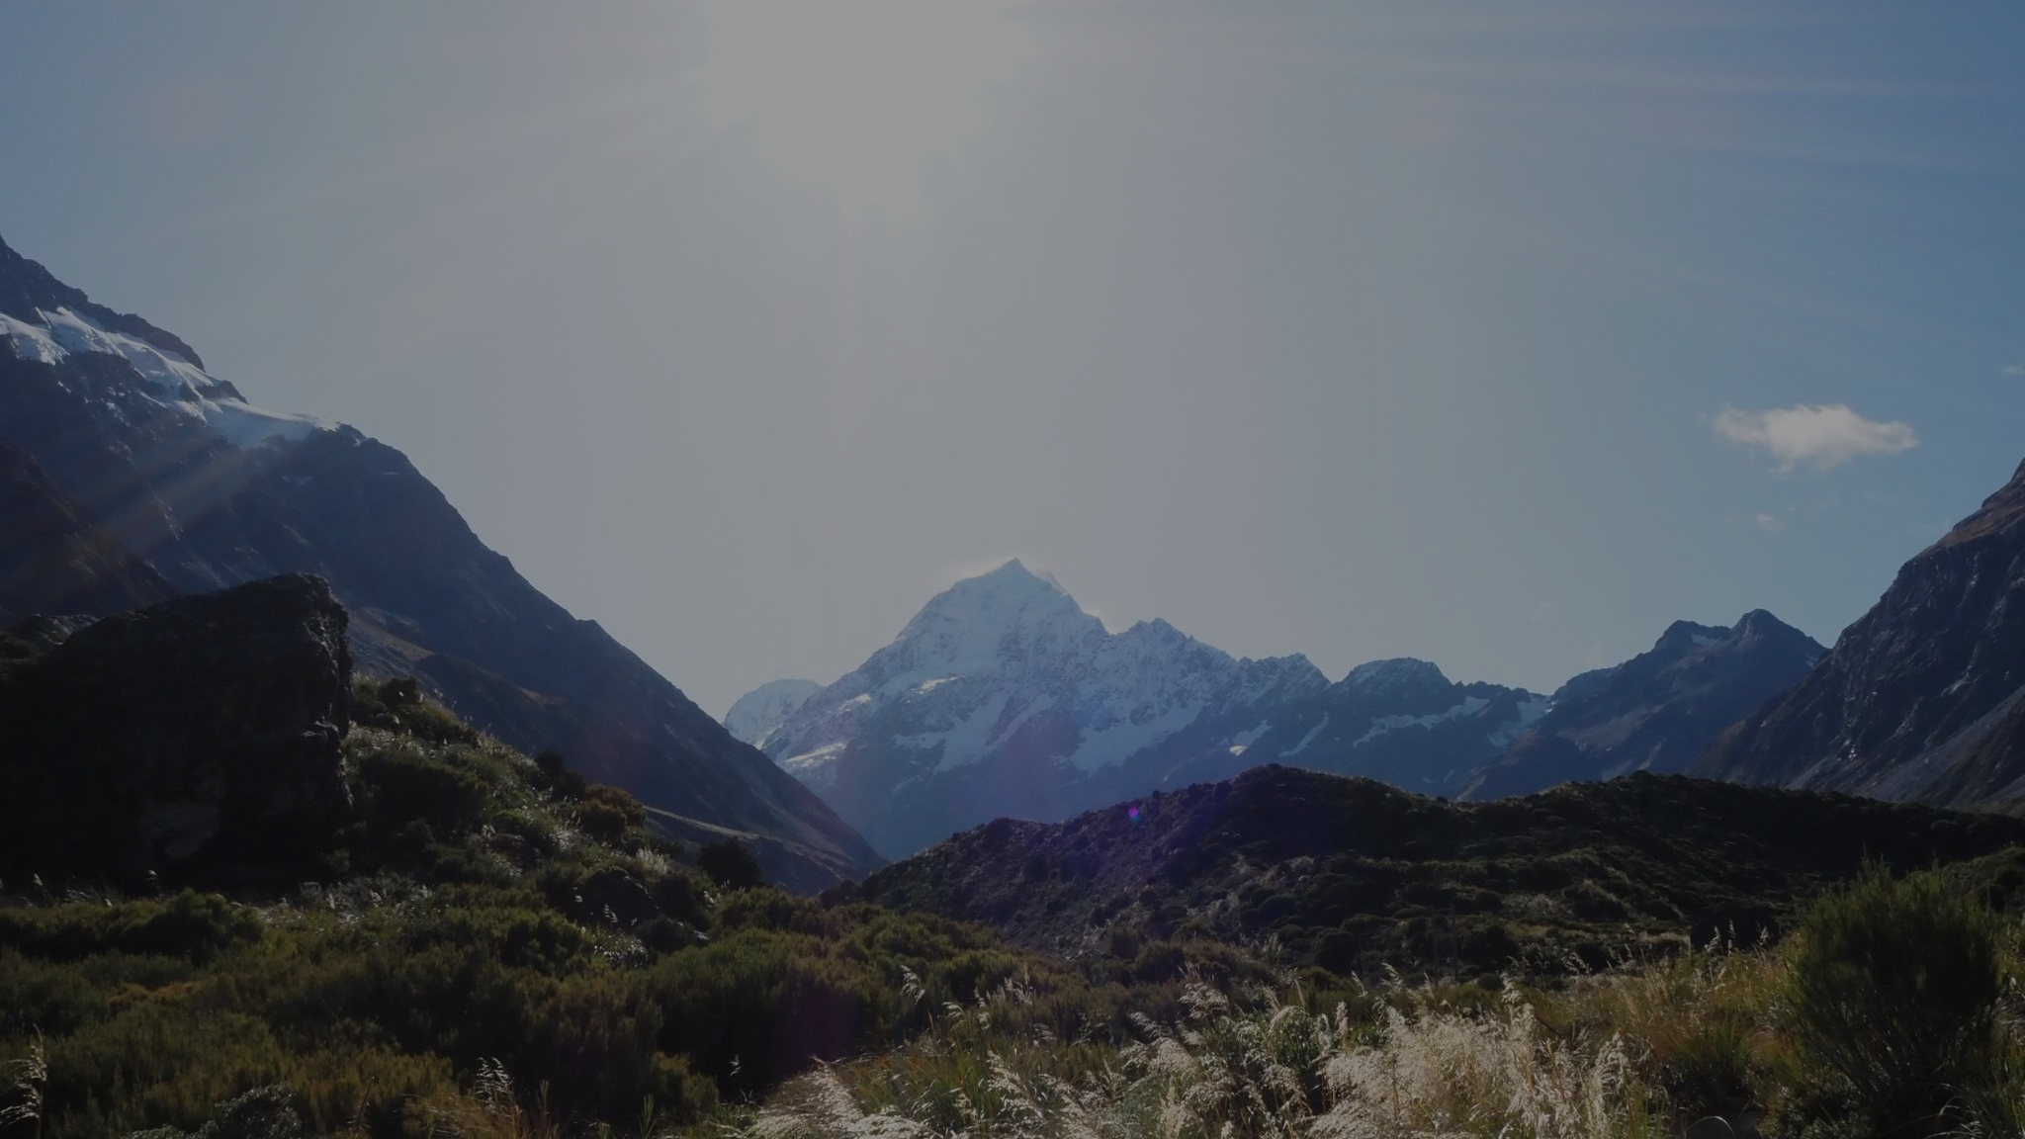
The purpose is to
uncover non-disruptive skink monitoring methods.
[15]
3
Notes:
(15s) iffy

Slide 5
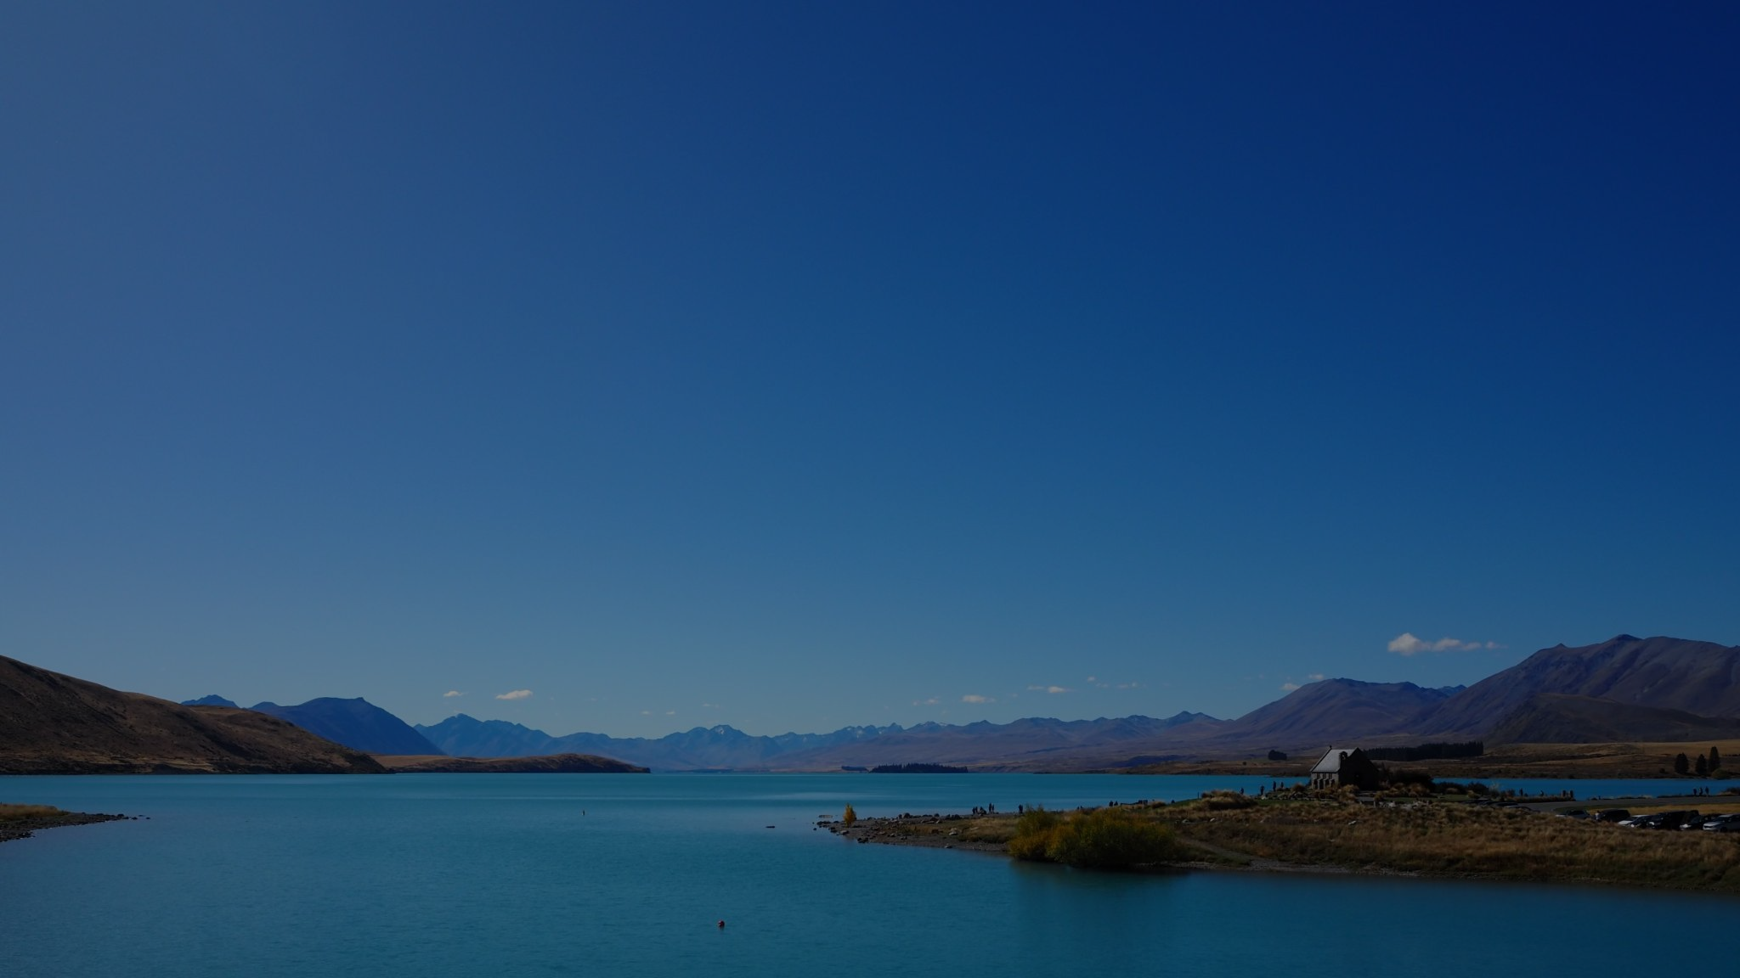
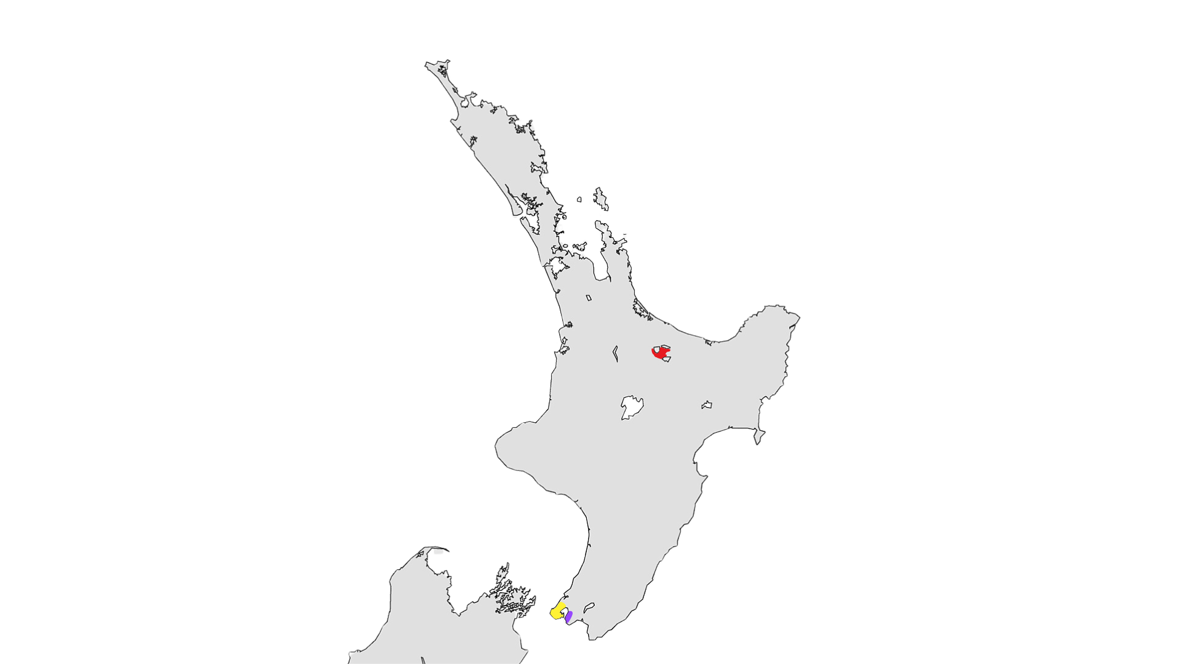
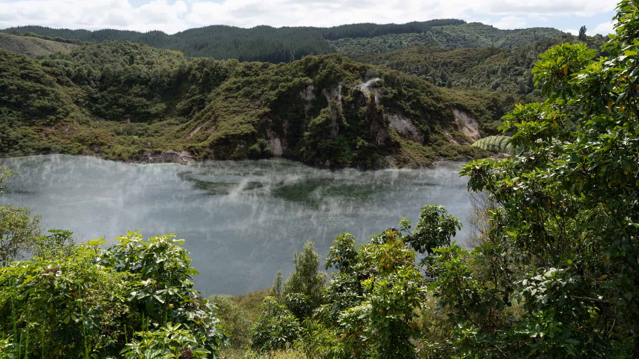
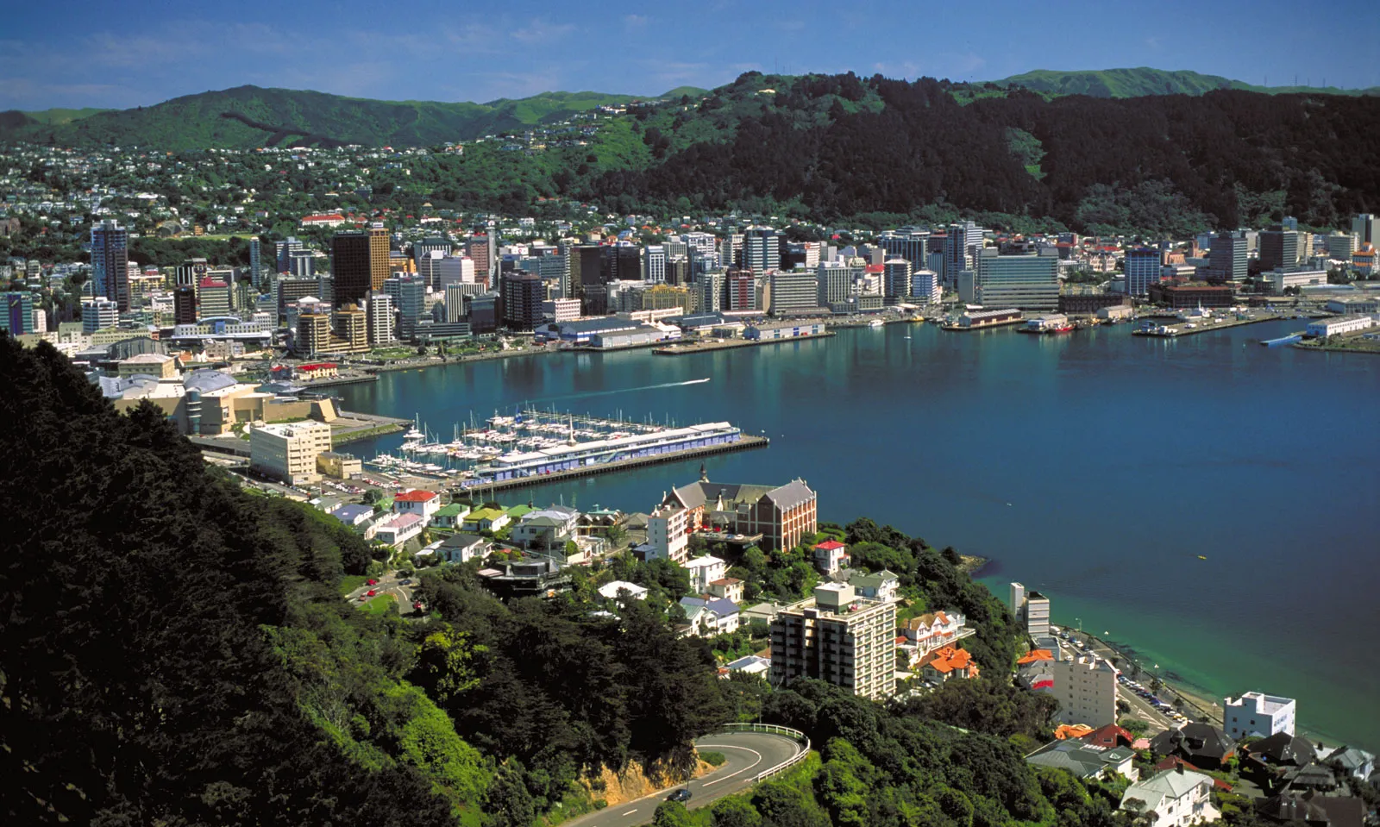
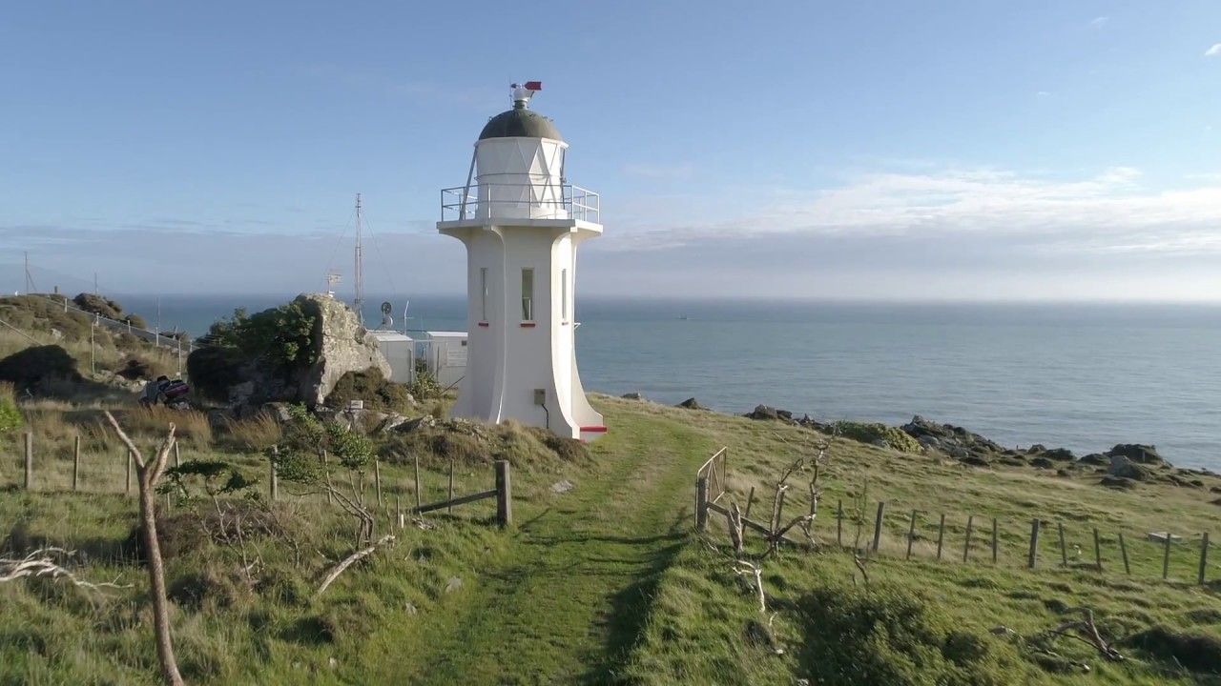
Understanding
the project sites
Rotorua
[10]
Wellington
Baring Head
[19]
[3]
[13]
4
Notes:
(25s) started a lil late
For our project, We will be working in three locations in the North Island of New Zealand . For the most part, we will be living in the capital, wellington. We will be going 2 to 3 times to baring head, which faces wellington harbour and is part of the East Harbour Regional Park. There, we will carry out experiments to track skink population. We will also be staying for 1-2 weeks in Rotorua, which a city in the north-central part of the north with volcanic activity and a lot of maori cultural heritage. There we will carry out interviews with the iwi.

Slide 6
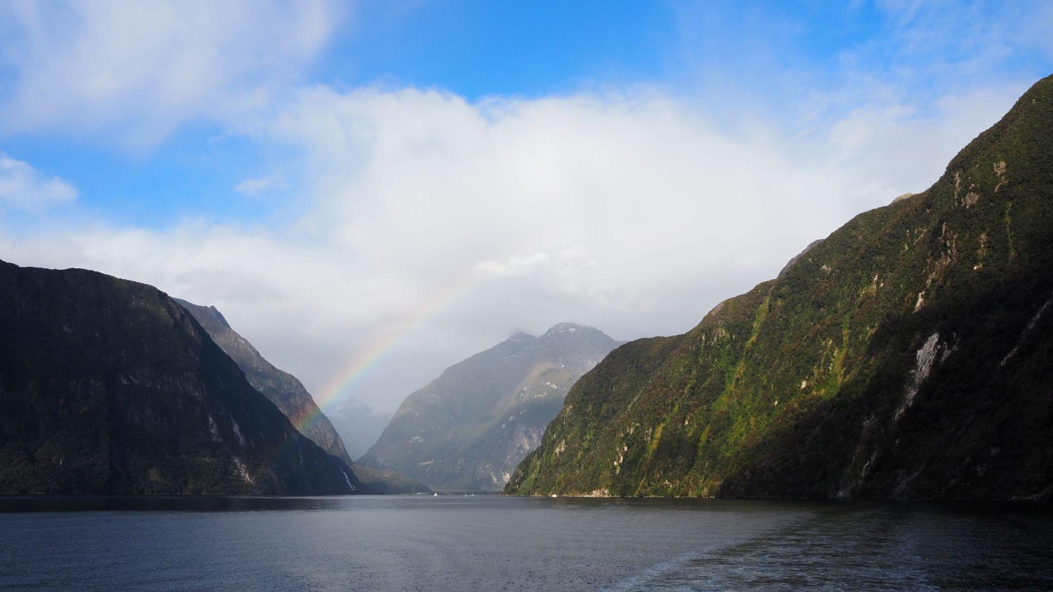
Two-eyed seeing: a way of viewing the world that combines Indigenous and Western knowledge and worldviews
Background
[14]
5
Notes:
(30s)

Slide 7
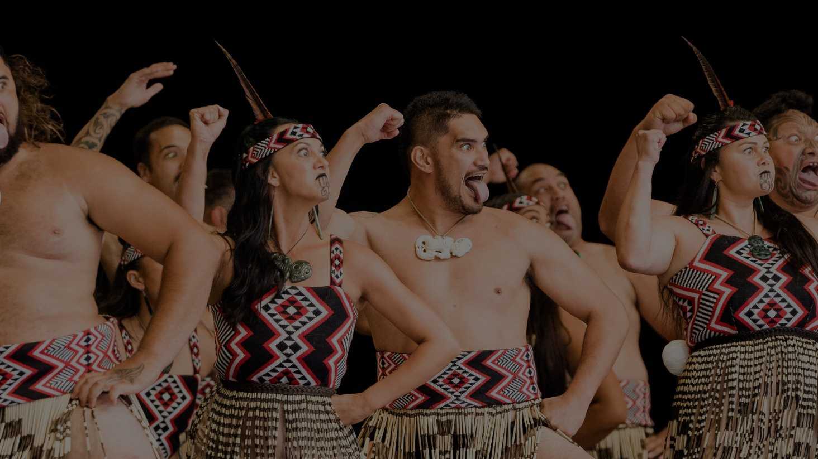
Mātauranga Māori can be a powerful
addition to Western science
Whakapapa: genealogies
Kaitiakitanga guardianship
Taonga: treasure
[8]
6
Notes:
(45s)
Two eyed seeing is learning to see from one eye with the strengths of Indigenous knowledges and ways of knowing, and from the other eye with the strengths of Western knowledges and ways of knowing… and learning to use both these eyes together, for the benefit of all” [34].
https://pmc.ncbi.nlm.nih.gov/articles/PMC8291645/#:~:text=For%20instance%2C%20many%20of%20the,knowing%E2%80%A6%20and%20learning%20to%20use

Slide 8
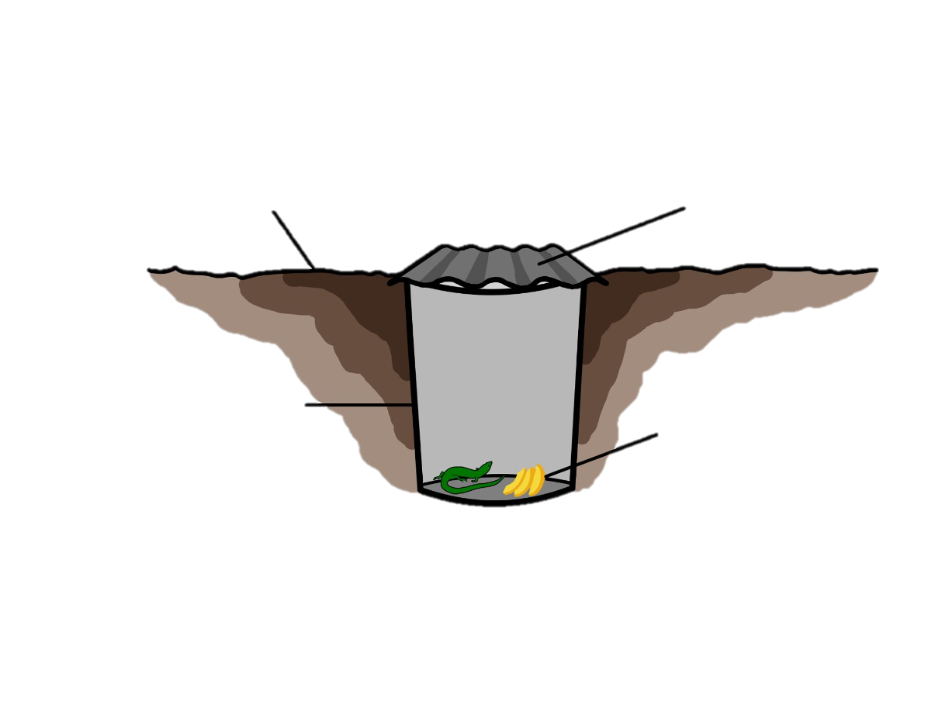
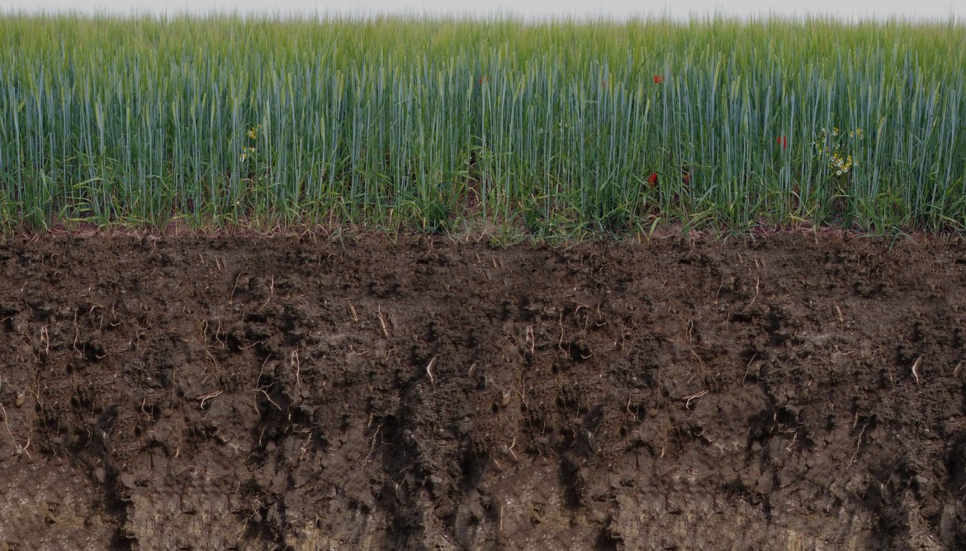
Pitfall Trap
Ground level
Cover
Bucket
Bait
[17]
7
Notes:
https://regenerationinternational.org/2018/02/14/no-till-farmers-push-healthy-soils-ignites-movement-plains/farm-field-barley-soil-cross-section/
https://www.shutterstock.com/search/soil-cross-section

Slide 9
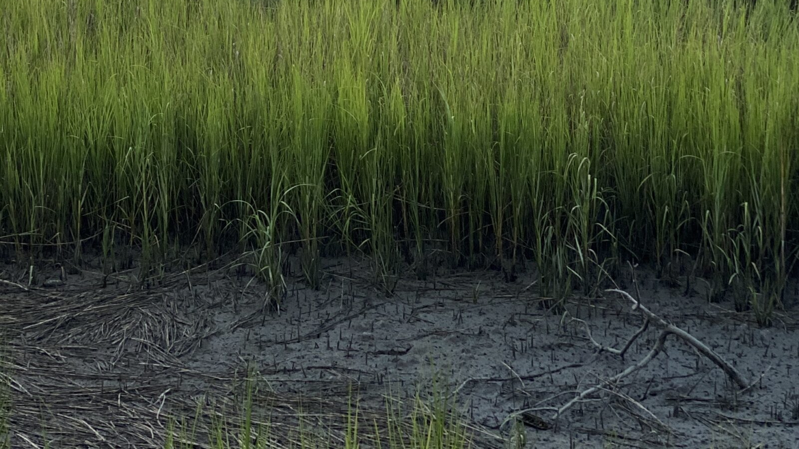
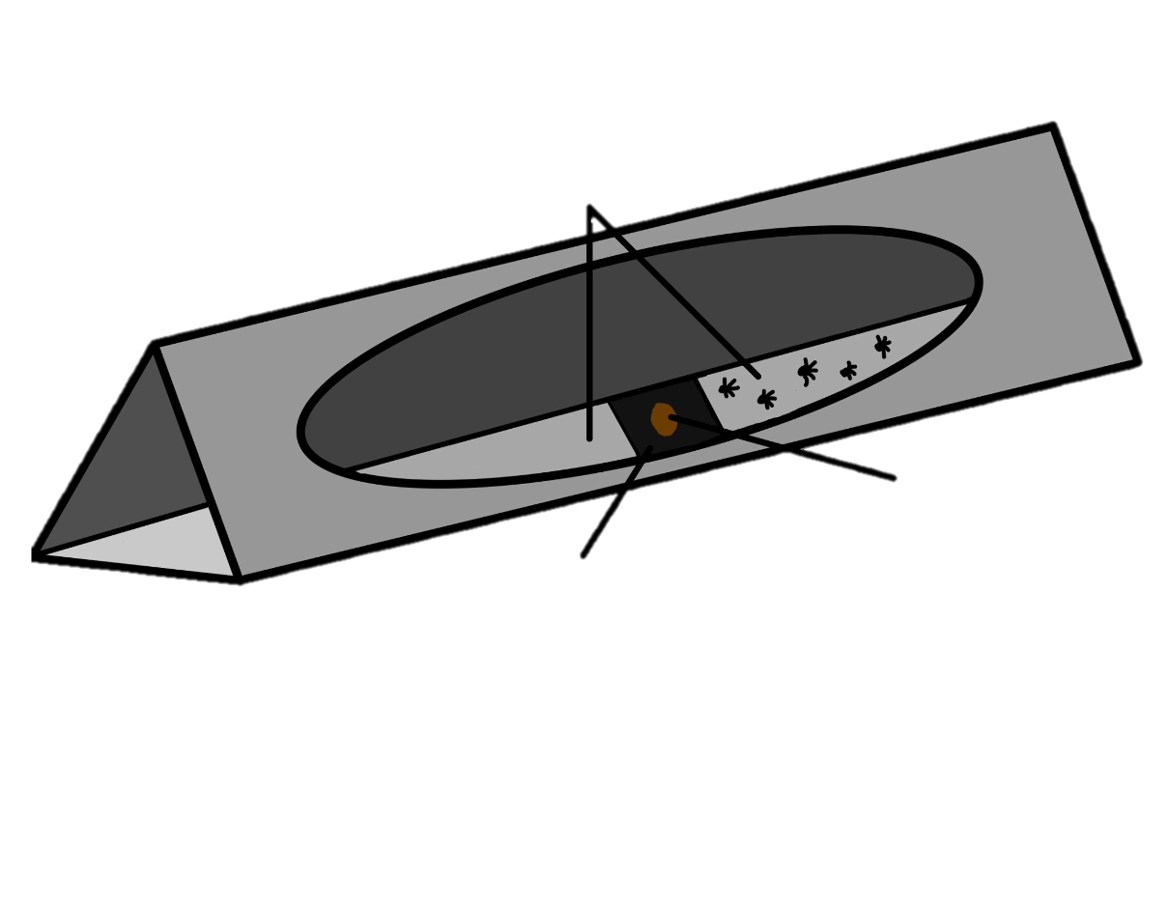
Tracking Tunnel
White Cards
Bait
Tracking Ink
[18]
8
Notes:
Josh

Slide 10
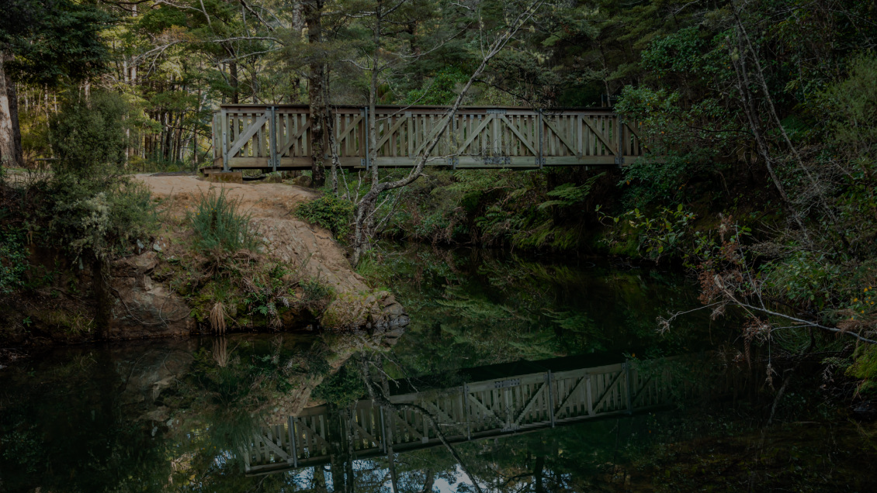
Our Goal is to
investigate non-disruptive methods of skink monitoring alongside scientific and cultural partners
[9]
9
Notes:
With that being said, our goal is to investigate non-disruptive methods of skink monitoring. We will be doing this alongside both scientific and cultural partners.
To achieve this goal we have identified three main objectives.

Slide 11
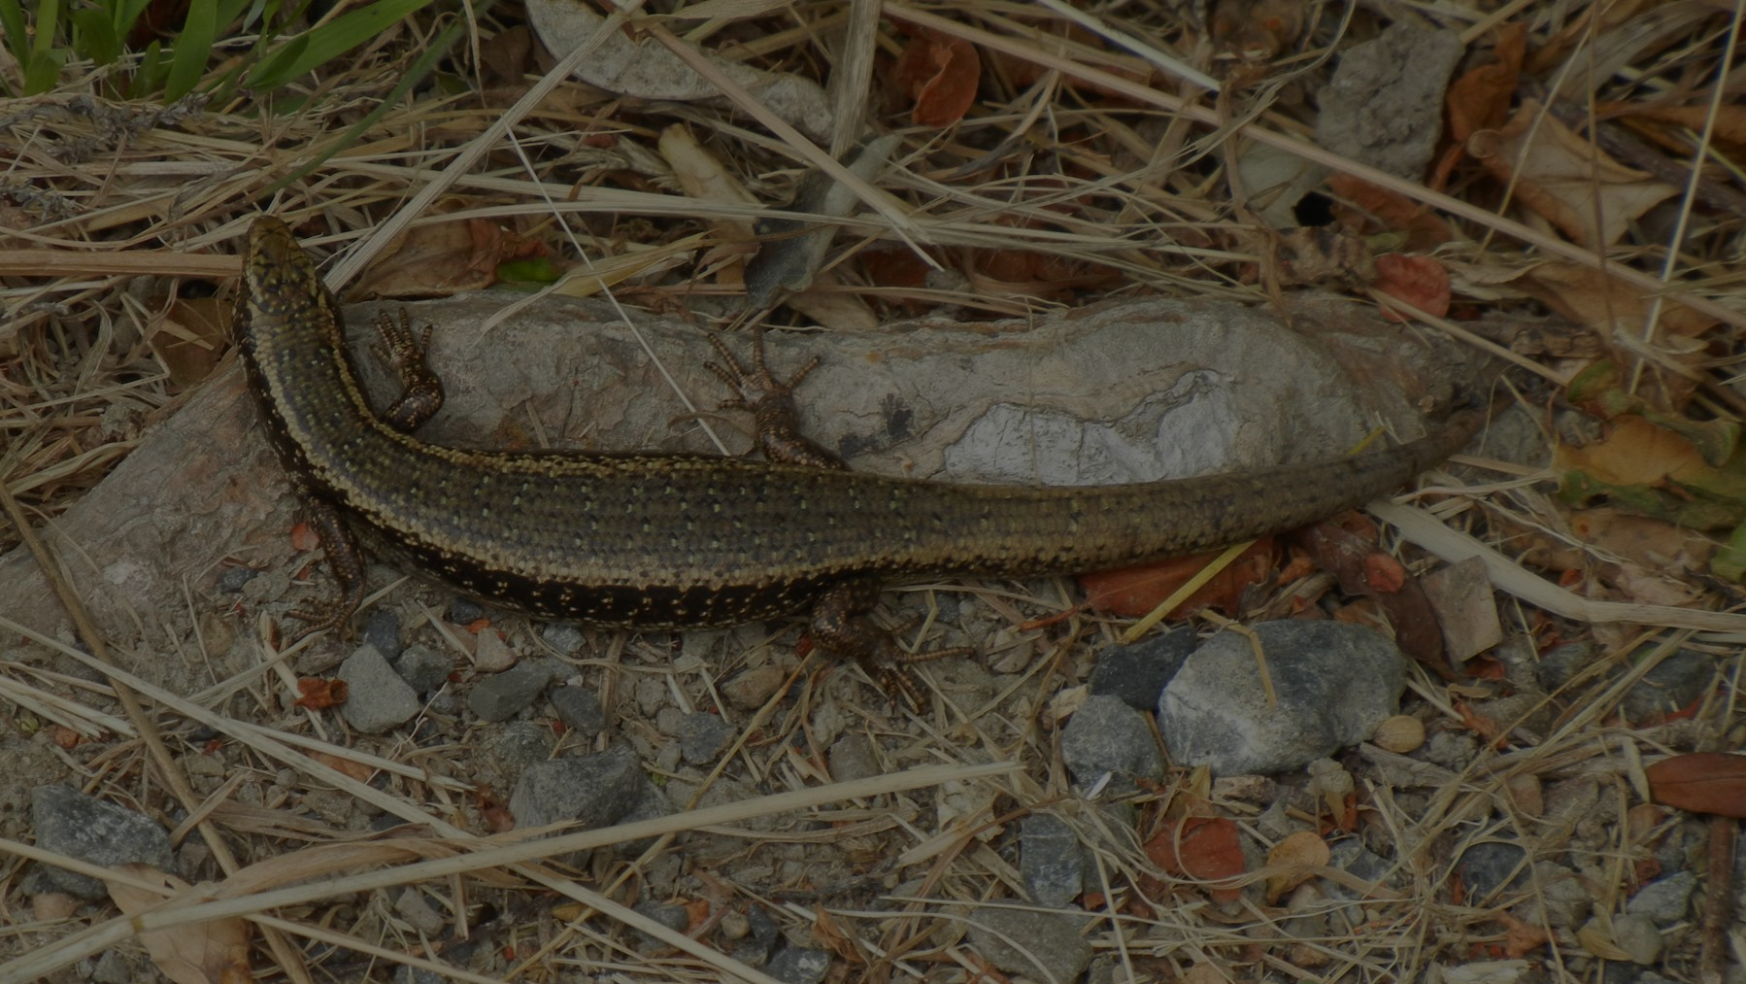
Objective 1
Objective 1
Objective 2
Objective 3
Investigate tracking approaches through testing bait types.
Compare tracking
tunnel and pitfall trap
data.
Collect perceptions and Matauranga Maori of skinks.
[5]
[7]
[6]
10
Notes:
Our first objective is to investigate tracking approaches through testing the effectiveness of those two baits: peanut butter and fresh fruit against a control.
The second objective will involve comparing both our data and existing tracking tunnel data against the popular approach of pitfall trapping.
The third objective will include collecting the perceptions and matauranga maori of skinks and will take place in that longer stay in Rotorua.

Slide 12
Objective 1
Objective 1
Objective 2
Objective 3
Investigate tracking approaches through testing bait types.
Compare tracking
tunnel and pitfall trap
data.
Collect perceptions and Matauranga Maori of skinks.
Site Assessment
Experimentation
Data analysis
Identify existing tunnel locations
Test bait types
Detection rates and chi-squared analysis
[5]
[7]
[6]
11
Notes:
(last 3 slides 1:18s)
Our first objective is broken up into three methods.
The first one will include a site assessment where we go out to Baring Head and identify the 8 existing tracking tunnel lines out there, as well as get a sense for the environment that we will be doing our research in.
The second method will be the actual experimentation element of this project where we test the two bait types against a control in these tracking tunnels.
Finally, we will do some data analysis using detection rates and a chi-squared analysis to determine the effectiveness of each bait type.

Slide 13
Objective 2
Acquire Data
Qualitative Review
Pre-existing pitfall trap and tracking tunnel data
Compare Pitfall data with tracking tunnel research
[7]
12
Notes:
(25s)

Slide 14
Objective 3
Historical Research
GWRC Interviews
Iwi Interviews
Scientific Community
Maori Community
[6]
13
Notes:
(60s)
Collect perceptions and Matauranga Maori of skinks
When we arrive we plan to look through books and records that can be found in both public libraries or Victoria University of Wellington along with continuing any digital research. We really want to make sure we truly comprehend the importance of skink conservation.
For The GWRC our questions will focus on any current research they have been doing with tracking tunnels or Skink conservation
While for the iwi, the focus will be on Matauranga Maori of skinks including any passed down stories or legends the skinks might hold.

Slide 15
[9]
14
Notes:
(15s)
To summarize, this diagram illustrates how our objectives connect together. By detmering the most effective bait type, comparing trackin tunnel with pitfall trap data and getingt insights into the cultural and ecological value of skinks, we aim to develop effective and culturally aware strategies for monitoring skinks in Aotearoa.

Slide 16
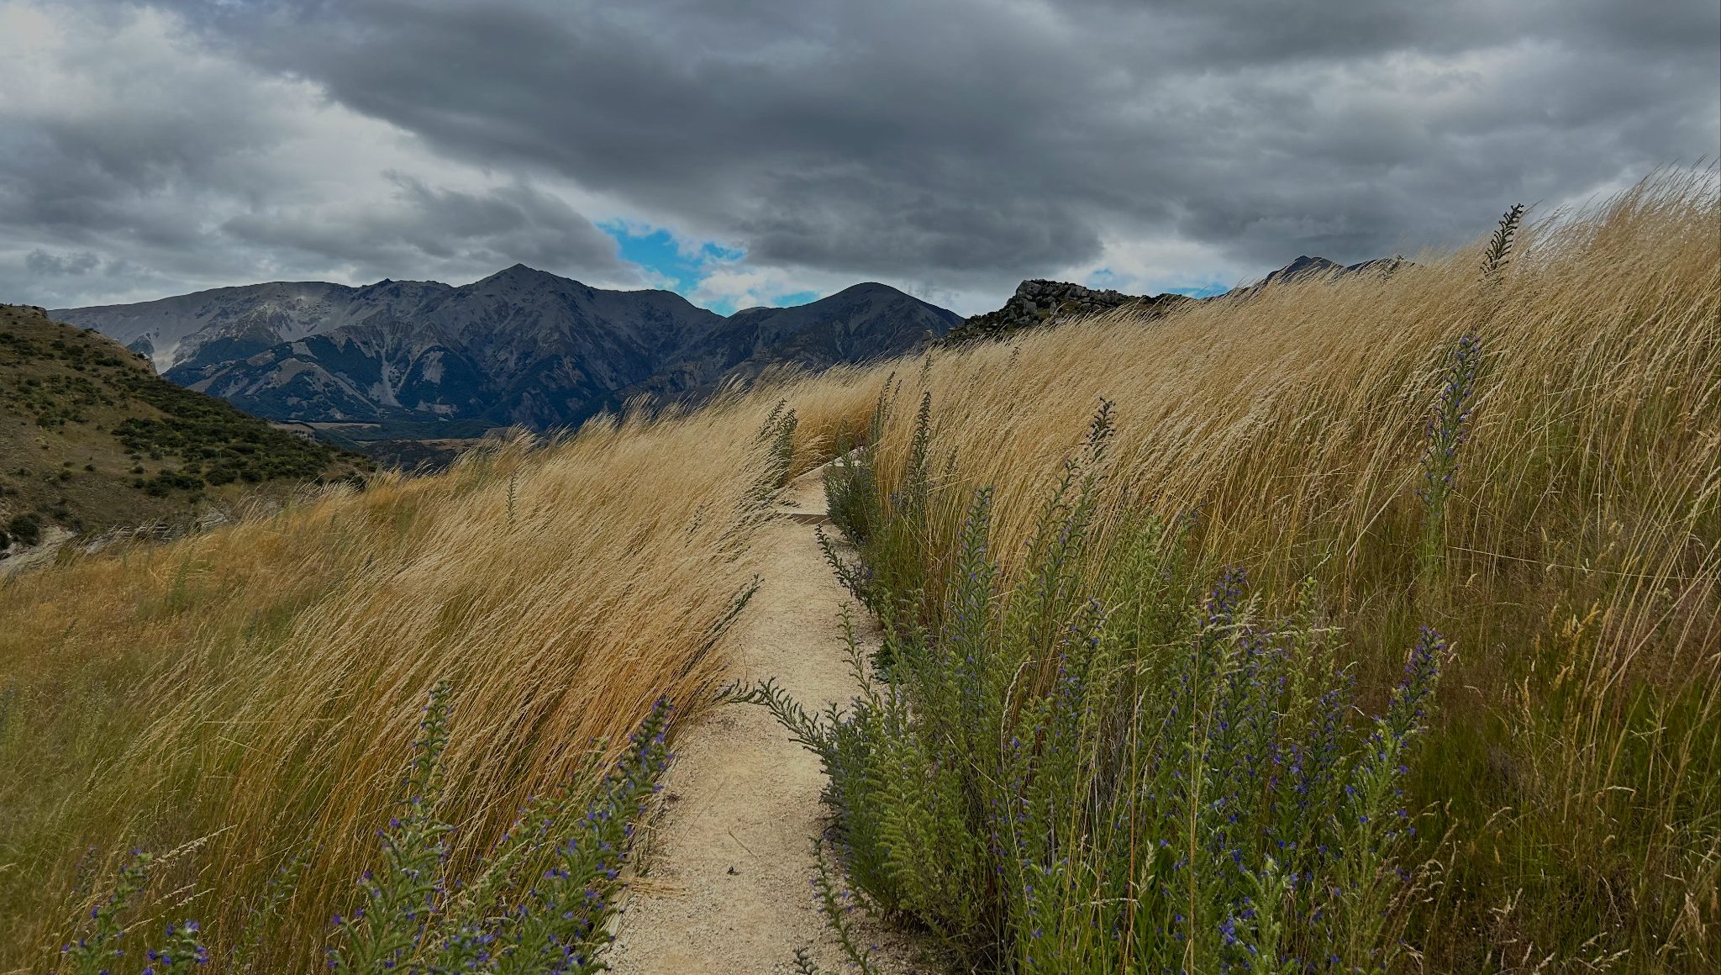
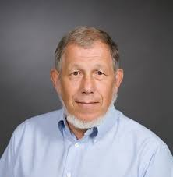
Acknowledgements
Professor Robert Kinicki
Co-Advisor
Professor Ingrid Shockey
Co-Advisor
Dr. Sara Belcher
Partner
[12]
15
Notes:
This is the end of our presentation. To conclude we would like to thank our adivsors prof kinicki, prof shockey an of couse our partner Dr. Sara Belcher. We would also like to thank everyone for listening to our presentation.

Slide 17
References
Image References
1: East Harbour Regional Park. (2024, July 1). Greater Wellington; Greater Wellington. https://www.gw.govt.nz/parks/east-harbour-regional-park/
2: Ellis, N. (n.d.). Whakairo rakau (Māori wood carving) | The Encyclopedia of Crafts in WCC-Asia Pacific Region (EC-APR). Retrieved December 4, 2024, from https://encyclocraftsapr.com/whakairo-rakau-maori-wood-carving/
3: Focus on Baring Head/Ōrua-pouanui - redevelopment of the lighthouse cottages and compound. (2020). Greater Wellington. https://www.gw.govt.nz/parks/east-harbour-regional-park/focus-on-baring-headorua-pouanui-redevelopment-of-the-lighthouse-cottages-and-compound/
4: Jarvie, S., & Monks, J. (2014). Step on it: can footprints from tracking tunnels be used to identify lizard species? New Zealand Journal of Zoology, 41(3), 210–217. https://doi.org/10.1080/03014223.2014.911753
5: Kinicki, R. (2024, October 28). Skink photo from 2016 [Email to Henry Wagg, Leah Uglevich, Jose Perez, Joshua Caputo, Macayle Wells, & Ingrid Shockey].
6: Kinicki, R. (2024, November 14). A couple of Rotorua photos circa 2016 [Email to Henry Wagg, Leah Uglevich, Jose Perez, Joshua Caputo, Macayle Wells, & Ingrid Shockey].
7: Making a tracking tunnel. (2019, May 5). Science Learning Hub. https://www.sciencelearn.org.nz/resources/1171-making-a-tracking-tunnel
8: Maori Party, & 2021. (2021). Toi Māori. Te Pāti Māori. https://www.maoriparty.org.nz/toi_maori
9: Milligan, M. (2021, February 18). The Sunken Secrets of Dunwich: England&39s Lost Medieval Town. HeritageDaily - Archaeology News. https://www.heritagedaily.com/2021/02/ancient-kauri-trees-points-to-a-turning-point-in-earths-history-42000-years-ago/137226
10: Rey. (2023, November 4). A Magical 3-Day Rotorua Itinerary. Getaway Compass. https://www.getawaycompass.com/the-ultimate-3-day-rotorua-itinerary/
11: Saluzzi, M., Uttecht, D., & Avadhuta, R. (2024). Exploring Value Systems: Māori Perspectives in Scholarly Literature on Mice-Invertebrate Interactions in Aotearoa New Zealand. : Worcester Polytechnic Institute.
12: Wagg, E. (2023). Arthur’s Pass [Photograph]
13: Wagg, E. (2023). Lake Tekapo [Photograph]
14: Wagg, E. (2023). Milford Sound [Photograph]
15: Wagg, E. (2023). Mountains! [Photograph]
16: Wagg, E. (2023). New Zealand West Coast [Photograph]
17. Farm field barley soil cross section. (2018, February 14). Regeneration International. https://regenerationinternational.org/2018/02/14/no-till-farmers-push-healthy-soils-ignites-movement-plains/farm-field-barley-soil-cross-section/
18. beaufortsc. (2020, October 14). Spartina Marsh Grass, The Circle of Life. Eat, Stay, Play: Beaufort’s Best for Locals & Visitors. https://www.eatstayplaybeaufort.com/spartina-marsh-grass/
19. Wellington | New Zealand, Map, Population, & Facts | Britannica. (n.d.). Retrieved December 9, 2024, from https://www.britannica.com/place/Wellington-New-Zealand
16

Slide 18
References
Andersen, J. (2010). Māori Life in Ao-Tea (1st ed.). Ams Pr Inc. https://www.abebooks.com/9780404144005/Māori -Life-Ao-Tea-Andersen-Johannes-0404144004/plp
Baring Head Atmospheric Research Station, NIWA. (2022). https://niwa.co.nz/atmosphere/baring-head-atmospheric-research-station
Baring Head/Ōrua-pouanui Historic Area. (2023). Heritage New Zealand Pouhere Taonga. https://www.heritage.org.nz/list-details/9621/Baring-Head-%C5%8Crua-pouanui-Historic-Area
Bradshaw, R. E., Bellgard, S. E., Black, A., Burns, B. R., Gerth, M. L., McDougal, R. L., Scott, P. M., Waipara, N. W., Weir, B. S., Williams, N. M., Winkworth, R. C., Ashcroft, T., Bradley, E. L., Dijkwel, P. P., Guo, Y., Lacey, R. F., Mesarich, C. H., Panda, P., & Horner, I. J. (2020). Phytophthora agathidicida: Research progress, cultural perspectives and knowledge gaps in the control and management of kauri dieback in New Zealand. Plant Pathology, 69(1), 3–16. https://doi.org/10.1111/ppa.13104
Crisp, P. (2011). Baring Head ecological values. Greater Wellington. https://www.gw.govt.nz/assets/Documents/2022/03/Baring-Head-Ecological-Values-Report.pdf
Downes, T. W. (1937). Māori Mentality Regarding the Lizard and Taniwha in the Whanganui River Area. The Journal of the Polynesian Society, 46(4(184)), 206–224.
Duncan, R., & Robson-Williams, M. (2024). Co-designing a research programme for impact: Lessons learned from practice by Aotearoa New Zealand’s Biological Heritage National Science Challenge Ngā Koiora Tuku Iho. Kōtuitui, 19(2), 164–189. https://doi.org/10.1080/1177083X.2023.2227675
Hood, I. (2021). Kauri dieback. Plant Pathology, 70(4), 764–766. https://doi.org/10.1111/ppa.13356
Jarvie, S., & Monks, J. (2014). Step on it: can footprints from tracking tunnels be used to identify lizard species? New Zealand Journal of Zoology, 41(3), 210–217. https://doi.org/10.1080/03014223.2014.911753
Kaiser, L. H., & Saunders, W. S. A. (2021). Vision Mātauranga research directions: Opportunities for iwi and hapū management plans. Kōtuitui, 16(2), 371–383. https://doi.org/10.1080/1177083X.2021.1884099
Lawrence, S. A., Burgess, E. J., Pairama, C., Black, A., Patrick, W. M., Mitchell, I., Perry, N. B., & Gerth, M. L. (2019). Mātauranga-guided screening of New Zealand native plants reveals flavonoids from kānuka (Kunzea robusta) with anti-Phytophthora activity. Journal of the Royal Society of New Zealand, 49(sup1), 137–154. https://doi.org/10.1080/03036758.2019.1648303
Leathwick, J. R., & Mitchell, N. D. (1992). Forest Pattern, Climate and Vulcanism in Central North Island, New Zealand. Journal of Vegetation Science, 3(5), 603–616. https://doi.org/10.2307/3235827
Letcher, K. (2013, February 8). Rotorua. Britannica. https://school.eb.com/levels/high/article/Rotorua/64198
Lettink, M., & Monks, J. (2016). Survey and monitoring methods for New Zealand lizards. Journal of the Royal Society of New Zealand, 46(1), 16–28. https://doi.org/10.1080/03036758.2015.1108343
Lettink, M., Young, J., & Monks, J. M. (2022). Comparison of footprint tracking and pitfall trapping for detecting skinks. New Zealand Journal of Ecology, 46(2), 1-5. https://doi.org/10.20417/nzjecol.46.24
Mackintosh, L. (2001). Overview of New Zealand’s climate, NIWA. MIWA, Taihoro Nukurangi. https://niwa.co.nz/climate-and-weather/overview-new-zealands-climate
McLintock, A. H., Susan Bailey, B. A., & Taonga, N. Z. M. for C. and H. T. M. (1966). ROTORUA [Web page]. An Encyclopaedia of New Zealand, Edited by A. H. McLintock, 1966.; Ministry for Culture and Heritage Te Manatu Taonga. https://teara.govt.nz/en/1966/rotorua
McRae, J. (2017). Māori oral tradition: He kōrero nō te ao tawhito / Jane McRae. Auckland, New Zealand : Auckland University Press, 2017. https://natlib.govt.nz/records/38185126
Mead, H. M. (2022, June 18). Understanding Mātauranga Māori . E-Tangata. https://e-tangata.co.nz/comment-and-analysis/understanding-matauranga-Māori /
MetService, New Zealand Climate. (n.d.). Retrieved November 15, 2024, from https://about.metservice.com/our-company/learning-centre/new-zealand-climate/
Roberts, M. (2012). Genealogy of the sacred: Māori beliefs concerning lizards. In D. Hooke, G. Pungetti, & G. Oviedo (Eds.), Sacred Species and Sites: Advances in Biocultural Conservation (pp. 249–264). Cambridge University Press. https://doi.org/10.1017/CBO9781139030717.025
Roberts, M., Norman, W., Minhinnick, N., Wihongi, D., & Kirkwood, C. (1995). Kaitiakitanga: Māori perspectives on conservation. Pacific Conservation Biology, 2(1), 7–20. https://doi.org/10.1071/PC950007
Roberts, M. (2013). WAYS OF SEEING: WHAKAPAPA | Sites: A Journal of Social Anthropology and Cultural Studies. 10, 93–120.
Smith, S. A., Sadlier, R. A., Bauer, A. M., Austin, C. C., & Jackman, T. (2007). Molecular phylogeny of the scincid lizards of New Caledonia and adjacent areas: Evidence for a single origin of the endemic skinks of Tasmantis. Molecular Phylogenetics and Evolution, 43(3), 1151–1166. https://doi.org/10.1016/j.ympev.2007.02.007
Sorensen, T. (2022). Species Interactions Between the Plague Skink, Indigenous Skinks, and Invasive Mammals [Thesis, ResearchSpace@Auckland]. https://researchspace.auckland.ac.nz/handle/2292/60997
Windchief, S., & Cummins, J. (2022). Considering Indigenous Research Methodologies: Bicultural Accountability and the Protection of Community Held Knowledge. Qualitative Inquiry, 28(2), 151–163. https://doi.org/10.1177/10778004211021803
17

Slide 19
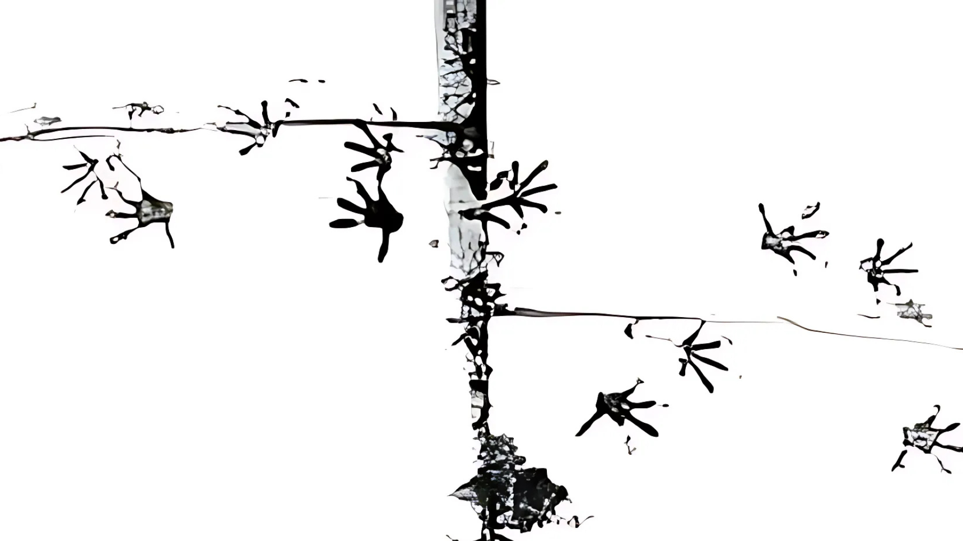
Questions
[4]
18
Notes:
If you have any questions, please this is the time to answe

