Slide 1
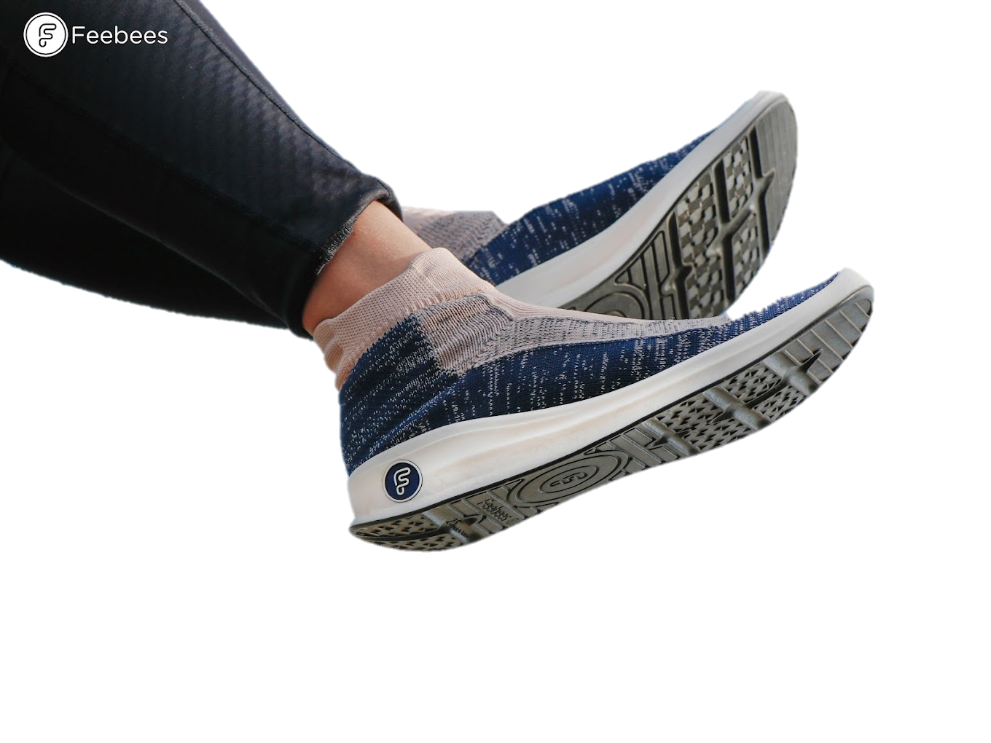
Expanding the Market of Recyclable Shoes in Taiwan
[1]
Presented by
Roey Chen, Brian Chung
Willa Royce-Roll, Benjamin Skarnes
Presented to
Kuming Chen

Slide 2
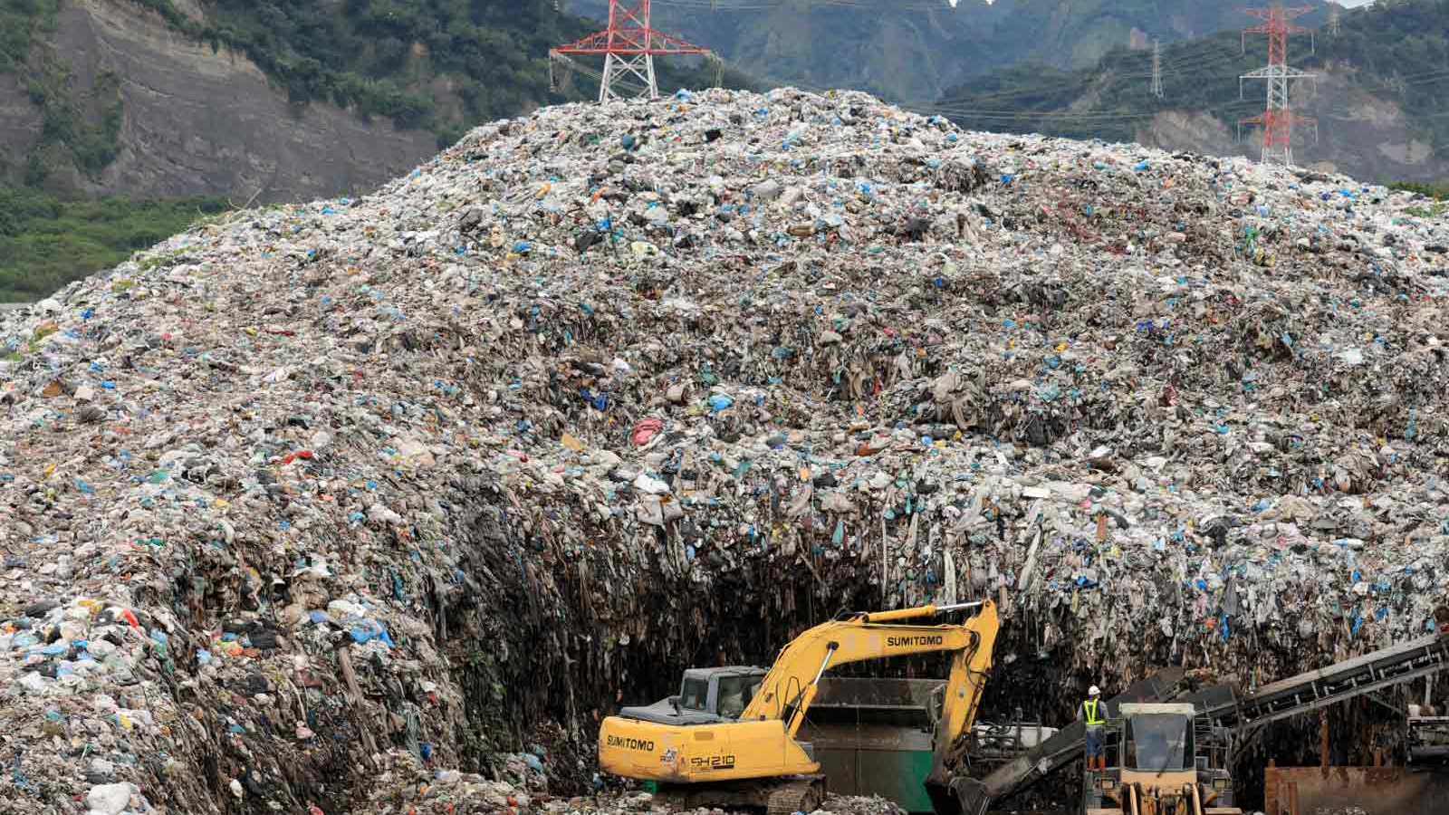
[2]
Global shoe industry contributes
8%
of global
CO₂ emissions
148
mega tons of
waste by 2030
2

Slide 3
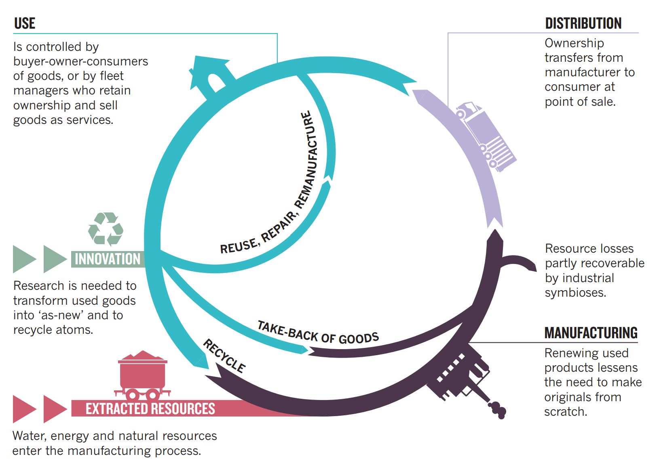
Circular Economy
Repurposing & repairing products to achieve an end of waste
[3]
3

Slide 4
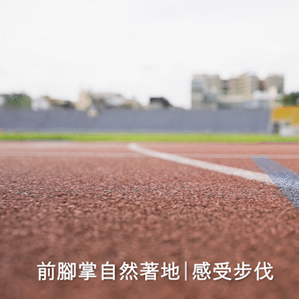
Feebees
Upper knit
sock
[5]
[4]
Lower molded
PU
4

Slide 5
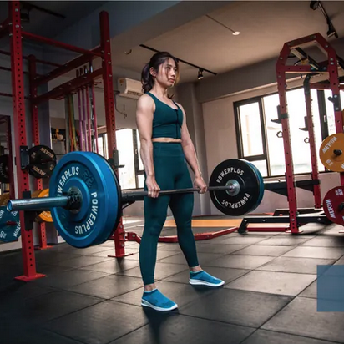
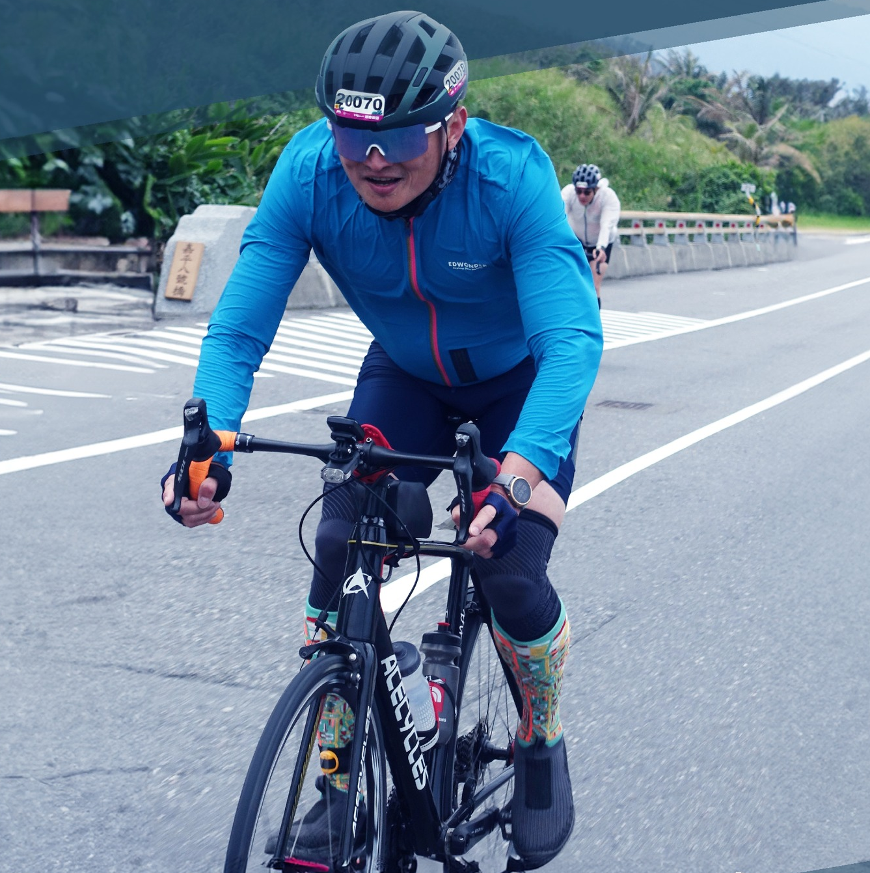
Branding
A company’s identity and values
Marketing
How a company reaches to consumers
5
Current Branding
Current Marketing
Young adults, high intensity
Old adults, high intensity
[7]
[8]

Slide 6
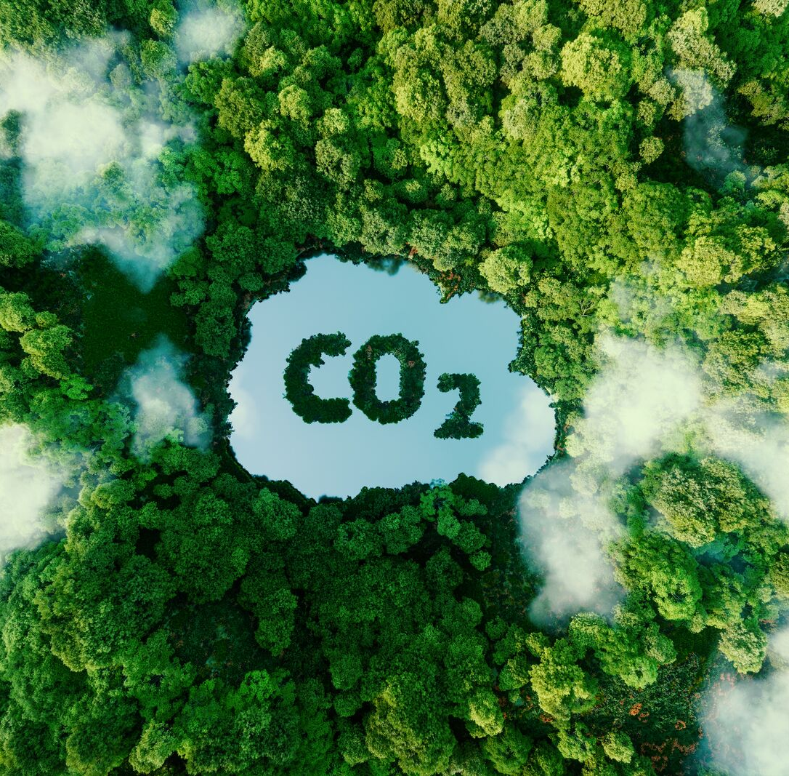
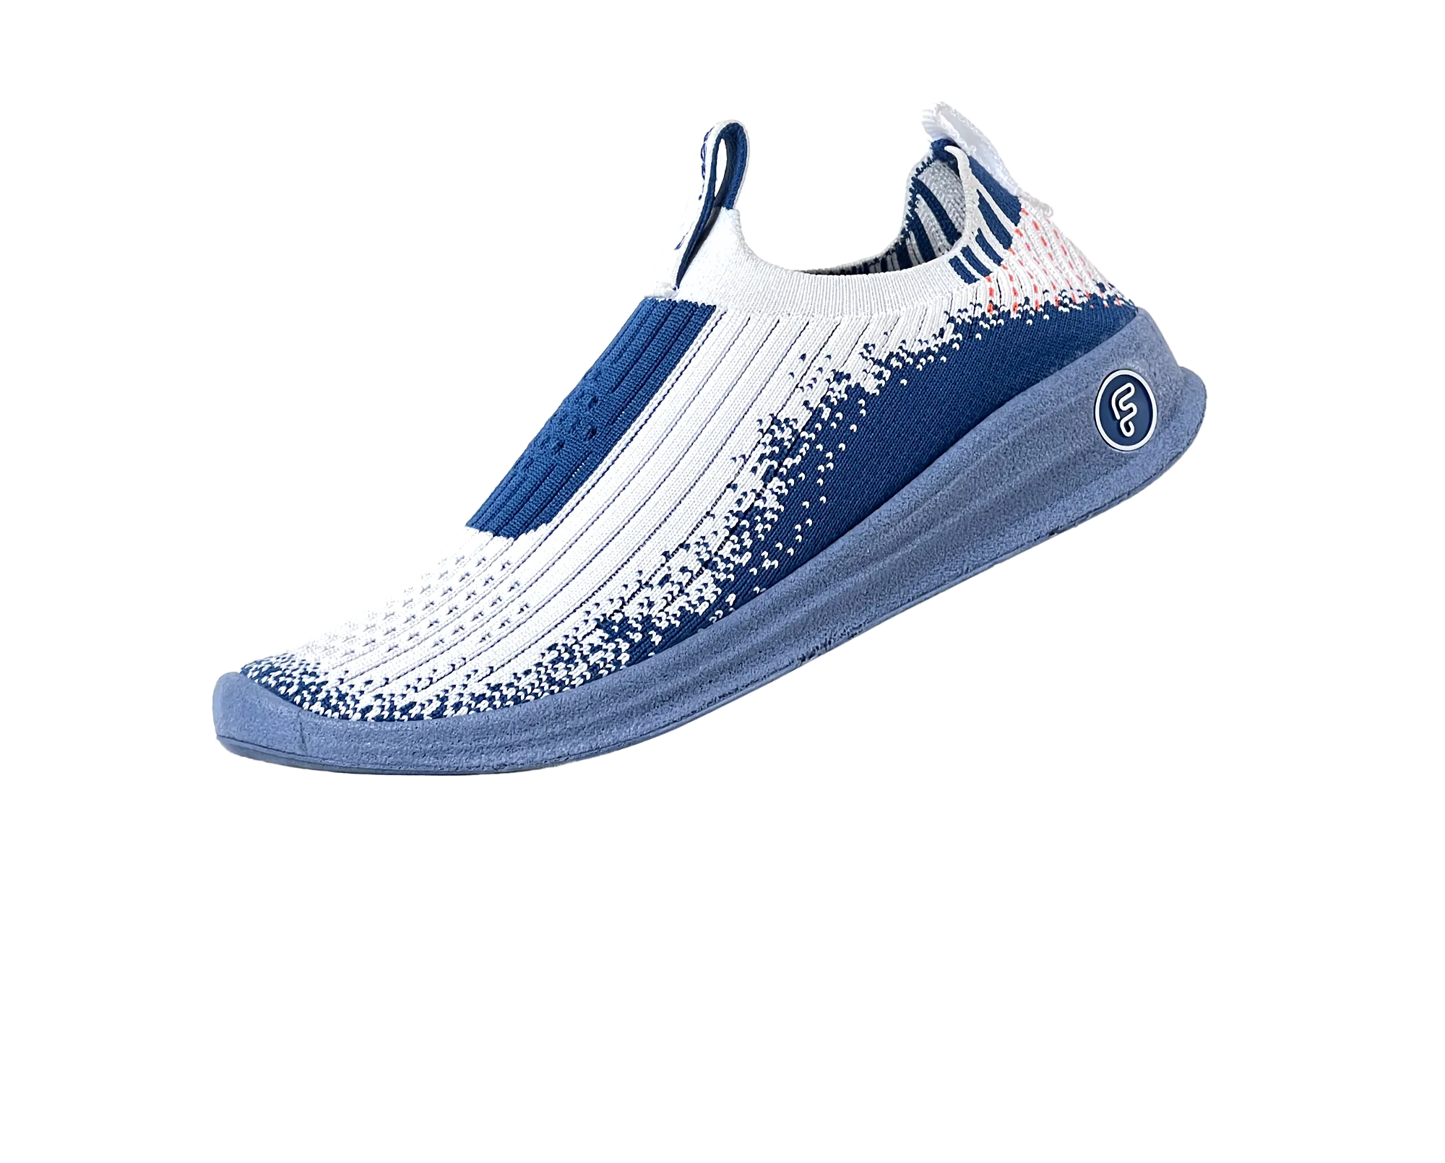
Branding
A company’s identity and values
Marketing
How a company reaches to consumers
Current Branding
Current Marketing
Young adults, high intensity
Old adults, high intensity
[6]
[7]
6
[8,9]

Slide 7
Current Branding
Current Marketing
Young adults, high intensity
Old adults, high intensity
[6]
[7]
[8,9]
7

Slide 8
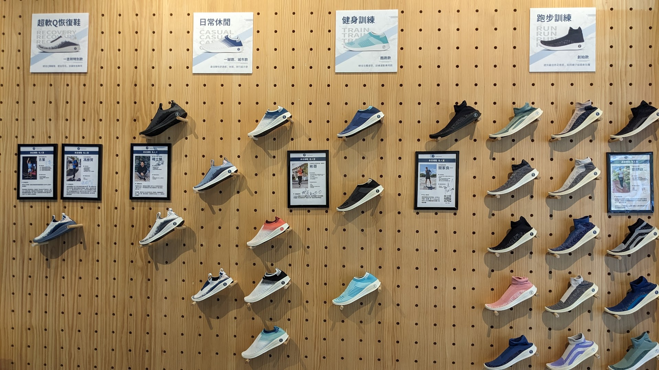
Mission
Project Objectives
Determine an effective branding and marketing strategy for Feebees to expand its customer outreach and emphasize their sustainability mission
8

Slide 9
Mission
Project Objectives
Investigate
factors between sustainable shoe brands
Assess
sneaker preferences of Taiwanese public
Determine
views on sustainable branding
Determine an effective branding and marketing strategy for Feebees to expand its customer outreach and emphasize their sustainability mission
9

Slide 10
Investigate
factors between sustainable shoe brands
Assess
sneaker preferences of Taiwanese public
Determine
views on sustainable branding
Project Objectives
10

Slide 11
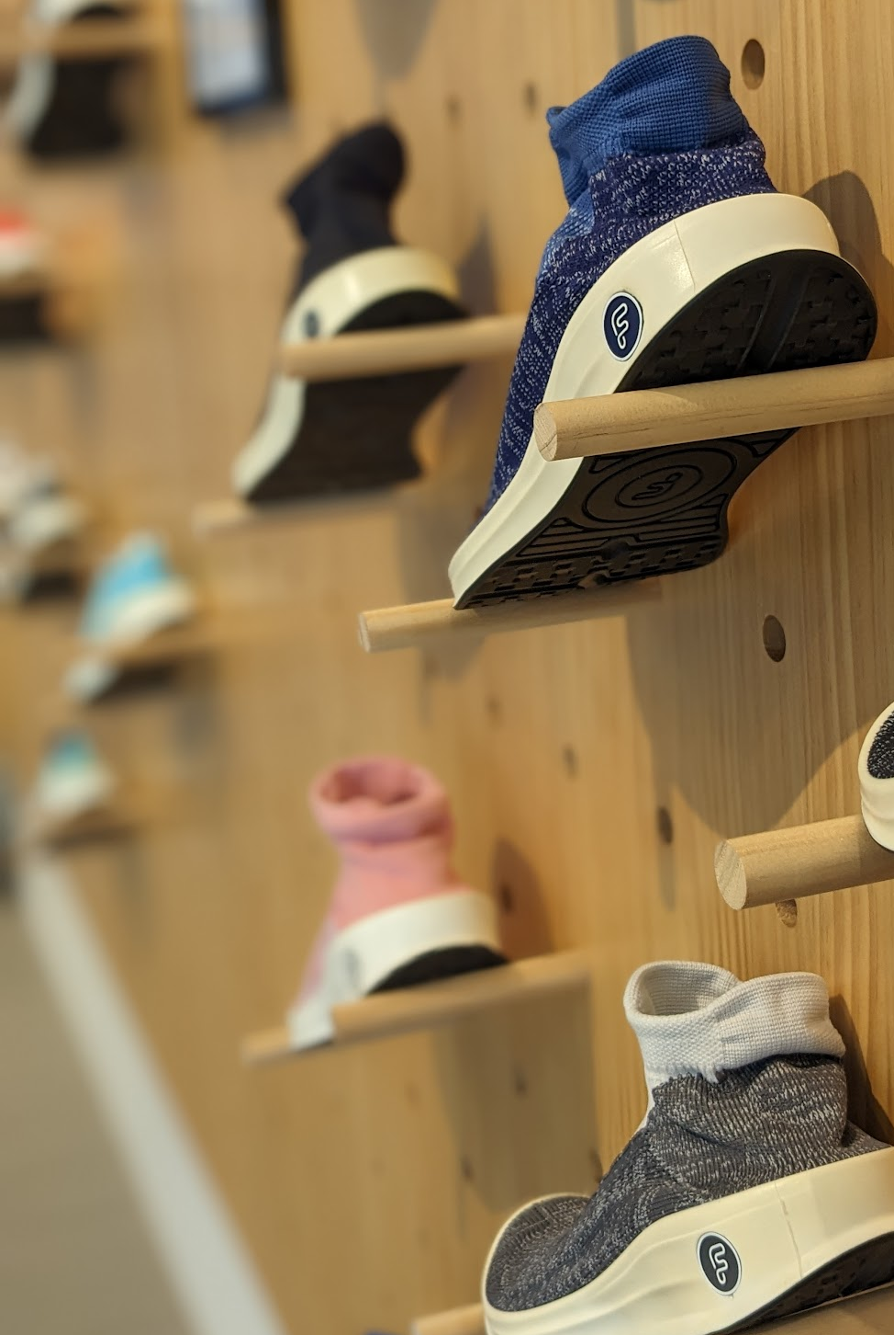
Competitor Analysis
9 companies
11
3 interviews
1 from Feebees
2 from Metro Oasis

Slide 12
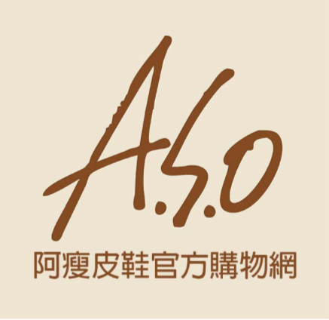
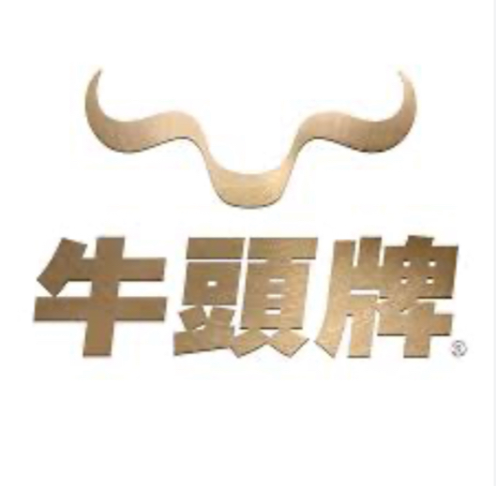
12

Slide 13
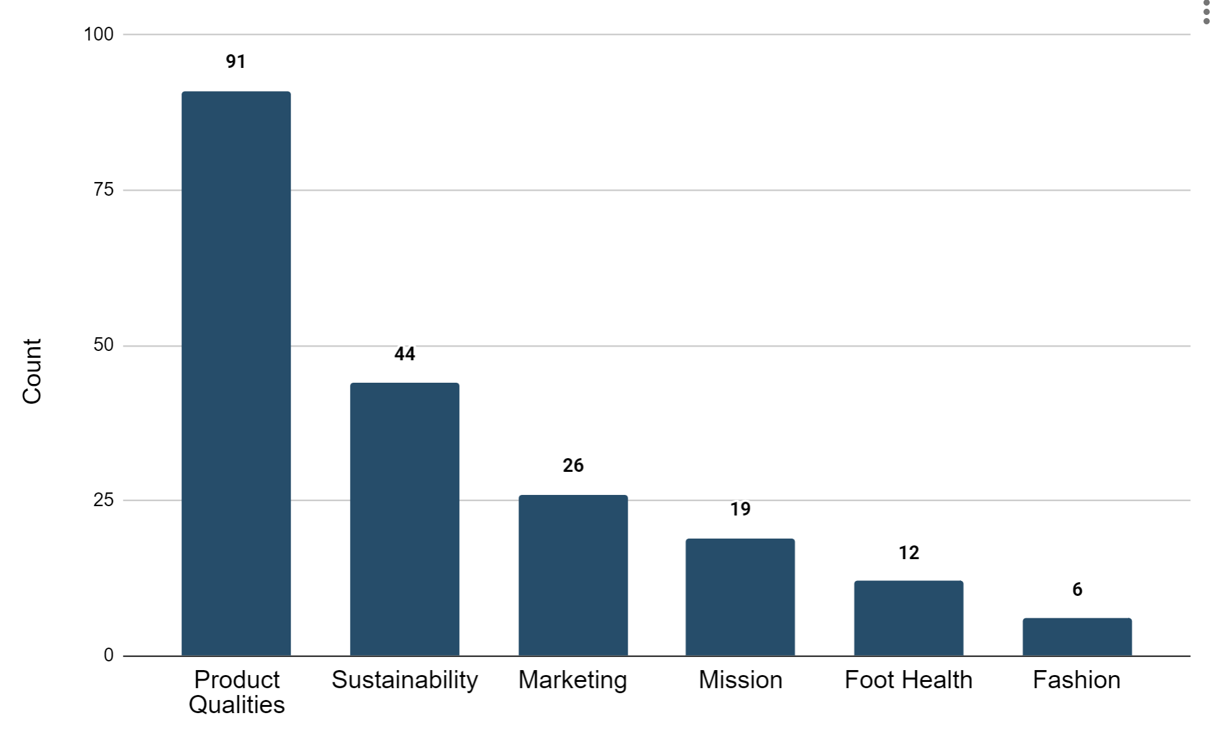
Company Branding Seems to Focus on Product Qualities and Sustainability
(n=9)
13

Slide 14
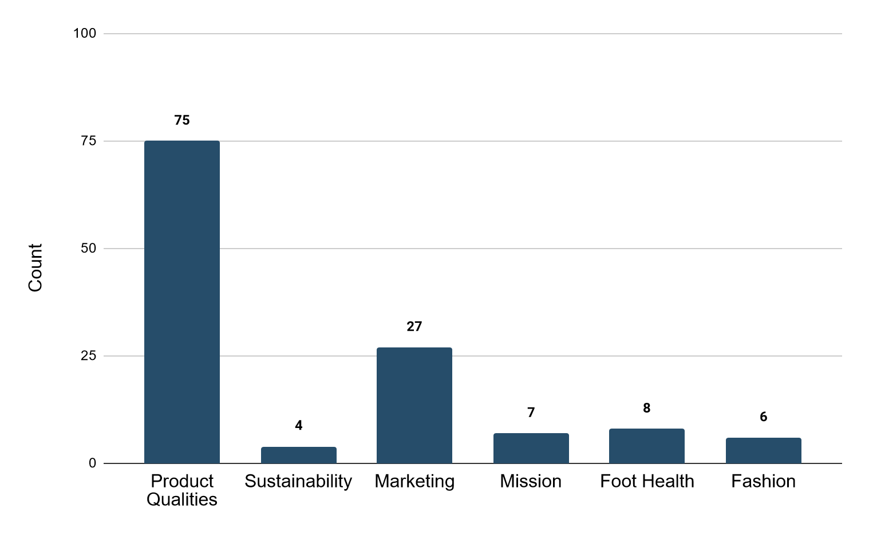
Company Branding Mainly Focuses on Product Qualities
n=8
(n=8)
14

Slide 15
Feebees sneakers are made for…
n=8
Casual and leisure activities
Long distance walking and running
Marathons and triathlons
Gym and training
Sports
15

Slide 16
[10]

Slide 18
[12]

Slide 19
Distributor Interview
3 interviews
1 from Feebees
2 from MetrOasis
19
3 interviews
1 from Feebees
2 from Metro Oasis

Slide 20
Sustainability Has Negative Meaning
“
Taiwan is actually very afraid of environmentally friendly materials because [they] are not durable in Taiwanese people’s minds
”
-Interviewee A
“
… the customer would also think that the recyclable shoes will [break down] easily
”
-Interviewee C
20

Slide 21
A Possible Solution for Sustainability
“
I think in the Taiwanese market, you have to give back the benefits of environmental protection to consumers. For example, you can recycle their old shoes and give them a discount on new shoes. This will resonate.
”
-Interviewee A
21

Slide 22
Customers Buy Feebees for Comfort and Leisure Sport
“
[Middle aged and elderly] would prefer that the shoes they buy are less heavy, lighter, and... more flexible…[Feebees] are more convenient to wear and can [be used for leisure] sports.
”
-Interviewee A
22

Slide 23
Consumer Survey
Target
Feebees consumers
Non-Feebees consumers
23
3 interviews
1 from Feebees
2 from Metro Oasis

Slide 24
Consumer Survey Demographics
Age (n=36)
36 total responses
24 non-Feebees consumers
12 Feebees consumers
24

Slide 25
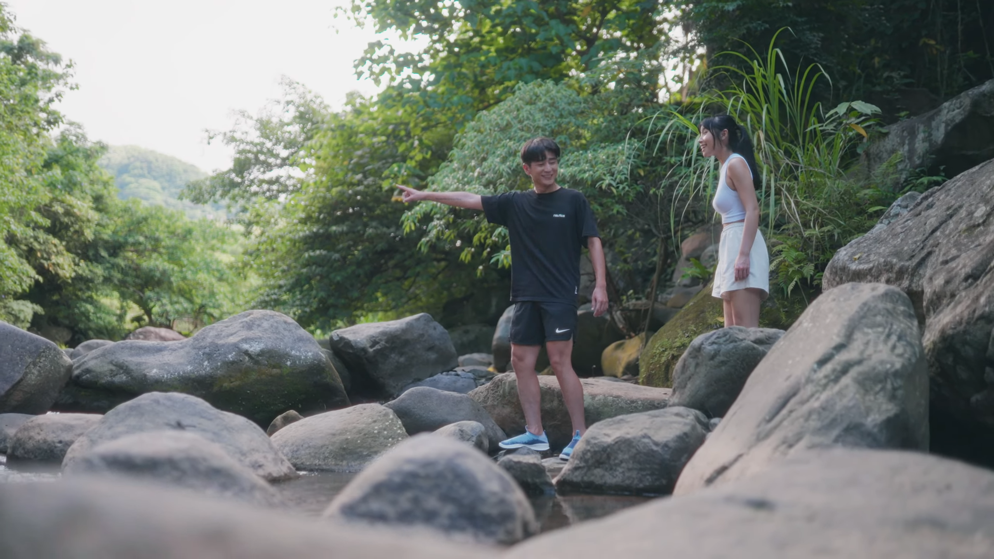
75%
[14]
Taiwanese People Want to Be Sustainable
n=36
Non-Feebees consumers were interested in a sneaker recycling and repair program
n=24
100%
Feebees consumers would recycle or repair their sneakers rather than throwing them out
n=12
25

Slide 26
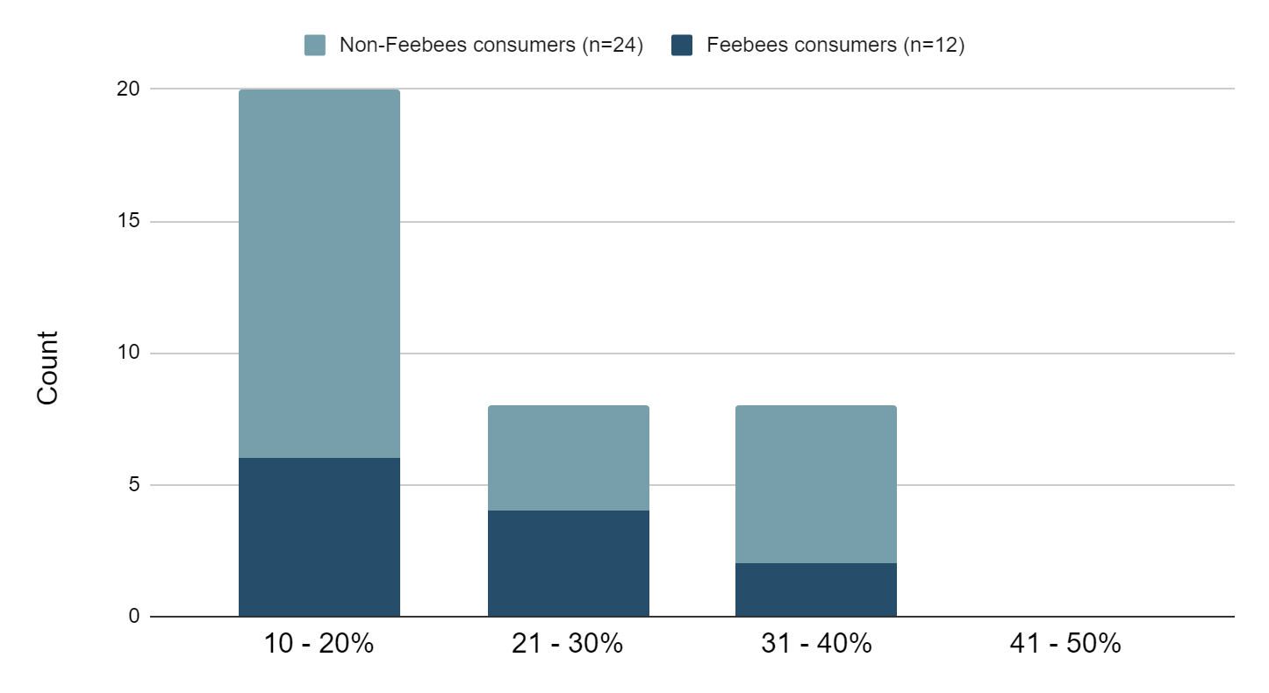
Consumers Don’t Need a Big Incentive to Recycle or Repair
26

Slide 27
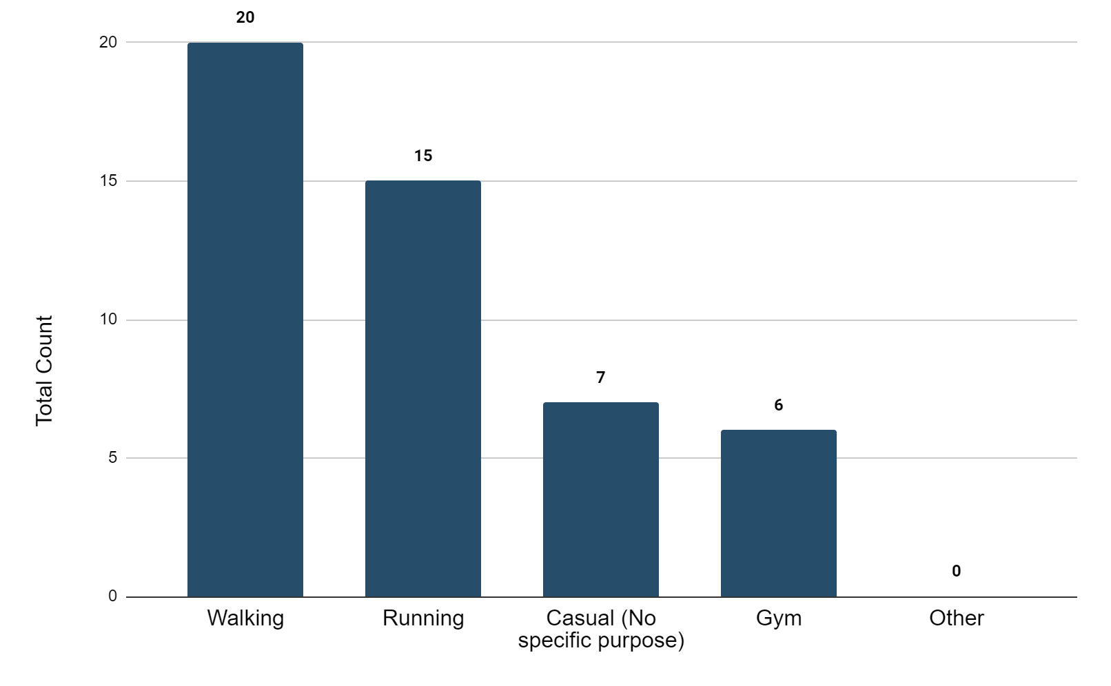
Non-Feebees Consumers Buy Sneakers for Walking
(n=24)
27

Slide 28
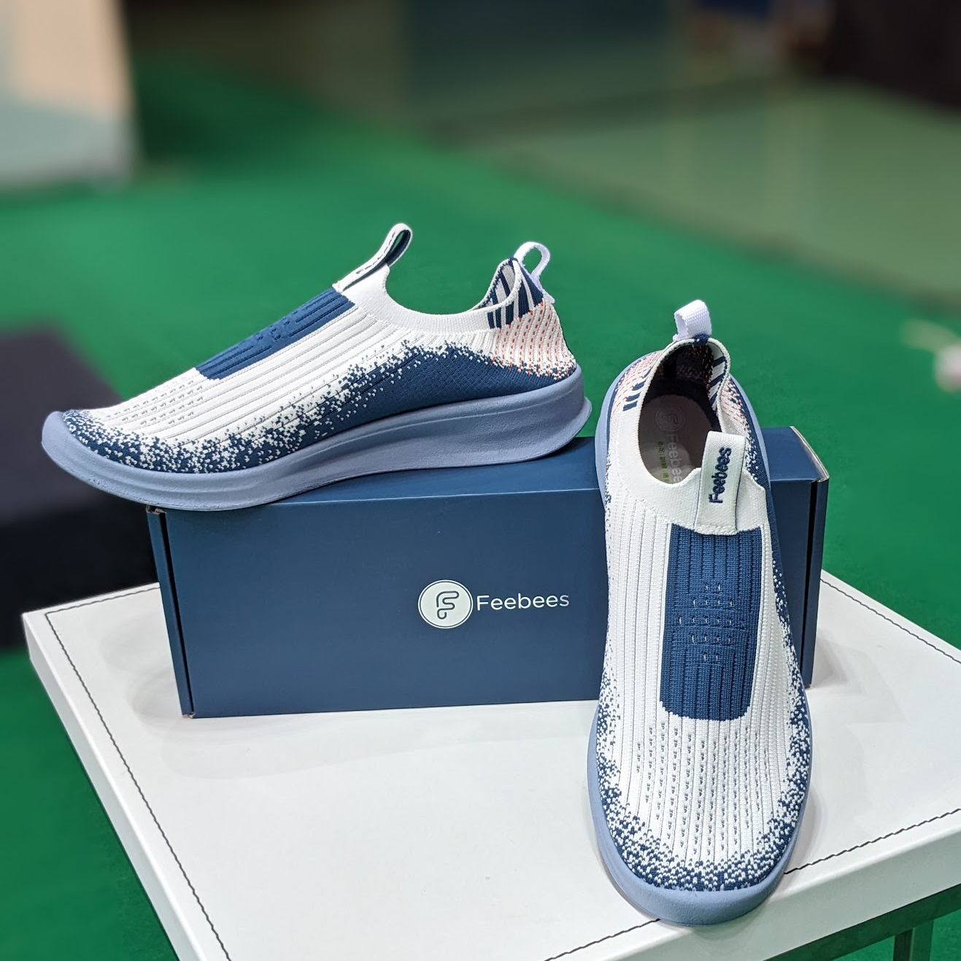
Recommendation 1: Change How Sustainability of Sneakers is Promoted
Current
Recyclable sneakers made of recycled materials
Recommended
Recyclable sneakers
28
Promote recycling program on homepage
Provide 10-20% price incentive for recycling or repair programs

Slide 29
Recommendation 1: Change How Sustainability of Sneakers is Promoted
Recommended
Recyclable sneakers
Promote recycling program on homepage
Provide 10-20% price incentive for recycling or repair programs
29

Slide 30
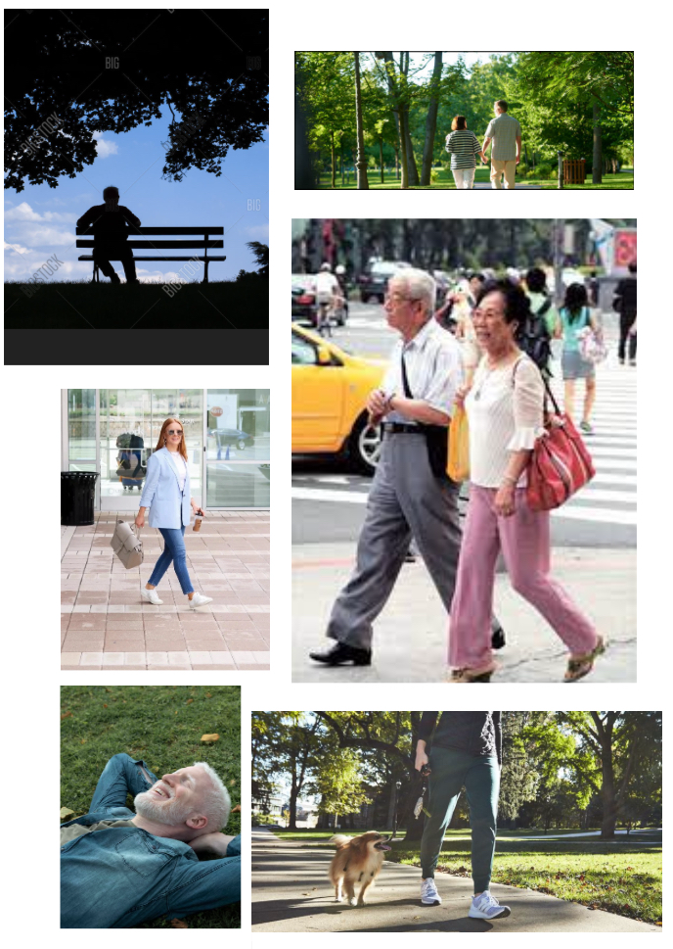
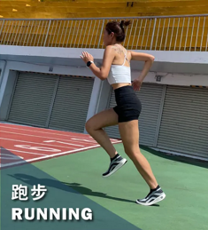
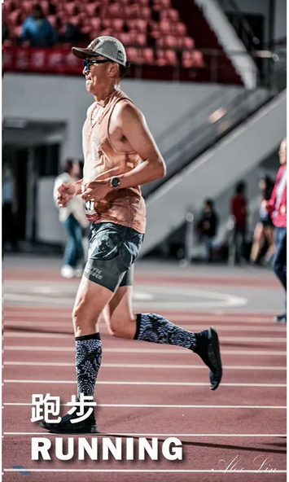
Recommendation 2: Promote Leisure Lifestyle
[16]
[15]
Current
Recommended
30

Slide 31
Acknowledgements
Thanks to
Professor Wen-Hua Du, Robert Kinicki
Special thanks to
Kuming Chen
Amy, Jennifer, Larissa, Riley, and Vicky
27
31

Slide 32
謝謝！ Questions?
[17]
32

Slide 33
Image Sources
[1] Feebees Google Review Photos https://lh3.googleusercontent.com/p/AF1QipMqyVLfaSn0ncqBX5OsbHX-fOTTl5GDXIB_qmwl=s1360-w1360-h1020
[2] https://english.cw.com.tw/article/article.action?id=3252
[3] https://www.nature.com/articles/531435a
[4] https://www.feebees.com.tw/pages/feebees-features-1
[5] https://en.pinkoi.com/product/pqULRwm5
[6, 10, 16] https://www.feebees.com.tw/
[7] https://www.facebook.com/Feebees0825/posts/pfbid02qWbda9np2jZ6nJ3u5StbF7XH5FUdsRGBV6B9f5Tmk8r58DwFCozoqYZqK9DyevVml
[8] https://www.facebook.com/photo.php?fbid=721945670095604&set=pb.100068405326821.-2207520000&type=3
[9] https://www.aninews.in/news/business/business/indias-new-market-for-green-credits-a-promising-initiative-for-environmental-sustainability-insight-by-libf-india20231009171626/
[11] https://www.facebook.com/Feebees0825/posts/pfbid0rV4Tx9tTRqwrPGEQHc4N4TEsPryhtX3mPizCsSzKaUZpbQbRgWa5FibLdYk5jd4Rl
[12] https://www.facebook.com/Feebees0825/posts/pfbid0mNzVAioScxE7R3MECX55s1L1mvNacth1eR7PDZwzdKtiBLfSfpdtF52escGNB12hl
[13] https://www.facebook.com/Feebees0825/posts/pfbid02FED6rBLBCuhxLzjkuXcego8eNTHKDQQhEMu9oW3ieJN55yMaiPonGacd1mnBGcj4l
[14] https://www.youtube.com/watch?v=o6rqhJXpcBs
[15] Stock images
[17] https://www.feebeeshop.com.tw/ecommerce/%E9%98%B2%E6%BD%91%E6%B0%B4%E6%87%B6%E4%BA%BA%E9%81%8B%E5%8B%95%E8%A5%AA%E9%9E%8B-1.html
33

Slide 34
Appendix

Slide 35
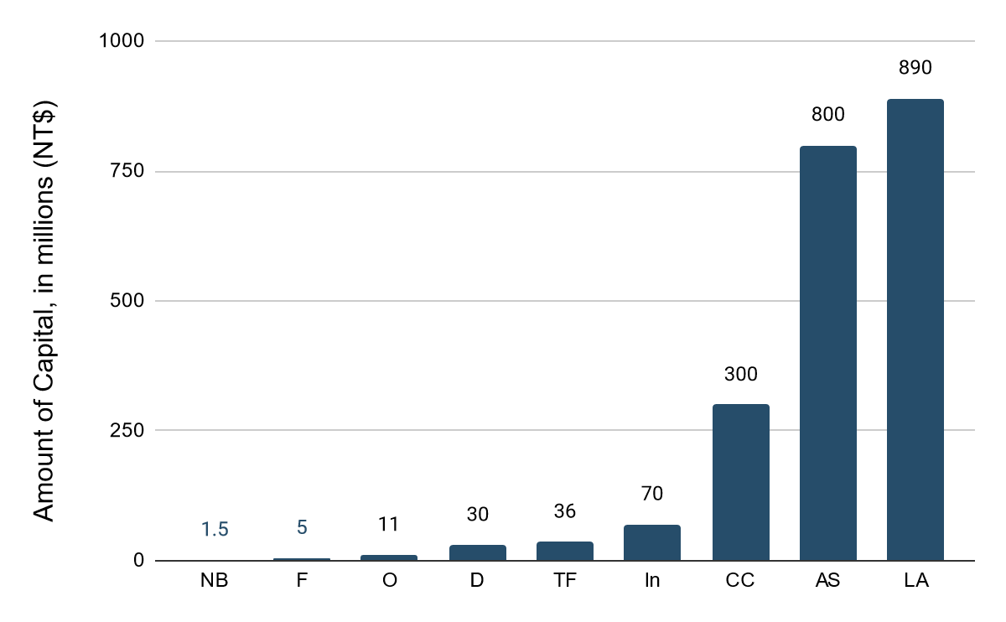
Total Capital of Companies

Slide 36
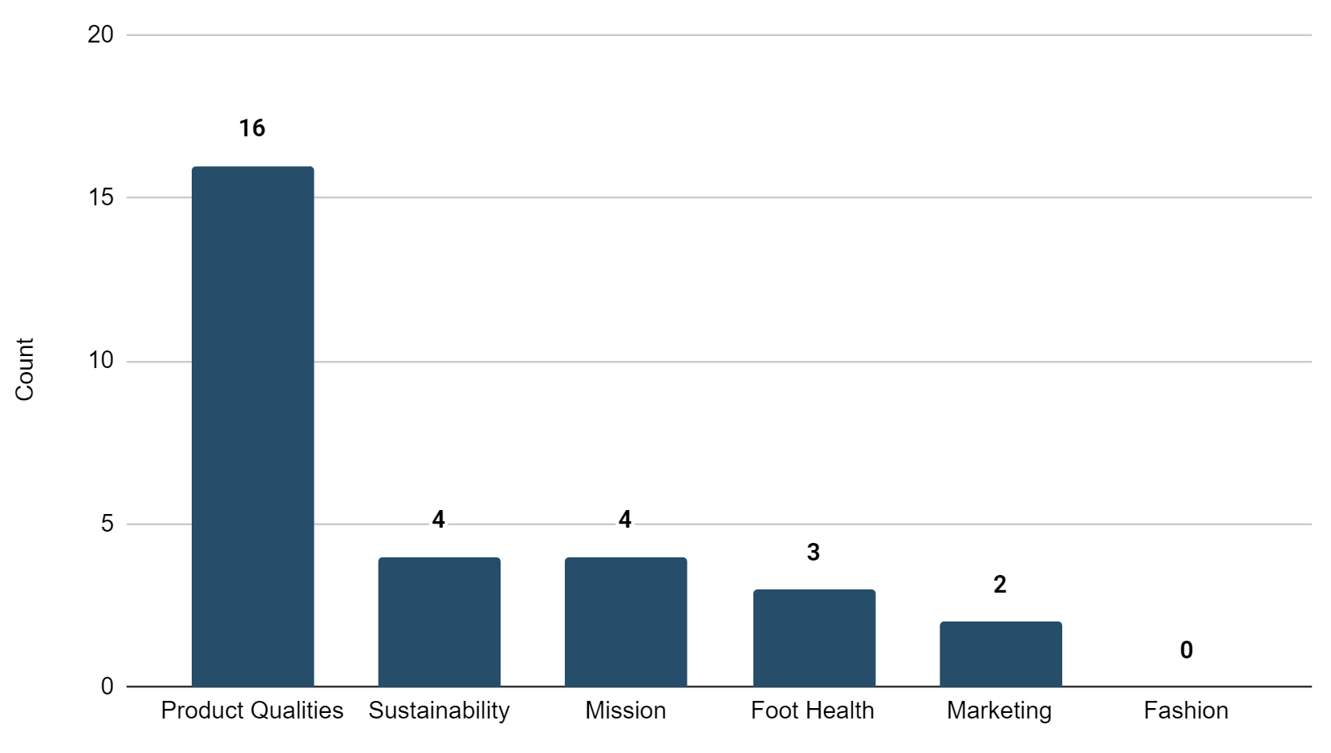
Feebees Branding Mainly Focuses on Shoe Qualities
n=8

Slide 37
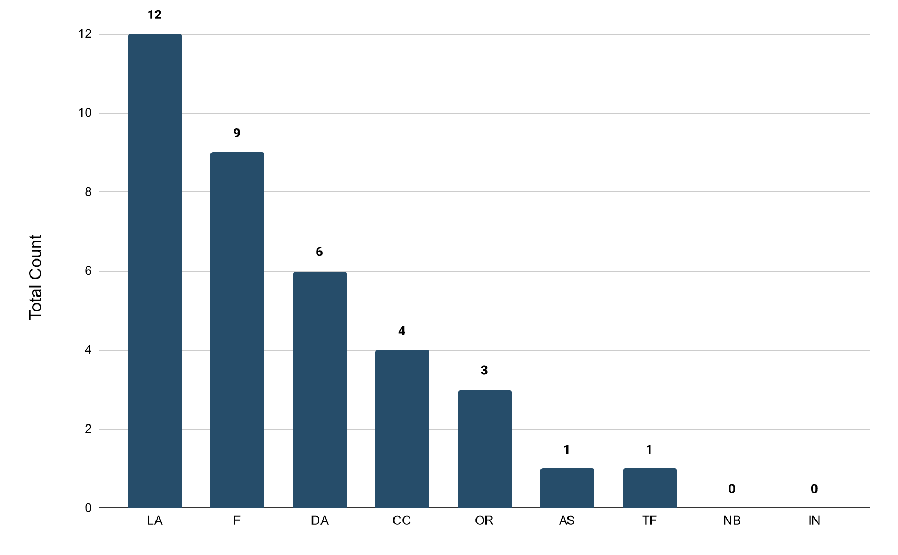
Feebees Brands Comfort
n=30

Slide 38
Feebees Customers Already Associate Brand with Comfort (n=12)

Slide 39
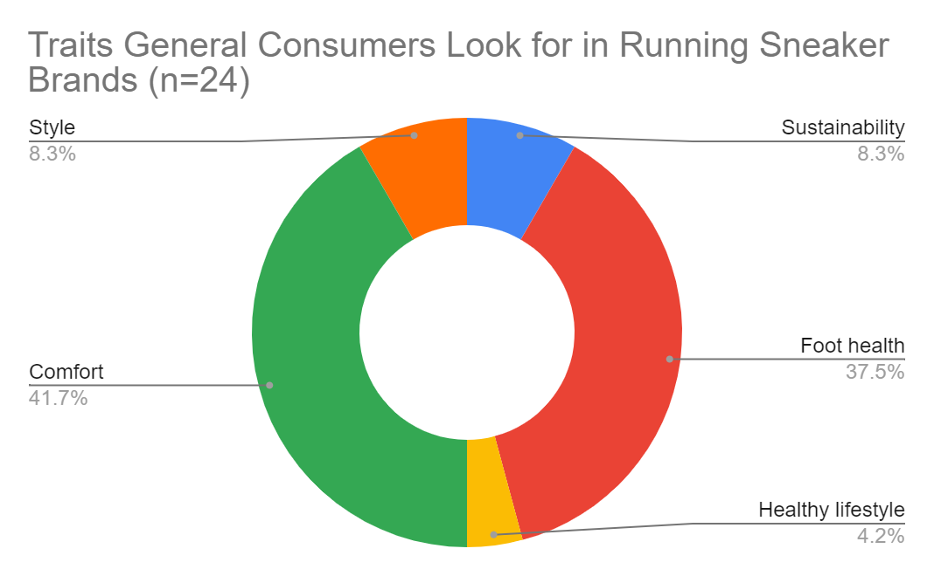

Slide 40
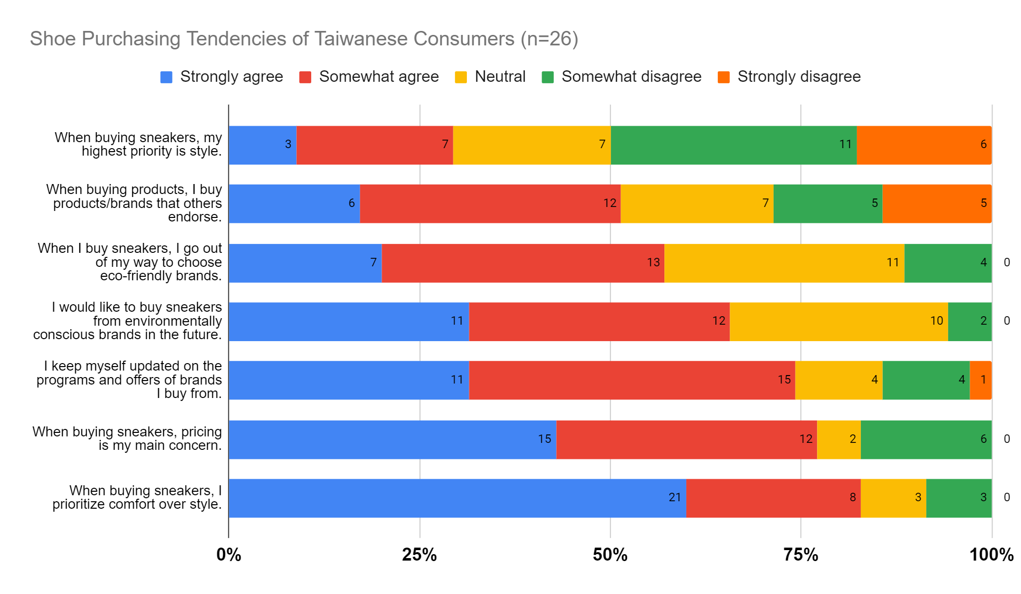
Sneaker Purchasing Tendencies
n=36

