Slide 1
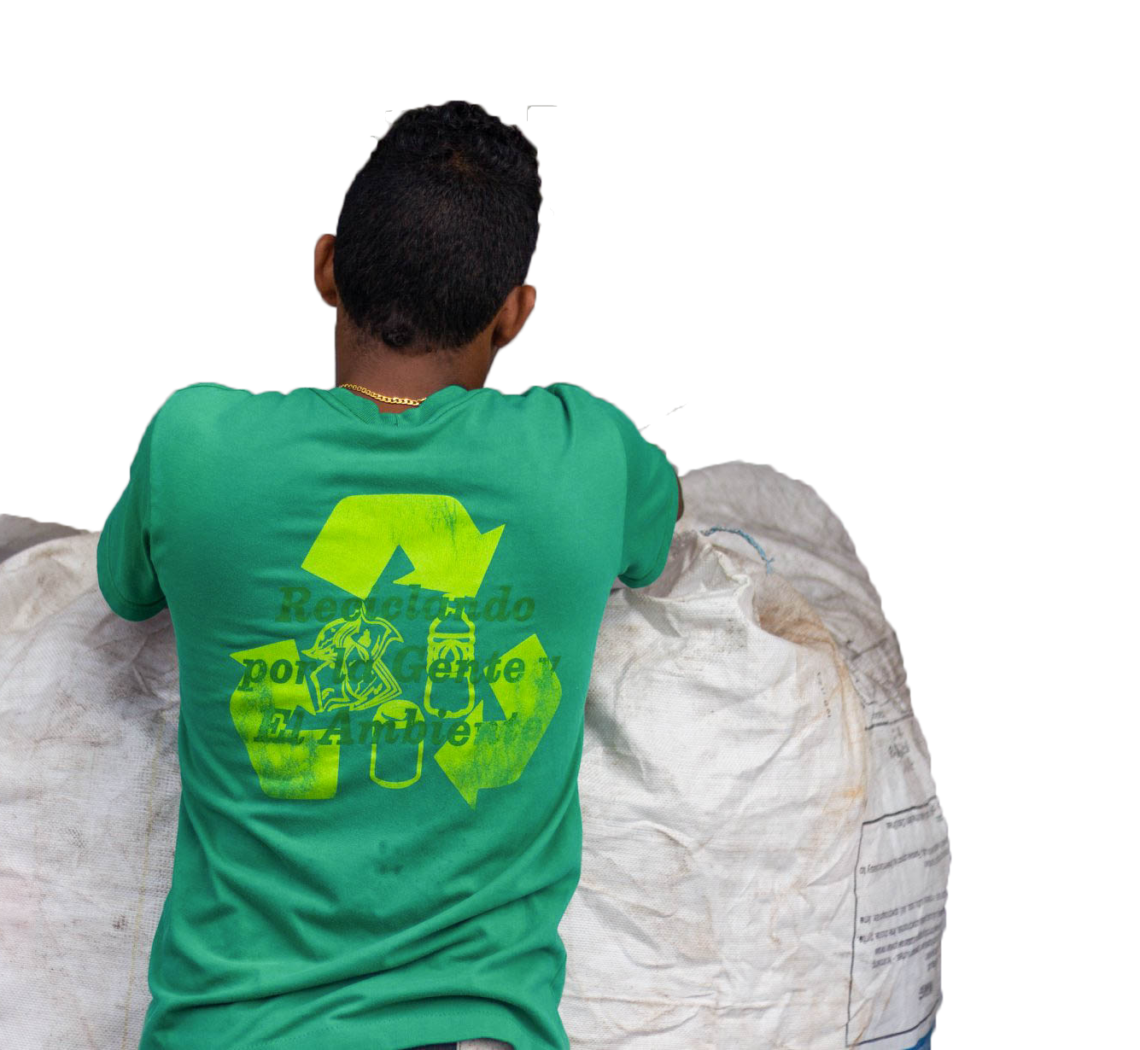
AN ANALYSIS OF CENTRO DE ACOPIO DE RECICLABLES IN CIUDAD DEL SABER, PANAMA
Xavier Curney, John Hoang Do, Ethan Graham, Katherine Pawlak
October 13, 2020
[1]
A FAS Employee working in the recycling center
Notes:
Good morning and welcome to our presentation. We are a team of 4 students from Worcester Polytechnic Institute working with Ciudad del Saber in Panama, and today we are excited to present our complete project. My name is Ethan and may I please have the rest of my team introduce themselves (team introduces themselves).

Slide 2
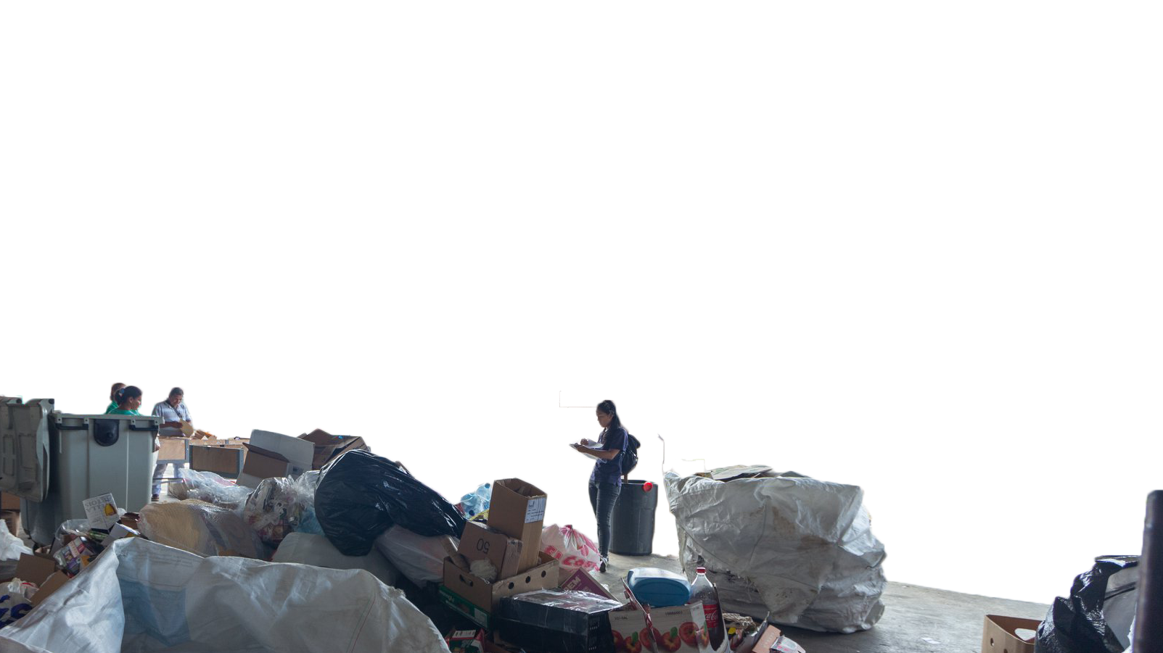
PRESENTATION OUTLINE
Overview of the Project
Results and
Analysis
Methodology
Recommendations
The great amount of materials at the recycling center (CAR) to be classified
[2]
2
Notes:
In this presentation, we will first provide a brief overview of our project and our goals. We will then discuss the methods that we used to achieve those goals followed by the actual results that were achieved when the methods were implemented. And finally, we will present some of the recommendations that we have for the center. John will now discuss the background of our project.

Slide 3
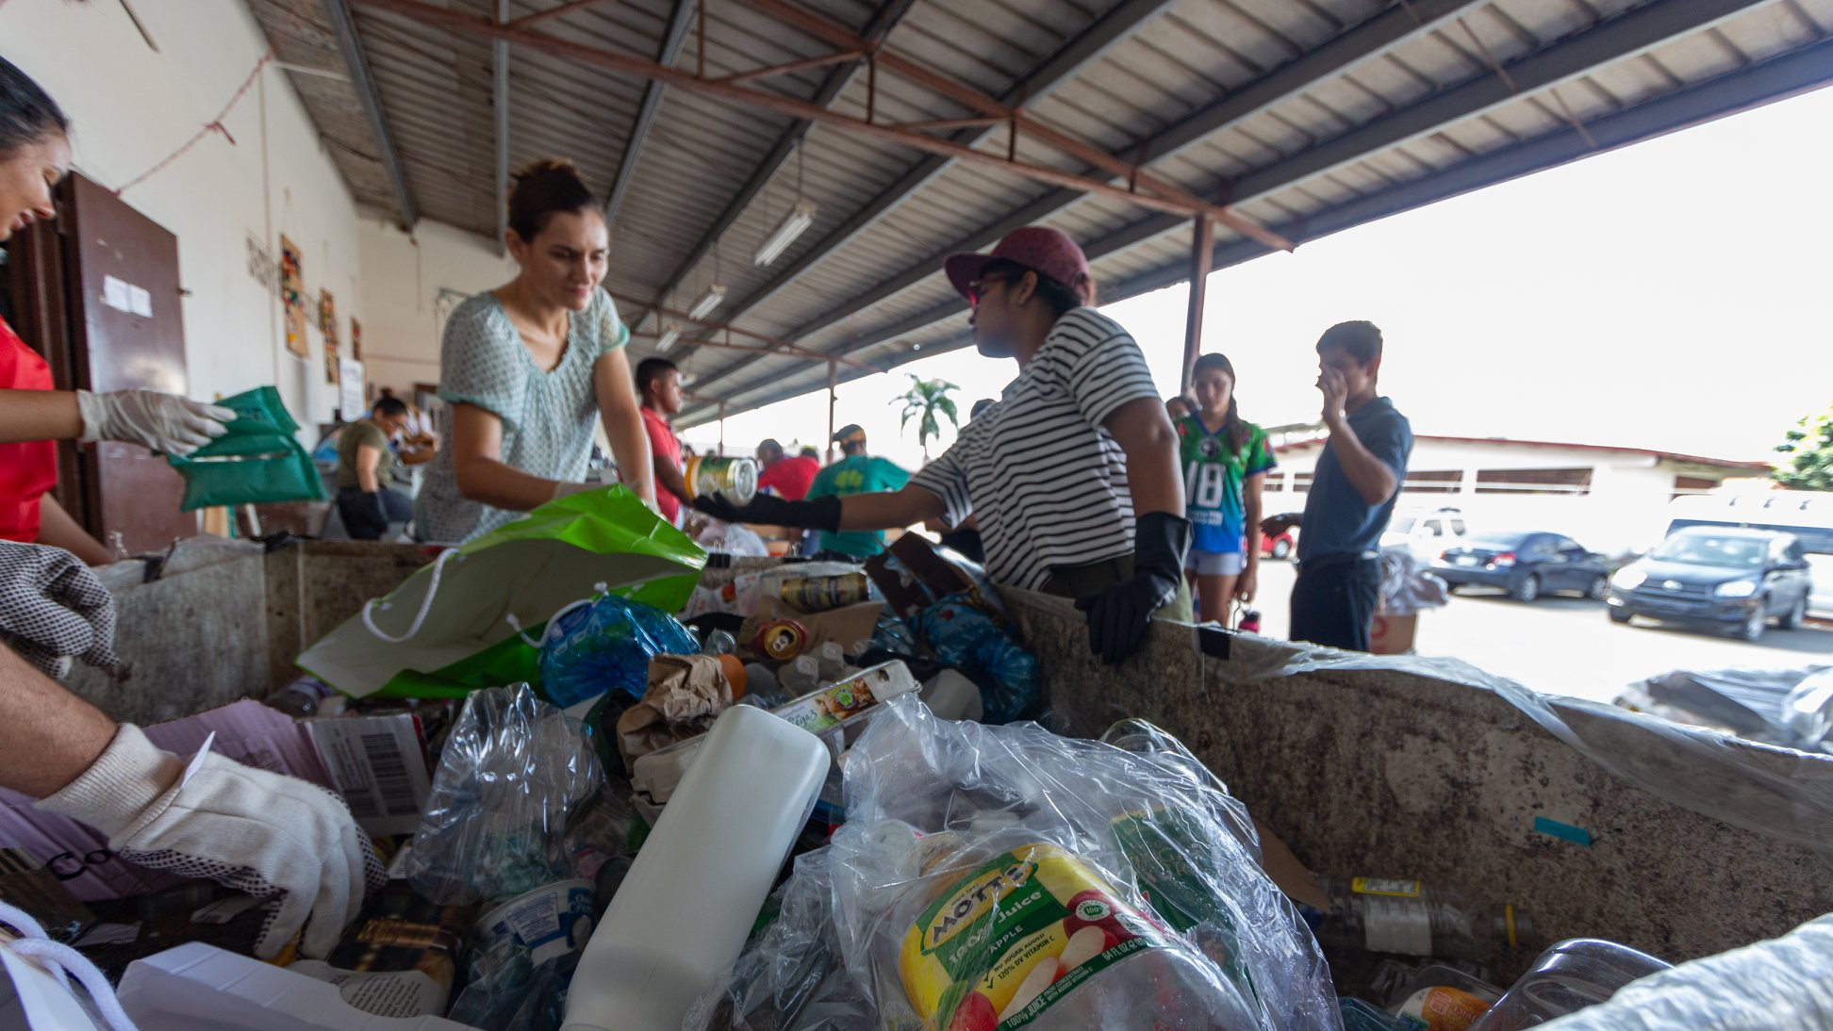
RECYCLING IN PANAMA
4.4 million metric tons
5%
Source: Evaluación Regional del Manejo de Residuos Sólidos Urbanos en Latinoamérica y el Caribe (2010)
Source: Ciudad del Saber (n.d.)
[3]
3
Notes:
As you might know, Panama is the second fastest growing economy in the Latin America and the Caribbean region. As an economy grows, so does the amount of waste generated. Indeed, in 2010, Panama generated 4.4 million metric tons of waste. Unfortunately, the country does not currently have a strong municipal recycling infrastructure to accompany this rapid generation of waste. For instance, recycled materials were only 5 percent of the total waste collected. When compared to a developed country like the United States who recycled 35.2 percent of its waste, our team believes that recycling in Panama can be improved.

Slide 4
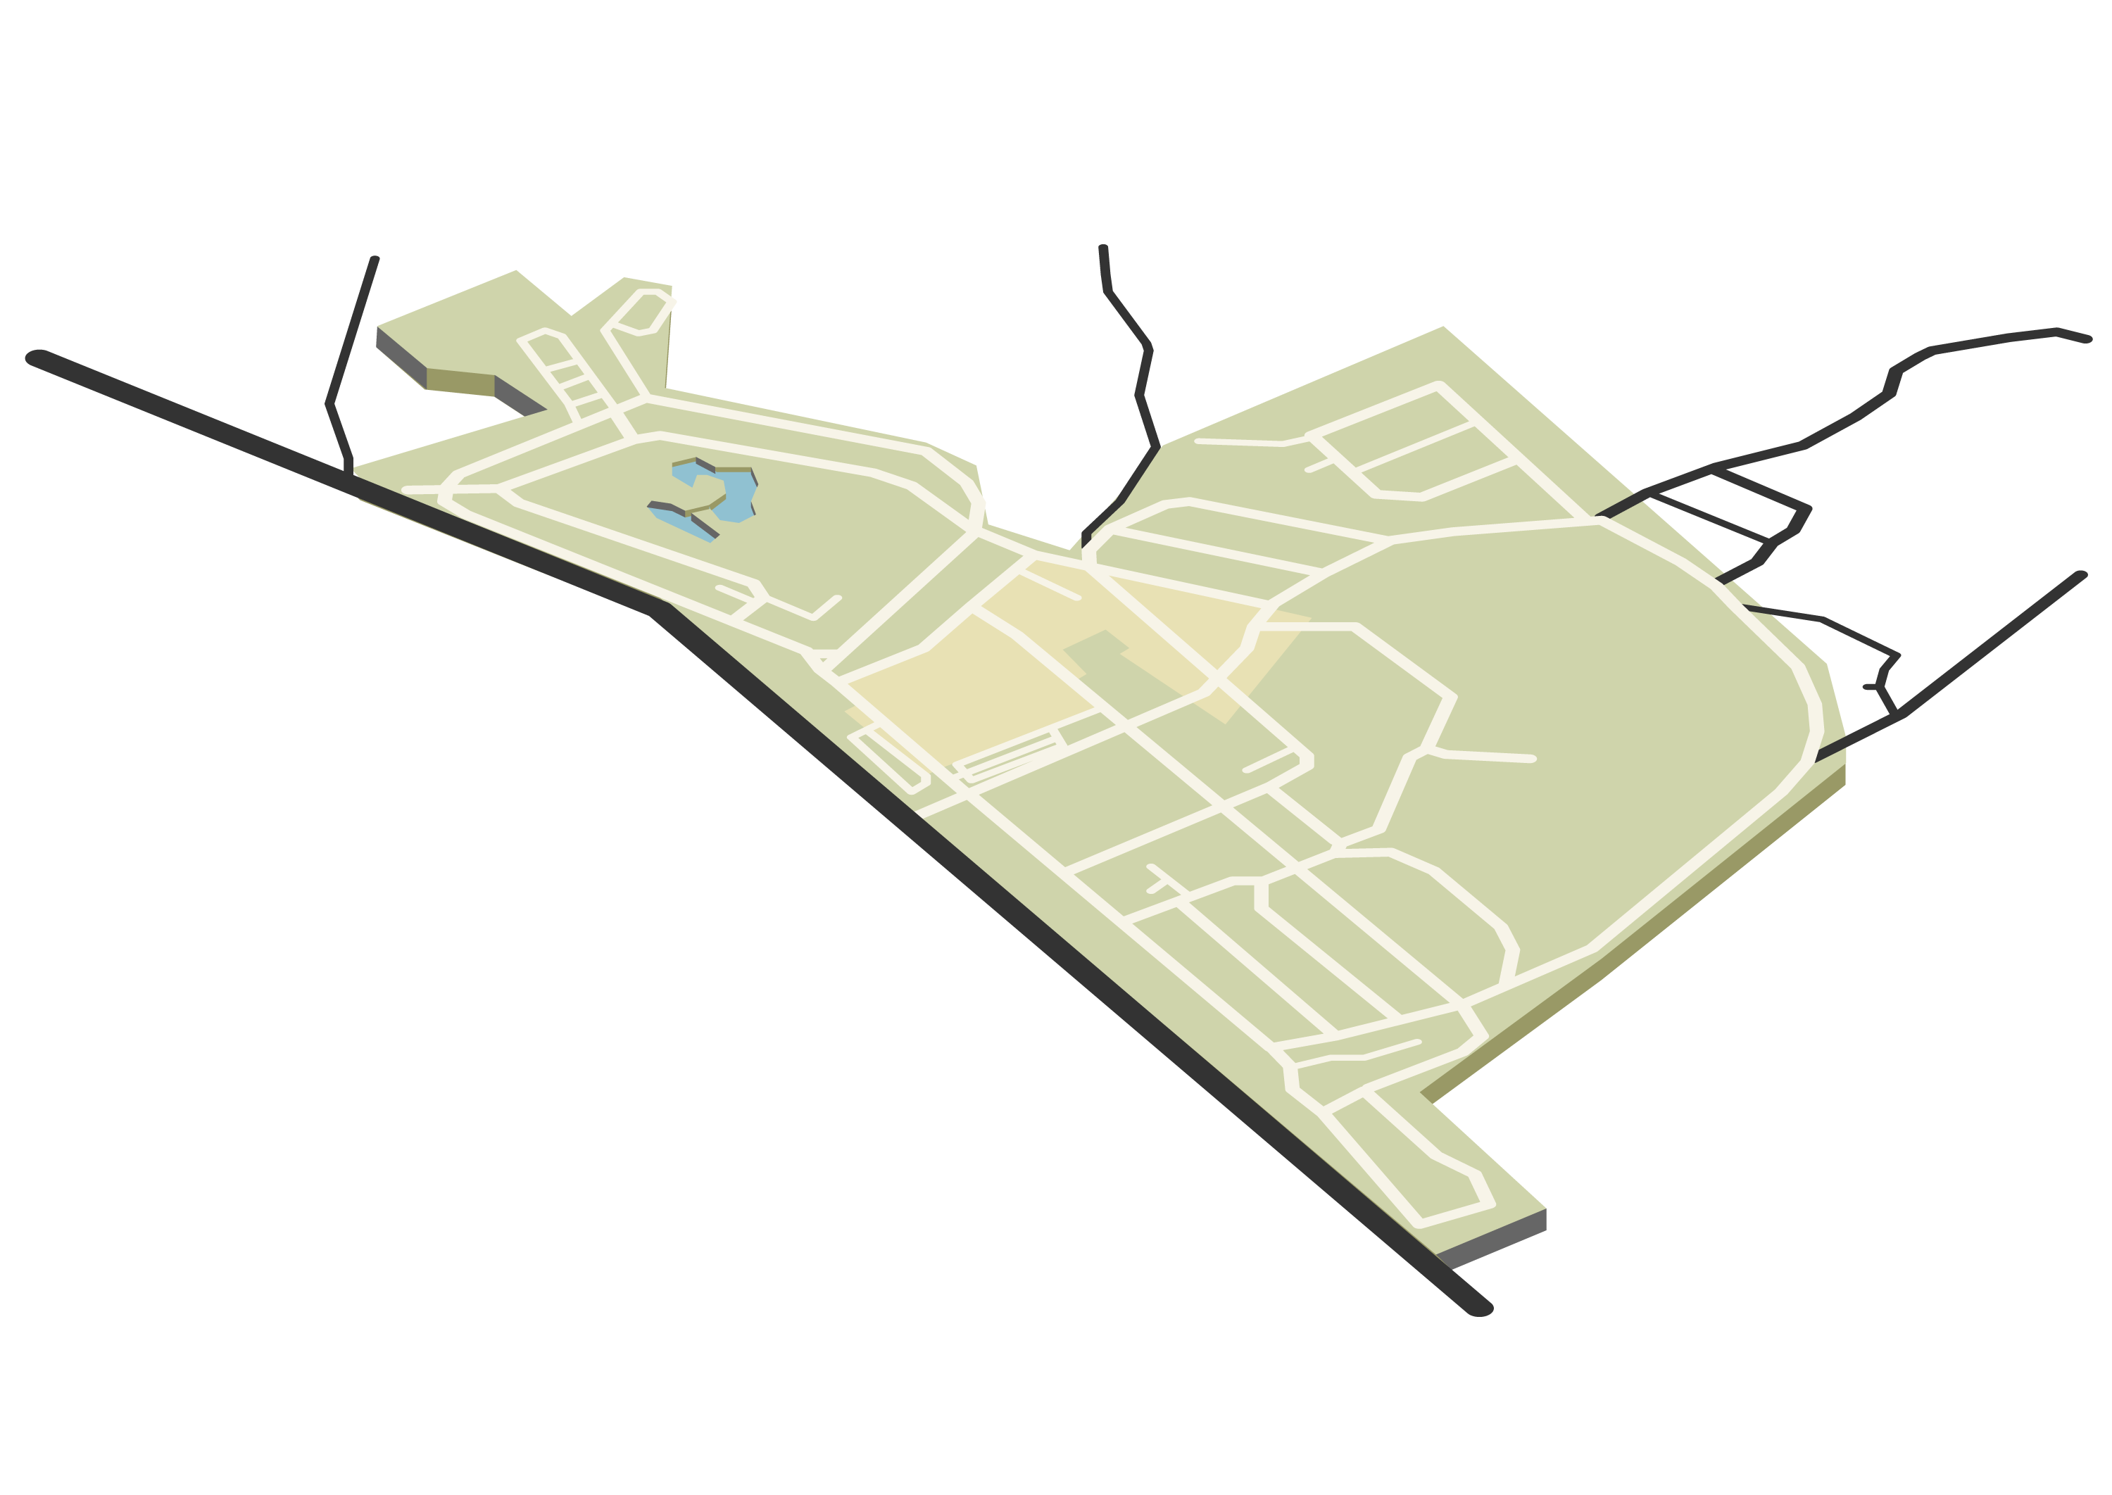
Fundación de Acción Social - Panama (FAS)
Recycling Center (CAR)
Design, promote and execute projects that raise awareness, guide, train and implement practices, technologies and lifestyles in harmony with the environment, especially those related to the environmental management of solid waste, improving the quality of life and integrating experiences, values ​​and customs of the beneficiary groups.”
“
“
Here, entrepreneurs, scientists, thinkers, artists, community leaders, as well as experts from the government, NGOs, and international organizations work together to develop initiatives that trigger social change.”
Fundación
Ciudad del Saber (FCdS)
4
Notes:
For this project, our team worked remotely from Worcester, Massachusetts with our sponsor, Fundación Ciudad del Saber in Panama (FCdS). FCdS’s main function is to manage the Ciudad del Saber campus (CdS), located in Panama City near the Panama Canal.
We have also been working with FAS Panama, a company that operates the recycling center in CdS, or C.A.R. FAS offers two main recycling services at C.A.R.: on-campus recyclable collection service, and reception services of voluntary donation for visitors off-campus.
Overall, the motivation for this project is to help the two organizations achieve their missions in the area of recycling and sustainability development. As the CdS community is considered as a model for Panama City, we hope the impact of this project will lead to positive changes on and off campus.

Slide 5
PROJECT GOAL STATEMENT
Through working with Ciudad del Saber and FAS Panama,
our team strives to improve the recycling process currently in place, as well as educate the visitors about the importance and correct practices of recycling.
5
Notes:
Through working with Ciudad del Saber in Panama, our team strives to improve the recycling process currently in place at CAR and on the CdS campus, as well as educate the visitors to the recycling center about the importance and correct practices of recycling.

Slide 6
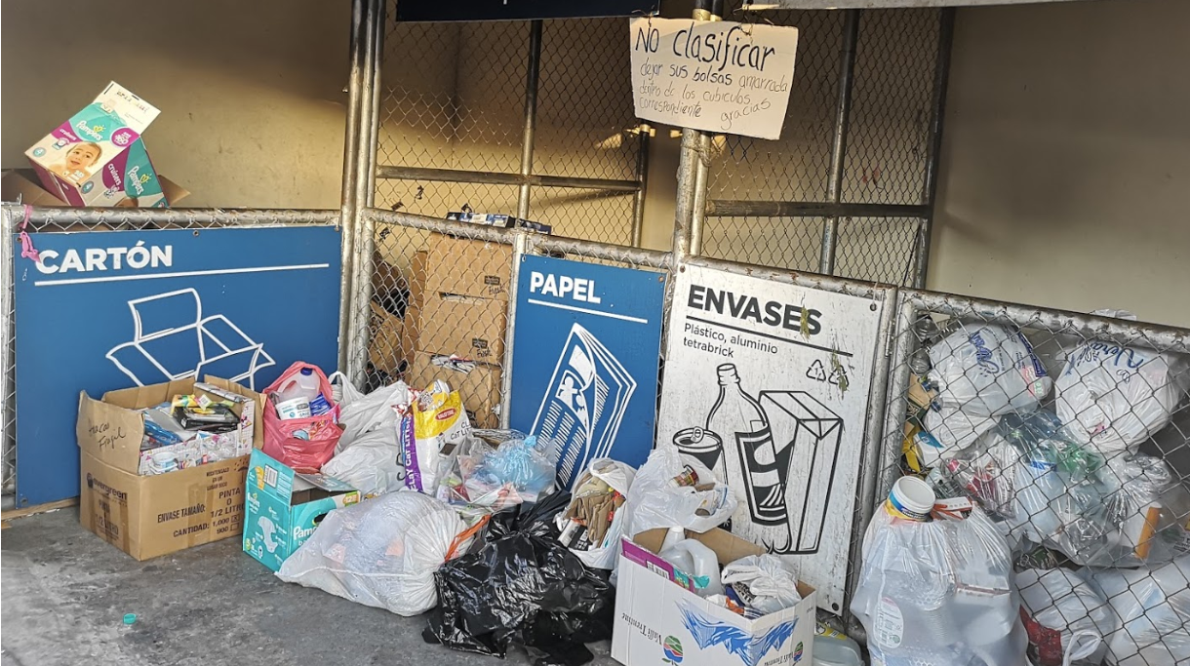
OBJECTIVE 1
OBJECTIVE 2
OBJECTIVE 3
OBJECTIVE 4
PROJECT OBJECTIVES
[4]
Understand the current waste management process at Ciudad del Saber
Determine the current level of understanding about recycling
Recommend improvements to the current waste management process at Ciudad del Saber
Propose new signage and education programs
Self-Service
Drop-off Area at CAR
6
Notes:
Our team identified four objectives that help us achieve this goal. The first one is to understand the current waste management process at CdS. The second objective is to determine the current level of understanding about recycling. The last two objectives are to recommend improvements to the current waste management process, and the educational efforts.

Slide 7
METHODOLOGY
7
Notes:
To achieve the objectives of the project, our team utilized three methods. Survey, interview, and virtual observation

Slide 8
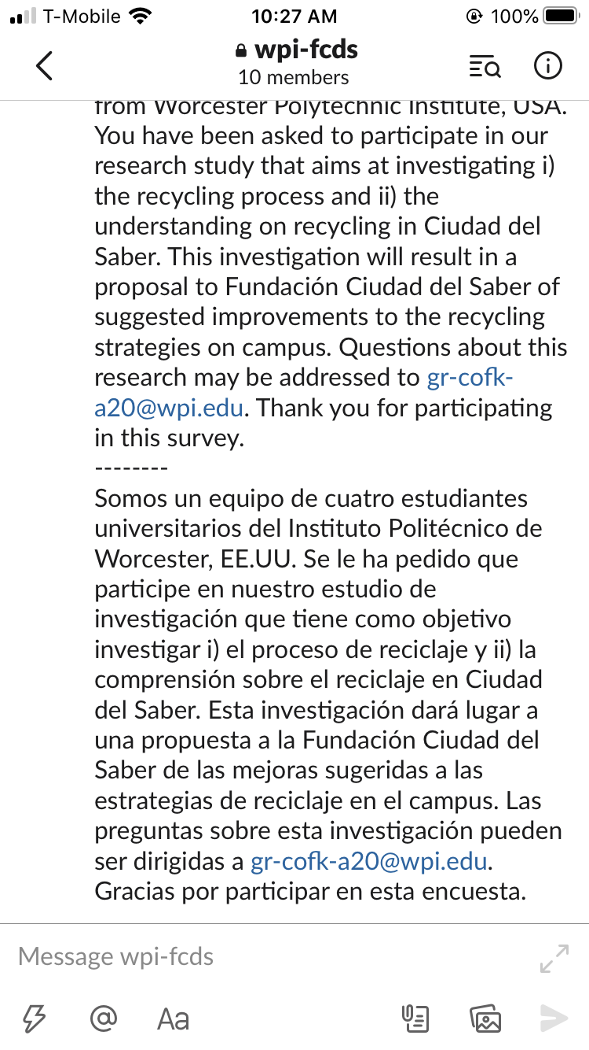
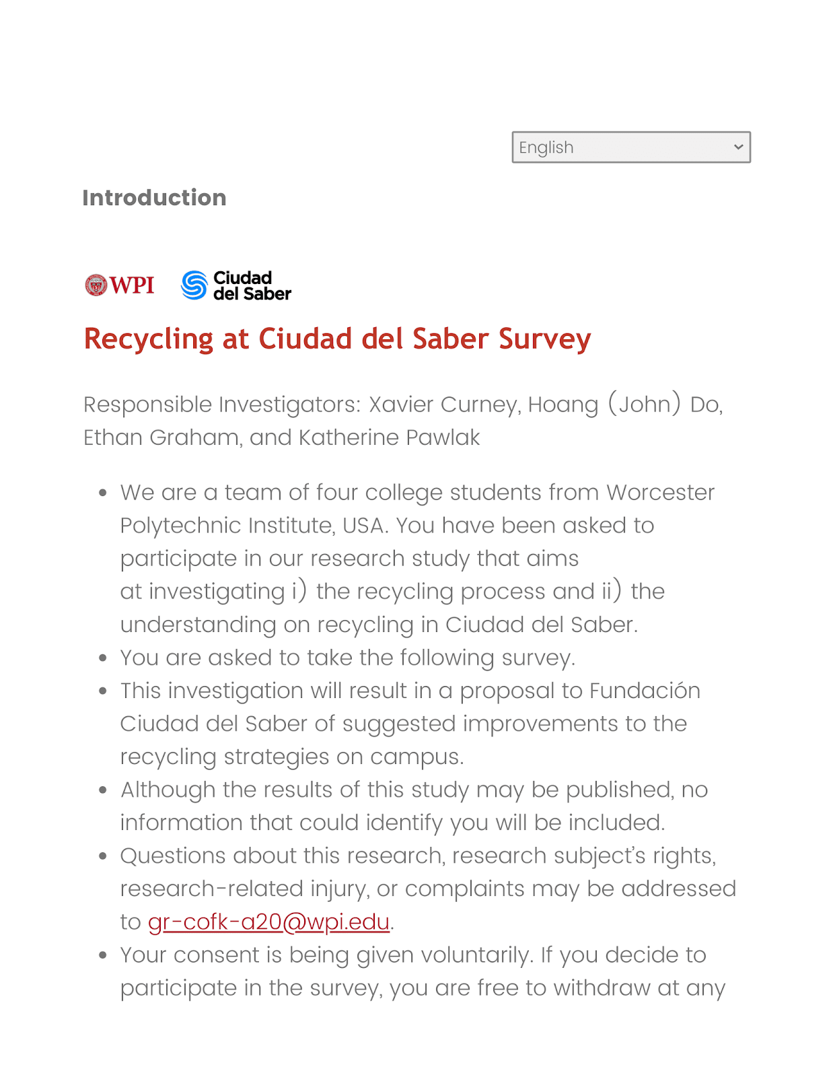
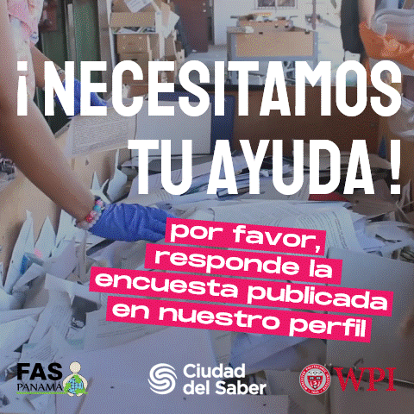
SURVEY
FAS’s Instagram post on October 5
Slack announcement
Introduction to the survey (EN)
8
Notes:
The first method was survey. The sponsor aided our survey distribution using two media: Slack workspace and FAS’s social media platforms. The survey was first sent out on September 25 to Slack, and on October 5 to Instagram. Up to date, we have collected 228 responses.

Slide 9
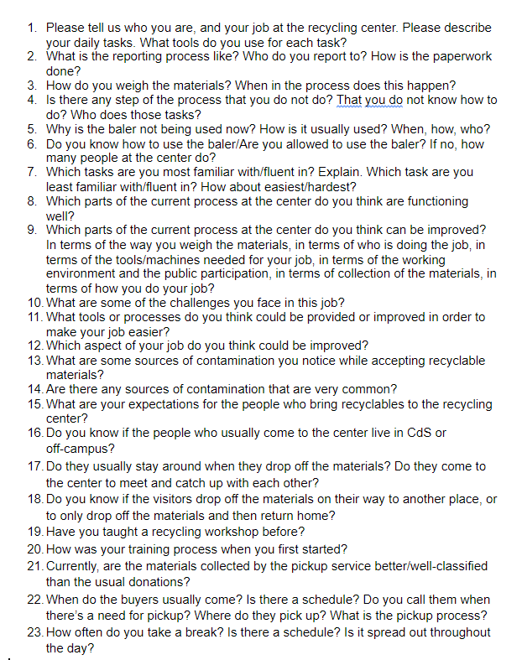
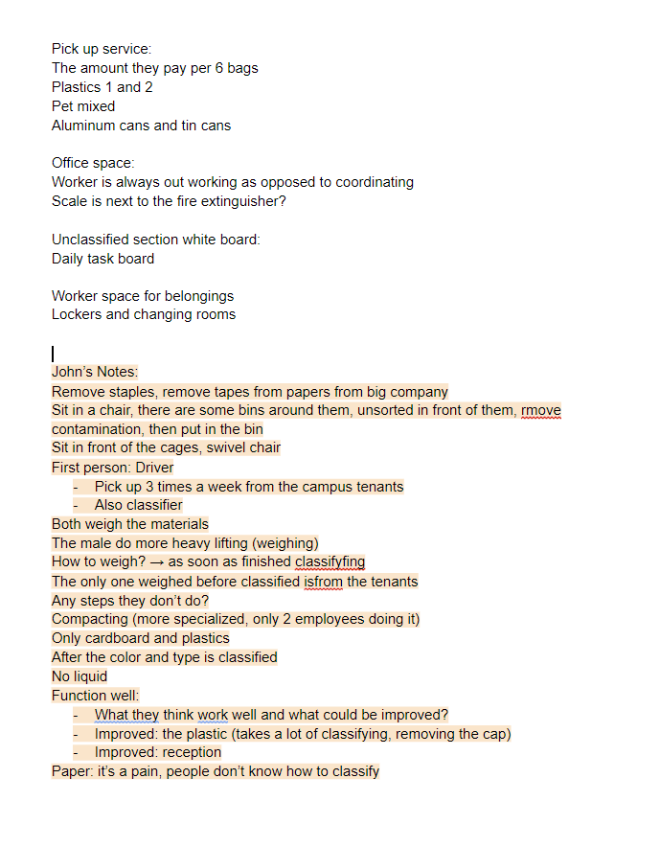
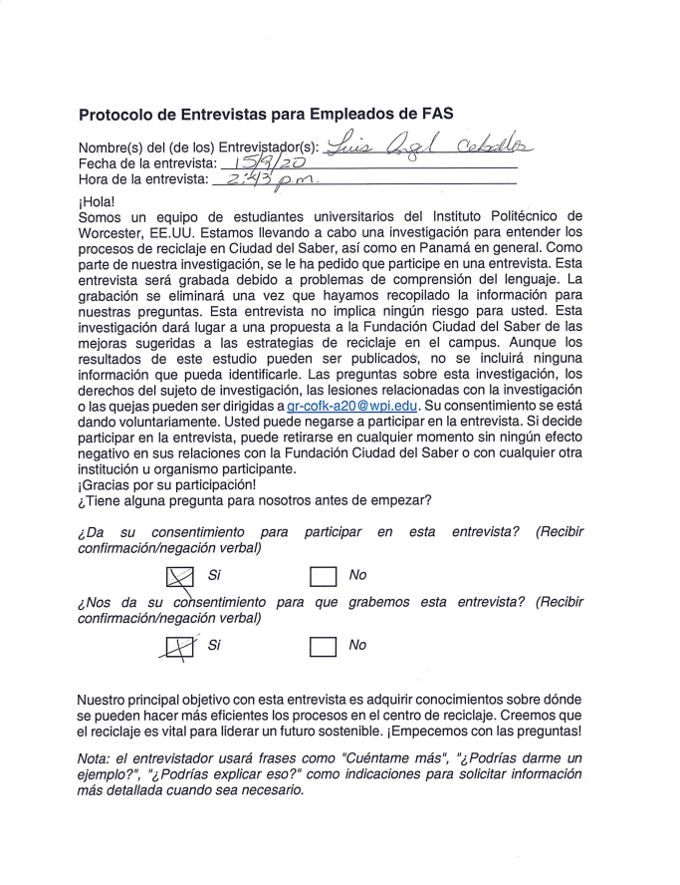
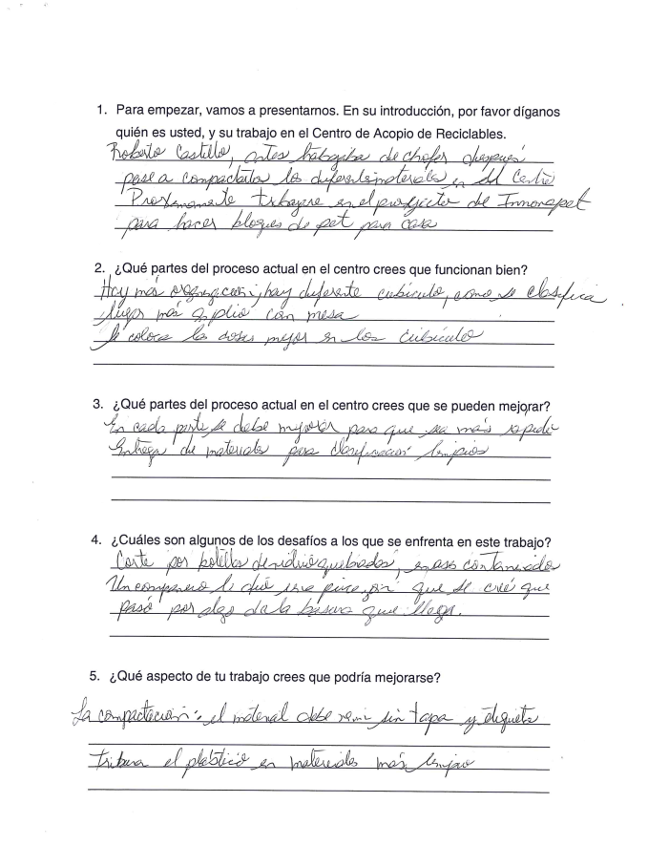
INTERVIEW
Question list for the Direct Interview
Delegated Interview Recording #1
Note sheet from the Direct Interview
Excerpt of the note sheet from Delegated Interview #2
Microsoft Teams meeting with our sponsor
Excerpt of the note sheet from Delegated Interview #3
9
Notes:
The second method was interviews. These were used to obtain information from the FAS workers and to learn more about the center. There were two types of interviews: “Delegated” and “Direct”.
For the Delegated method, an FCdS employee conducted three interviews on our behalf, recorded the videos and took notes during each interview. Our sponsor also helped translate these interviews afterwards and conduct cross-reference with the notes taken.
For the Direct method, we conducted a live interview of two other members of FAS via Microsoft Teams. In this meeting we were able to ask more specific questions relating to their usual work, and to ask them to elaborate on some findings we were unsure of. During this interview, three of our team members were taking notes so we could double check the validity of our notes.

Slide 10
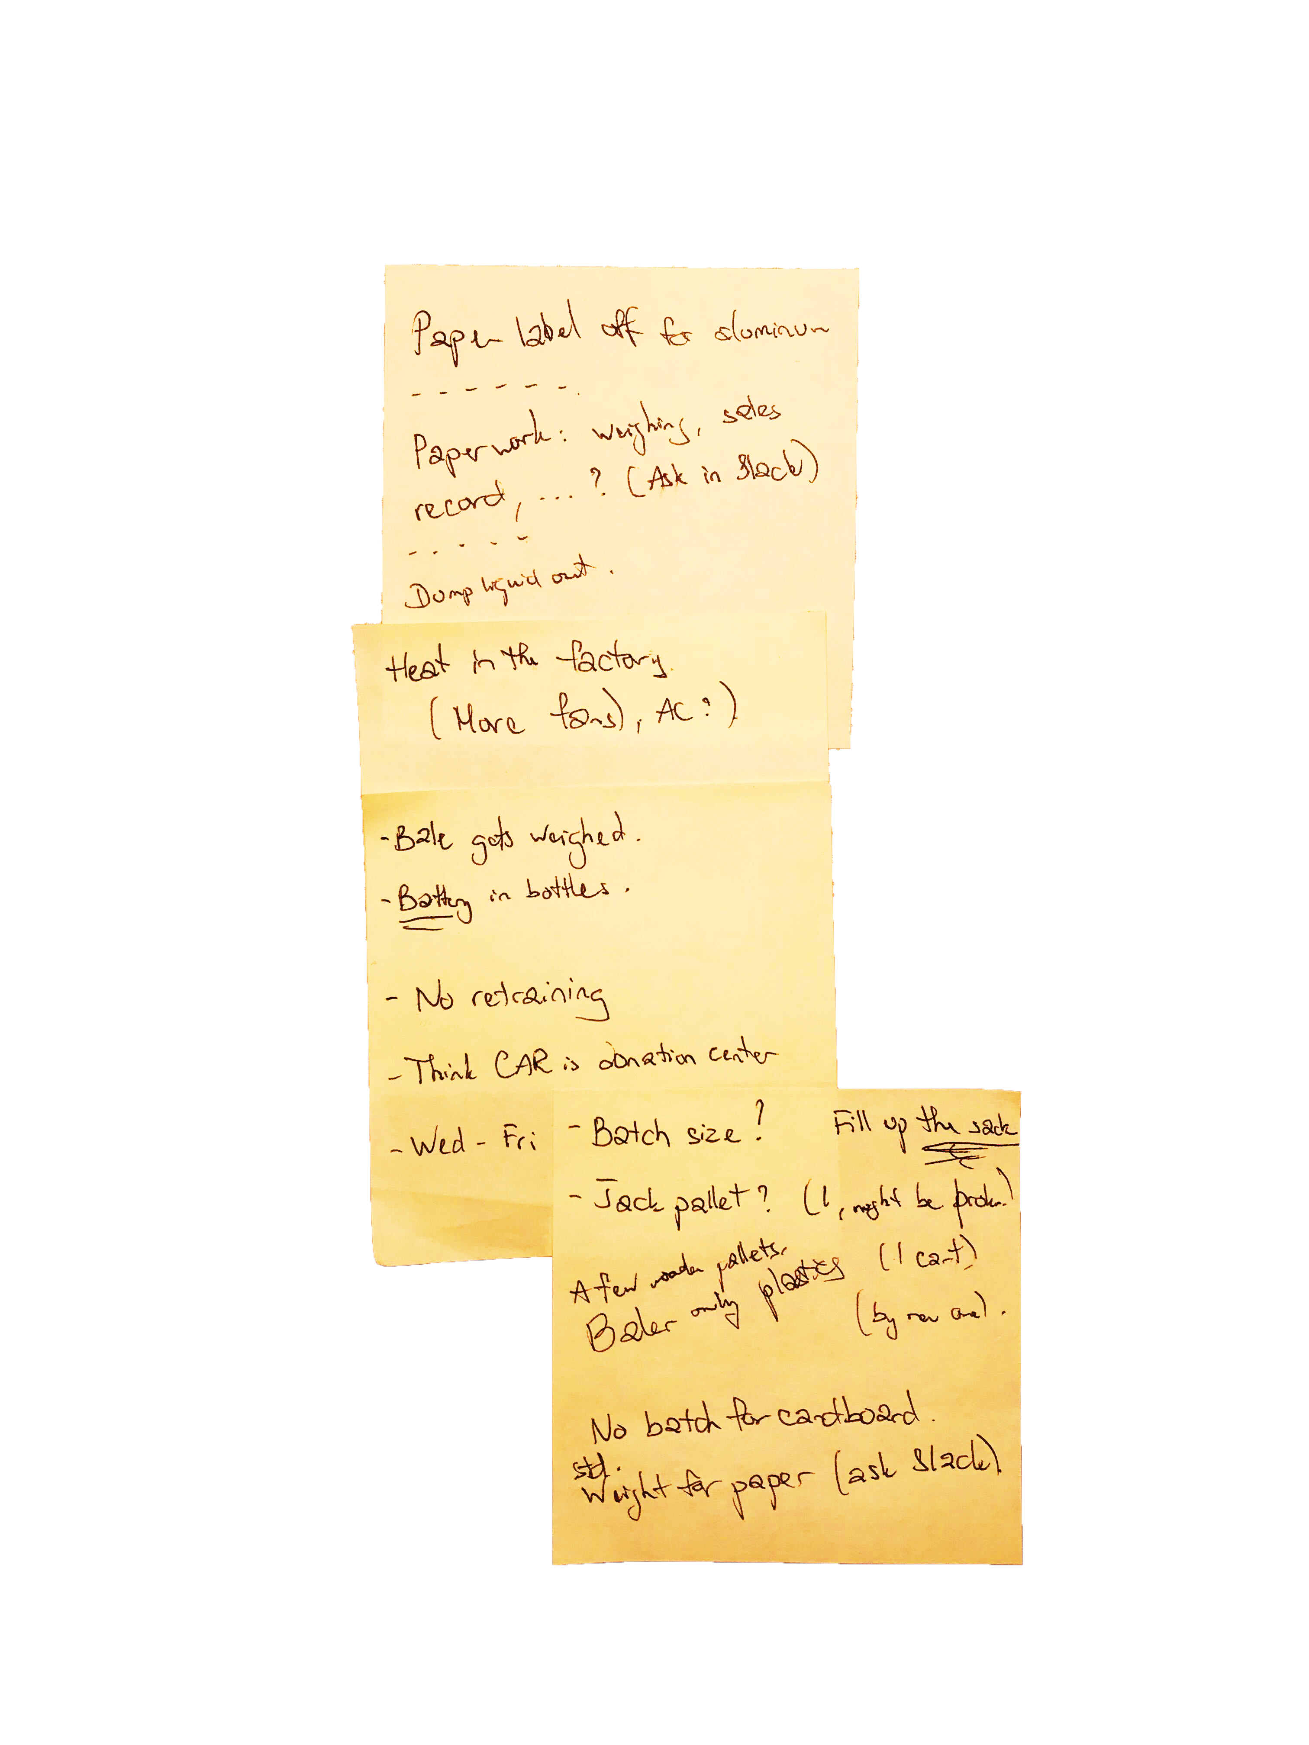
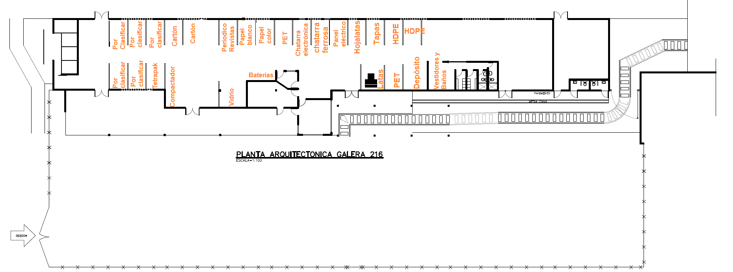
VIRTUAL OBSERVATION
Annotated floor plan draft (ES)
Sample of written notes during the virtual tours
10
Notes:
Thirdly, the virtual observation method included taking two virtual tours of the center and watching the employees working in the center. The observations added valuable information on top of that from the survey and interview for our team to analyze the current situation.

Slide 11
RESULTS & ANALYSIS
11
Notes:
Now that the team has discussed our methods for the project, we would like to share some of the major findings that we have been analyzing.

Slide 12
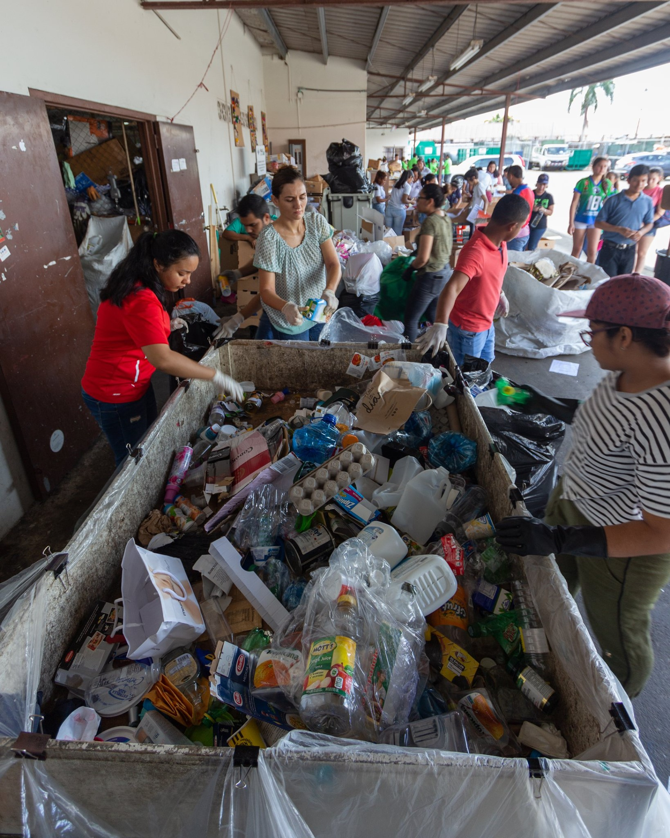
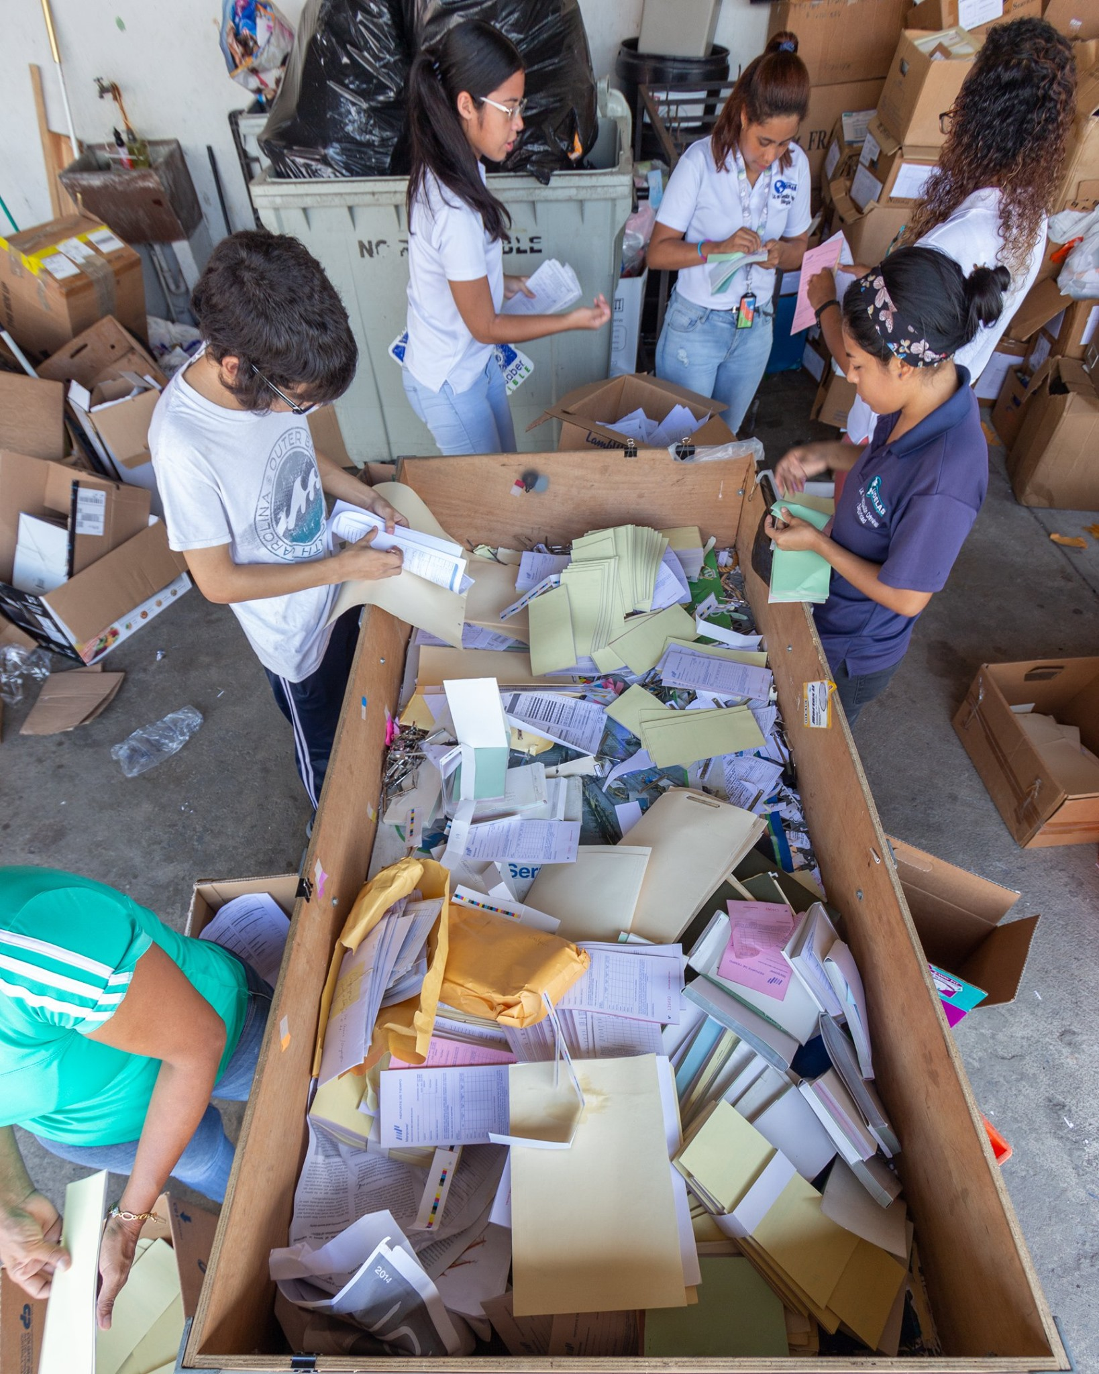
MATERIAL CONTAMINATION
wrong type of plastics
plastic bag
Recyclables mixed with non-recyclables
receipt
Recyclables mixed together
[5]
[6]
12
Notes:
With the data collected through our observations and interviews, the project gained insight into the contamination of recyclable materials at the center. There are two types of material contaminations that plague the center: recyclable materials all in one container, and recyclable materials mixed with non recyclable materials.
There are cases, like shown on the right, where all recyclable materials are in one pile, but they are different kinds of recyclable materials. For example, white and colored paper are mixed into the same pile but they are not the same recyclable material which will cause a lot of extra time classifying for the employees.
The image on the left shows recyclable materials mixed with non-recyclable materials. Katherine will now discuss how the responses to our survey help explain how trash and non-recyclable materials are wrongly dropped off at the center

Slide 13
PUBLIC KNOWLEDGE
N=50
13
Notes:
Thank you Ethan. Indeed, trash is a major problem for CAR, as it accounted for 7.6 percent of the total material brought to CAR by visitors in 2019. In the graph, materials that are actually accepted at CAR are shown on the left in the green, and materials that are not accepted by CAR are on the right in red. As seen in the graph, people seem to be unsure about cooking oil, batteries, and electronic scrap despite these materials being accepted at the center. Visitors were also unsure of wood, light bulbs, receipts, coffee cups, and plastic bags which are all items not accepted at CAR. Clearly, the majority of visitors to the center have many misconceptions and knowledge gaps regarding recycling. During our interviews with FAS employees and our sponsor, we learned that FAS workers do not have confidence to speak up to people that bring items that are not accepted at the center.

Slide 14
HUMAN RESOURCES
From our sponsor
“They (FAS Employees) should feel confident in telling people No.”
“There’s no retraining.”
From the Direct interview
“Role rotation cannot work as there is an old woman working”
“If we don’t have to focus on classifying so much (voluntary donations), we can focus on classifying paper more.”
[7]
Another FAS Employee working in the recycling center
14
Notes:
Upon further interviewing, we believe this confidence issue stemmed from the lack of training and retraining for the employees. The current training process is quite informal, as there are no documentations for the process, and the employees have not gone through retraining since they joined the center. Without frequent retraining, the workers became less empowered and less likely to speak up when they noticed something wrong in the center.
The next finding concerns the fiscal health of the center.

Slide 15
MATERIALS VALUE
15
Notes:
Through analyzing the 2019 reports, we learned that the CdS tenants donated lots of paper to FAS’s on campus collection program, as compared to voluntary donations that comprised a great amount of plastics. The graph here shows the breakdown in estimated revenue from on campus collection and voluntary donations for each material.
Paper brought in almost double the revenue of PET and HDPE plastics combined. Therefore, it is within CAR’s best interest to encourage more tenants to recycle, so that the center can receive more paper than plastics. Paper is more compact and is easier to store in the center, while plastic material takes up a lot of space and does not stack easily.

Slide 16
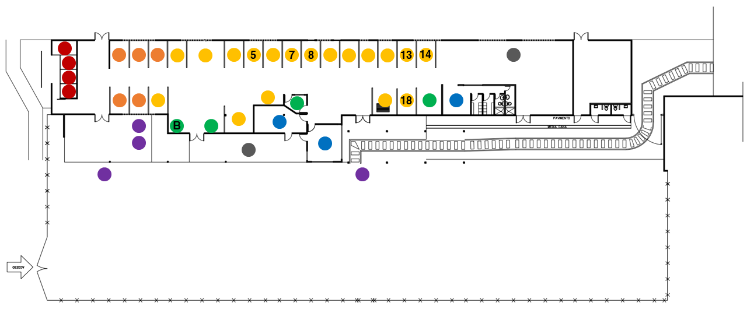
INFRASTRUCTURE
Legends
Self-Service Area
Unsorted Material Storage
Sorted Material Storage
Equipment/General Storage
Offices
Pick-up/Drop-off Area
Other
Annotated Current Floor Plan at CAR
16
Notes:
Thank you Katherine for the previous analysis. Our next major finding concerns the infrastructure of the recycling center. Through virtual observation, we learned that / there is an excessive amount of movement and transportation that can be minimized.
With the floor plan on the screen, our team determined that currently, plastics are stored in cages 7, 13, 14, and 18. The baler is currently on the left hand side of the diagram, shown by the letter B. This diagram shows that the employees have to travel long distances between the storage cages for plastic and the baler. Specifically, a worker would need to travel 115 meters one way from cage 14 to the baler. On the other hand, materials nearer to the baler, such as white paper (cage 5) and electronic scrap (cage 8), do not go through the baling process at all. Additionally, the workers have trouble with moving heavy materials across the long distance as the supporting equipment, such as the jack lift, is not well-maintained. This makes the task more physically straining on the employees.

Slide 17
RECOMMENDATIONS
17
Notes:
With all these results in mind, our team has proposed a set of six recommendations to achieve our goal.

Slide 18
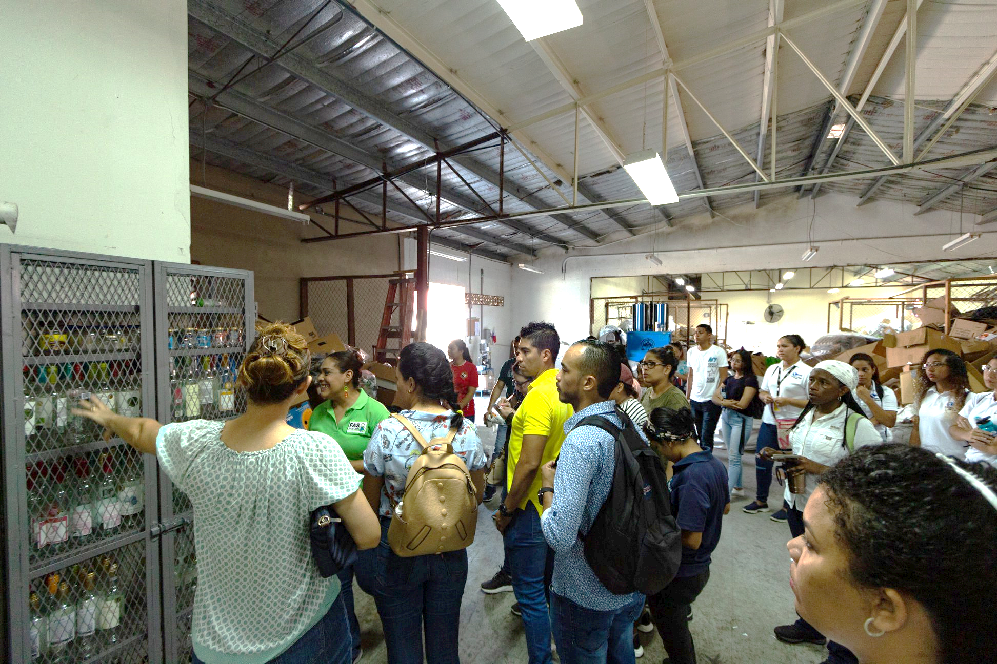
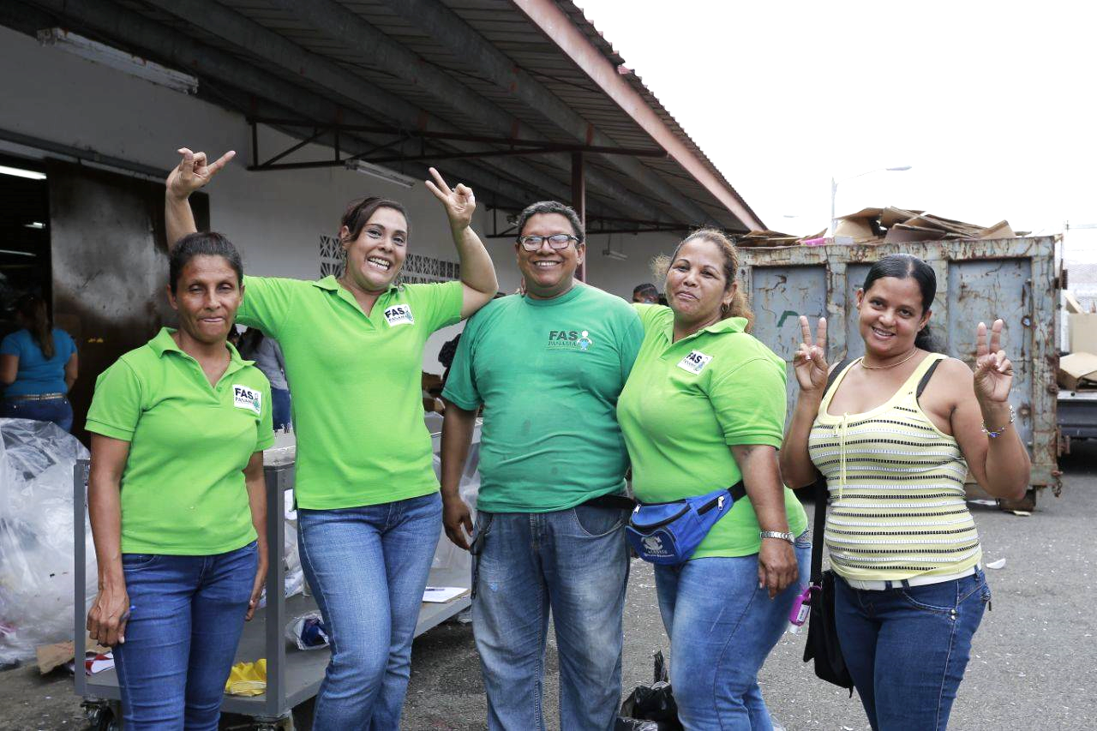
TRAINING/RETRAINING
[8]
[9]
Improved volunteer training process can reduce the time spent on training and increase the time spent on sorting and classifying
Retraining can empower employees to be more self-confident and more active in providing feedback about the process
18
Notes:
Our team’s first recommendation is the retraining of workers. Retraining would give workers the confidence to speak to visitors who do not know how to sort or are confused, as well as empower them to provide feedback to the supervisors. Proper use of the center should decrease contamination, and the amount of trash collected.

Slide 19
TAILORED EDUCATION
N = 155
19
Notes:
Next, we suggest tailored education to bridge the knowledge gaps and increase participation and source separation. Instagram, and signages around the building would be excellent methods of conveying information on correct recycling practices, common misconceptions about recycling, and the process that goes on at CAR. Indeed, In the past month, Ciudad del Saber and FAS have already started to create videos that educate visitors on proper use of the center. Here is the video for the reopening of the center after COVID-19.

Slide 21
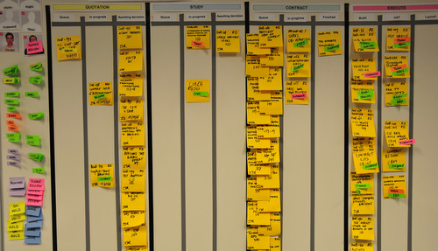
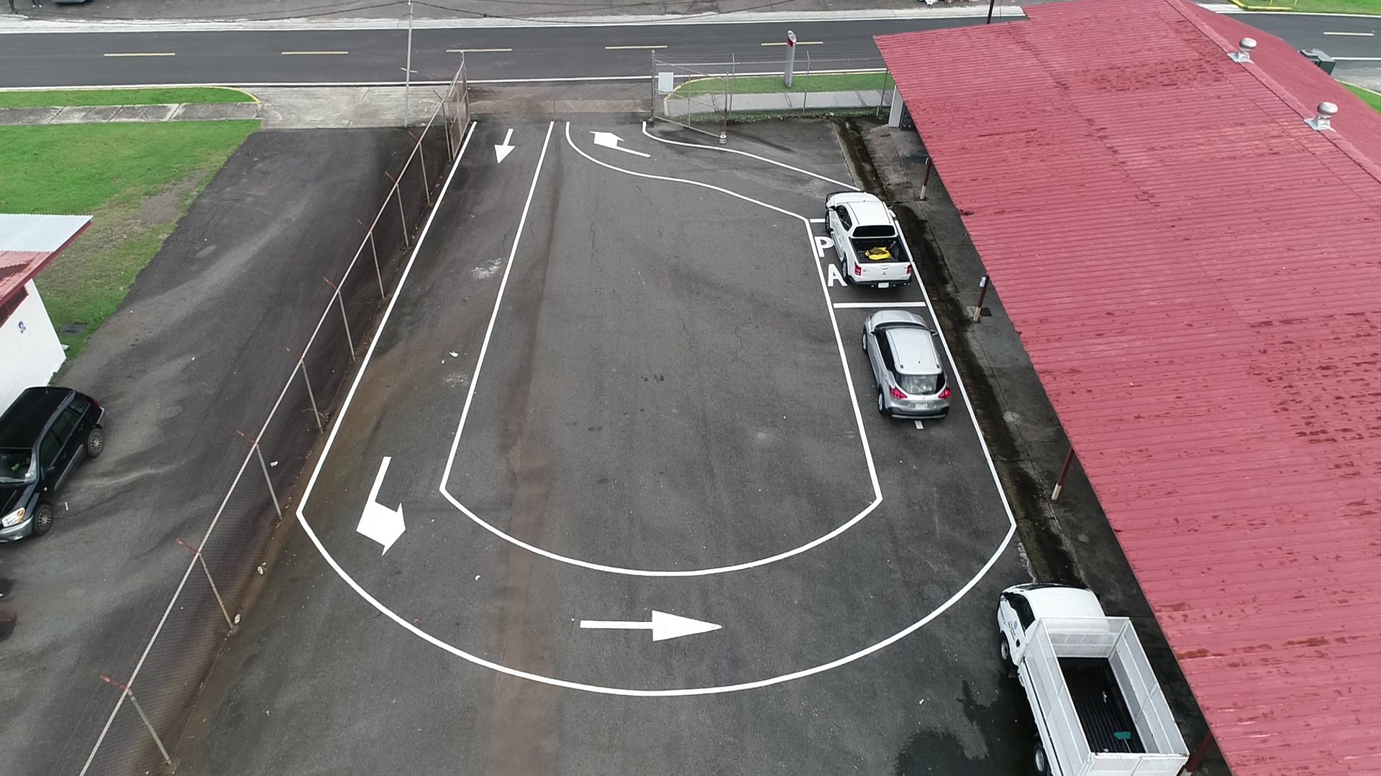
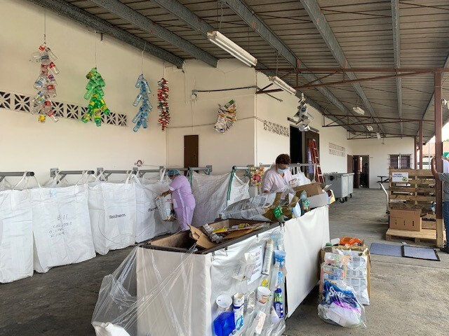
VISUAL CONTROL
[10]
[11]
Use of Visual Control to direct traffic flow at CAR
A sample of a Visual Control task board
Use of Visual Control to inform visitors to CAR about sorting method and correct locations of materials
21
Notes:
The third recommendation is to increase the use of visual control at the center, such as signs and markings. As seen in this slide and the video, FAS has recently implemented visual control with the traffic marking, and new signages for the drop-off area, which is great news for our team to hear. We also want to encourage the center to use a task board as shown on the slide. The sticky notes will allow the workers to indicate what task in the whole operation they are doing / so that everyone at the center is well-informed.

Slide 22
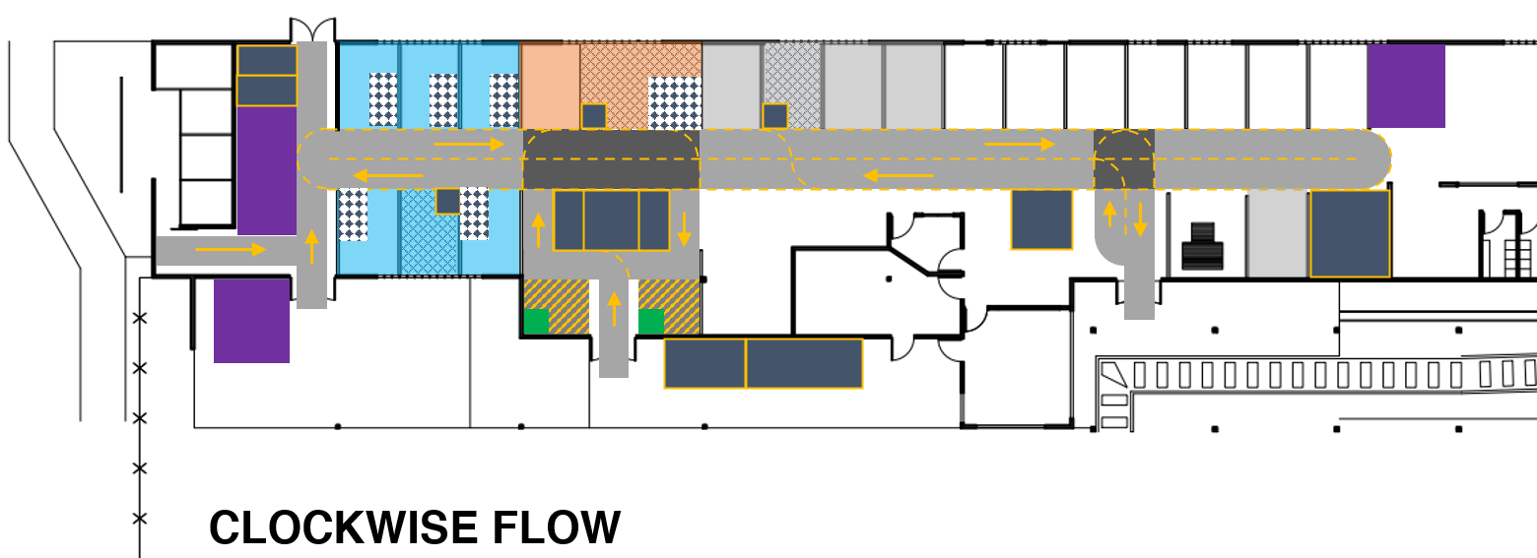
REARRANGEMENT
One of the suggested flows and rearrangements for CAR
22
Notes:
As mentioned above, the locations of the cages are not ideal. And thus, our team recommends that the cages should be rearranged. As seen in this diagram, the blue area shows our proposed location of the plastics. This location is nearer to the scale, and the baler, therefore reducing the distance travelled and time spent by the workers to transport the heavy materials. This rearrangement also increases the number of storage spaces across the entire center (shown by the navy blue rectangles), so that the workers have quicker access to any equipment needed for their task.

Slide 23
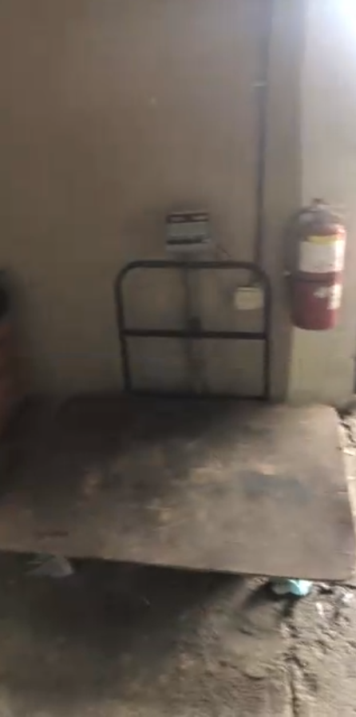
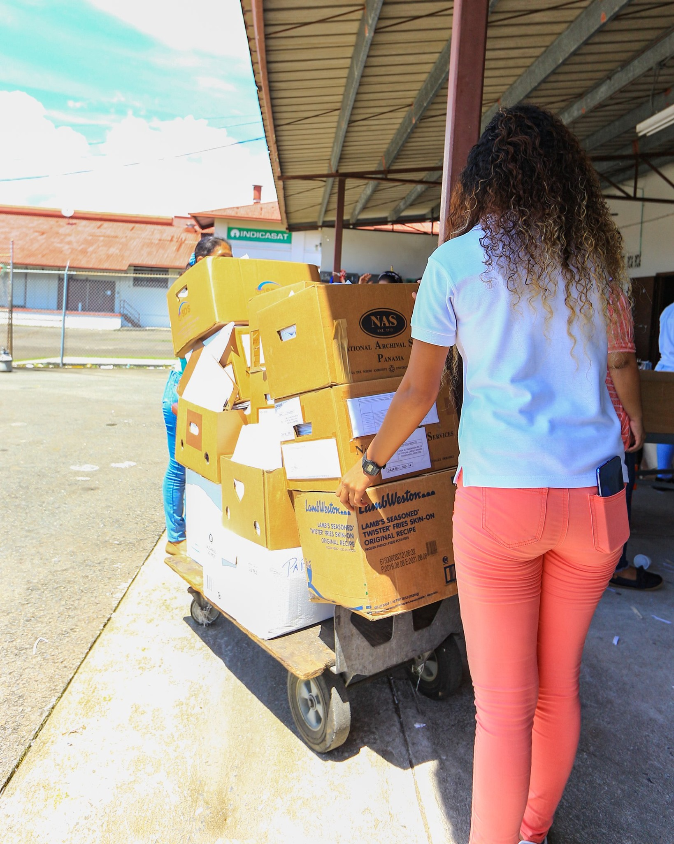
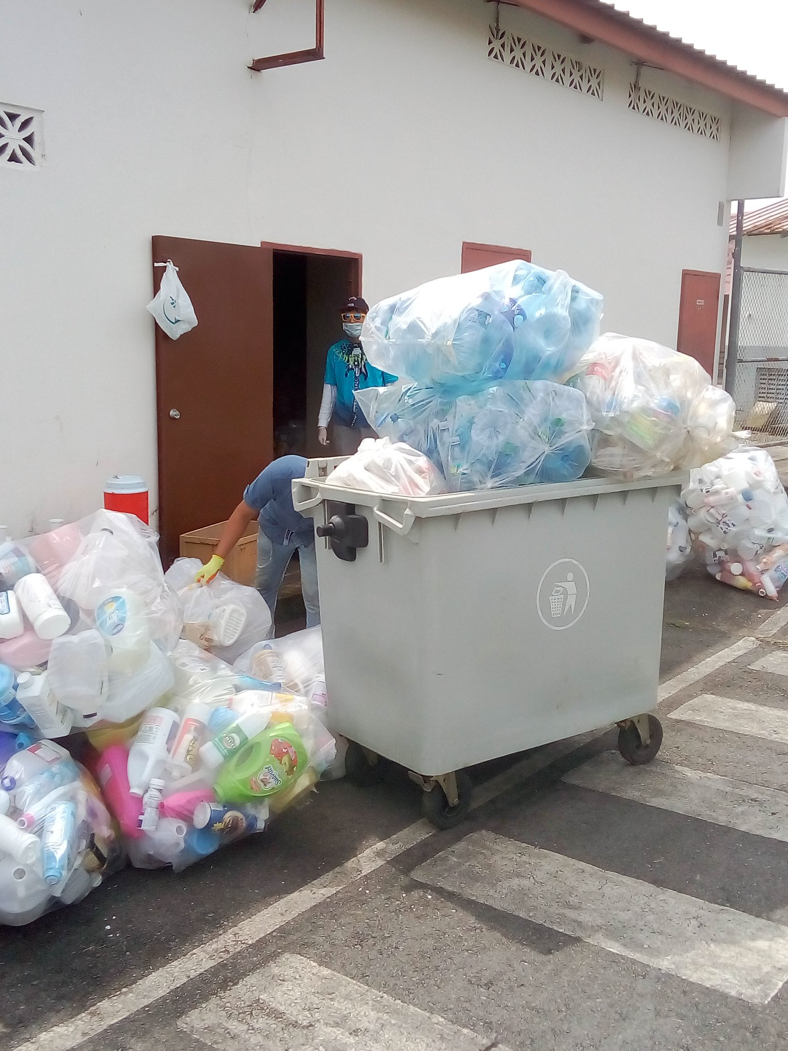
EQUIPMENT USAGE & MAINTENANCE
[12]
[13]
Weighing scale at CAR
Flatbed cart for material transportation at CAR
Wheeled bin for material transportation at CAR
23
Notes:
At the center, the use of equipment can positively influence many aspects of the worker experience. As can be seen in the pictures, there is a decent amount of equipment that is available for the workers. For example, if workers were to utilize the bins with wheels and the flatbed cart, it would greatly decrease the amount of time and stress that exists in their jobs. In addition, a nice side effect would be an improvement in worker morale, which leads to more efficient work

Slide 24
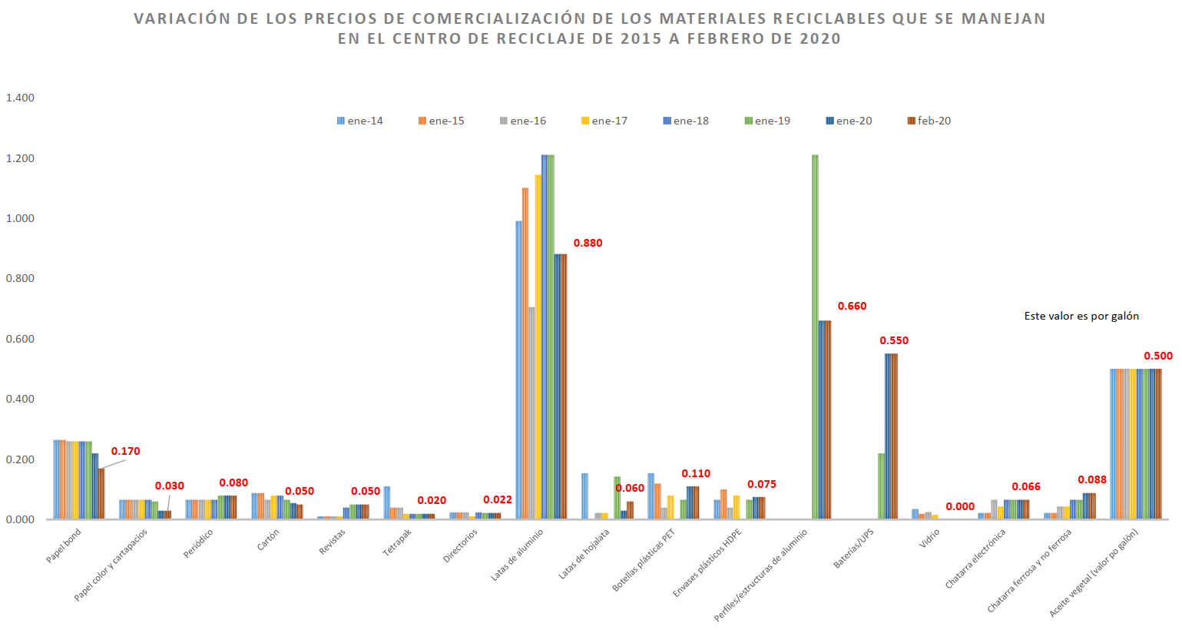
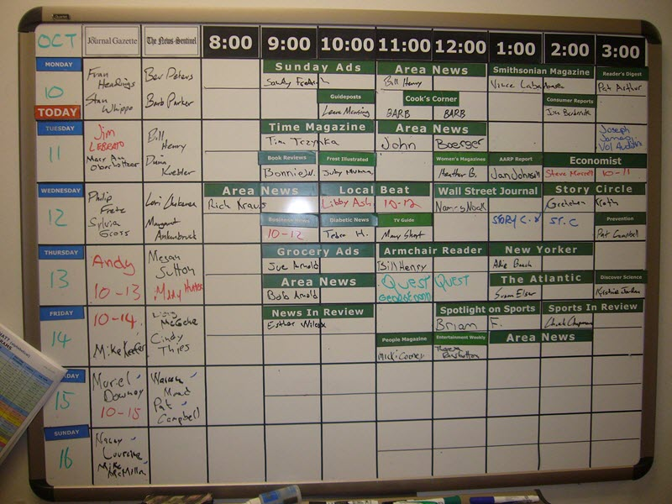
FORECASTING & SCHEDULING
[14]
[15]
A sample of a schedule board
Price variations over the years and months can provide information to forecast future prices (extracted from Feb 2020 FAS Report)
24
Notes:
This last recommendation aims to help the center better organize its operation by forecasting the price of materials and scheduling the pick-up schedule and the daily schedule. FAS collects the monthly price for each material. Using this information, they can implement the time series method for short term forecasting, which is a statistical technique that uses historical demand data over a period of time to predict future demand. They can also use a regression model for more long term forecasting.
Aluminum for example varies in price from year to year, so a forecasting model would greatly assist the center in predicting the resale price. With the forecasted price, the Administrative Staff and Director can then establish a corresponding work schedule that prioritizes higher-value materials, while still making sure that there is not a major backlog of material.
To do so, FAS can have a regular pick-up schedule with the vendors, so that the workers can have a set monthly or weekly quota to achieve. Once the quota is achieved, the employees can then start working to reduce the material backlog.

Slide 25
SUMMARY
Overview of the Project
Results and
Analysis
Methodology
Recommendations
The great amount of materials at the recycling center (CAR) to be classified
25
[2]
25
Notes:
Panama’s growing population leads to more trash and recyclables created each year and Panama’s recycling infrastructure is not robust enough to handle the increase in waste production. We hope that our recommendations to train or retrain its workers, tailor local education, improve signages, rearrange the cages, maintain their equipment, and schedule material pick up will help FAS with its mission of recycling and sustainability.

Slide 26
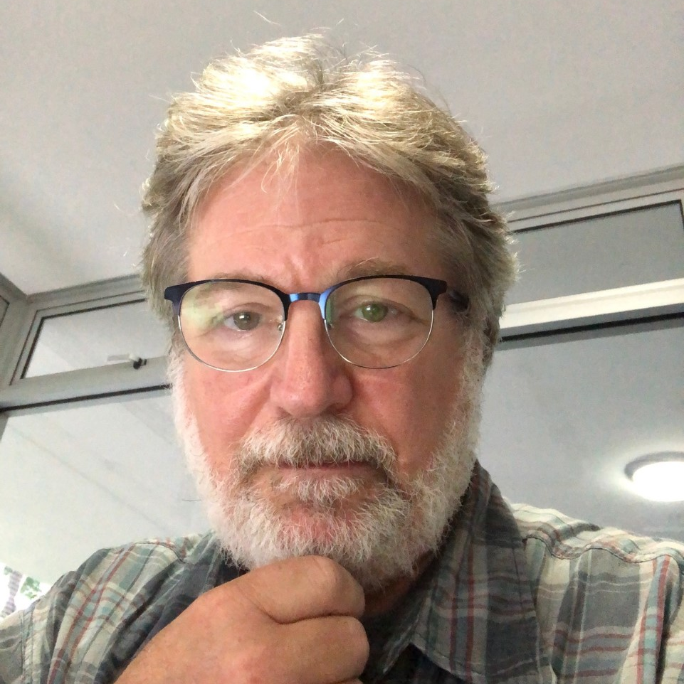
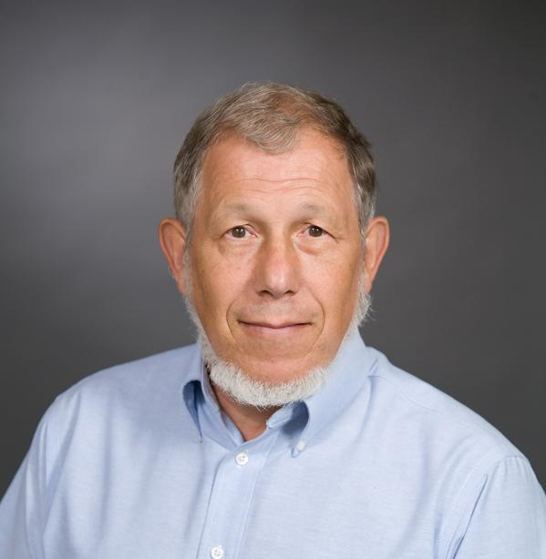
ACKNOWLEDGEMENT
Professor James Chiarelli
Advisor
Panama Project Center A20
Emeritus Professor Robert Kinicki
Co-Advisor
Panama Project Center A20
Ms. Alessa Stabile
Sustainability Manager
Fundación Ciudad del Saber
26
Notes:
We would like to acknowledge Prof Chiarelli, Prof Kinicki, Ms Stabile, FCdS Sustainability Team, FAS employees, and many more that have supported us throughout this project.

Slide 27
RESOURCES
[1] FAS Panama (2019) [FAS Employee 1] Retrieved from https://www.facebook.com/media/set/?vanity=faspanama.org&set=a.1168116056718798
[2] FAS Panama (2019) [Volunteer Day Prep] Retrieved from https://www.facebook.com/media/set/?vanity=faspanama.org&set=a.1168116056718798
[3] FAS Panama (2019) [Volunteer Day Sorting 1] Retrieved from https://www.facebook.com/media/set/?vanity=faspanama.org&set=a.1168116056718798
[4] Wen, Elisa (2019) [CAR Self-service] Retrieved from https://goo.gl/maps/d6Xuv4GBPVwM1ZP69
[5] FAS Panama (2019) [Volunteer Day Sorting 2] Retrieved from https://www.facebook.com/media/set/?vanity=faspanama.org&set=a.1168116056718798
[6] FAS Panama (2019) [Volunteer Day Sorting 3] Retrieved from https://www.facebook.com/media/set/?vanity=faspanama.org&set=a.1168116056718798
[7] FAS Panama (2019) [FAS Employee 2] Retrieved from https://www.facebook.com/media/set/?vanity=faspanama.org&set=a.1168116056718798
[8] FAS Panama (2019) [Volunteer Day Inside] Retrieved from https://www.facebook.com/media/set/?vanity=faspanama.org&set=a.1168116056718798
[9] FAS Panama (2018) [FAS Employees Happy] Retrieved from https://www.facebook.com/faspanama.org/photos/a.156607074536373/799509656912775
[10] Ciudad del Saber (2020) [U Turn]
[11] [Sticky Note Task Board] Retrieved from https://lh3.googleusercontent.com/proxy/c-OFBlY4J514Tzy0plFDLPjhFGhsBpSTbSSMWvjPbszjoQtBmS7tftah5gFNxYaqOzOzRHcV81kXVK6sIpmhf6JCmMWOIafJFYmAwvWijgYv2dpGjYUPUS4l
[12] FAS Panama (2019) [Volunteer Cart] Retrieved from https://www.facebook.com/media/set/?vanity=faspanama.org&set=a.1168116056718798
[13] FAS Panama (2018) [Wheeled bin] Retrieved from https://www.facebook.com/faspanama.org/photos/a.156607074536373/839352279595179
[14] Landau H., Marisol (2020, March 11). Carta de febrero 2020. Panama City: FAS Panama.
[15] [Schedule Board] Retrieved from https://www.teamup.com/wp-content/uploads/2017/01/library-reading-before800.jpg
[16] FAS Panama (2019) [Volunteer Paper] Retrieved from https://www.facebook.com/media/set/?vanity=faspanama.org&set=a.1168116056718798
27

Slide 28
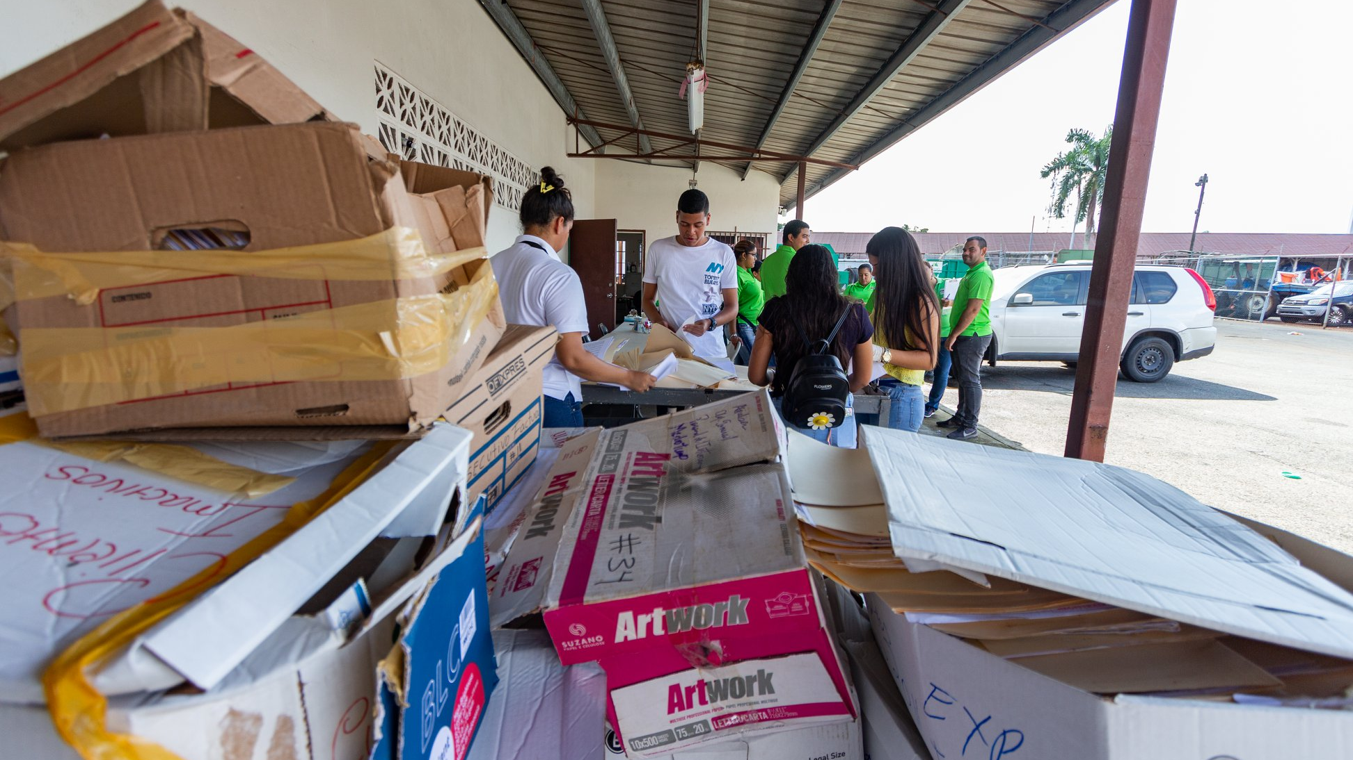
THANK YOU
[16]
28

Slide 29
SUPPLEMENTARY
MATERIALS

Slide 30
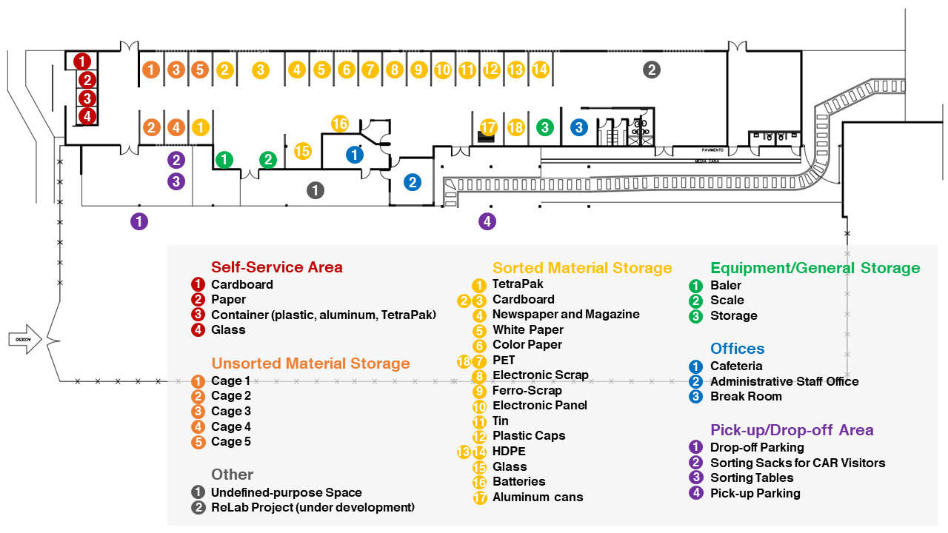

Slide 31
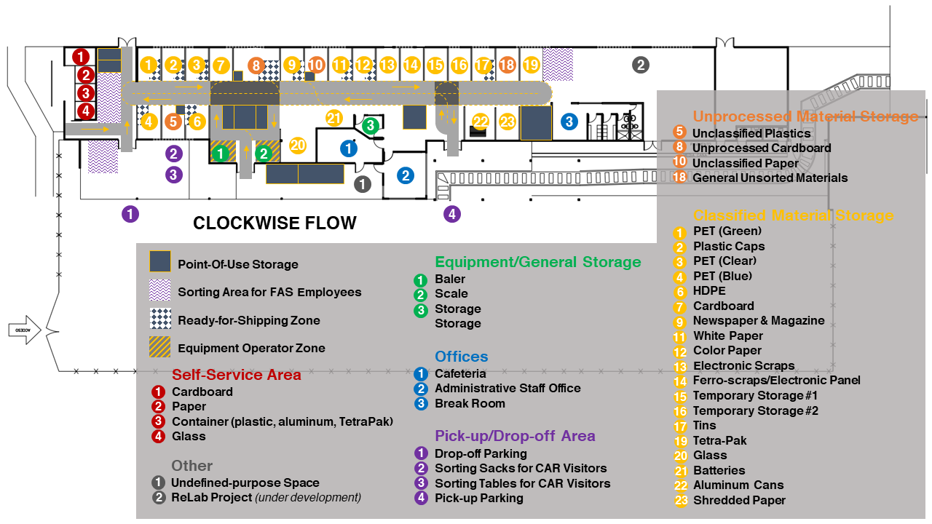

Slide 37
N = 228

Slide 38
N = 228

Slide 39
N = 155

Slide 40
N = 76

Slide 41
N = 76

Slide 42
N = 74

Slide 43
N = 152

Slide 44
N = 152

Slide 45
N = 155

Slide 47
N=50

Slide 49
PLASTICS (PET/HDPE)
Visitor to CAR
Material Receiver
Classifier
Administrative Staff
Vendor
Remove caps
Are
the materials
clean and sorted?
Bring the materials
Yes
Separate by color (clear/blue/green)
No
Place into clear bags
Record collected weight
Vendor arrives at CAR
Remove contaminants
Bale
Record classified weight
Move bales to loading area
Flowchart Legend
Sort into types
Weigh bale
Contact vendor
Load bales onto vehicle
Start/End
Weigh
Move bales to storage
Record sold weight
Weigh bale
Action
Record transactions
Make payment
Decision
PET or HDPE?
HDPE
Has the
vendor been contacted?
No
Create report
Flow Direction
PET
Yes

Slide 50
PAPER (WHITE/COLOR)
Visitor to CAR
Material Receiver
Classifier
Administrative Staff
Vendor
Are
the materials
clean and sorted?
Bring the materials
Yes
Remove binders, clips, etc.
Separate by color (white/color)
Record collected weight
Vendor arrives at CAR
No
Remove contaminants
Place into boxes
Record classified weight
Move bales to loading area
Flowchart Legend
Sort into types
Weigh
Contact vendor
Load bales onto vehicle
Start/End
Weigh
Move paper to storage
Record sold weight
Weigh bale
Action
Record transactions
Make payment
Decision
Has the
vendor been contacted?
No
Create report
Flow Direction
Yes

Slide 51
BATTERY/ELECTRONIC SCRAP/ELECTRONIC PANEL/FERRO-SCRAP
Visitor to CAR
Material Receiver
Classifier
Administrative Staff
Vendor
Are
the materials
clean and sorted?
Bring the materials
Yes
No
Vendor arrives at CAR
Remove contaminants
Record collected weight
Move bales to loading area
Flowchart Legend
Sort into types
Place into containers
Contact vendor
Load bales onto vehicle
Start/End
Weigh
Move containers to storage
Record sold weight
Weigh bale
Action
Record transactions
Make payment
Decision
Has the
vendor been contacted?
No
Create report
Flow Direction
Yes

