Slide 1
Taiwan's 6G Future: The Impact of Next-Gen Infrastructure
[3]
[1]
[2]
Aaron Zhang, Owen Sullivan, Bryce Lukacs, Jameson Courtney
PQP: Wen-Hua Du, Robert Kinicki
ID2050: Amanda Wittman

Slide 2
[4]
Mobile Data Statistics
(Average Per-User/Month)
5.3GB
Current (2022)
257GB
By 2030
Notes:
Vision and research directions of 6G technologies and applications, 2022)

Slide 3
Mobile Data Statistics
(2023 Subscribers)
4G/LTE
60.78%
5.142 Billion
5G
18.46%
1.562 Billion
Notes:
ericsson.com

Slide 4
Timeline Proposal for 6G
2022
2025
2030
2022
5G Rollout Complete
6G Cellular Workshop
6G Cellular Rollout

Slide 5
Timeline Proposal for 6G
2022
2025
2030
5G Rollout Complete
6G Cellular Workshop
6G Cellular Rollout

Slide 6
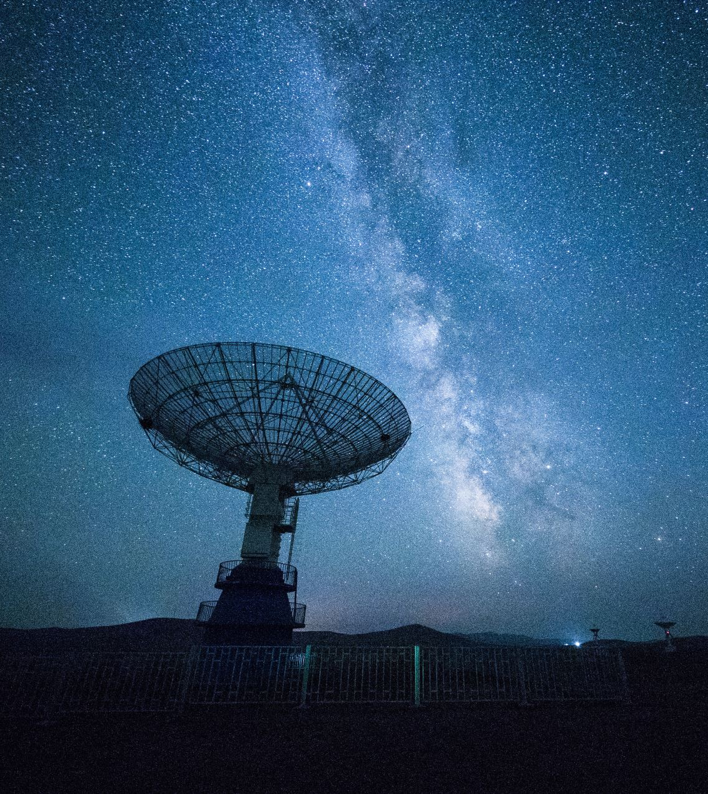
Our Project
We are tasked with identifying the steps necessary in the development of 6G in Taiwan and how the standard aims to benefit society
Notes:
-(START) 6G is set to provide universal high-speed internet with the utilization of AI, and improved internet coverage even in remote and underserved areas, thus enabling greater access to education, healthcare, and economic opportunities for all

Slide 7
Our Project
We are tasked with identifying the steps necessary in the development of 6G in Taiwan and how the standard aims to benefit society
Notes:
-(START) 6G is set to provide universal high-speed internet with the utilization of AI, and improved internet coverage even in remote and underserved areas, thus enabling greater access to education, healthcare, and economic opportunities for all

Slide 8
Our Project
Use of Artificial Intelligence
High-Speed Internet
Improved Coverage
Notes:
-(START) 6G is set to provide universal high-speed internet with the utilization of AI, and improved internet coverage even in remote and underserved areas, thus enabling greater access to education, healthcare, and economic opportunities for all

Slide 9
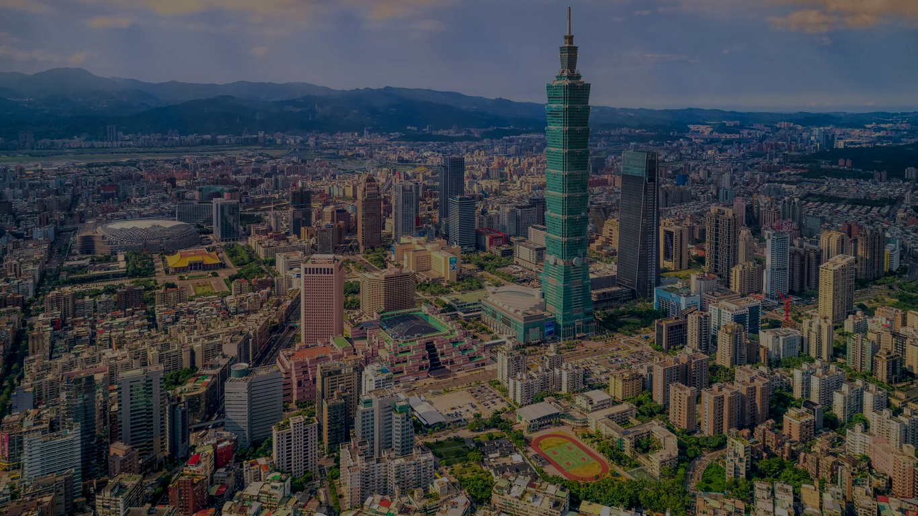
Taiwan’s Institute of Economic Research (TIER)
[2]
Researches: Domestic and Foreign Macroeconomics and Industrial Economics
Collaboration with TIER:
Resource for important background info and context for research
Provides: consultation to government and enterprises
Promotes: economic development of Taiwan
Private Independent Think Tank
Notes:
Because TIER is a think-tank and not a company
We can focus on a more holistic picture
We can incorporate significant research towards the social aspects
Our sponsor is the Taiwan Institute of Economic Research (TIER)
Research on domestic and foreign macroeconomics and industrial economics
Provides consultation to government and enterprises to promote economic development of Taiwan
How TIER fits in/working with this project:
Resource for important background info and context for research
Private independent think tank

Slide 10
Taiwan’s Institute of Economic Research (TIER)
Researches: Domestic and Foreign Macroeconomics and Industrial Economics
[2]
Collaboration with TIER:
Resource for important background info and context for research
Provides: consultation to government and enterprises
Promotes: economic development of Taiwan
Private Independent Think Tank
Notes:
Because TIER is a think-tank and not a company
We can focus on a more holistic picture
We can incorporate significant research towards the social aspects
Our sponsor is the Taiwan Institute of Economic Research (TIER)
Research on domestic and foreign macroeconomics and industrial economics
Provides consultation to government and enterprises to promote economic development of Taiwan
How TIER fits in/working with this project:
Resource for important background info and context for research
Private independent think tank

Slide 11
Social Aspects
Enhanced Connectivity
Quality of Life
Reduce Digital Divide
Fear of AI
Privacy Concerns
Increased Surveillance
Notes:
-As for the social aspects, there are both positive and negative outlooks
-Internet enhances communications, supply chains, and business practices, increasing productivity
-By improving connectivity and supporting smart city initiatives, 6G could enhance the quality of life and foster more sustainable, efficient, and livable urban environments
-

Slide 12
Social Aspects
[6]
Enhanced Connectivity
Quality of Life
Reduce Digital Divide
Fear of AI
Privacy Concerns
Increased Surveillance
Notes:
-As for the social aspects, there are both positive and negative outlooks
-Internet enhances communications, supply chains, and business practices, increasing productivity
-By improving connectivity and supporting smart city initiatives, 6G could enhance the quality of life and foster more sustainable, efficient, and livable urban environments
-

Slide 13
Goal
Investigate:
Historical rollout of 5G
Public data usage
Public perception on AI
1
2
Assist:
Taiwan’s Institute of Economic Research
Provide:
3
Recommendations and strategies on the deployment of 6G
6

Slide 14
Goal
Investigate:
Historical rollout of 5G
Public data usage
Public perception on AI
1
2
Assist:
Taiwan’s Institute of Economic Research
Provide:
3
Recommendations and strategies on the deployment of 6G
Notes:
We have three main goals in our projects:
We want to investigate areas relating to the current and historical rollouts of 5G, public data usage, and public perceptions on AI.
All of these will provide us with an understanding of the hurdles for 6G
The goal of our project is to assist Taiwan’s Institute of Economic Research in their research on Taiwan’s telecommunications future.
And allow us to provide recommendations and strategies on the deployment of 6G

Slide 15
Objectives
1
Examine:
Historical and current issues of 5G
Uncover:
2
Public Perception of 6G and AI
3
Determine:
Technical Feasibility of 6G in Taiwan
6
Notes:
Owen
Explain what our project will do to address the problem
Almost like the information from the eProjects listing
10,000 foot overview
Like eProjects but updated with what we have learned from our sponsor

Slide 16
Objectives
1
Examine:
Historical and current issues of 5G
Uncover:
2
Public Perception of 6G and AI
3
Determine:
Technical Feasibility of 6G in Taiwan
Notes:
Like with any new technology, there are bound to be both social and technical issues that have to be assessed and addressed.
Be very clear about distinction between social and technical objectives (left vs right)
We hope looking at both aspects of the problem will give us a more complete understanding of our goal as they pose very different challenges
For the social aspect:
We want to uncover the public perception of 6G and AI
Specifically, what is the general publics thoughts, what are some of their concerns, what are they looking forward towards
Do they like or not like the implementation of AI into another aspect of their life
As for the technical aspect: We want to focus on examining the historical and current issues of the implementation of 5G.
- Looking into areas like its rollout processes, complications, and accomplishments, what is good? What was bad?
And also
We want to determine the current technical feasibility of 6G in Taiwan.

Slide 17
Survey on AI and 6G Perception
Survey on Usage Habits:
Interview 5G Experts:
In-Person Interviews
Online Surveys
Online Surveys
Methods
Background
Roadblocks
Public perception
Digital divide
Internet usage
Phone carrier
Connection type
Familiarity with Tech
Impact of 5G on QOL
Perception of AI
Perception of 6G
Notes:
Owen
Explain what our project will do to address the problem
Almost like the information from the eProjects listing
10,000 foot overview
Like eProjects but updated with what we have learned from our sponsor

Slide 18
Survey on AI and 6G Perception
Interview 5G Experts:
Survey on Usage Habits:
In-Person Interviews
Online Surveys
Online Surveys
Methods
Background
Roadblocks
Public perception
Digital divide
Internet usage
Phone carrier
Connection type
Familiarity with Tech
Impact of 5G on QOL
Perception of AI
Perception of 6G
Notes:
Owen
Interview
- In person
- Semi-structured
- Qualitative
- Work with TIER to find candidates
- Snow ball sampling
Survey Habits
- Online
- Quantitative
- Work with TIER to distribute survey
Survey Perception
- Online
- Mixed
- Work with TIER to distribute survey

Slide 19
Project Outline
Goal
Objectives
Methods
Outcome
Determine technical feasibility of 6G, historical issues of 5G
Interview 5G experts
Anticipate hurdles for 6G
Recommend path for 6G adoption
Survey on usage habits
Determine public perception of 6G and AI
Survey on AI and 6G perception
Notes:
Just read left to right off the diagram

Slide 20
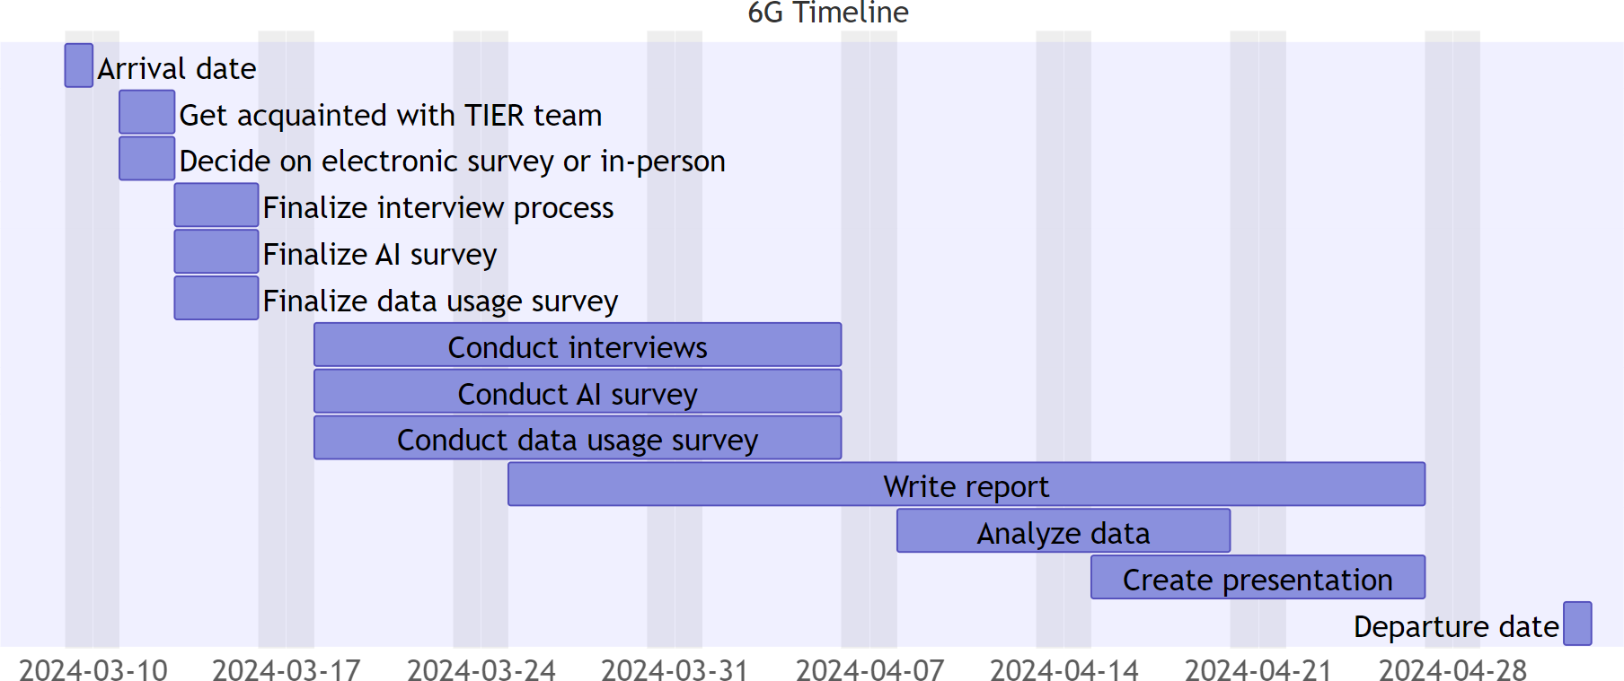
6G Timeline
Notes:
1 week meeting team, finishing survey
3 weeks gathering data
Start report week 3
Last weeks analyzing data, creating presentation

Slide 21
Recap
[2]
[5]
Notes:
To summarize our project:
We will be working with TIER to
- Anticipate hurdles that 6G will experience when being implemented
- and recommend a path to avoid these obstacles
- we will do this by leveraging surveys and interviews
We hope our work will advance certain United Nations Sustainable Development Goals:
- Decent work and Economic Growth
- Industry, Innovation and infrastructure
- reduced inequalities

Slide 22
Thanks
[1]
[2]
Any Questions?

Slide 23
Images
1 | https://en.wikipedia.org/wiki/Worcester_Polytechnic_Institute
2 | https://english.tier.org.tw/
3 | https://english.cw.com.tw/article/article.action?id=3491
4 | https://www.datamation.com/big-data/big-data-technologies/
5 | https://libguides.wpi.edu/sdgs
6 | https://www.escapemanila.com/2022/10/things-to-do-in-taipei.html

Slide 24
Taiwan’s Institute of Economic Research (TIER)
Researches: Domestic and Foreign Macroeconomics and Industrial Economics
Provides: consultation to government and enterprises
Promotes: economic development of Taiwan
How TIER Fits?
Resource for important background info and context for research
Private Independent Think Tank
[2]
Notes:
Because TIER is a think-tank and not a company
We can focus on a more holistic picture
We can incorporate significant research towards the social aspects
Our sponsor is the Taiwan Institute of Economic Research (TIER)
Research on domestic and foreign macroeconomics and industrial economics
Provides consultation to government and enterprises to promote economic development of Taiwan
How TIER fits in/working with this project:
Resource for important background info and context for research
Private independent think tank

Slide 25
Taiwan’s Institute of Economic Research (TIER)
[2]
Researches: Domestic and Foreign Macroeconomics and Industrial Economics
Collaboration with TIER:
Resource for important background info and context for research
Provides: consultation to government and enterprises
Private Independent Think Tank
Promotes: economic development of Taiwan
Notes:
Because TIER is a think-tank and not a company
We can focus on a more holistic picture
We can incorporate significant research towards the social aspects
Our sponsor is the Taiwan Institute of Economic Research (TIER)
Research on domestic and foreign macroeconomics and industrial economics
Provides consultation to government and enterprises to promote economic development of Taiwan
How TIER fits in/working with this project:
Resource for important background info and context for research
Private independent think tank

Slide 26
Our Sponsor
Our sponsor is the Taiwan Institute of Economic Research (TIER)
Private independent think tank
Research on domestic and foreign macroeconomics and industrial economics
Provides consultation to government and enterprises to promote economic development of Taiwan
How TIER fits in/working with this project:
Resource for important background info and context for research
[2]
Notes:
Because TIER is a think-tank and not a company
We can focus on a more holistic picture
We can incorporate significant research towards the social aspects

Slide 27
Our Project
Project Description:
Student team will assist TIER by
Interviewing experts
Surveying the people in Taiwan
In order to gain insight on
Public Opinion of
6G
AI
Data Usage/Preferences
We will provide TIER with our research and give recommendations on the implementation and release of 6G
How TIER fits in/working with this project:
Resource for important background info and context for research

Slide 28
Project Timeline
Arrival Date
Get acquainted with the TIER team

Slide 29
Project Objectives
Goal
Objectives
Methods
Outcome
Determine technical feasibility of 6G; historical issues of 5G
Interview 5G experts
Anticipate hurdles for 6G
Recommend path for 6G adoption
Survey on usage habits
Determine public perception of 6G and AI
Survey on AI and 6G perception
Notes:
Owen

Slide 30
Methods
Interview 5G Experts:
1
In-Person Interviews
Background
Roadblocks
Public perception
Digital divide
Survey on Usage Habits:
2
Online Survey
Survey Public
Internet usage
Phone carrier
Connection type
3
Online Survey
Familiarity with Tech
Impact of 5G on QOL
Perception of AI
Perception of 6G
Notes:
Owen
Explain what our project will do to address the problem
Almost like the information from the eProjects listing
10,000 foot overview
Like eProjects but updated with what we have learned from our sponsor

Slide 31
Methods
Interview 5G Experts:
1
In-Person Interviews
Background
Roadblocks
Public perception
Digital divide
Survey on Usage Habits:
2
Online Survey
Survey Public
Internet usage
Phone carrier
Connection type
3
Online Survey
Familiarity with Tech
Impact of 5G on QOL
Perception of AI
Perception of 6G
Notes:
Owen
Explain what our project will do to address the problem
Almost like the information from the eProjects listing
10,000 foot overview
Like eProjects but updated with what we have learned from our sponsor

Slide 32
Project Methods
Interview 5G experts
Survey on usage habits
Survey on AI and 6G perception
In-Person Interviews
Background
Roadblocks
Public perception
Digital divide
Online Survey
Internet usage
Phone carrier
Connection type
Online Survey
Familiarity with technologies
Impact of 5G on QOL
Perception of AI
Perception of 6G
Notes:
Owen
Interview with 5G experts
Survey on usage habits
Survey on AI and 6G perception

Slide 33
6G Timeline Proposal

Slide 34
Taiwan's 6G Future: The Impact of Next-Gen Infrastructure
[1]
[2]
Aaron Zhang, Owen Sullivan, Bryce Lukacs, Jameson Courtney
[3]

