Slide 1
Taiwan's 6G Future: The Impact of Next-Gen Infrastructure
[3]
[1]
[2]
Aaron Zhang, Owen Sullivan, Bryce Lukacs, Jameson Courtney

Slide 2
[4]
Mobile Data Statistics
(Average Per-User/Month)
5.3GB
Current (2022)
257GB
By 2030
Notes:
Vision and research directions of 6G technologies and applications, 2022)

Slide 3
[4]
Mobile Data Statistics
(2023 Subscribers)
4G/LTE
60.78%
5.142 Billion
5G
18.46%
1.562 Billion
Notes:
ericsson.com

Slide 4
Timeline Proposal for 6G
2022
2025
2030
5G Rollout Complete
6G Cellular Workshop
6G Cellular Rollout

Slide 5
Timeline Proposal for 6G
2022
2025
2030
5G Rollout Complete
6G Cellular Workshop
6G Cellular Rollout

Slide 6
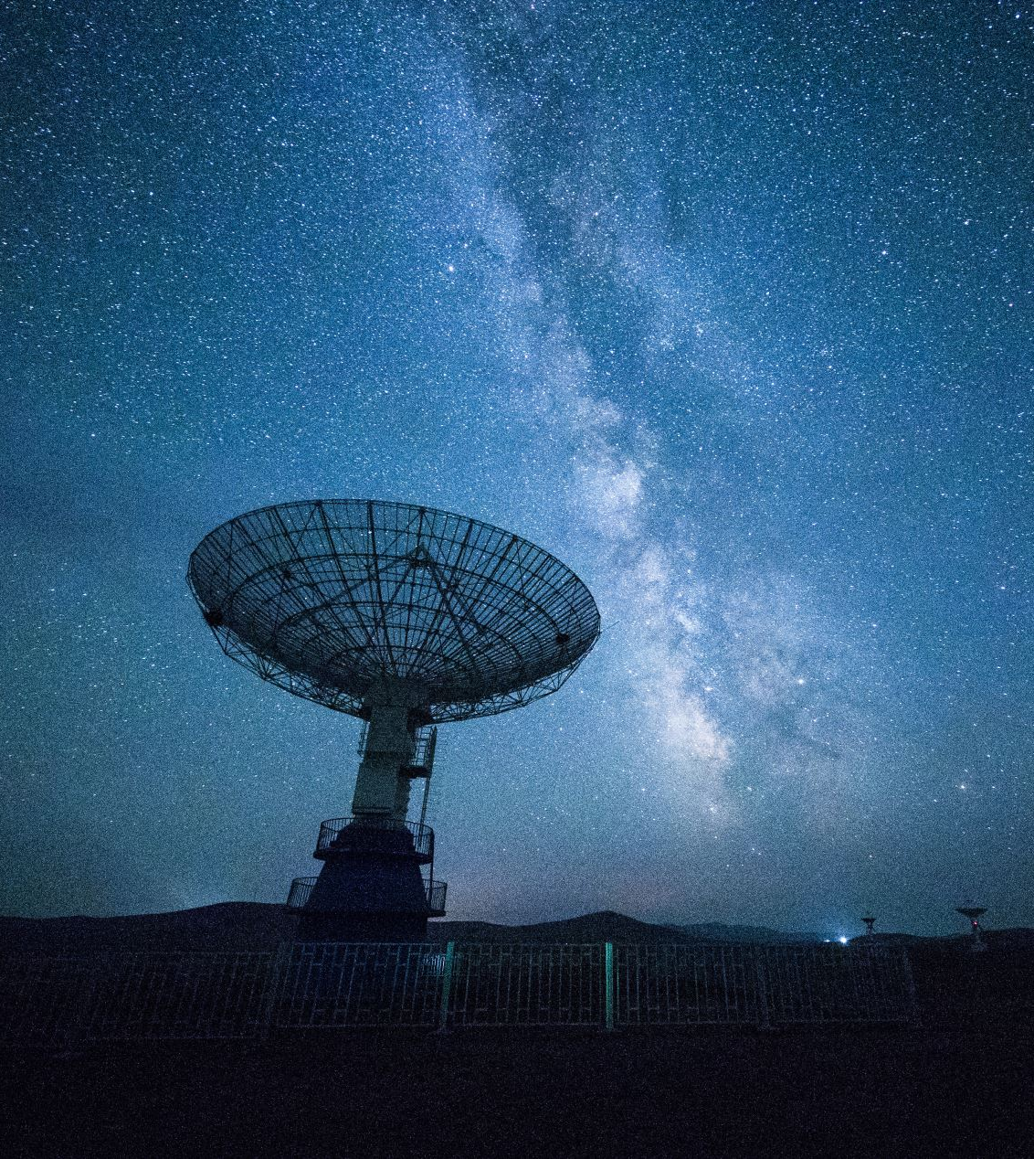
Goal Statement
We are tasked with identifying the steps necessary in the development of 6G in Taiwan and how the standard aims to benefit society
Notes:
-(START) 6G is set to provide universal high-speed internet with the utilization of AI, and improved internet coverage even in remote and underserved areas, thus enabling greater access to education, healthcare, and economic opportunities for all

Slide 7
Goal Statement
We are tasked with identifying the steps necessary in the development of 6G in Taiwan and how the standard aims to benefit society
Notes:
-(START) 6G is set to provide universal high-speed internet with the utilization of AI, and improved internet coverage even in remote and underserved areas, thus enabling greater access to education, healthcare, and economic opportunities for all

Slide 8
Goal Statement
Use of Artificial Intelligence
High-Speed Internet
Improved Coverage
Notes:
-6G is also set to utilize different factors such as the use of AI along with high speed internet and better coverage, with each factor essentially acting as a catalyst for the others

Slide 9
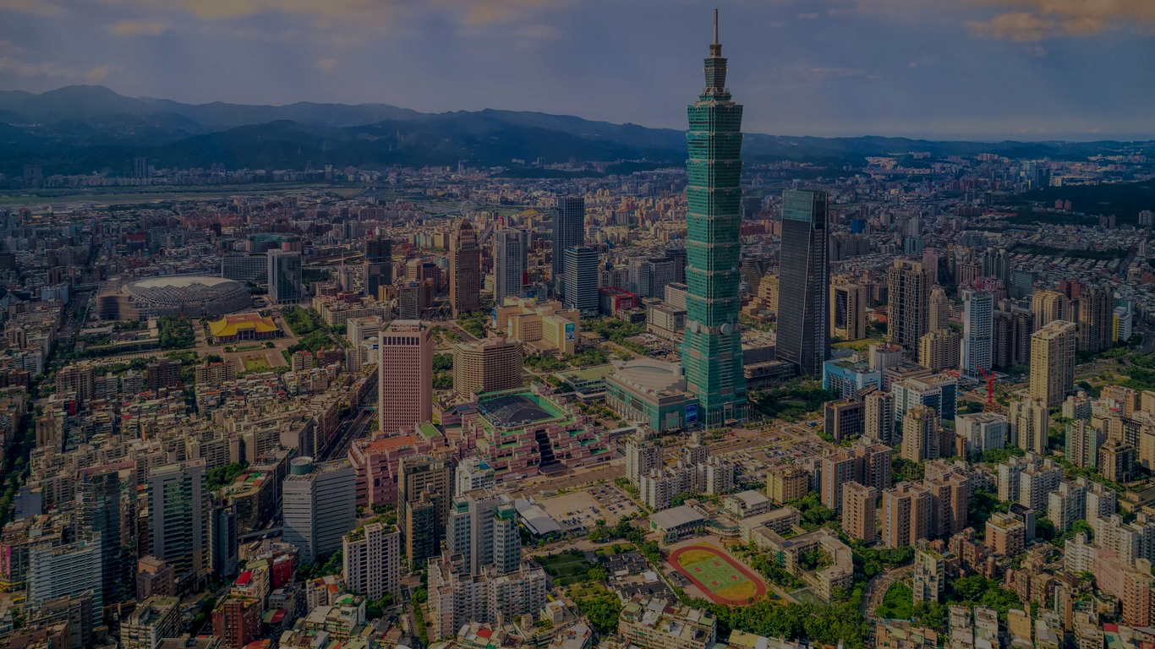
Taiwan’s Institute of Economic Research (TIER)
[2]
[7]
Researches: Domestic and Foreign Macroeconomics and Industrial Economics
Collaboration with TIER:
Resource for important background info and context for research
Provides: consultation to government and enterprises
Promotes: economic development of Taiwan
Private Independent Think Tank
7
Notes:
Because TIER is a think-tank and not a company
We can focus on a more holistic picture
We can incorporate significant research towards the social aspects
Our sponsor is the Taiwan Institute of Economic Research (TIER)
Research on domestic and foreign macroeconomics and industrial economics
Provides consultation to government and enterprises to promote economic development of Taiwan
How TIER fits in/working with this project:
Resource for important background info and context for research
Private independent think tank

Slide 10
Taiwan’s Institute of Economic Research (TIER)
[7]
Researches: Domestic and Foreign Macroeconomics and Industrial Economics
[2]
Collaboration with TIER:
Resource for important background info and context for research
Provides: consultation to government and enterprises
Promotes: economic development of Taiwan
Private Independent Think Tank
7
Notes:
Because TIER is a think-tank and not a company
We can focus on a more holistic picture
We can incorporate significant research towards the social aspects
Our sponsor is the Taiwan Institute of Economic Research (TIER)
Research on domestic and foreign macroeconomics and industrial economics
Provides consultation to government and enterprises to promote economic development of Taiwan
How TIER fits in/working with this project:
Resource for important background info and context for research
Private independent think tank

Slide 11
Social Aspects
Enhanced Connectivity
Quality of Life
Reduce Digital Divide
Fear of AI
Privacy Concerns
Increased Surveillance
8
Notes:
-As for the social aspects, there are both positive and negative outlooks
-Internet enhances communications, supply chains, and business practices, increasing productivity
-By improving connectivity and supporting smart city initiatives, 6G could enhance the quality of life and foster more sustainable, efficient, and livable urban environments
-

Slide 12
Social Aspects
[6]
Enhanced Connectivity
Quality of Life
Reduce Digital Divide
Fear of AI
Privacy Concerns
Increased Surveillance
8
Notes:
-As for the social aspects, there are both positive and negative outlooks
-By improving connectivity and supporting smart city initiatives, 6G could enhance the quality of life and foster more sustainable, efficient, and livable urban environments
-With increased coverage, faster internet will be more available, helping reduce the digital divide
-As for the negative aspects, there is the fear of AI, here in the US a few years ago there was public concern with 5G, this still applies to AI
-with this is also privacy concerns along with fear of an increase in surveillance, as AI could make it more efficient and accurate to survey

Slide 13
Goal
Investigate
Historical rollout of 5G
Public data usage
Public perception on AI
1
2
Assist
Taiwan’s Institute of Economic Research
Provide
3
Recommendations and strategies on the deployment of 6G
9

Slide 14
Goal
Investigate
Historical rollout of 5G
Public data usage
Public perception on AI
1
2
Assist
Taiwan’s Institute of Economic Research
Provide
3
Recommendations and strategies on the deployment of 6G
9
Notes:
Moving into specific details about our project, we want to focus one goal broken up into 3 parts.
First, we want to investigate areas relating to the current development and the historical rollout of 5G,
We want to look into the public data usage, and also the public perceptions on AI in Taiwan.
All of these will help us understand and anticipate some of the hurdles for 6G
Second, we want to assist TIER in their research on Taiwan’s telecommunications future.
Finally, all of this research will allow us to provide recommendations and strategies on the deployment of 6G in Taiwan

Slide 15
Objectives
1
Examine
Historical and current issues of 5G
Uncover
2
Public Perception of 6G and AI
3
Determine
Technical Feasibility of 6G in Taiwan
10

Slide 16
Objectives
1
Examine
Historical and current issues of 5G
Uncover
2
Public Perception of 6G and AI
3
Determine
Technical Feasibility of 6G in Taiwan
10
Notes:
Like with any new technology, there are bound to be both social and technical issues that have to be assessed and addressed.
We hope that by looking at both aspects of the problem, it will help give us a more complete understanding of our goal
as they pose very different challenges
For the social aspect, shown on the left:
We want to uncover the public perception of 6G and AI in Taiwan
So for 6G we want to explore areas like:
what are the general publics’ thoughts, what are some of their concerns about it, what are they looking forward towards
And for AI we would try and find out:
-their thoughts on the implementation of AI into another aspect of their life
As for the technical aspect, shown on the right: We want to focus on examining the historical and current issues of the implementation of 5G.
- Looking into areas like its rollout processes, complications, and accomplishments, what is good? What was bad?
In the end, determining the current technical feasibility of 6G in Taiwan.

Slide 17
Survey on AI and 6G Perception
Survey on Usage Habits
Interview 5G Experts
In-Person Interviews
Online Surveys
Online Surveys
Methods
Background
Roadblocks
Digital divide
Internet usage
Phone carrier
Connection type
Familiarity with Tech
Impact of 5G on QOL
Perception of AI / 6G
Notes:
Owen
Interview
- In person
- Semi-structured
- Qualitative
- Work with TIER to find candidates
- Snow ball sampling
Survey Habits
- Online
- Quantitative
- Work with TIER to distribute survey
Survey Perception
- Online
- Mixed
- Work with TIER to distribute survey

Slide 18
Survey on AI and 6G Perception
Interview 5G Experts
Survey on Usage Habits
In-Person Interviews
Online Surveys
Online Surveys
Methods
Background
Roadblocks
Digital divide
Internet usage
Phone carrier
Connection type
Familiarity with Tech
Impact of 5G on QOL
Perception of AI / 6G
Notes:
Owen
Identified social technological divide in objectives
Interview
- In person
- Semi-structured
- Qualitative
- Work with TIER to find candidates
- Snow ball sampling
Survey Habits
- Online
- Quantitative
- Work with TIER to distribute survey
Survey Perception
- Online
- Mixed
- Work with TIER to distribute survey

Slide 19
Project Outline
Goal
Objectives
Methods
Outcome
Determine technical feasibility of 6G, historical issues of 5G
Interview 5G experts
Anticipate hurdles for 6G
Recommend path for 6G adoption
Survey on usage habits
Determine public perception of 6G and AI
Survey on AI and 6G perception
Notes:
Just read left to right off the diagram

Slide 20
Project Outline
Goal
Objectives
Methods
Outcome
Determine technical feasibility of 6G, historical issues of 5G
Interview 5G experts
Anticipate hurdles for 6G
Recommend path for 6G adoption
Survey on usage habits
Determine public perception of 6G and AI
Survey on AI and 6G perception
Notes:
Just read left to right off the diagram

Slide 21
UN SDG Goals
[5]
Notes:
Goal – Recommend path for 6G adoption
Fits into WPI and UN SDGs
We hope our work will advance certain United Nations Sustainable Development Goals:
- Decent work and Economic Growth
- Industry, Innovation and infrastructure
- reduced inequalities
We hope in our research we can provide TIER with valuable insights into the future of 6G
- Allow Taiwan to explore the full benefits of the new tech
- Hopeful of social implications
- reducing digital divide
- boosting the economy
To summarize our project:
We will be working with TIER to
- Anticipate hurdles that 6G will experience when being implemented
- and recommend a path to avoid these obstacles
- we will do this by leveraging surveys and interviews

Slide 22
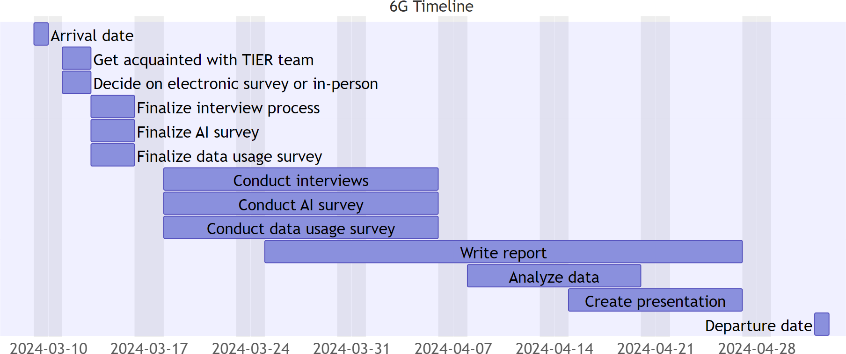
6G Project Timeline
Notes:
1 week meeting team, finishing survey
3 weeks gathering data
Start report week 3
Last weeks analyzing data, creating presentation

Slide 23
Acknowledgements
[8]
Thank you
PQP: Wen-Hua Du, Robert Kinicki
ID2050: Amanda Wittman
[1]
Special thanks Sponsor: TIER
[2]

Slide 24
Images
1 | https://en.wikipedia.org/wiki/Worcester_Polytechnic_Institute
2 | https://english.tier.org.tw/
3 | https://english.cw.com.tw/article/article.action?id=3491
4 | https://www.datamation.com/big-data/big-data-technologies/
5 | https://libguides.wpi.edu/sdgs
6 | https://www.escapemanila.com/2022/10/things-to-do-in-taipei.html
7 | https://www.kayak.com/Taipei-Hotels.19888.hotel.ksp
8 | https://www.cnn.com/travel/gallery/taiwan-prettiest-locations-photos/index.html

Slide 25
Thanks
[1]
[2]
Any Questions?

Slide 26
Taiwan’s Institute of Economic Research (TIER)
Researches: Domestic and Foreign Macroeconomics and Industrial Economics
Provides: consultation to government and enterprises
Promotes: economic development of Taiwan
How TIER Fits?
Resource for important background info and context for research
Private Independent Think Tank
[2]
Notes:
Because TIER is a think-tank and not a company
We can focus on a more holistic picture
We can incorporate significant research towards the social aspects
Our sponsor is the Taiwan Institute of Economic Research (TIER)
Research on domestic and foreign macroeconomics and industrial economics
Provides consultation to government and enterprises to promote economic development of Taiwan
How TIER fits in/working with this project:
Resource for important background info and context for research
Private independent think tank

Slide 27
Taiwan’s Institute of Economic Research (TIER)
[2]
Researches: Domestic and Foreign Macroeconomics and Industrial Economics
Collaboration with TIER:
Resource for important background info and context for research
Provides: consultation to government and enterprises
Private Independent Think Tank
Promotes: economic development of Taiwan
Notes:
Because TIER is a think-tank and not a company
We can focus on a more holistic picture
We can incorporate significant research towards the social aspects
Our sponsor is the Taiwan Institute of Economic Research (TIER)
Research on domestic and foreign macroeconomics and industrial economics
Provides consultation to government and enterprises to promote economic development of Taiwan
How TIER fits in/working with this project:
Resource for important background info and context for research
Private independent think tank

Slide 28
Our Sponsor
Our sponsor is the Taiwan Institute of Economic Research (TIER)
Private independent think tank
Research on domestic and foreign macroeconomics and industrial economics
Provides consultation to government and enterprises to promote economic development of Taiwan
How TIER fits in/working with this project:
Resource for important background info and context for research
[2]
Notes:
Because TIER is a think-tank and not a company
We can focus on a more holistic picture
We can incorporate significant research towards the social aspects

Slide 29
Our Project
Project Description:
Student team will assist TIER by
Interviewing experts
Surveying the people in Taiwan
In order to gain insight on
Public Opinion of
6G
AI
Data Usage/Preferences
We will provide TIER with our research and give recommendations on the implementation and release of 6G
How TIER fits in/working with this project:
Resource for important background info and context for research

Slide 30
Project Timeline
Arrival Date
Get acquainted with the TIER team

Slide 31
Project Objectives
Goal
Objectives
Methods
Outcome
Determine technical feasibility of 6G; historical issues of 5G
Interview 5G experts
Anticipate hurdles for 6G
Recommend path for 6G adoption
Survey on usage habits
Determine public perception of 6G and AI
Survey on AI and 6G perception
Notes:
Owen

Slide 32
Methods
Interview 5G Experts:
1
In-Person Interviews
Background
Roadblocks
Public perception
Digital divide
Survey on Usage Habits:
2
Online Survey
Survey Public
Internet usage
Phone carrier
Connection type
3
Online Survey
Familiarity with Tech
Impact of 5G on QOL
Perception of AI
Perception of 6G
Notes:
Owen
Explain what our project will do to address the problem
Almost like the information from the eProjects listing
10,000 foot overview
Like eProjects but updated with what we have learned from our sponsor

Slide 33
Methods
Interview 5G Experts:
1
In-Person Interviews
Background
Roadblocks
Public perception
Digital divide
Survey on Usage Habits:
2
Online Survey
Survey Public
Internet usage
Phone carrier
Connection type
3
Online Survey
Familiarity with Tech
Impact of 5G on QOL
Perception of AI
Perception of 6G
Notes:
Owen
Explain what our project will do to address the problem
Almost like the information from the eProjects listing
10,000 foot overview
Like eProjects but updated with what we have learned from our sponsor

Slide 34
Project Methods
Interview 5G experts
Survey on usage habits
Survey on AI and 6G perception
In-Person Interviews
Background
Roadblocks
Public perception
Digital divide
Online Survey
Internet usage
Phone carrier
Connection type
Online Survey
Familiarity with technologies
Impact of 5G on QOL
Perception of AI
Perception of 6G
Notes:
Owen
Interview with 5G experts
Survey on usage habits
Survey on AI and 6G perception

Slide 35
6G Timeline Proposal

Slide 36
Taiwan's 6G Future: The Impact of Next-Gen Infrastructure
[1]
[2]
Aaron Zhang, Owen Sullivan, Bryce Lukacs, Jameson Courtney
[3]

Slide 37
Project Outline
Goal
Objectives
Methods
Outcome
Determine technical feasibility of 6G, historical issues of 5G
Interview 5G experts
Anticipate hurdles for 6G in Taiwan
Recommend path for 6G adoption in Taiwan
Survey on data usage habits
Determine public perception of 6G and AI
Survey on AI and 6G perception
Notes:
Just read left to right off the diagram

