Slide 1
A Power Assignment Method for Multi-Sink WSN with Outage Probability Constraints
Marcelo E. Pellenz*, Edgard Jamhour*, Manoel C. Penna*, Richard D. Souza and Glauber G. Brante
*PPGIa, Pontificial Catholic University of Parana - Parana, Curitiba, Brazil
CPGEI, Federal University of Technology - Parana, Curitiba, Brazil
Presenter: Alexander W. Witt

Slide 2
Outline
Introduction
Related Work
Power & Outage-Based Capacity Model
Geometry-Based Clustering
Path-Based Clustering
Evaluation
Conclusion

Slide 3
Introduction
Wireless Sensor Networks (WSNs) for monitoring areas.
Multi-hop networks
Sinks for data aggregation
Smart Grids and Smart Cities
Energy efficiency, reliability, and network capacity are important for WSNs.
Planning cluster-based WSNs under using the aforementioned properties as constraints.

Slide 4
Related Work
Sinks and clustering reduce energy consumption at each node in a WSN
The k-means algorithm has been used to plan WSNs to meet a given network lifetime.
Minimizing average distance of nodes to sinks based on distance info of neighbors.
Cost models based on hops.
Routing topology.

Slide 5
Related Work (cont.)
Divide network into k-clusters for minimal hops and maximal average degree of sink nodes.
Maximize network reachability measured by info at sinks.
Model influence of fading effects due to wireless propagation.
Account for wireless interference for capacity

Slide 6
Power & Outage-Based Capacity Model
Wireless channel capacity function of radio channel impairments
Channel outage probability is a good predictor of packet error rate
Nakagami-m distribution models fading effects of wireless propagation environment.
Fading severity controlled through parameter m

Slide 7
Nakagami-m Fading Outage Probability Model
P = Power of a transmitting WSN node
d = Distance to the receiver from the WSN node
m = Severity of fading in the Nakagami-m distrib.
B = The threshold for error-free decoding

Slide 8
Increasing Transmission Power
In the previous model, the outage probability can be reduced by increasing the transmission power
Increasing this power, however, increases wireless interference in the WSN.
The range of interference is as far as the receiver sensitivity.
The author’s model assumes 100% interference within this sensitivity-gauged range.

Slide 9
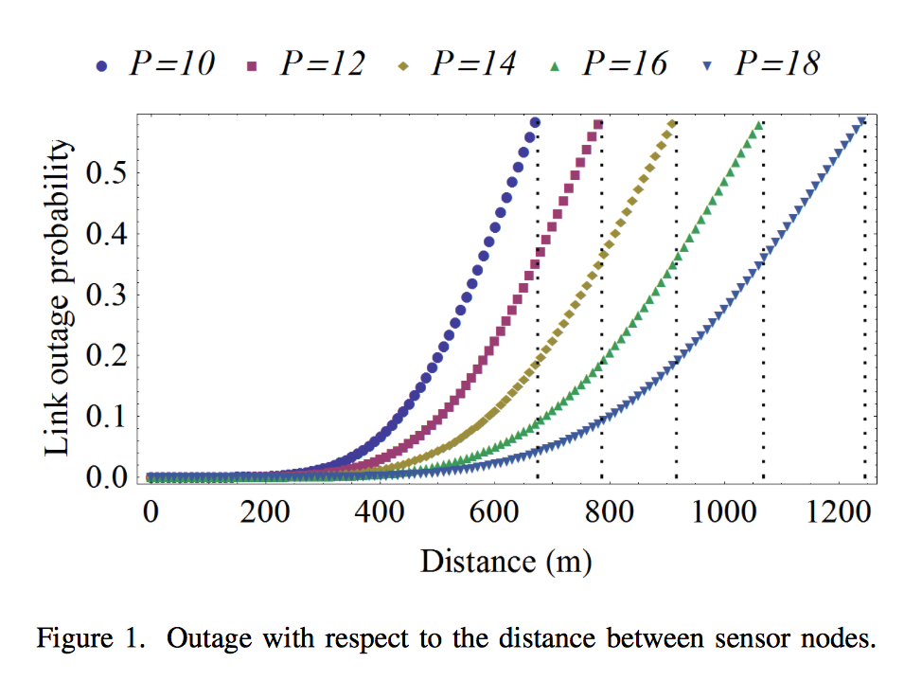
Affect of Transmission Power on Outage Probability
Modeled typical Zigbee radio for a single hop transmission.
Entered parameters for Zigbee radio into Nakagami-m fading outage probability model.

Slide 10
Estimating the Number of Transmissions
Assumes message re-transmission
Assumes channel gain remains constant during packet transmission
Can consequently estimate retransmissions from the outage probability of the WSN.

Slide 11
Node Transmission Distance
Depends on transmission power of the node
Depends on maximum acceptable outage
Is used by the authors to determine interference influence of a node in a WSN and traffic load.

Slide 12
Communication Interference
Total task load on path from transmitter node to receiver node (without interference).
All nodes within the transmission distance of a given node can cause interference.
The total traffic load in the collision domain of an edge.
Traffic load (no interference)
Collision Domain for nodes i and j
Collision Traffic load (Interference)

Slide 13
Node Transmission Capacity
Assume all demands made (i.e., tasks) are uniformly weighted.
The maximum transmission capacity of a node can be calculated as the maximum throughput capacity of the wireless channel divided by the traffic load of the most congested edge.

Slide 14
Node Power Consumption
With retransmission considered, the power for a node is modeled by the equation above.
Without re-transmission

Slide 15
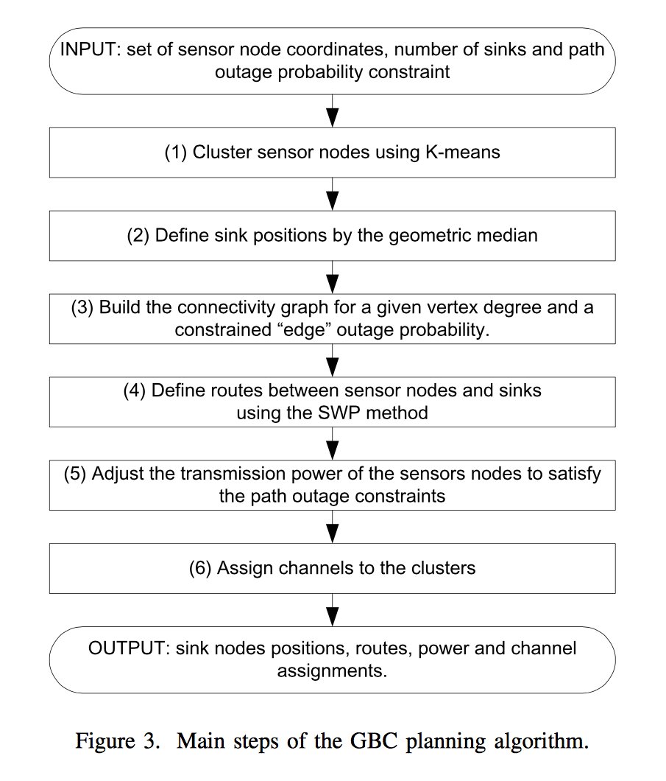
Geometry-Based Clustering (GBC)
Built using Wolfram Mathematica as a modeling tool.
Cannot account for interference effect of clusters operating on the same channel.

Slide 16
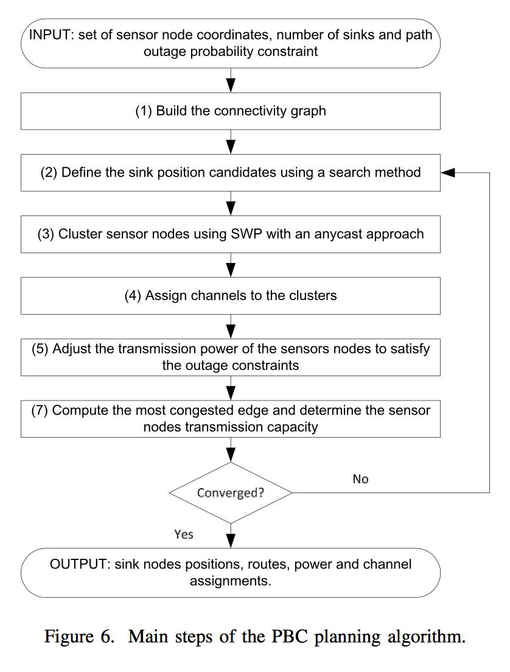
Path-Based Clustering
Focuses on maximizing the network capacity, which accounts for interference.
Less-energy efficient than GBC approach.
Better balancing of traffic in each channel when the number of clusters is higher than the number of channels.

Slide 17
Model Assumptions
Wireless channel in quasi-static fading.
WSN nodes operate in half-duplex mode.
Packet retransmission is being used in the WSN.
100% wireless interference of a given channel if within range of a transmitting node.
Node power consumption is an over-estimate.

Slide 18
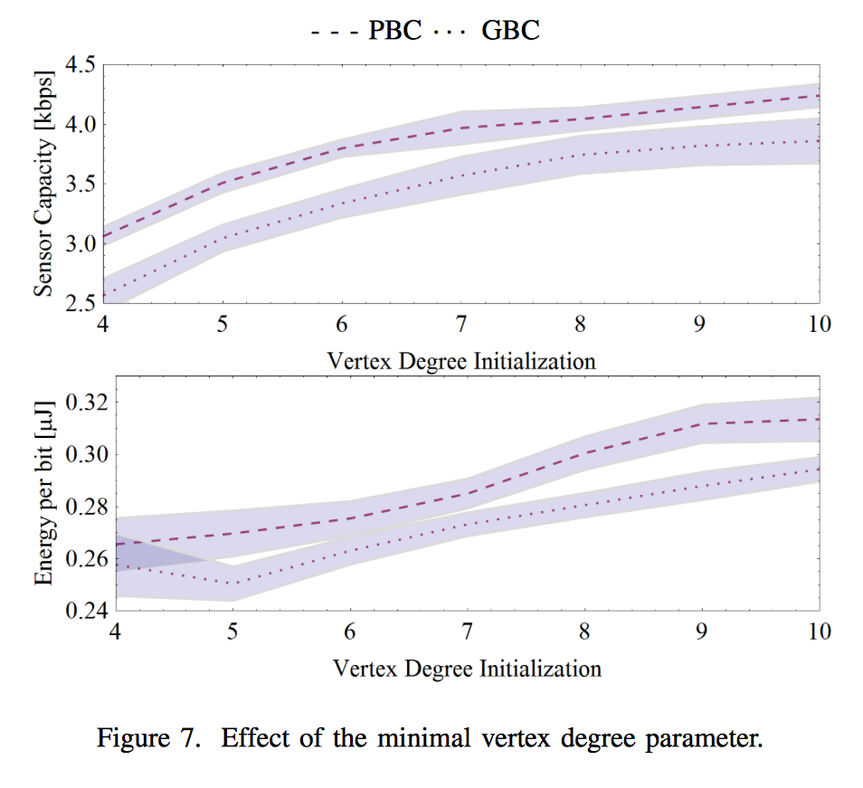
Evaluation

Slide 19
Conclusion
Planning large scale WSNs is a complex problem.
Power levels and channel assignment for nodes needs to be considered.
Sink placement is also important.
Using multiple stages to solve the problem can help.
The GBC approach is more energy efficient.
The PBC approach minimizes interference and maximizes capacity.

Slide 20
Critique
The paper was very thorough when it came to the describing the reasoning behind the selection of the models used.
The paper makes it clear that this is only progress made, but not a full solution.
The paper only models the situation for a real device mathematically and not through testing.

Slide 21
Questions?

Slide 22
Sources
All figures and equations mentioned in these slides were collected from the research paper mentioned in the title slide.

