Slide 1
Lithe: Lightweight Secure CoAP for the Internet of Things S. Raza, H. Shafagh, etc. IEEE Sensors 2013, Volume 13 Speaker: Renato Iida, Le Wang

Slide 2
Outline
Introduction
Background
CoAP and DTLS
6LoWPAN
DTLS Compression
DTLS-6LoWPAN Integration
6LoWPAN-NHC for the Record and Handshake Headers
6LoWPAN-NHC for ClientHello / ServerHello
6LoWPAN-NHC for other Handshake Messages
Implementation
Evaluation
Packet Size Reduction
RAM and ROM Requirement
Run-Time Performance
Conclusion

Slide 3
Outline
Introduction
Background
CoAP and DTLS
6LoWPAN
DTLS Compression
DTLS-6LoWPAN Integration
6LoWPAN-NHC for the Record and Handshake Headers
6LoWPAN-NHC for ClientHello / ServerHello
6LoWPAN-NHC for other Handshake Messages
Implementation
Evaluation
Packet Size Reduction
RAM and ROM Requirement
Run-Time Performance
Conclusion

Slide 4
Introduction
6LoWPAN (IPv6 over Low power Wireless Personal Area Network) enables IPv6 in low-power and lossy wireless networks such as WSNs.
6LoWPAN defines header compression mechanisms.
CoAP (Constrained Application Protocol) is designed for simplicity, low overhead and multicast support in resource-constrained environments.

Slide 5
Introduction
DTLS (Datagram Transport Layer Security) is used by CoAP as the security protocol
For key management and data encryption and integrity protection.
CoAPs is CoAP with DTLS support, similar to HTTPs.
Problem: DTLS is inefficient for constrained IoT devices.
Solution: Apply the 6LoWPAN header compression mechanisms to compress DTLS header.

Slide 6
Introduction: Lithe
Lithe: a lightweight CoAPs by compressing the underneath DTLS protocol with 6LoWPAN header compression mechanisms.
To achieve energy efficiency by reducing the message size;
To avoid 6LoWPAN fragmentation as 6LoWPAN protocol is vulnerable to fragmentation attaches.
Lithe is the proposal solution in this paper.

Slide 7
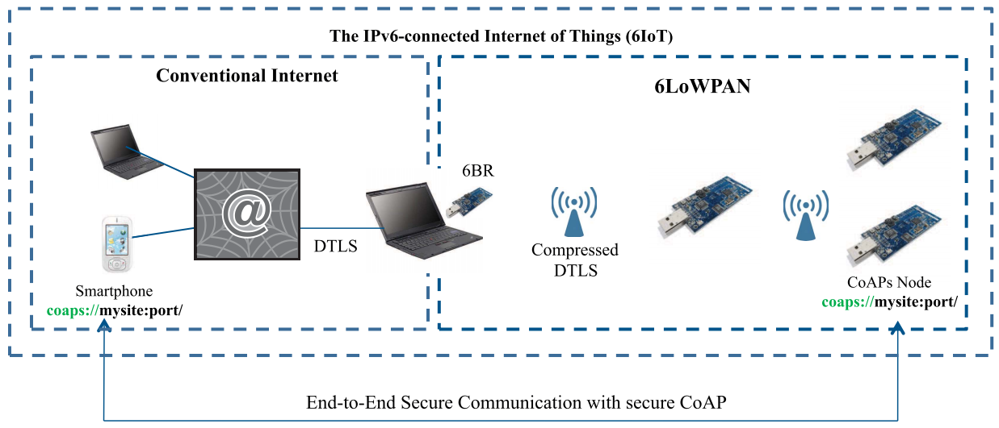
E2E Communication with CoAPs
6BR: 6LoWPAN Border Router is used between 6LoWPAN networks and the Internet to compress/decompress or/and fragment/reassemble messages before forwarding between the two realms.

Slide 8
Outline
Introduction
Background
CoAP and DTLS
6LoWPAN
DTLS Compression
DTLS-6LoWPAN Integration
6LoWPAN-NHC for the Record and Handshake Headers
6LoWPAN-NHC for ClientHello / ServerHello
6LoWPAN-NHC for other Handshake Messages
Implementation
Evaluation
Packet Size Reduction
RAM and ROM Requirement
Run-Time Performance
Conclusion

Slide 9
Background
Goal: To enable secure yet efficient communication among IoT devices that utilize the CoAP protocol.
CoAP and DTLS
6LoWPAN

Slide 10
CoAP
CoAP is a web protocol that runs over the UDP for IoT
A variant of HTTP
Datagram Transport Layer Security (DTLS) is used to protect CoAP transmission.
Similar to HTTPs (TLS-secured HTTP), CoAPs is DTLS-secured CoAP.
Coaps://myIPv6Address:port/MyResource

Slide 11
DTLS
DTLS consists of two sublayers:
Upper layer contains:
Handshake, Alert and ChangeCipherSpec protocols
Or application data.
Lower layer contains the Record protocol
Carrier for the upper layer protocols
Record header contains content type and fragment fields.
DTLS is between Application layer and Transport Layer
Notes:
Handshake process will be introduced in the next slide.
ChangeCipherSpec is used during the handshake process to indicate that the Record protocol should protect the subsequent messages with the newly negotiated cipher suite and security keys.
Alert protocol is used to communicate the error messages between the DTLS peers.
-----------------
The fragment field contains upper layer
The content type indicates which of the four content the upper layer contains.

Slide 12
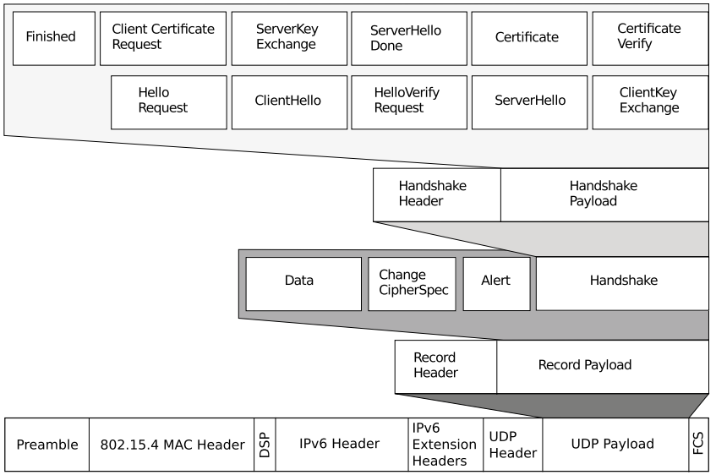
Layout of a packet secured with DTLS

Slide 13
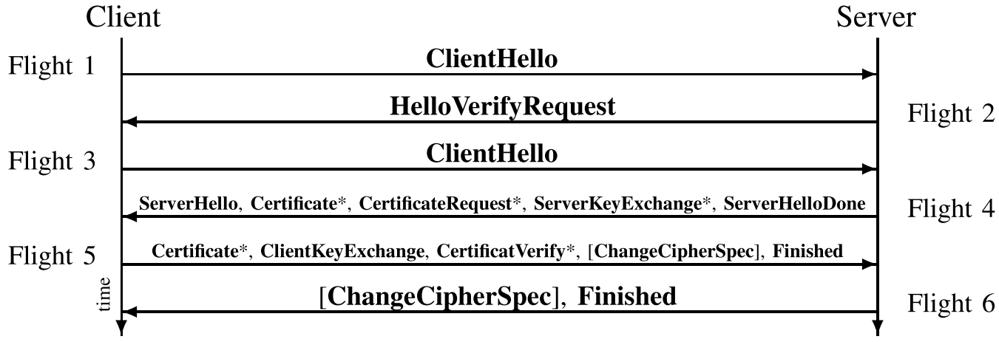
DTLS-Handshake Process
The handshake messages are used to negotiate security keys, cipher suites and compressing methods.
This paper is limited to the header compression process only.
During the handshake process the ClientHello message is sent twice.
Without cookie
With the server’s cookie
DTLS handshake protocol. * means optional.

Slide 14
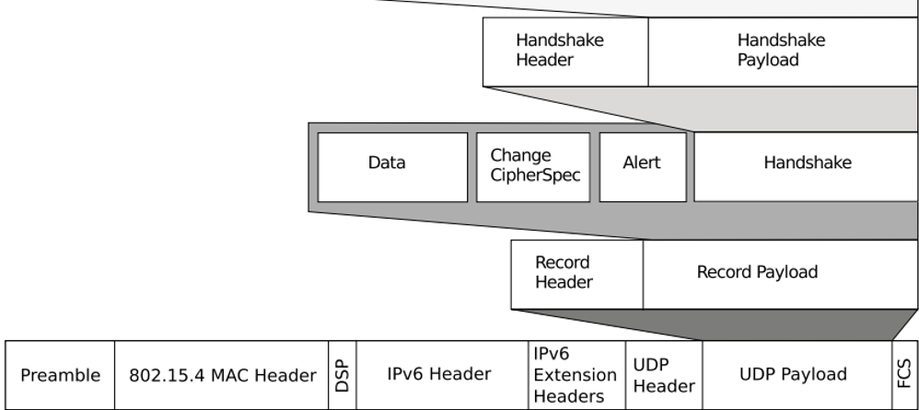
6LoWPAN
Header compression
IP Header Compression (IPHC)
Compress Header to 2 bytes for a single hop network
Or 7 bytes for a multi-hop networks (1-byte IPHC, 1-byte dispatch, 1-byte Hop Limit, 2-byte Source address and 2-byte Destination Address)
Next Header Compression (NHC)
Used to encode the IPv6 extension headers and UDP header.
Lithe extends the NHC range to UDP payload.
DTLS Layer
IPHC
NHC
Lithe
Notes:
Need to compress DTLS, DTLS is in the payload, so that extend compression to UDP payload.

Slide 15
Outline
Introduction
Background
CoAP and DTLS
6LoWPAN
DTLS Compression
DTLS-6LoWPAN Integration
6LoWPAN-NHC for the Record and Handshake Headers
6LoWPAN-NHC for ClientHello / ServerHello
6LoWPAN-NHC for other Handshake Messages
Implementation
Evaluation
Packet Size Reduction
RAM and ROM Requirement
Run-Time Performance
Conclusion

Slide 16
DTLS Compression
DTLS header compression is applied only within 6LoWPAN networks, i.e., between sensor nodes and the 6BR.
DTLS-6LoWPAN Integration
6LoWPAN-NHC for the Record and Handshake Headers
6LoWPAN-NHC for ClientHello / ServerHello
6LoWPAN-NHC for other Handshake Messages

Slide 17
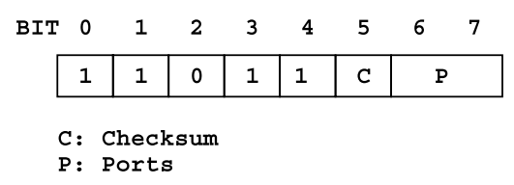
DTLS-6LoWPAN Integration
Apply 6LoWPAN header compression mechanism to compress headers in the UDP payload.
The ID bits in the NHC for UDP defined in 6LoWPAN:
11110 means the UDP payload is not compressed;
11011 means the UDP payload is compressed with 6LoWPAN-NHC.
6LoWPAN-NHC for UDP

Slide 18
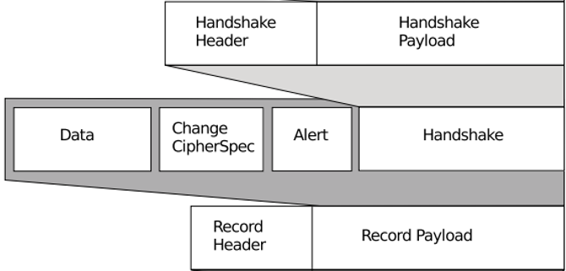
6LoWPAN-NHC for the Record and Handshake Headers
After compression, the Handshake header can decrease from 12 to 5 bytes and the Record header can decrease from 13 to 3 bytes.
6LoWPAN-NHC-RHS
6LoWPAN-NHC for Record + Handshake
For Handshake messages
6LoWPAN-NHC-R
6LoWPAN-NHC for Record
Applied after the DTLS handshake has been performed successfully
For application data.
Notes:
When the Record header fragment field contains a handshake message, compress both the Record header and the Handshake header using a single encoding byte.
When the fragment field in the Record header is application data, compress only the Record header.

Slide 19
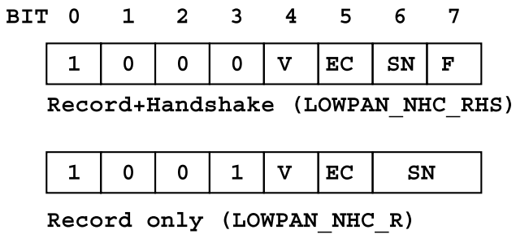
6LoWPAN-NHC-R and RHS
First 4 bits represent the ID field:
1000 – 6LoWPAN-NHC-RHS
1001 – 6LoWPAN-NHC-R
Version (v): DTLS version
0 – omit version field (16 bits)
Epoch (EC):
0, 8 bit epoch is used and the left most 8 bits are omitted.
1, all16 bit epoch is used.
Sequence Number (SN):
0, 16 bit SN, omit 32 bits
1, 48 bit SN
Fragment (F):
0, not fragment.
Omit 2 x ( offset + length ) 6 bytes.
1, fragment applied.

Slide 20
6LoWPAN-NHC-CH
First 4 bits is ID, 1010
When the parameter is set to 0, the corresponding field is omitted.
Session ID (SI): omit 8 bits
Cookie (C): omit 16 bits
Cipher Suites (CS): omit 16bits
Compression Method (CM): Omit 8 bits

Slide 21
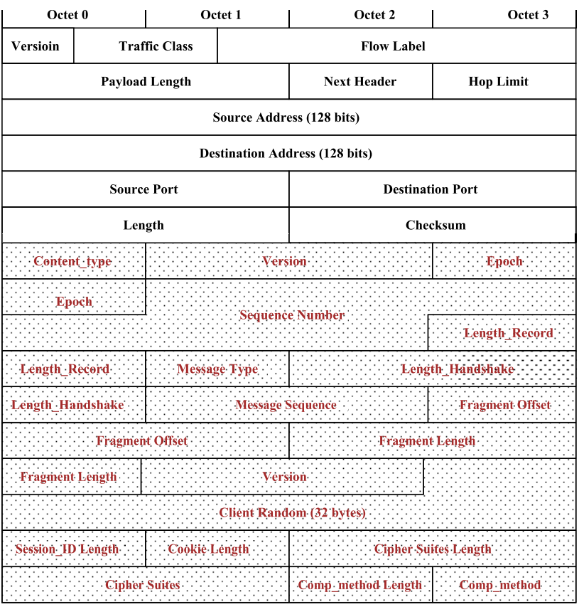
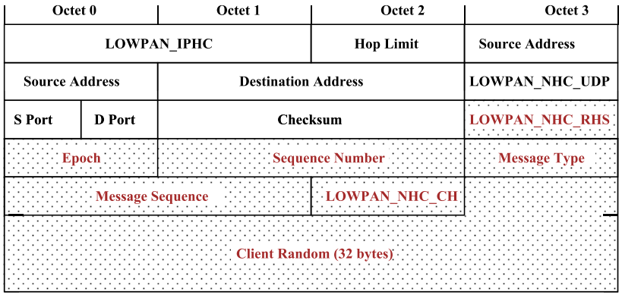
6LoWPAN-NHC for ClientHello

Slide 22
6LoWPAN-NHC-SH
Similar to ClientHello except:
ID field is 1011
V (Server DTLS Version): 0 - DTLS 1.0, omit 16 bits

Slide 23
6LoWPAN-NHC for other Handshake Messages
The remaining mandatory handshake messages:
ServerHelloDone,ClientKeyExchange, Finish have no fields that could be compressed.

Slide 24
Outline
Introduction
Background
CoAP and DTLS
6LoWPAN
DTLS Compression
DTLS-6LoWPAN Integration
6LoWPAN-NHC for the Record and Handshake Headers
6LoWPAN-NHC for ClientHello / ServerHello
6LoWPAN-NHC for other Handshake Messages
Implementation
Evaluation
Packet Size Reduction
RAM and ROM Requirement
Run-Time Performance
Conclusion

Slide 25
Implementation
Extension to the 6LoWPAN in the Contiki OS;
Hardware platform: WiSMote.
Lithe implementation consists of four components:
DTLS: open source tinyDTLS;
CoAP: default CoAP in Contiki;
CoAP-DTLS integration module: Connects the CoAP and DTLS to enable CoAPs.
DTLS header compression.

Slide 26
Implementation
The 6LoWPAN layer resides between the IP and MAC layers.
While applying header compression, the End-to-End security of DTLS is not compromised. .
Notes:
Output packets:
The packets from the IP layer that are ready to be transmitted from the node
The pre-configured default DTLS port is uded to identify CoAPs messages.
Input packets:
The packets from the MAC layer that are received to the node.
The DTLS port and the ID bits in the NHC-for-UDP and in the NHC for DTLS headers are used to distinguish the compressed headers from the uncompressed

Slide 27
Outline
Introduction
Background
CoAP and DTLS
6LoWPAN
DTLS Compression
DTLS-6LoWPAN Integration
6LoWPAN-NHC for the Record and Handshake Headers
6LoWPAN-NHC for ClientHello / ServerHello
6LoWPAN-NHC for other Handshake Messages
Implementation
Evaluation
Packet Size Reduction
RAM and ROM Requirement
Run-Time Performance
Conclusion

Slide 28
Evaluation
Packet Size Reduction
RAM and ROM Requirement
Run-Time Performance
DTLS Compression Overhead
CoAPs Initialization
CoAPs Request-Response

Slide 29
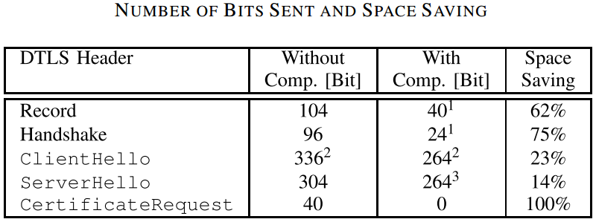
Evaluation - Packet Size Reduction
Notes:
The proposed DTLS header compression significantly reduces the number of header bits, which results in a similar reduction of radio transmission time.
Radio communication typically has an about 10 times higher energy consumption than in-node computations.
The tradeoff with compression is between
additional in-node computation overhead for compression/decompression
reducing radio transmissions.

Slide 30
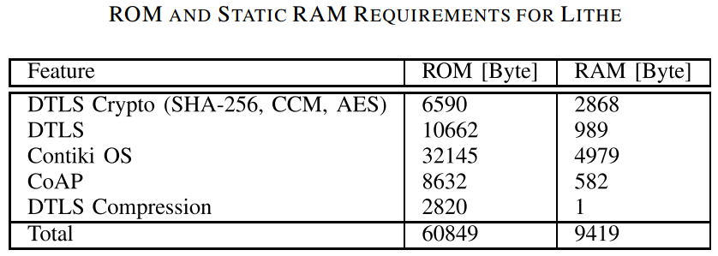
Evaluation – RAM/ROM Requirement
Notes:
Analyzed with msp430-size and msp430-objdump in the MSP430 toolchain.
DTLS including the cryptography and DTLS state-machine requires 16.8 kB of ROM and 3.7 kB of RAM.
DTLS Compression requires 2820B of ROM and 1B of RAM.
1B RAM holds the compression state of the UDP header.
Today’s sensor nodes, such as WiSMote, with 128kB of ROM can surely accommodate compressed CoAPs along with other operating system components.

Slide 31
Evaluation - Run-Time Performance
Radio Duty Cycling (RDC)
With RDC, the radio is off most of the time and is turned on either in certain intervals to check the medium for incoming packets or to transmit packets.
Duty cycled MAC protocol, X-MAC
Metrics:
Energy consumption
Energy estimation module in Contiki OS
Conversion from absolute timer values to energy:
Network-wide round trip time (RTT)

Slide 32
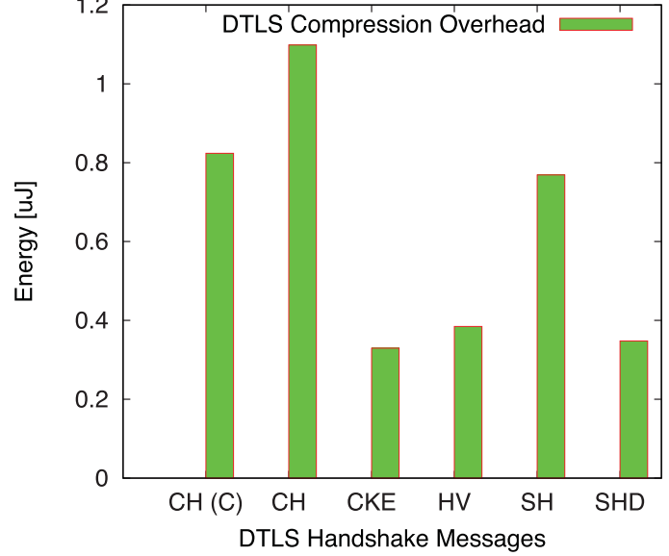
Evaluation - Run-Time Performance
DTLS Compression Overhead
The overhead caused through in-node computation for compression and decompression of DTLS headers is almost negligible.
For a DTLS handshake based on pre-shared keys, 4.2uJ of energy is consumed for compression
CH – ClientHello
CH(C) – ClientHello with Cookie
CKE – ClientKeyExchange
HV – HelloVerify
SH – ServerHello
SHD - ServerHelloDone
Additional Energy Consumption for Compression of the Handshake Messages.

Slide 33
Evaluation - Run-Time Performance
CoAPs Initialization
The tradeoff between additional in-node computation vs. reduced packet sizes shows itself in the energy consumption for packet transmission in a DTLS handshake.
15% less energy is used transmit/receive compressed packets.
Notes:
During the CoAPs initialization process, a secure session is established between the two communicating end-points using the DTLS handshake protocol.
The handshake process uses both Record and Handshake headers, which can be compressed.

Slide 34
Evaluation - Run-Time Performance
CoAPs Request-Response
Once the CoAPs initialization phase is completed, i.e., the handshake has been performed, a sensor node can send/receive secure CoAP messages using the DTLS Record protocol.
Metrics
Energy consumption
RTT

Slide 35
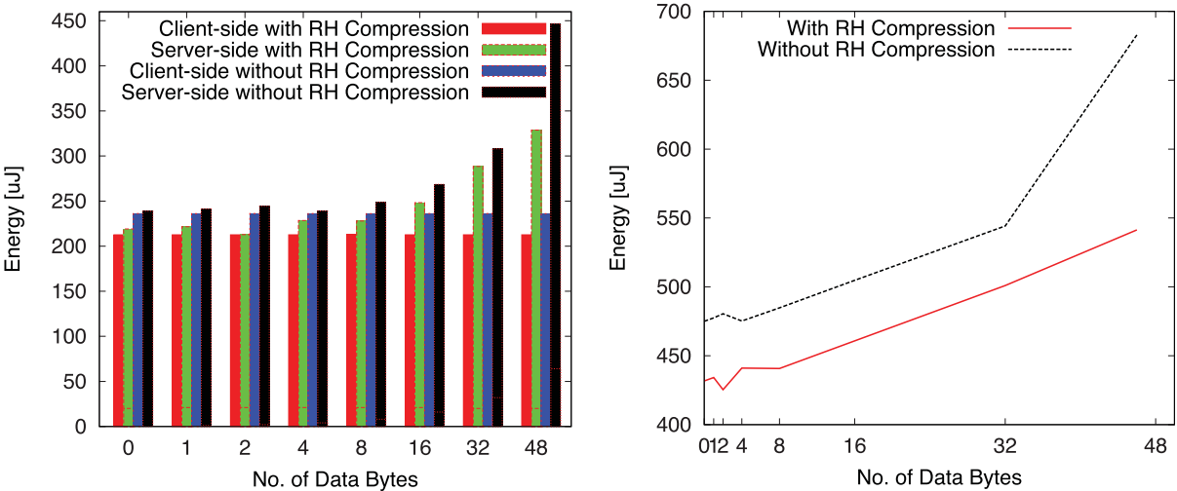
Evaluation – Energy Consumption
The Energy Consumption from Client/Server w/out RH Compression
The Energy Consumption from the sum of Client/Server w/out RH Compression

Slide 36
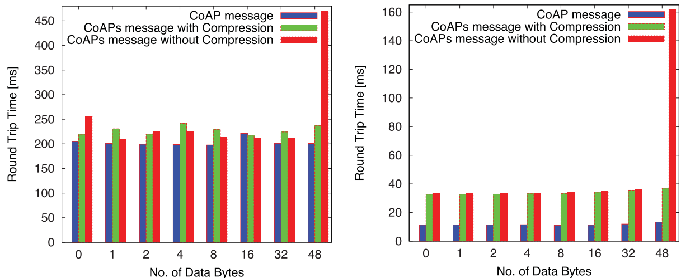
Evaluation – Round Time Trip (RTT)
Pure CoAP
Comparison of RTT for Lithe, CoAPs and CoAP

Slide 37
Outline
Introduction
Background
CoAP and DTLS
6LoWPAN
DTLS Compression
DTLS-6LoWPAN Integration
6LoWPAN-NHC for the Record and Handshake Headers
6LoWPAN-NHC for ClientHello / ServerHello
6LoWPAN-NHC for other Handshake Messages
Implementation
Evaluation
Packet Size Reduction
RAM and ROM Requirement
Run-Time Performance
Conclusion

Slide 38
Contribution
The first paper to propose 6LoWPAN compressed DTLS and enable lightweight CoAPs support for the IoT.
Provide novel and standard compliant DTLS compression mechanisms that aim to increase the applicability of DTLS and, thus, CoAPs for constrained devices.
Implement the compressed DTLS in an OS for the IoT and evaluate it on real headware;
Lithe is more efficient compared to uncompressed CoAP/DTLS.

