Slide 1
The Vision for the Internet of Things
CS525T Fall 2015

Slide 2
Internet of Things (IoT)

Slide 3
Cisco Commercial

Slide 4
A Few IoT Facts
The phrase ‘Internet of Things’ was first used in 1999.
First Article about IoT in 2004 from MIT researchers called I0 (Internet 0).
Why it is important to our future?
Optimistic prediction: 7 trillion wireless devices for
7 billion people by 2020
Does it exist now?
Some say – Yes !!

Slide 5
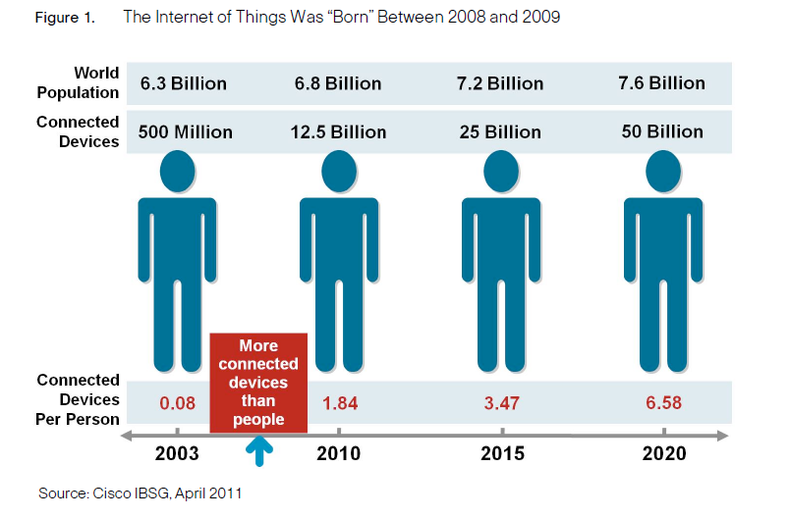
Birth of IoT?

Slide 6
A Few More IoT Facts
“In the second quarter of 2010 AT&T and Verizon announced that non-human objects - interconnected devices - came online in greater numbers than human subscribers. The Internet of Things is here, penetrating society quietly and efficiently" (Oxford, 2011).
“Engineers who have been preparing this technology have estimated that over 20% of the non-video traffic of the Net will come from Internet of Thing sensors in just a few years.” (Vasseur & Dunkel, 2010).

Slide 7
One Vision of the Internet of Things
The IoT includes many objects (preferably smart objects) connected and communicating effectively with people on the Internet to help solve the problems of the world.
“IoT can make a significant difference in closing the poverty gap.”

Slide 8
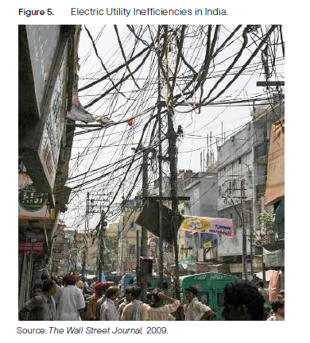
Fight Poverty?
Try to reduce the difference in price of water between Dharavi and Warden Road in Mumbai.
Price disparities are due to the high cost of delivering utilities.
Example:
in India

Slide 9
Thought Provoking Quotes
From IEEE Computer Magazine:
“To reach ambient intelligence, these things must understand the user’s context.” Roggin et al.
“After the World Wide Web and universal mobile accessibility, the IoT represents the most potentially disruptive technology revolution of our lifetime.” Feki et al.
“The IoT is an inherently democratic phenomenon, with many smarts, loosely coupled, each contributing as they can to a greater whole.” Kortuem et al. (from the Open University)
Senior Analyst at Forester Research:
“We should push sensor-laden devices – and not use of them – to enhance, not outsource, our cognitive experience.” Epps

Slide 10
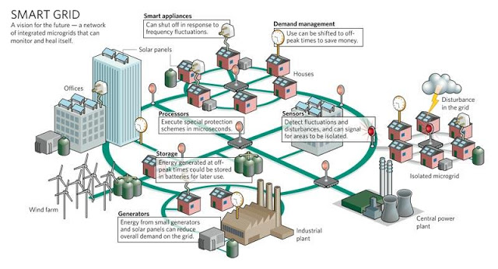
Smart Grid
LoCal Project

Slide 11
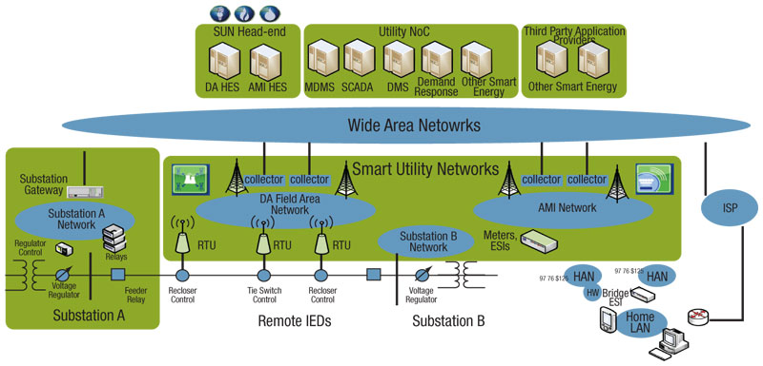
Smart Utility Networks (SUNs)
AMI and DA FAN Networks are evolving to become IPv6-enabled SUNs, which are an integral part of the IPV6 Smart Grid.

Slide 12
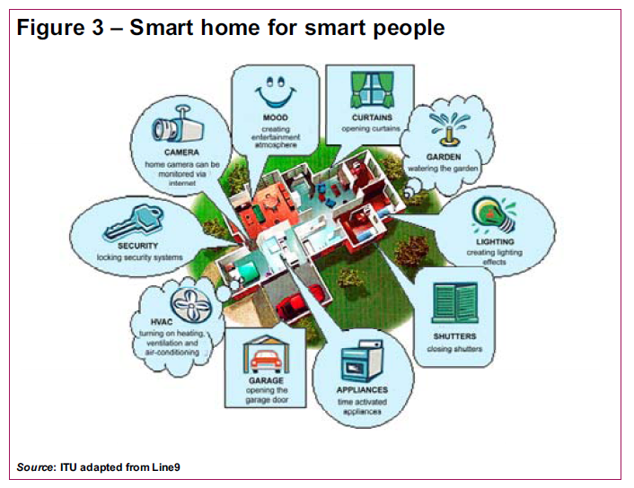
Smart Homes

Slide 13
A Smart Light (Philips’ Hue)
Tunable light, 16 million colors
Activated by smart phone or over Zigbee wireless
Can serve as alarm clock
Can synch colors to movies or possibly music
Philips never anticipated the demand - sold out in 3 months at Apple stores!

Slide 14
Wifi Connected Goal Light
“Budweiser Embraces the Internet of Things With
In-Home Automatic Hockey Goal Light” – wired.com

Slide 15
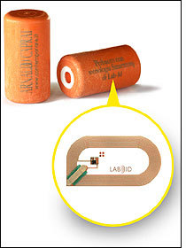
Smart Corks
The RFID read-write tags embedded into the corks use Philips' ISO 15693 I-Code SLI 13.56 MHz chip with 1,024 bits of memory.

Slide 16
More Smarts
Smart bathroom cabinet for medicine
Smart refrigerator
Smart traffic
Smart history (in museums)
Smart health (RFID in running shoes)
Smart buying (Near Field Communication)
Use smart phone to make payments

Slide 17
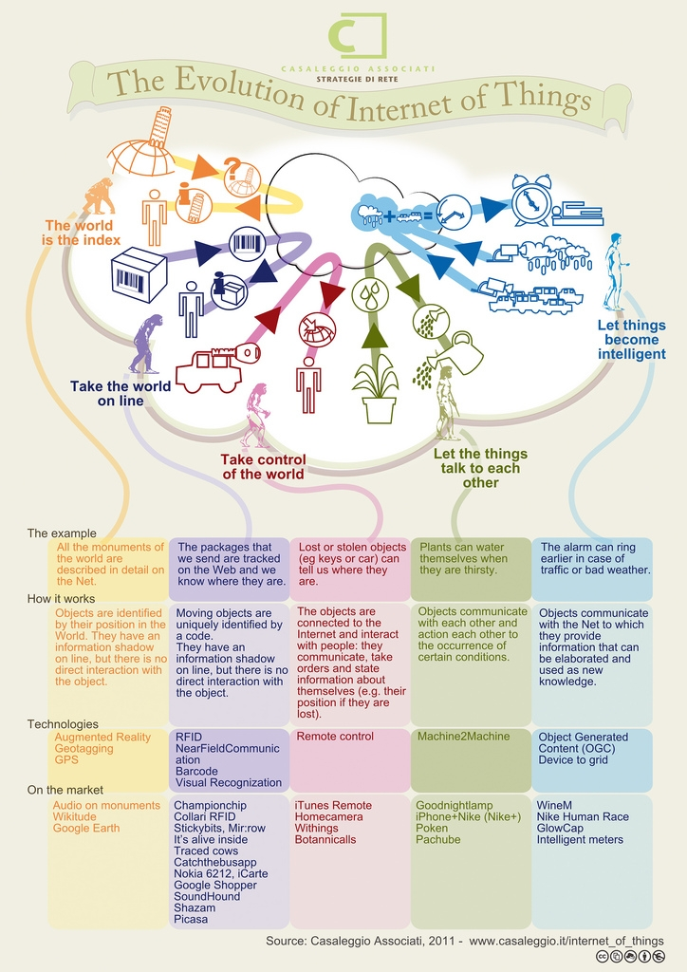

Slide 18
Enabling Technologies
Technologies needed:
RFID
Power for Sensors*
Mobile and Smart phones
Nanoscience and Miniaturization
Smart Objects (intelligence) and Robotics
M2M (Machine-to- Machine) communication
Standardization* of communication, protocols, security
IPv6*, 6LoWPAN, Zigbee
Others
Big Data
The Cloud

Slide 19
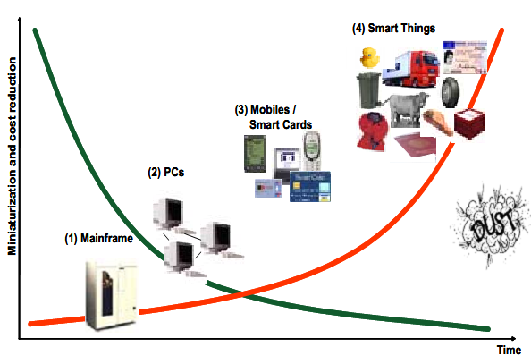
Miniaturization

Slide 20
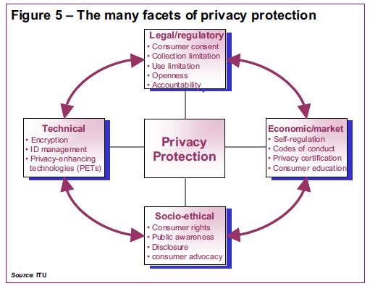
IoT Issues
Privacy, security and trust concerns
Social network blunders
Big Brother – security cameras, police state

Slide 21
Coke Commercial

Slide 22
Reaction to Coke Commercial
One Perspective
“Coke commercial about security cameras was so cool. Let's look at the world a little differently. Going to drink a coke in honor.”
Another Perspective
“Ad full of hidden security-cam moments: Coke proudly proclaims itself Official Soft Drink Of The Security State.”

Slide 23
Multi-dimensional Change

Slide 24
IoT Players
Involves industry – governments-academia cooperation
EU countries – Great Britain
Scandinavia Countries in the lead
Finland by 2017
Norway, Sweden*
Contiki protocol platform, Cooja simulator
Claim China* and India heavily committed to IoT.
* The Walmart connection {RFID}

Slide 25
Corporate IoT Players
Cisco
IBM
Philips
Walmart
Nokia (Finland)
Google - announces Brillo as IoT OS!
“Europe’s biggest chip maker, STMicroelectronics, and the world’s third-largest chip maker, Texas Instruments, are to use the tiny Mist operating system developed by Sweden’s Thingsquare for use by devices on the “Internet of things”. It should make it easier to connect anything from streetlights to thermostats.”
- March 13,2013 Wall Street Journal ‘Tech Europe’

Slide 26
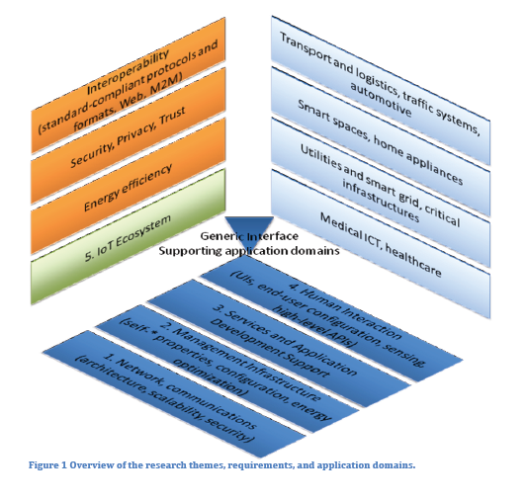
Research Themes

Slide 27
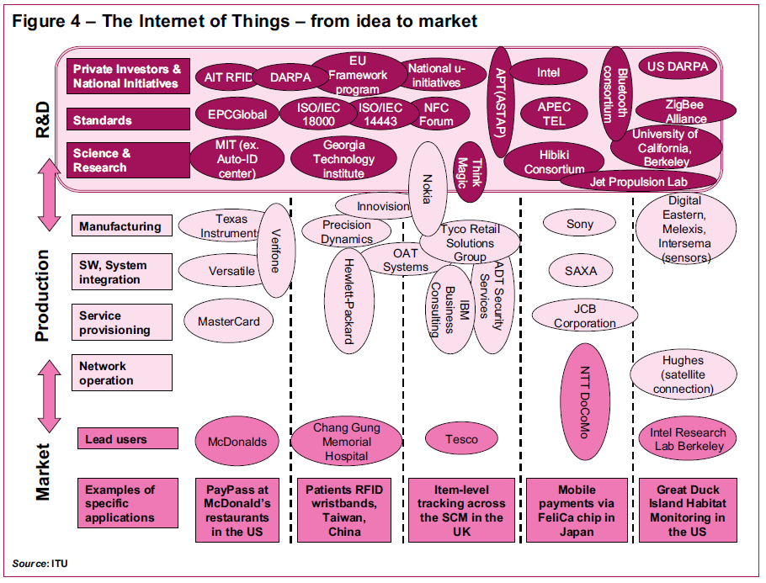

Slide 28
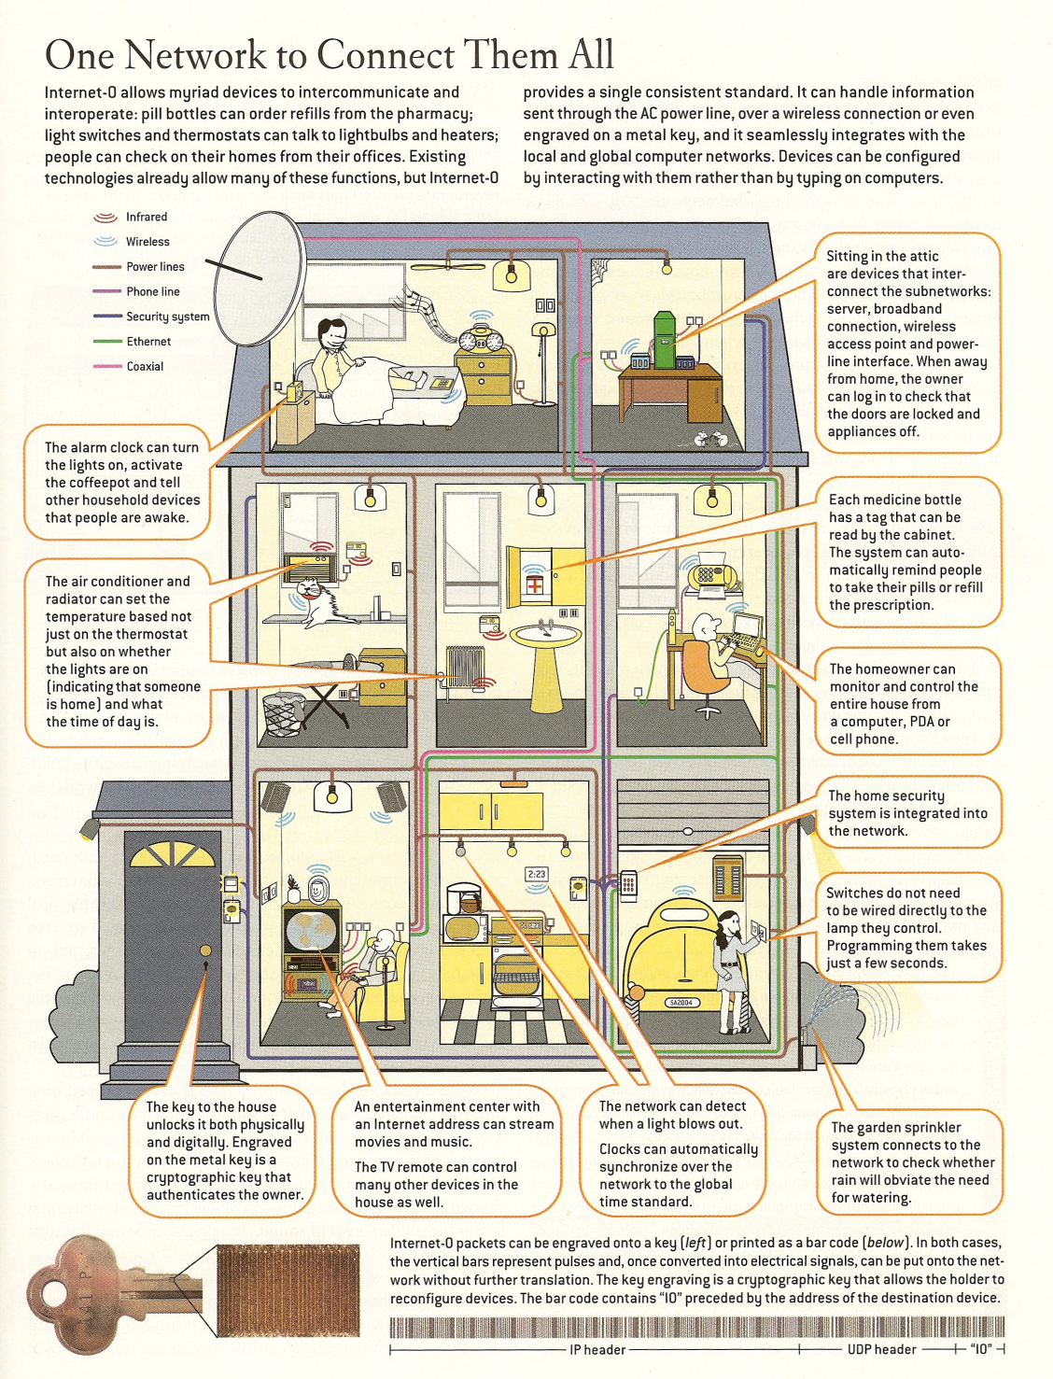

Slide 29
Summary
There is more than one vision for the Internet of Things.
Much “buzz” now but when will it be a reality.
Interoperability is essential and requires standards agreements.
Many opportunities and challenges
As a new area, IoT research is not well-established.

