Slide 1
Internet of Things – Fall 2015 Case Study on Intrusion of Sensor Networks
Aniket Shah & Alexander Witt

Slide 2
Introduction
Vehicular Ad-Hoc Networks (VANETs) are one of the technological emerging areas in the world of Internet of Things (IoT)
It is a subset of Mobile Ad-Hoc Networks (MANETs), which deals with Vehicle to Vehicle (V2V) communication and forms a part of the Intelligent Transport System
One of the focus areas within VANET research deals with security of the nodes (vehicles) and the communication
Here, we discuss the compromising of VANET nodes, the actions and mannerisms to do so and the possible solutions to counter the same

Slide 3
Introduction
Automobiles today, contain a number of different electronic components networked together that are responsible for monitoring and controlling the state of the vehicle
Modern automobiles contain upto 50 Electronic Control Units (ECUs) networked together with the overall safety of the vehicle depending on near real time communication between these various ECUs
When electronic networked components are added to any device, questions of the robustness and reliability of the code running on those devices can be raised; especially for vehicular networks

Slide 4
Introduction
In this study, we talk about bringing accessibility to automotive systems to security researchers in an open and transparent way
The fact that a risk of attack exists but there is not a way for researchers to monitor or interact with the system is distressing
Provide a framework that will allow the construction of such tools for automotive systems
Allow researchers to demonstrate the threat to automotive systems in a concrete way as well as write monitoring and control applications to help alleviate this threat

Slide 5
Electronic Control Units (ECUs)
ECUs are special embedded devices with specific purposes to sense the environment around them and take action to help the automobile
ECUs communicate with one another by sending Controller Area Network (CAN) packets
Packets are broadcast to all components on the bus; components decide whether packets intended for them
There is no source identifier or authentication built into CAN packets, making it is easy for components to sniff the CAN network, masquerade as other ECUs and send CAN packets

Slide 6
Electronic Control Units (ECUs)
Makes reverse engineering traffic more difficult
Reason: It is impossible to know which ECU is sending or receiving a particular packet
By examining the CAN in which the ECUs communicate, it is possible to send proprietary messages to the ECUs, take some action or even completely reprogram the ECUs
All relevant ECUs are on CAN-H and CAN-L buses

Slide 7
Types of ECUs
Engine Control Module (ECM)
Power Management Control Module
Transmission Control ECU
Main Body ECU
Power Steering ECU
Certification ECU (i.e. Smart Key ECU)
Skid Control ECU (i.e ABS System)
Airbag ECU
Combination Meter Assembly
Driving Support ECU
Parking Assist ECU
Seat belt Control ECU

Slide 8
Controller Area Network (CAN)
CAN bus is used for communication between the different ECUs
CAN packets are split into two sections:
Normal CAN packets
Diagnostic CAN packets
There are components such as a length field and checksums at a lower level in the protocol stack
The identifier is used as a priority field, the lower the value, the higher the priority
Helps ECUs determine whether they should process CAN packet or not; necessary since CAN traffic is broadcast in nature

Slide 9
Normal CAN
Normal packets are sent from ECUs and can be seen on the network at any given time
Either broadcast message or specific ECU commands
CAN packets do have a CAN ID associated with them but for normal CAN packets, each ECU independently determines whether they are interested in a message based on the ID
One complication arises when trying to simulate the traffic on CAN is that the CAN network is broadcast in nature, one cannot tell the source or intended destination of any of the messages

Slide 10
Diagnostic CAN
The other type of CAN packets seen in automotive systems are diagnostic packets
These packets are sent by diagnostic tools ,used to communicate with and interrogate an ECU; typically not be seen during normal operation of the vehicle
In the case of diagnostic packets, each ECU has a particular ID assigned to it, unlike normal packets, and are totally proprietary
Diagnostic packet formats typically follow pretty strict standards but unsure whether ECUs will actually respect them

Slide 11
CAN Communication
EcomCat - C software to read/write data into CAN bus
Mostly single commands sent but there is the option of continuous data transfer
With the scene of compromising VANET nodes, we look at injecting CAN packets into the bus to disrupt regular (expected) communication
Many problems associated in trying to make the vehicle perform actions by injecting packets into the CAN bus

Slide 12
Problems in CAN Communication
Everything cannot be controlled via the CAN bus directly
Takes a lot of reverse engineering to locate specific packets that are requests from one ECU for another ECU
Even once CAN IDs are identified, there are two problems that may occur:
You can send fake packets, which may confuse the recipient ECU with conflicting data.
The receiving ECU may have safety features built into it that makes it ignore the packets you are sending.

Slide 13
Problems in CAN Communication
There can be a lack of response or complete disregard for packets sent if there is contention on the bus
The ECU, for which packets are forged, continues sending traffic on the bus, unless it is completely removed from the network
As a result, ECUs consuming the data being sent may receive conflicting data

Slide 14
Attacks on ECUs
Safety critical attacks against modern automobiles generally require three stages:-
Stage 1: Consists of an attacker remotely gaining access to an internal automotive network
Stage 2: Involves injecting messages onto the network in an attempt to communicate with safety critical ECUs
Stage 3: Involves reverse engineering the messages on the network to perform some physical action; make the target ECU behave in a way that compromises vehicle safety

Slide 15
Different Remote Attack Surfaces
Passive Anti‐Theft System (PATS)
Tire Pressure Monitoring System (TPMS)
Remote Keyless Entry / Start (RKE)
Bluetooth
Radio Data System
Telematics / Cellular / Wi‐Fi
Internet / Apps

Slide 16
Attacks via CAN packets
Once the attacker has completed stage 2 and injected messages into the network, he can overwrite commands using code and corrupt data sent to the ECUs via the CAN bus
The attacks via the CAN bus can be done using either Normal packets or the Diagnostic packets
Attacks via the Normal CAN packets affect mainly the smaller or the less important ECUs while the attacks via the Diagnostic CAN packets have serious effects on vehicular safety

Slide 17
Attacks - Normal CAN packets
Speedometer
Odometer
On-board Navigation
Limited Steering
Steering
Braking
Acceleration

Slide 18
Attacks - Diagnostic CAN packets
Security Access
Brake engaging
Lights
Engine Kill
Horn
Door Lock
Fuel Gauge

Slide 19
Defending against Attacks
CAN messages provide a way to put the ECUs in various states
All of the messages can be issued on a periodic basis while the car is in any state
Additionally, the frequency of normal CAN packets is very predictable
Different ways to counter remote attacks:
Secure Remote Endpoints
CAN Injection Mitigations
Message Cryptography
Network Architecture
Attack Detection

Slide 20
Defending against Attacks
Secure Remote Endpoints - Minimize the attack surface and lock down remote services; complete security is not achievable
CAN Injection Mitigations - Use of good OS to block mitigations
Message Cryptography - Cryptographically verify CAN messages to make injection difficult
Network Architecture -Isolate those ECUs with remote functionality from those that control safety critical features
Attack Detection - Add attack detection and prevention technology into critical CAN networks

Slide 21
Case Study
Target Vehicle: Jeep Cherokee 2014
Aim: Expose vulnerabilities within the security of the vehicle and provide way for more secure connected cars
Reasons for choosing vehicle:
large attack surface
simple architecture
many advanced physical features that would make it an ideal candidate to try to continue further research

Slide 22
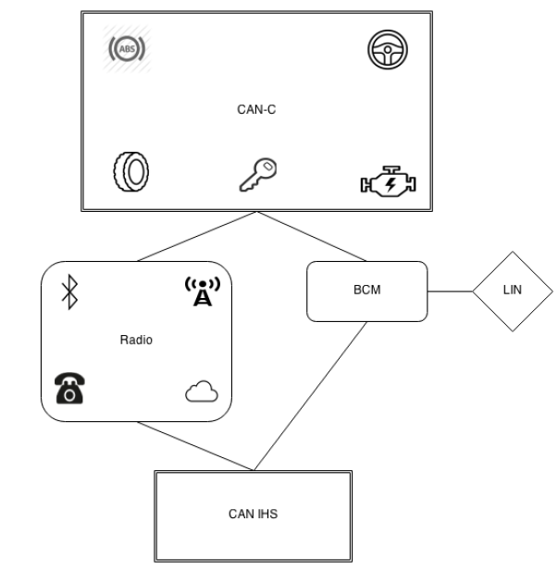
Network Architecture
Radio connected to both CAN buses
Access to CAN-IHS & CAN-C networks
Minimal architectural restrictions

Slide 23
Remote Attack Surfaces
Potential entry points and their communication channels

Slide 24
Uconnect System
Radio system manufactured by Harman Kardon as the sole source of infotainment, navigation, Wi-Fi, apps, Cellular connectivity
Contains a microcontroller and software that allows it to communicate with other electronic modules in the vehicle over the CAN-IHS
Runs the QNX operating system on a 32-bit ARM processor
Contains the following file systems:
Initial Program Loader (IPL)
IFS
Embedded Transaction File System (ETFS)
Multimedia Card (MMC)

Slide 25
Compromising the Jeep
Charlie Miller and Chris Valasek; authors of the papers on the hack on the Jeep, provide various methods to do so
Jailbreak of the Uconnect System
Exploiting the D-Bus service
Cellular Exploitation
Scanning more vulnerable vehicles using the Jeep cellular access

Slide 26
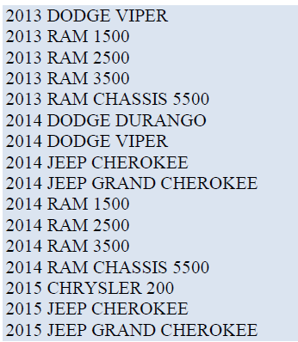
List of Vehicles Scanned
List of Vehicles that the authors could connect with without authentication
Scanned using the cellular access of Jeep’s Sprint Uconnect system

Slide 27
Attack using CAN messages on Jeep
Normal CAN packets
Accessed Turn signals using SPI communication
Accessed Locks using CAN-IHS bus
Accessed RPMS using CAN-C bus
Diagnostic CAN packets
Killed engine in session with Mechanical tool
Killed brakes in session with ABS ECU
Killed Steering in session with PAM and ABS ECUs

Slide 28
Case Study Conclusion
Demonstrated a remote attack that can be performed against many Fiat-Chrysler vehicles
Number of vehicles that were vulnerable were in the hundreds of thousands and it forced a 1.4 million vehicle recall by FCA as well as changes to the Sprint carrier network
Remote attack could be performed against vehicles located anywhere in the United States and requires no modifications to the vehicle or physical interaction by the attacker or driver

Slide 29
Conclusion
Without security, if an attacker (or even a corrupted ECU) can send CAN packets, it will affect the safety of the vehicle
Listed out methods for communication within a single node of VANET and problems associated with it
Identified the features that the car possesses which may help in taking physical control of the vehicle
Discussed Case study regarding the Jeep Cherokee to demonstrate the impact of lack of security in VANET nodes

