Slide 1
Network Layer
Computer Networks

Slide 2
Network Layer Topics
4.1 Introduction
4.2 Virtual circuit and datagram networks
4.3 What is inside a router?
4.4 IP: Internet Protocol
  Datagram Format
  IPv4 addressing
  Subnets
  CIDR
  ARP & DHCP
  NAT
4.5 Routing algorithms
  Algorithm Classification
  Link State
  Distance Vector
  Hierarchical Routing
4.6 Routing in the Internet
  RIP
  OSPF
  BGP
4.7 ICMP
K & R

Slide 3
Network Layer Introduction
Concerned with getting packets from source to destination.
The network layer must know the topology of the subnet and choose appropriate paths through it.
When source and destination hosts are in different networks, the network layer (IP) must deal with these differences.
Key issue: What service does the network layer provide to the transport layer?
connection-oriented or connectionless

Slide 4
Network Layer Design Goals
1. The services provided by the network layer should be independent of the subnet topology.
2. The transport layer should be shielded from the number, type and topology of the subnets present.
3. The network addresses available to the transport layer should use a uniform numbering plan (even across LANs, WANs and WLANs).

Slide 5
Network Layer
Messages
Messages
Transport
layer
Segments
Transport
layer
Network
service
Network
service
Network
layer
Network
layer
Network
layer
Network
layer
End system
α
Data link
layer
Data link
layer
Data link
layer
Data link
layer
End system
β
Physical
layer
Physical
layer
Physical
layer
Physical
layer
Leon-Garcia & Widjaja:
Communication Networks

Slide 6
Network Layer
Machine A
Machine B
Application
Application
Transport
Router/Gateway
Transport
Internet
Internet
Internet
Network Interface
Network Interface
Network Interface
Network 1
Network 2
Leon-Garcia & Widjaja:
Communication Networks

Slide 7
Metropolitan Area Network (MAN)
Gateway
Organization Servers
To the Internet or wide area network
s
s
Backbone
R
R
R
S
Departmental Server
S
S
R
R
R
s
s
s
s
s
s
s
s
s
Leon-Garcia & Widjaja:
Communication Networks

Slide 8
Wide Area Network (WAN)
Interdomain level
Border routers
Internet Service Provider (ISP)
Autonomous system
or domain
Border routers
LAN level
Intradomain level
Leon-Garcia & Widjaja:
Communication Networks

Slide 9
Modern Internet Backbone
National service provider A
National service provider B
NAP
NAP
National service provider C
Network Access
Point
National Internet Service Providers
Leon-Garcia & Widjaja:
Communication Networks

Slide 10
Network Access Point
NAP
R_{A}
Route server
R_{B}
LAN
R_{C}
often called
the default router
Leon-Garcia & Widjaja:
Communication Networks

Slide 11
Network Layer Topics
4.1 Introduction
4.2 Virtual circuit and datagram networks
4.3 What is inside a router?
4.4 IP: Internet Protocol
  Datagram Format
  IPv4 addressing
  Subnets
  CIDR
  ARP & DHCP
  NAT
4.5 Routing algorithms
  Algorithm Classification
  Link State
  Distance Vector
  Hierarchical Routing
4.6 Routing in the Internet
  RIP
  OSPF
  BGP
4.7 Broadcast and multicast routing
K & R

Slide 12
Datagram Packet Switching
Packet 1
Packet 1
Packet 2
Packet 2
Packet 2
Leon-Garcia & Widjaja:
Communication Networks

Slide 13
Datagram Routing Table
Destination
address
Output
port
0785
7
1345
12
IP addresses
1566
6
2458
12
Leon-Garcia & Widjaja:
Communication Networks

Slide 14
Virtual Circuit Packet Switching
Packet
Packet
Leon-Garcia & Widjaja:
Communication Networks

Slide 15
Virtual Circuit Routing Table
Identifier
Output
port
Next
identifier
12
13
44
Entry for packets
with identifier 15
15
9
23
Packet leaves with
new identifier 23
27
13
16
58
7
34
Leon-Garcia & Widjaja:
Communication Networks

Slide 16

Network Layer
transports segment from sending to receiving host.
encapsulates segments on sending side into datagram packets.
delivers segments on receiving side to the transport layer.
network layer protocols exist in every host, router.
router examines header fields in all IP datagrams passing through it.
application
transport
network
data link
physical
network
data link
physical
network
data link
physical
network
data link
physical
network
data link
physical
network
data link
physical
network
data link
physical
network
data link
physical
network
data link
physical
network
data link
physical
application
transport
network
data link
physical
network
data link
physical
network
data link
physical
K & R

Slide 17
Network Layer Topics
4.1 Introduction
4.2 Virtual circuit and datagram networks
4.3 What is inside a router?
4.4 IP: Internet Protocol
  Datagram Format
  IPv4 addressing
  Subnets
  CIDR
  ARP & DHCP
  NAT
4.5 Routing algorithms
  Algorithm Classification
  Link State
  Distance Vector
  Hierarchical Routing
4.6 Routing in the Internet
  RIP
  OSPF
  BGP
4.7 ICMP
K & R

Slide 18
Two Key Network Layer Functions
forwarding: move packets from router’s input to appropriate router output.
routing: determine route taken by packets from source to destination.
analogy:
forwarding: process of getting through single interchange
routing: process of planning trip from source to destination
K & R

Slide 19
Interplay between Routing and Forwarding
routing algorithm
Routing creates the tables.
Forwarding uses the tables.
local forwarding table
header value
output link
0100
0101
0111
1001
3
2
2
1
value in arriving
packet’s header
0111
1
3
2
K & R

Slide 20
Router Node Forwarding
node 15
Routing table
lookup
134 17
packet
packet
17
Incoming Link
Outgoing Link
Server
Router Link Buffer

Slide 21
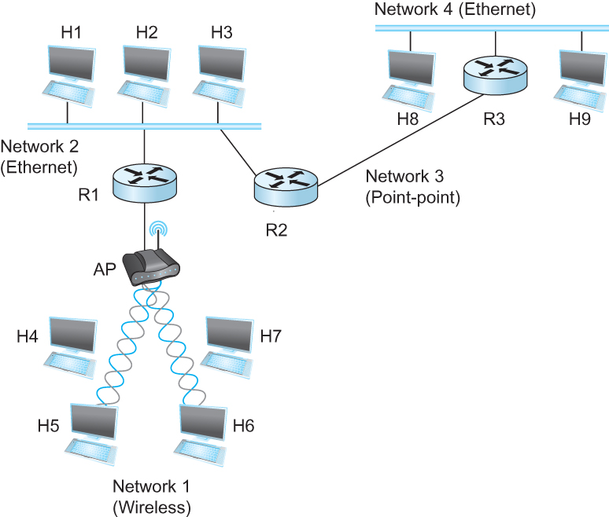
Routing in an internet
  Figure 3.14 A Simple internetwork with Three Routers

Slide 22
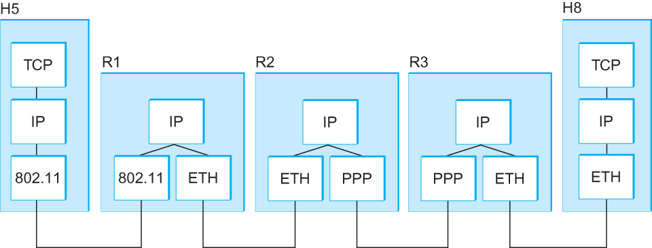
Protocol Layers along the Route
IP runs on all the nodes in a collection of networks and defines the infrastructure that allows these nodes and networks to function as a single logical internetwork.
  Figure 3.15 Protocol Layers used for a Simple internet

Slide 23
Forwarding Table Example
  Table 3.6 Complete Forwarding
  Table for Router R2 in Figure 3.14
  Note – As R2 is on Network 2 and Network 3, this table shows packets headed for H1, H2 and H3 are not forwarded by R2 to another router.
Network Number | Next Hop
1 | R1
2 | Interface 1
3 | Interface 0
4 | R3

Slide 24
The Internet Network Layer
Host, router network layer functions:
Transport Layer: TCP, UDP
Routing protocols
path selection
RIP, OSPF, BGP
IP protocol
addressing conventions
datagram format
packet handling conventions
Network
Layer
forwarding
table
ICMP protocol
error reporting
router “signaling”
Data Link Layer
Physical Layer
K & R

Slide 25
Network Layer Topics
4.1 Introduction
4.2 Virtual circuit and datagram networks
4.3 What is inside a router?
4.4 IP: Internet Protocol
  Datagram Format
  IPv4 addressing
  Subnets
  CIDR
  ARP & DHCP
  NAT
4.5 Routing algorithms
  Algorithm Classification
  Link State
  Distance Vector
  Hierarchical Routing
4.6 Routing in the Internet
  RIP
  OSPF
  BGP
4.7 ICMP
K & R

Slide 26
IPv4 Datagram Format
IP protocol version
number
32 bits
total datagram
length (bytes)
header length
(bytes)
ver
head.
len
type of
service
length
fragment
offset
Three fields
for
fragmentation/
reassembly
TOS:: data type
16-bit identifier
flgs
time to
live
upper
layer
header
checksum
TTL:: max hops
remaining (each
router decrements)
32 bit source IP address
upper layer protocol
to deliver payload to
32 bit destination IP address
Options (if any)
E.g. timestamp,
record route
taken, specify
list of routers
to visit.
how much overhead with TCP?
20 bytes of TCP
20 bytes of IP
= 40 bytes + app layer overhead
data
(variable length,
typically a TCP
or UDP segment)
K & R

Slide 27
IP Fragmentation & Reassembly
network links have MTU (max.transfer size) - largest possible link-level frame.
  different link types, different MTUs
large IP datagram divided (“fragmented”) within net
  one datagram becomes several datagrams.
  “reassembled” only at final destination.
  IP header bits used to identify, order related fragments.
fragmentation:
in: one large datagram
out: 3 smaller datagrams
reassembly
K & R

Slide 28
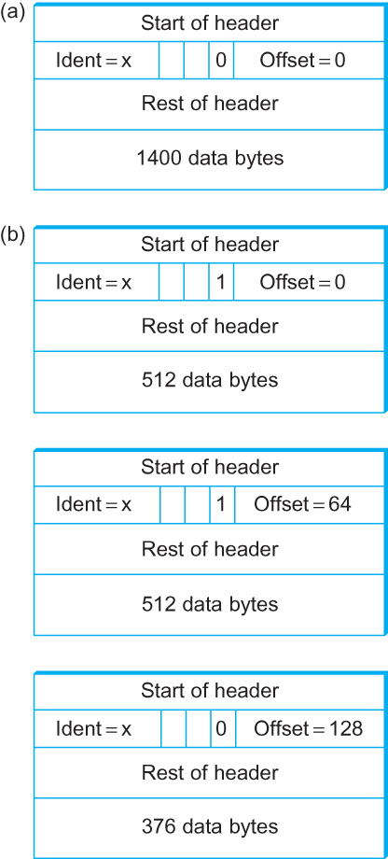
IP Fragmentation & Reassembly
Specified in
8 byte units
Figure 3.18 Header fields used in IP fragmentation: (a) unfragmented packet; (b) fragmented packets.

Slide 29
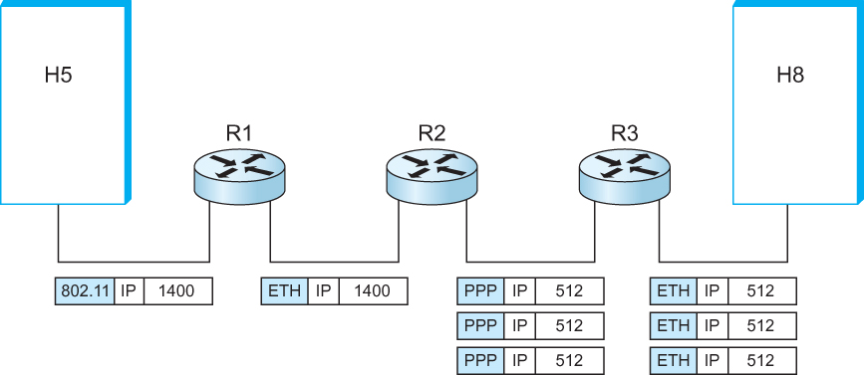
IP Fragmentation for Figure 3.14
Figure 3.17 IP datagrams traversing the sequence of physical networks graphed in Figure 3.14.

Slide 30
Network Layer Topics
4.1 Introduction
4.2 Virtual circuit and datagram networks
4.3 What is inside a router?
4.4 IP: Internet Protocol
  Datagram Format
  IPv4 addressing
  Subnets
  CIDR
  ARP & DHCP
  NAT
4.5 Routing algorithms
  Algorithm Classification
  Link State
  Distance Vector
  Hierarchical Routing
4.6 Routing in the Internet
  RIP
  OSPF
  BGP
4.7 Broadcast and multicast routing
K & R

Slide 31
Figure 4.1 The tree structure of the
Internet in 1990
Global Internet
Stanford
NSFNET backbone
ISU
BARRNET
MidNet
regional
Westnet
■ ■ ■
regional
regional
Berkeley
PARC
UNM
UNL
KU
NCAR
UA

Slide 32
Global Internet
Each provider network is regional and a single autonomous system (AS)
Major issues are:
  Scalability of routing
  Address utilization
    Now out of IPv4 addresses
Hierarchy is used to improve scalability.
  Namely, utilize subnets with masks.

Slide 33
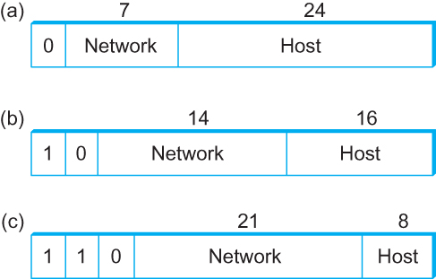
IPv4 Network Classes
Figure 3.19 IP addresses: (a) class A; (b) class B; (c) class C.

Slide 34
Network Number Problems
Assigning one network number per physical network uses up IP address too fast!
Adding more network numbers also increases forwarding table size.
Subnet solution ::
The idea is to take a single IP network number and allocate the IP addresses with that network number to several physical networks which are referred to as subnets.
The subnets need to be physically close to each other for routing purposes.

Slide 35
Subnetting
The mechanism by which a single network number can be shared among multiple networks involves configuring all the nodes on each subnet with a subnet mask.
The subnet mask enables introduction of a single subnet number which provides for another level of hierarchy into the IP address.
All hosts on a given subnet are configured with the same mask, i.e., there is one subnet mask per subnet.

Slide 36
IP Addressing: Introduction
IP address:: 32-bit identifier for host, router interface.
interface:: connection between host/router and physical link
  router’s typically have multiple interfaces.
  host typically has one interface.
  IP addresses are associated with each interface.
223.1.1.1
223.1.2.1
223.1.1.2
223.1.1.4
223.1.2.9
223.1.2.2
223.1.1.3
223.1.3.27
223.1.3.1
223.1.3.2
223.1.1.1 = 11011111 00000001 00000001 00000001
K & R
223
1
1
1

Slide 37
Subnets
IP address:
  subnet part (high order bits)
  host part (low order bits)
What is a subnet ?
  device interfaces with same subnet part of IP address.
  can physically reach each other without an intervening router.
223.1.1.1
223.1.2.1
223.1.1.2
223.1.1.4
223.1.2.9
223.1.1.3
223.1.2.2
223.1.3.27
subnet
223.1.3.1
223.1.3.2
network consisting of three subnets
K & R

Slide 38
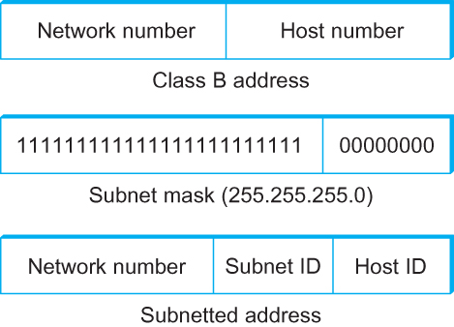
Subnet Masks
Figure 3.20 Subnet Addressing

Slide 39
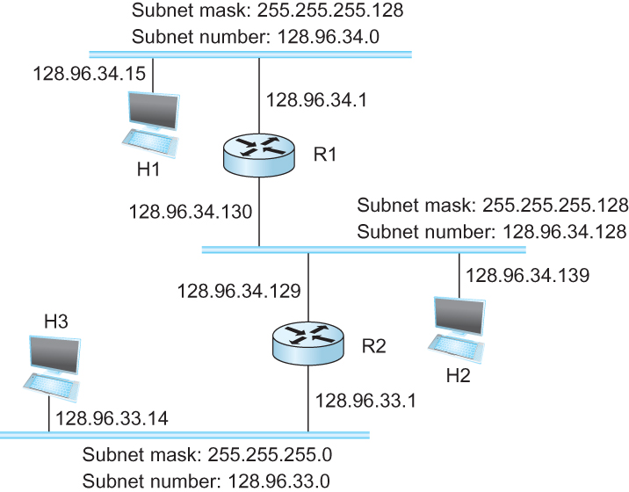
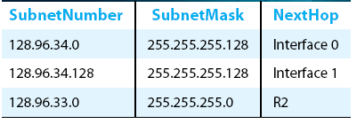
Subnetting Example
Figure 3.21
An Example of Subnetting
Table 3.7
Forwarding Table at Router R1

Slide 40
Subnets
Subnet Concepts
To determine the subnets, detach each interface from its host or router, creating islands of isolated networks. Each isolated network is called a subnet.
Sending host does bitwise AND between subnet mask and destination address to determine whether packet needs to be routed or not.
223.1.1.0/24
223.1.2.0/24
223.1.3.0/24
Subnet mask: /24 :: defined
by the leftmost 24 bits.
K & R

Slide 41
Subnets
223.1.1.2
How many subnets
in the figure?
223.1.1.1
223.1.1.4
223.1.1.3
223.1.9.2
223.1.7.0
223.1.9.1
223.1.7.1
223.1.8.1
223.1.8.0
223.1.2.6
223.1.3.27
223.1.2.1
223.1.2.2
223.1.3.1
223.1.3.2
K & R

Slide 42
IP Addressing: CIDR
CIDR: Classless InterDomain Routing
  Allows a subnet portion of address of arbitrary length.
  address format: a.b.c.d/x, where x is number of bits in subnet portion of address.
subnet
part
host
part
11001000 00010111 00010000 00000000
200.23.16.0/23
K & R

Slide 43
Classless Routing (CIDR)
CIDR helps aggregate routes by breaking up rigid boundaries between classes.
Handing out Class C addresses in contiguous blocks by address makes it possible for addresses to share a common prefix.
  allocate Class C networks as a power of 2.
We need a protocol that understands these rules, e.g., BGP
Network numbers are represented by (length,value) where length is the length of the prefix {similar to a mask}.

Slide 44
Classless Routing (CIDR)
Figure 4.27 Route Aggregation
with CIDR
P&D 4th

Slide 45
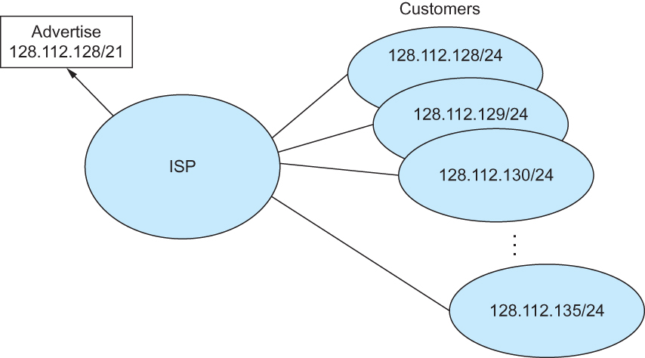
CIDR Route Aggregation
Eight ISP customers
share a 21-bit
common prefix.
Figure 3.22 Route Aggregation with CIDR

Slide 46
Network Layer Topics
4.1 Introduction
4.2 Virtual circuit and datagram networks
4.3 What is inside a router?
4.4 IP: Internet Protocol
  Datagram Format
  IPv4 addressing
  Subnets
  CIDR
  ARP & DHCP
  NAT
4.5 Routing algorithms
  Algorithm Classification
  Link State
  Distance Vector
  Hierarchical Routing
4.6 Routing in the Internet
  RIP
  OSPF
  BGP
4.7 ICMP
K & R

Slide 47
Routing
Algorithm Classification
Computer Networks
Network Layer

Slide 48
Routing
Routing algorithm:: that part of the Network Layer responsible for deciding on which output line to transmit an incoming packet.
Remember: For virtual circuit subnets the routing decision is made ONLY at set up.
Algorithm properties:: correctness, simplicity, robustness, stability, fairness, optimality, and scalability.

Slide 49
Routing Classification
Adaptive Routing
based on current measurements
of traffic and/or topology.
1. centralized
2. isolated
3. distributed
Non-Adaptive Routing
routing computed in advance and off-line
1. flooding
2. static routing using shortest path algorithms

Slide 50
Flooding
Pure flooding :: every incoming packet to a node is sent out on every outgoing line.
  Obvious adjustment – do not send out on arriving link (assuming full-duplex links).
  The routing algorithm can use a hop counter (e.g., TTL) to dampen the flooding.
  Selective flooding :: only send on those lines going “approximately” in the right direction.

Slide 51
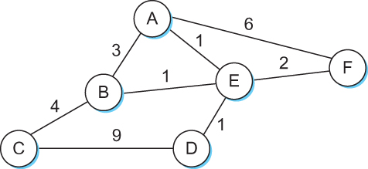
Routing is Graph Theory Problem
edges have costs
Figure 3.28 Network represented as a graph.

Slide 52
Shortest Path Routing
1. Bellman-Ford Algorithm [Distance Vector]
2. Dijkstra’s Algorithm [Link State]
What does it mean to be the shortest (or optimal) route?
We need a cost metric (edges in graph):
a. Minimize the number of hops along the path.
b. Minimize the mean packet delay.
c. Maximize the network throughput.

Slide 53
Internetwork Routing [Halsall]
Adaptive Routing
Centralized
Distributed
Isolated
[RCC]
[IGP]
Intradomain routing
Interdomain routing
[EGP]
Interior
Gateway Protocols
[BGP,IDRP]
Exterior
Gateway Protocols
Distance Vector routing
Link State routing
[RIP]
[OSPF,IS-IS,PNNI]

Slide 54
Adaptive Routing Design
Design Issues:
How much overhead is incurred due to gathering the routing information and sending routing packets?
What is the time frame (i.e, the frequency) for sending routing packets in support of adaptive routing?
What is the complexity of the routing strategy?

Slide 55
Adaptive Routing
Basic functions:
1. Measurement of pertinent network data {e.g. the cost metric}.
2. Forwarding of information to where the routing computation will be done.
3. Compute the routing tables.
4. Convert the routing table information into a routing decision and then dispatch the data packet.

Slide 56
Centralized Routing
A
W
RCC
B
Z

Slide 57
Network Layer Topics
4.1 Introduction
4.2 Virtual circuit and datagram networks
4.3 What is inside a router?
4.4 IP: Internet Protocol
  Datagram Format
  IPv4 addressing
  Subnets
  CIDR
  ARP & DHCP
  NAT
4.5 Routing algorithms
  Algorithm Classification
  Link State
  Distance Vector
  Hierarchical Routing
4.6 Routing in the Internet
  RIP
  OSPF
  BGP
4.7 ICMP
K & R

Slide 58
Distance Vector Routing
{Tanenbaum & Perlman version}
Computer Networks
Network Layer

Slide 59
Distance Vector Routing
Historically known as the old ARPANET routing algorithm {or known as Bellman-Ford (BF) algorithm}.
BF Basic idea: each router maintains a Distance Vector table containing the distance between itself and ALL possible destination nodes.
Distances, based on the chosen metric, are computed using information from the neighbors’ distance vectors.
Distance Metric: usually hops or delay

Slide 60
Distance Vector Routing
Information kept by DV router
each router has an ID
associated with each link connected to a router, there is a link cost (static or dynamic).
Distance Vector Table Initialization
Distance to itself = 0
Distance to ALL other routers = infinity number

Slide 61
Distance Vector Algorithm [Perlman]
A router transmits its distance vector to each of its neighbors in a routing packet.
Each router receives and saves the most recently received distance vector from each of its neighbors.
A router recalculates its distance vector when:
  It receives a distance vector from a neighbor containing different information than before.
  It discovers that a link to a neighbor has gone down (i.e., a topology change).
The DV calculation is based on minimizing the cost to each destination.

Slide 62
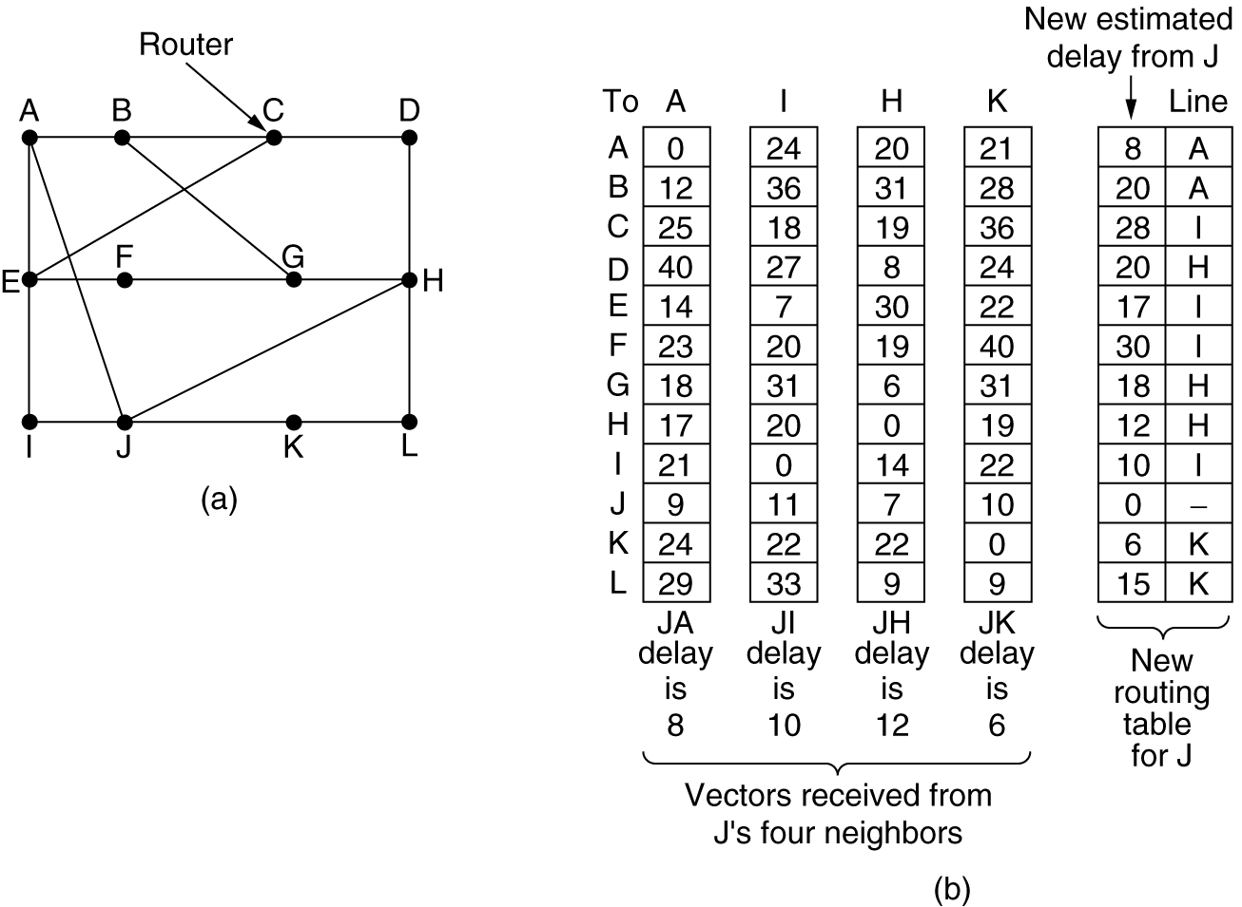
Distance Vector Example
Figure 5-9.(a) A subnet. (b) Input from A, I, H, K, and the new routing table for J.
Tanenbaum

Slide 63
Distance Vector Routing
{Kurose & Ross version}
Computer Networks
Distance Vector Routing

Slide 64
Distance Vector Algorithm
Bellman-Ford Equation (dynamic programming)
Define
d_{x}(y) := cost of least-cost path from x to y
Then
d_{x}(y) = min {c(x,v) + d_{v} (y)}
where min is taken over all neighbors v of x.
v

Slide 65
Bellman-Ford Example
5
Clearly, d_{v}(z) = 5, d_{x}(z) = 3, d_{w}(z) = 3
v
3
w
2
5
u
z
B-F equation says:
2
1
3
1
2
d_{u}(z) = min { c(u,v) + d_{v}(z),
c(u,x) + d_{x}(z),
c(u,w) + d_{w}(z) }
= min {2 + 5,
1 + 3,
5 + 3} = 4
x
y
1
The node that achieves minimum is next
hop in shortest path ➜ forwarding table.
Namely, packets from u destined for z are
forwarded out link between u and x.

Slide 66
Distance Vector Algorithm (3)
D_{x}(y) = estimate of least cost from x to y
Node x knows cost to each neighbor v: c(x,v)
Node x maintains distance vector
D_{x} = [D_{x}(y): y є N ]
Node x also maintains its neighbors’ distance vectors
  For each neighbor v, x maintains
  D_{v} = [D_{v}(y): y є N ]

Slide 67
Distance Vector Algorithm (4)
DV Basic idea:
From time-to-time, each node sends its own distance vector estimate to neighbors.
Asynchronous
When a node x receives a new DV estimate from any neighbor v, it saves v’s distance vector and it updates its own DV using B-F equation:
D_{x}(y) ← min_{v}{c(x,v) + D_{v}(y)} for each node y ∊ N
Under minor, natural conditions, the estimate D_{x}(y) converges to the actual least cost d_{x}(y).

Slide 68
Distance Vector Algorithm (5)
Iterative, asynchronous: each local iteration caused by:
local link cost change
DV update message from neighbor
Distributed:
each node notifies neighbors only when its DV changes
  neighbors then notify their neighbors if necessary.
Each node:
wait for (change in local link cost or msg from neighbor)
recompute estimates
if DV to any destination has changed, notify neighbors

Slide 69
D_{x}(y) = min{c(x,y) + D_{y}(y), c(x,z) + D_{z}(y)}
= min{2+0 , 7+1} = 2
D_{x}(z) = min{c(x,y) +
D_{y}(z), c(x,z) + D_{z}(z)}
= min{2+1 , 7+0} = 3
node x table
cost to
cost to
x y z
x y z
x
0 2 7
x
0
2
3
y
y
from
∞
∞
∞
from
2 0 1
z
∞
∞
∞
z
7 1 0
node y table
cost to
x y z
y
2
1
x
∞
∞
z
∞
2 0 1
x
y
7
from
z
∞
∞
∞
node z table
cost to
x y z
x
∞ ∞ ∞
y
from
∞
∞
∞
z
7
1
0
time

Slide 70
D_{x}(y) = min{c(x,y) + D_{y}(y), c(x,z) + D_{z}(y)}
= min{2+0 , 7+1} = 2
D_{x}(z) = min{c(x,y) +
D_{y}(z), c(x,z) + D_{z}(z)}
= min{2+1 , 7+0} = 3
node x table
cost to
cost to
cost to
x y z
x y z
x y z
x
0 2 7
x
0 2 3
x
0 2 3
y
y
from
∞
∞
∞
from
2 0 1
y
from
2 0 1
z
∞
∞
∞
z
7 1 0
z
3 1 0
node y table
cost to
cost to
cost to
x y z
x y z
x y z
y
2
1
x
∞
∞
x
0 2 7
z
∞
2 0 1
x
0 2 3
x
y
y
7
from
from
2 0 1
y
from
2 0 1
z
∞
∞
∞
z
7 1 0
z
3 1 0
node z table
cost to
cost to
cost to
x y z
x y z
x y z
x
∞ ∞ ∞
x
0 2 7
x
0 2 3
y
y
2 0 1
y
from
2 0 1
from
from
∞
∞
∞
z
z
3 1 0
z
3 1 0
7
1
0
time

Slide 71
Distance Vector: Link Cost Changes
Link cost changes:
node detects local link cost change.
updates routing info, recalculates
distance vector.
if DV changes, it notifies neighbors .
1
y
4
1
x
z
50
At time t₀, y detects the link-cost change, updates its DV, and informs its neighbors.
“good
news
travels
fast”
At time t₁, z receives the update from y and updates its table.
It computes a new least cost to x and sends its neighbors its DV.
At time t₂, y receives z’s update and updates its distance table.
y’s least costs do not change and hence y does not send any
message to z.

Slide 72
Distance Vector: Link Cost Changes
Link cost changes:
good news travels fast
bad news travels slow - “count to
infinity” problem!
44 iterations before algorithm
stabilizes: see P&D page 248!
Does this solve count to infinity problem?
60
y
4
1
x
z
50
Possible solutions:
Keep ‘infinity ‘ small {depends on graph diameter}.
Split Horizon: node does not send those routes learned from a neighbor back to that neighbor.
Split Horizon with Poison Reverse:
  If z routes through y to get to x, z tells y its (z’s) distance to x is infinite (so y won’t route to x via z).

Slide 73
Network Layer Topics
4.1 Introduction
4.2 Virtual circuit and datagram networks
4.3 What is inside a router?
4.4 IP: Internet Protocol
  Datagram Format
  IPv4 addressing
  Subnets
  CIDR
  ARP & DHCP
  NAT
4.5 Routing algorithms
  Algorithm Classification
  Link State
  Distance Vector
  Hierarchical Routing
4.6 Routing in the Internet
  RIP
  OSPF
  BGP
4.7 ICMP
K & R

Slide 74
Link State Algorithm
Each router is responsible for meeting its neighbors and learning their names.
Each router constructs a link state packet (LSP) which consists of a list of names and cost to reach each of its neighbors.
The LSP is transmitted to ALL other routers. Each router stores the most recently generated LSP from each other router.
Each router uses complete information on the network topology to compute the shortest path route to each destination node.

Slide 75
Figure 3.32 Reliable LSP Flooding
Reliable Flooding

Slide 76
Reliable Flooding
The process of making sure all the nodes participating in the routing protocol get a copy of the link-state information from all the other nodes.
LSP contains:
  Sending router’s node ID
  List of connected neighbors with the associated link cost to each neighbor
  Sequence number
  Time-to-live (TTL) {an aging mechanism}

Slide 77
Reliable Flooding
First two items enable route calculation.
Last two items make process reliable
  ACKs and checking for duplicates is needed.
Periodic Hello packets used to determine the demise of a neighbor.
The sequence numbers are not expected to wrap around.
  ➔ this field needs to be large (64 bits) !!

Slide 78
A Link-State Routing Algorithm
Dijkstra’s algorithm
net topology, link costs known to all nodes
  accomplished via “link state broadcast”.
  all nodes have same info.
computes least cost paths from one node (‘source”) to all other nodes
  gives forwarding table for that node.
iterative: after k iterations, know least cost path to k destinations.
Notation:
c(x,y): link cost from node x to y; = ∞ if not direct neighbors.
D(v): current value of cost of path from source to destination v
p(v): predecessor node along path from source to v
N': set of nodes whose least cost path is definitively known.
K & R

Slide 79
Dijsktra’s Algorithm [K&R]
1 Initialization:
2 N' = {u}
3 for all nodes v
4 if v adjacent to u
5 then D(v) = c(u,v)
6 else D(v) = ∞
7
8 Loop
9 find w not in N' such that D(w) is a minimum
10 add w to N'
11 update D(v) for all v adjacent to w and not in N' :
12 D(v) = min( D(v), D(w) + c(w,v) )
13 /* new cost to v is either old cost to v or known
14 shortest path cost to w plus cost from w to v */
15 until all nodes in N'
K & R

Slide 80
Dijkstra’s Algorithm: Example
Step
0
1
2
3
4
5
N'
u
ux
uxy
uxyv
uxyvw
uxyvwz
D(v),p(v)
2,u
2,u
2,u
D(w),p(w)
5,u
4,x
3,y
3,y
D(x),p(x)
1,u
D(y),p(y)
∞
2,x
D(z),p(z)
∞
∞
4,y
4,y
4,y
5
v
3
w
2
5
u
2
1
z
3
1
2
x
y
1
K & R

Slide 81
Dijkstra’s Algorithm: Example (2)
Resulting shortest-path tree from u:
v
w
u
z
x
y
Resulting forwarding table in u:
destination
link
v
(u,v)
x
(u,x)
y
(u,x)
w
(u,x)
z
(u,x)
K & R

Slide 82
Dijkstra’s Algorithm, Discussion
Algorithm complexity: n nodes
each iteration: need to check all nodes, w, not in N
n(n+1)/2 comparisons: O(n²)
more efficient implementations possible: O(nlogn)
Oscillations possible:
e.g., link cost = amount of carried traffic
1
A
A
A
A
1+e
2+e
0
0
2+e
2+e
0
D
0
0
B
D
B
D
B
D
B
1+e
1
0
0
1+e
1
0
e
0
0
1
1+e
0
e
C
C
C
C
1
1
e
… recompute
routing
… recompute
… recompute
initially
K & R

Slide 83
Network Layer Topics
4.1 Introduction
4.2 Virtual circuit and datagram networks
4.3 What’s inside a router
4.4 IP: Internet Protocol
  Datagram Format
  IPv4 addressing
  Subnets
  CIDR
  ARP & DHCP
  NAT
4.5 Routing algorithms
  Algorithm Classification
  Link State
  Distance Vector
  Hierarchical Routing
4.6 Routing in the Internet
  RIP
  OSPF
  BGP
4.7 ICMP
K & R

Slide 84
Hierarchical Routing
Our routing study thus far - idealization
all routers identical
network “flat”
… not true in practice
scale: with 200 million destinations:
can’t store all destinations in routing tables!
routing table exchange would swamp links!
administrative autonomy
internet = network of networks
each network admin may want to control routing in its own network.

Slide 85
Hierarchical Routing
aggregate routers into regions, “autonomous systems” (AS)
routers in same AS run same routing protocol
  “intra-AS” routing protocol
  routers in different AS can run different intra-AS routing protocol
Gateway router
Direct link to router in another AS

Slide 86
Interconnected AS’s
3c
3a
2c
3b
2a
AS3
2b
1c
AS2
1a
1b
1d
AS1
forwarding table configured by both intra- and inter-AS routing algorithm
  intra-AS sets entries for internal destinations.
  inter-AS & intra-AS sets entries for external destinations.
Intra-AS
Routing
algorithm
Inter-AS
Routing
algorithm
Forwarding
table

Slide 87
Inter-AS Tasks
suppose router in AS1 receives datagram destined outside of AS1:
  router should forward packet to gateway router, but which one?
AS1 must:
learn which dests are reachable through AS2, which through AS3
propagate this reachability info to all routers in AS1
Job of inter-AS routing!
3c
3a
2c
3b
2a
AS3
2b
1c
AS2
1a
1b
1d
AS1

Slide 88
Network Layer Topics
4. 1 Introduction
4.2 Virtual circuit and datagram networks
4.3 What is inside a router?
4.4 IP: Internet Protocol
  Datagram format
  IPv4 addressing
  Subnets
  CIDR
  ARP & DHCP
  NAT
4.5 Routing algorithms
  Algorithm Classification
  Link State
  Distance Vector
  Hierarchical Routing
4.6 Routing in the Internet
  RIP
  OSPF
  BGP
4.7 ICMP

Slide 89
Intra-AS Routing
also known as Interior Gateway Protocols (IGP)
most common Intra-AS routing protocols:
  RIP: Routing Information Protocol
  OSPF: Open Shortest Path First
  IGRP: Interior Gateway Routing Protocol (Cisco proprietary)

Slide 90
Network Layer Topics
4. 1 Introduction
4.2 Virtual circuit and datagram networks
4.3 What is inside a router?
4.4 IP: Internet Protocol
  Datagram format
  IPv4 addressing
  Subnets
  CIDR
  ARP & DHCP
  NAT
4.5 Routing algorithms
  Algorithm Classification
  Link State
  Distance Vector
  Hierarchical Routing
4.6 Routing in the Internet
  RIP
  OSPF
  BGP
4.7 ICMP

Slide 91
Routing Information Protocol (RIP)
RIP had widespread use because it was distributed with BSD Unix in “routed”, a router management daemon in 1982.
RIP - most used Distance Vector protocol.
RFC1058 in June 1988
Runs over UDP.
Metric = hop count
Big problem is max. hop count =16
➔ RIP limited to running on small networks (or AS’s that have a small diameter)!!

Slide 92
Routing Information Protocol (RIP)
From router A to subnets:
u
v
destination hops
u 1
v 2
w 2
x 3
y 3
z 2
A
B
w
x
z
C
D
y
Sends DV packets every 30 seconds (or faster) as Response Messages (also called advertisements).
each advertisement: list of up to 25 destination subnets within AS.
Upgraded to RIPv2

Slide 93
Figure 4.17 RIP Packet Format
RIP Packets
(network_address,
distance)
pairs
P&D 4th

Slide 94
RIPv2
Allows routing on a subnet (subnet masks)
Has an authentication mechanism
Tries to deal with multicast
Uses route tags
Has the ability for router to announce routes on behalf of another router.

Slide 95
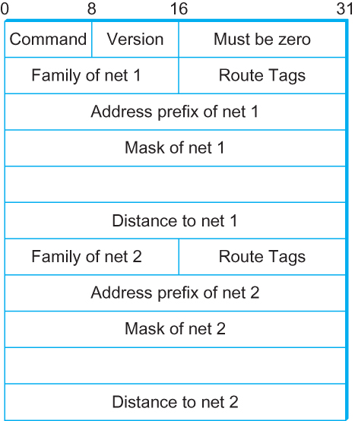
RIPv2 Packets
subnet masks
Figure 3.31 RIPv2 Packet Format

Slide 96
Network Layer Topics
4.1 Introduction
4.2 Virtual circuit and datagram networks
4.3 What’s inside a router
4.4 IP: Internet Protocol
  Datagram Format
  IPv4 addressing
  Subnets
  CIDR
  ARP & DHCP
  NAT
4.5 Routing algorithms
  Algorithm Classification
  Link State
  Distance Vector
  Hierarchical Routing
4.6 Routing in the Internet
  RIP
  OSPF
  BGP
4.7 ICMP
K & R

Slide 97
OSPF (Open Shortest Path First)
“open” :: publicly available (due to IETF)
uses Link State algorithm
  LS packet dissemination
  topology map at each node
  route computation uses Dijkstra’s algorithm.
OSPF advertisement carries one entry per neighbor router.
advertisements disseminated to entire AS (via flooding*).
  carried in OSPF messages directly over IP (rather than TCP or UDP).
* However hierarchy (partitioning domains into areas) reduces flooding impact.

Slide 98
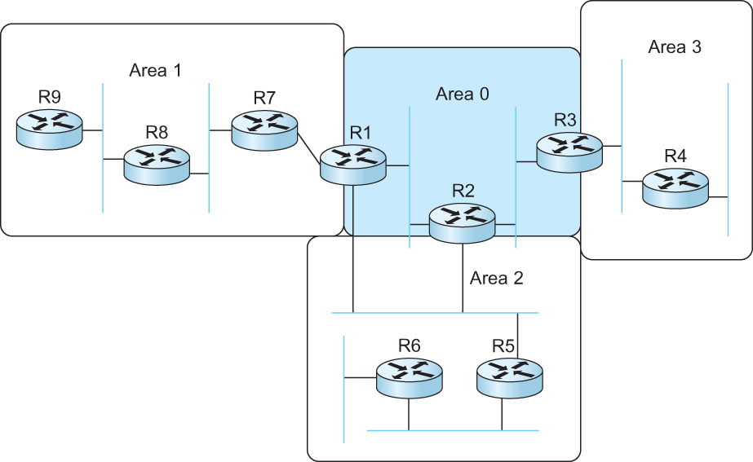
Partitioning Domains
Figure 4.2 A domain divided into areas

Slide 99
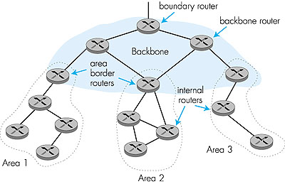
Hierarchical OSPF

Slide 100
Hierarchical OSPF
Two-level Hierarchy:: local area, backbone.
  Some Link-State Advertisement (LSA) types are only sent into one area.
  Each node has detailed area topology; only knows direction (shortest path) to nets in other areas.
area border routers: “summarize” distances to nets in own area, advertise to other Area Border routers.
backbone routers: run OSPF routing limited to backbone.
boundary routers: connect to other AS’s.

Slide 101
OSPF LSA Types
1. Router link advertisement [Hello message]
2. Network link advertisement
  identifies connected networks.
3. Network summary link advertisement
4. AS border router’s summary link advertisement
5. AS external link advertisement

Slide 102
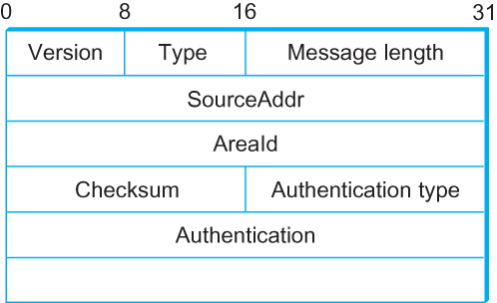
OSPF Header
Figure 3.34 OSPF Header Format

Slide 103
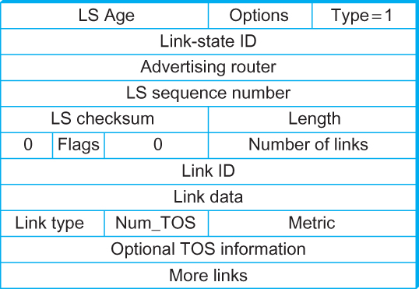
Type 1 OSPF LSA
Figure 3.3 OSPF Link-State Advertisement (LSA)

Slide 104
OSPF “Advanced” Features (not in RIP)
security: all OSPF messages authenticated (to prevent malicious intrusion).
multiple same-cost paths means distributed load balancing of traffic over routes (only one path in RIP).
For each link, multiple cost metrics for different TOS (e.g., satellite link cost set “low” for best effort; high for real time).
integrated uni- and multicast support:
  Multicast OSPF (MOSPF) uses same topology data base as OSPF.
hierarchical OSPF is used in large domains.

Slide 105
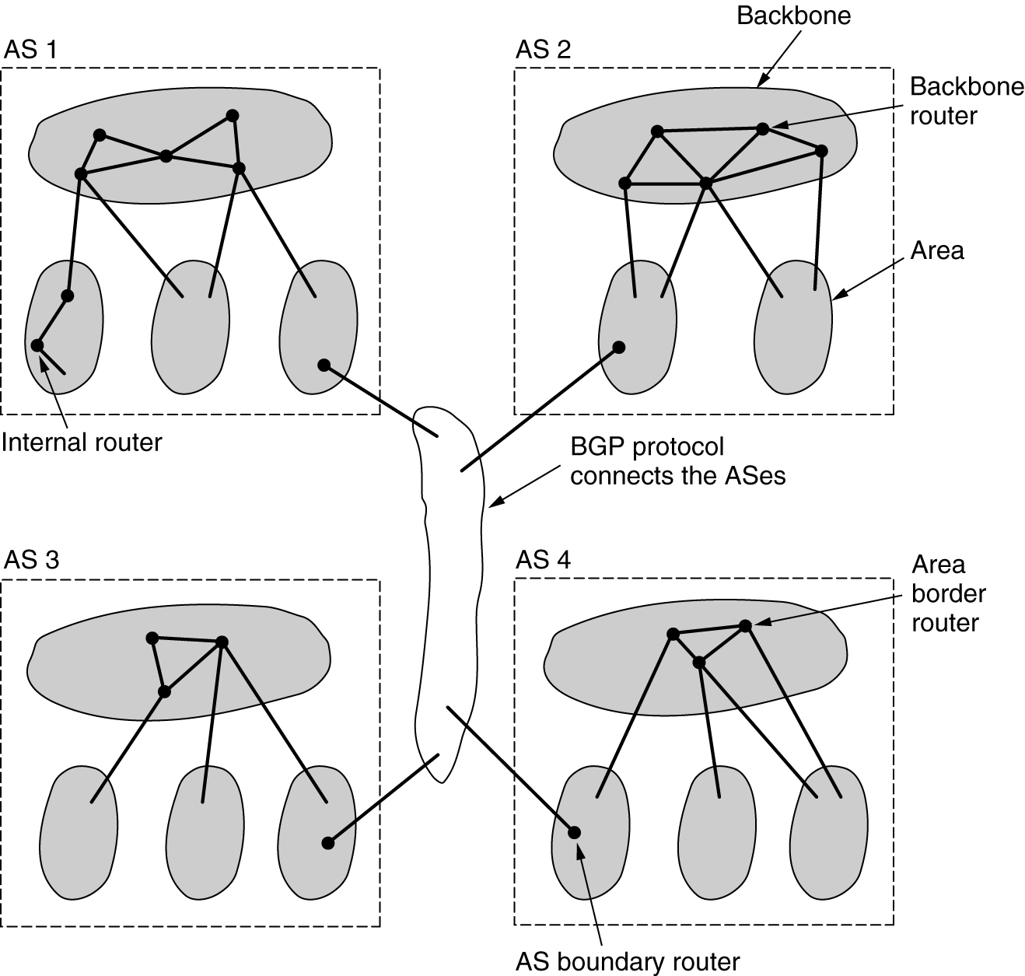
OSPF
Figure 5-65.The relation between AS’s, backbones, and areas in OSPF
Tanenbaum

Slide 106
Network Layer Topics
4.1 Introduction
4.2 Virtual circuit and datagram networks
4.3 What is inside a router?
4.4 IP: Internet Protocol
  Datagram Format
  IPv4 addressing
  Subnets
  CIDR
  ARP &DHCP
  NAT
4.5 Routing algorithms
  Algorithm Classification
  Link State
  Distance Vector
  Hierarchical Routing
4.6 Routing in the Internet
  RIP
  OSPF
  BGP
4.7 ICMP
K & R

Slide 107
Internet Inter-AS Routing: BGP
BGP (Border Gateway Protocol): de facto standard interdomain routing protocol.
BGP provides each AS a means to:
  Obtain subnet reachability information from neighboring ASs.
  Propagate reachability information to all AS-internal routers.
  Determine “good” loop-free routes to subnets based on reachability information and policy.
allows subnet to advertise its existence to rest of Internet: “I am here!”

Slide 108
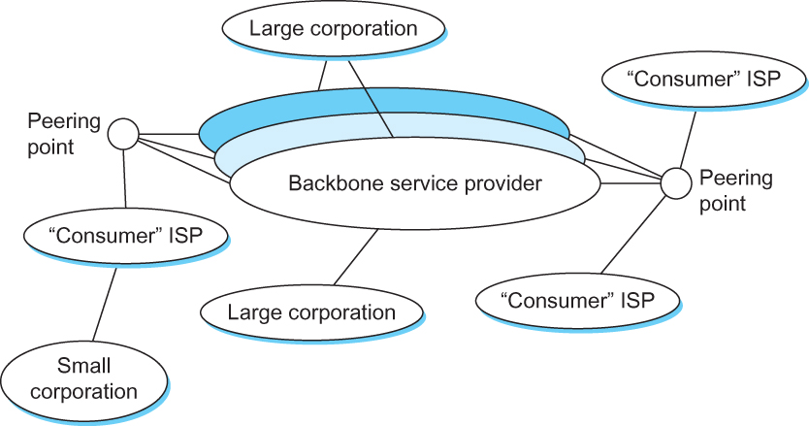
BGP Assumes an Arbitrary
Interconnection of AS’s
Figure 4.4 A simple multi-provider Internet

Slide 109
BGP Issues/Concerns
Scalability: An Internet backbone router must be able to forward any packet destined anywhere in the Internet.
  Having a routing table that will provide a match for any valid IP address.
Autonomous nature of the domains
  It is impossible to calculate meaningful path costs for a path that crosses multiple ASs.
  A cost of 1000 across one provider might imply a great path but it might mean an unacceptable bad one from another provider.
Issues of trust
  Provider A might be unwilling to believe certain advertisements from provider B.

Slide 110
BGP-4: Border Gateway Protocol
Define local traffic as traffic that originates at or terminates on nodes within an AS, and transit traffic as traffic that passes through an AS.
Classify AS's into three types:
  Stub AS:: an AS that has only a single connection to one other AS; such an AS will only carry local traffic (small corporation in Figure 4.4 ).
  Multihomed AS:: an AS that has connections to more than one other AS, but refuses to carry transit traffic (large corporation at the top in Figure 4.4).
  Transit AS:: an AS that has connections to more than one other AS, and is designed to carry both transit and local traffic (backbone providers in Figure 4.4).

Slide 111
BGP
BGP does not belong to either of the two main classes of routing protocols (distance vectors and link-state protocols).
BGP advertises complete paths as an enumerated lists of ASs to reach a particular network. Hence, often referred to as a path-vector protocol.
  BGP paths need to be loop-free!!
  ➔ Carried AS numbers need to be unique.

Slide 112
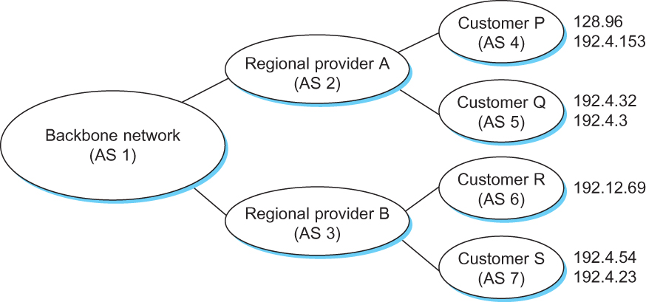
BGP Interdomain Routing
Figure 4.5 Example of a network running BGP

Slide 113
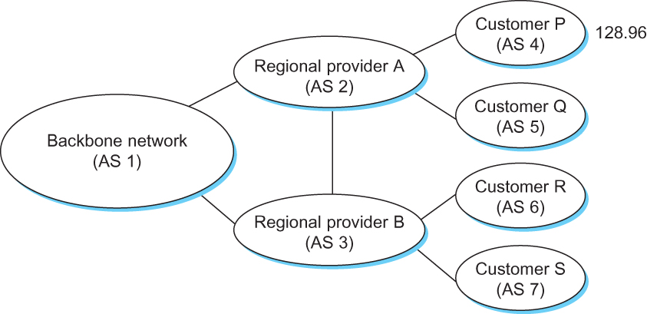
Loops in AS Topology
Figure 4.6 Example of loop among autonomous systems

Slide 114
Network Layer Topics
4.1 Introduction
4.2 Virtual circuit and datagram networks
4.3 What is inside a router?
4.4 IP: Internet Protocol
  Datagram Format
  IPv4 addressing
  Subnets
  CIDR
  ARP & DHCP
  NAT
4.5 Routing algorithms
  Algorithm Classification
  Link State
  Distance Vector
  Hierarchical Routing
4.6 Routing in the Internet
  RIP
  OSPF
  BGP
4.7 ICMP
K & R

Slide 115
Address Resolution Protocol (ARP)
A mechanism is needed to translate IP addresses into DL layer addresses that make sense on that network (e.g., 48-bit Ethernet addresses on an Ethernet LAN).
Address pair == (hostID, Network Point of Attachment address)
where
hostID == IP address
  NPA address == Ethernet address
This translation is needed by a local interior router (e.g., R1 in Figure 3.14) and by hosts on the LAN (e.g., H1- H3 in Figure 3.14)

Slide 116
Routing in an internet
  Figure 3.14 A Simple internetwork with Three Routers

Slide 117
Address Resolution Protocol (ARP)
One solution :: have the router maintain a table of address pairs for all hosts attached to the LAN. Table is then copied to each host on the LAN.
  This will generate lots of extra traffic on the LAN.
* a better solution:: each host dynamically learns the contents of this address pairs table using the LAN.
This is the function performed by ARP (Address Resolution Protocol).

Slide 118
Address Resolution Protocol (ARP)
Each node maintains an address pairs table in its cache.
If IP address of destination host is NOT found in the cache, it invokes ARP over the LAN.
An ARP query for desired IP address is broadcast on the LAN. The query includes address pair of sending host.
Each IP host receives the query and checks to see if it matches its own IP address.

Slide 119
Address Translation Protocol (ARP)
The target host sends an ARP reply with its DL layer address and adds sending address pair to its local table.
Query originator updates information in its cached ARP table.
Note - target hosts will ‘refresh’ their cache entry if originator is in local cache, but will not make a new table entry otherwise.
ARP cache entries time out periodically (e.g., every 15 minutes) and non-refreshed entries are discarded.

Slide 120
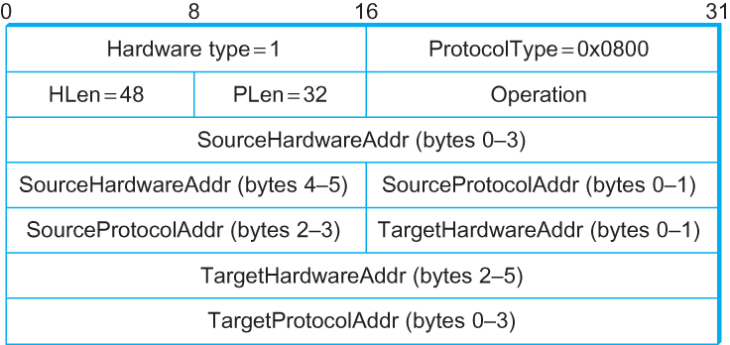
ARP Packet Format
  HardwareType: type of physical network (e.g., Ethernet)
  ProtocolType: type of higher layer protocol (e.g., IP)
  Hlen & Plen: length of link layer and protocol layer addresses
  Operation: request or response
Figure 3.23 ARP packet format for mapping
IP addresses into Ethernet addresses

Slide 121
IP Addresses: How to Get One?
Q: How does a host get IP address?
hard-coded by system admin in a file
  Windows: control-panel->network->configuration->tcp/ip->properties
  UNIX: /etc/rc.config
DHCP: Dynamic Host Configuration Protocol: A host dynamically gets address from a server.
  A “plug-and-play” protocol

Slide 122
Host Configurations
Ethernet addresses are configured into network by manufacturer and they are unique.
IP addresses must be unique on a given internetwork but also must reflect the structure of the internetwork.
Most host operating systems provide a mechanism to manually configure the host’s IP information.
Manual configuration disadvantages:
  A lot of work to configure all the hosts in a large network.
  Configuration process is error-prone.
Automated configuration process is required.

Slide 123
DHCP
Relies on the existence of a DHCP Server that provides configuration information.
Uses UDP and ports 67 and 68.
Has widespread use in wireless LANs.
DHCP server maintains a pool of available addresses that are allocated on demand.

Slide 124
DHCP: Dynamic Host Configuration Protocol
Goal: Allow a host to dynamically obtain its IP address from network server when it joins the network.
  Can renew its lease on address in use.
  Allows reuse of addresses (only hold address while connected and “on”).
  Support for mobile users who want to join network (more shortly). {widely used in WLANs}
DHCP overview:
  host broadcasts “DHCP discover” msg [optional]
  DHCP server responds with “DHCP offer” msg [optional]
  host requests IP address: “DHCP request” msg
  DHCP server sends address: “DHCP ACK” msg

Slide 125
DHCP Client-Server Scenario
A
223.1.1.1
DHCP
223.1.2.1
server
223.1.1.2
223.1.1.4
223.1.2.9
B
223.1.2.2
E
arriving DHCP
client needs
address in this
network
223.1.1.3
223.1.3.27
223.1.3.1
223.1.3.2
K & R

Slide 126
DHCP Client-Server Scenario
DHCP server: 223.1.2.5
arriving
client
1. DHCP discover
src : 0.0.0.0, 68
dest.: 255.255.255.255,67
yiaddr: 0.0.0.0
transaction ID: 654
2. DHCP offer
src: 223.1.2.5, 67
dest: 255.255.255.255, 68
yiaddrr: 223.1.2.4
transaction ID: 654
Lifetime: 3600 secs
3. DHCP request
src: 0.0.0.0, 68
dest:: 255.255.255.255, 67
yiaddrr: 223.1.2.4
transaction ID: 655
Lifetime: 3600 secs
time
4. DHCP ACK
src: 223.1.2.5, 67
dest: 255.255.255.255, 68
yiaddrr: 223.1.2.4
transaction ID: 655
Lifetime: 3600 secs
K & R

Slide 127
DHCP: More than IP address
DHCP can return more than just allocated IP address on subnet:
  address of first-hop router for client
  name and IP address of DNS sever
  network mask (indicating network versus host portion of address).

Slide 128
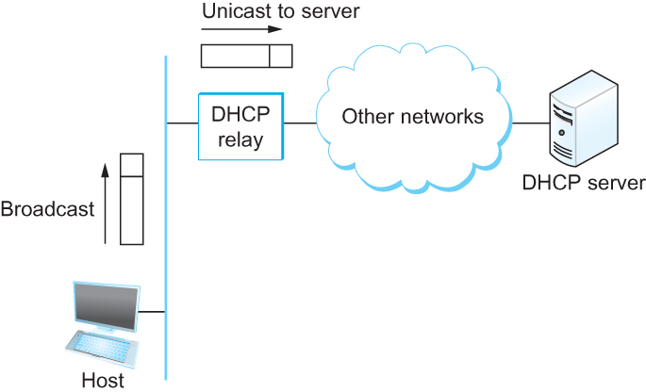
DHCP Relay Agent
Figure 3.24 DHCP relay agent receives DISCOVER message
To avoid a DHCP server on every network, DHCP relay agent unicasts the message to DHCP server and waits for the response.

Slide 129
DHCP: Example
DHCP
DHCP
UDP
IP
Eth
Phy
connecting laptop needs its IP address, addr of first-hop router, addr of DNS server: use DHCP
DHCP
DHCP
DHCP
DHCP
DHCP request encapsulated in UDP, encapsulated in IP, encapsulated in 802.1 Ethernet.
DHCP
DHCP
UDP
IP
Eth
Phy
DHCP
168.1.1.1
DHCP
DHCP
Ethernet frame broadcast (dest: FFFFFFFFFFFF) on LAN, received at router running DHCP server.
DHCP
router
(runs DHCP)
Ethernet demux’ed to IP demux’ed, UDP demux’ed to DHCP.
K & R

Slide 130
DHCP: Example
DHCP
DHCP
UDP
IP
Eth
Phy
DCP server formulates DHCP ACK containing client’s IP address, IP address of first-hop router for client, name & IP address of DNS server
DHCP
DHCP
DHCP
encapsulation of DHCP server, frame forwarded to client, demux’ing up to DHCP at client.
client now knows its IP address, name and IP address of DNS server, IP address of its first-hop router.
DHCP
DHCP
UDP
IP
Eth
Phy
DHCP
DHCP
DHCP
router
(runs DHCP)
DHCP
K & R

Slide 131
DHCP: Wireshark Output (home LAN)
reply
reply
Message type: Boot Request (1)
Hardware type: Ethernet
Hardware address length: 6
Hops: 0
Transaction ID: 0x6b3a11b7
Seconds elapsed: 0
Bootp flags: 0x0000 (Unicast)
Client IP address: 0.0.0.0 (0.0.0.0)
Your (client) IP address: 0.0.0.0 (0.0.0.0)
Next server IP address: 0.0.0.0 (0.0.0.0)
Relay agent IP address: 0.0.0.0 (0.0.0.0)
Client MAC address: Wistron_23:68:8a (00:16:d3:23:68:8a)
Server host name not given
Boot file name not given
Magic cookie: (OK)
Option: (t=53,l=1) DHCP Message Type = DHCP Request
Option: (61) Client identifier
Length: 7; Value: 010016D323688A;
Hardware type: Ethernet
Client MAC address: Wistron_23:68:8a (00:16:d3:23:68:8a)
Option: (t=50,l=4) Requested IP Address = 192.168.1.101
Option: (t=12,l=5) Host Name = "nomad"
Option: (55) Parameter Request List
Length: 11; Value: 010F03062C2E2F1F21F92B
1 = Subnet Mask; 15 = Domain Name
3 = Router; 6 = Domain Name Server
44 = NetBIOS over TCP/IP Name Server
……
Message type: Boot Reply (2)
Hardware type: Ethernet
Hardware address length: 6
Hops: 0
Transaction ID: 0x6b3a11b7
Seconds elapsed: 0
Bootp flags: 0x0000 (Unicast)
Client IP address: 192.168.1.101 (192.168.1.101)
Your (client) IP address: 0.0.0.0 (0.0.0.0)
Next server IP address: 192.168.1.1 (192.168.1.1)
Relay agent IP address: 0.0.0.0 (0.0.0.0)
Client MAC address: Wistron_23:68:8a (00:16:d3:23:68:8a)
Server host name not given
Boot file name not given
Magic cookie: (OK)
Option: (t=53,l=1) DHCP Message Type = DHCP ACK
Option: (t=54,l=4) Server Identifier = 192.168.1.1
Option: (t=1,l=4) Subnet Mask = 255.255.255.0
Option: (t=3,l=4) Router = 192.168.1.1
Option: (6) Domain Name Server
Length: 12; Value: 445747E2445749F244574092;
IP Address: 68.87.71.226;
IP Address: 68.87.73.242;
IP Address: 68.87.64.146
Option: (t=15,l=20) Domain Name = "hsd1.ma.comcast.net."
request
K & R

Slide 132
Network Layer Topics
4.1 Introduction
4.2 Virtual circuit and datagram networks
4.3 What’s inside a router
4.4 IP: Internet Protocol
  Datagram Format
  IPv4 addressing
  Subnets
  CIDR
  ARP & DHCP
  NAT
4.5 Routing algorithms
  Link State
  Distance Vector
  Hierarchical Routing
4.6 Routing in the Internet
  RIP
  OSPF
  BGP
4.7 ICMP
K & R

Slide 133
NAT: Network Address Translation
local network
(e.g., home network)
10.0.0/24
rest of
Internet
10.0.0.1
10.0.0.4
10.0.0.2
138.76.29.7
10.0.0.3
All datagrams leaving local
network have the same single source NAT IP address: 138.76.29.7,
with different source port numbers
Datagrams with source or
destination in this network
have 10.0.0/24 address for
source, destination (as usual).
K & R

Slide 134
NAT: Network Address Translation
Motivation: local network uses just one IP address as far as outside world is concerned:
  range of addresses not needed from ISP: just one IP address for all devices.
  can change addresses of devices in local network without notifying outside world.
  can change ISP without changing addresses of devices in local network.
  devices inside local net not explicitly addressable, visible by outside world (a security plus).

Slide 135
NAT: Network Address Translation
Implementation: NAT router must:
  outgoing datagrams: replace (source IP address, port #) of every outgoing datagram to (NAT IP address, new port #)
    . . . remote clients/servers will respond using (NAT IP address, new port #) as destination address.
  remember (in NAT translation table) every (source IP address, port #) to (NAT IP address, new port #) translation pair.
  incoming datagrams: replace (NAT IP address, new port #) in dest fields of every incoming datagram with corresponding (source IP address, port #) stored in NAT table.

Slide 136
NAT: Network Address Translation
NAT translation table
WAN side addr LAN side addr
1: host 10.0.0.1
sends datagram to
128.119.40.186, 80
2: NAT router
changes datagram
source addr from
10.0.0.1, 3345 to
138.76.29.7, 5001,
updates table
138.76.29.7, 5001 10.0.0.1, 3345
…… ……
S: 10.0.0.1, 3345
D: 128.119.40.186, 80
10.0.0.1
1
2
S: 138.76.29.7, 5001
D: 128.119.40.186, 80
10.0.0.4
10.0.0.2
138.76.29.7
S: 128.119.40.186, 80
D: 10.0.0.1, 3345
4
S: 128.119.40.186, 80
D: 138.76.29.7, 5001
3
10.0.0.3
4: NAT router
changes datagram
dest addr from
138.76.29.7, 5001 to 10.0.0.1, 3345
3: Reply arrives
dest. address:
138.76.29.7, 5001
K & R

Slide 137
NAT Traversal Problem
client wants to connect to server with address 10.0.0.1
  server address 10.0.0.1 local to LAN (client can’t use it as destination addr)
  only one externally visible NATted address: 138.76.29.7
Solution 1: statically configure NAT to forward incoming connection requests at given port to server
  e.g., (138.76.29.7, port 2500) always forwarded to 10.0.0.1 port 25000
10.0.0.1
Client
?
10.0.0.4
138.76.29.7
NAT
router
K & R

Slide 138
NAT Traversal Problem
Solution 2: Universal Plug and Play (UPnP) Internet Gateway Device (IGD) Protocol allows NATted host to:
  learn public IP address (138.76.29.7)
  add/remove port mappings (with lease times)
  i.e., automate static NAT port map configuration.
10.0.0.1
IGD
10.0.0.4
138.76.29.7
NAT
router
K & R

Slide 139


NAT Traversal Problem
Solution 3: relaying (used in Skype)
  NATed client establishes connection to relay node.
  External client connects to relay.
  Relay bridges packets between to connections.
2. connection to
relay initiated
by client
1. connection to
relay initiated
by NATted host
10.0.0.1
3. relaying
established
Client
138.76.29.7
NAT
router
K & R

Slide 140
Network Layer Topics
4.1 Introduction
4.2 Virtual circuit and datagram networks
4.3 What is inside a router?
4.4 IP: Internet Protocol
  Datagram Format
  IPv4 addressing
  Subnets
  CIDR
  ARP & DHCP
  NAT
4.5 Routing algorithms
  Algorithm Classification
  Link State
  Distance Vector
  Hierarchical Routing
4.6 Routing in the Internet
  RIP
  OSPF
  BGP
ICMP
K & R

Slide 141
Internet Control Message Protocol (ICMP)
IP is always configured with a companion protocol (ICMP) that defines a collection of error messages that are sent back to the source host whenever a router or host is unable to process an IP datagram successfully, e.g.,
  Destination host unreachable due to link /node failure.
  Reassembly process failed.
  TTL had reached 0 (so datagrams don't cycle forever)
  IP header checksum failed
ICMP includes several control messages that a router can use to send back to a source host.
  ICMP-Redirect
  Sent from router R1 to a source host to inform host there exists a better path through R2 to a particular destination.
  Contains better route information.

Slide 142
Other ICMP functions
ping uses ICMP echo messages to determine if a node is reachable and alive. Can be used to estimate RTT.
traceroute is used to determine the set of routes along the path to a desintination.
* Note - some routers send ICMP packets through a separate ‘special’ queue.

Slide 143
Network Layer Summary
4.1 Introduction
4.2 Virtual circuit and datagram networks
4.3 What is inside a router?
4.4 IP: Internet Protocol
  Datagram Format
  IPv4 addressing
  Subnets
  CIDR
  ARP & DHCP
  NAT
4.5 Routing algorithms
  Algorithm Classification
  Link State
  Distance Vector
  Hierarchical Routing
4.6 Routing in the Internet
  RIP
  OSPF
  BGP
ICMP
K & R

