Slide 1
HyperText Transfer Protocol (HTTP)
Computer Networks
Spring 2012

Slide 2
HTTP Outline
Web and HTTP Overview
HTTP (Non-persistent and Persistent)
HTTP Request and Response Messages
Cookies
Web Caching with Proxy Servers
Caching Example

Slide 3
Web and HTTP
Web terminology:
A web page consists of objects.
Object can be HTML file, JPEG image, Java applet, audio file,video clip, …
A web page consists of a base HTML-file which includes several referenced objects.
Each object is addressable by a URL.
Example URL:
www.someschool.edu/someDept/pic.gif
host name
path name

Slide 4
HTTP Overview
HTTP: HyperText Transfer Protocol
Web’s application layer protocol
client/server model
client: a browser that requests, receives and “displays” Web objects.
server: a Web server sends objects in response to requests.
HTTP request
PC running
Explorer
HTTP response
HTTP request
Server
running
Apache Web
server
HTTP response
Mac running
Navigator
K & R

Slide 5
HTTP Overview (continued)
Uses TCP:
client initiates TCP connection (creates socket) to server, port 80.
server accepts TCP connection from client.
HTTP messages (application-layer protocol messages) exchanged between browser (HTTP client) and Web server (HTTP server).
TCP connection closed.
HTTP is “stateless”
server maintains no information about past client requests.
aside
Protocols that maintain “state” are complex!
past history (state) must be maintained.
if server/client crashes, their views of “state” may be inconsistent, must be reconciled.
K & R

Slide 6
HTTP Connections
Non-persistent HTTP
At most one object is sent over a TCP connection.
HTTP 1.0
Persistent HTTP
Multiple objects can be sent over single TCP connection between client and server.
HTTP 1.1

Slide 7
Nonpersistent HTTP
(contains text,
references to 10
jpeg images)
Suppose user enters URL www.someSchool.edu/someDepartment/home.index
1a. HTTP client initiates TCP connection to HTTP server (process) at www.someSchool.edu on port 80.
1b. HTTP server at host www.someSchool.edu waiting for TCP connection at port 80. “accepts” connection, notifying client.
2. HTTP client sends HTTP request message (containing URL) into TCP connection socket. Message indicates that client wants object someDepartment/home.index
3. HTTP server receives request message, forms response message containing requested object, and sends message into its socket.
time
K & R

Slide 8
Nonpersistent HTTP (cont.)
4. HTTP server closes TCP connection.
5. HTTP client receives response message containing html file, displays html. Parsing html file, finds 10 referenced jpeg objects.
May be done as
parallel TCP connections.
time
6. Steps 1-5 repeated for each of 10 jpeg objects.
K & R

Slide 9
Nonpersistent HTTP: Response Time
Definition of RTT: time for a small packet to travel from client to server and back.
Response time:
one RTT to initiate TCP connection
one RTT for HTTP request and first few bytes of HTTP response to return
file transmission time
initiate TCP
connection
RTT
request
file
RTT
time to
transmit
file
file
received
time
time
total time = 2RTT+transmit time
K & R

Slide 10
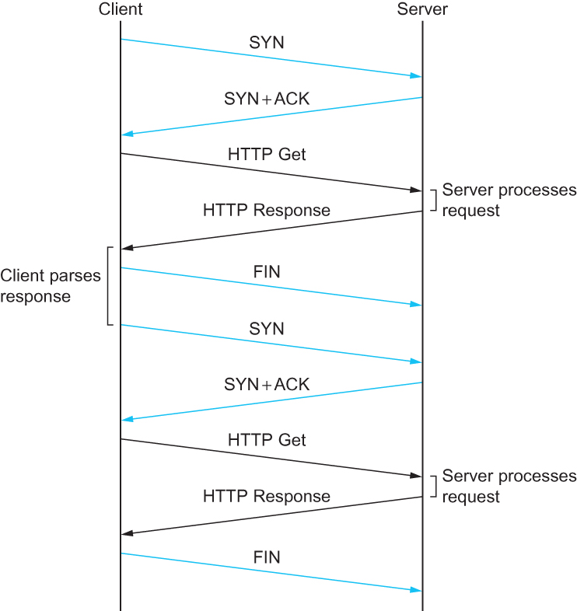
HTTP 1.0 Behavior
Figure 9.4 HTTP 1.0 Behavior

Slide 11
Persistent HTTP
Nonpersistent HTTP issues:
requires 2 RTTs per object.
OS overhead for each TCP connection.
browsers often open parallel TCP connections to fetch referenced objects.
Persistent HTTP
server leaves connection open after sending response.
subsequent HTTP messages between same client/server sent over open connection.
client sends requests as soon as it encounters a referenced object.
as little as one RTT for all the referenced objects.
K & R

Slide 12
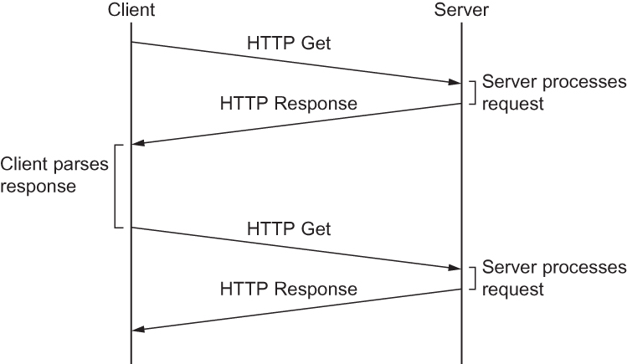
HTTP 1.1 Behavior
Figure 9.5 HTTP 1.1 Behavior with Persistent Connections

Slide 13
HTTP Request Message
two types of HTTP messages: request, response
HTTP request message:
ASCII (human-readable format)
request line
(GET, POST,
HEAD commands)
GET /somedir/page.html HTTP/1.1
Host: www.someschool.edu
User-agent: Mozilla/4.0
Connection: close
Accept-language:fr
(extra carriage return, line feed)
header
lines
Carriage return,
line feed
indicates end
of message.
K & R

Slide 14
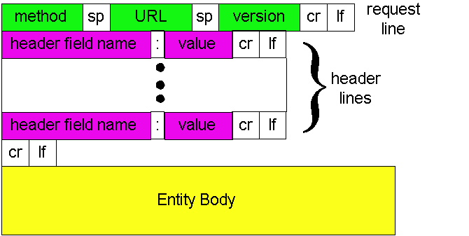
HTTP Request Message: General Format
method :: operation to be performed.
URL :: Web page object for operation.
version :: HTTP version used.

Slide 15
Table 9.1 HTTP Request Operations

Slide 16
Uploading Form Input
Post method:
Web page often includes form input.
Input is uploaded to server in entity body.
URL method:
Uses GET method.
Input is uploaded in URL field of request line:
www.somesite.com/animalsearch?monkeys&banana

Slide 17
Method Types
HTTP/1.0
GET
POST
HEAD
asks server to leave requested object out of response.
HTTP/1.1
GET, POST, HEAD
PUT
uploads file in entity body to path specified in URL field.
DELETE
deletes file specified in the URL field.

Slide 18
Table 9.2 Five Types of HTTP Result Codes

Slide 19
HTTP Response Message
status line
(protocol
status code
status phrase)
HTTP/1.1 200 OK
Connection: close
Date: Thu, 06 Aug 1998 12:00:15 GMT
Server: Apache/1.3.0 (Unix)
Last-Modified: Mon, 22 Jun 1998 …...
Content-Length: 6821
Content-Type: text/html
data data data data data ...
header
lines
data, e.g.,
requested
HTML file

Slide 20
HTTP Response Status Codes
In first line in server->client response message.
A few sample codes:
200 OK
request succeeded, requested object later in this message.
301 Moved Permanently
requested object moved, new location specified later in this message (Location:).
400 Bad Request
request message not understood by server.
404 Not Found
requested document not found on this server.
505 HTTP Version Not Supported

Slide 21
Trying out HTTP (client side) for yourself
1. Telnet to your favorite Web server:
telnet cis.poly.edu 80
Opens TCP connection to port 80
(default HTTP server port) at cis.poly.edu.
Anything typed in sent
to port 80 at cis.poly.edu
2. Type in a GET HTTP request:
GET /~ross/ HTTP/1.1
Host: cis.poly.edu
By typing this in (hit carriage
return twice), you send
this minimal (but complete)
GET request to HTTP server
3. Look at response message sent by HTTP server!

Slide 22
User-Server Interaction: Cookies
Example:
Susan always accesses Internet from PC.
visits specific e-commerce site for first time. (Amazon)
when initial HTTP requests arrives at site, site creates:
unique ID
entry in backend database for ID.
Many major Web sites use cookies.
Four components:
cookie header line of HTTP response message
cookie header line in HTTP request message
cookie file kept on user’s host, managed by user’s browser
back-end database at Web site
K & R

Slide 23
Cookies: Keeping State
client
server
ebay 8734
usual http request msg
Amazon server
creates ID
1678 for user
cookie file
usual http response
Set-cookie: 1678
create
entry
ebay 8734
amazon 1678
usual http request msg
cookie: 1678
cookie-
specific
action
access
one week later:
usual http response msg
backend
database
access
ebay 8734
amazon 1678
usual http request msg
cookie: 1678
cookie-
spectific
action
usual http response msg
K & R

Slide 24
Cookies (continued)
aside
What cookies can bring:
authorization
shopping carts
recommendations
user session state (Web e-mail)
Cookies and privacy:
cookies permit sites to learn a lot about you.
you may supply name and e-mail to sites.
How to keep “state”:
protocol endpoints: maintain state at sender/receiver over multiple transactions.
cookies:: http messages carry state.
K & R

Slide 25
Web Caches (Proxy Server)
Goal: satisfy client request without involving origin server.
User sets browser: Web accesses via cache.
Browser sends all HTTP requests to cache.
object in cache: cache returns object.
else cache requests object from origin server, then returns object to client.
origin
server
Proxy
server
HTTP request
HTTP request
client
HTTP response
HTTP response
HTTP request
HTTP response
client
origin
server

Slide 26
More About Web Caching
Why Web caching?
Reduces response time for client request.
Reduces traffic on an institution’s access link.
Enables “poor” content providers to effectively deliver content on Internet dense with caches (but so does P2P file sharing).
Cache acts as both client and server.
Typically cache is installed by ISP (university, company, residential ISP)

Slide 27
Caching Example
Assumptions
average object size = 1,000,000 bits
avg. request rate from institution’s browsers to origin servers = 15 requests/sec
delay from institutional router to any origin server and back to router = 2 sec
Consequences
utilization on LAN = 15%
utilization on access link = 100%
total delay = Internet delay + access delay + LAN delay
= 2 sec + minutes (congested) + milliseconds
origin
servers
public
Internet
15 Mbps
access link
institutional
network
100 Mbps LAN
institutional
cache
K & R

Slide 28
Caching Example (cont)
Possible Solution
increase bandwidth of access link to, say, 100 Mbps
Consequences
utilization on LAN = 15%
utilization on access link = 15%
Total delay = Internet delay + access delay + LAN delay
= 2 sec + msecs + msecs
BUT…often a costly upgrade
origin
servers
public
Internet
100 Mbps
access link
institutional
network
100 Mbps LAN
institutional
cache
K & R

Slide 29
Caching Example (cont)
Possible Solution: Install Cache
suppose hit rate is 0.4
Consequences
40% requests will be satisfied almost immediately
60% requests satisfied by origin server
utilization of access link reduced to 60%, resulting in negligible delays (say 10 msec)
total avg delay = Internet delay + access delay + LAN delay = .6*(2.01) secs + .4*milliseconds < 1.4 secs
origin
servers
public
Internet
15 Mbps
access link
institutional
network
100 Mbps LAN
institutional
cache
K & R

Slide 30
Caching - Conditional GET
cache
server
Goal: don’t send object if cache has up-to-date cached version.
cache: specify date of cached copy in HTTP request.
If-modified-since: <date>
server: response contains no object if cached copy is up-to-date:
HTTP/1.0 304 Not Modified
HTTP request msg
If-modified-since: <date>
object
not
modified
HTTP response
HTTP/1.0
304 Not Modified
HTTP request msg
If-modified-since: <date>
object
modified
HTTP response
HTTP/1.0 200 OK
<data>

Slide 31
HTTP Summary
HTTP (Nonpersistent and Persistent)
HTTP Request and Response Messages
Keeping State - Cookies
Web Caching with Proxy Servers
Caching Example

