Slide 1
Ultra-Low Duty Cycle MAC with Scheduled Channel Polling
Wei Ye and John Heidemann
CS577
Brett Levasseur

Slide 2
Outline
Introduction
Scheduled Channel Polling (SCP-MAC)
Energy Performance Analysis
Implementation
Conclusions

Slide 3
Introduction
Sensor networks need to save power
Controlling the power and duty cycle is critical
Synchronization techniques are power efficient but have complex management
Contention based protocols used more often but must be kept at low duty cycles

Slide 4
Related Work
Low Power Listening (LPL)
Low power probe to check channel activity
No long wake period
Requires transmission preamble
Scheduled Protocols
Sleep/Wake schedules
Only transmit when receiver is listening
Requires coordination

Slide 5
Limitations
Scheduling and LPL require 1 -2% duty cycle
Scheduling has long wake time
LPL has long transmit preamble
Authors propose Schedule Channel Polling (SCP)
Ultra low duty cycles of 0.01 – 0.1%
Reduce energy consumption by factor of 10-100

Slide 6
Outline
Introduction
Scheduled Channel Polling (SCP-MAC)
Energy Performance Analysis
Implementation
Conclusions

Slide 7
SCP-MAC
Combines short channel polling from LPL with scheduling
Periodic channel polling (LPL)
Polling time is synchronized across nodes
Reduced transmit preamble size
Requires less energy

Slide 8
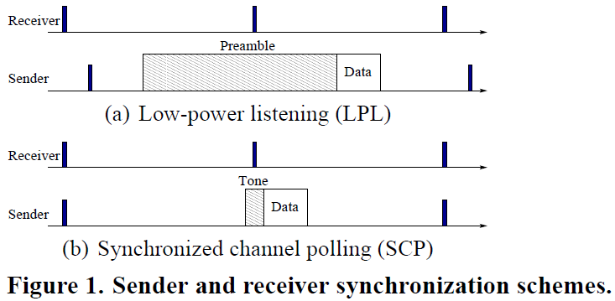
Synchronized Channel Polling
LPL requires long preamble
Preamble at least as long as channel polling period
SCP synchronizes polling time
Only short wake up tone is required
Requires synchronization

Slide 9
Bursty Traffic
Running SCP-MAC at low duty cycle adds latency during heavy traffic periods
Low duty cycle means more time between transmission opportunities
Detect bursty traffic and add polling slots
The new slots allows for more transmissions in less time

Slide 10
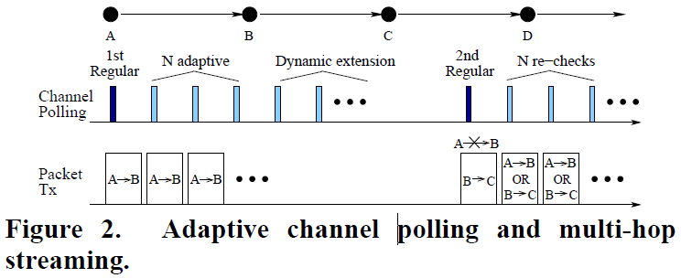
Adaptive Polling
Node B adds n polling slots when it receives from A
Node A can give up transmitting to B so B can transmit to C
This gets C to add its own n polling slots
Should add one poll per node that needs to send

Slide 11
Two-Phase Contention
Carrier sense in CW1 before sending tone
If channel idle send wakeup tone
If tone sent successfully node performs carrier sense in CW2
If channel idle then send data

Slide 12
Overhearing Avoidance
Hearing a packet meant for another node
Causes overhearing node to waste power
Stop listening to packets not meant for the node
With RTS/CTS nodes can see when the channel is busy
Without RTS/CTS nodes examine MAC headers and goes back to sleep if receiving address is not for them

Slide 13
Outline
Introduction
Scheduled Channel Polling (SCP-MAC)
Energy Performance Analysis
Implementation
Conclusions

Slide 14
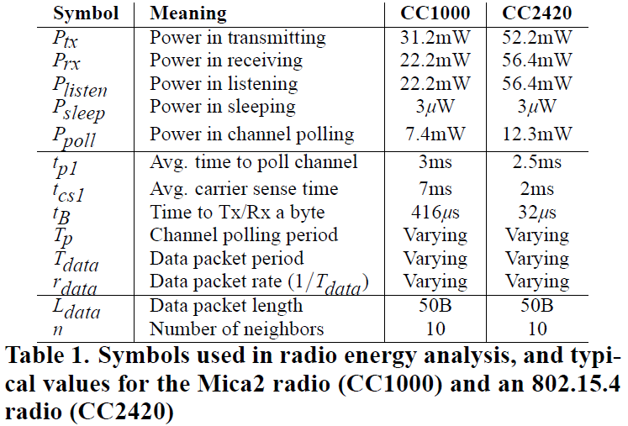
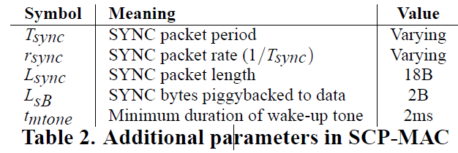
Energy Performance Analysis

Slide 15
Energy Consumption
Sum of energy used for each state
Carrier Sense
Transmit
Receive
Poll
Sleep

Slide 16
Asynchronous Channel Polling
What is the energy cost to poll using asynchronous channel polling in LPL?
Length of preamble
Time for carrier sense
Time for polling
Time spent sleeping
Transmission/Reception rate

Slide 17
LPL Preamble
Preamble must be as long as the polling interval T_{p}
t_{b} is the time to transmit a byte
L_{preamble} is the length of the preamble in bytes

Slide 18
LPL Carrier Sense
Nodes perform carrier sense before preamble
t_{cs1} is the average carrier sense time
r_{data} is the rate of sending data

Slide 19
Time Transmitting/Receiving
Transmit is sending preamble and data
Receive is sum across all nodes
n is the number of nodes

Slide 20
Polling and Sleeping
Normalized time for polling and sleeping
The node is asleep when not in carrier sense, transmission, reception or polling

Slide 21
Random Channel Polling LPL
Power consumed determined by
Neighborhood size
Data rate
Channel polling
Small T_{p} reduces cost of polling but increases transmit and reception cost

Slide 22
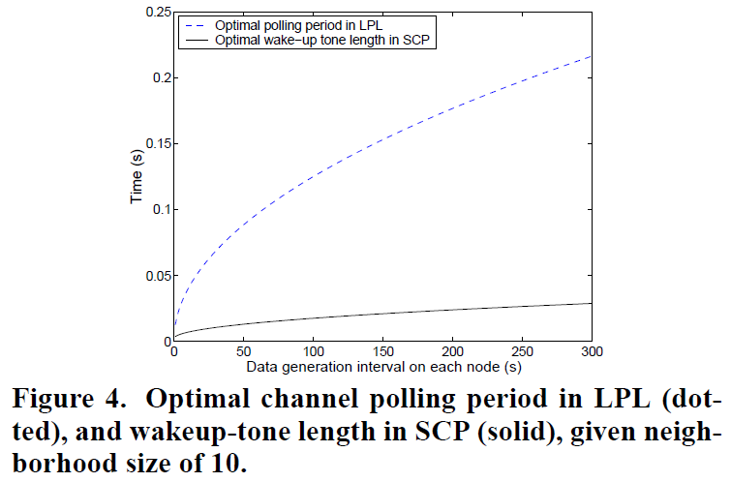
Optimize Polling Time LPL

Slide 23
Synchronization
Nodes broadcast scheduling information
Occurs every synchronization period
Required every 10 – 60 minutes
Piggyback synchronization with data when possible
Clock drift requires guard time

Slide 24
Clock Drift
T_{sync} – Synchronization period
r_{clk} – Clock drift rate
t_{diff}
T_{sync}r_{clk}
Current Time
Time

Slide 25
Guard Time 2 Nodes
Difference between 2 nodes requires 2t_{diff}
t_{guard}
t_{diff}
T_{sync}r_{clk}
T_{sync}r_{clk}
Time

Slide 26
Guard Time n + 1 Nodes
Every node sends a SYNC in each T_{sync} period
For n neighbors this reduces clock drift (n+1) times
4 * T_{sync}r_{clk}
(4 * T_{sync}r_{clk}) / (n + 1)
Time

Slide 27
Wake-up Tone
Guard time plus a short fixed time
t_{mtone} is time needed to detect tone
T_{guard}
T_{tone}
Time

Slide 28
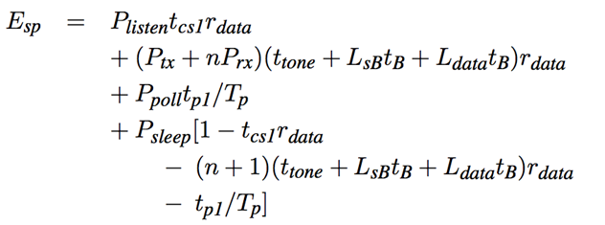
SCP with Piggybacking
Perfect piggyback means all synchronization goes out with application data
Carrier Sense
Tx / Rx
Polling
Sleep

Slide 29
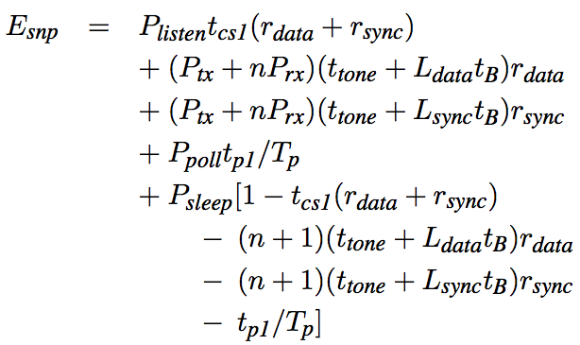
SCP without Piggybacking
More time needed to transmit and receive synchronization packets

Slide 30
Poll Time (T_{p}) in LPL and SCP
LPL
Larger poll time adds to transmission and reception cost
SCP
Larger poll time does not add to transmission and reception cost

Slide 31
With/Without Piggybacking
With piggybacking synchronization sent with data
Without synchronization data sent on its own

Slide 32
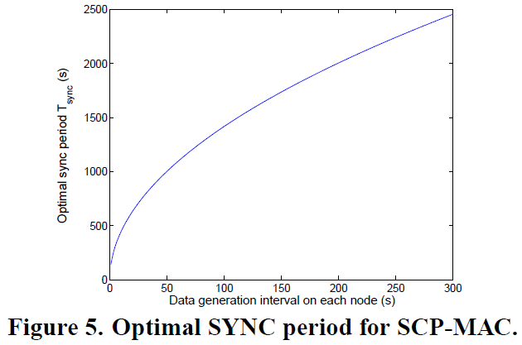
Optimal T_{sync}

Slide 33
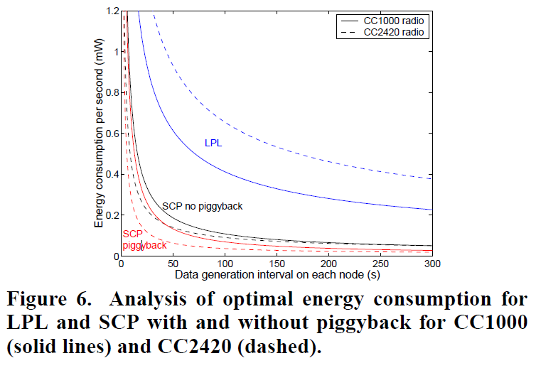
Optimum Energy Consumption
LPL uses 3-6 times more energy than SCP
Piggybacking reduces energy cost when data is rarely sent
Benefits minimal when data sent frequently
LPL worse on newer radio, SCP better

Slide 34
Outline
Introduction
Scheduled Channel Polling (SCP-MAC)
Energy Performance Analysis
Implementation
Conclusions

Slide 35
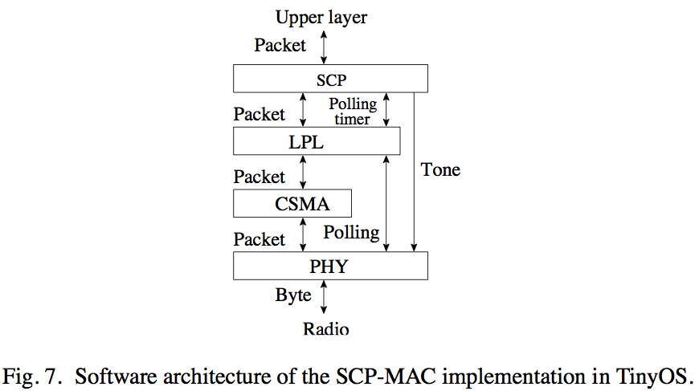
Implementation
TinyOS on Mica2 (CC1000) and MicaZ (CC2420) motes
Layered approach
LPL used for polling
SCP used for scheduling
TinyOS controls CPU power and timers
[Wei 05]

Slide 36
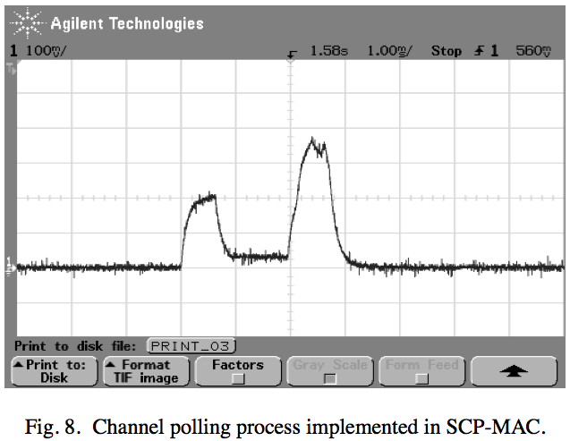
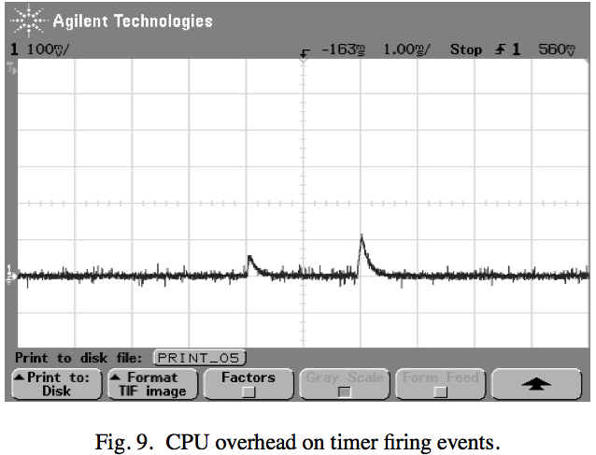
Power Consumption
4 mA
1 ms
[Wei 05]
[Wei 05]
Energy required to maintain timers is less than using the radio
Adding timers for scheduling is a low energy impact

Slide 37
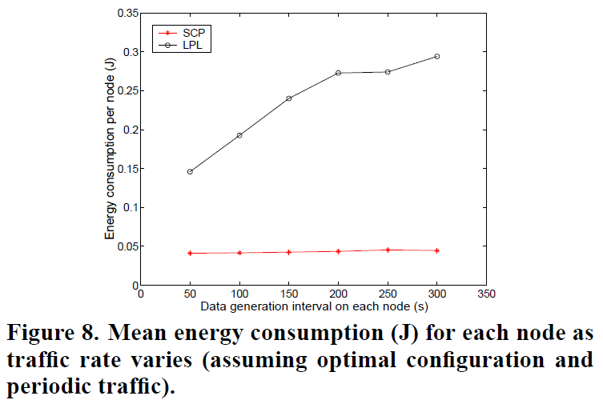
Optimal Setup
Periodic traffic
10 nodes all in range
40B data message
1 message every 5 – 30 seconds
LPL requires 2 – 2.5 times more energy than SCP

Slide 38
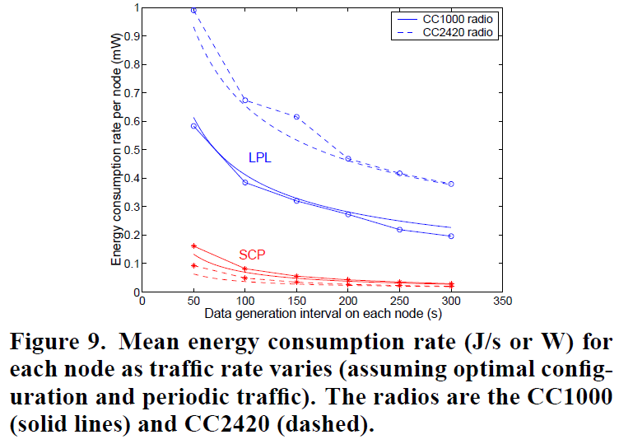
Optimal Setup Cont
LPL needs 3–6 times more power than SCP
Both optimized for periodic traffic
Experimental results similar to analytical results

Slide 39
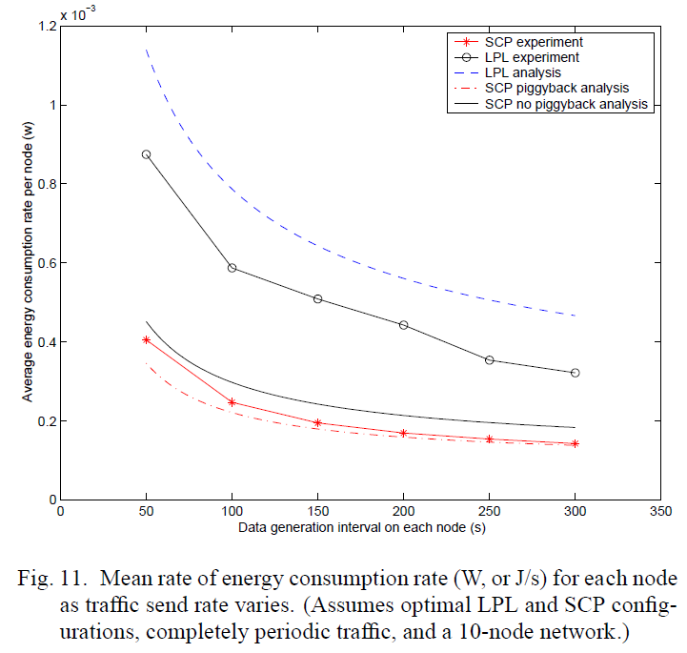
Experiment vs Analysis
[Wei 05]

Slide 40
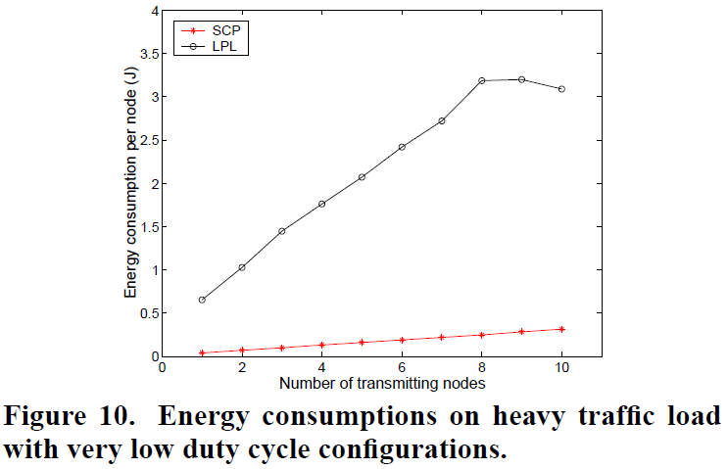
Unanticipated Traffic
Long down time and then large amount of traffic
0.3% duty cycle
Poll every second
Busy mode
20, 100B long messages
LPL uses 8 times more energy than SCP
Mostly preamble

Slide 41
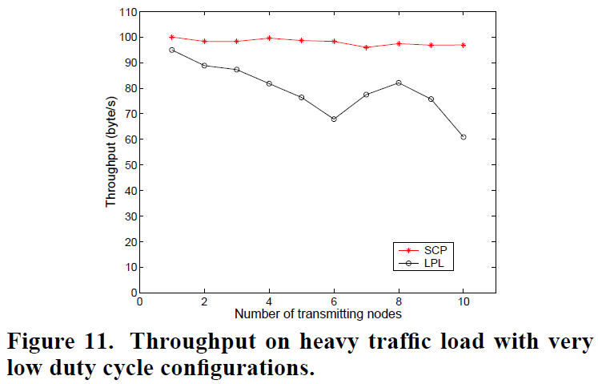
Unanticipated Traffic Cont
Heavy traffic load leads to contention
LPL has one congestion window
32 slots, 10 nodes
About 1/3 chance of nodes conflicting
SCP has two congestion windows
Collision rate about 4%

Slide 42
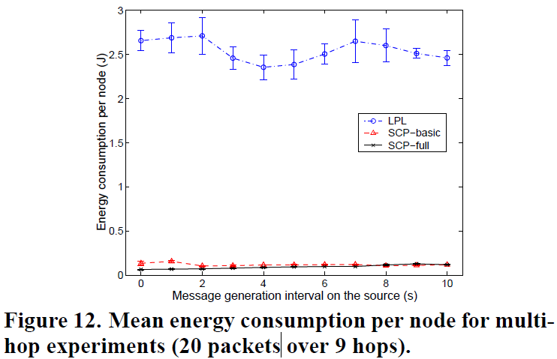
Mean Energy
LPL uses 20 – 40 times more energy than full (adaptive polling) SCP-MAC
Long preamble
Overhearing nodes
False wakeups
LPL needs to receive full preamble

Slide 43
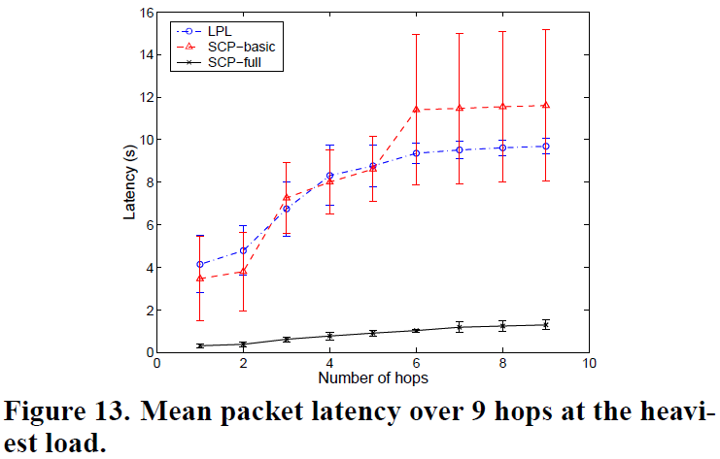
Mean Latency
Basic SCP and LPL have similar latency
Polling interval latency
Adaptive channel polling causes lower latency for SCP full
All nodes switch to higher duty cycle polling after first packet

Slide 44
Conclusions
Proposed SCP (LPL with scheduling)
Found best operating points for LPL and SCP
SCP showed less power usage than LPL
3 – 6 times better under ideal scenario (periodic traffic)
SCP has greater improvements when using newer radios

Slide 45
Questions

Slide 46
References
[Wei 06] - Wei Ye, Fabio Silva, and John Heidemann. 2006. Ultra-low duty cycle MAC with scheduled channel polling. In Proceedings of the 4th international conference on Embedded networked sensor systems (SenSys '06). ACM, New York, NY, USA, 321-334. DOI=10.1145/1182807.1182839 http://doi.acm.org/10.1145/1182807.1182839
[Wei 05] - Wei Ye, Fabio Silva, and John Heidemann. 2005. Ultra-low duty cycle MAC with scheduled channel polling. http://www.isi.edu/~johnh/PAPERS/Ye05a.pdf

