Slide 1
Inferring Internet Denial-of-Service Activity
David Moore, Colleen Shannon, Douglas J. Brown, Geoffrey M. Voelker, and Stefan Savage
Presented by Qian HE (Steve)
CS 577 – Prof. Bob Kinicki

Slide 2
How prevalent are DoS attacks in the Internet?

Slide 3
Agenda
Introduction
Background
Methodology
Attack Detection and Classification
Analysis of Denial-Of-Service Activity
Conclusion

Slide 4
Agenda
Introduction
Background
Methodology
Attack Detection and Classification
Analysis of Denial-Of-Service Activity
Conclusion

Slide 5
Introduction - Examples
Feb 2000, Yahoo, Ebay, and E*trade.
Jan 2001, Microsoft’s name server.
2002, root DNS servers.
Late 2003, SCO’s corporate Website.
“2,000–3,000 active denial-of-service attacks per week”
“68,700 attacks on over 34,700 distinct Internet hosts belonging to more than 5,300 distinct organizations”

Slide 6
Introduction - Motivation
Many of the attacks are motivated by mischief or spite, others are likely born out of religious, ethnic or political tensions, and still others have been clearly focused around commercial gain.

Slide 7
Introduction - Problems
There is little quantitative data about the prevalence of these attacks nor any representative characterization of their behavior.
Obstacles hampering the collection of an authoritative DoS traffic dataset:
ISPs consider such data sensitive and private
Measuring Internet-wide attacks presents a significant logistical challenge.

Slide 8
Agenda
Introduction
Background
Methodology
Attack Detection and Classification
Analysis of Denial-Of-Service Activity
Conclusion

Slide 9
Background - Attack Types
There are two principal classes of attacks:
Logic Attacks
Resource Attacks (this paper focuses solely on)

Slide 10
Background - Resource Attacks
Related consequences:
Overwhelm the capacity of intervening network devices.
Overwhelm the capacity of CPU.
Notes:
Ping-of-Death
Sending a large number of spurious requests

Slide 11
Background - IP Spoofing
Spoof the IP source address of each packet the attacker send
This paper focuses solely on attacks using random address spoofing

Slide 12
Agenda
Introduction
Background
Methodology
Attack Detection and Classification
Analysis of Denial-Of-Service Activity
Conclusion

Slide 13
Methodology - Ideas
Attacker’s source address is selected at random.
Victim’s responses are also distributed across the entire Internet address space.

Slide 14
Methodology - Backscatter
Borrowed from Geoffrey M. Voelker’s Presentation
Notes:
Here the attacker sends a series of SYN packets towards the victim V, using a series of random spoofed source addresses named B, C, and D. Upon receiving these packets the victim responds by sending SYN/ACKs to each of spoofed hosts.

Slide 15
Methodology - Backscatter Analysis
During an attack of m packets, the p of 1 given host receiving at least 1 unsolicited response from the victim is
If 1 monitors n distinct IP addresses, then the expected p of observing at least 1 packet from the attack is

Slide 16
Methodology - Backscatter Analysis
The expected number of unsolicited responses seen during an attack of m packets at a single host is
The expected number of monitoring n distinct IP addresses, the responses seen is

Slide 17
Methodology - Backscatter Analysis
Use the average arrival rate of unsolicited responses directed at the monitored address range to estimate the actual rate of the attack being directed at the victim:

Slide 18
Methodology - Analysis Limitations
Address uniformity: attackers spoof source addresses at random.
Reliable delivery: attack traffic is delivered reliably to the victim and backscatter is delivered reliably to the monitor.
Backscatter hypothesis: unsolicited packets observed by the monitor represent backscatter.

Slide 19
Methodology - Analysis Limitations
Address Uniformity
Many attacks today do not use address spoofing at all.
“Reflector attacks” pose a second problem for source address uniformity.
Motivation for address spoofing has been reduced.

Slide 20
Methodology - Analysis Limitations
Reliable Delivery
Packets may be queued and dropped.
from the attacker
from victim
Packets may be filtered or rate-limited by firewall or intrusion detection software.
Some forms of attack traffic (e.g. TCP RST messages) do not typically elicit a response.

Slide 21
Methodology - Analysis Limitations
Backscatter Hypothesis
Any server in the Internet is free to send unsolicited packets.
Misinterpretation of random port scans as backscatter
Vast majority of attacks can be trivially differentiated from typical scanning activity.

Slide 22
Methodology
“In spite of its limitations, we believe our overall approach is sound and provides at worst a conservative estimate of current denial-of-service activity. “ – this paper

Slide 23
Agenda
Introduction
Background
Methodology
Attack Detection and Classification
Analysis of Denial-Of-Service Activity
Conclusion

Slide 24
Attack Detection and Classification
Extracting Backscatter Packets
Flow-Based Classification
Flow-Based Identification
Flow Timeout
Deriving Denial-of-Service Attacks
Packet Threshold
Attack Duration
Packet Rate
Extracted Information

Slide 25
Extracting Backscatter Packets
Remove
packets involving legitimate hosts
packets that do not correspond to response traffic
traffic from hosts that use TCP RST packets for scanning
duplicate packet with the same flow tuple <source IP address, destination IP ad- dress, protocol, source port, destination port> in the last five minutes

Slide 26
Flow-Based Classification
Flow-Based Identification
Flow is a series of consecutive packets sharing the same victim IP address.
The first packet seen for a victim creates a new flow.
If the packets arrive at the telescope from that victim within a fixed timeout relative to the most recent packet in this flow, we associate these packets with that flow.

Slide 27
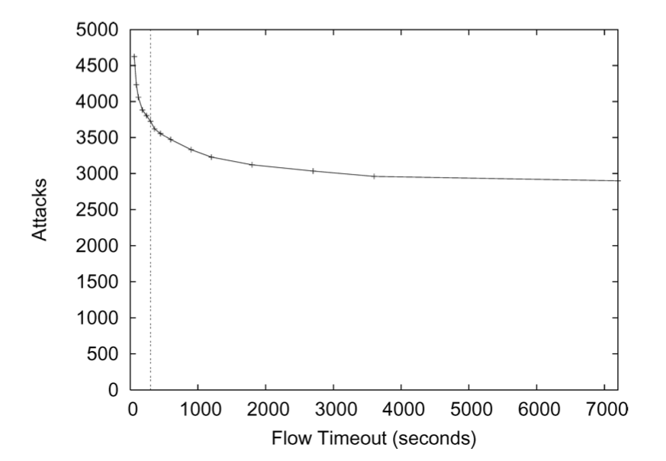
Flow-Based Classification
Flow Timeout (5 minutes)

Slide 28
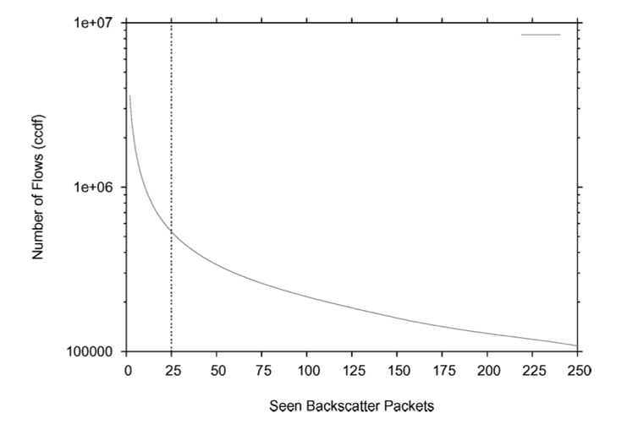
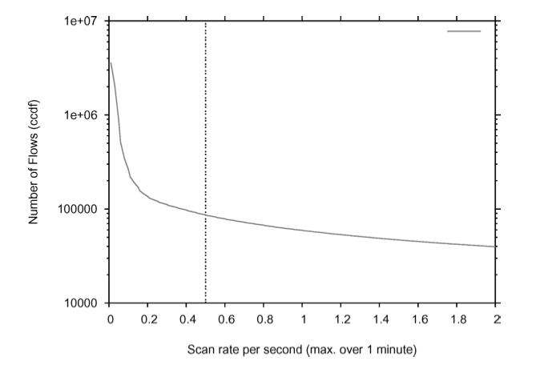
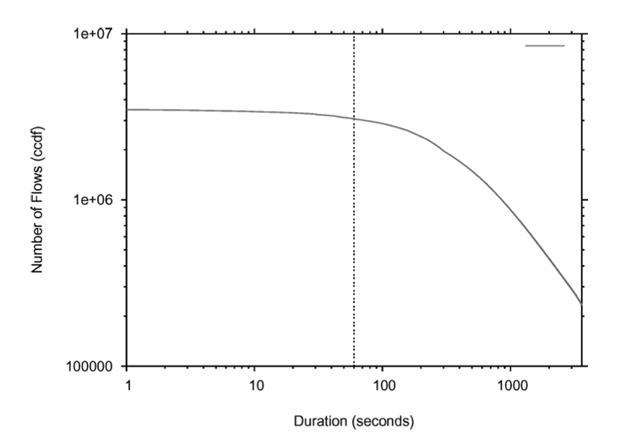
Deriving Denial-of-Service Attacks
Packet Threshold (> 25 packets)
Attack Duration (> 60 seconds)
Packet Rate (> 0.5 pps)

Slide 29
Extracted Information
IP protocol
TCP flag settings
ICMP payload (copies of the original packet)
Port settings
DNS information (source address, the victim).

Slide 30
Agenda
Introduction
Background
Methodology
Attack Detection and Classification
Analysis of Denial-Of-Service Activity
Conclusion

Slide 31
Analysis of Denial-Of-Service Activity
Borrowed from Thangam Seenivasan & Rabin Karki’s Presentation

Slide 32
Summary of Attack Activity
From 02/01/2001 to 02/25/2004
22 traces of DoS activity
Each trace roughly spans one week
68,700 attacks to 34,700 unique victim IP addresses in 5,300 distinct DNS domains
1,066 million backscatter packets (less than 1/256 of the backscatter traffic)

Slide 33
Interesting Features
No strong diurnal patterns.
Rate of attack doesn’t change significantly over the period of time.
Attacks were not clustered on particular subnets.
Exhibits daily periodic behavior.
At the same time everyday, attack increases from est. 2,500 pps to 100,000-160,000 pps.
Attack persists for one hour before subsiding again.
Tuesdays off (suggests attacks are scripted).

Slide 34
Attack Classification
Attack Protocols
The vast majority of attacks (93%) and packets (88%) use TCP
2.6% used ICMP
Most popular services targeted are HTTP (port 80), IRC (6667), port 0, and Authd (113)
Attack Rate
500 SYN pps is enough to overwhelm a server
65% of attacks had an estimated rate of this rate or higher
A server can be disabled by a flood of 14,000 pps
4% of attacks would compromise these attack-resistant firewalls
Attack Duration
60% attacks less than 10 min
80% are less than 30 min
85% last less than 1 hr
2.4% are greater than 5 hrs
1.5% are greater than 10 hrs
0.53% span multiple days

Slide 35
Victim Classification
Victim Type
Top-Level Domains
Victims of Repeated Attacks

Slide 36
Victim Type
roughly half of the victims are broadband users
slightly less than 10% are dial-up
5–10% of the victims are located on educational networks
a small number of victims appear to be Internet hosting centers
the majority of victims of the attacks are home users and small businesses
a significant number of attacks against victims running IRC
many reverse DNS mappings have been clearly compromised by attackers (e.g. “is.on.the.net.illegal.ly”).
a small but significant fraction of attacks directed against network infrastructure
Over 1.3% of attacks target routers
1.7% target name servers

Slide 37
Top-Level Domains
over 10% of the attacks targeted the .com and .net TLDs
fewer attacks (1.3–1.7%) targeted the .edu and .org domains
a disproportionate concentration of attacks to a small group of countries
attackers targeted Romania (.ro) as frequently as .net and .com
attackers targeted Brazil (.br) more than .edu and .org combined.

Slide 38
Victims of Repeated Attacks
most victims (89%) were attacked in only one trace (typically spanning roughly one week)
most of the remaining victims (7.8%) appear in two traces
victims can appear in multiple traces because of attacks that span trace boundaries
74% of the victims in each trace were targeted only during the collection of that trace
a small percentage of victims (3%) appear in more than three traces
Trace: attack that covers a week or more)

Slide 39
Validation
Nearly all of the packets are attributed to backscatter that does not itself provoke a response (e.g. TCP RST, ICMP Host Unreachable)
Distribution of destination addresses is consistent with a uniform distribution at the 0.05 significance level.
Data from several university-related networks in Northern California and Asta Networks qualitatively confirmed it.

Slide 40
Conclusion
presented a new technique, “backscatter analysis,” for estimating DoS attack activity in the Internet
observed widespread DoS attacks in the Internet
witnessed over 68,000 attacks
the size and length of the attacks were heavy-tailed
a surprising number of attacks directed at a few foreign countries, at home machines, and towards particular Internet services

Slide 41
Thanks
Q & A

