Slide 1
The ContikiMAC Radio Duty Cycling Protocol Adam Dunkels Swedish Institute of Computer Science SICS Tech Report T2011:13 Presenter - Bob Kinicki
Advanced Computer Networks
Fall 2013

Slide 2
Introduction
The Internet of Things is a current ‘buzz’ term that many see as the direction of the “Next Internet”.
This includes activities such as Smart Grid and Environmental monitoring.
This is a world of ubiquitous sensor networks that emphasizes energy conservation!

Slide 3
Internet of Things (IoT)

Slide 4
Steps for IoT Interoperability
1. Interoperability at the IPv6 layer
Contiki OS provides IPv6 Ready stack.
2. Interoperability at the routing layer
Interoperability between RPL implementations in Contiki and TinyOS have been demonstrated.
3. low-power interoperability
Radios must be efficiently duty cycled.
Not yet done!!

Slide 5
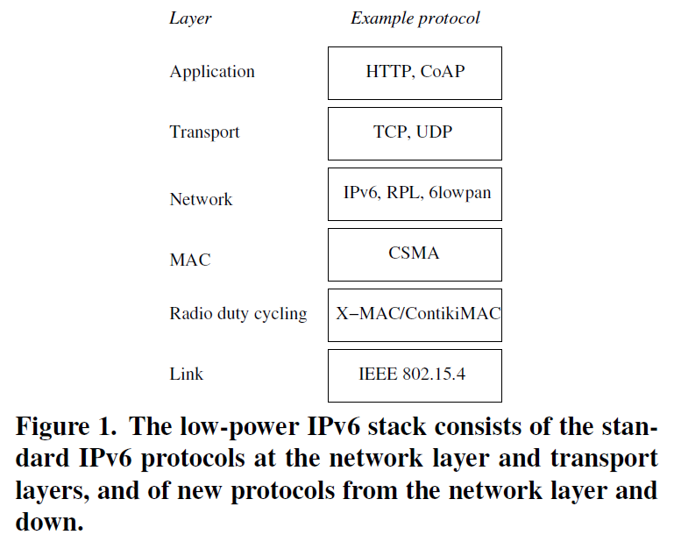
Low-Power IPv6 Stack
choices
for
MAC Layer

Slide 6
IPv6 for Low-Power Wireless
IPv6 stack for low-power wireless follows IP architecture but with new protocols from the network layer and below.
6LowPAN adaptation layer provides header compression mechanism based on IEEE 802.15.4 standard to reduce energy use for IPv6 headers.
Also provides link-layer fragmentation and reassembly for 127-byte maximum 802.15.4 frame size.

Slide 7
ContikiMac Overview
ContikiMAC is a radio duty cycling protocol that uses periodic wakeups to listen from packet transmissions from neighbors.
Uses fast sleep mechanism to allow receivers to quickly detect false positives
Uses transmission phase-lock optimization to increase energy efficiency.

Slide 8
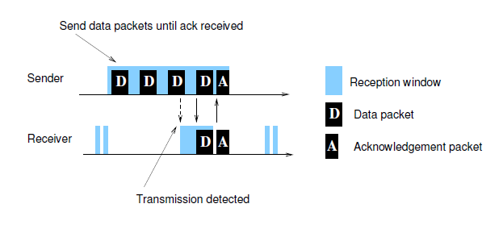
Figure 1 ContikiMAC
Figure 1 Unicast ContikiMAC
Receiver sends ACK

Slide 9
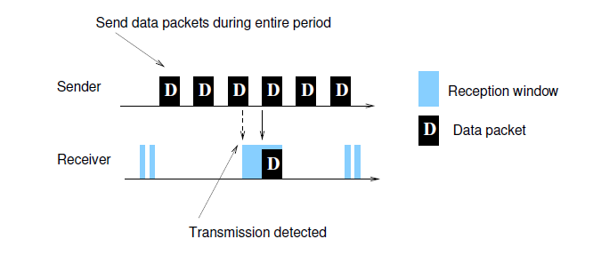
Figure 2 ContikiMAC
Figure 2 Broadcast ContikiMAC
No ACK sent.

Slide 10
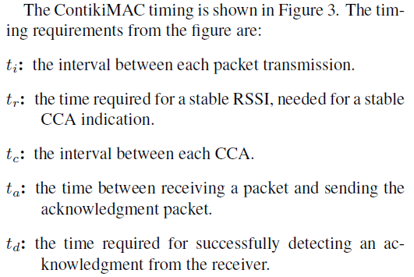
ContikiMAC Timing
: is the transmission time of the longest possible packet.

Slide 11
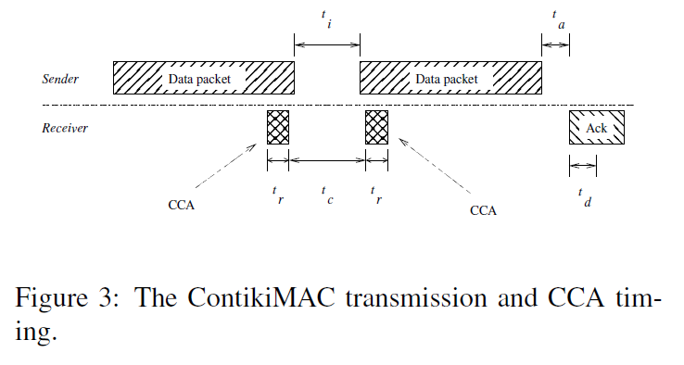
Figure 3 CCA Timing
CCA already part of CSMA and uses RSSI threshold (ambiguous)

Slide 12
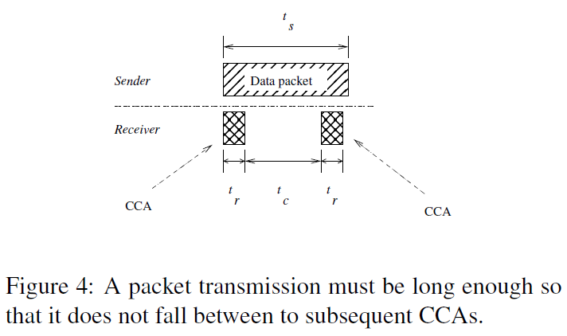
Figure 4 ContikiMAC Packet Length
t_{s} > t_{c} + 2 t_{r}

Slide 13
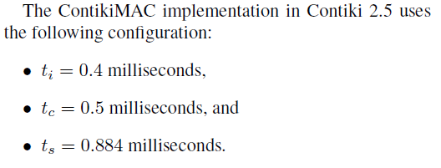
ContikiMAC Timing Constraints
Leads to 16-byte packet
payload minimum

Slide 14
CCA Ambiguity
Above RSSI threshold due to:
1. Neighbor is transmitting to another receiver (overhearing)
2. Another device is radiating radio energy
3. Hidden terminal transmission {not considered in this paper}
Naive awake period > t_{i} + 2 t_{l}

Slide 15
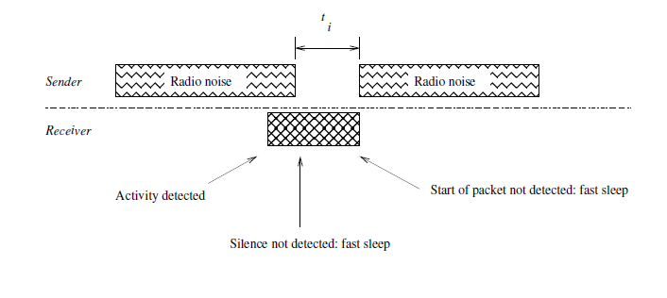
Figure 5 Fast Sleep Optimization
Figure 5 Fast Sleep Optimization
Fast Sleep triggered if radio activity duration too long,
silence gap too long or no start of packet detected

Slide 16
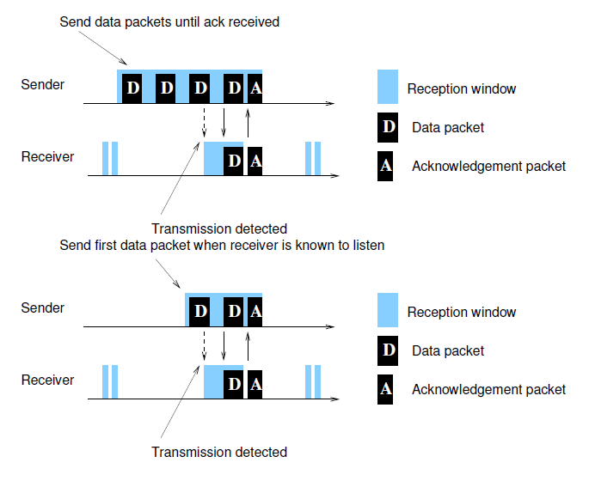
Figure 6 Transmission Phase-Lock

Slide 17
Implementation Details
ContikiMAC uses Contiki OS real-time timers to schedule periods.
Protothreads implement fast sleep optimization.
Phase-lock mechanism is a separate module from ContikiMAC
Maintains list of neighbors and wakeup phases.
If neighbor dies or suffers clock skew, neighbor is evicted after 30 sec of no ACKs.

Slide 18
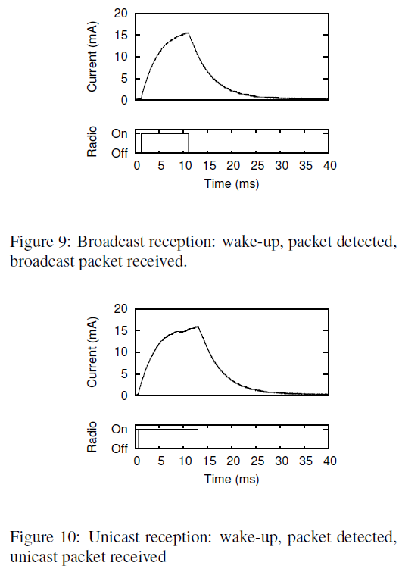
Figures 9 and 10 Micro Energy Measurements
Unicast sends an ACK

Slide 19
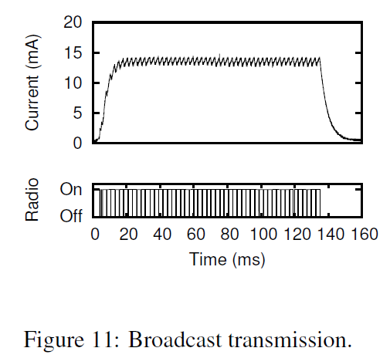
Figures 11 Broadcast Energy

Slide 20
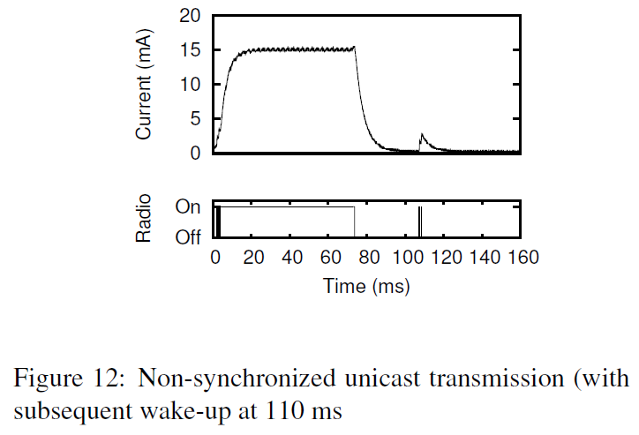
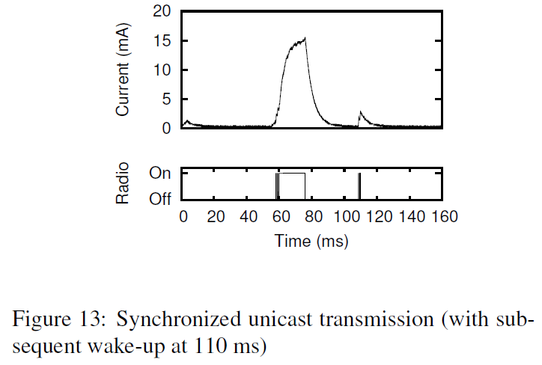
Figures 12 and 13 Unicast Energy

Slide 21
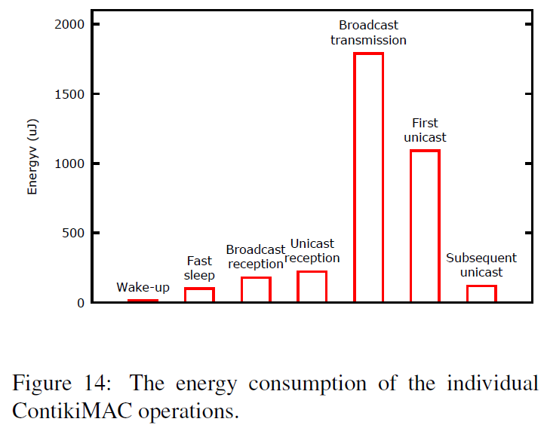
Figure 14 Micro Summary

Slide 22
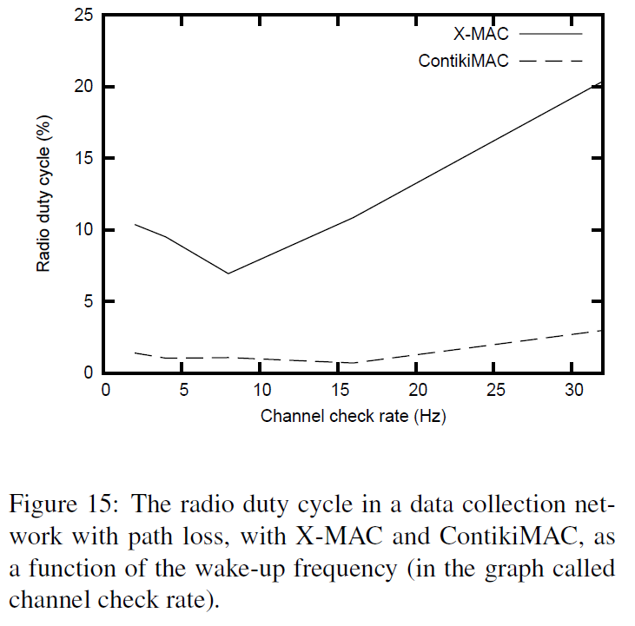
Figure 15 Duty Cycle Percentages
WARNING!!
Figures 15-17 use
Cooja simulator

Slide 23
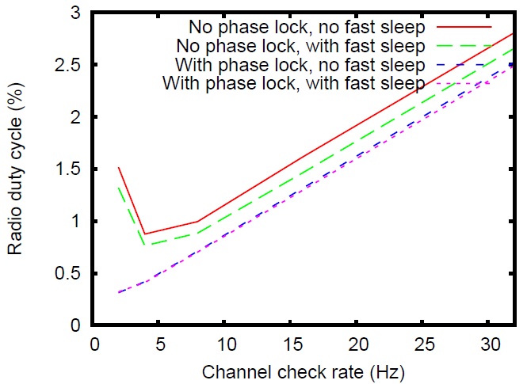
Figure 16 Duty Cycle Percentages
Figure 16 ContikiMAC with no path loss

Slide 24
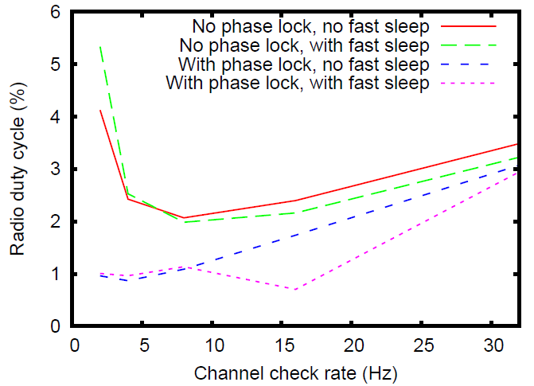
Figure 17 Duty Cycle Percentages
Figure 17 ContikiMAC with path loss

Slide 25
Summary of Results
CCA mechanism saves energy in ContikiMAC
Phase-Lock (a form of synchronization) reduces sender energy.
Fast sleep reduces the cost associated with two CCAs for probe mechanism.

Slide 26
Critique
Experiments were minimal – no broadcast tests.
Topology never stated – is there a base station?
No consideration for delay costs or multiple hop traversals over extended sensor neighborhoods.

Slide 27
Questions ?
The ContikiMAC Radio Duty Cycling Protocol

