Slide 1
An Analysis of the Skype Peer-to-Peer Internet Telephony Protocol
Salman Baset and Henning Schuzrinne INFOCOMM 2006
Presenter - Bob Kinicki

Slide 2
Outline
Skype Overview
Skype Components
Review of NATs
Experimental Set Up
Skype Functionality
Login, Login Server, User Search, Call Establishment, Conferencing
Super Node Facts
Conclusions

Slide 3
Skype Overview
Developed by Kazaa as an overlay P2P (peer-to-peer) network.
Provides a VoIP client that supports voice calls, instant messaging, audio conferencing and buddy lists. {Currently supports video!}
Uses TCP for signaling and TCP and UDP for transporting media traffic.
Uses 256-bit AES encryption.
Employs wideband codecs (iLBC, ISAC and iPCM) that allow frequencies between 50-8000 Hz.

Slide 4
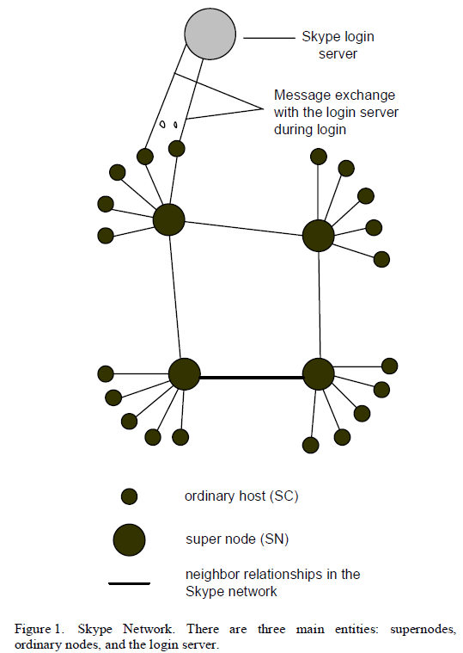
Skype Network
Ordinary Host
Skype Client (SC)
Super Node (SN)
Skype Client
Must have public IP address
Has sufficient capacity, CPU and memory
Skype Login Server

Slide 5
Skype Overview
Ordinary hosts (SC) must connect through a super node (SN) and authenticate itself via the Skype login server.
Skype handles ordinary hosts behind a port-restricted NAT (Network Address Translation) and/or a UDP-restricted firewall.
Authors infer from experimentation that variant of STUN (Session Traversal Utilities for NAT [RFC5389) protocol is used by non-centralized Skype servers to determine the type of NAT and firewall the SC is behind.

Slide 6
Skype Components
SC randomly selects UDP listening port at install.
SC also opens ports 80 and 443 to listen for incoming HTTP and HTTP-over-TLS* requests, respectively.
* Transport Layer Security supersedes and is an extension of SSL.

Slide 7
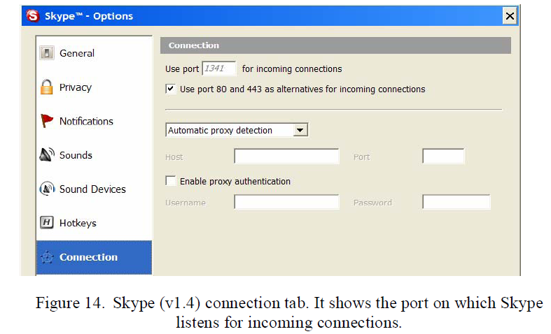
SC Ports

Slide 8
Host Cache
Local table contains IP address, port pairs for reachable SNs {max is 200 entries}.
Host cache is populated on the first login.
SNs are periodically added/dropped as Skype runs.
[Keating 09]

Slide 9
NAT: Network Address Translation
local network
(e.g., home network)
10.0.0/24
rest of
Internet
10.0.0.1
10.0.0.4
10.0.0.2
138.76.29.7
10.0.0.3
All datagrams leaving local
network have same single source NAT IP address: 138.76.29.7,
different source port numbers
Datagrams with source or
destination in this network
have 10.0.0/24 address for
source, destination (as usual)

Slide 10
NAT: Network Address Translation
Motivation: local network uses just one IP address as far as outside world is concerned:
range of addresses not needed from ISP: just one IP address for all devices.
can change addresses of devices in local network without notifying outside world.
can change ISP without changing addresses of devices in local network.
devices inside local net not explicitly addressable, visible by outside world (a security plus).

Slide 11
NAT: Network Address Translation
Implementation: NAT router must:
outgoing datagrams: replace (source IP address, port #) of every outgoing datagram to (NAT IP address, new port #)
. . . remote clients/servers will respond using (NAT IP address, new port #) as destination address.
remember (in NAT translation table) every (source IP address, port #) to (NAT IP address, new port #) translation pair
incoming datagrams: replace (NAT IP address, new port #) in dest fields of every incoming datagram with corresponding (source IP address, port #) stored in NAT table.

Slide 12
NAT: Network Address Translation
NAT translation table
WAN side addr LAN side addr
1: host 10.0.0.1
sends datagram to
128.119.40.186, 80
2: NAT router
changes datagram
source addr from
10.0.0.1, 3345 to
138.76.29.7, 5001,
updates table
138.76.29.7, 5001 10.0.0.1, 3345
…… ……
S: 10.0.0.1, 3345
D: 128.119.40.186, 80
10.0.0.1
1
2
S: 138.76.29.7, 5001
D: 128.119.40.186, 80
10.0.0.4
10.0.0.2
138.76.29.7
S: 128.119.40.186, 80
D: 10.0.0.1, 3345
4
S: 128.119.40.186, 80
D: 138.76.29.7, 5001
3
10.0.0.3
4: NAT router
changes datagram
dest addr from
138.76.29.7, 5001 to 10.0.0.1, 3345
3: Reply arrives
dest. address:
138.76.29.7, 5001

Slide 13
NAT Traversal Problem
client wants to connect to server with address 10.0.0.1
server address 10.0.0.1 local to LAN (client can’t use it as destination addr)
only one externally visible NATted address: 138.76.29.7
Solution 1: statically configure NAT to forward incoming connection requests at given port to server
e.g., (123.76.29.7, port 2500) always forwarded to 10.0.0.1 port 25000
10.0.0.1
Client
?
10.0.0.4
138.76.29.7
NAT
router

Slide 14
NAT Traversal Problem
Solution 2: Universal Plug and Play (UPnP) Internet Gateway Device (IGD) Protocol. Allows NATted host to:
learn public IP address (138.76.29.7)
add/remove port mappings (with lease times)
i.e., automate static NAT port map configuration
10.0.0.1
IGD
10.0.0.4
138.76.29.7
NAT
router

Slide 15
NAT Traversal Problem
Solution 3: relaying (used in Skype)
NATed client establishes connection to relay
External client connects to relay
relay bridges packets between to connections
2. connection to
relay initiated
by client
1. connection to
relay initiated
by NATted host
10.0.0.1
3. relaying
established
Client
138.76.29.7
NAT
router

Slide 16
Skype Experimental Setup
Performed traffic analysis on Windows Skype version 1.4.0.84 and Linux Skype version 1.20.18 in November-December 2005.
Windows XP machines (3 GHz Pentium 4 CPU, 1GB RAM) with 10/100 Mbps Ethernet card connected to 100 Mbps network.
(Wireshark) Ethereal network protocol analyzer
Captures all traffic passing over a network.
NetPeeker
Used to tune capacity levels.

Slide 17
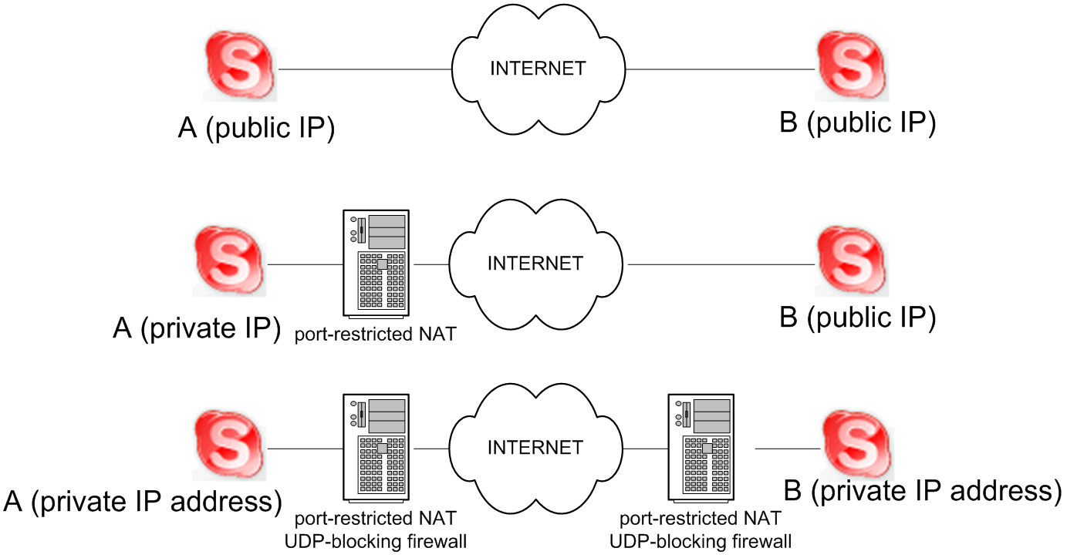
Experimental Setup
Taken from INFOCOMM06 Presentation
[Keating 09]

Slide 18
Skype Functionality Login Login Server User Search Call Establishment Conferencing
Advanced Computer Networks
Analysis of Skype 2006

Slide 19
Skype Login
On the first login, Skype client establishes UDP connection with Bootstrap SuperNode (BN).
Hard-coded into Skype client application.
Logins routed through a SuperNode.
If no SuperNodes are reachable, login fails.
Attempts to use Ports 80 and 443 if behind firewall.

Slide 20
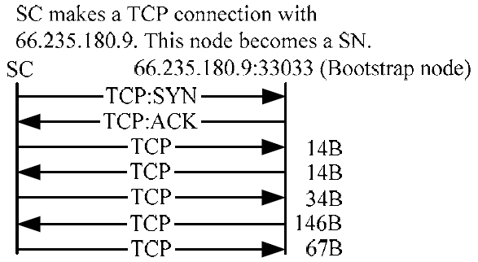
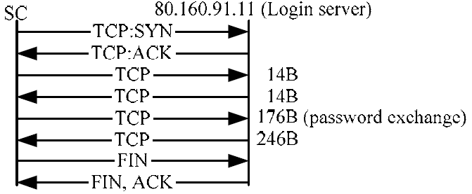
Login {Public IP and NAT}
SC->BN UDP Connection
SC->SN TCP Connection
SC->Login Server Auth
3-7 seconds
[Keating 09]

Slide 21
Skype ver 1.4 Login Experiment
Copy of SC uninstalled; Windows registry cleared of Skype entries;
new copy of SC installed.

Slide 22
Mystery ICMP Packets
USA
Sweden
Australia
Japan

Slide 23
Login Server
Login Server is ONLY central component in Skype P2P network.
After SC connects to SN, SC authenticates with Login Server.
Experiments show SC exchanging data over TCP with 212.72.49.141 or 195.215.8.141 (Login Servers).

Slide 24
Skype User Search
Uses Global Index technology.
Skype guarantees it will find any user logged in (public or private IP) in last 72 hours.
Search depends on where SC resides.
Experiments show SC performs user information caching at intermediate nodes.

Slide 25
User Search from Public IP/NAT
16b
TCP
101b
UDP
UDP
UDP
…
[Keating 09]

Slide 26
User Search from UDP–Restricted Firewall
SuperNode performs search
16B
TCP
52B
406B
TCP
…
1104B
[Keating 09]

Slide 27
Call Establishment
Skype uses buddy list.
Call signaling carried out with TCP.
Initial message exchanges uses a “challenge-reponse” mechanism.

Slide 28
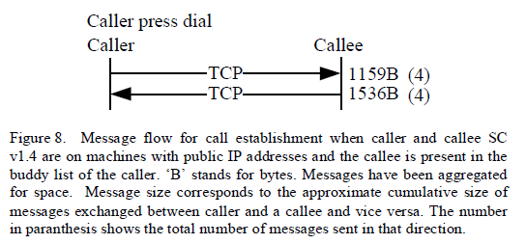
Caller and Callee Public IP Addresses

Slide 29
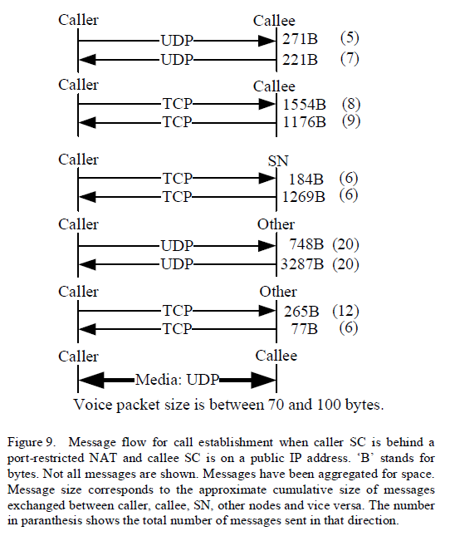
Caller behind NAT

Slide 30
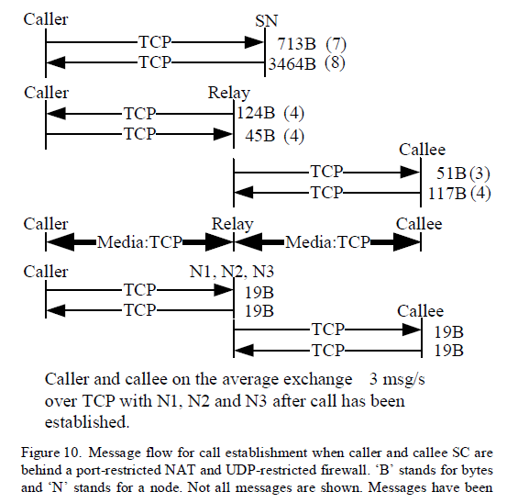
Caller and Callee behind NAT
Users generally do not like
that arbitrary traffic can
flow across their machine!!

Slide 31
Media Transfer
Internet Speech Audio Codec (iSAC)
Frequency range: 50-8000Hz
Public IPs communicate directly.
NAT/firewall users use an SN relay node.
Uses UDP Transport if possible.
5 kilobytes/sec
UDP-restricting firewall users communicate over TCP
Does not perform Silence Suppression.

Slide 32
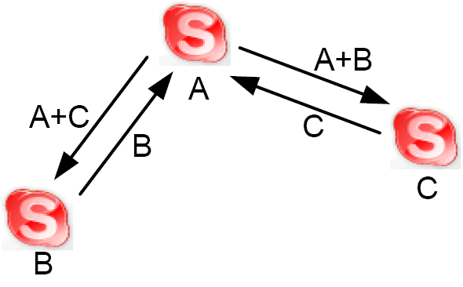
Skype Conferencing
A: 2GHz P4 w/ 512MB RAM
B, C: 300MHz P2 w/ 128MB RAM
A acts as mixer for both B and C

Slide 33
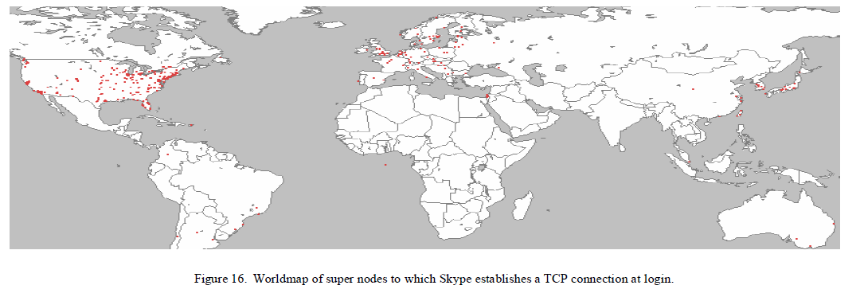
Skype Super Nodes

Slide 34
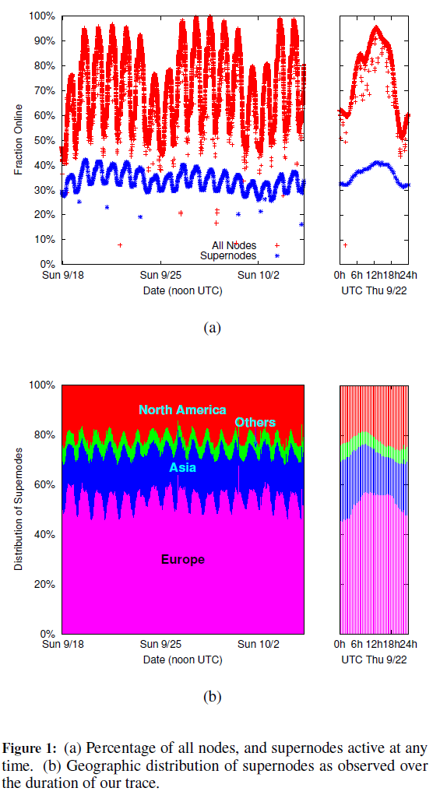
Super Node Behavior
[Guha 06]

Slide 35
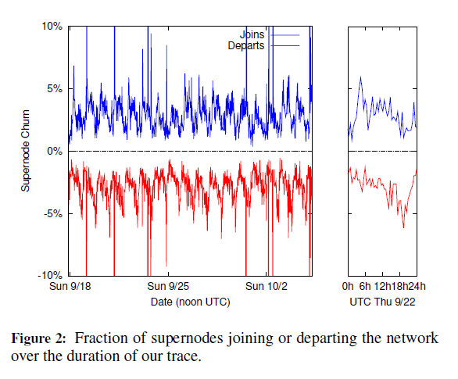
Super Node ‘Churn’
[Guha 06]
[Guha 06]

Slide 36
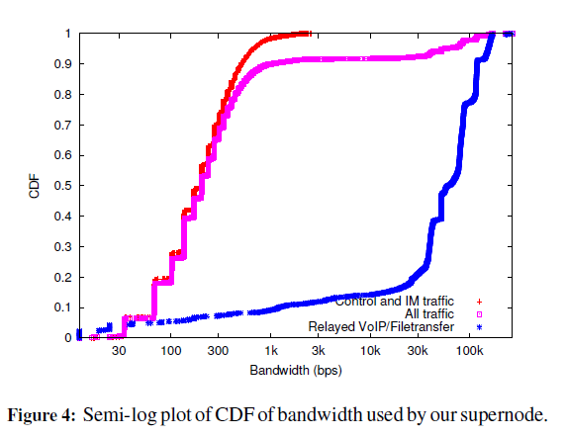
Super Node Bandwidth Consumption
[Guha 06]

Slide 37
Conclusions
Skype can work behind NATs and firewalls using STUN protocol.
Skype architecture relies on Super Nodes with public IP addresses.
Skype uses TCP for signaling and prefers to use UDP for media transfer.
Skype packets are encrypted and Skype uses a central Login Server to authenticate Skype users.

Slide 38
References
[Guha 06] S. Guha, N. Dawani and R. Jain, “An Experimental Study of the Skype Peer to Peer VoIP System”, The Fifth International Workshop on Peer-to-Peer Systems (IPTPS06), Santa Barbara, CA, February 2006.
[Keating 09] Andrew Keating presentation in CS577 Fall 2009.

Slide 39
Thanks! Questions?
Advanced Computer Networks
Analysis of Skype 2006

