Slide 1
Random Early Detection Gateways for Congestion Avoidance*
_{* 5886 citations as of 19Sep11}
Sally Floyd and Van Jacobson,
IEEE Transactions on Networking, Vol.1, No. 4, (Aug 1993), pp.397-413.
Presented by Bob Kinicki

Slide 2
Outline
Introduction
Background: Definitions and Previous Work
The RED Algorithm
RED Parameters
RED Simulation Results
Evaluation of RED Design Goals
Conclusions and Future Work

Slide 3
Introduction
Main idea :: to provide congestion control at the router for TCP flows.
RED Algorithm Goals
The primary goal is to provide congestion avoidance by controlling the average queue size such that the router stays in a region of low delay and high throughput.
To avoid global synchronization (e.g., in Tahoe TCP).
To control misbehaving users (this is from a fairness context).
To seek a mechanism that is not biased against bursty traffic.

Slide 4
Definitions
congestion avoidance – when impending congestion is indicated, take action to avoid congestion.
incipient congestion – congestion that is beginning to be apparent.
need to notify connections of congestion at the router by either marking the packet [ECN] or dropping the packet {This assumes a router drop is an implied signal to the source host.}

Slide 5
Previous Work
Drop Tail (FIFO)
Random Drop
Early Random Drop
Source Quench Messages
DECbit Scheme

Slide 6
Drop Tail Router
FIFO queuing mechanism that drops packets from the tail when the queue overflows.
Introduces global synchronization when packets are dropped from several connections.

Slide 7
Random Drop Router
When a packet arrives and the queue is full, randomly choose a packet from the queue to drop.

Slide 8
Early Random Drop Router
p
Drop level
If the queue length exceeds a drop level, then the router drops each arriving packet with a fixed drop probability p.
Reduces global synchronization.
Does not control misbehaving users (UDP flows).

Slide 9
Source Quench Messages
Router sends source quench messages back to source before the queue reaches capacity.
Complex solution that gets router involved in end-to-end protocol.
This solution violates the end-to-end tenet of Internet architects!!

Slide 10
DECbit Scheme
Uses a congestion-indication bit in packet header to provide feedback about congestion.
Upon packet arrival, the average queue length is calculated for last (busy + idle) period plus current busy period.
When the average queue length exceeds 1, the router sets the congestion-indicator bit in arriving packet’s header.

Slide 11
DECbit Scheme
The source updates its window every two RTTs.
If at least half of packets in source’s last window have the bit set, decrease the congestion window exponentially.
Otherwise, the window is increased linearly.

Slide 12
RED Algorithm
for each packet arrival
calculate the average queue size avg
if min_{th} ≤ avg < max_{th}
calculate the probability p_{a}
with probability p_{a}:
mark the arriving packet
else if max_{th} ≤ avg
mark the arriving packet.

Slide 13
RED Drop Probability ( p_{a} )
p_{b} = max_{p} x (avg - min_{th})/(max_{th} - min_{th}) [1]
where
p_{a} = p_{b}/ (1 - count x p_{b}) [2]
Note: this calculation assumes queue size is measured in packets. If queue is in bytes, we need to add [1.a] between [1] and [2]
p_{b} = p_{b} x PacketSize/MaxPacketSize [1.a]

Slide 14
avg - Average Queue Length
avg = (1 – w_{q}) x avg + w_{q} x q
where q is the newly measured queue length.
This Exponential Weighted Moving Average (EWMA) is designed such that short-term increases in queue size from bursty traffic or transient congestion do not significantly increase average queue size.

Slide 15
RED/ECN Router Mechanism
1
Dropping/Marking Probability
maxp
0
minth
maxth
Queue Size
Average Queue Length

Slide 16
‘Gentle’ RED
1
Dropping/Marking Probability
maxp
0
minth
maxth
Queue Size
Average Queue Length

Slide 17
RED Parameter Settings
w_{q} authors suggest 0.001 <= w_{q} <= 0.0042
authors use w_{q} = 0.002 for simulations
min_{th}, max_{th} depend on desired average queue size
bursty traffic ➔ increase min_{th} to maintain link utilization.
max_{th} depends on the maximum average delay allowed.
RED is most effective when max_{th} - min_{th} is larger than typical increase in calculated average queue size in one round-trip time.
“parameter setting rule of thumb”: max_{th} at least twice min_{th} . However, max_{th} = 3 times min_{th} is used in some of the experiments shown.

Slide 18
Packet-Marking Probability
The goal is to uniformly spread out the marked packets. This reduces global synchronization.
Method 1: Geometric random variable
When each packet is marked with probability p_{b,}, the packet inter-marking time, X, is a geometric random variable with E[X] = 1/ p_{b.}
This distribution will both cluster packet drops and have some long intervals between drops!!

Slide 19
Packet-Marking Probability
Method 2: Uniform random variable
Mark packet with probability p_{b}/ (1 - count x p_{b}) where count is the number of unmarked packets that have arrived since last marked packet.
E[X] = 1/(2 p_{b}) + 1/2

Slide 20
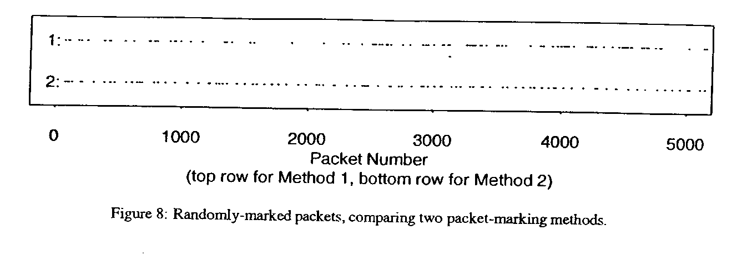
Method 1: geometric p = 0.02
Method 2: uniform p = 0.01
Result :: marked packets more clustered for method 1 ➔ uniform is better at eliminating “bursty drops”

Slide 21
Setting max_{p}
“RED performs best when packet-marking probability changes fairly slowly as the average queue size changes.”
This is a stability argument in that the claim is that RED with small max_{p} will reduce oscillations in avg and actual marking probability.
They recommend that max_{p} never be greater than 0.1
{This is not a robust recommendation.}

Slide 22
RED Simulation* Results
Figure 4: Four heterogeneous FTP sources
Figure 6: Two homogeneous FTP sources
Figure 10: 41 Two-way, short FTP and TELNET flows
Figure 11: Four FTP non-bursty flows and one bursty FTP flow
*As direct predecessor of NS2, Real
simulator is paper’s biggest contribution.

Slide 23
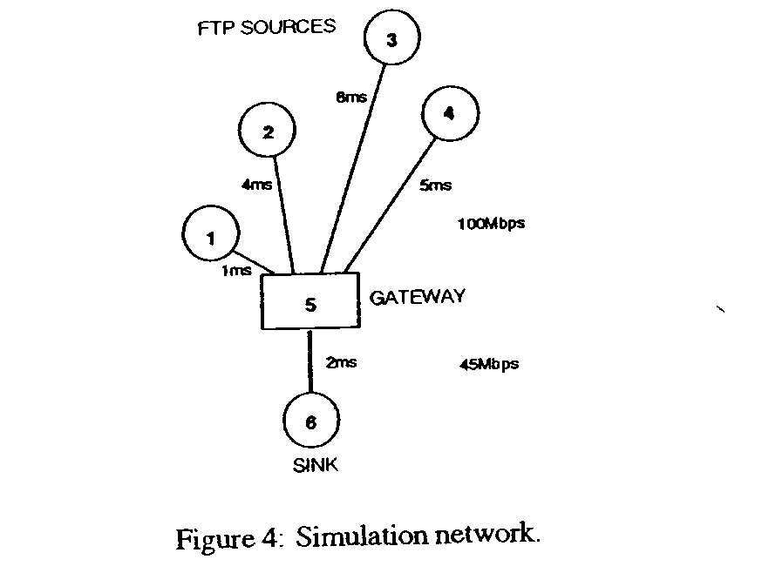
Simple Simulation
Four Heterogeneous FTP Sources
TCP Tahoe
1KB packet size
wq = 0.002
maxp = 1/50
minth = 5
maxth = 15
max cwnd = bdp
Large buffer with
no drop-tail
packet drops.

Slide 24
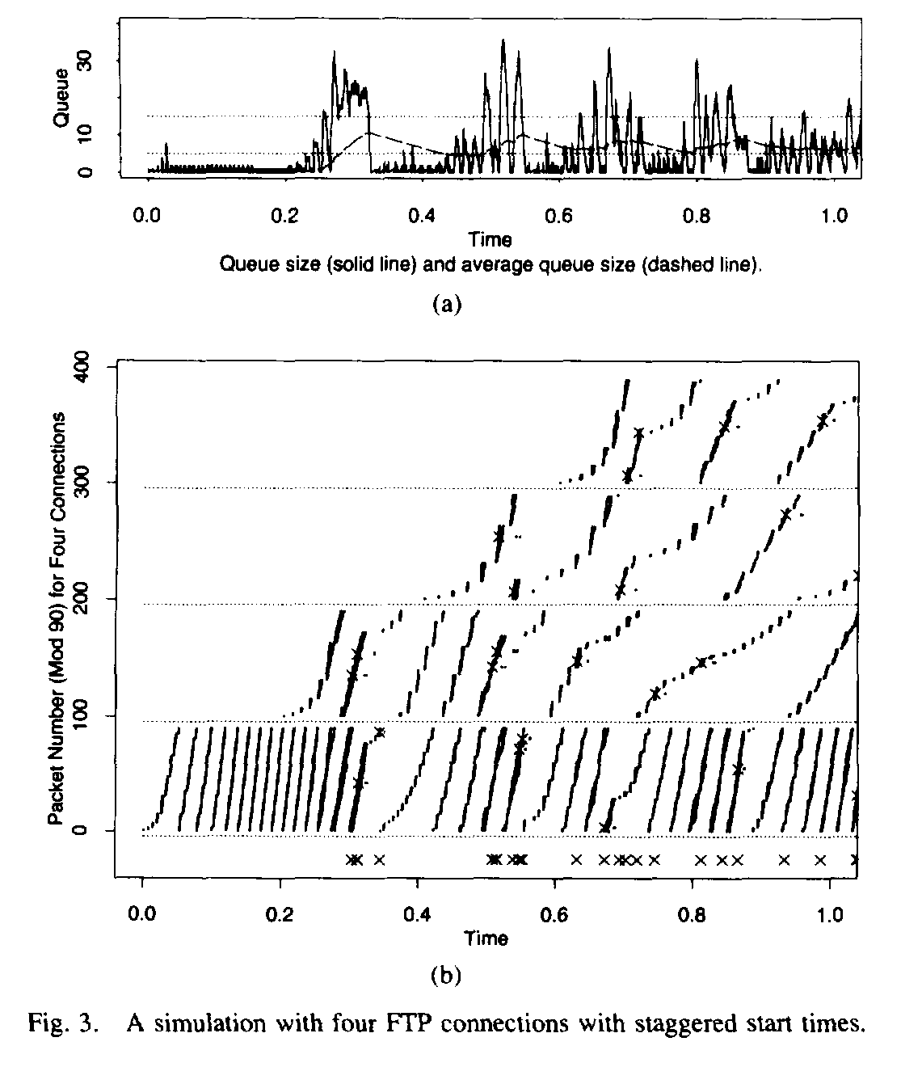
Note:
staggered
start times
and uneven
throughputs

Slide 25
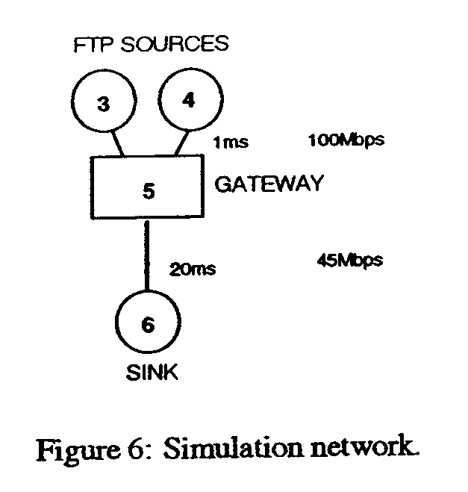
Two Homogeneous FTP Sources
RED varies minth from 3 to 50 packets with fixed buffer of 100 packets.
maxth set to 3 minth
Drop Tail varies buffer from 15 to 140 packets
max cwnd = 240 packets

Slide 26
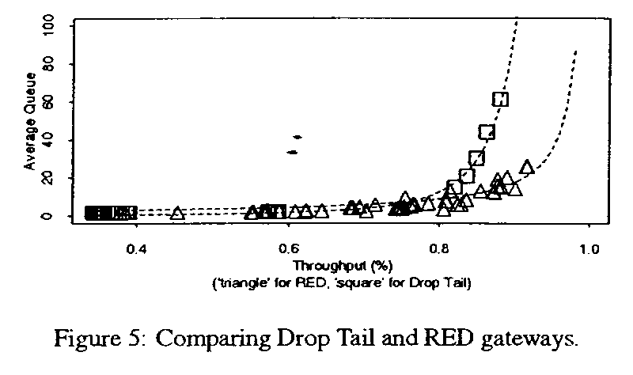
Two Homogeneous FTP Sources
Figure 5 represents many 5-sec. simulation experiments.
RED yields lower queuing delay as utilization improves by increasing minth from 3 to 50 packets.
Drop-tail yields unacceptable delay at high utilization.
The power measure is better for RED !

Slide 27
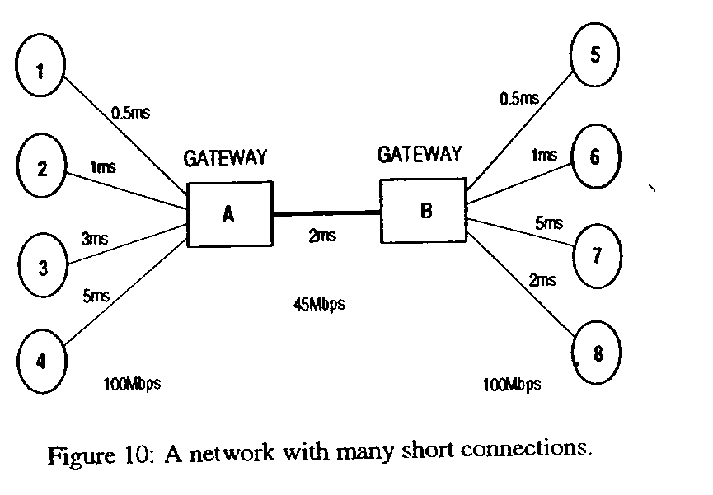
Network with
41 Short Duration Connections
Traffic going in both
directions.
Mostly FTP and a few
TELNET connections.
Total packets varies from
20 to 400 packets per
connection.

Slide 28
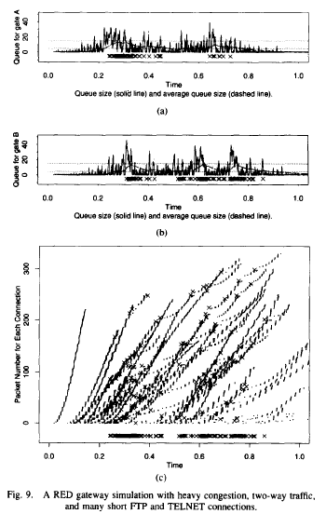
Short, Two-Way
FTP and TELNET Flows
- RED controls the average
queue size in both directions.
- Flows have small cwnd
maximums (8 or 16).
- Packet dropping is higher and
bursty.
- Low utilization: (61% and 59%).
- ACK-compression contributes
to bursty packet arrivals.
.

Slide 29
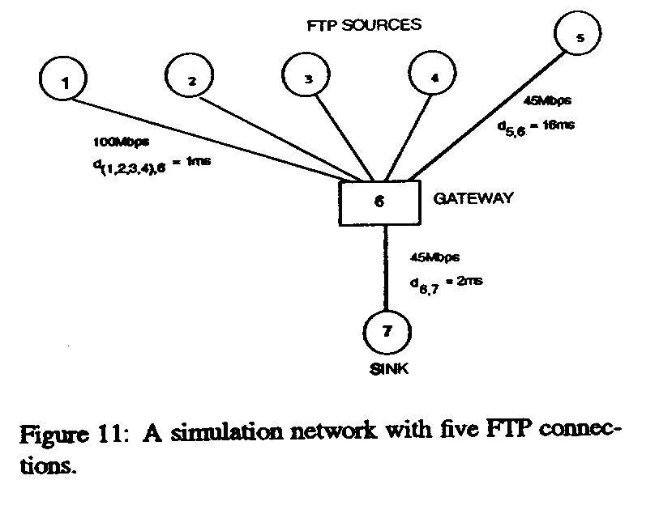
Five FTP Flows
Including One Bursty Flow

Slide 30
Simulation Details
Flow 5 is a bursty flow due to large RTT, small cwnd (8 packets).
First four flows are robust due small RTT, small cwnd of 12 packets.
Gateway buffer varies from 8 to 22 packets for “drop” queues.
Each simulation runs for 10 seconds and each mark in the figures represents one second (i.e., 10 throughput data points per cwnd size).
Graphs show flow 5 utilizations.

Slide 31
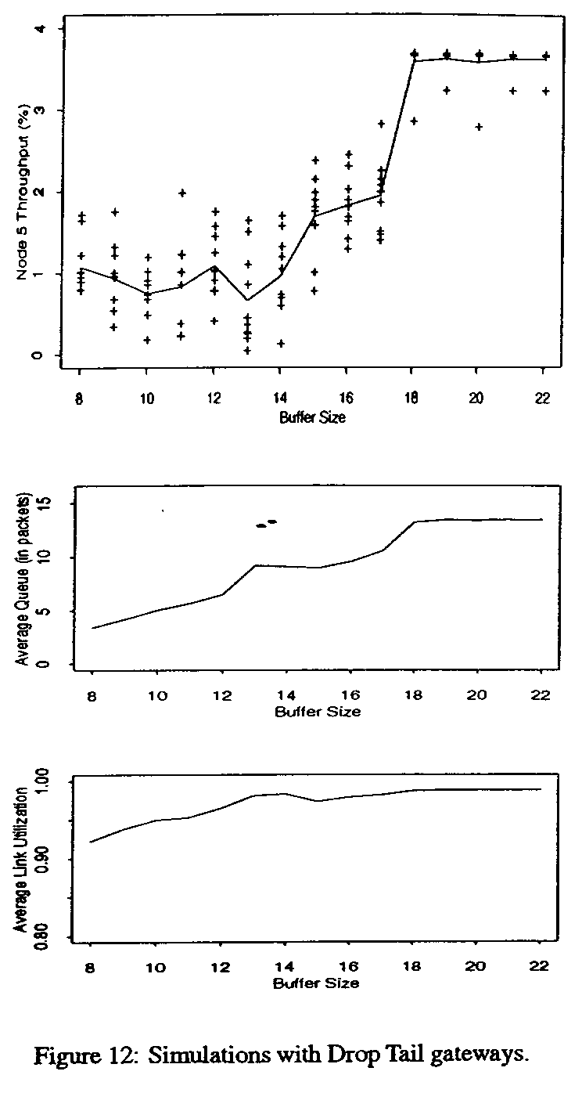
Drop Tail Gateways

Slide 32
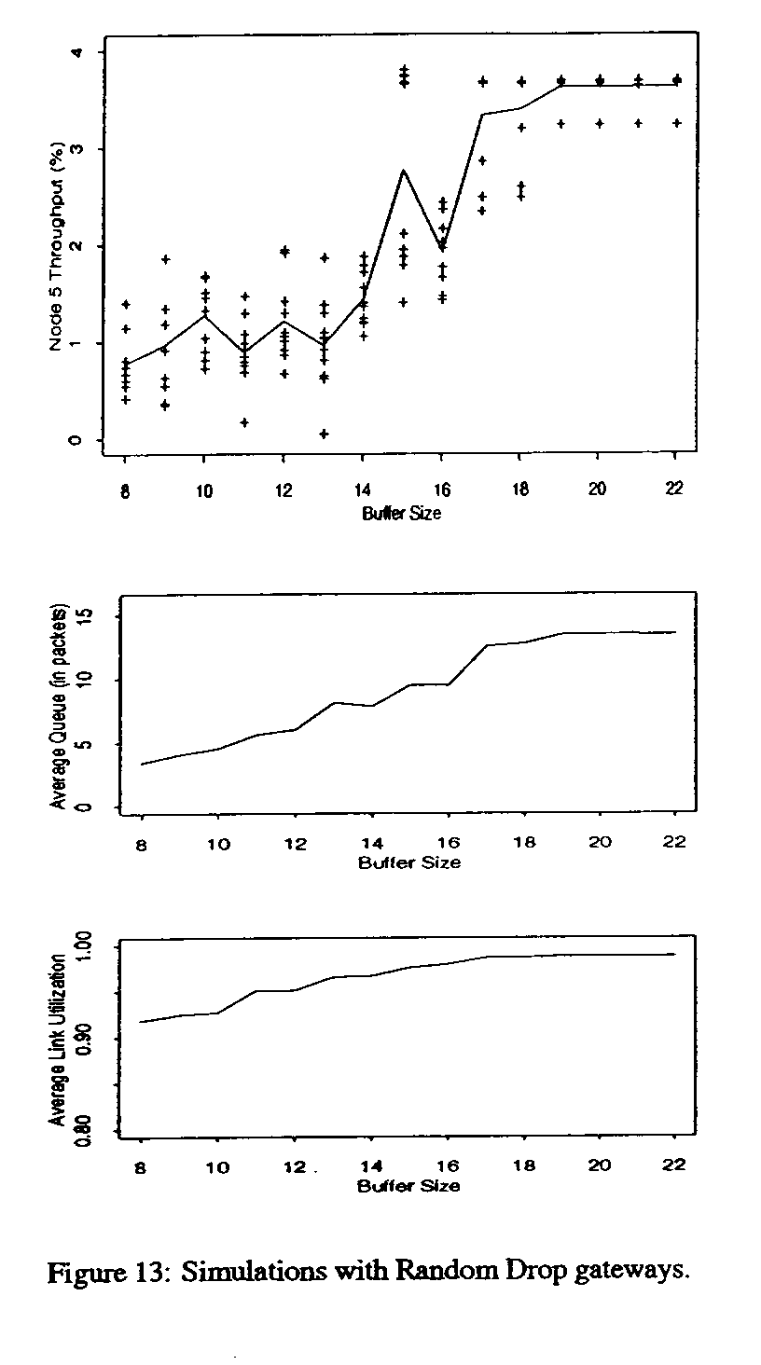
Random Drop Gateways

Slide 33
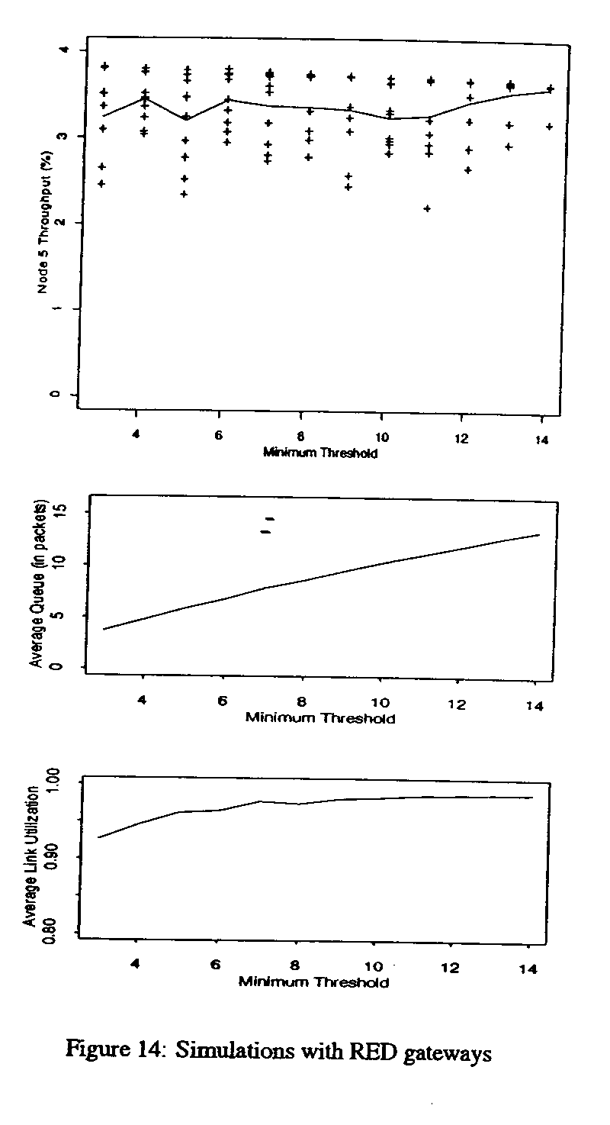
RED Gateways

Slide 34
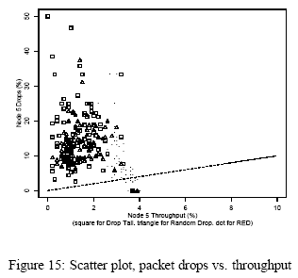
Bursty Flow Packet Drop Bias
RED
performance

Slide 35
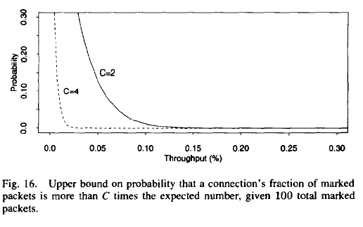
Identifying Misbehaving Flows
The assumption is
marked packets
matches the flows’
share of the bandwidth.

Slide 36
Evaluation of RED Design Goals
congestion avoidance
If RED drops packets, this guarantees the calculated average queue size does not exceed the max threshold. If w_{q} is set properly, RED controls the actual average queue size.
If RED marks packets when avg exceeds max_{th}, the router relies on source cooperation to control the average queue size. {not part of RED, this is ECN.}

Slide 37
Evaluation of RED Design Goals
appropriate time scales
claim:: The detection time scale roughly matches time scale of source’s response to congestion.
RED does not notify connections during transient congestion at the router.
{This argument is weak here.}

Slide 38
Evaluation of RED Design Goals
no global synchronization
RED avoids global synchronization by marking at as low a rate as possible with marking distribution spread out.
simplicity
detailed argument about how to cheaply implement in terms of adds and shifts.
{Historically, the simplicity of RED has been strongly refuted because RED has too many parameters to make it robust.}

Slide 39
Evaluation of RED Design Goals
maximizing global power
power is ratio of throughput to delay.
see Figure 5 for comparison against drop tail.
fairness
The authors’ claim fairness is not well-defined.
{This is an obvious side-step of this issue.}
[later this becomes a big deal - see FRED paper.]

Slide 40
Evaluation of RED Design Goals
Appropriate for a wide range of environments
Discussion is weak.
Shifts into parameter sensitivity discussion.

Slide 41
Conclusions
RED is an effective mechanism for congestion avoidance at the router in cooperation with TCP.
By controlling the calculated average queue size, RED provides an upper bound on the average delay at the gateway.
claim:: The probability that RED chooses a particular connection to notify during congestion is roughly proportional to that connection’s share of the bandwidth.

Slide 42
Future Work (circa 1993)
Is RED really fair?
How do we tune RED?
Is there a way to optimize power?
What happens with other versions of TCP?
How does RED work when mixed with drop tail routers?
How robust is RED?
What happens when there are many flows?

