Slide 1
Worcester Polytechnic Institute CS577/ECE537 Advance Computer Networks Kerberos Authentication Protocol
Murad Kaplan mkaplan@wpi.edu

Slide 2
What is Kerberos?
Network Authentication Protocol
Uses private-key Cryptography
Built on Needam/Schroeder Scheme
Protects Against
Eavesdropping
Replay Attacks
Trusted third part is required
Developed before public-key methods

Slide 3
History
Developed at MIT out of Athena Project
Athena is a distributed file sharing project
Developed based on other protocols with the addition of a timestamp to prevent replay attacks.
Implementations
MIT
Heimdal
Sun
Microsoft

Slide 4
How did it get its name?
Kerberos is the three headed dog in Greek mythology (also known as Cerberus)
Three Heads
Authentication
The users must be able to prove who they are..
Authorization
The user must have access to the resource it is trying to get.
Accounting
The user cannot deny accessing something, these resources are accounted for.

Slide 5
Why do we need protocols?
Benefits of Kerberos
Single sign-on capability
* the user doesn’t have to authenticate him/herself for every interaction
Passwords never get sent across the network.
Replay Attacks are not possible
This builds upon previous protocols vulnerabilities

Slide 6
Organization
Trusted Third
Party
Email Server
Print Server
Remote Access Server
Key establishment is done through a third party.
Client
…
Client

Slide 7
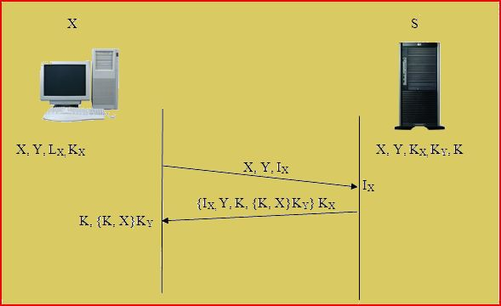
Needam/Schroeder
Message | Definition
X Y I_{X} I_{Y} K_{X} K_{Y} K | Identifier of Client X Identifier of Client Y One time used identifier of X One time used identifier of Y Private key of client X Private key of client Y Private session key of X and Y

Slide 8
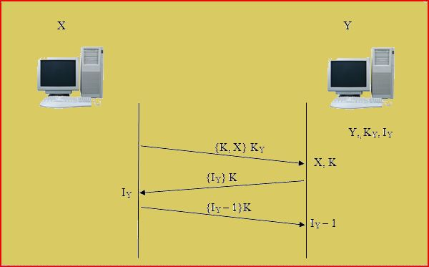
Needham/Schroeder (con’t)
Message | Definition
X Y I_{X} I_{Y} K_{X} K_{Y} K | Identifier of Client X Identifier of Client Y One time used identifier of X One time used identifier of Y Private key of client X Private key of client Y Private session key of X and Y

Slide 9
Kerberos
What is new?
Timestamp
TGS

Slide 10
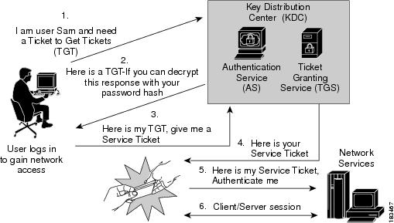
Authentication (Ticket Exchange)
http://www.cisco.com/en/US/docs/security/nac/appliance/configuration_guide/412/cas/s_adsso.html

Slide 11
Implementation - Terminology
Term | Definition
Principle Client (C) Server (S) Authentication Server (AS) Ticket-granting Server (TGS) Ticket (T_{X,Y}) Authenticator (A_{X}) (K_{X}) (K_{X,Y}) | Each entity that uses the Kerberos system Entity that request service Entity that provide service Kerberos server that provides initial authentication service Kerberos server that grants service tickets Identification credential for X to get service from Y One time identification credential generated by X X’s secret key Session key for X and Y

Slide 12
Message Types
Session | Message types | Directions
The Authentication Service Exchange | KRB_AS_REQ | Client to AS
 | KRB_AS_REP | AS to client
The Ticket Granting Service (TGS) Exchange | KRB_TGS_REQ | Client to TGS
 | KRB_TGS_REP | TGS to Client
The Client/Server Authentication Exchange | KRB_AP_REQ | Client to Application server
 | KRB_AP_REP | [optional] Application server to client

Slide 13
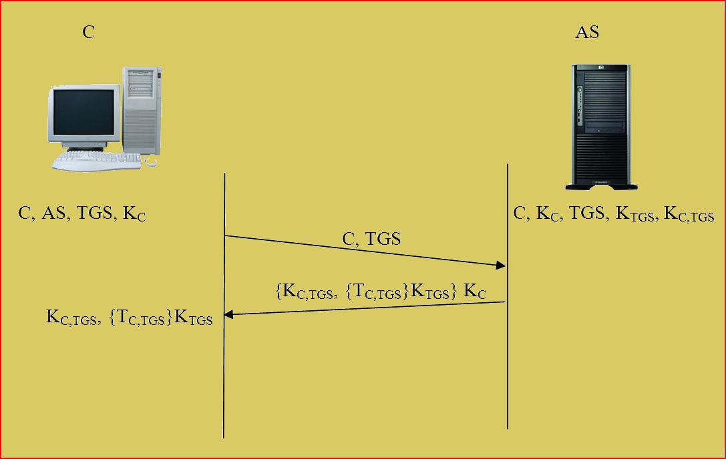
Authentication Service Exchange
Client authenticates to the AS once using a long-termed shared secret password and receives a ticket from the AS

Slide 14
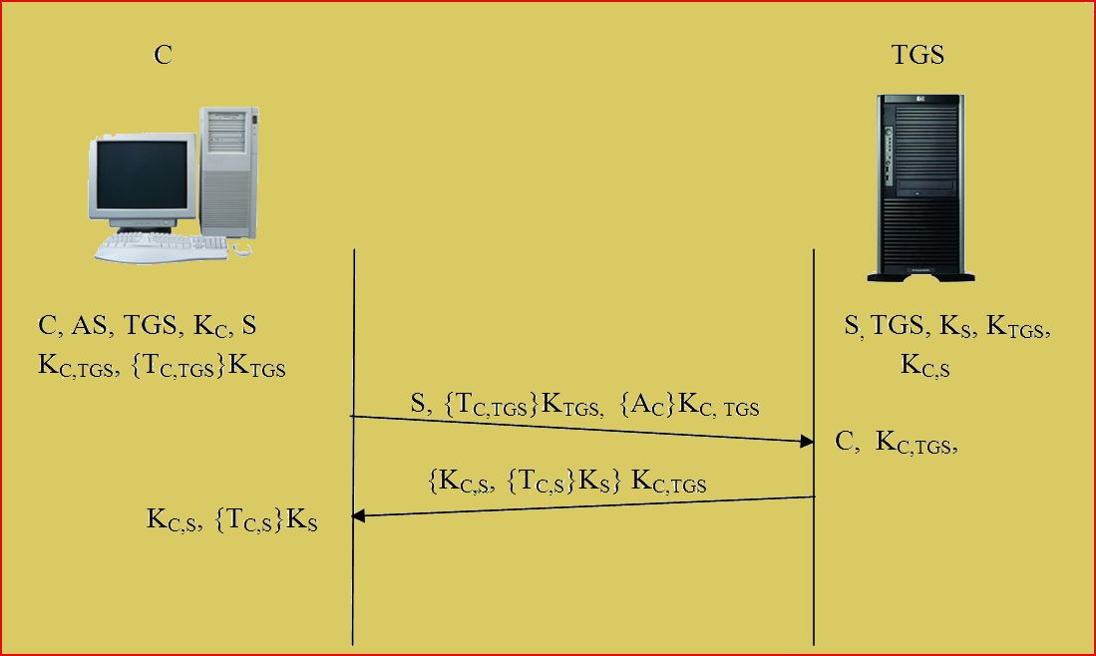
Ticket Granting Exchange
Client sends the TGS a message composed of the TGT and the name of the requested service.
The client also sends a message that contains the authenticator, usually a client ID and timestamp
The TGS decrypts messages using a secret key and sends back a client to server ticket and a client/server session key that is encrypted with the client/TGS session key

Slide 15
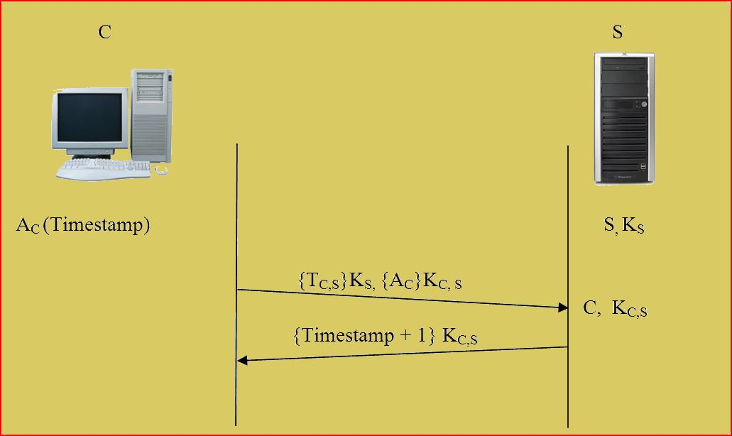
Client – Server Exchange
The client sends the client to server ticket and an authenticator to the Service Server.
The server checks that everything has been completed correctly and provides the requested service.

Slide 16
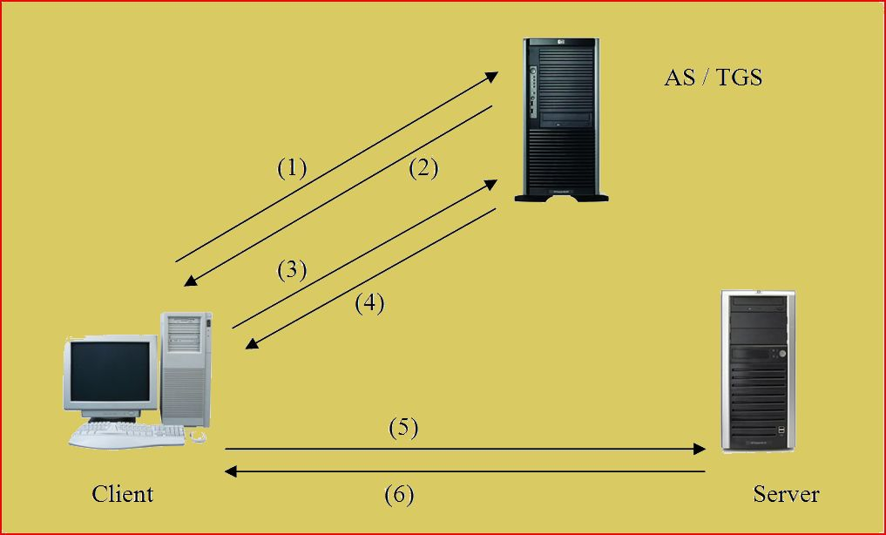
Overall Sequence
Number | Message types | Directions
1 | KRB_AS_REQ | Client to AS (Authentication Server)
2 | KRB_AS_REP | AS to client
3 | KRB_TGS_REQ | Client to TGS
4 | KRB_TGS_REP | TGS to Client
5 | KRB_AP_REQ | Client to Application server
6 | KRB_AP_REP | [optional] Application server to client

Slide 17
Environmental Assumptions
Applications must be tied into the protocol.
"Denial of service" attacks are not solved with Kerberos.
Principals must keep their secret keys secret
"Password guessing" attacks are not solved by Kerberos.
Each host on the network must have a clock which is "loosely synchronized" to the time of the other hosts.

Slide 18
IPSec
Functions and Features:
Authentication (using Kerberos)
Data integrity
Anti-replay
Key generation
IP Packet filtering

Slide 19
Kerberos and IPSec
 | IPSec | Kerberos
Authentication | computer-to-computer | user-to-service
Communications | transfer of IP packets | single log-in
OSI Layer | Network Layer | Application Layer

Slide 20
PKINIT
Public Key based initial authentication in Kerberos
Used by Microsoft, Cyber safe and Heimdal
Uses CA
Obviates the human users' burden to manage strong passwords
Not recommended for Wireless Networks

Slide 21
Kerberos in Wireless communications
Susceptible, interception of data in transit and eavesdropping are very easy.
W-Kerberos
Energy consumption !

Slide 22
Kerberos in Real World Use
Open Standard
Microsoft
Unix
Oracle
US army

Slide 23
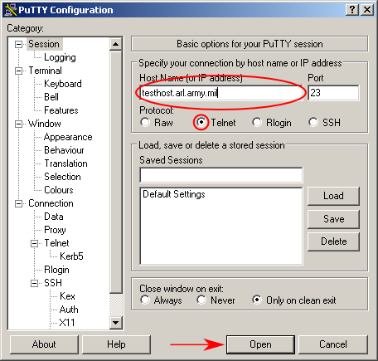
Real World Use – Army HPC Access
The client can access the server remotely.

Slide 24
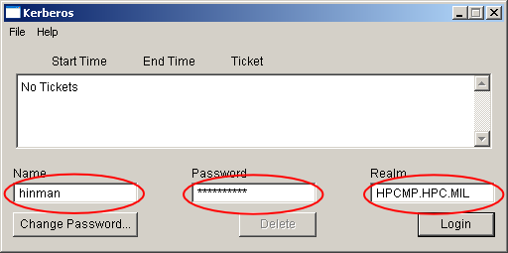
HPC Access (con’t)
Client enters a username and password.

Slide 25
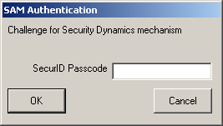
HPC Access (con’t)
A code from the SecurID card is entered.
The TGS checks the client ID, password and SecurID password for validity.

Slide 26
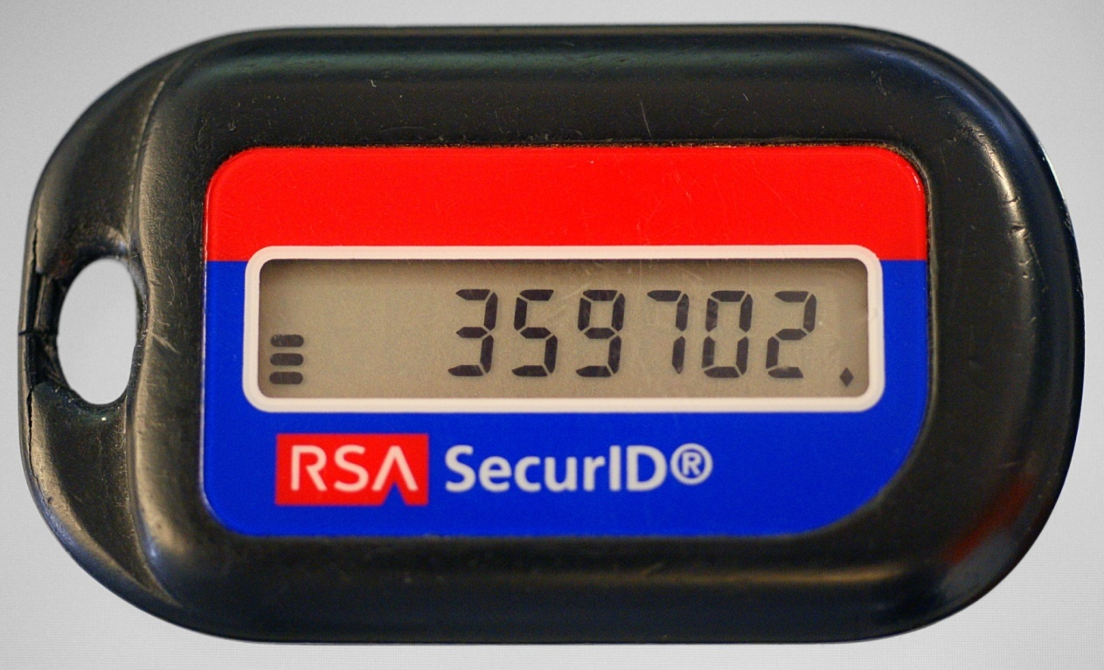
SecurID Card
The SecurID authentication scheme adds in a hardware or software token that generates an authentication code at fixed intervals using a factory-encoded random key.

Slide 27
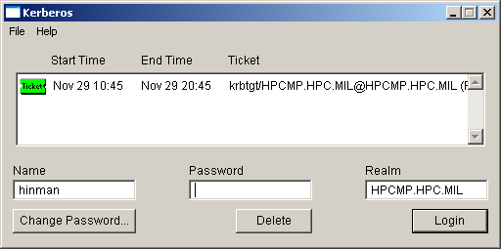
HPC Acces (con’t)
A ticket (including timestamp) is issued by the TGS. This is used by the service server when granting services to the client.

Slide 28
Other Authentication Protocols
Challenge-Handshake Authentication Protocol (CHAP)
MS-CHAPv2
NT LAN Manager (NTLM)
NTLMv2
Wi-Fi Protected Access
WPA2
Remote Authentication Dial In User Service (RADIUS)
Diameter
Secure Remote Password protocol (SRP)
Protected Extensible Authentication Protocol (PEAP)
Terminal Access Controller Access-Control System (TACACS)
TACACS+

Slide 29
NTLM
NET LAN Manager
Implemented by Microsoft
Was default until Windows NT Server 4.0

Slide 30
Kerberos v.s NTLM in MS
 | NTLM | Kerberos
Cryptographic Technology | Symmetric Key | Basic Kerberos: Symmetric Key Cryptography Kerberos PKINIT: Symmetric and Asymmetric Cryptography
Trusted third party | Domain Controller | Basic Kerberos: Domain controller with KDC service Kerberos PKINIT: domain controller with KDC service and Enterprise CA
Microsoft supported platform | Windows 95, Windows 98, Windows ME, Windows NT4, Windows 2000, Windows XP, Windows Vista, Windows Server 2003, Windows Server 2008 | Windows 2000, Windows XP, Windows Vista, Windows Server 2003, Windows Server 2008
Features | Slower authentication because of pass-through authentication | Faster authentication because of unique ticketing system
 | No mutual authentication | Mutual authentication
 | No support for delegation of authentication | Support of authentication
 | Proprietary: Microsoft authentication protocol | Open standard

Slide 31
Weaknesses of Kerberos
Design Problems
Key Distribution Center (KDC) Vulnerability
Brute force attacks
Denial Of Service (DOS) attacks
Protocol Problems
Ticket-stealing and replay attacks with multi-user client systems
Implementation Problems
Client machines and service providers (servers) need to be designed with Kerberos in mind
Renewing tickets is a must for long-running processes

