Slide 1
Effective Propositional Logic Search
Use WalkSAT
Use min-Conflict heuristic
Similar to hill climbing and simulated annealing
Pick unsatisfied clause then pick a symbol to flip to satisfy the clause by
Use Min Conflict
Or Random
Downside→ will fins solution if they exists fast but not good if no solution exits as it keeps running but faster than David Putman search

Slide 2
First order Logic

Slide 3
First Order Logic (AKA-Predicate Calculus) vs (Propositional Logic)
Propositional Logic we talk about atomic facts
Propositional logic has no objects.
Because it has no objects it also has no relationships between objects, or functions that names objects
FOL- Stronger ontological commitment
Objects (with individual identities)
Objects have properties
Relations between objects
FOL is very well understood

Slide 4
First Order Logic Syntax
ForAll | ThereExists

Slide 5
First order logic has
SENTENCES that represent Boolean facts
TERMS which represent objects
CONSTANTS and VARIABLES which represent objects
PREDICATE which given an object (I.e. TERM) it returns true or false
FUNCTIONS which given an object will return another object

Slide 6
All students are WPI are smart.
There exists a student at WPI that is smart

Slide 7
All students are WPI are smart.
AtWPI(x) means a person is at WPI
Smart(y) means person y is smart.
ForAll(x) AtWPI(x)=> Smart(x)
There exists a student at WPI that is smart
ThereExists(x) AtMIT(x) ^ Smart(x)
What does this mean?
∃ s at(s,MIT) => smart(s)
If there is an object that is not at MIT then this statement will be true

Slide 11
Equality : Define Sibling

Slide 12
ForAll x,y Sibling(x,y) ⬄ not(x=y) AND [ThereExists p Parent(p,x) AND Parent(p,y)]

Slide 17
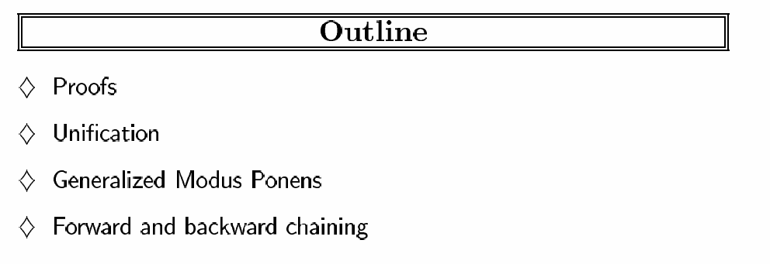
FOL

Slide 18
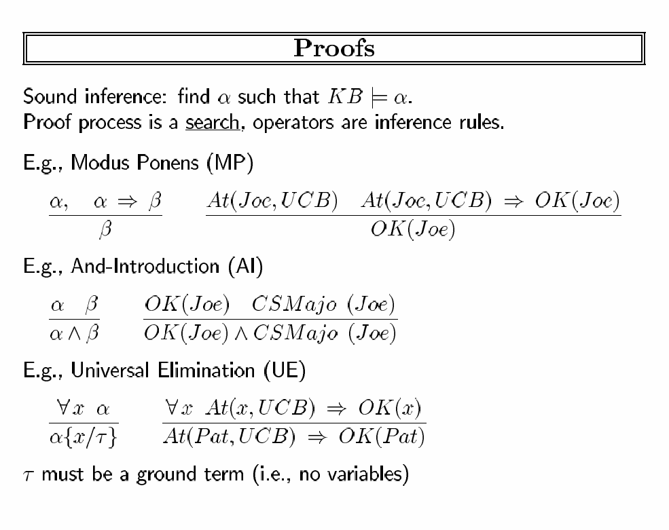

Slide 19
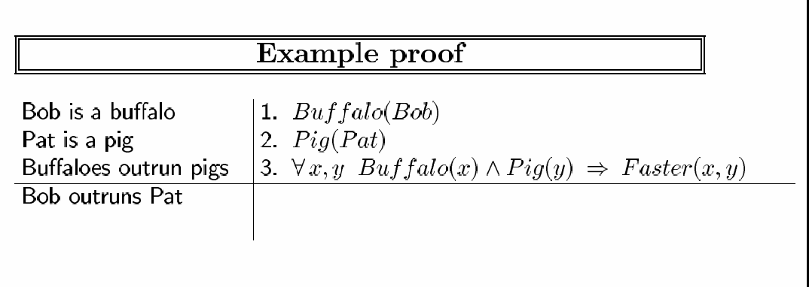

Slide 21
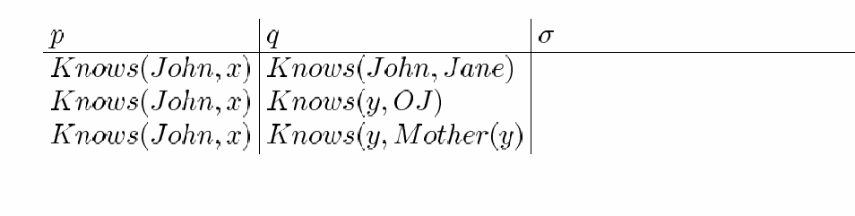
Unification A substitution x unifies an atomic sentence p and q if px=qx

Slide 22
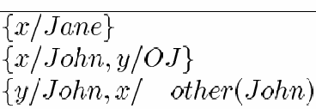
Unification A substitution x unifies an atomic sentence p and q if px=qx
Mother(John)}

Slide 24
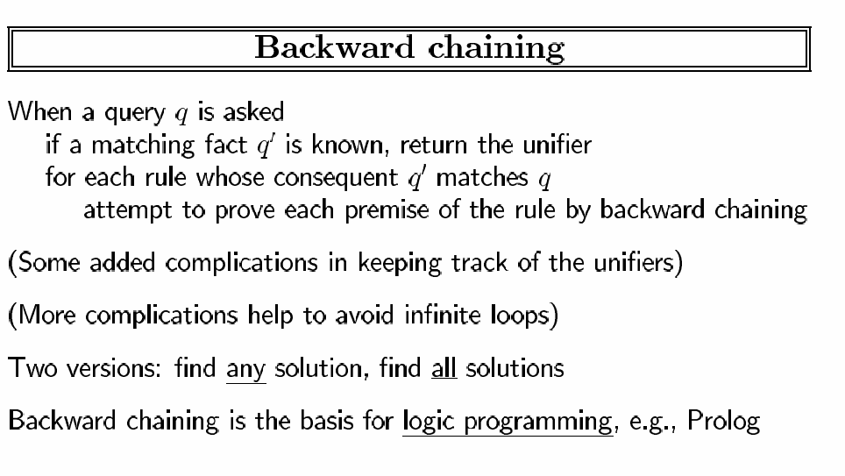

Slide 25
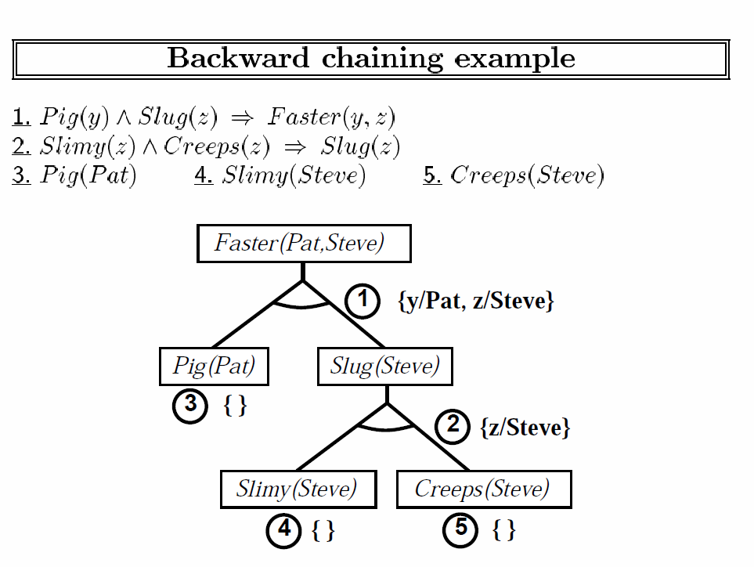

Slide 26
Industrial Strength Inference
Completeness
Resolution
Logic Programming

Slide 27
Horn Clauses
A Horn Clause is a disjuntion of literals with the additional caveat that there is at most one positive literal.
~a v b v ~c is a Horn Clause (a ^ c) => b
~a v ~b v ~c is very Horn (a ^ b ^ c) => True
~a v b v c is not a Horn Clause(a => b v c)
All Horn Clause can we written as a implication where there are a set of things anded together to imply a literal
A V B => C
Easy to understand.
Entailment can be decided in linear time in the size of the KB

Slide 28
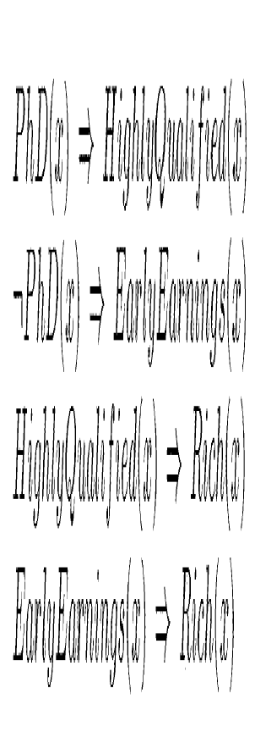
Completeness in FOL?
Forward and backward chaining are complete for Horn Clause Knowledge Bases but incomplete for general first order logic
Eg
But should be able to infer Rich(Me) but FC/BC won’t do it
Does a complete algorhtm exist?

Slide 29
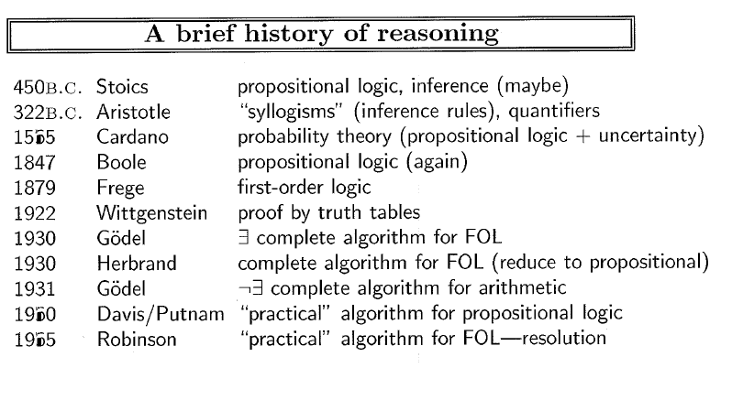

Slide 30
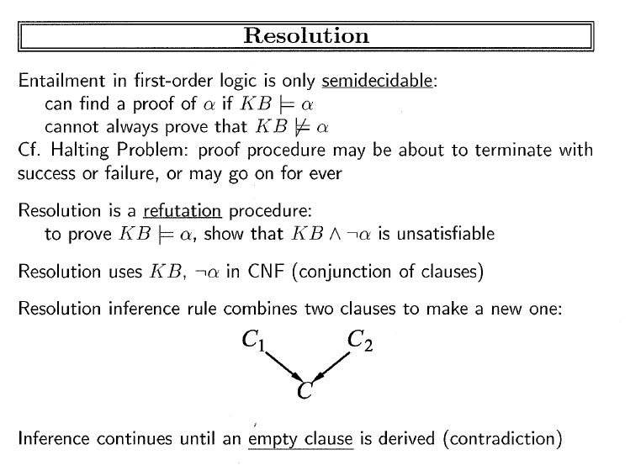

Slide 31
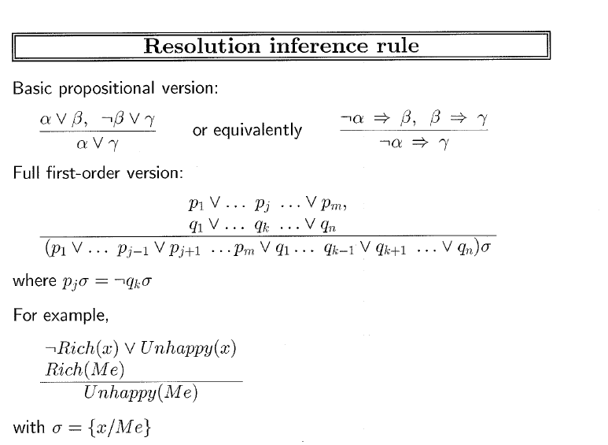

Slide 32
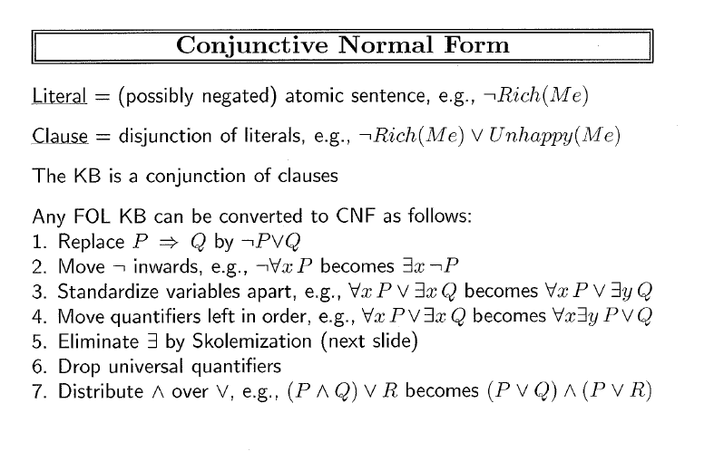

Slide 33
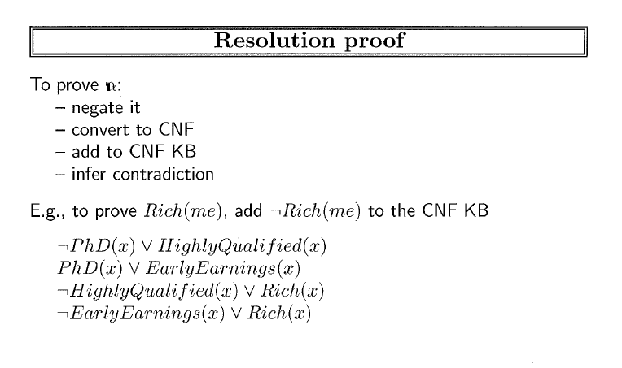

Slide 34
Draw a proof

Slide 35
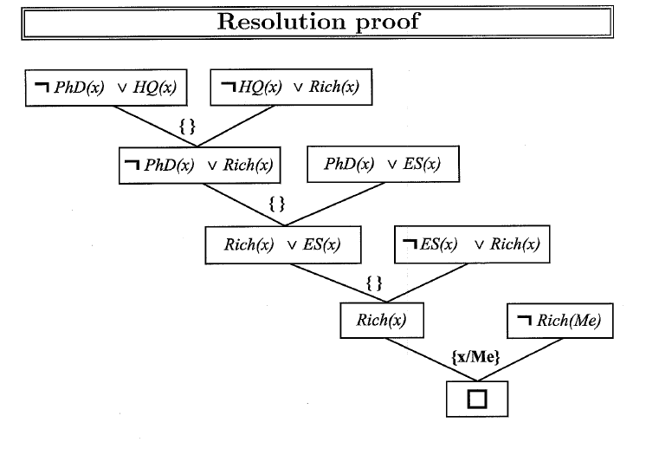

Slide 36
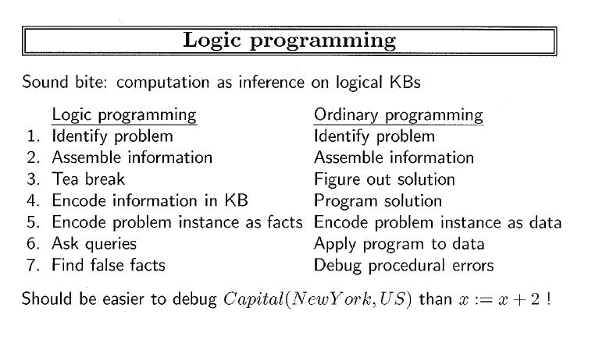

Slide 37
