Slide 1
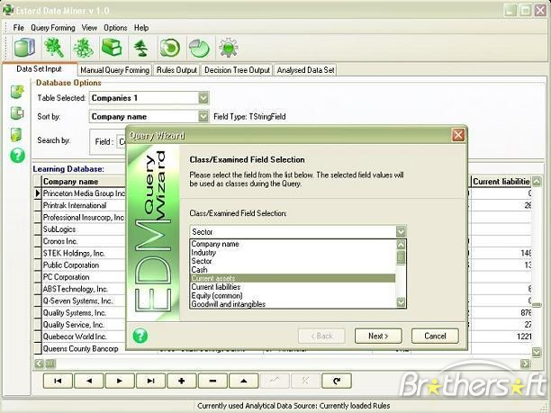
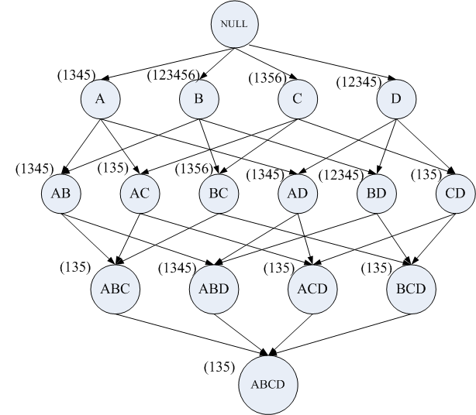
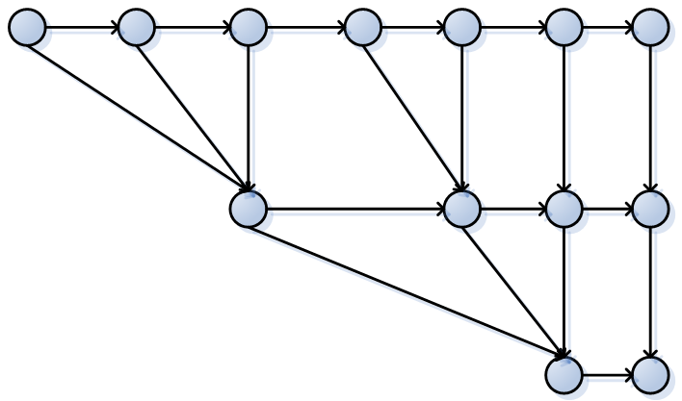
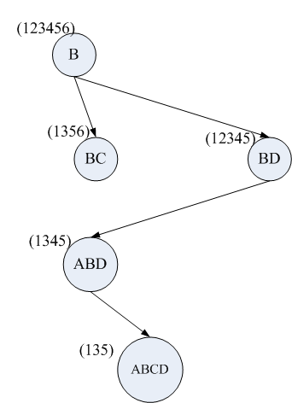
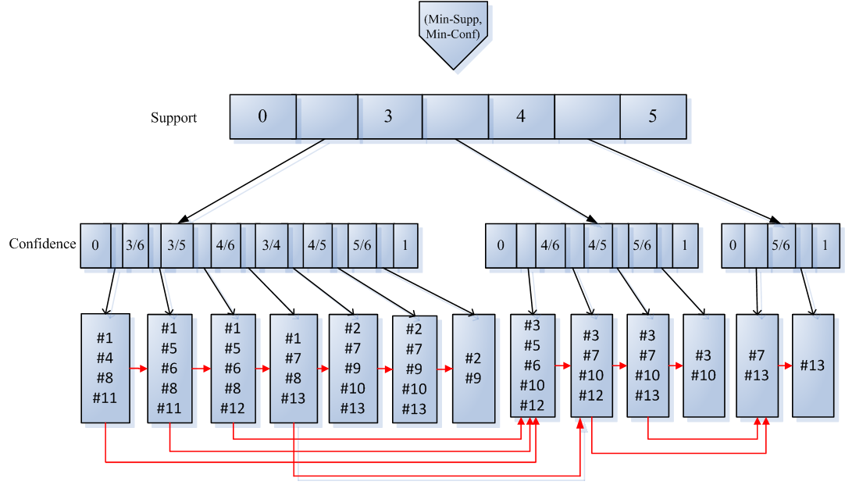
Summarizing Parameter Space for Interactive Exploration of Association Rules
Abhishek Mukherji, Xika Lin, Professor Elke A. Rundensteiner, Professor Matthew O. Ward
XMDVTool, Department of Computer Science
This project is supported by NSF under grants IIS-080812027 and CCF-0811510.
INTERACTIVE AND EXPLORATORY DATA MINING
SUMMARIZING PARAMETER SPACE
GOAL: Retrieve the right number of interesting rules.
Large continuous parameter space
minSupp
minConf
Redundant rules:
AB=>C | A=>B | A=>BC
Patterns are non-uniformly distributed over the data set.
No prior knowledge of how new rules will be generated with change in parameter values.
Analysts proceed by trial-and-error.
Repeated rules:
Once valid, rule X=>Y will remain valid for the entire subspace.
Confidence
Data Miner
Cumbersome to store rules for potentially infinite number of threshold pairs.
Redundant and repeated rules may clutter users understanding.
{ARs}
Support
☹ Limitations
Can we store-n-reuse?
Long response time.
No reuse of results.
PARAMETER SPACE CONSTRUCTION
OVERALL TECHNIQUE
RULE GRAPH SEARCH
Full lattice representing a dataset
Reduced lattice*
1
AC->BD CD->AB C->B A->BD D->B | C->B A->BD D->B | D->B
AC->BD CD->AB C->B B->D D->B | C->B A->BD B->D D->B | B->D D->B
AC->BD CD->AB C->B B->D D->B | D->AB C->B A->BD B->D
A->BCD C->ABD B->D D->B
A->BCD C->ABD B->C B->AD D->AB | B->C B->AD D->AB C->B A->BD
D->ABC A->BCD C->ABD B->C B->AD
B->ACD D->ABC A->BCD C->ABD
Confidence
5/6
(12345)
1. Determine all cut-points in the parameter space.
2. Populate each block with rules.
Confidence
D
4/5
1. Determine all cut-points in the parameter space.
2. Populate each block with association rules.
A=>BCD
S = 3,
C = 3/4
3/4
4/6
Support
3/5
support list
itemset
3/6
Redundancy eliminating search over a directed acyclic graph.
C->B
A->BD
D->B
0
0
3
4
Support
5
1
B->D
INDEX STRUCTURE
CONTRIBUTIONS
5/6
Confidence
Explored the parameter space for ARs.
Defined stable regions in the parameter space.
Developed efficient index and search mechanisms.
Achieved store-n-reuse for quick response to interactive user queries .
Stable region:
NO new ARs are produced despite change in parameters.
4/5
D->AB
1. Eliminate repeated rules
Each rule is only stored once.
3/4
4/6
2. Create 2-level search tree.
3/5
B->C B->AD
3/6
0
0
3
4
Support
5
*Mohammed J. Zaki. Mining non-redundant association rules. Data Mining Knowledge Discovery, 9(3):223-248, 2004

